Slide 1
Malak AL-Tamimi
Nezar Imreziq
Supervisor: Dr.Abbas Mansour
Fever of Unknown Origin
FUO
Pyrexia of Unknown Origin
PUO

Slide 2
Outlines :
Introduction and the pathophysiology of Fever
Definition of FUO
Classification of the causes
-infections
Brucellosis
Endocarditis
TB
-Neoplastic diseases
-Connective disorders
Temporal arteritis
-Drug induced Fever
How to approach the history of FUO
Physical Examination
Management

Slide 3
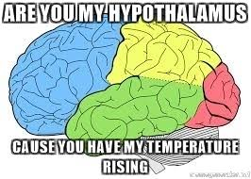
Normal body Temp. 36.5-37.5 C.
The hypothalamus helps in regulating body Temp.
To raise Body Temperature
Obligate heat production
Muscular work
Shivering
Heat conservation
Vasoconstriction
Heat preference
To lower Body Temperature
Vasodilatation
Sweating
Cold preference

Slide 4
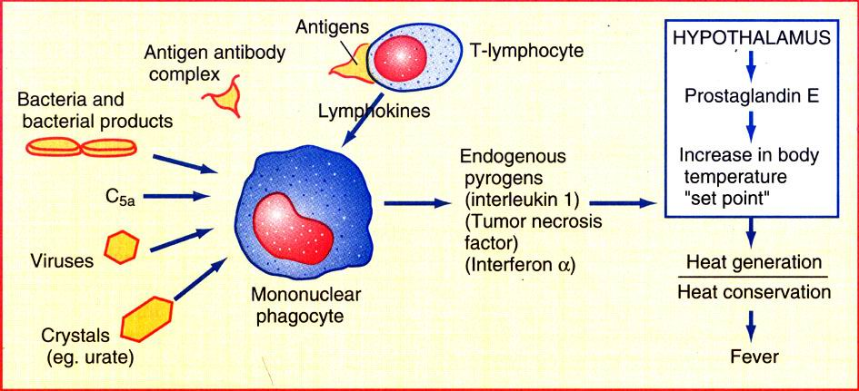
Fever = Inflammation ≠infection

Slide 5
Chill is a sensation of cold occurring in most fevers
Rigor is a profound chill with pilo-erection associated with teeth chattering and severe shivering.
Fever
increase in the hypothalamic heat-regulating set point
Hyperthermia
(>41°) that overrides or bypasses the normal homeostatic mechanisms
According to periodicity:
1)Continuous (Typhoid)
2)Intermittent (Malaria)
3)Remittent(Hectic fever/pus)
4)Relapsing(Lyme/Malta fever/lymphoma)

Slide 6
Definition :
Fever of unknown origin (FUO) :
is body temperature ≥ 38.3° C (101° F) rectally that does not result from transient and self-limited illness, rapidly fatal illness, or disorders with clear-cut localizing symptoms or signs or with abnormalities on common tests such as chest x-ray, urinalysis, or blood cultures.
FUO is currently classified into 4 distinct categories:

Slide 7
Classic FUO: Fever for > 3 weeks with no identified cause after 3 days of hospital evaluation or ≥ 3 outpatient visits
Health care–associated FUO: Fever in hospitalized patients receiving acute care and with no infection present or incubating at admission if the diagnosis remains uncertain after 3 days of appropriate evaluation

Slide 8
Immune-deficient FUO: Fever in patients with neutropenia and other immunodeficiency if the diagnosis remains uncertain after 3 days of appropriate evaluation, including negative cultures after 48 hours
HIV-related FUO: Fever for > 3 weeks in outpatients with confirmed HIV infection or > 3 days in inpatients with confirmed HIV infection if the diagnosis remains uncertain after appropriate evaluation

Slide 9
What are the causes of FUO?
infections
Neoplastic diseases
Non-infectious inflammat-ory
Factitious fever
Drug-related fever
Habitual hyperther-mia
Major disease categories
Minor disease categories

Slide 10
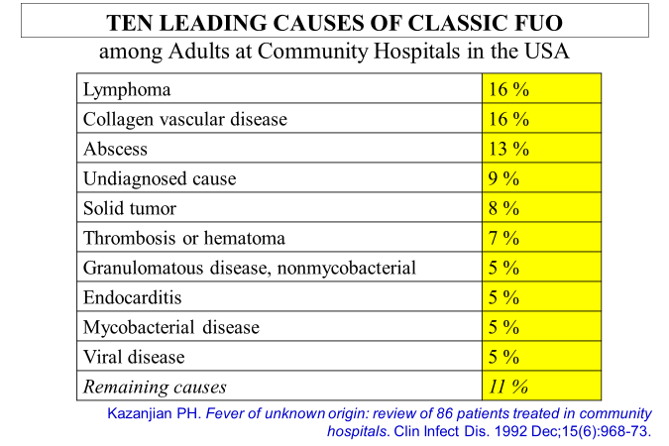
Distribution of the different disease catecories
Shift in the relative proportion of specific disease categories during the last decade:
Infections ↓ tumors ↓ NIID ↑ Undiagnosed ↑
Geographical differences
In developing countries, tropical area:more infections.

Slide 11
Systemic infections
Most common:
Tuberculosis and endocarditis
Less common:
- Epstein-Barr virus and cytomegalovirus
- toxoplasmosis, brucellosis
- Q fever, cat-scratch disease, malaria
- HIV or opportunistic infections associate with AIDS
Abscess
Endocarditis
Indwelling catheter
Osteo
UTI
Localized infections
Most common:
Occult abscess (liver, spleen, kidney, brain, bone)
Less common:
- Cholangitis
- Osteomyelitis
- Urinary tract infection
- Paranasal sinusitis

Slide 12
Case 1:
A 30 year old farmer working in a diary farm in Tamil Nadu was admitted to the ward with low grade fever and evening rise of temperature. On examination there was generalized lymphadenopathy and hepatosplenomegaly. Blood routine, Chest X-ray PA view & Blood Widal test were negative

Slide 13
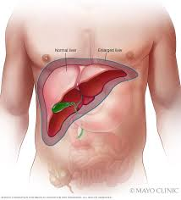
Brucellosis
History
• farmers, breeders, veterinarians
• Travel to an endemic area
• Consumption of unpasteurized milk
Presentation
• Fever and excessive sweating
• Hepatosplenomegaly
• Polyarthritis or septic arthritis

Slide 14
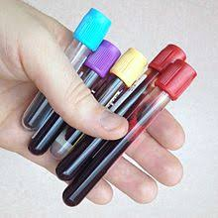
Complications
Infective endocarditis . (Cause of death)
Culture negative
Secondary infection and abscess in lumber vertebral column (non caseating granuloma),sacroiliitis
Investigations
• IgM IgG and IgA antibodies(Somatic-O only)
• Isolation from blood, CSF, marrow or joint

Slide 15
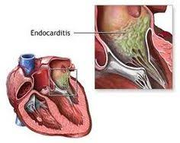
Endocarditis
History
IVDA, Hx Endocarditis, prosthetic valve
Acute
Path: Staph. or
Strep.
Pt: CHF+ Bacteremia+
Toxic+ (-ve) rheumatology
Sub-acute
Path: HACEK
Pt: Fever
non toxic
(+ve) rheumatology
Dx: blood culture
Empirical till
–ve cx
Dx: blood culture
No empirical till +ve cx
Duke

Slide 16
The Management :
If infective endocarditis is suspected, then the patient should be admitted to a hospital, and empiric intravenous antibiotics should be commenced after three sets of blood cultures have been collected.
The recommended empiric therapy of infective endocarditis is gentamicin, benzylpenicillin and flucloxacillin; however, this may vary with different patient factors and should be discussed with an infectious diseases specialist

Slide 17
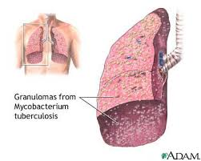
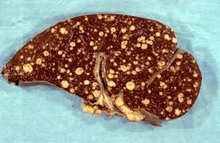
Tuberculosis (TB)
Usually extrapulmonary or miliary
History
Immunosuppression ,Cancer , Transplantation , HIV , Malnutrition , Diabetes or Silicosis, travel Hx
Presentation:
Weakness and fatigue (90%)
Fever and weight loss (80%)
Chills, night sweats are common
Cough, Hemoptysis,Anorexia
• Hepatomegaly and lymphadenopathy are common
• Pott’s disease, meningitis or CNS tuberculoma

Slide 18
Lab investigation
• CBC - Leukopenia/leukocytosis
• ESR - elevated in approximately 50% of patients
• Lumbar puncture - strongly considered
Lymphocytic predominance (70%)
Elevated protein levels (90%)
Low glucose levels (90%)
Acid-fast bacilli (≥40%)
• Cultures for mycobacteria
• PCR
CXR Up to 30-50% have a normal chest radiograph
• Bilateral pleural effusions
• Nodules characteristic of miliary TB may be better visualized on lateral chest radiography
• Nodules are the size of millet seeds (1-5mm,mean=2mm)

Slide 19
Chest CT scanning
has higher sensitivity and
specificity than chest radiography in displaying well-defined randomly distributed nodules
Ultrasonography
Diffuse liver disease
Hepatomegaly
Splenomegaly
Para-aortic lymph nodes
Minimum pleural effusion
Therapy
RIPE
• Treatment may continue for 6-9 months
• 9-12 months with meningeal involvement

Slide 20
NEOPLASTIC DISEASES
Most common:
- lymphoma (both Hodgkin's and non-Hodgkin's)
- leukemia
Less common:
- Primary and metastatic tumors of the liver
- Renal cell carcinomas
- Atrial myxoma
- Chronic lymphocytic leukemia
- Multiple myeloma
Lymphoma: Source of fever → production of cytokines. Fever is a negative prognostic factor. Fatigue · Night sweats, chills, and fever · Unexplained weight loss.
Renal Cell Carcinoma (Adult) :20% → Fever ,Microscopic hematuria/Erythrocytosis

Slide 21
Connective tissue disorders
Temporal arteritis
Adult Still’s disease
Systemic lupus erythematosus
Rheumatoid arthritis
Poly-arteritis nodosa
Mixed connective tissue disease
Relapsing polychondritis

Slide 22
Case 2
A 75 year-old man came with fever and
headache of 4 months duration. He had
generalized body aches and pains. He was
admitted to ophthalmic hospital one week
before for complaints of sudden loss of
vision in one eye. Routine investigations
were negative except for a high ESR

Slide 23
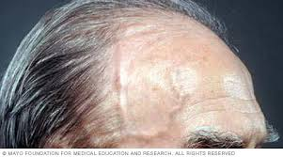
Temporal arteritis
History
• women >50 years
• Scandinavian
• Headaches and polyarthralgias
Examination
• Tortuous and thickened temporal artery
• Anterior Ischemic Optic Neuropathy

Slide 24
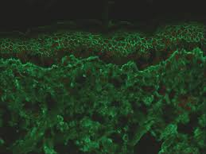
Investigation
• High ESR, Normochromic Anemia
• Temporal artery biopsy
Therapy : Corticosteroid STAT
Collagen Work up in FUO
Rheumatological tests
• RF ,Anti CCP in RA
• Anti-Ro ,Anti-La in Sjogren’s
ANA Profile
• Anti dsDNA, Anti Smith-SLE
• Anti U1 RNP in SLE MCTD
Direct Immunoflourescence

Slide 25
Drug Fever
 Almost any drug can cause fever
PATHOGENESIS
 Contamination of the drug with a pyrogen or microorganism.
 Related to the pharmacologic action of the drug itself (e.g amphotericin B).
 Allergic (hypersensitivity) reaction to the drug.
Fever out of proportion to clinical picture
 Pattern of fever variable
 Associated findings: Rigor (43%), Myalgia (25%), Rash (18%),Headache (18%)
 Leukocytosis (22%), Eosinophilia (22%), Serum sickness (fever,
swelling, rash, LN enlargement), Proteinuria, Abnormal liver
function test

Slide 26
drug-induced fever
sarcoidosis
Whipple's disease
familial Mediterranean fever
recurrent pulmonary emboli
alcoholic hepatitis
Thyroiditis
Castleman disease
factitious fever
Agents commonly associated with drug-induced fever
Allopurinol
Captopril
Cimetidine
Clofibrate
Erythromycin
Heparin
Hydralazine
Hydrochlorothiazide
Isoniazid
Meperidine
Methyldopa
Nifedipine
Nitrofurantoin
Penicillin
Phenytoin
Procainamide
Quinidine

Slide 28
Most probable diagnosis according to the associated symptoms
1)Fever + constipation +relative bradycardia =Typhoid
2) Fever (3 weeks) then 10 days free + arthralgia
+lymphadenopathy + History of contact with milk products =Brucella
3) Fever + tender hepatomegaly +GIT upset = amoebic liver abscess
4)Fever + lymphadenopathy + history of dealing with cats=Toxoplasmosis
5)Fever + arthritis +UTI = gonococcal or chlamydia infection
6)Fever +diarrhea +Hemolytic anemia =Hemolytic uremic syndrome or TTP
7) Fever +low platelets + sub conjuctival hge = Dengue fever
8) Fever +neck rigidity+ photophobia +headache + agitation =meningitis
9) Fever +headache +nick stiffness + manifestation of cerebral
dysfunction(aphasia , convulsion , monoplegia or flexion U.L
and extension L.L ) + urinary incontinence=encephalitis
10) Fever +High E.S.R >100+renal impairment + hypercalcemia in old age =multiple myeloma

Slide 29
History
Fever (Pattern, periodicity, how was it measured
associated symptoms such as sweating, vomiting, headaches etc.)
Past medical and surgical history ( prosthesis in situ, cardiac illness, diabetes,h/o transplant)
Occupation, Travel
Contact with ticks, animals
Diet (Drinking unpasteurised milk)
History of addiction
Sexual behaviour(any other high risk behaviour)
Drug history
Immunisation

Slide 30
Physical examination
The general appearance, particularly for cachexia, jaundice, and pallor, is noted
The skin is inspected for focal erythema and rash. inspection should include the perineum and feet, particularly in diabetics
The entire body (particularly over the spine, bones, joints, abdomen, and thyroid) is palpated for areas of tenderness, swelling, or organomegaly; digital rectal examination and pelvic examination are included.
Red flags
Immunocompromise
Heart murmur
Presence of inserted devices (eg, IV lines, pacemakers, joint prostheses)
Recent travel to endemic areas
Rose spots in Typhoid (abdomen + trunk ) Blench with pressure on it which mean it’s not purpura.

Slide 31
Lab Testing
Complete blood count with differential
Erythrocyte sedimentation rate
Liver tests
Serial blood cultures (ideally before antimicrobial therapy)
HIV antibody test, RNA concentration assays, and polymerase chain reaction assay
Tuberculin skin test or interferon-gamma release assay

Slide 32
Imaging Tests
Typically, areas of discomfort should be imaged—eg, in patients with back pain, MRI of the spine (to check for infection or tumor)
CT of the chest, abdomen, and pelvis should be considered to check for adenopathy and occult abscesses even when patients do not have localizing symptoms or signs.
if blood cultures are positive or heart murmurs or peripheral signs suggest endocarditis, echocardiography is done.
MRI is more sensitive than CT for detecting most causes of FUO involving the central nervous system (CNS) and should be done if a CNS cause is being considered.
Venous duplex imaging may be useful for identifying cases of deep venous thrombosis.

Slide 33
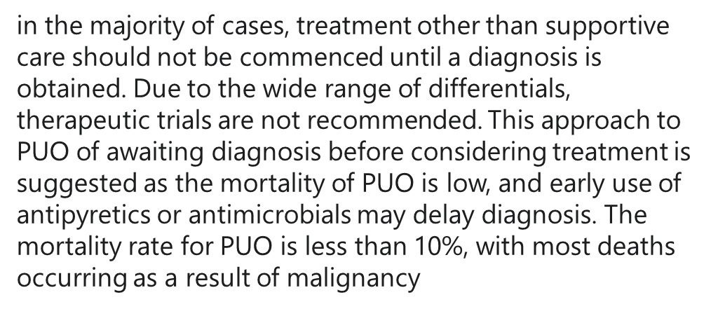
Management of fever of unknown origin

Slide 34
References:
Davidson's Principles and Practice of Medicine
Step-up to Medicine
Thank You

