Slide 1
Cardiogenic Shock
Done by :
majd majed algmool
Wasan theeb alrawwad

Slide 2
Notes:
1

Slide 3
Cardiogenic Shock
Inadequate tissue perfusion resulting from cardiac dysfunction leading to metabolic disturbances and, ultimately, irreversible organ damage.﻿
Occurs when heart is unable to generate a cardiac output sufficient to maintain tissue perfusion
Clinical definition: decreased CO and tissue hypoxia in the presence of adequate intravascular volume
Hemodynamic definition: Sustained SBP<90 mm Hg,with urine output <20 mL/hr,CI <2.2 L/min/m², PCWP > 15 mm Hg

Slide 4
How to identify Cardiogenic Shock
History
Physical Exam
EKG
Chest xray
Echocardiogram
Swan-Ganz Catheter

Slide 5
History: Who gets Cardiogenic Shock?
Acute MI( the most common cause)
septic shock with myocardial depression
ventricular septal defect
blunt cardiac trauma
End-stage cardiomyopathy
Myocarditis
Prolonged cardiopulmonary bypass
Septic shock with myocardial depression
Valvular disease: AS, AR, MS, MR
Certian drugs( beta blockers, calcium channel blockers)

Slide 6
Pathophysiology
#underlying event causes dysfunction of the heart → ↓ cardiac contractility and/or SV → ↓ CO
#Systemic circulation: ↓ CO and ↓ BP → ↑ catecholamines → vasoconstriction and ↑ myocardial
oxygen demand → ↑ renin-angiotensin-aldosterone system → further ↑ vasoconstriction and
retention of sodium and water → shunting of blood to the brain and vital organs → insufficient
perfusion of peripheral organs
#Pulmonary circulation: ↓ cardiac contractility and/or ↓ SV → ↑ pulmonary hydrostatic pressure
→ pulmonary edema

Slide 7
Symptoms
Rapid shallow respiration
Severe shortness of breath
Loss of consciousness or fainting
Sweating
Pale skin
Cold extremities
Oliguria
Nausea, vomiting
Altered consciousness:Drowsiness, confusion, irritability (usually occurs late)
Diaphoresis, exertional dyspnea, or dyspnea at rest.
Syncope, palpitations, generalized anxiety, and depression .
Signs of congestive heart failure alongside shock (e.g., ↑ JVP, crackles on lung auscultation)

Slide 8
PPHYSICAL EXAMINATION
cyanosis , cold skin and mottled extremities.
Weak pulse and Hypotension (systolic BP < 100 mmHg).
Tachycardia (> 100/min) .... May be absent in patient on Bata blocker
Jugular venous distention and crackles in the lungs are usually present; peripheral edema also may be present.
Heart sounds are usually distant, and third and fourth heart sounds may be present.
A systolic murmur (acute mitral regurgitation or ventricular septal rupture).

Slide 9
Diagnosis
ECG : look for signs of ischemia (ST segment elevation suggesting acute MI) / arrhythmias / LBBB/Q waves
Echocardiogram: can diagnose a variety of mechanical complications of MI, valve disease, estimate EF, pericardial perfusion,etc
Hemodynamic monitoring with a Swan-Ganz catheter may be indicated: PCWP, pulmonary artery pressure, cardiac output, cardiac index, SVR—keep cardiac output >4 L/min, cardiac index >2.2, PCWP <18 mm Hg
ABG— Acidosis as↑ Lactate (> 2 mEq/L) due tissue hypoperfusion and is associated with poorer outcomes
Chest X-Ray: Pulmonary edema, cardiac enlargement, or pleural effusions
CBC, LFT .
cardiac markers: ↑ troponin I and troponin T in acute coronary syndrome
Renal function tests: ↑ BUN, ↑ creatinine, other signs of AKI or ATN (e.g., on urinalysis)

Slide 10
Management :
Cardiogenic shock is an emergency requiring immediate resuscitative therapy .
All patients require admission to intensive care unit (ICU).
Percutaneous Coronary Intervention or coronary artery bypass are the treatment of choice for cardiogenic shock due to MI.
Thrombolytics is the second best.

Slide 11
Initial stabilization of the patient with suspected cardiogenic shock consists of :
1.venous access:
includes fluid resuscitation to correct hypovolemia and hypotension, unless pulmonary edema is present.
Central venous and arterial lines are often required.
Swan-Ganz catheterization and continuous percutaneous oximetry are routine
Electrolyte abnormalities should be corrected .
2.supplemental oxygen:
Many patients require endotracheal intubation and mechanical ventilation, if only to reduce the work of breathing and facilitate sedation and stabilization before cardiac catheterization.
3.continuous ECG monitoring:

Slide 12
4. pain relief: Morphine (1 to 2 mg every 5 minutes)
-Relieves pain and anxiety
-Reduces excessive sympathetic activity
-Decreases oxygen demand
- Decrease preload and afterload.
5. arrhythmia correct :
Atrial bradyarrhythmias or tachyarrhythmias or ventricular tachyarrhythmias can reduce cadiac output → so it should be corrected.
-antiarrhythmic drugs IV : Amiodarone, Procainamide, Lidocaine
- electrical cardioversion
-pacing
6. Thrombolytic Therapy: If the cause is likely an acute MI
Aspirin and heparin should be given immediately.
7. Hemodynamic Support:
Maintenance of adequate blood pressure is essential to break the vicious circle of progressive hypotension and further myocardial ischemia.

Slide 13
Vasopressors for hypotension which is unresponsive to fluids :
Norepinephrine and dopamine are considered first-line drugs for hypotension in this situation .
Dopamine acts as both an inotrope (particularly at 3 to 10 μg/kg/minute) and a vasopressor (10 to 20 μg/kg/minute).
Norepinephrine (0.02 to 1.0 μg/kg/minute) acts primarily as a vasoconstrictor, has a mild inotropic effect, and increases coronary flow

Slide 14
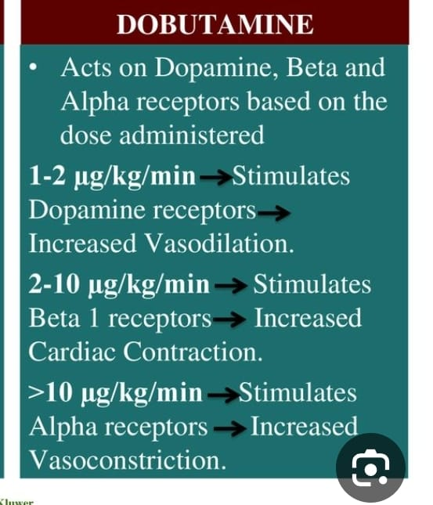
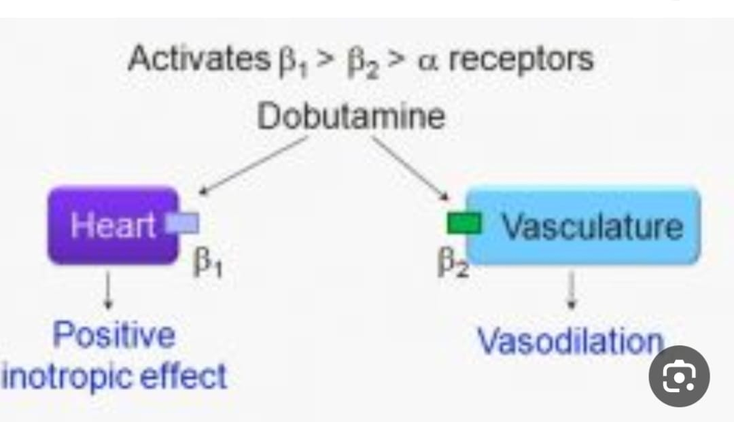
If tissue perfusion remains inadequate despit norepinephrine and dopamine, inotropic therapy should be initiated:
1.Dobutamine :(2.5 to 20 mg/kg/minute),
improve myocardial contractility
increase cardiac output
it is the initial agent of choice in patients with a low-output syndrome and systolic blood pressures greater than 90 mm Hg.
Side effect :may exacerbate hypotension in some patients owing to its vasodilatory effects, and it can precipitate tachyarrhythmias.

Slide 15
2. Milrinone : (0.125 to 0.75 μg/kg/minute)
phosphodiesterase inhibitor,
has fewer chronotropic and arrhythmogenic effects than catecholamines
Has a long half-life and can cause hypotension; in patients whose clinical status is tenuous .
it is usually reserved for situations in which other agents have proved ineffective.

Slide 16
3.Levosimendan : (0.05 to 0.2 μg/kg/minute)
calcium sensitizer that has BOTH inotropic and vasodilatory properties and does not increase myocardial oxygen consumption.
More effective than dobutamine in treating low-output heart failure.

Slide 17
Intra-aortic Balloon Pump :
A device that gives mechanical support to the failing heart .
Often used for hemodynamic support (not definitive therpy)
Effects include :
Decreased afterload
Increased cardiac output
Decreased myocardial oxygen demand

Slide 18
A balloon catheter is positioned in the descending thoracic aorta just distal to the subclavian artery .
It facilitates ventricular emptying by deflating just before the onset of systole (reducing afterload) and increases coronary perfusion by inflating at the onset of diastole (increasing diastolic pressure).
The net effect is enhanced myocardial oxygenation and increased cardiac output.

Slide 19
Reperfusion:
1. PCI “coronary angioplasty”
Benefit highest when performed early (within 90 minutes of hospital arrival)
2.CABG: coronary artery bypass graft
more likely to provide complete revascularization and achieves long-term survival rates comparable to PCI,

Slide 20
Surgery :
1.surgical valve repair or replacement:
For acute mitral regurgitation owing to papillary muscle rupture following MI
within 48 hours of the rupture.
2.Ventricular septal or free wall rupture, Placement of a septal occluding device may be helpful.
Cardiac tamponade : Pericardiocentesis

Slide 23
References :
*Step up to Medicine – Fourth edition
*Davidson’s Principles & Practice of Medicine 21 st edition
*http://emedicine.medscape.com/article/152191-overview#a0104

