Slide 1
MI Management

Slide 2
INTRODUCTION
Roaa Alzawahreh

Slide 3
Myocardial infarction
-MI one of ischemic heart disease , occurs when there is a diminished blood supply to the heart due to blockage of the coronary vessels which leads to myocardial cell damage and ischemia (necrosis).
-(Time is muscle ) The faster blood flow can be restored the better chance the patient has of minimizing irreversible death of the cardiac cells.
-Also known as heart attack

Slide 4
Types of MI
1- based on which artery was occluded :
A- anterior MI : caused by occlusion of LAD artery
B- posterior MI : caused by an occlusion of left circumflex artery
C- inferior MI : caused by occlusion of right coronary artery
2- based on ECG findings :
A_ ST segment elevation infarct : transmural (involves entire thickness of wall) mostly larger B_ Non ST segment elevation infarct : subendocardial (involves inner one third to the half of the wall) tends to be smaller , similar to unstable angina which can be distinguished by cardiac enzymes

Slide 5
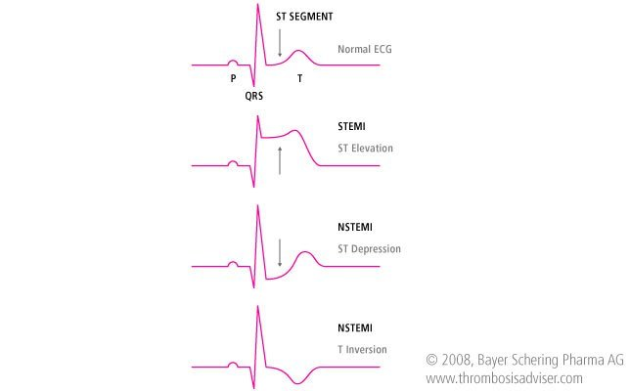

Slide 6
Clinical findings
1- chest pain : intense substernal with pressure sensation
2- onset : rapid over a few minutes
3- radiating to the neck , jaw , sometimes epigastrium
4_nausea and vomiting
5_ diaphoresis ( excessive sweating )
7- feeling of impending death ( angor animi )
8- prolonged duration
9- not relieved by rest or nitrate
10- usually very severe

Slide 7
Risk Factors of MI
Stress , stimulants (caffeine)
Smoking
Obesity
Diabetes and hypertension
Diet (high cholesterol )
Race ( higher in African American males )
Age (over 50 )
Sex ( men more women)

Slide 8
Diagnosis
Safaa Matar

Slide 9
ECG
-Peaked T waves: Occur very early and may be missed
-ST-segment elevation infarct: Transmural (involves entire thickness of wall); diagnostic of an acute infarct
-Non–ST-segment elevation infarct: Subendocardial (involves inner one-third to one-half of the wall
-It was be found according to location of infarction

Slide 10
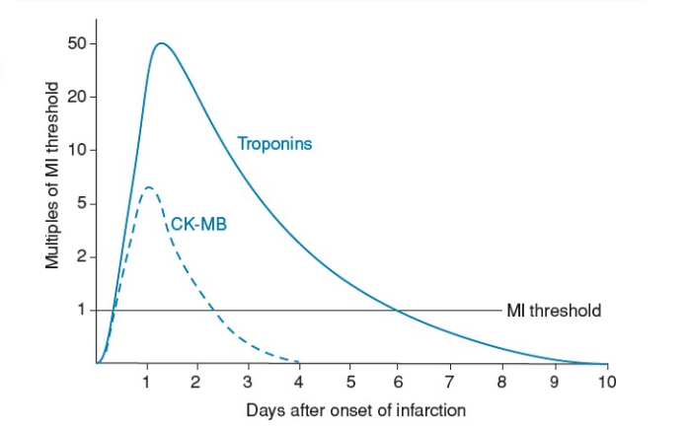
Cardiac Enzymes
-Currently the diagnostic gold standard for myocardial injury :
Troponins (Troponin I and T)—most important enzyme test to order
CK-MB—less commonly used

Slide 11
3- Echocardiography:
-Ventricular wall motion abnormalities.
4- Coronary angiography:
-reveals which vessels have been affected and the extent of damage.
5- Leukocytosis, ↑ ESR: as there is tissue damage.

Slide 12
How to diagnosis MI
Requires at least 2 of the following criteriae
Prolonged ischemic-type chest discomfort.
Serial ECG changes.
Elevation of cardiac markers in serum.

Slide 13
Principles of MI Management
Raghad Amr

Slide 14
-Patients should ideally be managed in a dedicated cardiac unit (CCU), where the necessary monitoring and resuscitation facilities are available.
-Clinical risk factor analysis using tools such as the GRACE score should be performed to identify patients that should be selected for intensive therapy, and specifically early inpatient coronary angiography
-If there are no complications and risk factor analysis shows that angiography is not required, the patient can be mobilized from the second day and discharged after 2–3 days.
-Establish the IV access

Slide 15
GRACE Score
The GRACE Score is prospective studied scoring system used to risk stratify patients with ACS to estimate their in-hospital and 3-month to 3-year mortality.
Involves 8 variables :
1- Killip class
2- Age
3- Heart rate
4- SBP
5- Serum creatinine level
6- Cardiac arrest at admission
7- Elevated cardiac enzymes
8- ST - segment deviation

Slide 16
Killip class
Classing system used in patients with acute myocardial infarction (heart attack ) taking into account physical examination and the development of heart failure
Class I : no evidence of heart failure
Class II : mild to moderate heart failure ( eg. S3 gallop , jugular venous distention )
Class III : overt pulmonary edema
Class IV : cardiogenic shock

Slide 17
GRACE Score

Slide 18
Case example
A 68-year-old male having SBP 99mmhg , heart rate 95/min , killip class II , serum creatinine level 76umol/L. He has ST segment elevation and elevated cardiac enzymes , what is the probability of in hospital death ?
Answer : 18%

Slide 19
Management
Definitive
Initial
STEMI
NSTEMI

Slide 20
Initial Management
1-Admit patient to a cradiac monitored floor (CCU ) and establish IV access. Give sup-plemental oxygen for hypoxia and analgesics( nitrates, morphine ).
2- Goals of medical therapy: treat arrhythmic complications, to minimize ischemic time before reperfusion, to use antithrombotic therapy to inhibit thrombus propagation and embolization, to improve oxygen supply–demand imbalance, to inhibit adverse remodeling, and to treat mechanical complications.
A- Aspirin
B- P2Y12 Inhibitors (Clopidogrel ,Ticagrelor)
C- b-Blockers
D- ACE Inhibitors
E- Statins
F- Oxygen
G- Nitrates
H- Morphine
I- Heparin

Slide 21
Management
Batool Gharaibeh

Slide 22
Definitive Management
STEMI Management
Emergency Revascularization
Benefit highest when performed early (within 90 min of hospital arrival for all patient with STEMI or LBB
Methods of Revascularization
Percutaneous coronary intervention (PCI)
Coronary artery bypass grafting (CABG)
Thrombolytic therapy

Slide 23
Percutaneous coronary intervention (PCI)
This preferred treatment for STEMI as long as it can be performed as quickly as possible (door to balloon time less than 90 min ) and by skilled personnel.
Also preferred in patients with contraindications for thrombolytic therapy; no risk for intracranial hemorrhage.
It is proved to reduce mortality.
Clopidogrel or ticagrelor therapy should be initiated in all patients who undergo PCI and receive a stent.
Dual antiplatelet treatment with aspirin and a P2Y12 inhibitor (clopidogrel or ticagrelor) should continue according to the type of stent.

Slide 24
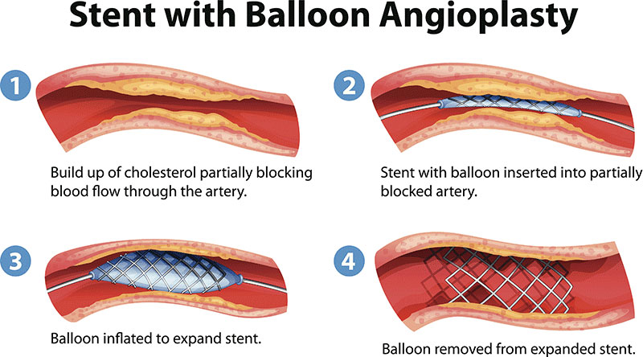
PCI
-procedure uses coronary catheterization to visualise the blood vessels on X-ray imaging. After this, an interventional cardiologist can perform a coronary angioplasty, using a balloon catheter in which a deflated balloon is advanced into the obstructed artery and inflated to relieve the narrowing; certain devices such as stents can be deployed to keep the blood vessel open.

Slide 25
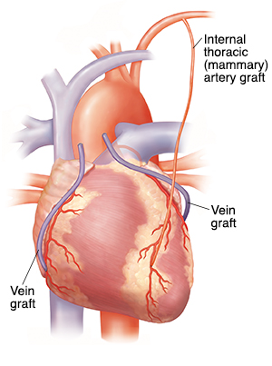
Coronary Artery Bypass Grafting (CABG)
- Less often used than the other two in the acute setting.
- Benefits of CABG include low rates of event-free and reintervention-free survival.
- It remains the procedure of choice in patients with severe multivessel disease and complex coronary anatomy
-Urgent/emergent CABG is typically performed only in the setting of mechanical complications of an acute MI, cardiogenic shock, life-threatening ventricular arrhythmias, or after failure of PCI.
- It is almost never performed in the acute setting on a stable patient.

Slide 26
Thrombolytic therapy
-Early treatment is crucial to salvage as much of the myocardium as possible, Administer as soon as possible up to 24 hours after the onset of chest pain, Outcome is best if given within the first 6 hours.
-Indications: ST-segment elevation in two contiguous ECG leads in patients with pain onset within 6 hours who have been unrelieved by nitroglycerin .
-Alteplase causes the breakdown of a clot by inducing fibrinolysis.has been shown to have the best outcomes among thrombolytic medications, and is the first choice in many centers, despite its high costs.
-Alternatives include streptokinase, Tenecteplase, reteplase, lanoteplase, and urokinase.

Slide 27
Absolute Contraindications to Thrombolytic Therapy:
Trauma: Recent head trauma or traumatic CPR.
Previous stroke.
Recent invasive procedure or surgery.
Dissecting aortic aneurysm.
Active bleeding or bleeding diathesis.
Pregnancy
Complications : internal bleeding , hypotension or some parts of the broken clot may go and cause infarctions in other areas.

Slide 28
Definitive Management
-NSTEMI Management
which usually happens because of a partial coronary artery blockage or blockage in a branch of your main coronary artery.
We do Risk Stratification to determine if the patient needs special intervention or monitoring is good enough.
High risk patients Low-intermediate risk patients
Antiplatelets (clopidogrel)
Anticoagulants (heparin)
Beta blocker
Revascularization by
[PCI/CABG]
Monitoring ECG/ cardiac biomarkers
Anticoagulants
Antiplatelets
Beta-blockers
Nitrates
Statins
Angiotensin-converting-enzyme Inhibitors (ACE)

Slide 29
Rehabilitation
Cardiac rehabilitation is a physician-supervised regimen of exercise and risk factor reduction after MI (e.g. smoking, diet, obesity, Alcohol ).
Shown to reduce symptoms and prolong survival.

Slide 30
Thank You

