Slide 2
VULVAR ITCHING
DONE BY : ABDELRAHMAN BDEIR
SUPRVISED BY : DR HASHEM

Slide 3
Definition :
Vulvar itching or vulvar pruritus is a tingling or irritation of any part of the vulva, with a desire to scratch.
Pruritus vulvae is a symptom, not a condition in itself. Pruritus vulvae can be caused by many different conditions.
95% of women with vulvar itching have yeast ??

Slide 4
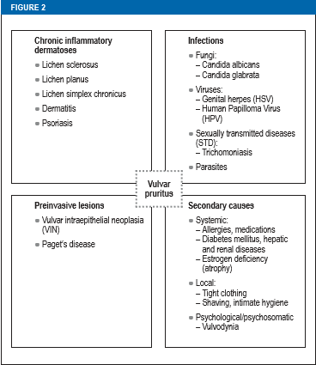
CAUSES
SKIN DISEASE
Contact Dermatitis
Psoriasis
Lichen Sclerosus
Lichen Planus.
Lichen Simplex Chronicus
INFECTIOUS
Bacterial vaginosis
Herpes simplex virus.
Scabies.
STDs
Fungul infection
OTHERS
Stress
Menopause , pregnancy
DM
Vulvar cancer
Neuropathy

Slide 5
Vaginal candidiasis
The most common cause of vulvar itching. affects up to 3 out of 4 women at some point in their lifetimes.
5% suffer from recurrence (4episodes within 1 year)
Risk factors: High dose OCP, diaphragm use with spermicide, DM, antibiotic use, immunosuppression.

Slide 6
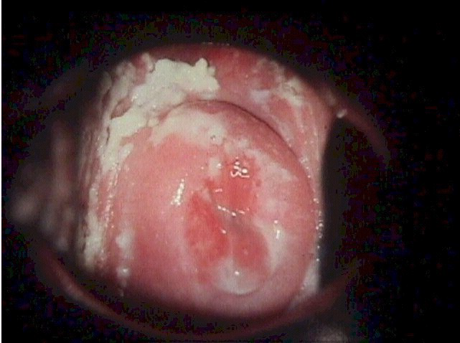
Presentation:
Itching and irritation in the vagina and vulva
A burning sensation, especially during intercourse or while urinating
Redness and swelling of the vulva
Vaginal pain and soreness
Vaginal rash
Thick, white vaginal discharge with a cottage cheese appearance
Watery vaginal discharge

Slide 7
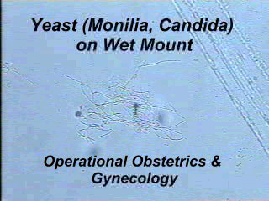
Diagnosis:
1- Wet mount preparation shows budding yeast pseudohyphae, in 50%-70% of cases
2- Fungal culture if negative mount
Treatment:
1- the topically applied azole
2- in severe case we give oral
3- azole resistant therapy boric acid. used only to treat candida fungus that is resistant to the usual antifungal agents.

Slide 8
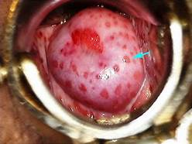
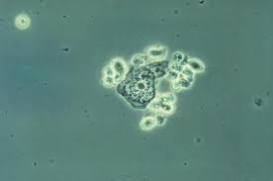
Trichomoniasis :
Caused by trichomonas vaginalis which is protozoal flagellate
20% of infected women are asymptomatic carriers
Presents usually by foul smelling and frothy vaginal discharge .
Vaginal examination may reveal strawberry appearance and bubbly discharge
Diagnosis:
Wet mount show pear shaped trophozoits with their jerky movement
Treatment:
Metronidazole is effective in most cases
Partner should be treated as its STD

Slide 9
Genital warts:
Caused by Human Papilloma virus (HPV) , mainly type 6 &
11 (condyloma acuminata).
Peak incidence among 15 -25 yrs , soon after onset of
sexual activity.
Soft , sessile, and or verrucous lesions.
Usually multifocal & asymptomatic , although itching,
burning , bleeding & pain can occur.
External genital warts are highly contagious >75%.
Usually diagnosed clinically.

Slide 10
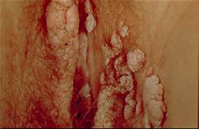
treatment:
The goal of the treatment is the removal of the warts,
it is not possible to eradicate the viral infection.
Treatment modalities : application of cytotoxic or
keratolytic agents , surgical excision cryotherapy ,
laser & immune modulators (interferon)

Slide 11
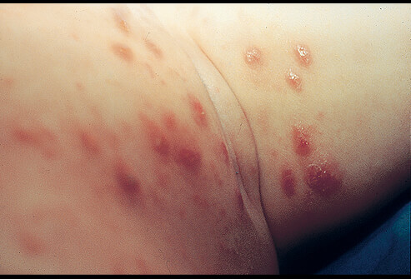
Scabies:
Sarcoptes scabiei(mite)
Usually occur in dirty over crowded areas
Purities is intensified by warmth and perspiration(usually nocturnal)
Diagnosis is usually made by characteristic lesion and distribution .
Recovery of the mite from their tunnels and examined under microscope.
Treatment::
Good wash of the area by soap to open the tunnels
Rubbing with acaricidal solution
Clothes should also be sterilized by boiling

Slide 12
Lichen Sclerosus
Lichen sclerosus (LS) is a chronic inflammatory condition of unknown etiology, LS believed to be an autoimmune disorder.
complex pathogenesis that may genetic, hormonal, and infectious factors
LS affects both sexes and all areas of the body with the most common site of affection being the genitalia. It is more common in women, manifesting most commonly on the vulva.
Onset can occur at any age, but notable bimodal peaks are seen at times of low estrogen in prepubertal girls and menopausal women

Slide 13
Most patients present complaining of vulvar pruritus or irritation.
LS can be asymptomatic.
Physical examination reveals atrophic, hypopigmented-to-white, often atrophic, plaques associated with pruritus and pain that result in genital scarring and adhesion.
Plaques classically distributed around the vulva, perineal body, and perianal skin.

Slide 14
Scratching may lead to thickening of the skin
which can mask the classic atrophic appearance.
As the disease progresses, the symptoms may shift
from pruritus to pain, including dyspareunia, dysuria,
and pain with bowel movements, which can be associated
with a late physical finding of purpura, erosions,
resorption of the labia minora, and fusion of the clitoral hood.
Diagnosis is confirmed with biopsy showing
hyperkeratosis and atrophic epidermis

Slide 15
Patients with LS have an increased incidence of other autoimmune diseases, particularly thyroid disease, vitiligo, pernicious anemia.
Approximately 2% to 5% of women with vulvar LS will develop vulvar squamous cell carcinoma.
Treatment is super-potent topical corticosteroids (eg, clobetasol propionate) for most cases.
The essential components of managing vulvar LS include controlling symptoms, minimizing scarring, and preventing, or detecting early, malignancy.

Slide 16
Lichen planus:
Lichen planus (LP) is another chronic inflammatory dermatosis considered to be an autoimmune condition.
Lichen planus is the most common chronic erosive vulvar dermatosis
LP can affect the mucous membranes of the vagina, conjunctiva, urethra, and anus as well as cutaneous skin, scalp, and nails.
Vulvovaginal LP most commonly presents in postmenopausal woman but can occur earlier in adult women and on rare occasions in children.
A typical presentation is a menopausal woman reporting vulvovaginal pain or pruritus, dyspareunia.

Slide 17
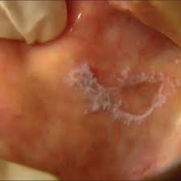
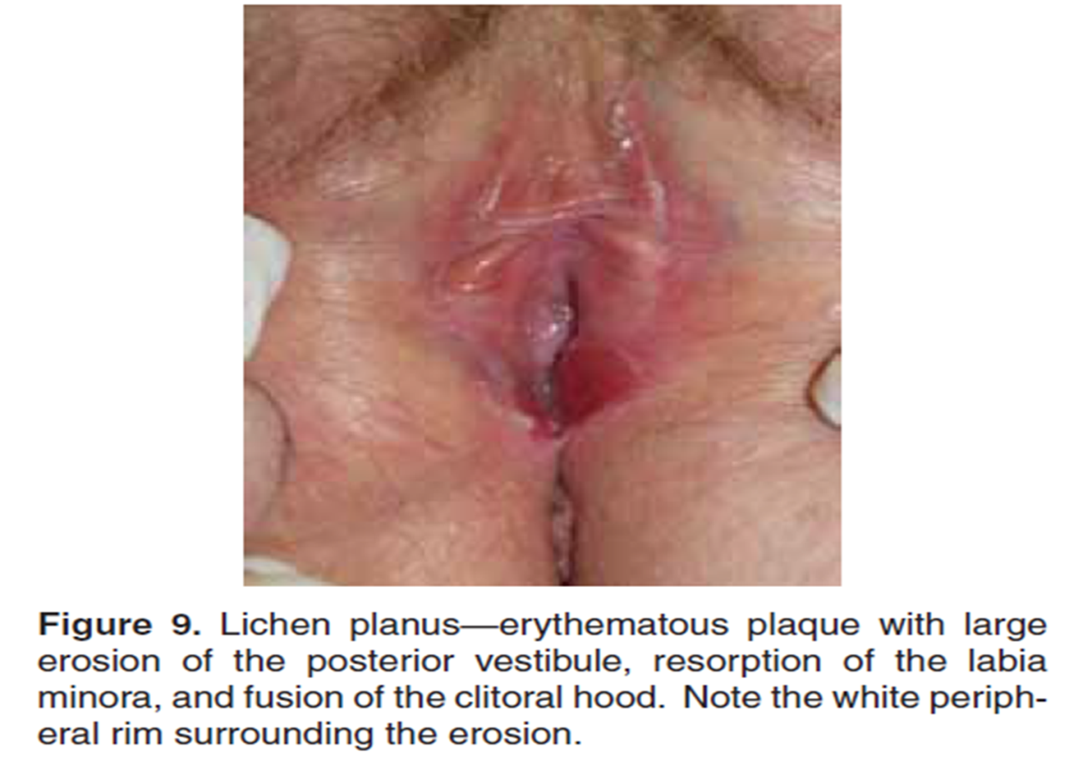
Examination of oral mucosa can yield significant
diagnostic clues, as many women with vulvar LP
also have evidence of oral LP on examination.
Oral LP, which can be painful or asymptomatic,
may manifest as erosions, reticulate striae
( wickham striae )on the
buccal mucosa, or gingival inflammation
LP is treated primarily with super-potent
topical steroids in a regimen similar to that
described above for LS.

Slide 18
Lichen simplex chronicus:
Lichen simplex chronicus (LSC) is a localized plaque of chronic eczematous inflammation created by repeated rubbing or scratching of the skin in response to a sensation of pruritus.
While this rubbing and scratching yields relief and feels pleasurable, the act of rubbing and scratching produces more irritation and more itching, giving rise to a phenomenon often referred to as the itch/scratch cycle. It is because of this cycle that the scratching becomes habitual and recurrence is common.
The itching and inflammation may be treated with a lotions or steroid cream (such as triamcinolone or Betamethasone) applied to the affected area of the skin.

Slide 19
Psoriasis:
Psoriasis is a complex, chronic, multifactorial, inflammatory disease that involves hyperproliferation of the keratinocytes in the epidermis, with an increase in the epidermal cell turnover rate.
resulting in characteristic, well-demarcated, erythematous plaques with silvery scale.
Identifying classic lesions of psoriasis elsewhere on a full-body skin examination can focus the differential diagnosis.
Typical locations, including the elbows, knees, and scalp, and for psoriatic nail changes, including pitting, oil spots, and onycholysis

Slide 20
Treatment:
topical CS
Non-biologic systemic treatments frequently used for psoriasis include methotrexate & ciclosporin
Retinoid vitamin A
These agents are also regarded as first-line treatments for psoriatic erythroderma , Oral CS should not be used, for they can severely flare psoriasis upon their discontinuation

Slide 21
Complications of an itchy vulva:
An itchy vulva can result in a lot of psychological distress and sleeplessness.
Scratching injures the skin, which can lead to pain and secondary bacterial infection.

Slide 22
Diagnostic evaluation
An examination for evidence of systemic disease or of a generalized skin condition is advisable.
Cervical cytology and colposcopic examination of the cervix and vagina may be useful and are mandatory if the vulvar condition is thought to be premalignant.
It is important to take biopsies whenever there is any doubt about the diagnosis. These can be performed readily under local anaesthesia .
Examination may reveal apparently normal skin, scratch marks (excoriations) and the specific features associated with the underlying cause of the itching.
Inguinal LN ??

Slide 23
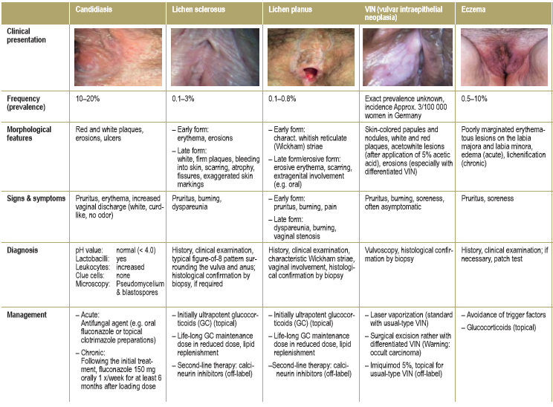

Slide 24
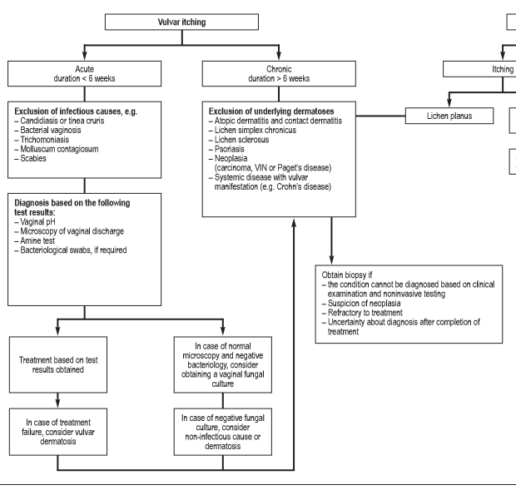
h

