Slide 1
Cardiovascular system
Dr.Bushra Al-Tarawneh, MD

Slide 2
TOPICS: - CARDIOMYOPATHIES. - MYOCARDITIES. - PERICARDIAL DISEASE. - CARDIAC TUMORS.

Slide 3
CARDIOMYOPATHIES

Slide 4
Cardiomyopathies (literally, “heart muscle diseases”): Cardiac diseases attributable to intrinsic myocardial dysfunction.
These can be primary—that is, principally
confined to the myocardium—or secondary presenting as the cardiac manifestation of a systemic disorder.

Slide 5
For purposes of general diagnosis and therapy, three time-honored clinical, functional, and pathologic patterns are recognized:
1. Dilated cardiomyopathy (DCM) (including arrhythmogenic right ventricular cardiomyopathy)
2. Hypertrophic cardiomyopathy (HCM)
3. Restrictive cardiomyopathy

Slide 6
1-Dilated Cardiomyopathy
characterized by progressive cardiac dilation and contractile (systolic) dysfunction, usually with concurrent hypertrophy; regardless of cause, the clinicopathologic patterns are similar.

Slide 7
At least five general pathways can lead to end-stage DCM :
• Genetic causes. DCM has a hereditary basis in 20% to 50% . They Could be:
1. Autosomal dominant inheritance is the predominant pattern, most commonly involving mutations in encoding cytoskeletal proteins, or proteins that link the sarcomere to the cytoskeleton.
2. X-linked DCM is most frequently associated with dystrophin gene mutations
affecting the cell membrane protein that physically couples the intracellular
cytoskeleton to the ECM.).
3. Mutations of genes in the mitochondrial genome.
• Infection. Mostly viral in origin.
• Alcohol or other toxic exposure.
. Peripartum cardiomyopathy occurs late in gestation or several
weeks to months postpartum. The etiology is likely to be multifactorial.
• Iron overload in the heart can result either from hereditary hemochromatosis or from multiple transfusions.

Slide 8
MORPHOLOGY
The heart in DCM characteristically is enlarged (up to 2-3 times the normal weight) and flabby, with dilation of all chambers).
The characteristic histologic abnormalities in is DCM secondary to iron overload, in which marked accumulation of intramyocardial hemosiderin is demonstrable by staining with Prussian blue.
Most myocytes exhibit hypertrophy with enlarged nuclei, but many are attenuated, stretched, and irregular. There is also variable interstitial and endocardial fibrosis, with scattered areas of replacement fibrosis.
Mural thrombi are often present.

Slide 9
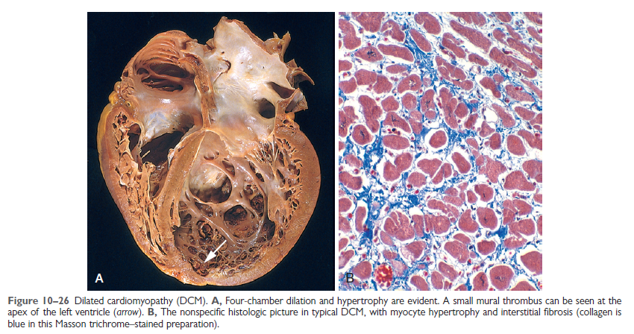

Slide 10
Clinical Features
DCM can occur at any age but most commonly is diagnosed between the ages of 20 and 50 years.
It typically manifests with signs of slowly progressive CHF, including Dyspnea and easy fatigability.
The fundamental defect in DCM is ineffective contraction. Thus, in end-stage DCM, the cardiac ejection fraction typically is less than 25%.
Secondary mitral regurgitation and abnormal cardiac rhythms are common, and embolism from intracardiac (mural) thrombi can occur.
Half of the patients die within 2 years.
Cardiac transplantation is the only definitive treatment. Implantation of long-term ventricular assist devices is being increasingly utilized.

Slide 11
Arrhythmogenic Right Ventricular Cardiomyopathy
Is an autosomal dominant disorder of cardiac muscle with variable penetrance.
It classically manifests with right sided heart failure and rhythm disturbances that can cause sudden cardiac death.
Morphologically, the right ventricular wall is severely thinned owing to myocyte replacement by massive fatty infiltration and lesser amounts of fibrosis.
Many of the mutations involve genes encoding

Slide 12
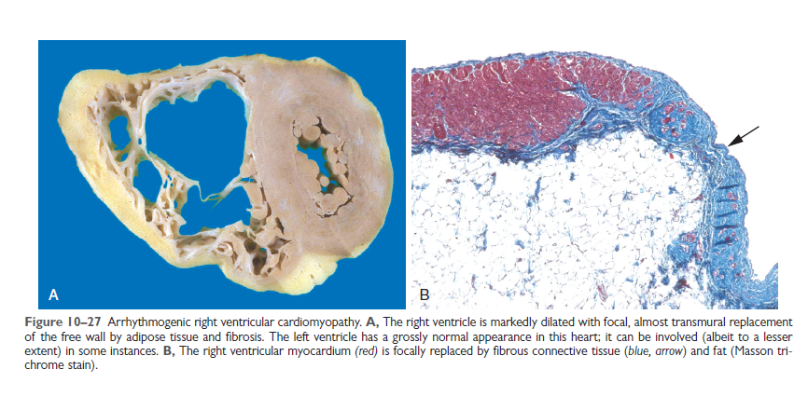

Slide 13
Hypertrophic cardiomyopathy (HCM)
Characterized by myocardial hypertrophy, defective diastolic filling, and—in a third of cases—ventricular outflow obstruction.
The heart is thick-walled, heavy, and hypercontractile.
Systolic function usually is preserved in HCM, but the myocardium does not relax and therefore exhibits primary diastolic dysfunction.
HCM needs to be distinguished clinically from disorders causing ventricular stiffness (e.g., amyloid deposition) and ventricular hypertrophy (e.g., aortic stenosis and hypertension).
HCM is fundamentally a disorder of sarcomeric proteins. Of these, β-myosin heavy chain is most frequently affected.

Slide 14
MORPHOLOGY
Classically, there is disproportionate thickening of the ventricular septum relative to the left ventricle free wall (so-called asymmetric septal hypertrophy); nevertheless, in about 10% of cases of HCM, concentric hypertrophy is seen. On longitudinal sectioning, the ventricular cavity loses its usual round-to-ovoid shape and is compressed into a “banana-like” configuration.
The characteristic histologic features in HCM are marked myocyte hypertrophy, haphazard myocyte (and myofiber) disarray, and interstitial fibrosis.

Slide 15
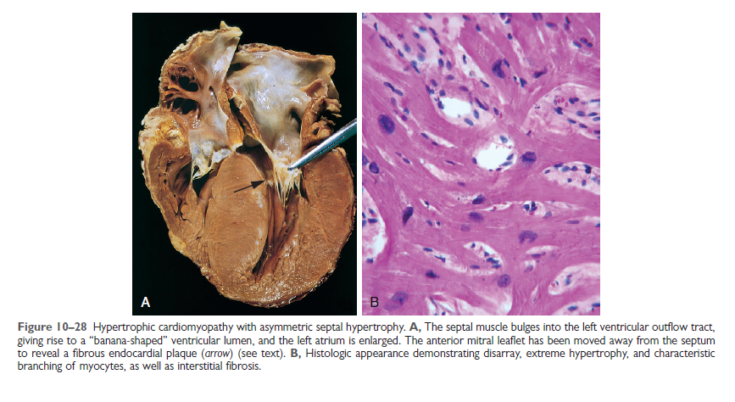

Slide 16
Clinical Features
Although HCM can present at any age it typically manifests during the postpubertal growth spurt.
In almost one third of the cases of sudden cardiac death in athletes under the age of 35, the underlying cause is HCM.
Atrial and ventricular fibrillations with mural thrombus formation, infective endocarditis of the mitral valve, CHF, and sudden death.
Most patients are improved by therapy that promotes ventricular relaxation or partial surgical excision.

Slide 17
Restrictive Cardiomyopathy
Characterized by a primary decrease in ventricular compliance, resulting in impaired ventricular filling during diastole (simply put, the wall is stiffer).
Restrictive cardiomyopathy can be idiopathic or associated with systemic diseases that also happen to affect the myocardium also happen to affect the myocardium, for example:
* Radiation fibrosis.
* Amyloidosis.
* Products of inborn errors of metabolism.

Slide 18
Amyloidosis is caused by the deposition of extracellular proteins with the predilection for forming insolubleβ-pleated sheets. Cardiac amyloidosis can occur with systemic amyloidosis or can be restricted to the heart, particularly in the case of senile cardiac amyloidosis.
Endomyocardial fibrosis is principally a disease of children and young adults in Africa and other tropical areas;
. It is characterized by dense diffuse fibrosis of the ventricular endocardium and subendocardium, often involving the tricuspid and mitral valves.
. Endomyocardial fibrosis has been linked to nutritional deficiencies and/or inflammation related to helminthic infections (e.g., hypereosinophilia); worldwide, it is the most common form of restrictive cardiomyopathy.
Loeffler endomyocarditis also exhibits endocardial fibrosis, typically associated with formation of large mural thrombi, but without geographic predilection. Histologic examination typically shows peripheral hypereosinophilia and eosinophilic tissue infiltrates.

Slide 19
MORPHOLOGY
The ventricles are of approximately normal size or only slightly enlarged, the cavities are not dilated, and the myocardium is firm.
Microscopic examination reveals variable degrees of interstitial fibrosis.

Slide 21
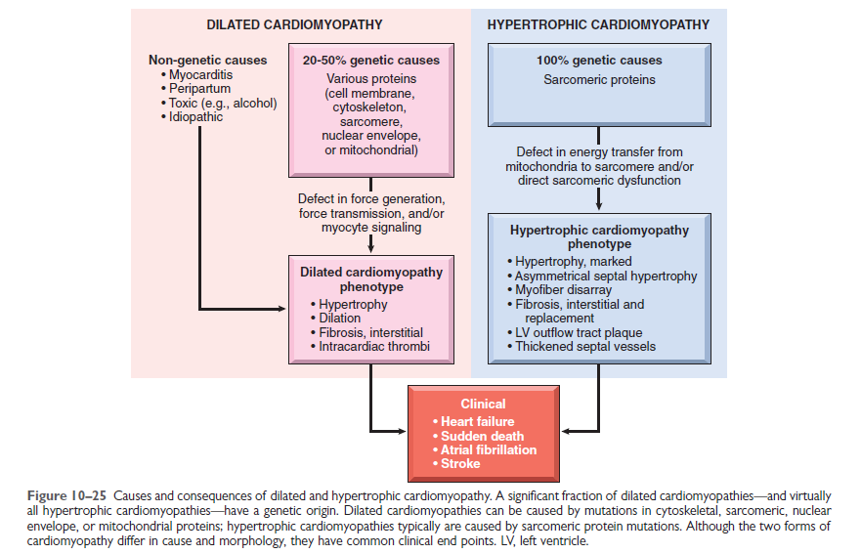

Slide 22
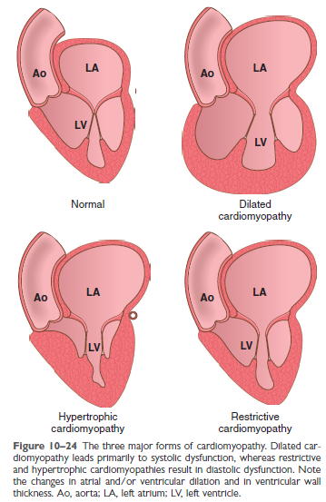

Slide 23
Myocarditis
Myocarditis encompasses a diverse group of clinical entities in which infectious agents and/or inflammatory processes primarily target the myocardium.

Slide 24
Infectious causes
1-Viral infections are the most commoncause of myocarditis, with coxsackieviruses A and B and other enteroviruses accounting for a majority of the cases.
2-The nonviral infectious causes of myocarditis :
The protozoan Trypanosoma cruzi is the agent of Chagas disease.
Toxoplasma gondii (household cats are the most
common vector), particularly in immunocompromised persons.
Trichinosis is the most common helminthic disease with associated cardiac involvement.
Noninfectious causes
Associated with systemic diseases of immune origin, such as systemic lupus erythematosus and polymyositis.
Drug hypersensitivity reactions (hypersensitivity myocarditis).

Slide 25
MORPHOLOGY
In acute myocarditis, the heart may appear normal or dilated; in advanced stages, the myocardium typically is flabby and often mottled with pale and hemorrhagic areas.
Microscopically, active myocarditis is characterized by edema, interstitial inflammatory infiltrates, and myocyte injury .
In hypersensitivity myocarditis, interstitial and perivascular
infiltrates are composed of lymphocytes, macrophages,
and a high proportion of eosinophils.
Giant cell myocarditis is a morphologically distinctive entity characterized by widespread inflammatory cellular infiltrates containing multinucleate giant cells.
Chagas myocarditis is characterized by the parasitization
of scattered myofibers by trypanosomes accompanied
by an inflammatory infiltrate of neutrophils, lymphocytes, macrophages, and occasional eosinophils.

Slide 26
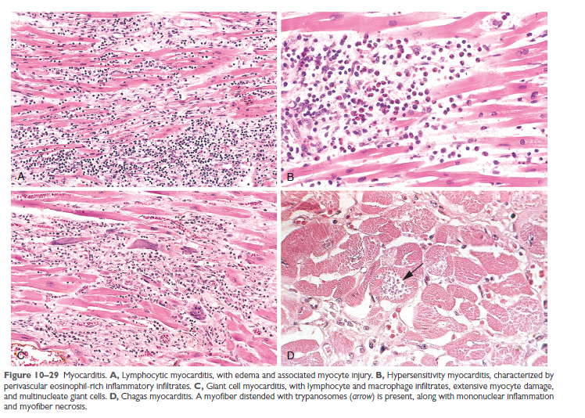
Xxxxxxw```````3w32ws22

Slide 27
PERICARDIAL DISEASE

Slide 28
1-Pericarditis
Primary pericarditis is uncommon. It most often is due to
viral infection (typically with concurrent myocarditis),
although bacteria, fungi, or parasites may also be involved.
In most cases, pericarditis is secondary to acute MI, cardiac surgery, radiation to the mediastinum, or processes involvingother thoracic structures (e.g., pneumonia or pleuritis).
*Uremia is the most common systemic disorder associated
with pericarditis.
Pericarditis can:
Cause immediate hemodynamic complications if it elicits a large effusion (resulting in cardiac tamponade).
Resolve without significant sequelae.
Progress to a chronic fibrosing process.

Slide 29
Clinical Features
Atypical chest pain (not related to exertion and worse in recumbency)
Pominent friction rub.
Cardiac tamponade, with declining cardiac output and consequentshock.
Chronic constrictive pericarditis produces a combination of right-sided venous distention and low cardiac output, similar to the clinical picture in restrictive cardiomyopathy.

Slide 30
MORPHOLOGY
Tuberculous pericarditis:
Exhibits areas of caseation
Acute viral pericarditis or uremia:
The exudate typically is fibrinous, imparting an irregular, shaggy
appearance to the pericardial surface (so-called “bread and
butter” pericarditis).
Pericarditis due to malignancy
Associated with an exuberant, shaggy fibrinous exudate and a bloody effusion.
Acute bacterial pericarditis:
The exudate is fibrinopurulent (suppurative), often with areas of frank pus .
Notes:
In most cases, acute fibrinous or fibrinopurulent
pericarditis resolves without any sequelae. With
extensive suppuration or caseation, however, healing can
result in fibrosis (chronic pericarditis).
Chronic pericarditis may be associated with delicate
adhesions or dense, fibrotic scars that obliterate the pericardial
space. In extreme cases, the heart is so completely
encased by dense fibrosis that it cannot expand normally
during diastole—resulting in the condition known as constrictive
pericarditis.

Slide 31
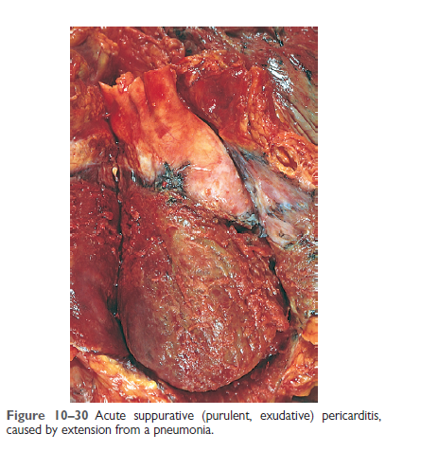

Slide 32
2-Pericardial Effusions
Normally, the pericardial sac contains at most 30 to 50 mL of clear, serous fluid.
1. Serous and/or fibrinous effusions in excess of this amount occur most commonly in the setting of pericardial inflammation.
2. Serous: congestive heart failure, hypoalbuminemia of any cause
3. Serosanguineous: blunt chest trauma, malignancy, ruptured
MI or aortic dissection
4. Chylous: mediastinal lymphatic obstruction
The consequences of pericardial accumulations depend on the volume of fluid and the ability of the parietal pericardium to stretch.
slowly accumulating
effusions—even as large as 1000 mL—can be welltolerated
rapidly developing collections of as little as 250 mL can so restrict diastolic cardiac filling as to produce potentially fatal cardiac tamponade.

Slide 33
CARDIAC TUMORS

Slide 34
Tumor metastases constitute the most common malignancy of the heart.
Primary cardiac tumors are uncommon; moreover, most also are (fortunately) benign.
The five most common have nomalignant potential and account for 80% to 90% of all primary heart tumors. In descending order of frequency, these are myxomas, fibromas, lipomas, papillary fibroelastomas, and rhabdomyomas. Angiosarcomas
Clinical Features:
Valvular “ball-valve” obstruction.
Embolization.
Syndrome of constitutional signs and symptoms including fever and malaise.
Echocardiography is the diagnostic modality of choice, and surgical resection is almost uniformly curative.
Notes:
In descending order these are lung cancer, lymphoma, breast cancer, leukemia,
melanoma, hepatocellular carcinoma, and colon cancer. Primary Neoplasms

Slide 35
Myxomas are the most common primary tumors of the adult heart.
Roughly 90% are atrial, with the left atrium accounting for 80% of those.
* Histologically, myxomas are composed of stellate, frequently multinucleated myxoma cells (typically with hyperchromatic nuclei), admixed with cells showing endothelial,
smooth muscle, and/or fibroblastic differentiation.
Rhabdomyomas are the most frequent primary tumors of the heart in infants and children; they frequently are discovered owing to valvular or outflow obstruction. Cardiac rhabdomyomas occur with high frequency in patients with tuberous sclerosis caused by mutations in the TSC1 or TSC2 tumor suppressor genes.
* Histologic examination shows a mixed population of cells; most characteristic, however, are large, rounded, or polygonal cells containing numerous glycogen-laden vacuoles separated by strands of cytoplasm running from the plasma membrane to the centrally located nucleus, so-called spider cells.
Notes:
; loss of TSC-1 and -2 activity leads to myocyte overgrowth. Because they often regress spontaneously, rhabdomyomas are best considered to be
hamartomas rather than true neoplasms. Like certain other
tumors that appear in very young children (e.g., neuroblastoma),
rhabdomyomas often regress spontaneously for
unknown reasons.

Slide 36
Lipomas are localized, poorly encapsulated masses of adipose tissue; these can be asymptomatic, create ball-valve obstructions (as with myxomas), or produce arrhythmias.
Papillary Fibroelastomas usually are only incidentally identified lesions, although they can embolize. Generally located on valves, they form distinctive clusters (up to 1 cm in diameter) of hairlike projections.
*Histologic examination shows myxoid connective tissue containing abundant mucopolysaccharide matrix and laminated elastic fibers, all surrounded by endothelium.
Cardiac Angiosarcomas.
*Histologic examination revealed lesions ranging from plump atypical
endothelial cells that form vascular channels (to undifferentiated spindle cell tumors without discernible blood vessels.

Slide 37
