Slide 1
Enterocutaneous fistula
Edited By : Basil Smadi

Slide 2
Definition
A fistula is an abnormal communication between two epithelialized surfaces
Enterocutaneous fistula : is an abnormal communication between the small or large bowel and the skin.
ECF can arise from the duodenum, jejunum, ileum, colon, or rectum.
ECF is an external fistula
The ileum was the most common site of ECF

Slide 3
Pathophysiology
* The pathophysiology of all forms of small-bowel fistulas is related to the exposure of nonintestinal tissue to intestinal contents because of the fistula .
* The local effect of intestinal fluid can be damaging or corrosive to the nonintestinal tissue, leading to breakdown, erosions, and loss of normal organ or organ system function.

Slide 4
Classification of Fistula
1 _Anatomic classifications define the sites of fistula origin, drainage point, and whether the fistula is internal or external
2_ Physiologic classifications rely on fistula output in a 24-hour period
The type of ECF, as based on the output of the enteric contents :
Low-output fistula (< 200 mL/day),
Moderate-output fistula (200-500 mL/day)
High-output fistula (>500 mL/day)
3 _Etiologic classifications (eg malignancy, Inflammatory bowel disease , or radiation) define the associated disease entity leading to the development of the fistula

Slide 5
Etiology
The etiology of ECFs can be characterized as
Postoperative 75-90 %
Traumatic
spontaneous.
Postoperative :
Disruption of anastomosis
Inadvertent enterotomy
Inadvertent small-bowel injury
15-25 %
Notes:
75-95% is Iatrogenic
Enterotomy ;; Occurs especially in patients with adhesions, when dissection can cause multiple serosal tears and an occasional full-thickness tear
Small bowel injury : Occurs during abdominal closure, especially after ventral hernia repair

Slide 6
Disruption of anastomosis can result from inadequate blood flow due to an improper vascular supply, especially when extensive mesenteric vessels have to be ligated.
Tension anastomosis
Minimal leak or infection can lead to perianastomotic abscess formation, resulting in disruption .
Notes:
if anastomosis is performed in an unhealthy bowel (eg, diseased, ischemic), it can lead to disruption and cause an ECF.

Slide 7
Gastroduodenal fistulas are seen most often after surgery for perforated peptic ulcer.
In patients with a perforated duodenal ulcer, when the perforation is large, extensive contamination is present. When the duration between perforation and surgery is long, there is a high possibility of a postoperative leak, leading to a lateral duodenal fistula. This problem is difficult to treat, and mortality is high.

Slide 8
Surgery for appendicitis, appendicular perforation at the base, or drainage of an appendicular abscess can also lead to a colocutaneous fistula.
Radiation therapy is also another major cause of colonic fistula.

Slide 9
Traumatic
Traumatic ECF results from iatrogenic surgical trauma to the bowel that may or may not be recognized. Road traffic accidents with injury to the gut can also lead to an ECF.

Slide 10
Spontaneous
Spontaneous causes of ECF :
Malignancy
Radiation enteritis with perforation
Intra-abdominal sepsis
IBD (eg, Crohn disease)
Diverticulitis (mcc of CCT)

Slide 11
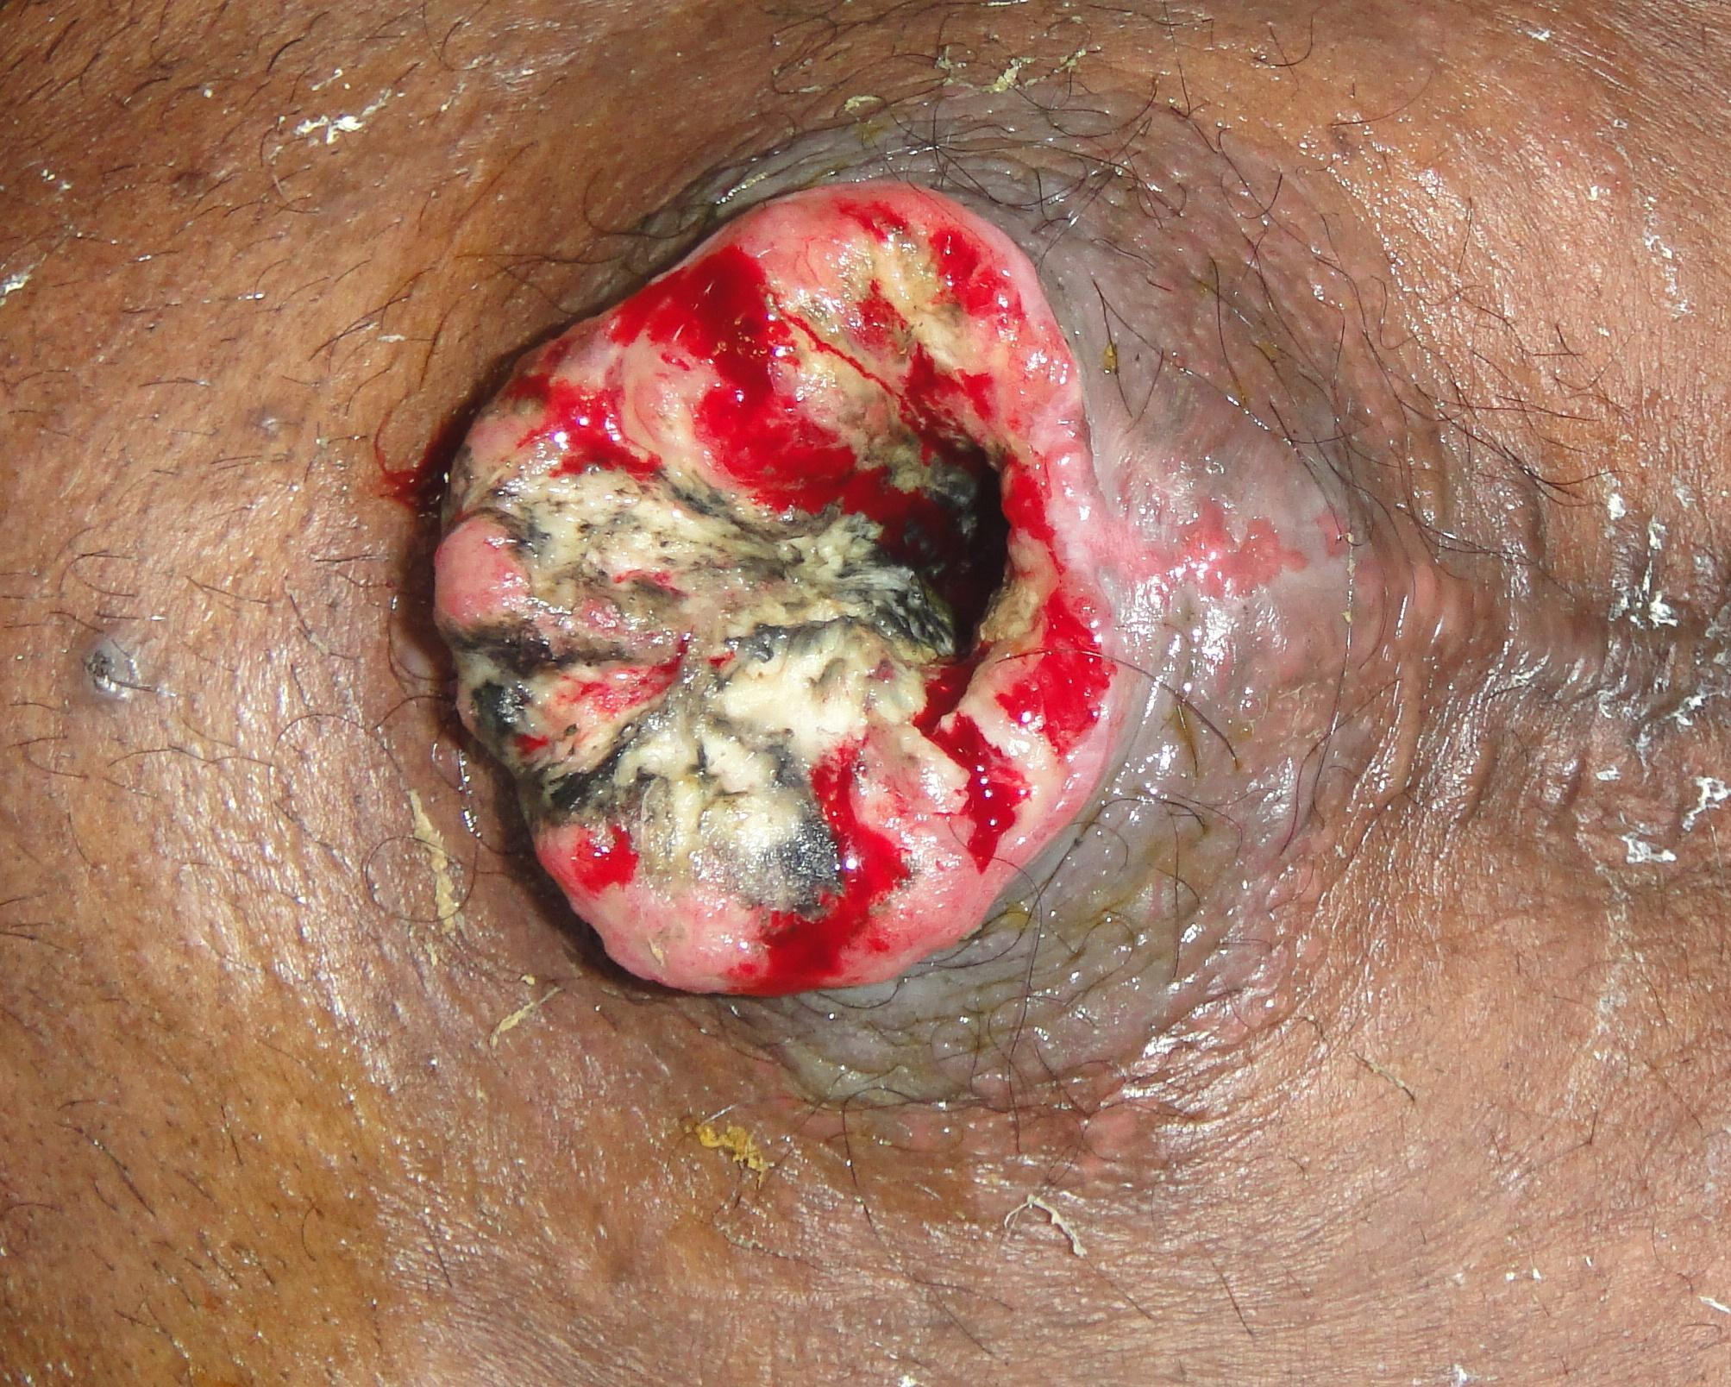

Slide 12
History & Physical Examination
Features suggestive of an enterocutaneous fistula (ECF) include
postoperative abdominal pain,
tenderness,
distention,
enteric contents from the drain site, and the main abdominal wound. Tachycardia and pyrexia may also be present, as may signs of localized or diffuse peritonitis, including guarding, rigidity, and rebound tenderness.

Slide 13
Complications
Patients with ECF present with associated complications :
Sepsis
dehydration
Electrolyte and fluid abnormalities
Malnutrition
Skin excoriation

Slide 14
The degree of sepsis depends on the state of the ECF.
If the fistula forms a direct tract through which the bowel contents are draining onto the skin, then the sepsis may be minimal,
whereas if the fistula forms an indirect tract through which the bowel contents are draining into an abscess cavity and then onto the skin, the degree of sepsis may be higher.
In the presence of extensive peritoneal contamination or generalized peritonitis with ECF, the patient can be toxic due to severe sepsis.

Slide 15
Leakage of protein-rich enteric contents, intra-abdominal sepsis, or electrolyte imbalance–related paralytic ileus, as well as a general feeling of ill health, leads to reduced nutritional intake by these patients, resulting in malnutrition.
in patients with high-output enterocutaneous fistulas because of intestinal fluid loss. Hypokalemia, hypochloremia, and metabolic alkalosis
Notes:
Electrolyte imbalance : intestinal fluid loss/// paralytic ileus // sepsis
in patients with high-output enterocutaneous fistulas because of intestinal fluid loss. Hypokalemia, hypochloremia, and metabolic alkalosis

Slide 16
Skin excoriation
Skin excoriation is one of the complications that can lead to significant morbidity in patients with ECF. When the enteric contents are more fluid than solid, this becomes a difficult problem; the skin excoriation makes it difficult to put a collecting bag or dressings over the fistula, and more leakage leads to an increase in the excoriation.

Slide 18
Laboratory Studies
Total white blood cell (WBC) count - This is important because sepsis can lead to leukocytosis
Serum sodium, potassium, and chloride levels - Electrolyte abnormalities can result from fluid and electrolyte loss
Complete blood count (CBC), total proteins, serum albumin, and globulin - These can demonstrate the presence of malnutrition-associated anemia/hypoalbuminemia
Serum transferrin - Low levels (< 200 mg/dL) are a predictor of poor healing
Serum C-reactive protein (CRP) - Levels may be elevated

Slide 19
Prognosis
ECF is a common condition in most general surgical wards. Mortality has fallen significantly since the late 1980s, from as high as 40-65% to as low as 5-20%, largely as a result of advances in intensive care, nutritional support, antimicrobial therapy, wound care, and operative techniques. Even so, the mortality is still high, in the range of 30-35%, in patients with high-output ECFs.
Once a patient develops an ECF, the morbidity associated with the surgical procedure or the primary disease increases, affecting the patient's quality of life, lengthening the hospital stay, and raising the overall treatment cost. Malnutrition, sepsis, and fluid electrolyte imbalance are the primary causes of mortality in patients with an ECF.
Notes:
a

Slide 20
However, patients with an ECF with favorable factors for spontaneous closure have a good prognosis and a lower mortality.
Favorable factors for spontaneous closure
End fistulas
Jejunal fistulas
Colonic fistulas
Continuity-maintained fistulas
Small-defect fistulas

Slide 21
Long-tract fistulas
Spontaneous closure is also possible if the bowel-wall disruption is partial and other factors are favorable.

Slide 22
Unfavorable factors for spontaneous closure
Factors preventing the spontaneous closure of an ECF can be remembered by using the acronym HIS FRIEND, which represents the following :
1. High output fistula (>500cc/day)
2. Intestinal destruction ( >50% of circumference)
3. Short segment fistula ( <2.5cm)
4. Foreign body
5. Radiation
6. Inflammation/infection/IBD
7. Epithelialization of the fistula tract

Slide 23
8. Neoplasm (malignancy)
9. Distal obstruction - A distal obstruction prevents the spontaneous closure of an ECF, even in the presence of other favorable factors; if present, surgical intervention is needed to relieve the obstruction
10. Lateral duodenal fitsula

Slide 25
Thank you

Slide 26
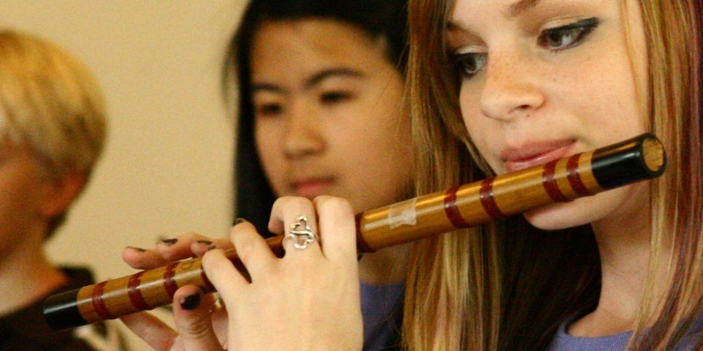
Suliman Dmor

Slide 27
MANAGEMENT
S-S-N-A-P
Stabilization and resuscitation
Control of Sepsis and appropriate Skin care
Nutrition
Define underlying Anatomy
Plan to deal with the fistula

Slide 28
Stabilization and Resuscitation
- Restoration of normal circulating blood volume
- electrolyte & acid base imbalance.
-hypokalemia and metabolic acidosis, which require correction.
- albumin administration.

Slide 29
Rehydration --isotonic fluid(NS/RL)
Strict input and output measurements
- Urine output should be restored to greater than 0.5mL/kg/hr.

Slide 30
Control Of Sepsis & Fistula Effluent
- fever, tachycardia and leukocytosis along with failure to improve adequately points towards possible sepsis or abscesses.
- May require surgical drainage of abscess, if any along with adequate antibiotic cover.

Slide 31
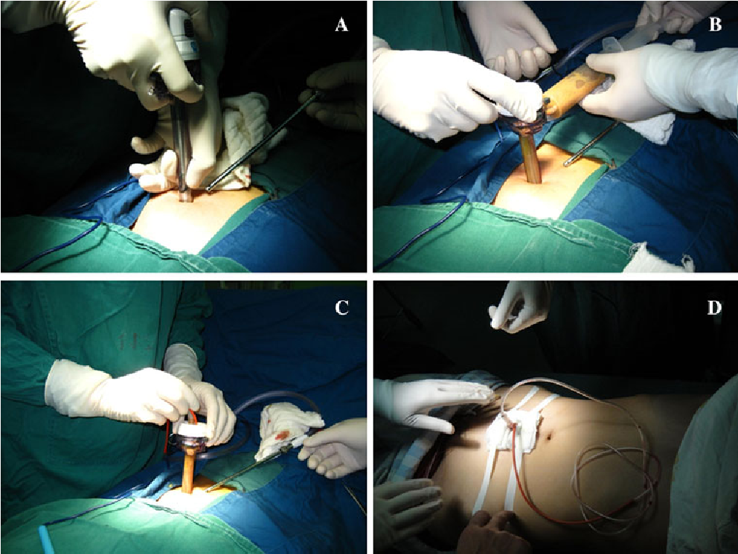

Slide 33
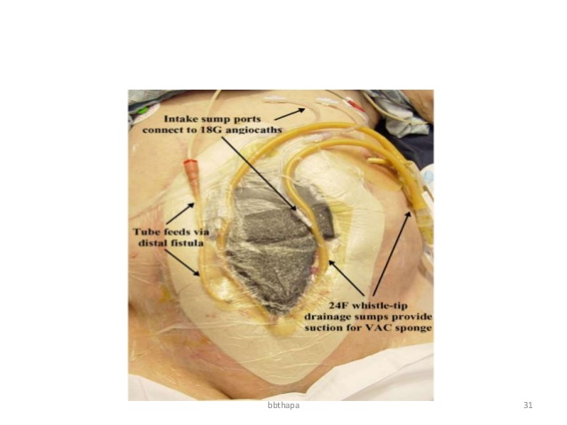

Slide 34
Vacuum assisted closure [VAC]
- device drainage system.
- Due to the negative pressure application, helps to control drainage, minimizes the size of the abdominal wound, reduces frequency of dressing and protects the skin while helping to promote fistula healing.
- Removes chronic edema, leading to increased localized blood flow, and the applied forces result in the enhanced formation of granulation
tissue”

Slide 35
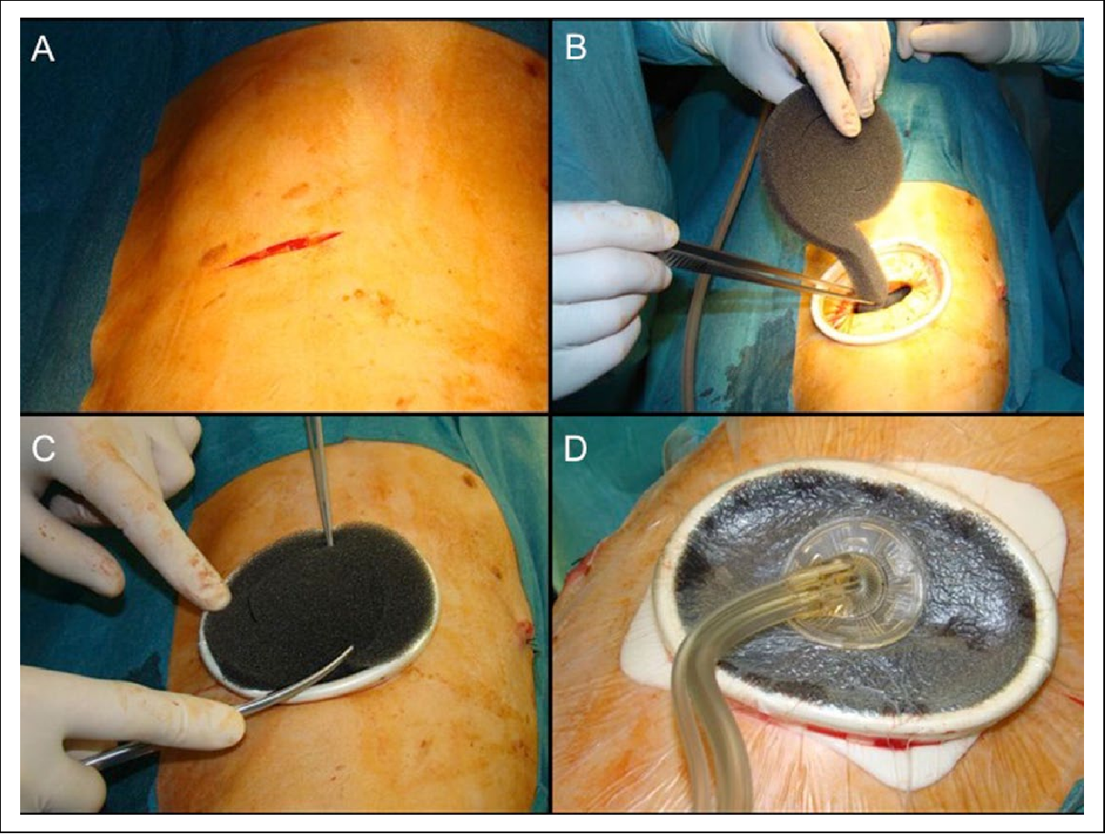

Slide 36
Laparotomy may be required for:
1- Extensive cellulitis/necrotising fascitis
2- Incomplete percutaneous drainage of collections
3- Disruption of anastomosis

Slide 37
Skin care management
• Problems in skin around the fistula:
Wetness
Burning pain
Discomfort from skin edema

Slide 38
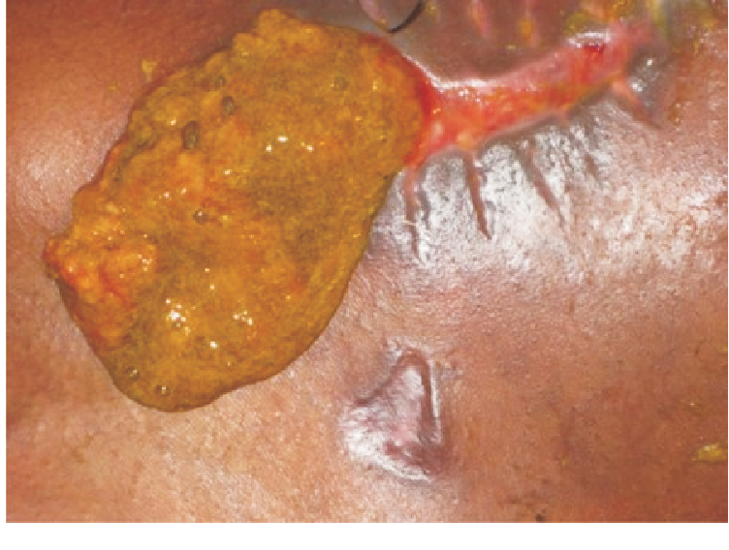
• Goals of skin care: Containing the effluent

Slide 39
Skin Barriers:
1- Solid wafers (pectin based):
provide a good barrier, before the skin breaks down and ulcerates.
2- Powders (Pectin/ Karaya based):
Powders are preferred over a paste in wet, weepy, perifistular skin when severe skin maceration is present.
3- Paste
4- Spray and wipes
5- Ointments and creams (zinc/petroleum based)

Slide 40
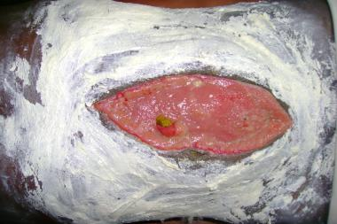
Zinc oxide cream barrier for skin protection.

Slide 41
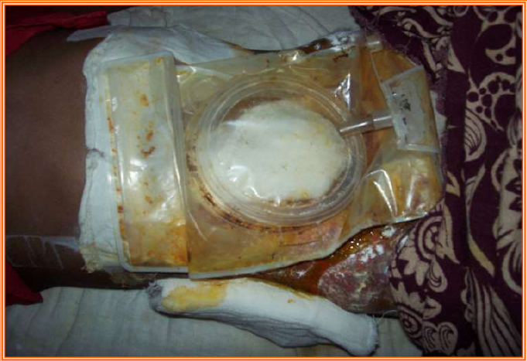
• Wound pouch dressings

Slide 42
Pharmacological Support
SOMATOSTATIN N ANALOGUE
- Octreotide
Reduces fistula output by 40 – 60% by the end of 24 hrs.
- Octreotide and TPN seem to have a synergistic effect on reduction of effluent volume and improvement in fistula closure rates.
- Proton-pump inhibitors and H2 receptor antagonists/antimotality agent also help reduce fistula
output especially in proximal fistulas.

Slide 43
• Mode
– Inhibit gastrin & cholecystokinin
– Reduces splanchic blood flow
– Reduces rate gastric emptying
– Inhibit gall bladder contraction
Plasma half life 1-2 min
- Should be discontinued if ineffective for 48 hrs as it has side effects like
hyperglycemia, elevated cholesterol and reduced bowel motility.

Slide 44
Cyclosporine helps to treat refractory fistulae associated
with Crohn’s disease.
Infliximab administeration helped in partial resolution of 68% of multiple lesions and complete closure in 55% of patients.

Slide 45
- Excessive fistula output can be controlled by:
1.nasogastric tube placement
2.withdrawal of oral feeds
3.initiation of parenteral nutrition

Slide 46
Nutritional management
- May be:
• Enteral
• Parenteral
- based on the anatomy of the fistula.
- combination of parenteral and enteral nutrition can be used in high-output fistulas

Slide 47
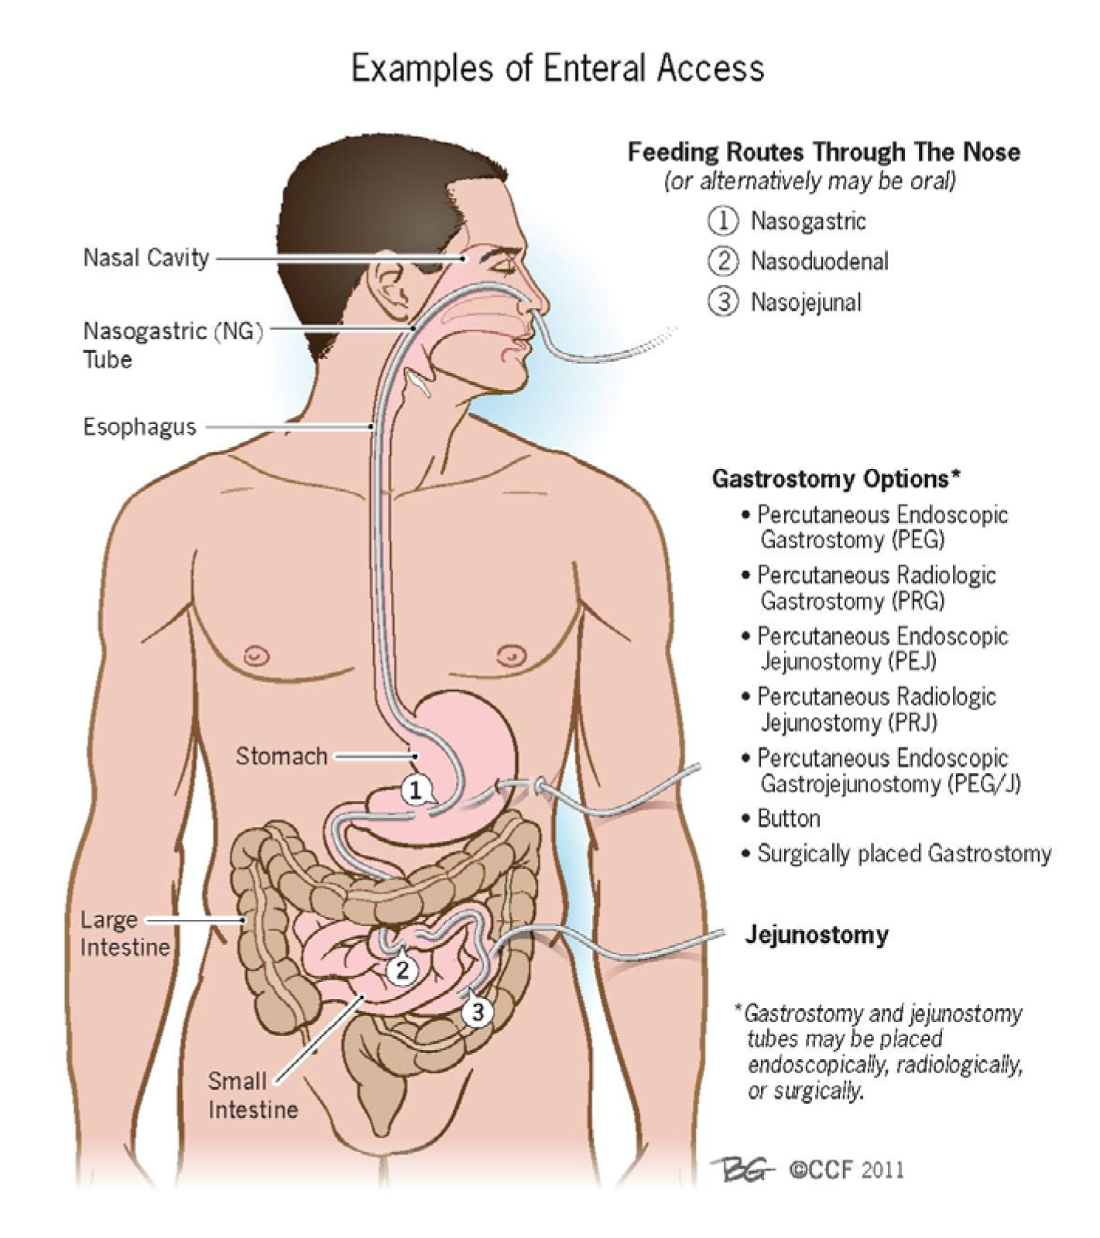

Slide 48
- Nutrition via the enteral route helps in maintaining the intestinal mucosal barrier, more efficacious delivery of nutrients, stimulating hepatic protein synthesis.
- The routes of administration via nasogastric/jejunal tubes or a gastrostomy,High rates of feeding should be avoided to prevent hyperosmolar diarrhea.
- In proximal fistulae, the enteral feeding tube may be entered beyond the fistula to provide enteral nutrition(fistuloclysis)
- In patients with a proximal fistula, if a nasojejunal tube can be introduced beyond the site of the fistula, then these patients can be supported with enteral nutrition, provided that there is at least 4-5 ft (1.2-1.5 m) of functional bowel distal to it and no distal obstruction.
- Patients with chronic small-bowel ECFs may need additional supplementation with copper, folic acid, and vitamin B12.
- During the time the enteral nutrition is increasing, patient should be supplemented with TPN.

Slide 49
- If BW loss> 20%, TPN initiated gradually to avoid
refeeding syndrome
TPN indications
1- gastric, duodenal, or small-bowel fistula.
2- Inability to obtain enteral access
3- High output fistulas
4- GI intolerance with enteral nutrition
5- Multiple unfavorable factors (ileus, obst,)
- Patients should receive 3000 to 5000 non
proteins calories per day

Slide 50
Requirements for TPN
1- Electrolyte requirements
Sodium (Na) - 80-100 mEq/day
Potassium (K) - 75-100 mEq/day
Magnesium (Mg) - 15-20 mEq/day
Calcium (Ca) - 15-20 mEq/day
2- Water 1 mL/kcal/day or 30ml/kg/day
3- Calorie and protein requirements are as follows:
25-30 kcal, 1.0-1.2 g/kg/day
4- nonprotein calorie-to-nitrogen ratio should be as follows:
200-300:1
5- Glucose, 75 g
Amino acids, 20 g
Lipids, 30 g/L
Conc. dextrose: 500ml of 20% Dex. (=400 kcal)
Fat: 500 ml 10% fat emulsion (=450 kcal)
Crystalline Amino Acids: 500 ml 10% Amino acids
(=8.4 g Nitrogen)
Daily Vitamin Supplementation ( Vit. K 10 mg/wk)

Slide 51
• Rate of infusion
• Starting: 50 – 100 ml/hr
• Gradually increased by 25 – 50 ml/hr every second day

Slide 54
Surgical therapy
Haneen Al-Hayajneh

Slide 55
Imaging
Imaging (7-10 days) following stabilization.
Objectives of investigation plan: To define-
• Precise anatomical location
• Is the bowel in continuity or is disrupted
• Abscess cavity
• Condition of adjacent bowel
• Is there a distal obstruction

Slide 56
Often, a combination of studies is necessary to fully appreciate the fistula anatomy. Computed tomography, fistulography, a small bowel follow-through study, and contrast enemas are all useful modalities for defining anatomy depending on the location of the fistula.
Magnetic resonance enterography is another adjunct, particularly useful in patients with IBD..

Slide 57
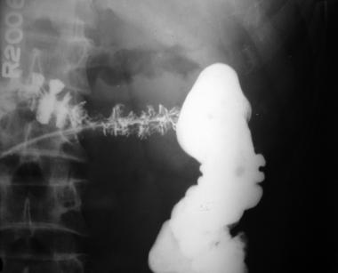
Fistulography
During fistulography a water-soluble contrast is injected into the fistulous tract.

Slide 58
Fistulography provides the following information:
Length of the tract
Extent of the bowel-wall disruption
Location of the fistula
Presence of a distal obstruction
fistulogram, and percutaneous drainage may decompress a complex fistula and convert it to a simple one.

Slide 59
CT scan
CT scan with oral contrast is considered the single best radiologic test
locating the fistula
defining its anatomy
commenting on the gut surrounding fistula
abdominal leaking
presence of any intra-abdominal abscess
distal obstruction/pathology
foreign bodies
CT scan is highly recommended for duodenal and pancreatic fistula.
CT scan can be therapeutic by helping in CT-guided aspiration of intra-abdominal abscesses, if any.

Slide 60
Endoscopy may also be used occasionally though its principal use is in internal
fistulas.
Endoscopy is usually delayed till acute inflammation gets reduced.
CT scan

Slide 61
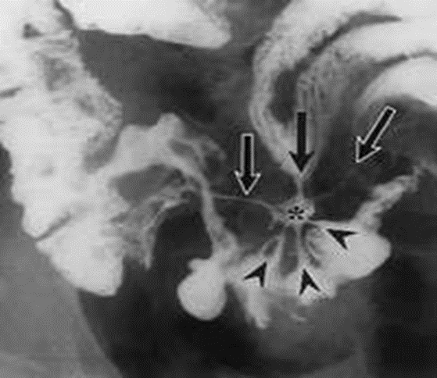
Water-soluble contrast enema
The different types of tracts that can be seen by using a water-soluble contrast enema (WCE) in patients with ECF with failure of low colorectal anastomosis may be classified as follows :
I – Simple, short blind ending, < 2 cm
II - Continuous linear, long single, >2 cm
III - Continuous complex, multiple linear

Slide 62
Closure rates without operative intervention in the era of advanced wound care and parenteral nutrition (PN) vary considerably in reports 19 to 92%, with most studies demonstrating closure rates in the 20 to 30% range.
With historical wound care measures, 90% of spontaneous closure occurred in the first month after sepsis resolution, with an additional 10% closing in the second month, and none closing spontaneously after 2 months.
With vacuum assisted closure (VAC) and other negative pressure wound therapies (NPWT) therapy, there are case reports of fistulae closure well into the second and third month
However, the development and management of an ECF remains a chronic, debilitating condition associated with prolonged intensive care unit and hospital length of stay, and hospital costs of over $500,000

Slide 63
Timing of surgery
Depending on the surgeon, 2 to 3 months of will be attempted before the surgical correction of a fistula is considered.
This waiting period gives the fistula an appropriate amount of time to close spontaneously. It also decreases the morbidity and mortality of surgical correction.
The absolute minimal waiting interval after original surgery to return to the operating room is 6 weeks.

Slide 64
The time interval in which operative intervention is associated with a significantly higher mortality has been outlined by Fazio et al, counting from the day of previous surgery: return to the operating room within 10 days resulted in 13% mortality, operating between 11 and 42 days was associated with 21% mortality, and after 42 days mortality returns to 11% in average patients

Slide 65
There is a high risk for recurrence. Surgical approach may be difficult due to previous surgeries and adhesions. The bowel must be run carefully, and extreme care must be taken to not cause any accidental enterotomies during lysis of adhesion and bowel mobilization.
As long as the bowel looks healthy, the best option is to excise the fistula tract and resect a small amount of associated bowel followed by an anastomosis to reestablish bowel continuity.
To decrease recurrence rate, one must make sure to close the fascia where the fistula tract was traversing.

Slide 66
Avoidance and proper repair of any enterotomy is essential since 36% of recurrent fistulas result from inadvertent injury to the bowel. Operative success for definitive ECF resolution ranges from 80 to 95%.
Additionally, following surgery, ECF recurrence is 14 to 34%. Recurrence rates are minimized (18%) when the involved bowel is fully mobilized and resected. Oversewing or wedge resection/bowel repair results in higher rates of recurrence at 33%.
Similarly, Runströmet al reported that ECF failure rate is lower when no anastomosis is constructed and, instead, a stoma is chosen (recurrence rate 14 vs. 34% with anastomosis).
More broadly, one has to balance the risk of ECF recurrence with the morbidity of another operation if anastomosis is avoided.

Slide 67
Indications for surgery
ECF with adverse factors may require earlier surgical intervention
Lateral duodenal or ligament of Treitz fistula
Ileal fistula
High-output fistula
Fistula associated with diseased bowel, distal obstruction, or eversion of mucosa
Enteroatmospheric fistula

Slide 68
Surgery timing
30-70 per cent need definitive surgerical repair
In patients with adverse factors, surgical intervention should be undertaken after a 6 week trial of conservative therapy
Pt with no adverse factors Wait atleast 3 months from the initial insult
Needs resolution of acute inflammatory response

Slide 69
Fit for surgery
if the patient is stable
optimization of nutrition
eradication of infection

Slide 70
Preoperation
Antibiotic prophylaxis should be performed and
parenteral nutritional supplementation
Enteral feeding should be decreased to allow luminal antibiotic preparation

Slide 71
Surgery main steps
1 . Access : The entire bowel from the ligament of Treitz to the rectum is made free of all adhesions.
2. intestinal repair : resect segment containg fistula + anastomosis
bowel continuity : 2 layers
A : outer non reabsorbale suture
b: inner absorbable suture
3. abdominal wall closure : primary closure best
Biological mesh second best

Slide 72
The abdomen should be irrigated and any bleeding controlled.
The large abdominal wall defect is closed with the musculocutaneous flap latissimus dorsi flap

Slide 73
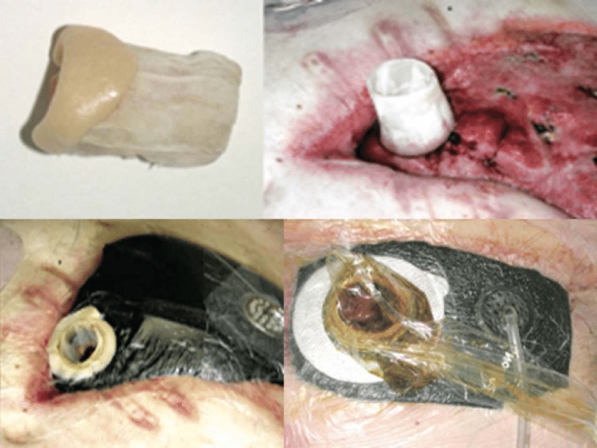
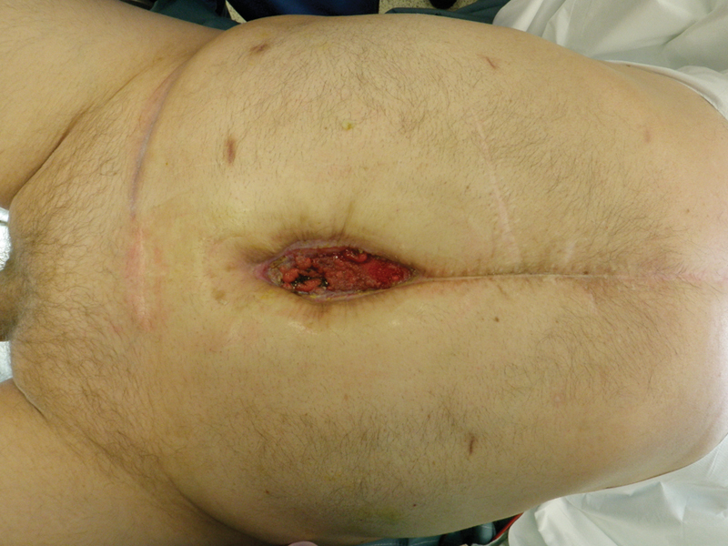
Enteroatmospheric fistula
floating stoma
Fistuloclysis in combination with NPWT may also be quite useful in select patients.

Slide 74
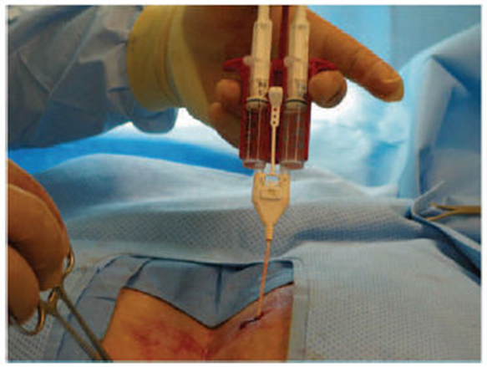
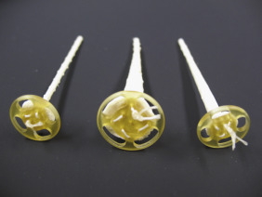
Other Interventions Use of fibrin glue and plugs
Use of fibrin glue and plugs: Once a fistula had been endoscopically located, fibrin glue injected through a catheter
May expedite fistula closure
Usually used with endoclip
Endoclips (for acute fistulas)
Fistula plug

Slide 75
