Slide 1
Hypopituitarism
DONE BY :
GHADEER AL-MANASEER
LUJAIN ALDGHAIM

Slide 2
OBJECTIVES :
INTRODUCTION
DEFINITION
ETIOLOGY
CLINICAL FEATURES
DIAGNOSIS
TREATMENT

Slide 3
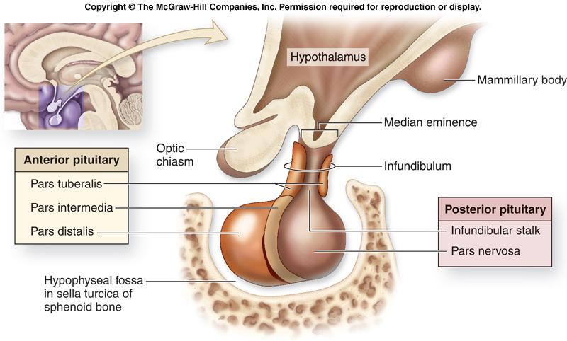
INTRODUCTION
The pituitary is located at the base of the brain, in a small depression of the sphenoid bone (sella turcica).
Purpose: control the activity of many other endocrine glands.
“ Master gland”
The pituitary is divided into 2 lobes—the anterior lobe, which constitutes 80% of the pituitary, and the posterior lobe, which is the storage site for hormones produced by the neurosecretory neurons (supraoptic and paraventricular nuclei) within the hypothalamus. The 2 hormones stored in the posterior lobe are ADH (antidiuretic hormone or vasopressin) and oxytocin.

Slide 5
Anterior Lobe Hormone: Functions
Growth Hormone (GH):
Effects growth of skeletal muscles and long bones.(linear growth)
Causes fat to be broken down and used for energy.
Helps to maintain blood sugar homeostasis.
Prolactin (PRL):
Stimulates and maintains milk production by the mother’s breasts after childbirth.
Adrenocorticotropic Hormone (ACTH):
Stimulates growth of adrenal cortex and secretion of its hormones
Thyroid Stimulating Hormone (TSH):
Stimulates growth of thyroid and secretion of T3 and T4 via cAMP
Gonadotropic Hormones:
Regulate the hormonal activity of the gonads (ovaries and testes).
Follicle Stimulating Hormone (FSH):
Stimulates follicle development in ovaries in women. As they mature, they produce estrogen.
Stimulates sperm development by the testes in men.
Luteinizing Hormone (LH):
Triggers ovulation of an egg from the ovary in women.
Stimulates testosterone production by the interstitial cells of testes in men.

Slide 6
POSTERIORLobe Hormone: Functions
Oxytocin :
Causes uterine contraction
Breast milk secretion
Vasopressin(ADH) :
Acts at renal collecting ducts on V2 receptors to cause insertion of aquaporin channels and increases water reabsorption thereby concentrating urine

Slide 7
Definition
Hypopituitarism is partial or complete loss of anterior (and/or) posterior function that may result from any lesion that destroys the pituitary or hypothalamus or that interferes with the delivery of releasing and inhibiting factors to the anterior hypothalamus.
They are affected in this order: growth hormone (GH), gonadotropins: follicle-stimulating hormone (FSH) and luteinizing hormone (LH), thyroid-stimulating hormone (TSH), and adrenocorticotrophic hormone (ACTH), prolactin (PRL).
Panhypopituitarism is deficiency of all anterior hormones, usually caused by irradiation, surgery, or pituitary tumour

Slide 8
Etiology
Large pituitary tumors, or cysts, as well as hypothalamic tumors (craniopharyngiomas, meningiomas, gliomas) can lead to hypopituitarism. Pituitary adenomas(Nonfunctional) are the most common cause of panhypopituitarism. The mass can grow in size→ compress the functional cells in the pituitary → Hypopituitarism
Pituitary apoplexy is a syndrome associated with acute hemorrhagic infarction of a preexisting pituitary adenoma, presents with sudden loss of pituitary hormones (shock from loss of cortisol), severe headache, nausea or vomiting, and altered level of consciousness. It is a medical and neurosurgical emergency.
Inflammatory diseases can lead to hypopituitarism: granulomatous diseases (sarcoidosis, tuberculosis [TB], syphilis), eosinophilic granuloma, and autoimmune lymphocytic hypophysitis (usually associated with other autoimmune diseases such as Hashimoto thyroiditis and gastric atrophy).
Trauma, radiation, surgery, infections, and hypoxia may also damage both the pituitary and hypothalamus

Slide 9
Sheehan postpartum necrosis (pituitary infarction due to excessive post-partum blood loss and hypovolemic shock) ,initial sign being the inability to lactate
infiltrative diseases including hemochromatosis and amyloidosis may induce this state as well.
Stroke can also damage these cells. Stroke can cause central diabetes insipidus due to damage of hypothalamus and/or posterior pituitary.
Empty Sella Syndrome : is the condition when the pituitary gland shrinks or becomes flattened, filling the sella turcica with cerebrospinal fluid instead of the normal pituitary Rarely can compress pituitary → hypopituitarism • More common in women with obesity, hypertension

Slide 10
CLINICAL FEATURES
• GH deficiency is not clinically detectable in adults, though it may manifest as fine wrinkles and increased sensitivity to insulin (hypoglycemia). GH deficiency gives an asymptomatic increase in lipid levels and a decrease in muscle mass. It also may accelerate atherosclerosis, and it increases visceral obesity.
• GH deficiency in children results in growth failure and short stature.
• Gonadotropin deficiency (LH and FSH) can occur in women and lead to amenorrhea, genital atrophy, infertility , and loss of axillary and pubic hair.
• In men, decreased LH and FSH results in impotence, testicular atrophy, infertility, decreased libido, and loss of axillary and pubic hair.
• Thyrotropin (TSH) deficiency results in hypothyroidism with fatigue, weakness, hyperlipidemia, cold intolerance, and puffy skin without goiter.

Slide 11
• Adrenocorticotropin (ACTH) deficiency occurs last and results in secondary adrenal insufficiency caused by pituitary disease.
• There is decreased cortisol, which results in fatigue, decreased appetite, weight loss , gastrointestinal disturbances , hypoglycemia , hypotension, and hyponatremia.
Electrolyte changes like hyperkalemia and salt loss are minimal in secondary adrenal insufficiency because aldosterone production is mainly dependent on the renin-angiotensin system.
ACTH deficiency does not result in the salt wasting, and hyperkalemia that are associated with aldosterone deficiency
• Prolactin: inability to breastfeed
• ADH: symptoms of diabetes insipidus (extreme thirst, polydipsia, hypernatremia)
• Oxytocin: usually asymptomatic – only needed during labour and breastfeeding

Slide 12
Diagnosis
Thorough clinical examination including visual field charting is essential
Simultaneous measurements of basal anterior pituitary and target organ hormone levels
Dynamic/provocative tests are necessary to assess GH secretory reserve and ACTH-adrenal axis

Slide 13
HORMONE TEST BLOOD SAMPLE
GH:
The most reliable stimulus for GH secretion is insulin-induced hypoglycemia. After injecting 0.1 µ/kg of regular insulin, blood glucose declines to less than 40mg/dL; in normal conditions that will stimulate GH levels to >10 mg/L and exclude GH deficiency.
Arginine infusion can also stimulate growth hormone release. Measure GH levels after infusing arginine. This is less dangerous because it does not lead to hypoglycemia.
Another test to diagnosis GH deficiency Glucagon , Clonidine (in children).

Slide 14
HORMONE TEST BLOOD SAMPLE
ACTH:
Insulin tolerance test is diagnostic and involves giving 0.05–0.1 U/kg of regular insulin and measuring serum cortisol; plasma cortisol should increase to >19 mg/Dl
Metyrapone tests for decreased ACTH production. Metyrapone blocks cortisol production, which should increase ACTH levels. A failure of ACTH levels to rise after giving metyrapone would indicate pituitary insufficiency
STANDARD ACTH STIMULATION TEST – Cosyntropin 0.25 mg

Slide 15
HORMONE TEST BLOOD SAMPLE
TSH:
BASAL THYROID FUNCTION TESTS – T3, T4, TSH
TRH TEST
LH,FSH:
In the male, measure random serum testosterone, LH and FSH
In the pre-menopausal female, ask if the menses are regular
In the post-menopausal female, measure random serum estrogen, LH and FSH (FSH normally > 30 IU/L and LH > 20 IU/L)

Slide 16
HORMONE TEST BLOOD SAMPLE
Cranial diabetes insipidus:
Only investigate if patient complains of polyuria/polydipsia, which may be masked by ACTH or TSH deficiency
Exclude other causes of polyuria with blood glucose, potassium and calcium measurements

Slide 17
Further investigations
MRI may show various tumors . Tumors smaller than 1 cm are referred to as microadenomas, and larger lesions are called macroadenomas
CT may be used if MRI is not available
Visual field testing , as this would show evidence of optic nerve compression by a tumor.
ferritin (elevated in hemochromatosis), angiotensin converting enzyme (ACE) levels (often elevated in sarcoidosis), and human chorionic gonadotropin (often elevated in tumor of germ cell origin).

Slide 18
MRI images showing the normal pituitary gland (solid white arrow) and a pituitary tumor (dashed white arrow).

Slide 19
Treatment
Management of hypopituitarism involves treating the underlying causes. Multiple target hormones must be replaced, but the most important is cortisol replacement, except that sodium depletion is not an important component to correct.
ACTH DEFICIENCY: Hydrocortisone is the preferred agent.
TSH DEFICIENCY: Levothyroxine is the treatment of choice.

Slide 20
TREATMENT
Growth hormone (GH) : Somatotrophin mimics human GH, is administered by daily subcutaneous self-injection to children and adolescents
GONADOTROPHIN DEFICIENCY MEN : Testosterone replacement has beneficial effects
GONADOTROPHIN DEFICIENCY WOMEN : Oestrogen replacement alleviates symptoms of deficiency and is bone protective.

Slide 21
THANK YOU

