Slide 1
Hyperbilirubinaemia
Dr. A. Tarawneh
Neonatologist

Slide 2
Background
Jaundice is the most common condition that requires medical attention in newborns.
Jaundice is observed during the 1st wk
60% of term infants
80% of preterm infants
The yellow coloration of the skin and sclera (icterus) is the result of accumulation of unconjugated bilirubin.
In most infants:
unconjugated hyperbilirubinemia reflects a normal transitional phenomenon.
unconjugated bilirubin is neurotoxic (kernicterus).

Slide 3
BILIRUBIN METABOLISM Bilirubin Production
Lysis of red blood cells (RBCs) releases heme from hemoglobin
heme is then converted to biliverdin by Heme oxygenase-1 (HO-1)
This rate-limiting step produces free iron and carbon monoxide (CO)
biliverdin is converted to bilirubin by biliverdin reductase
1 g of hemoglobin forms 34 mg
of bilirubin
Catabolism of heme to bilirubin by mirosomal
heme oxygenase and biliverdin reductase.
Notes:
The iron is conserved for reuse, whereas carbon monoxide is excreted through the lungs and can be measured in the patient's breath to quantify bilirubin production.

Slide 4
BILIRUBIN METABOLISM Transport of Bilirubin in Plasma
Unconjugated bilirubin released into the circulation by the reticuloendothelial cells is rapidly bound to albumin
7 to 8 mg/dL of unconjugated bilirubin can be bound to each 1 gram of albumin.
Binding of bilirubin to albumin increases postnatally with age and is reduced in infants who are ill.
The presence of endogenous and exogenous binding competitors, such as certain drugs, also decreases the binding affinity of albumin for bilirubin

Slide 5
BILIRUBIN METABOLISM Hepatic Uptake of Bilirubin
Bilirubin enters the liver cell by a process of carrier-mediated diffusion, with B-ligandin (Y protein) of the liver cell cytoplasm as the major intracellular transport protein.
Bilirubin dissociates from circulating albumin before its entry into the liver cell.
Ligandin concentrations are low at birth but rapidly increase over the first few weeks of life.
Uptake of bilirubin into hepatocytes increases with increasing ligandin concentrations
Ligandin concentrations may be increased by the administration of pharmacologic agents such as phenobarbital.

Slide 6
BILIRUBIN METABOLISM Conjugation & Excretion of Bilirubin
Bilirubin is bound to glucuronic acid (conjugated) in the hepatocyte endoplasmic reticulum in a reaction catalyzed by uridine diphosphoglucuronyltransferase (UDPGT).
Water-solubility allows conjugated bilirubin to be excreted into bile.

Slide 7
BILIRUBIN METABOLISM Enterohepatic Absorption of Bilirubin
Conjugated bilirubin is not absorbed from the intestine, whereas unconjugated bilirubin is absorbed
Unconjugated bilirubin then may be reabsorbed across the intestinal mucosa to return to the liver via the portal circulation.

Slide 8
The Bilirubin “Life Cycle” Summary
Bilirubin is the end product of haemoglobin breakdown
Bilirubin is formed from non-toxic biliverdin
Bilirubin is released into the circulation in the unconjugated form
Unconjugated bilirubin binds with albumin and is transported to the liver
Many medications compete with bilirubin for these albumin binding sites

Slide 9
The Bilirubin “LifeCycle” Summary
Uptake of bilirubin by hepatocytes requires intracellular proteins known as “Ligandins”
Bilirubin is converted to its conjugated form via glucuronidation
The conjugated form is then excreted into the GI tract and eliminated from the body via the stool
Reabsorption of stercobilin can occur from the GI tract via the enterohepatic circulation

Slide 10
Neonatal Risk Factors
High initial haematocrit and decreased red blood cell survival
t1/2 of adult RBC’s is 120 days, of HbF containing RBC’s is 90 d.
Frequent occurrence of haematomas (e.g. cephalhaematoma) and bruising
The newborn liver Metabolism in utero occurs via the placenta and maternal liver
At birth there is a sudden increased bilirubin load
Decreased ligandin concentration

Slide 11
Neonatal Risk Factors
Decreased activity of the glucuronidation pathway
Increased enterohepatic circulation
Relative dehydration in the first few days concentrates the bilirubin
Relative calorie deprivation in the first few days decreases glucuronidation
These last 2 factors more marked in breast fed babies.

Slide 12
Neonatal Risk Factors Binding Site Competitors
Sulfonamides
Oxacillin
Diazepam
Cefonicid
Cefotetan
Ceftriaxone
Cefmetazole
Moxalactam
Avoid all these agents in the neonatal period, especially if jaundiced, they may displace bilirubin from albumin binding sites and precipitate kernicterus

Slide 13
Diagnosis of Hyperbilirubinaemia History
Presentation and duration of neonatal jaundice
Typically, presentation is on the second or third day of life.
Jaundice that is visible during the first 24 hours of life is likely to be nonphysiologic
Infants who present with jaundice after 3-4 days of life may also require closer monitoring.
In infants with severe jaundice or jaundice that continues beyond the first 1-2 weeks of life:
the results of the newborn metabolic screen should be
checked for galactosemia and congenital hypothyroidism

Slide 14
Diagnosis of Hyperbilirubinaemia History
Family history
Previous sibling with jaundice in the neonatal period, particularly if the jaundice required treatment
Other family members with jaundice or known family history of Gilbert syndrome
Anemia, splenectomy, or bile stones in family members or known heredity for hemolytic disorders
Liver disease

Slide 15
Diagnosis of Hyperbilirubinaemia History
History of pregnancy and delivery
Maternal illness suggestive of viral or other infection
Maternal drug intake
Delayed cord clamping
Birth trauma with bruising

Slide 16
Diagnosis of Hyperbilirubinaemia History
Postnatal history
Loss of stool color
Breast feeding
Greater than average weight loss
Symptoms or signs of hypothyroidism
Symptoms or signs of metabolic disease (eg, galactosemia)
Exposure to total parental nutrition

Slide 17
Diagnosis of Hyperbilirubinaemia Physical examination
In most infants color is the only finding on physical examination.
More intense jaundice may be associated with neurologic findings :
drowsiness
such as changes in muscle tone
seizures
altered cry characteristics
in a significantly jaundiced infant these are danger signs and require immediate attention to prevent kernicterus.

Slide 18
Diagnosis of Hyperbilirubinaemia Physical examination
Neonatal jaundice with , Hepatosplenomegaly, petechiae, and microcephaly may be associated with :
hemolytic anemia
sepsis
congenital infection
infant's weight curve should be evaluated

Slide 19
Diagnosis of Hyperbilirubinaemia Bilirubin Screening
Visible jaundice at about 5 mg/dl
TCB Monitors (transcutaneous bilirubinometers)
Non invasive
Actual levels usually less than TCB
Heelstick vs. venous serum levels
Correlate well with levels < 10 mg/dl
Heel sticks run about 1 mg higher when levels > 10 mg/dl

Slide 20
Diagnosis of Hyperbilirubinaemia When To Work Up
Conjugated hyperbilirubinaemia; any time
Cord bilirubin (if obtained) > 70 μmol/l
Total bilirubin > 170 μmol/l at or before 24 hours of life
An increase of > 85 μmol/l/day
A total bilirubin > 250 μmol/l in any infant

Slide 21
Diagnosis of Hyperbilirubinaemia The Initial Work Up
A full history and physical exam , Attention to :
birth weight
discharge weight
weight on admission
feeding history
state of hydration

Slide 22
Diagnosis of Hyperbilirubinaemia The Initial Work Up
Total and direct bilirubin
CBC
Blood type and Rh determination in mother and infant
Direct antiglobulin test (DAT) in the infant (direct Coombs test)
Hemoglobin and hematocrit value
Serum albumin levels

Slide 23
Diagnosis of Hyperbilirubinaemia Blood Group Incompatibility
Blood group type and Coombs test on infant if :
There is a set up for blood group incompatibility : if the mom O and baby A or B
significant anaemia
Reticulocytosis
The Direct Coombs test :
Reliable predictor of Rhesus ( if the mom –ve and baby +ve ) and minor blood group incompatibility
Poor test in ABO incompatibility due to the relative lack of type specific antigen on the surface of neonatal RBC’s, therefore often negative.

Slide 24
Diagnosis of Hyperbilirubinaemia
Peripheral blood film for erythrocyte morphology
Reticulocyte count
Conjugated bilirubin levels
Liver function tests:
Aspartate aminotransferase (ASAT or SGOT) and alanine aminotransferase (ALAT or SGPT) levels are elevated in hepatocellular disease.
Alkaline phosphatase and γ -glutamyltransferase (GGT) levels are often elevated in cholestatic disease.
Ultrasonography: Ultrasonography of the liver and bile ducts is warranted in infants with laboratory or clinical signs of cholestatic disease

Slide 25
Diagnosis of Hyperbilirubinaemia
Tests for viral and/or parasitic infection: These may be indicated in infants with
Hepatosplenomegaly
petechiae
Thrombocytopenia
Reducing substance in urine: This is a useful screening test for galactosemia
Blood gas measurements: The risk of bilirubin CNS toxicity is increased in acidosis.
Thyroid function tests

Slide 26
Physiologic jaundice

Slide 27
Physiologic jaundice
Neonatal physiologic jaundice results from simultaneous occurrence of the following 2 phenomena:
Bilirubin production is elevated because of increased breakdown of fetal erythrocytes. This is the result of the shortened lifespan of fetal erythrocytes
Hepatic excretory capacity is low both because of :
low concentrations of the binding protein ligandin in the hepatocytes
low activity of glucuronyl transferase, the enzyme responsible for binding bilirubin to glucuronic acid, thus making bilirubin water soluble (conjugation).

Slide 28
physiologic jaundice TERM NEONATE
characterized by a progressive rise in TSB concentration from approximately 2 mg/dL (34 μmol/L) in cord blood to a mean peak of :
5 to 6 mg/dL (86 to 103 μmol/L) between 48 and 120 hours of age
most infants presenting at 72 to 96 hours of age
10 to 14 mg/dL (171 to 239 μmol/L) between 72 and 120 hours of age.
This is followed by a rapid decline to approximately 3 mg/dL (51 μmol/L) by the 5-7 day of life.

Slide 29
Physiologic jaundice TERM NEONATE
results from :
Six fold increase in the load of bilirubin
marked deficiency in UGT activity
Hepatic uptake and excretion of bilirubin are also deficient during this period

Slide 30
Physiologic jaundice PRETERM NEONATE
in premature neonates is more severe than in full-term neonates
mean peak TSB concentrations reaching 10 to 12 mg/dL (171 to 205 μmol/L) by the fifth day of life.
This delay in reaching the maximum concentration as compared with the full-term neonates primarily reflects the delay in maturation of hepatic UGT activity.

Slide 31
Physiologic jaundice PRETERM NEONATE
Because mean peak unconjugated bilirubin concentrations of 10 to 12 mg/dL (171 to 205 μmol/L) may be associated with acute bilirubin encephalopathy or kernicterus
all degrees of visible jaundice in premature neonates should be monitored closely and investigated fully

Slide 32
PATHOLOGIC HYPERBILIRUBINEMIA

Slide 33
Conjugated Hyperbilirubinemia
Direct fraction > 10-30% of the total bilirubin level
Always pathologic
Phototherapy ineffective, and in fact will stimulated melanin formation leading to the bronze baby syndrome

Slide 34
Conjugated Hyperbilirubinemia Differential Diagnosis
Biliary atresia
Choledochal cysts
Choledocholithiasis
Bile duct plugs, perforation, or compression
Galactosemia
Fructosemia
Glycogen storage disease type IV
Tyrosinemia
Niemann-Pick
Gaucher disease
Wolmann Disease
Cholesterol ester storage disease

Slide 35
Conjugated Hyperbilirubinemia Differential Diagnosis
Trisomy 18
Down syndrome
Alpha1 antitrypsin deficiency
Hypopituitarism
Cystic fibrosis
Zellweger syndrome
Familial hepatosteatosis
Persistent intrahepatic cholestasis
Drug induced cholestasis
TPN hepatitis

Slide 36
Conjugated Hyperbilirubinemia Differential Diagnosis
Infections
Hepatitis B and C
Syphilis
Toxoplasmosis
Rubella
CMV
HSV
Varicella
Echovirus
Coxsackie
Leptospirosis
Tuberculosis
Bacterial sepsis

Slide 37
Unconjugated Hyperbilirubinemia
By far more common
Usually physiologic
Pathologic etiology considered when:
Clinical jaundice in the first 24 hours
Rapid rise in level (> 85 μmol/L/day)
Prolonged jaundic
> 1 week term, > 2 weeks preterm
Approaching threshold for therapy

Slide 38
Unconjugated Hyperbilirubinemia Differential Diagnosis
Autoimmune hemolytic anemia
Rh, ABO, minor blood group incompatibility
RBC defects
Spherocytosis, elliptocytosis, G-6-PD deficiency, thalassaemia
Hemorrhage
Cephalhaematoma, birth trauma, clotting disorders

Slide 39
Unconjugated Hyperbilirubinemia Differential Diagnosis
Sepsis
Maternal diabetes
Hypothyroidism
Crigler- Najjar (types I & II)
Gilberts
Upper GI obstruction

Slide 40
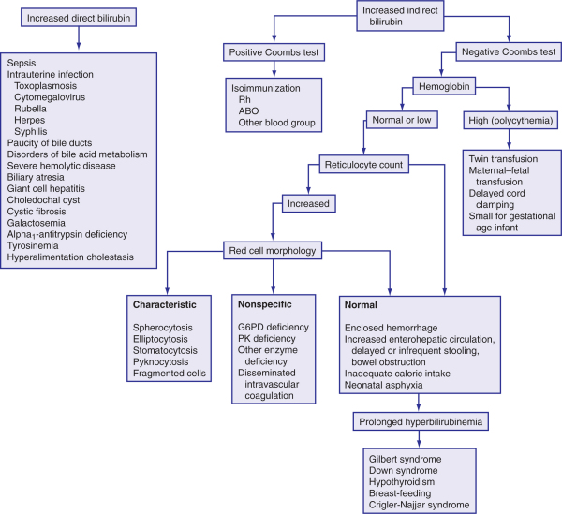
approach to the diagnosis of neonatal jaundice

Slide 41
Breast Milk Jaundice

Slide 42
Breast Feeding Jaundice
Decreased elimination and increased enterohepatic reabsorption
associated with poor feeding practices and not with any change in milk composition.
In contrast, the breast milk jaundice is apparently related to a change in the composition or physical structure of the milk
Poor initial feeding and lactation
Relative dehydration and calorie deprivation
Occurs within the first few days of life
Treatment should focus on establishing adequate lactation

Slide 43
True Breast Milk Jaundice
Relatively uncommon
β-glucuronidase may play a role by uncoupling bilirubin from its binding to glucuronic acid, thus making it available for reabsorption
fatty acids in the breast milk interfere with bilirubin uptake
Onset usually at about one week of age
By definition, infant should be well nourished and gaining weight
Brief cessation of BM will cause dramatic fall in levels

Slide 44
Isoimmunization

Slide 45
Rh Isoimmunization
RH blood group proteins; are a highly antigenic causing severe isoimmunization with a high risk of fetal hydrops and death
the D antigen may produce maternal sensitization with a fetomaternal hemorrhage as small as 0.1 mL.
Rh hemolytic disease was the most common cause of kernicterus.
maternal prophylaxis with high-titer anti-D immunoglobulin G (RhoGAM) combined with aggressive fetal surveillance and transfusion has greatly reduced the incidence and severity of this disease.

Slide 46
ABO Isoimmunization
Neonates with group A or B erythrocytes may have, hemolysis, and positive Coombs’ tests
because of transfer of maternal anti-A or anti-B antibody into the fetal circulation.
The disorder may occur in the first-born without prior sensitization of the mother and is generally milder and of shorter duration than Rh erythroblastosis
may also cause severe hemolysis, jaundice, and kernicterus.

Slide 47
Kernicterus

Slide 48
Kernicterus
Acute complication of Conj. Hyperbilirubinaemia
Bilirubin stains and injures basal ganglia
High pitched cry
Neck retraction/opisthotonous
Lethargy & coma
Seizures
Death

Slide 49
Kernicterus phases of kernicterus
ACUTE FORM
Phase 1 (1st 1–2 days):
poor sucking
stupor
hypotonia
seizures
Phase 2 (middle of 1st wk):
hypertonia of extensor muscles
opisthotonos
fever
Phase 3 (after the 1st wk):
hypertonia
CHRONIC FORM
First year:
Hypotonia
active deep tendon reflexes
obligatory tonic neck reflexes
delayed motor skills
After 1st yr:
movement disorders (choreoathetosis, tremor), upward gaze, sensorineural hearing loss

Slide 50
Kernicterus Outcome
Long-term survivors often demonstrate :
choreoathetoid cerebral palsy
upward gaze palsy
sensorineural hearing loss
mental retardation
dental dysplasia during later infancy and childhood.

Slide 51
Kernicterus Vigintophobia (fear of 20 (mg/dl)
1952 study of Rh incompatible infants
50% with bilirubin levels > 500 μmol/l developed kernicterus
No cases in 200 consecutive infants with bilirubin levels < 340 μmol/l (20 mg/dl)
1959 study on 54 healthy full term infants without Rh or ABO disease
19 infants > 425 μmol/l
9 infants > 510 μmol/l
All with normal N/D exams at 6 months, 1, 2, and 4 years
However kernicterus can occur in the absence of haemolysis

Slide 52
Kernicterus The Dilemma
Not clear what level represents a risk to normal, healthy, term infants
Infants with Rhesus disease clearly at risk > (20 mg/dl)
ABO probably the same risks as those with Rhesus disease
Premature infants can probably develop kernicterus at levels well below 340 μmol/l
Sepsis increases risk for any infant
Hyperosmolar states injure the blood brain barrier and make it more permeable to bilirubin

Slide 53
Hyperbilirubinemia Treatment
Conjugated
Treat underlying illness
Phenobarbital, has minor effect
Actigall (Ursodeoxycholic acid by mouth) appears moderately effective.
Unconjugated
Benign neglect (With close follow up!)
Phototherapy
IVIG
Exchange transfusion

Slide 54
Hyperbilirubinemia Treatment
Breast feeding can be continued in the majority of infants
If there is significant weight loss or poor breast feeding , you may supplement with formula
If close to exchange level, D/C feeding as you may have to insert umbilical lines.

Slide 55
Conj. Hyperbilirubinemia Treatment Phototherapy
Induces a conformational change in the shape of the bilirubin molecule.
Leads to 2 carboxyl groups becoming separated and thus ionized
Therefore the bilirubin becomes water soluble.
Known as photo-isomerization.

Slide 56
Conj. Hyperbilirubinemia Treatment Phototherapy
Start therapy at a bilirubin level which is 85 μmol/l
The lights should cover the entire baby
Increase in either intensity or body surface area covered will increase effectiveness.
Double phototherapy is more effective, especially if all round illumination is provided

Slide 57
Conj. Hyperbilirubinemia Treatment Phototherapy
There are no known long term effects from phototherapy
Animal studies have demonstrated a risk for retinal damage
All infants should have their eyes covered when being treated
Minor adverse effects include :
abdominal distension
frequent green stools
decrease serum calcium
Eye covers :
interfere with maternal-infant interaction
increase risk of conjunctivitis.

Slide 58
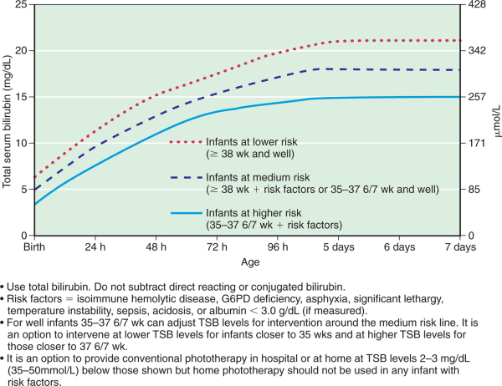
Guidelines for phototherapy in hospitalized infants of 35 or more G.A

Slide 59
Conj.Hyperbilirubinemia Treatment IVIG
1992 – Rubo J, et al prospective randomized trial:
32 infants with Rh haemolytic disease
Study group treated with 500 mg/kg as a single dose
Both groups treated with phototherapy
11/16 controls required exchange transfusions vs. 2/16 study patients
No adverse effects in treatment group.
Alpay F, et al. Acta Paediatrica 1999;88(2):
Another randomized study, 58 patients per group which also showed benefit in haemolytic disease with less exchange transfusion required.

Slide 60
Conj.Hyperbilirubinemia Treatment Exchange Transfusions
All infants with bilirubin > 500 μmol/l
All infants with haemolytic disease and bilirubin > 340 μmol/l
Implement exchange transfusion at lower levels when there is:
Rapid rise
Failed phototherapy
Prematurity

Slide 61
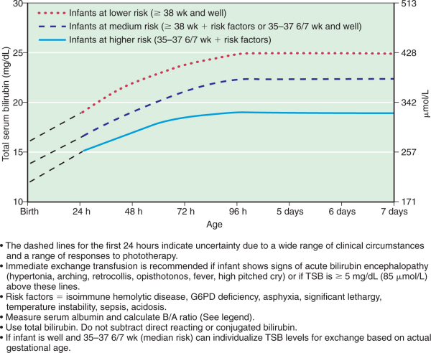
Guidelines for exchange transfusion in hospitalized infants of 35 or more G.A

Slide 62
Complications of Exchange Transfusion
Thrombocytopenia particularly with repeat transfusions
Portal vein thrombosis or other thromboembolic complications
Umbilical or portal vein perforation
Acute necrotizing enterocolitis
Arrhythmia, cardiac arrest
Hypocalcemia, hypomagnesemia, hypoglycemia
Respiratory and metabolic acidosis
Graft-versus-host disease
Human immunodeficiency virus, hepatitis B and C infections
All other potential complications of blood transfusions

Slide 63
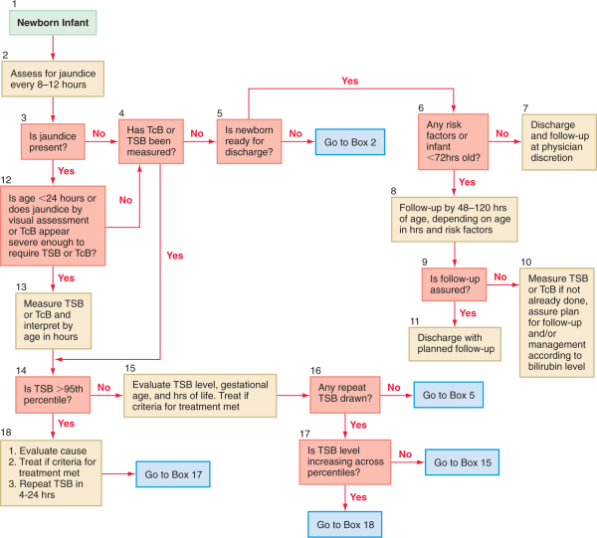
Algorithm for the management of jaundice in the newborn nursery

Slide 64
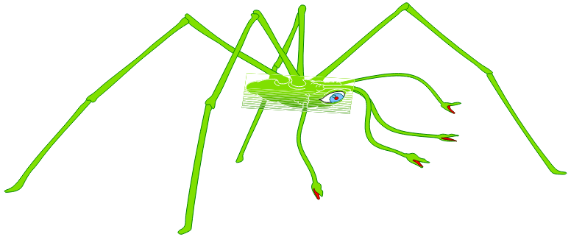
Any Questions?

