Slide 1
Associate Professor of Chest Diseases
Dr.Samah Shehata

Slide 2
CARDIOGENIC PULMONARY OEDEMA.

Slide 3
ARDS

Slide 4
non cardiogenic
cardiogenic
vs

Slide 6
CAUSES OF ARDS

Slide 7
Maintaining a low tidal volume
Monitoring plateau pressure
Setting PEEP based on the FiO2 requirement

Slide 11
TARGETS OF VENTILAION STRATEGY
Avoid overdistending lung units by
limiting the inflation volume and
pressure
Avoid repetitive opening and
collapse by applying adequate PEEP
Ideally, ventilation would take place in a “zone of safety”on the deflation limb of the PV curve

Slide 13
The “Baby lung”
ARDS Lung has: “normal” alveoli
partially aerated alveoli unaerated alveoli
“Normal” segments inflate easily
Unaerated segments distend poorly
High pressure Slow response
Normal lung segments may be over-inflated when ventilated with traditional tidal volumes

Slide 16
Ventilatory strategies of ARDS

Slide 17
NIV

Slide 19
NIV stands as the first-line approach; NIV may be attempted in ARDS patients with a PaO2/FiO2 > 150, in the absence of hemodynamic instability or altered consciousness. By contrast, 84% of severe ARDS required intubation and NIV did not appear beneficial in this subset of patients

Slide 20
FACE MASK VS HELMET NIV MASK
In a single-center trial, 83 patients with ARDS who required NIV using full face mask for at least eight hours were randomly assigned to continue face mask NIV or switch to helmet- delivered NIV .
Helmet-delivered NIV involves the administration of positive pressure and oxygen through a transparent hood that covers the entire head and face and is sealed with a rubber collar at the neck.
Helmet-delivered NIV reduced the need for intubation (18 versus 62 percent) in ARDS patients, most of whom had mild or moderate disease. In addition,
it was also associated with a higher rate of ventilator-free days, shorter ICU stay, and lower 90-day mortality without an increase in adverse effects

Slide 22
Invasive mechanical ventilation

Slide 26
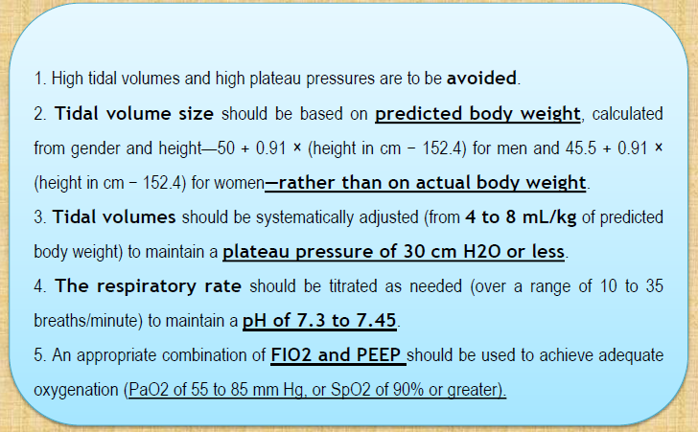
Synchronized Intermittent Mandatory Ventilation- Volume Control (SIMV-VC)

Slide 27
a lower-tidal-volume ventilatory strategy (4-6 mL/kg predicted body weight, plateau pressure < 30 cm H2O)
Ventilator-free days and organ failure–free days are significantly improved in the low-tidal-volume strategy.

Slide 29
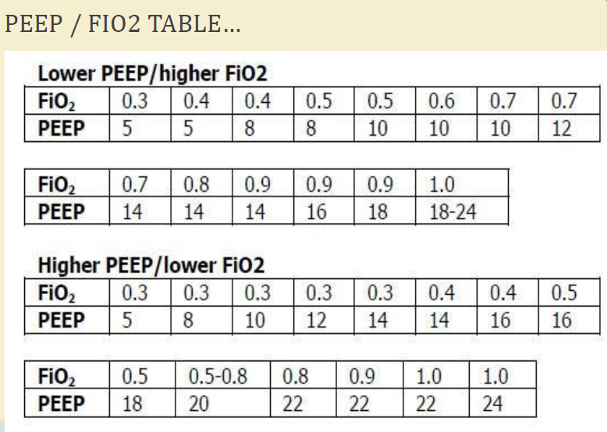

Slide 30
PRONING

Slide 40
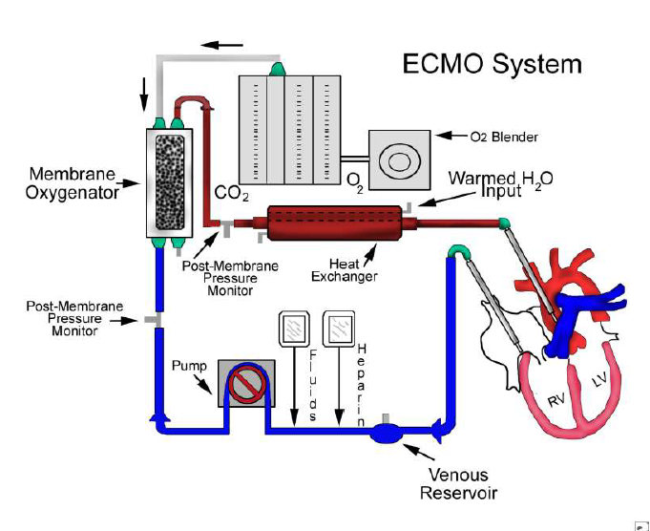

Slide 41
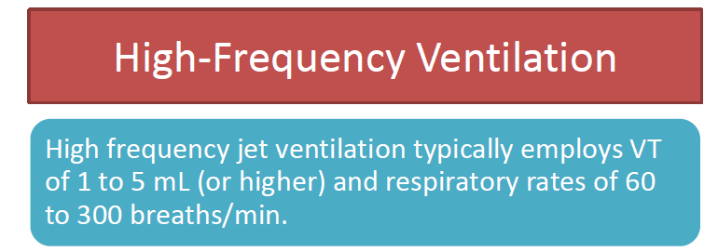

Slide 42
summary

