Slide 2
neurosergery
shahd Ayoub

Slide 3
discripe what you see in this image?
there was x ray photo showing osteophytes and the vertebra was lucent
what is the most common extradural spinal cord tumor?
secondary to MTZ
give example of intradural extramedullary?
meningeoma
give example of intradural intramedullary?
hemangeoplastoma

Slide 4
pt open his eye when he asked to,localizes to pain,inapropriate words,what is GCS?
11
what is the severity?
modrate
give 2 findings?
lens shape hyperdinsity in the right frontoparital area
,midline shift
what is the mangement?
crainiotomy and drainage

Slide 5
discripe what you see(image type,veiw, enhancement,lesion site,other finding)?
this is mri , T1 w/contrast,axial veiw,left frontal mass,other finding:tail attached to dura
what is the most likely diagnosis?
meningeoma
صورة الامتحان كان الموقع
around falx celrebri
وكان في
tail

Slide 6
pt comes after RTA ,bradycardia+hypotention, can’t extend his elbow , cant feel his leg with minimal leg movement MRC scale(1/5)
what is the cause of hypotention and bradycardia(name the condition name)?
spinal shock
what is the type of the fracture?
burst fracture
according to dennis score is it stable aor unstable?
unstable
what is the level?
C7
what is the ASIA grade?
ASIA grade c
صورة
dermatome
بتبيين انو ما في احساس على مستوى
c7
وتحت
(c7 is respnsaple for elbow extention)

Slide 7
what is the name of each zone?
zone 1: ischemia
zone 2: autoregulation
zone 3: hyperemia
what controles the cerebral bloos flow CBF?
cerebral vascular resistance
(CVR)
give example of condion dicrease the range of zone 2?
obstructive hydcephalus
مش متأكدة من الاجابات لهذا السؤال :)
ZONE 2
ZONE 1
ZONE 3

Slide 8
Neurosergery

Slide 9
1-diagnosis 2-most common cause of this case 3-WFNS score 4-best way for diagnosis 5-mangment

Slide 10
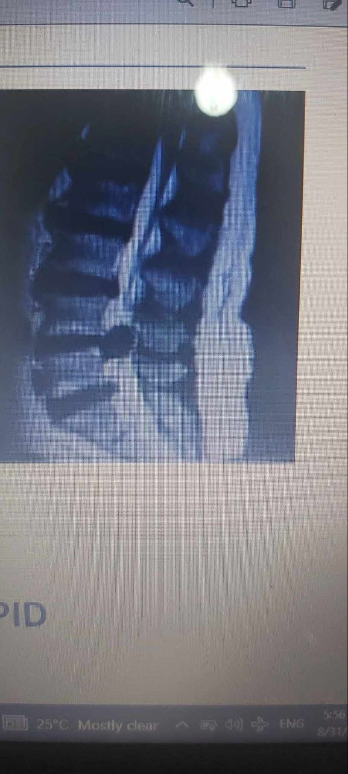
1-describe image(type, orintation, level, finding)
2-which dermatome will be affected if It was posterilateral
3-which joint will be affected
4-if disc herniate centrally What is the syndrome
5-what is the management
6-what is the test will you do



Slide 11
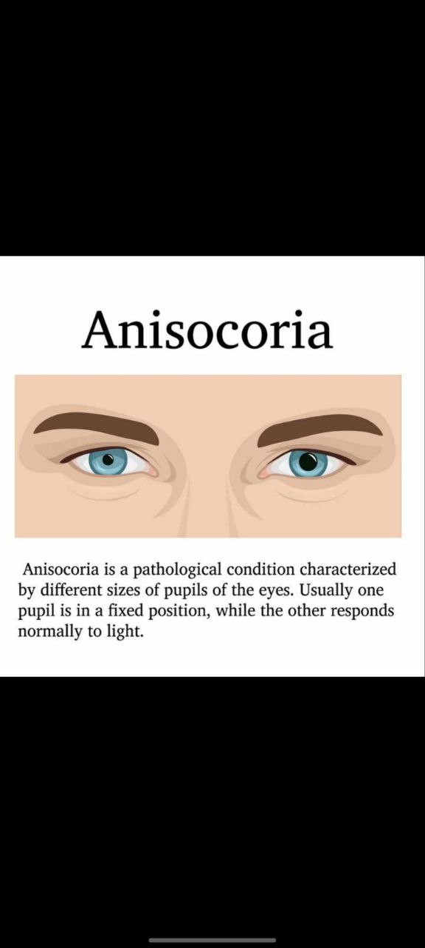
اسم كل مرحلة فيهم ? كان المريض عنده hypotention شو الtreatment اله? اي اشي من المكتوب بالسلايد ما عدا Head elevation Mannitol Sedation حكاهم الدكتور بالريكورد كأنه كمان كان طالب mechanesium of compensation؟ Type of herniation? uncal herniation Name of sign ? anisocoria Nerve that affected ?

Slide 12
1glasgow coma scale(open eye with pain, incomprehinsive voice, Flexion with pain ‏ 2Mangment in ER 3Description 4 source of bleeding

Slide 13
Vasogenic edema ⬇️ Type of edema? Mechanism of edema? Diagnosis? Other differential diagnosis? Next image?

Slide 14
Neurosurgery
10/5/2023
الامتحان عباره عن case عليها اسئله
5 question in 35 minute
مهم التركيز مع الدكتور فيه اسئله من الريكورد
Rahma saraireh

Slide 15
diagnosis : SAH most common cause of this case : spontaneous> berry aneurysms never before day 3 : vasospasm role of CCB: for vasospasm ☹ WFNS score : 3 mangment:
بالمختصر مريض عنده اسوء صداع في حياته ومش متعرض لحادث

Slide 16
glasgow coma scale( no respone in eye with pain, incomprehinsive voice, extention with pain) GCS : 5 ‏ tow finding : midline shifting and crescent hypodense lesion Management in ER : intubation ddx :epidural , SAH definitive ttt :
Uncal hernation we exam :
anisocoria ,,, oculomoter nerve

Slide 17
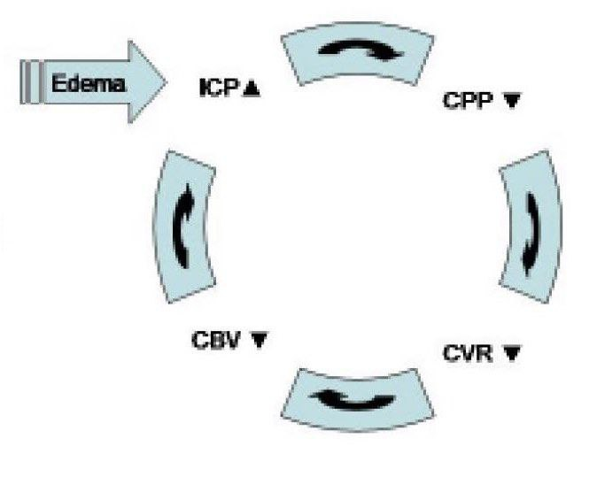
مريض عامل حادث عنده pneumothoraxes , abdominal injury اجا على الطوارئ مغيب عنده hypotension ,tachycardia, decrease in o2 sat بعد ما دخل المستشفى تحسن شوي بعدها غيب وما صحي بما معناه ( vegetative stat)
discripe what you see(image type,veiw,
type of edema : cytotoxic
Why edema occcur : na-k defect
ايش السبب in case
diffuse axonal injery
المريض بعد فتره صار no reflex . Intubation .
السؤال فيه اعراض ال
brain death
وااضحه
Gcs :3
What occur : brain death
vicious cycle :

Slide 18
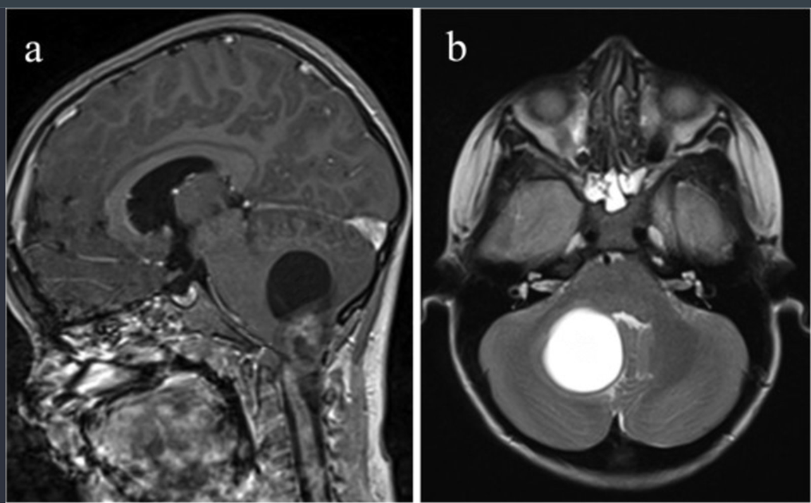
طفله 5 سنوات عندها projectile vomiting Brain tumor
describe what you see
image type,veiw, Mri t1 with contrast , axial and sagittal
enhancement, ring Enhancment
lesion site, Infratentorial
Diagnoses pinealoma
With and what type : hydrocephalus , obstructive
Ttt: surgery
If intial ttt contraindication بماا معناه لانه كانه فيه complication : IDK maybe EVD
مش نفس الصوره ^-^

Slide 19
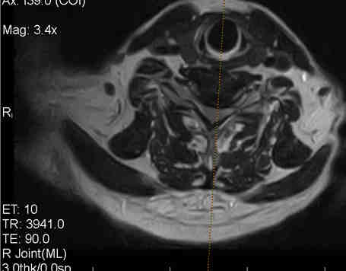
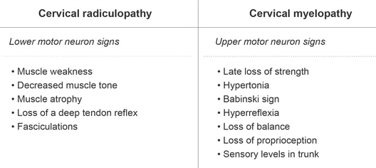
مريض عنده
Weakness may also be felt in the triceps.feeling a lack of sensation in middle finger. movement right arm Against gravity not against resistance
describe(image type,veiw ) mri .sagittal
DIAGNOSIS : disk
at level :c6-c7
motor for right arm : 3
Ttt: conservative ,surgery
جدول
 | Radiculo-pathy | Myelo-pathy
Sign
Symptom

