Slide 1
Dr. Eman Shaat Professor of Medical Biochemistry and Molecular Biology
C V S Lipoprotein metabolism Pt. I Lect. Bio 3 ( 19 slides)

Slide 2
Introduction
Lipid compounds: are Relatively water insoluble. Therefore, they are transported in plasma as Lipoproteins.
For triacylglycerol transport (TG-rich): CM & VLDL.
For cholesterol transport (cholesterol-rich): LDL & HDL.
Function of lipoproteins: Serve to transport lipids and lipid-soluble compounds between tissues and organs.
Substrates for energy metabolism (TG)
Essential components for cells (PL, C)
Precursors for hormones and bile acids (C)
Lipid soluble vitamins (D, E, K, A)

Slide 3
Classification of plasma lipoproteins
Lipoproteins differ in the ratio of protein to lipids, & in the particular apoproteins & lipids that they contain.
They are classified based on their density:
Chylomicron (CM) (largest; lowest in density due to high lipid/protein ratio; highest % weight triacylglycerols)
VLDL (very low density lipoprotein; 2nd highest in triacylglycerols as % of weight)
IDL (intermediate density lipoprotein)
LDL (low density lipoprotein, highest in cholesteryl esters as % of weight)
HDL (high density lipoprotein; highest in density due to high protein/lipid ratio)

Slide 4
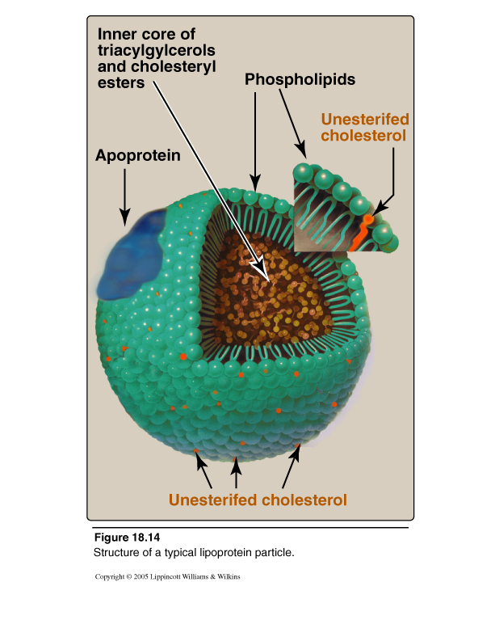
Plasma lipoproteins
All lipids in plasma are transported in the form of lipoproteins.
Lipoproteins solubilize lipids in plasma.
The structure of lipoprotein is:
Central core formed of non-polar lipids:
Triacylglycerols (TG; TAG).
Cholesterol esters (CE).
Outer layer contains polar lipids:
Phospholipids (PL).
Non-esterified cholesterol (C).
Proteins (apoproteins).

Slide 5
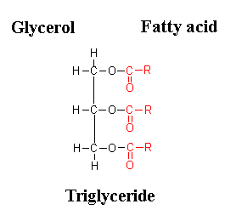
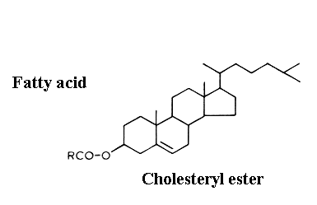
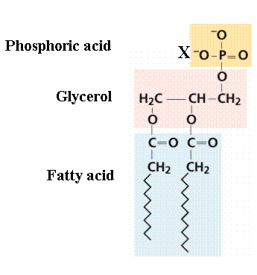
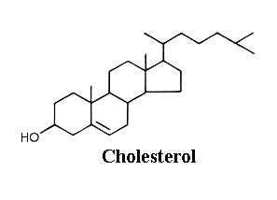
Hydrophobic lipids
Amphiphilic lipids

Slide 6
Important enzymes and proteins involved in lipoprotein metabolism
Enzymes (LPL, HL, LCAT, CETP).
Apolipoproteins (A, B, C, D, E, H).
Apolipoproteins B: form LDL .(mostly beta-sheet structure and associate with lipid droplets irreversibly). (apo-B48 & apo-B100). [Integral apolipoproteins].
Apolipoproteins A: form HDL. (alpha-helices and associate with lipid droplets reversibly). (apo A-I,….)
Apolipoprotein E: Form IDL (apoE-I, ….).
[Peripheral apolipoproteins (apoA, apoC and apoE)].
Functions of apolipoproteins:
Structural and transport function
Enzymatic function
Ligands for receptors

Slide 7
Types of apolipoproteins
Apo Lp (a) | E | CI,II,III | B100 | B48 | AI & AII
In liver | In liver & Intestine | synthesized in the liver | synthesized in the liver. | synthesized in the intestine | synthesized in the intestine
In Lp(a) | in VLDL, HDL, chylomicron | CII lipoprotein lipase | In LDL & VLDL | In chylom | AI in HDL LCAT
 | Peripheral | Peripheral Transferable | Integral | Integral | Peripheral Transferable
Attached to B100; impairs fibrinolysis; atherogenic | Helps in receptor recognition | HDL chylomicron and VLDL | Helps in receptor recognition |  | Chylomic HDL
+
+

Slide 8
Lipoprotein classes
Lipo-protein | Source | Apo Proteins | Protein/lipid % Main lipid component | Diameter(nm) | Function
CM | Intest. | (A I,II,III,IV) (B48) (C I,II,III) (E) | 1/99 % TG | 90-1000 | Dietary: FFA → Adipose/muscle CE → Liver via remnants
CM remnants | CM | (B48) (E) | 6/94 TG, PL, C | 45-150
VLDL | liver | (B100) (CI,II,III) | 7/93 TG | 30-90 | Synthesized: FFA→ adipose/muscle CE → LDL
IDL | VLDL | (B100) (E) | 11/89 TG, cholesterol | 25-35
LDL | Blood (VLDL) | B100 | 21/79 cholesterol | 20-25 | CE to liver (70%) and peripheral cells (30%)
HDL 1,2,3 | Liver, intes., VLDL, CM | (A1,II,IV) (CI,II,III) (D in HDL2,3) (E) | PL, cholesterol HDL1: 32/68 HDL2: 33/67 HDL3: 57/43 preβHDL: 70/30 | HDL1: 20-25 (only apo-E) HDL2: 10-20 HDL3: 5-10 preβHDL:<5 | supplies apo CII, E to chylomicrons and VLDL; mediates reverse cholesterol transport
Albumin/FFA | Adipose tissue |  | Free fatty acids 99/1

Slide 9
A
A
apo-E receptor

Slide 10
Metabolism of CM I- Synthesis of nascent chylomicrons
Nascent chylomicrons are formed in the intestinal mucosa and pass to the chyle and then to the blood stream through the thoracic duct.
Triglycerides are the predominant lipid in chylomicrons and form 90% of the total lipid present in them. ( Exogenous ; dietary triglycerides )
Its protein content is about 1%.
Apo-A and apo-B48 are component of the nascent cylomicrons.
II- conversion of nascent chylomicrons to mature chylomicrons
After entering the blood stream, the chylomicron particles transfer apo-A to HDL and acquire apo-C from HDL.

Slide 11
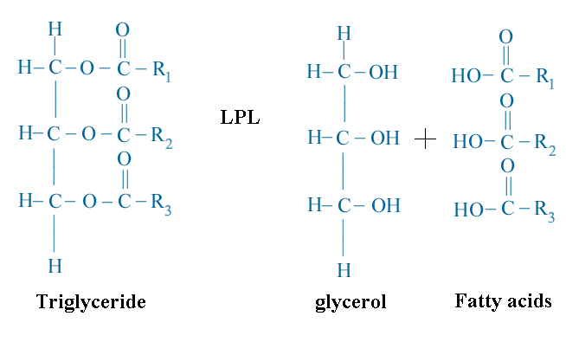
Metabolism of CM III- Degradation of chylomicrons
Apo-C_{II} activates lipoprotein lipase (LPL= clearing factor)
LPL located in the capillaries of adipose and other peripheral tissues as cardiac and skeletal muscles and lactating mammary gland.
LPL Hydrolyze triglyceride (TG) in the core of CM and VLDL to free fatty acids and glycerol.
Insulin enhances the synthesis of this enzyme and heparin increases its activity.
Lipoprotein lipase (LPL)

Slide 12
Metabolism of CM III- Degradation of chylomicrons
2. Triglycerides in chylomicrons are hydrolyzed into glycerol and FFA.
The fatty acids are released and oxidized in muscles or stored as triglycerides in adipose tissue. They are transported bound to plasma albumin.
Glycerol is taken by the liver cells mainly (due to high activity of glycerol kinase).
IV- Formation of chylomicron remnants
1. As triglycerides are removed from the hydrophobic core of chylomicrons, the surface area of cylomicrons decreases.
2. The more hydrophilic surface components (apo-C, unesterified cholesterol and phospholipids) are transferred to HDL.
The remaining particles are termed chylomicron remnants.

Slide 13
Metabolism of CM V- Fate of chylomicron remnants
They are triglycerides poor particles and consist mainly of cholesterol esters, apo-B48, apo-E.
They interact with receptors on liver cells and are taken by endocytosis, where they are catabolized within the hepatic lysosomes and the products (amino acids, fatty acids, cholesterol) are released into the cytosol and reutilized by the hepatic cells.
remnants are taken up by liver cells due to apoE recognition sites.

Slide 14
70%
HDL
30%
apo-B/E receptor

Slide 15
Metabolism of VLDLs
Assembled and secreted by liver directly into blood as nascent form.
Carry lipids (hepatic origin; endogenous TG) from liver to peripheral tissues.
Mature VLDLs: contain Apo B-100 plus Apo C-II and Apo E (both from HDL). ApoC-II is required for activation of lipoprotein lipase.
Lipoprotein lipase is required to degrade TG into glycerol and fatty acids.
As TG is degraded, VLDLs become
- Smaller in size.
- More dense.
- Apo C back to HDL.

Slide 16
Metabolism of VLDLs
Exchange of TG with cholesterol ester (HDL) by cholesterol ester transfer protein (CETP)
End products: IDL (returns Apo E to HDL) and become LDL
Most core lipid in LDL is cholesterol ester.
ApoB100 is only apolipoprotein in the surface.
VLDL
TG
CE
HDL
Choleteryl Ester Transfer Protein (CETP)

Slide 17
LDL receptor
Also named as apoB-100/apoE receptors. because of its ability to recognize particles containing both apos B and E.
LDL receptors exist in the liver and in most peripheral tissues
LDL cholesterol levels are positively related to risk of cardiovascular disease. Therefore, cholesterol in LDL has been called “bad cholesterol”
Fates of cholesterol intracellular:
Non-hepatic cells obtain cholesterol from the plasma LDL rather than by synthesizing it.
LDL uptake occurs by receptor mediated mechanism. Receptor-LDL complex fuses with lysosomes. Cholesterol esters are hydrolyzed by lysosomal acid lipase to free cholesterol that is either:
Used unesterified for biosynthesis of cell membrane.
Re-esterified for storage inside the cell by ACAT.
Synthesis of steroids in specified tissues.

Slide 18
Fates of cholesterol intracellular.
Apo-B100
Apo-B100/E receptor
C, CE> TG
LDL
TG
Membrane
C
C
HL
ACAT
FA+Glycerol
Storage
CE
Steroids
Liver

Slide 19
Coordinate control of cholesterol uptake and synthesis:
Increased uptake of LDL-cholesterol results in:
Inhibition of HMG-CoA reductase (reduced cholesterol synthesis)
Stimulation of acyl CoA:cholesterol acyl transferase (ACAT)
increased cholesterol storage
Decreased synthesis of LDL-receptors
“down-regulation”
decreased LDL uptake
Hepatic Lipase (HL):
Bound to the surface of liver cells.
Hydrolyzes TG → FFA + glycerol
Unlike LPL, HL does not react readily with CM or VLDL but is concerned with TG hydrolysis in VLDL remnants and HDL metabolism.
Thank you & Best wishes Dr. Eman Shaat

