Slide 1
New treatment methods in management of ovarian cancer
Presented by: - Sara Alkhamaiseh - Malak Malkawi
-Yazied Abusaleh
-Dania Shaqoura
Supervised by: Dr. Alaa Owais

Slide 2
Molecular Therapy & Maintenance in Ovarian Cancer

Slide 3
Epidemiology & Impact
Ovarian epithelial cancer is the 7th most common cancer among women globally.
• Includes ovarian, fallopian tube, and primary peritoneal cancers.
• Over 313,000 new cases in 2020; 5% of cancer deaths in the UK.
• 5-year survival rate is around 42.6%.

Slide 4
BRCA Mutations
30–70% risk of high-grade serous carcinoma (HGSC) by age 70 with BRCA1/2 mutations.
• Germline: inherited, present in all body cells.
• Somatic: acquired, appear only in tumor cells.
• TCGA data: 9% BRCA1, 8% BRCA2 germline; 3% somatic mutations.

Slide 5
Conventional Therapy
Surgery to remove all visible tumor (debulking).
• Followed by platinum-based chemotherapy.
• Despite initial response, 70% of patients relapse.

Slide 6
Molecular Advances
Understanding DNA repair pathways led to targeted therapies.
• High-grade serous ovarian cancer often has HRD (Homologous Recombination Deficiency).
• HRD present in ~50% of HGSC cases.

Slide 7
PARP Inhibitors (PARPi)
Target cancer cells with defective DNA repair (like BRCA mutations).
• Block PARP enzyme, leading to cell death in HR-deficient tumors.
• Shown to improve progression-free survival in clinical trials.

Slide 8
Goal of This Review
To educate gynecologic oncologists on:
• - BRCA and HRD testing strategies.
• - Current evidence on PARPi and molecular therapies.
• - Practical application in ovarian cancer management.

Slide 9
High-Grade Serous Carcinoma (HGSC)
Comprehensive Molecular Overview for Clinical Presentation

Slide 10
Epidemiology & Clinical Features
• HGSC accounts for ~70% of epithelial ovarian carcinomas.
• More common in Caucasian women, average age ~65 years.
• 80% present with advanced-stage disease (FIGO III/IV).
• Nonspecific symptoms lead to late diagnosis.

Slide 11
Pathogenesis: Origin of HGSC
• Most HGSCs originate from the fimbrial end of the fallopian tube.
• Precursor lesion: Serous Tubal Intraepithelial Carcinoma (STIC).
• Fallopian tube is now considered the primary site in HGSC pathogenesis.

Slide 12
Genomics of HGSC (TCGA 2011)
• Comprehensive study of 489 HGSC cases.
• TP53 mutation present in ~96% of cases.
• BRCA1/2 mutations in ~20% of cases.
• BRCA-mutated tumors are highly responsive to platinum and PARP inhibitors.

Slide 13
BRCAness Phenotype and HRD
• Some tumors behave like BRCA-mutated despite BRCA-wildtype status.
• Known as 'BRCAness', associated with Homologous Recombination Deficiency (HRD).
• HRD may result from methylation or other gene defects.
• >50% of HGSC cases show HRR pathway disruption.

Slide 14
DNA Damage Response (DDR) Mechanisms
• DNA replication exposes strands to damage.
• Major repair pathways include:
• - MMR, NER, BER, NHEJ, HRR.
• HRR: error-free, precise (S/G2 phase).
• NHEJ: quick but error-prone (all phases).

Slide 15
HRR Pathway Genes & HR Deficiency
• HRR controlled by genes: BRCA1/2, ATM, PALB2, RAD51C/D, etc.
• HRD occurs via mutation or epigenetic silencing.
• Results in genomic instability due to reliance on error-prone pathways.

Slide 16
PARP & Synthetic Lethality
• PARP enzymes crucial for BER pathway (SSB repair).
• PARP inhibition in BRCA-mutant cells leads to DNA damage accumulation.
• Triggers cell death - a concept called 'synthetic lethality'.
• Basis for PARPi use in BRCA/HRD-positive ovarian cancer.

Slide 17
PARP Inhibitors in Clinical Use
• Target cells with defective HR repair mechanisms.
• Effective in BRCA-mutated and HRD-positive tumors.
• Improve progression-free survival significantly.
• Examples: Olaparib, Niraparib, Rucaparib.

Slide 18
Comparison: HRR vs NHEJ (DSB Repair)
Feature | HRR (Homologous Recombination Repair) | NHEJ (Non-Homologous End Joining)
Accuracy | High (error-free) | Low (error-prone)
Cell Cycle Phase | S/G2 phase | All phases
Key Proteins | BRCA1/2, RAD51 | Ku70/80, DNA-PKcs

Slide 20
PARP Inhibitors in Ovarian Cancer
Mechanisms, Drugs, Clinical Use, and Toxicities

Slide 21
PARP Enzymes and DNA Repair
• PARPs, especially PARP-1, are essential for Base Excision Repair (BER).
• PARP-1 recruits DNA polymerase β and detects replication fork issues.
• Modifies proteins involved in HRR.
• PARP-1/2/3 regulate NHEJ via negative feedback.

Slide 22
PARP Inhibitors: Mechanisms of Action
• Main mechanism: PARP trapping – enzymes get stuck to DNA breaks.
• Blocks replication forks, causing cytotoxicity.
• Synthetic lethality: BRCA mutation + PARP inhibition = cell death.
• Inhibits NHEJ regulation, increasing genomic instability.

Slide 23
Approved PARP Inhibitors
• Olaparib (Lynparza): 100 & 150 mg tablets.
• Niraparib (Zejula): 100 mg capsules.
• Rucaparib (Rubraca): 200, 250 & 300 mg tablets.
• All are oral maintenance therapies.

Slide 24
Treatment Duration & Indications
• Relapsed cases: until progression, toxicity, or patient choice.
• First-line setting:
• - Olaparib: up to 2 years (+/- bevacizumab for 15 months).
• - Niraparib: up to 3 years.
• Monitored by oncology team.

Slide 25
Class-Wide Toxicities of PARPi
• Fatigue, abdominal pain, GI upset, diarrhea.
• Hematologic: anemia, neutropenia, thrombocytopenia.
• Toxicities vary among different PARPi drugs.

Slide 26
Drug-Specific Toxicity Highlights
• Olaparib: Nausea (76%), anemia (43%), fatigue (66%).
• Niraparib: High thrombocytopenia (61%), anemia (50%).
• Rucaparib: Elevated liver enzymes (ALT), anemia (37%).
• Each drug has a unique adverse effect profile.

Slide 27
Clinical Trials and Regulatory Approvals
• Olaparib: SOLO-1, SOLO-2, PAOLA-1.
• Niraparib: NOVA, PRIMA.
• Rucaparib: ARIEL-3.
• Approved by NICE and included in Cancer Drug Fund (CDF).
Drug | Efficacy (PFS) | Common Side Effects | Approval Trials
Olaparib | SOLO-1: 49.9 mo (BRCA+) | Anemia, Fatigue, Nausea | SOLO-1, SOLO-2, PAOLA-1
Niraparib | PRIMA: 13.8 mo (HRD+) | Thrombocytopenia, Nausea | NOVA, PRIMA
Rucaparib | ARIEL3: 10.8 mo (BRCA+) | Liver Enzyme ↑, Fatigue | ARIEL3

Slide 28
Comparison of Approved PARP Inhibitors
Drug | Efficacy (PFS) | Common Side Effects | Approval Trials
Olaparib | SOLO-1: 49.9 mo (BRCA+) | Anemia, Fatigue, Nausea | SOLO-1, SOLO-2, PAOLA-1
Niraparib | PRIMA: 13.8 mo (HRD+) | Thrombocytopenia, Nausea | NOVA, PRIMA
Rucaparib | ARIEL3: 10.8 mo (BRCA+) | Liver Enzyme ↑, Fatigue | ARIEL3
Drug | Efficacy (PFS) | Common Side Effects | Approval Trials
Olaparib | SOLO-1: 49.9 mo (BRCA+) | Anemia, Fatigue, Nausea | SOLO-1, SOLO-2, PAOLA-1
Niraparib | PRIMA: 13.8 mo (HRD+) | Thrombocytopenia, Nausea | NOVA, PRIMA
Rucaparib | ARIEL3: 10.8 mo (BRCA+) | Liver Enzyme ↑, Fatigue | ARIEL3
Drug | Efficacy (PFS) | Common Side Effects | Approval Trials
Olaparib | SOLO-1: 49.9 mo (BRCA+) | Anemia, Fatigue, Nausea | SOLO-1, SOLO-2, PAOLA-1
Niraparib | PRIMA: 13.8 mo (HRD+) | Thrombocytopenia, Nausea | NOVA, PRIMA
Rucaparib | ARIEL3: 10.8 mo (BRCA+) | Liver Enzyme ↑, Fatigue | ARIEL3

Slide 29
Homologous Recombination Deficiency (HRD) Assays

Slide 30
Purpose of HRD Testing
To identify patients most likely to benefit from PARP inhibitors.Three main testing methods:
1. HRR Gene Alterations
2. Genomic Scarring Assays
3. Functional Assays

Slide 31
1. HRR Genetic Assays
Detect abnormalities in genes related to homologous recombination repair (HRR).
Can result from:
Loss-of-function mutations
Epigenetic silencing (e.g., BRCA1 or RAD51C methylation)

Slide 32
Types:
BRCA1/2 Mutations:Can be germline (inherited) or somatic (acquired).
Non-BRCA HRR Gene Mutations:
TCGA found ~30% of HGSC cases have mutations in other HRR genes.
Epigenomic silencing – methylation of gene promoters of BRCA1 and RAD51C instigates a ‘silencing’ effect whereby their expression is significantly reduced. Thisleads to HRD like that created by loss-of-functionmutations. TCGA detected BRCA1 hypermethylation in11% of HGSC cases.5Genomic scars

Slide 33
2. Genomic Scars
HRR phenotype can be inferred through quantifyinggenomic scars in malignant cells. The unstable genome inHRD cancers exhibits a profile comprising various somaticmutations including single-base substitutions (SBSs) andstructural variants (SVs). These assays reflect the resultantphenotype, not the causative effect.Available genomic scarring assays include copy numbervariation, mutational signature and functional assays.
Copy number variationsCopy number variations are a structural abnormality inwhich genomic changes including deletions and duplicationsresult in distinct variations among individuals. These changesinclude large scale transitions (LST), loss of heterozygosity(LOH) and telomeric allelic imbalance (TAI). Quantifyingthese variations can indicate ‘genomic scarring’ reflectingabberations that might have instigated a malfunction incertain DNA repair pathways, rendering the cells’ susceptabilityto malignant changes.

Slide 34
Approved Tests:
MyChoice® CDx (Myriad Genetics):
Uses GIS (Genomic Instability Score: LOH + LST + TAI)
FoundationFocus™ CDxBRCA (Foundation Medicine):
Combines subchromosomal LOH with BRCA mutation status
3. Mutational Signatures
These are characteristic genomic patterns reflecting historicmutational events that are possibly implicted in diseasedevelopment and progression. Point mutuational signaturesare referred to as single base substitutions (SBS). Certain SBSare associated with clinical outcome and survival. Forinstance, SBS signature 3 is linked with BRCA1/2mut

Slide 35
Functional HRD Assays
Functional HRD assays can precisely identify HRR statusbased on real-time quantification of nuclear RAD51.However, it cannot provide information on other defects inthe HRR pathway beyond RAD51. These assays are oftentechnically challenging and are not yet ready for clinical use.However, they have the potential to provide an up-to-datereadout of the HRD status.1

Slide 36
Molecular Testing Pathways
A reliable molecular tissue-based assessment depends onproper sampling and careful handling
Requires coordination between:Gynaecological oncologists ,Radiologists, Pathologists.
Sampling Recommendations
First-line sampling during:
Interventional radiology biopsy (e.g., omental)Primary cytoreductive surgery
At least 5 tissue cores recommended for HRD testing.

Slide 37
Molecular Testing Pathways
Tissue Sample Handling
Proper handling essential for accurate molecular testing.
Requires coordination between:Gynaecological oncologists ,Radiologists, Pathologists.
Sampling Recommendations
The initialsampling event could either take place in interventionalradiology or during primary cytoreductive surgery. Inradiologically guided omental biopsies, obtaining at leastfive cores is recommended for a sufficient sample forHRD testing.

Slide 38
vailability in England (NHS)MyChoice®
HRD test is available for newly diagnosed stage III/IV high-grade nonmucinous epithelial ovarian cancers.
BRCA1/2 testing is available through the Genomic Laboratory Hubs (GLH) for any stage, nonmucinous high-grade epithelial ovarian cancers.
sgnificant Clinical Trials –
PARPi in Relapsed Ovarian Cancer Background PARPi (Olaparib, Niraparib, Rucaparib) approved as maintenance therapy in platinum-sensitive relapsed ovarian cancer (PSROC).
Key trials:
Study-19, SOLO2, NOVA, ARIEL3

Slide 39
1. Study-19 (Olaparib) first trial to investigate olaparib asmaintenance therapy in recurrent platinum-sensitive highgrade serous ovarian cancer.8 Patients were eligible regardlessof their BRCA1/2 status
Median PFS:
Olaparib: 8.4 months
Placebo: 4.8 months
HR = 0.35; p < 0.0001
BRCA-mutated subgroup:PFS improved to 11.2 vs 4.3 months
HR = 0.18
Overall survival (OS) data after a median follow-upof 6.5 years showed improved outcome with olaparibcompared with placebo in both the overall population (29.8[27.2–35.7] versus 27.8 [24.4–34.0] months respectively, HR0.73 [0.64–1.21]; p = 0.44) and in the BRCA1/2mut population(34.9 [29.2–not calculable] versus 30.2 [23.1–40.7] monthsrespectively, HR 0.62 [0.45–1.17]; p = 0.19)h

Slide 40
2. SOLO2 Trial
trial was a confirmatory randomised phase 3trial in 295 patients with a BRCA1/2 mutation. It examinedolaparib as maintenance in relapsed platinum-sensitive highgrade ovarian cancer (serous or endometrioid).
PFS:
Olaparib: 19.1 months
Placebo: 5.5 months
HR : .3
Final OS analysis was released after amedian follow-up of 65.7 months for olaparib and64.5 months for placebo. Olaparib extended median OS by12.9 months compared with placebo (median OS 51.7 [41.5–59.1] versus 38.8 [31.4–48.6] months, respectively, HR 0.74[0.54–1.00]; p = 0.054).
OS (final analysis):Olaparib: 51.7 months
Placebo: 38.8 months
HR = 0.74

Slide 41
3. OPINION Study
BRCA-wildtype patients
PFS: Median 9.2 months overall
HRD-positive subgroup had longer PFS (11.1 months)---
4. NOVA Trial (Niraparib)
BRCA-mutated:
PFS: 21.0 vs 5.5 months
HR = 0.27

Slide 42
BRCA-wildtype
:PFS: 9.3 vs 3.9 months
HR = 0.45
OS (final analysis):BRCA-mutated: 43.8 vs 34.1 months
No OS benefit in BRCA-wildtype---
5. ARIEL3 Trial (Rucaparib)All-comer PSROC
PFS:
Rucaparib: 10.8 months
Placebo: 5.4 months

Slide 43
BRCA-mutated:
PFS: 16.6 vs 5.4 months
HRD-positive (retrospective):PFS: 13.6 vs 5.4 months
HRD-negative:PFS: modest benefit (6.7 vs 5.4 months)
First-Line PARPi Maintenance Trials
1. SOLO1 Trial (Olaparib – BRCA-mutated)
Newly diagnosed advanced HGSC (Stage III/IV)
3-year PFS :Olaparib: 60% progression-free
Placebo: 27%
HR = 0.30
5-year update:PFS: 56 vs 13.8 months

Slide 44
PAOLA-1 (Olaparib + BevacizumabBRCA-mutated or HRD-positive advanced HGSC
PFS:
Olaparib + Bev: 22.1 months
Placebo + Bev: 16.6 months
HR = 0.59
Subgroups:
BRCA-mutated: 37.2 vs 17.7 months
HRD-positive: 28.1 vs 16.6 months
HRD-negative: no benefit observed

Slide 45
3. PRIMA Trial (Niraparib)
Advanced HGSC (HRD and overall population)
HRD-positive:
PFS: 21.9 vs 10.4 months
Overall population: PFS : 13.8 vs 8.2 months
No OS difference at 24 months (data still maturing)
4. VELIA Trial (Veliparib)
Veliparib + chemotherapy + maintenance
BRCA-mutated: PFS 34.7 vs 22 months
HRD-positive: PFS 31.9 vs 20.5 months
Not yet approved by NICE/FDA/EMA

Slide 46
NICE Approvals (UK Guidelines)
National Institute for Health and Care Excellence (NICE) Approvals for PARP Inhibitors Olaparib
Full approval for:
Platinum-sensitive relapsed high-grade epithelial ovarian cancer with BRCA1/2 mutation , After at least three courses of platinum-based chemotherapy
CDF (Cancer Drugs Fund) approval for:
After two courses of platinum-based chemotherapy
First-line maintenance in BRCA1/2-mutated advanced ovarian cancer (FIGO III/IV)
In combination with bevacizumab for HRD-positive patients after first-line chemo

Slide 47
Full approval for:
Platinum-sensitive relapsed HGSC, regardless of BRCA1/2 status
CDF approval for:
First-line maintenance in advanced HGSC (FIGO III/IV) after response to platinum-based chemotherapy—
Rucaparib
Maintenance treatment of relapsed platinum-sensitive high-grade ovarian cancer after response to platinum-based chemotherapy

Slide 48
Long-Term Impact (Cochrane Review)
2022 Cochrane Meta-Analysis: 15 Trials Included
Progression-Free Survival (PFS) Improvements:Newly diagnosed epithelial ovarian cancer (EOC):
PARPi + chemo + maintenance > chemo alone
PARPi maintenance alone > placebo
Relapsed platinum-sensitive EOC:
PARPi maintenance > placebo

Slide 49
Little to No PFS Benefit:
When PARPi were combined with chemo only
When PARPi were used as monotherapy vs chemo in relapse
No data for platinum-resistant EOC

Slide 50
Quality of Life (QoL) Considerations
PFS alone may not reflect real patient benefit
Recommend using:Quality-Adjusted PFS (QA-PFS)
Q-TWIST (Quality-adjusted Time Without Symptoms or Toxicity)
Adverse Effects
PARPi associated with higher risk of:
Serious side effects: RR = 2.62
Myelodysplastic syndrome (MDS) and Acute Myeloid Leukemia (AML): OR = 2.63

Slide 51
Resistance to PARPi and Future Therapies
Mechanisms of Resistance
Secondary mutations in HRR genes (restoring function)
Drug efflux pumps reducing intracellular drug levels
Loss of PARP trapping capability
Strategies to Overcome Resistance
Combination therapies (e.g., with anti-angiogenics or immunotherapy)
Sequential regimens
Ongoing research into biomarkers and novel combinations

Slide 52
Challenges, Limitations & Ethical Considerations
HRD Assay Challenges
No gold standard HRD test
Different trials use different GIS cut-offs:MyChoice®: GIS ≥ 42
VELIA trial: GIS ≥ 33
Most studies based on formalin-fixed samples, not fresh-frozen
Oligometastatic RecurrenceSolitary relapse during maintenance therapyMay require:
Surgical resectionStereotactic radiotherapy
Restarting PARPiLacks dedicated clinical trials

Slide 53
Ethical Issues
Tumor BRCA1/2 mutation (tBRCA) may lead to germline testing
Informed consent required for germline BRCA testing (via blood)
Implications for family members if gBRCA1/2 mutation is found

Slide 54
PARP inhibitors represent a major advancement in treating high-grade ovarian cancers, especially HGSC.
Consistent PFS improvement across multiple RCTs.
HRD-positive patients benefit most from PARPi.
More research needed on:
Long-term OS outcomes
QoLResistance mechanisms
Combination strategies

Slide 55
Hyperthermic Intraperitoneal chemotherapy (HIPEC)
In the management of ovarian cancer

Slide 56
Introduction

Slide 57
Epithelial tubo-ovarian cancer is most commonly diagnosed when disease has already disseminated intraperitoneally(FIGO stageIII/IV).
The standard treatment of tubo-ovarian cancer :
(primary surgery):cytoreductive surgery followed by six cycles of platinum-based (IV)chemotherapy.
(interval surgery):neoadjuvant chemotherapy(3cycles) →cytoreductive surgery after 3weeks →the remaining cycles restarted within 3-4 weeks of surgery.
Best survival outcomes following primary or interval surgery are associated with achievement of nil macroscopic residual disease (NMRD) at surgery.
Despite improvements in outcomes of cytoreductive surgery and survival benefit seen with maintenance treatment;median survival following surgery remains low at(29-63)months,and the recurrence occurs in 80% of patient the majority peritoneally.(so further treatment strategies are therefore needed and [HIPEC) has been proposed as an additional therapy).

Slide 58
Intraperitoneal chemotherapy
intraperitoneal (IP)chemotherapy protocols comprise of: 3-weekly treatments for six cycles.
Chemotherapeutic agents:
Some trials replaced carboplatin with cisplatin.
In the GOG 172trial, IV paclitaxel doses were administered in addition to IP platinum.
Results of trials:
GOG 172 trial: A survival benefit from IP chemotherapy was seen, but only 42% of patients completed the full treatment due to complications and toxicities.
GOG 252 trial:Did not find any increase in progression-free survival (PFS) with intraperitoneal regimens.
iPOCC trial:included dose-dense weekly paclitaxel, did report prolonged (PFS).

Slide 59
Hyperthermic intraperitoneal chemotherapy

Slide 60
Hyperthermic intraperitoneal chemotherapy
It is an adjuvant treatment.
Instilled after cytoreductive surgery has been performed.
Given in hyperthermic conditions as a one-off dose intraoperatively.
The most important element is cytoreductive surgery to [NMRD],due to limited penetration depths of IP treatment even with HIPEC.
HIPEC is also used in other types of cancer, like: gastric cancer,colorectal cancer .

Slide 61
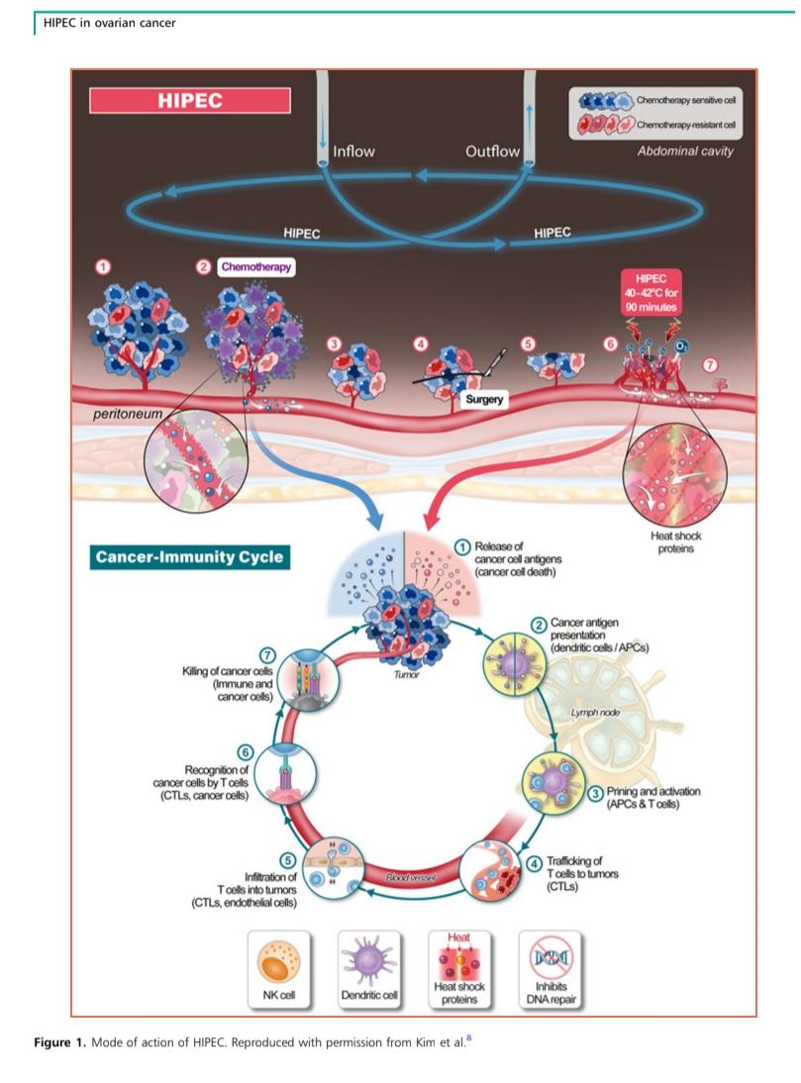
The proposed mode of action of HIPEC

Slide 62
Local Action of [HIPEC]
-(1) Tumor deposits include chemo-sensitive and chemo-resistant cells.
-(2) Neoadjuvant chemotherapy reduces tumor size.
-(3–5) Surgery removes visible tumors.
-(6)HIPEC is administered directly into peritoneal cavity (Heated for (40-42)c and circulated for 90 minutes).

Slide 63
Systemic Effects(Cancer-ImmunityCycle)
Immune Activation Post-HIPEC:
1. Tumor cell death releases cancer antigens.
2. Dendritic cells present antigens to T-cells.
3. T-cells are activated and primed.
4. Activated T-cells circulate and target tumor cells.
5. T-cells infiltrate tumor sites.
6. Recognition of cancer cells.
7. Destruction of cancer cells by CTLs and NK cells.

Slide 64
Advantages of [HIPEC]
Advantages of intraperitoneal administration of chemotherapy:
Higher drug concentration at the peritoneal surface.
Limiting the systemic toxicity.

Slide 65
Advantages of heating:
Enhances the penetration of chemotherapy at the peritoneal surface.
Increases the cytotoxic effect of chemotherapy.
Increases the sensitivity of the cancer to chemotherapy by impairing DNA repair.
Degrades the (BRCA gene) leading to a transient impairment of homologous recombination in tumour cells,which restricting the cells ability to repair double strand breaks in DNA.
Induces the activation of the systemic immune response by activating heat-shock proteins.

Slide 66
Advantages of timing (during interval surgery):
Effective against remaining chemotherapy-resistant cancer cells following neoadjuvant chemotherapy.
Intra-operative drug delivery precedes the formation of intraperitoneal adhesions.
Shorter gap between chemotherapy treatments.

Slide 67
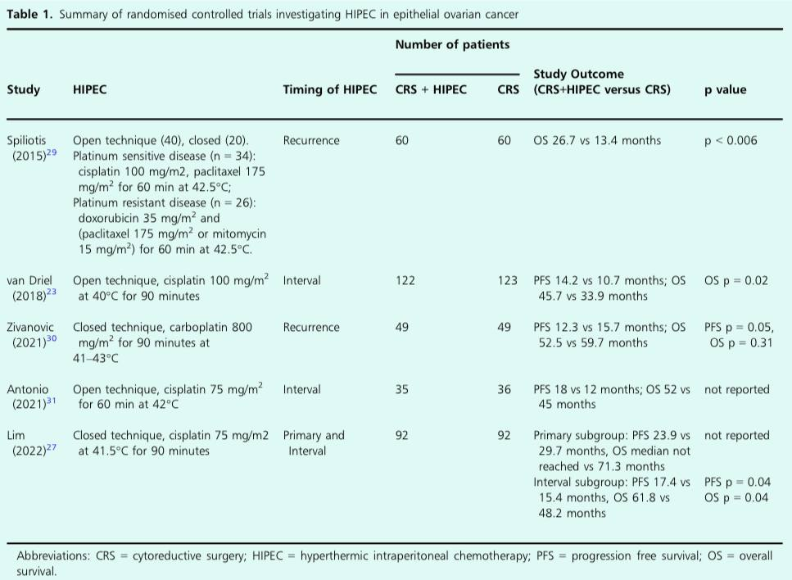

Slide 68
HIPEC Administration: Open Technique
• A plastic cuff is stitched around the open abdominal wall to raise the edges.
• Two input and two output drains are placed into the abdominal cavity, filled with saline.
• A heat exchanger warms the fluid to maintain intra-abdominal temperature.
• Cisplatin is perfused for 90 minutes.
• Post-procedure: the abdominal cavity is emptied, the cuff removed, and the abdomen closed.

Slide 69
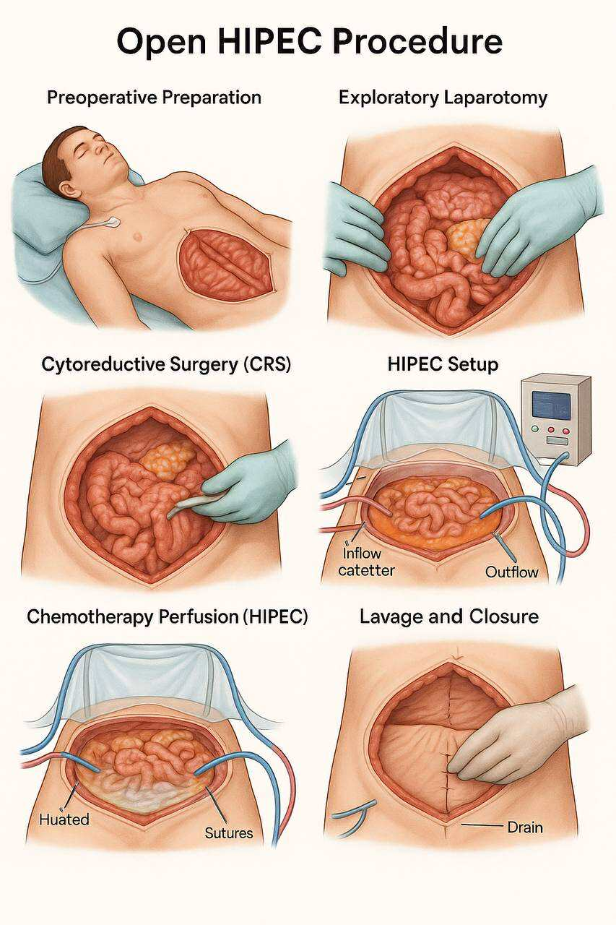

Slide 70
HIPEC Administration: Closed Technique
• Tubing placed as in the open technique.
• Abdominal wall is temporarily stitched to allow re-opening after HIPEC or closed in layers.
• Allows the use of closed-loop circulation for heated chemotherapy.

Slide 71
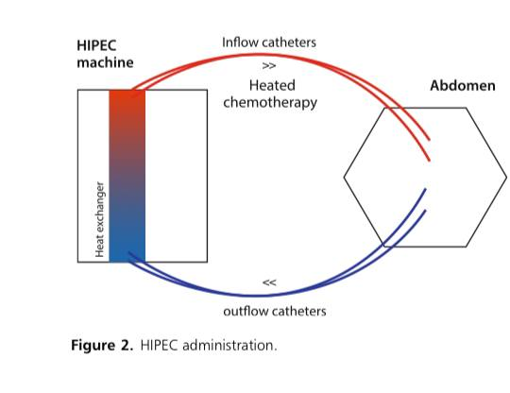
Diagram: HIPEC Machine and Circulation Flow

Slide 72
Requirements for a HIPEC Service
• Regulatory approval is required.
• Multidisciplinary input: surgery, anaesthesia, oncology, pharmacy, and theatre teams.
• Locally approved training programmes are essential.
• A perfusionist or trained theatre team member manages the HIPEC machine.
• Continuous case audits should be in place.
• ERAS principles should guide perioperative care.

Slide 73
HIPEC complications
A significant increase in the rate of acute kidney injury and electrolyte imbalance was found in the Korean study, but sodium thiosulphate was not given consistently, and the investigators found that when given appropriately, no difference in the rate of acute kidney toxic effects and electrolyte imbalance were seen.
Effects such as anaemia may be attributed to the cytoreductive surgery itself, rather than an effect of HIPEC.
(ASA) score of equal or less than 2 recommended to reduce risk of severe post-operative complications.

Slide 74
Pre-operative Factors for HIPEC
all patients with a suspected tubo-ovarian malignancy should be discussed by the gynaecological oncology cancer centre multidisciplinary team.
. If neoadjuvant chemotherapy is recommended, patients with a FIGO stage III or IV high grade serous tubo-ovarian carcinoma may be considered for HIPEC after three or four cycles of chemotherapy.
Trial protocols and studies have used an age range up to 70 or 75 to avoid the comorbidities associated with frailty.
Haematology and biochemistry assessment is recommended to confirm white blood cell count >3.5 x 109 /l; platelets >100 x 109 /l, serum creatinine 60 ml/min.
Written consent for both surgery and HIPEC must be obtained
. Due to these stringent inclusion criteria, HIPEC may only be feasible in 35–46% of patients undergoing interval surgery.

Slide 75
Intra-operative Factors for HIPEC
• Anaesthetic:
- Remove warming devices; use cooling methods if needed.
- Manage fluids carefully to maintain organ perfusion.
-prevent nephrotoxicity with sodium thiosulphate (iv prior to administration of cisplatin)
- Monitor urine output >1 ml/kg/hr for 3 hours post-HIPEC.
- Avoid excess IV fluid;
consider blood/albumin if needed.
• Surgical:
- Adds ~2 hours to theatre time.
- Proceed if residual disease ≤2.5 mm post-surgery.
- Anastomosis before or after HIPEC affects chemo delivery.
- Recommend at least one post-op abdominal drain.

Slide 76
Post-operative Factors
• Routine admission to enhanced post-operative care is advised after HIPEC.
• Many patients require this due to the extensive nature of surgery.
• Ongoing monitoring:
- Fluid balance assessment
- Daily creatinine measurement for first 3 post-op days
• Oral intake should be resumed promptly.
• Consider parenteral nutrition if oral intake is delayed.

Slide 77
Guidelines Relevant to HIPEC
• NCCN: HIPEC with cisplatin may be considered during interval surgery for stage III disease after neoadjuvant chemo.
• NICE : HIPEC provides survival benefit for peritoneal carcinomatosis; safe as other major surgeries.
- Recommends clinical governance and specialized centers.
• ESGO: HIPEC should be limited to well-designed RCTs.
• BGCS: No specific recommendations regarding HIPEC.

Slide 79
Limitations of HIPEC
• HIPEC remains controversial despite promising results.
• Criticisms:
- Ineffective for retroperitoneal/extra-abdominal tumors
- Limited drug penetration depth
- High-dose IV chemotherapy may be equally effective
- Trials show inconsistent benefit
• Strict selection criteria reduce patient eligibility.
• Many patients are unfit for prolonged surgery,because of poor patient performance status and multiple co-morbidites.
• Neoadjuvant chemotherapy preferred for extensive disease.

Slide 80
conclusion
Current evidence suggests a survival benefit associated with HIPEC in patients with tubo-ovarian cancer undergoing interval cytoreductive surgery, with comparible complication rates to those undergoing surgery without HIPEC.
Additional studies to clarify an optimal treatment protocol are essential. The current evidence does not suggest benefit at the time of primary cytoreductive surgery, but the results of a major ongoing RCT are pending.
Further high quality RCTs would be valuable to further assess the role of HIPEC in the setting of recurrent disease.

