Slide 1
GLUTEAL REGION
By
Dr Abulmaaty Mohamed Assistant professor Anatomy & Embryology Mutah University

Slide 2
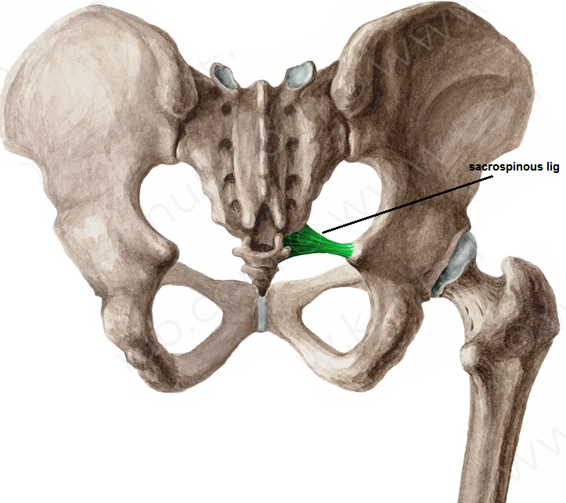
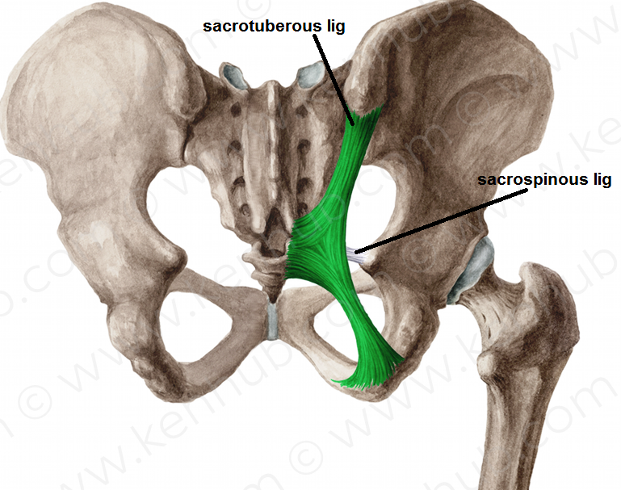
ligaments
sacrospinous lig. :
From tip of ischial spine.
To margin of last sacral &
1st coccygeal vertebrae
sacrotuberous lig. :
From medial border of ischial tuberosity
To back of sacrum & coccyx
Functions
-transform sciatic notches into foramina

Slide 3
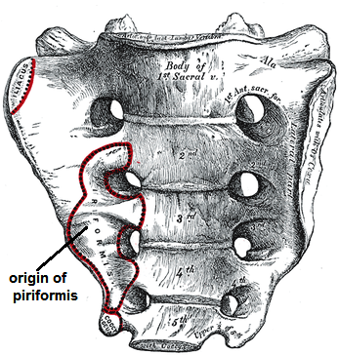
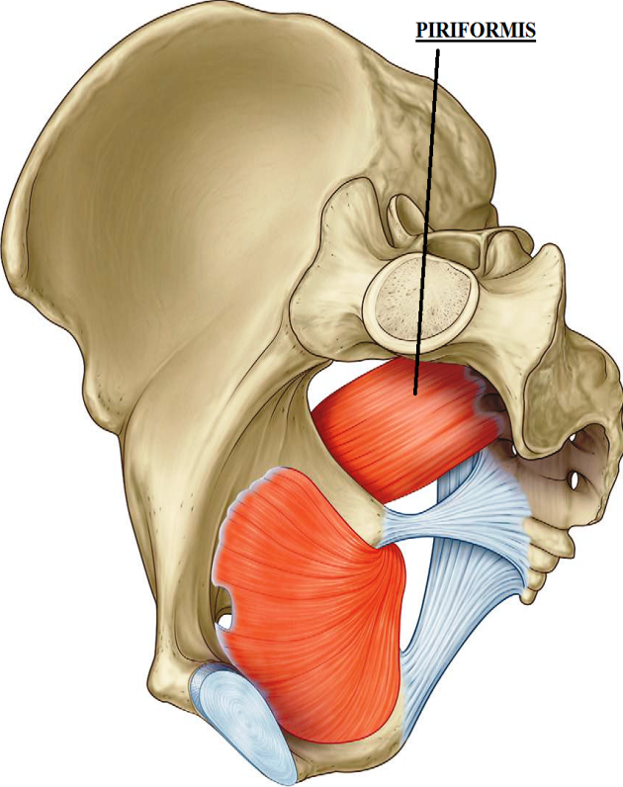
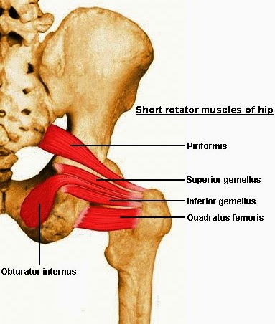
muscles
DEEP MUSCLES
piriformis
O.:- anterior surface of middle3 sacral vertebrae
I.:- pass through greater sciatic foramen
to upper border of greater trochanter
N.S.:- sacral plexus (S1, 2 nerves)
A.:- lateral rotation of thigh

Slide 4
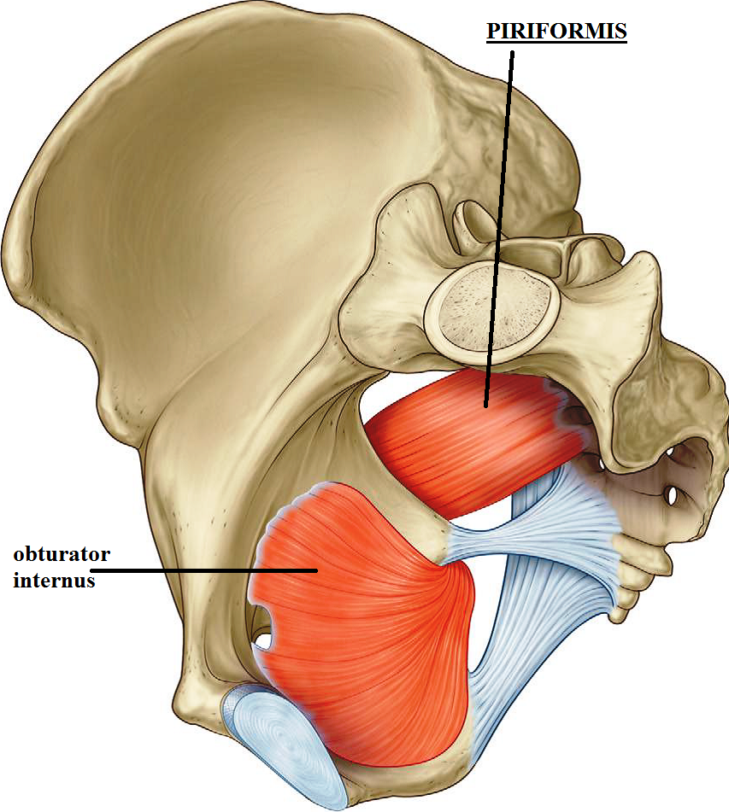
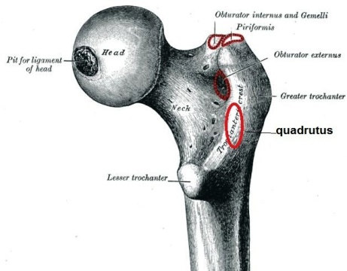
muscles
DEEP MUSCLES
obturator internus
O.:- inner surface of obturator membrane
& the surrounding bone
I.:- pass through lesser sciatic foramen
to insert in greater trochanter
above trochanteric fossa
N.S.:-sacral plexus, n. to obturator internus
A.:- lateral rotation of thigh

Slide 5
muscles
DEEP MUSCLES
superior gemellus
O.:- upper border of lesser sciatic notch
I.:- upper border of tendon of obturator internus
then to medial surface of greater trochanter
N.S.:-n. to obturator internus
A.:- lateral rotation of thigh
inferior gemellus
O.:- lower border of lesser sciatic notch
I.:-lower border of tendon of obturator internus
then to medial surface of greater trochanter
N.S.:-n. to quadratus femoris
A.:- lateral rotation of thigh

Slide 6
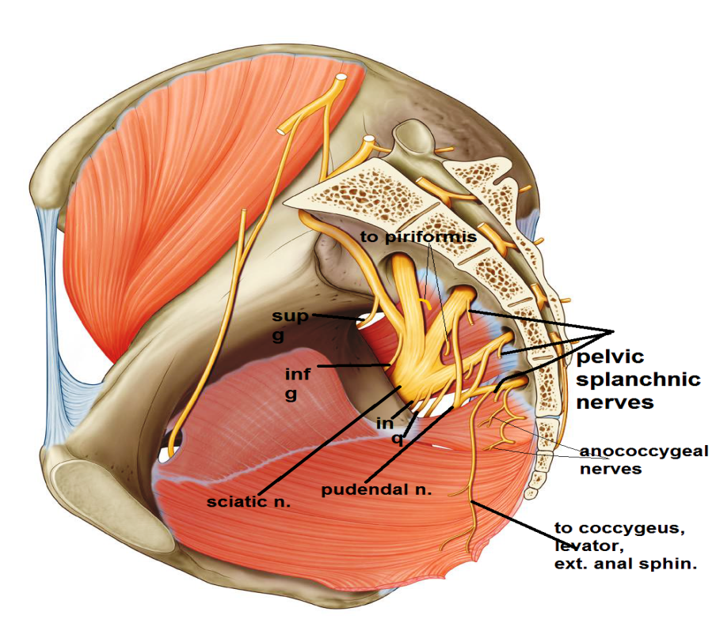
muscles
DEEP MUSCLES
quadratus femoris
O.:- Lateral border of ischial tuberosity
I.:-quadrate tubercle
N.S.:-sacral plexus, n. to quadratus femoris
A.:- lateral rotation of thigh

Slide 8
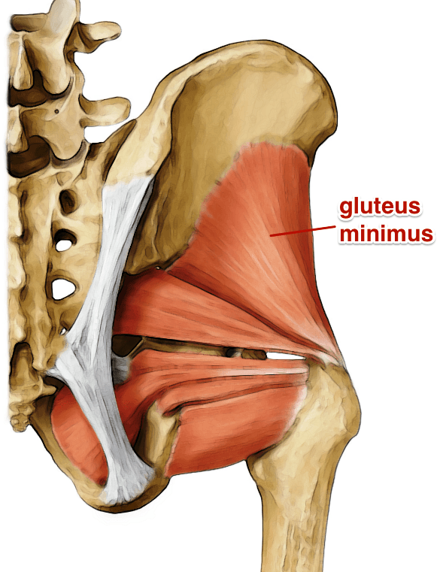
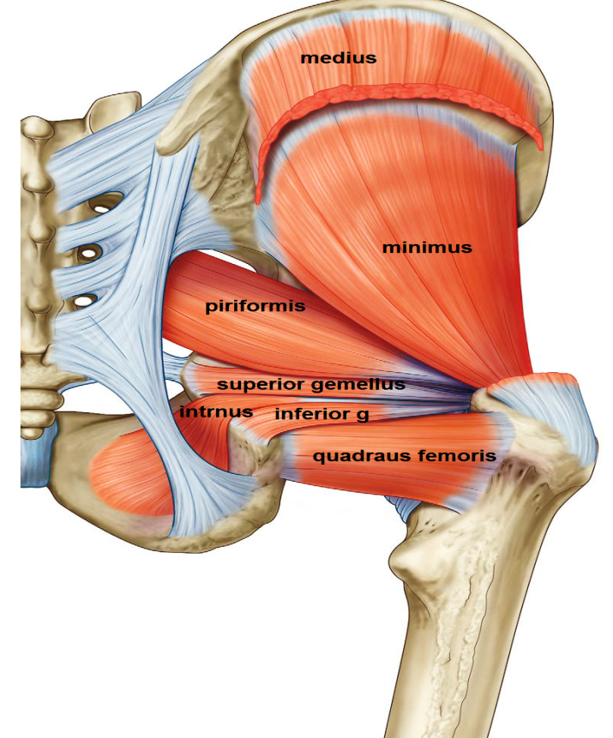
muscles
SUPERFICIAL MUSCLES
Gluteus minimus:
O.: outer surface of ilium( )ant.& inferior gluteal lines
I. : front of greater trochanter.
gluteus medius :
O. : outer surface of ilium ( ). post. & ant. gluteal lines
I. :lateral aspect of greater trochanter.
N.S : both supplied by superior gluteal n.
ACTION :
1- abduction of thigh
2- Medial rotation of thigh by the ant. fibers
3-prevent tilting of pelvis towards unsupported
side on standing on one limb so paralysis of these muscles on both sides causes waddling gait

Slide 9
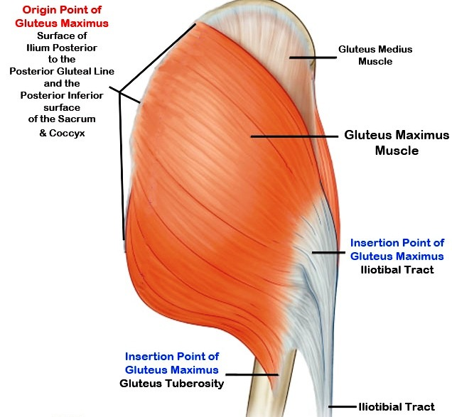
muscles
SUPERFICIAL MUSCLES
gluteus maximus:
O. : outer surface of ilium behind post. gluteal line
Back of sacrum & coccyx &
sacrotuberous lig.
: superficial 3 / 4 insert in
post. border of iliotibial tract
deep 1 / 4 insert in
gluteal tuberosity
N.S. : inferior gluteal n.
A. :
1-main extensor of hip joint
2- tense iliotibial tract in standing position
to keep bone of L.L above each other

Slide 10
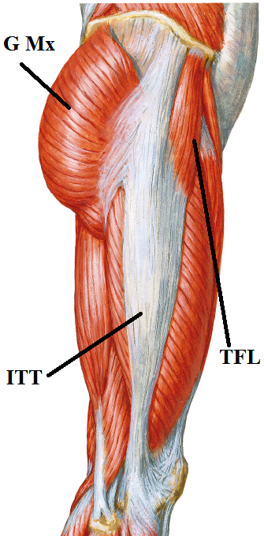
muscles
SUPERFICIAL MUSCLES
tensor fascia lata :
O.: ant. 5cm of outer lip of iliac crest
I.: ant. border of iliotibial tract
N.S.: superior gluteal n.
A.:
1-abduction of thigh
2-tense iliotibial tract in standing position
to keep bone of L.L above each other

Slide 11
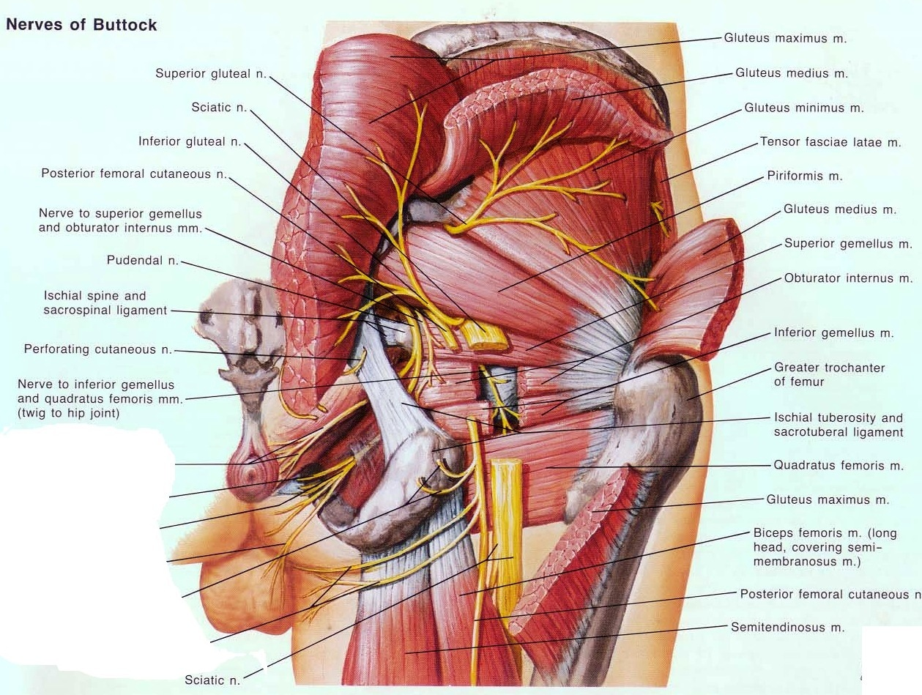
foramina
greater sciatic foramen :
piriformis
structures above piriformis
superior gluteal n &
superior gluteal vessels
structures below piriformis
inferior gluteal n.&
inferior gluteal vessels
sciatic n.
post. cut. n. of thigh.
n. to quadratus femoris
n. to obturator internus
int. pudendal vessels
Pudendal n.

Slide 12
foramina
lesser sciatic foramen :
- obturator internus
- n. to obturator internus
- int. pudendal vessels
- pudendal n.

Slide 13
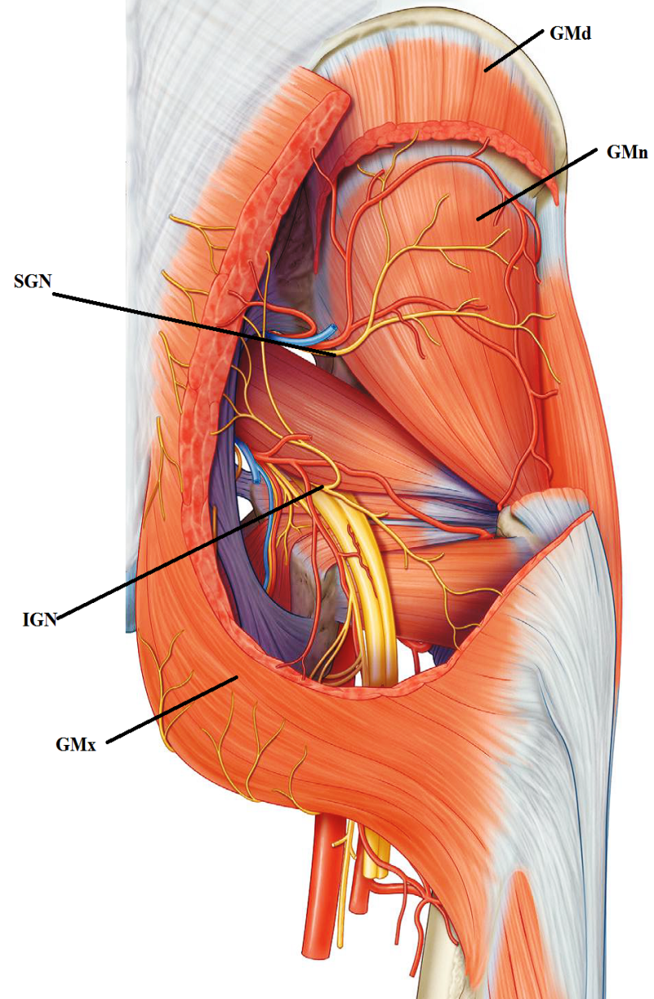
nerves of gluteal region :
-superior gluteal n. -inferior gluteal n.
-sciatic n -post. cut. n. of thigh
-to Quadratus femoris -n. to obturator internus
-pudendal n.
superior gluteal n.
-arise inside pelvis from sacral plexus
-pass through greater sciatic foramen above piriformis
-pass ( ) gluteus medius & minimus
- supply gluteus medius& minimus & tensor fascia lata
inferior gluteal n. :
- arise inside pelvis from sacral plexus
-pass through greater sciatic foramen below piriformis
-supply gluteus maximus

Slide 14
THANQ

