Slide 1
Complements
Dr.Eman Albataineh,
Assistant Prof. Immunology
College of Medicine, Mu’tah university
Immunology, 2nd year students

Slide 2
The complement system consists of a number of small proteins found in the blood, generally synthesized by the liver, and normally circulating as inactive precursors (pro-proteins).
When stimulated by one of several triggers, activation cascade is started and lead to functional effects.
Over 25 proteins and protein fragments make up the complement system. They account for about 5% of the globulin fraction of blood serum.

Slide 3
Complement was discovered many years ago as to ‘complement’ the antibacterial activity of antibody, hence the name.
Although first discovered as an effector arm of the antibody response (Adaptive), complement can also be activated early in infection in the absence of antibodies (innate) .

Slide 4
In the case of the complement system, the precursor are widely distributed throughout body fluids and tissues without adverse effect. At sites of infection, however, they are activated locally
There are three distinct pathways through which complement can be activated on pathogen surfaces. These pathways depend on different molecules for their initiation, but they generate the same set of effector molecules

Slide 5
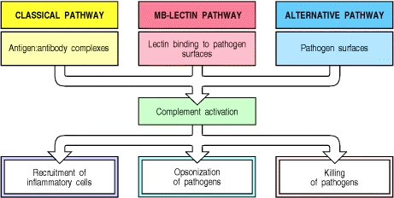

Slide 6
Complement pathways activation
Classical pathway; recognize antibody binding microbe as viruses or bacteria (IGG1, IGG3, IGA and IGM) it is arm of humoral immunity
Alternative; recognize LPS or endotoxins of microbe (part of innate response)
Lectin pathway. The lectin is a protein bind carbohydrates on microbe (mannose)

Slide 7
Complements
The classical pathway, so called because it was discovered first, uses a plasma protein called C1q to detect antibodies bound to the surface of a microbe or other structure. Once C1q binds to the Fc portion of the antibodies, two associated serine proteases, called C1r and C1s, become active and initiate a proteolytic cascade involving other complement proteins (C2, C4) to make C3 convertase. The classical pathway is one of the major effector mechanisms of the humoral arm of adaptive immune responses.

Slide 8
Classical pathway
C1 exists in blood serum as a molecular complex containing:
C1q
C1r
C1s
The IGM and IGG that bound by antigen, contain a binding site for C1q. (A single molecule of IgM is enough to initiate the pathway. IgG is far less efficient, requiring many molecules to do so.)
Binding of C1q activates C1s and C1r.
Activated C1s (a protease) cleaves two serum proteins:
C4 is cleaved into a large fragment
C4b, which binds covalently to surface of antigen (opsonisation) and
C4a, smaller, inactive, which diffuses away.
C2 is cleaved into
C2b, which binds to a site on C4b,
C2a a smaller, inactive, fragment of which diffuses away.
The complex of C4b2b on surface of microbe is called "C3 convertase" because it catalyzes the cleavage of C3.

Slide 9
Complement
The alternative pathway, is triggered when a complement protein called C3 recognizes certain microbial surface structures, such as bacterial LPS and then simultaneously degraded to C3b that.
C3b undergoes its post-cleavage conformational change, a binding site for a plasma protein called Factor B is also exposed. Factor B then binds to the C3b protein that is now covalently tethered to the surface of a microbial or host cell. Bound factor B is in turn cleaved by a plasma serine protease called Factor D, releasing a small fragment called Ba and generating a larger fragment called Bb that remains attached to C3b on surface of microbe.
The C3bBb complex is the alternative pathway C3 convertase,

Slide 11
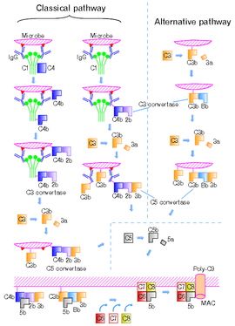

Slide 12
Lectin pathway
Lectin pathway. The lectin (proteins macromolecules in blood that are highly specific to mannose on pathogen) pathway is homologous to the classical pathway, but with mannose-binding lectin (MBL) instead of C1q, and in the absence of antibody
This pathway is activated by binding of lectin to mannose residues on the pathogen surface, which can then split C4 into C4a and C4b and C2 into C2a and C2b the rest pathway is similar to classical

Slide 13
C3
Recognition of microbes by any of the three complement pathways results in sequential recruitment and assembly of additional complement proteins
C3 is the most abundant protein of the complement system. Because of its abundance and its ability to activate itself (as described later), it greatly magnifies the response.
C3 convertase cuts C3 into major fragments:
C3b, which binds covalently to glycoproteins scattered across the microbial cell surface. Macrophages and neutrophils have receptors for C3b and can bind the C3b-coated cell or particle preparatory to phagocytosis. This effect qualifies C3b as an opsonin.
C3a This small fragment is released into the surrounding fluids. It can bind to receptors on basophils and mast cells triggering them to release their vasoactive contents (e.g., histamine). Because of the role of these materials in anaphylaxis, C3a is called an anaphylatoxins.
C3d:

Slide 14
C3d link innate to humoral immunity
antigen gets “tagged” with the appropriate C3d product via the classical or lectin complement pathways.
C3d bind both the antigen receptor on B cell (IGM) and complement receptor CR2 (CD21)on B cells, during antigen-induced activation regulating humoral immunity and enhancing signaling through the B cell Ag receptor

Slide 15
Membrane attack complex (MAC
-C5 convertase formed by joining C3 convertase to C3b
Cleavage of C5 by the (C3bBb3b )and other complements (C4b•2b.3b)(which is thus a "C5 convertase".) produces:
C5a, which is released into the fluid surroundings where it
is a potent anaphylatoxin
is a chemotactic attractant
C5b, which serves as the anchor for the assembly of a single molecule each of
C6;
C7, and
C8.
The Membrane Attack Complex (MAC)
The resulting complex C5b•6•7•8 guides the polymerization of as many as 18 molecules of C9 into a tube inserted into the lipid bilayer of the plasma membrane. This tube forms a channel allowing the passage of ions and small molecules. Water enters the cell by osmosis and the cell lyses.

Slide 16
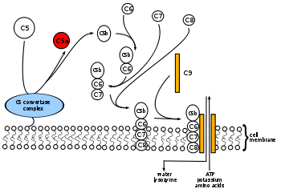

Slide 17
Summary of complement functions
Opsonization by C3b, C4b and C5b targets foreign particles for phagocytosis.
Chemotaxis by C5a, C4a and C3a attracts phagocytic cells to the site of damage.
This is aided by the increased permeability (anaphylatoxins) they cause smooth muscle contraction, vasodilation, histamine release from mast cells, and enhanced vascular permeability.mediated by C3a, C5a, C4a.
C3b ; are also important for solubilizing antigen-antibody complexes and elimination from the body ( by binding the immune complex to CR1 on erythrocyte). otherwise aggregation of the complexes lead to immune complex disorder (SLE, diabetes mellitus, RA)
Lysis of target cells (C5b-9).
Promoting B cell activation and antibody formation. Breakdown of C3 generates a fragment (C3d) that binds to antigens enhancing their binding by B cells.

Slide 18
Complement receptors
Type 1 receptor(CR1); bind C3b, and C4b. Expressed in erythrocytes, macrophages, neutrophil
Do opsonization and Induce phagocytosis (with antibody)
Help to remove immune complexes from blood to liver and spleen (erythrocytes)
Type 2 receptor (CR2),
bind C3d, and, expressed on B lymphocytes and enhance B cell response to antigen
Receptor for epstein barr virus on B cells
Type 3 and 4 receptors on phagocytes
bind opsonizing C3b and lead to phagocytosis. Found on macrophages and neutrophils

Slide 19
Regulation of complement activity
The explosive potential of the complement system requires that it be kept under tight control. At least 12 proteins are known that do this. Three examples:
Factor H and Decay-accelerating factor (DAC), removes Bb from the alternative pathway C3 convertase.
Factor I inactivates C3b.
C1 inhibitor (C1INH) binds to sites on activated C1r and C1s shutting down their proteolytic activity.
CD59 on normal tissue cells which inhibit association of C9 with C5b-8

Slide 20
Disorders of the complement system
With so many proteins involved, it is not surprising that inherited deficiencies of one or another are sometimes encountered in humans. Four examples:
C3. An inherited deficiency of C3 predisposes the person to frequent bouts of bacterial infections mainly gram negative bacteria.
C2 , C1, C3 or C4. immune complex diseases. This emphasizes the important role of the complement system in clearing away antigen-antibody complexes. A deficiency of C2 is frequently found in patients with lupus erythematosus (SLE).
C9. most people who cannot make C9 have no problem with bacterial infections. Laboratory studies suggest that the C5b•6•7•8 complex by itself is able to lyze bacteria although not as efficiently as C9.
C1INH. A deficiency of C1INH produces hereditary angioedema. The massive release of anaphylatoxins (C3a, C5a) may cause dangerous swelling (edema) of the airways, as well as of the skin and intestine.
CD59 deficiency in its expression lead to inadequate control of MAC assembly results in intravascular red cell lyses called paroxysmal nocturnal haemoglobinuria

