Slide 1
Summation & Tetanization
Prof. Sherif W. Mansour
Physiology dpt., Mutah School of medicine 2024

Slide 2
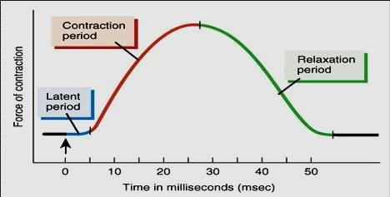
The simple muscle twitch
Definition: It is the response of the muscle to a single maximal stimulus and consists of:
Latent period: -It is the time between time of stimulus & response.
-About 0.01 second duration. - Due to: 1- conduction of impulse in nerve 2- production of MEP
potential. 3-conduction of impulse in the muscle. 4- contraction and 5- the time of recording.
Contraction period: during it the muscle contracts either isometrically or isotonically.(0.04 sec.)
Relaxation period: the muscle relaxed (= 0.05 sec. In isotonic relaxation).
N.B.: The simple muscle twitch can be studied in the nerve muscle preparation (siatic – gastrocnemius
frog muscle).

Slide 3
- Fatigue:
Definition:- It is the gradual decrease in the muscle contraction and prolonged duration of all phases of the SMT, especially relaxation due to repeated and strong stimulation of the muscle. • The effect: decrease strength and prolonged duration of contraction and incomplete or absent relaxation
The cause of fatigue: - In case of indirect stimulation (via stimulation of its motor nerve) is the gradual exhaustion of Ach at the MEP.
-Also direct stimulation of the muscle may lead to fatigue due to depletion of sources (ATP) or accumulation of metabolites.
- In living muscle (after exercise), fatigue is caused by: exhaustion of energy
1-Decrease blood supply to the muscle. 2-Decrease energy sources.
3-Accumulation of metabolites which depress the brain and spinal cord, central effect.
- Contracture may occur with fatigue due to decrease in ATP required for separation
between the thin and thick filaments and muscle relaxation.

Slide 4
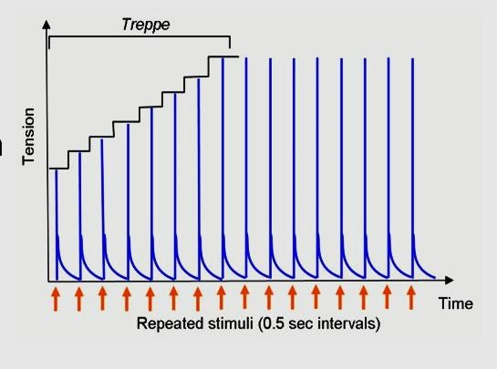
- Stair-case (Treppe) phenomenon:
-It occurs in the skeletal and cardiac muscle.
-It is a gradual increase in muscle contraction until plateau.
-This occurs by application of series of maximal stimuli just after relaxation period of each muscle twitch.
-This is due to: 1- accumulation of Ca++ intracellular.
2- ↑ temperature of the muscle.
3-↓ K+ & ↑ Na+ intra-cellulary → ↑ Ca+2 release from sarcoplasmic reticulum→↑contraction.

Slide 5
Summation of muscle contractions
Since the contraction phase in the skeletal muscle starts with the relative refractory period, the muscle respond to another stimulus during either cont. or relaxation → summation of contraction.
(a) Effect of two successive stimuli:
According to frequency of stimulation:
If the 2nd stimulus falls in relation to preceding one:
1- During the latent period → no response during (ARP). 2- During the contraction period → more strong contract.
3- During the relaxation period → 2 peaks contraction.
4- Just after the relaxation period→ stair-case phenomenon. 5 - After relaxation → normal second contraction.
(b ) Effect of multiple successive stimuli:
-If the frequency is low → separate twitches with Stair – case phenomenon.
-If the frequency increases and stimuli falls during relaxation phase of preceding twitch → Clonus (incomplete tetanus).
-If the frequency increases more and stimuli falls during contraction phase → sustained contraction (complete tetanus).
N.B.: Cooling, fatigue & anti-cholinesterase (Eserine) change clonus into complete tetanus. However, warmness and rest cause the reverse.

Slide 6
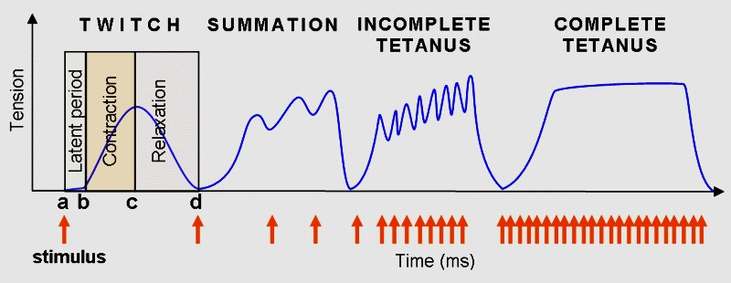
Treppe
Clonus

Slide 7
Thank You

