Slide 1
Seronegative – spondyloarthropathies
inflammatory arthritis (joints that are swollen and painful and warm) for which the usual blood tests for rheumatoid arthritis are negative.
Features of seronegative arthritis:
• Autoimmune, chronic, inflammatory, and systemic disease
• Oligoarthritis (2-3 joint)
• (Asymmetrical joint)
• affect usually large joint and lower limb usually
Arthritis without rheumatoid factor (no anti-IgG antibody) = seronegative
Strong association with HLA-B27 (MHC class I serotype).
Family history common
Subtypes (PAIR):
1. Psoriatic arthritis
2. Ankylosing spondylitis (SIJ) SACROILIAC ARTHRITIS
3. Enteropathic-arthropathy
4. Reactive arthritis

Slide 2
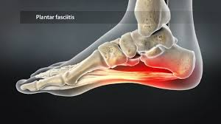
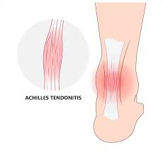
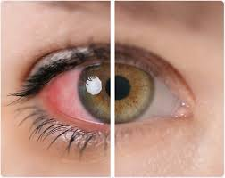
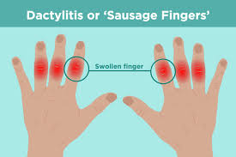
All the types share variable occurrence of:
Inflammatory back pain (associated with morning stiffness, improves with exercise and
hot shower and worse with rest and inactivity
➢ Peripheral arthritis
➢ Enthesitis (inflamed insertion sites of tendons, eg, Achilles) tendonitis, plantar fasciitis
➢ Dactylitis (“sausage fingers”),
➢ Uveitis.

Slide 3
1-Ankylosing spondylitis
>spondyloarthropathies:
1.radiographic axial spondyloarthritis.
2.non-radiographic axial spondyloarthritis

Slide 4
Pathophysiology:
increase osteoclast activity, joint erosion+ subchondral sclerosis.
Initiation of innate immune response >The mechanism for triggering innate immunity is unclear, but is thought to be associated with pathogens invading the systemic circulation via disruption in the gut mucosal barrier.
Release of cytokines (TGF-beta and TNF-α) and interleukins (IL-17 and IL-23)
Infiltration of paravertebral and sacroiliac entheses with macrophages, CD4 T cells, and CD8 T cells
Chronic enthesitis leads to:
Erosion of the iliac part of the sacroiliac joints This is the earliest radiological sign of ankylosing spondylitis.
Vertical formation of syndesmophytes along the spinal ligament or around the annulus fibrosus of the intervertebral discs .
Fusion of syndesmophytes → ankylosis of intervertebral discs and vertebral bodies .

Slide 5
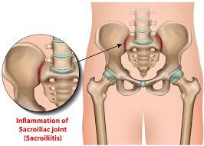
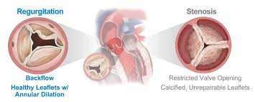
Articular manifestations
1-Features of inflammatory back pain (most common presenting symptom) [4][5]
Symmetric(bilateral) involvement of spine and sacroiliac joints
Age at onset < 45 years male
Insidious onset of dull pain that progresses slowly
Morning stiffness > 30 minutes that improves with activity
Pain is independent of positioning
Pain persists with rest and is also present at night.
Alternating gluteal pain
2-Tenderness over the sacroiliac joints (SIJ)
3-Reduced spinal mobility
4-Extraspinal joint pain
Inflammatory enthesitis
Dactylitis
Arthritis outside the spine (hip, shoulder, knee joint)
Aortic regurgitation :
(Ascending aortitis)

Slide 6
Extraarticular manifestations
Acute, unilateral anterior uveitis (most common extraarticular manifestation; ∼ 25% of patients)
Constitutional symptoms such as fatigue , weakness, fever, and weight loss
Restrictive pulmonary disease
Due to decreased mobility of the thoracic spine and costovertebral joints
Secondary to apical pulmonary fibrosis or more widespread interstitial lung disease
Gastrointestinal symptoms: due to associated chronic IBD (∼ 5–10% of patients)
Prostatitis
Aortic root inflammation and subsequent aortic valve insufficiency, atrioventricular blocks IgA nephropathy (rare)

Slide 7
Extra-articular features of axial spondyloarthritis
• Fatigue, anaemia
• Anterior uveitis (25%)
• Prostatitis (80% of men) and sterile urethritis
• Inflammatory bowel disease (in up to 50%)
• Osteoporosis
• Osteoproliferation and osteosclerosis
• Cardiovascular disease (aortic valve disease 20%)
• Amyloidosis (rare)
• Atypical upper lobe pulmonary fibrosis (very rare)
Costovertebral and costosternal
ankylosis may cause restrictive lung
disease

Slide 8
Diagnosis:
Imaging +lab
1. imaging studies of lumbar spine and pelvis. Sacroiliac joints (PA view) [4]
Indication: best initial test to confirm the diagnosis of AS and evaluate disease severity
Characteristic findings (usually symmetrical)
Signs of sacroiliitis: erosion and sclerosis (increased radiodensity) of the sacroiliac joints
Ankylosis: fusion of the articular surfaces
Spine (AP and lateral views)
Characteristic findings
Loss of lumbar lordosis: abnormal straightening of the spine
Ankylosis of costosternal and costovertebral joints
Dagger sign ; radiodense.
Bamboo spine: seen in later stages and is caused by the following
2. (plain film, MRI, or CT) reveal sacroiliitis
In AS, X-rays of the sacroiliac joint show irregularity
and loss of cortical margins ,widening of the joint space
and subsequently sclerosis, joint space narrowing
3. “bamboo spine.” vertebral fusion
4. Elevated ESR in up to 75% of patients
diagnosis by : 1.typical clinical feature. 2.image finding. 3.labs inflamatory marker. 4. HLAB27 +

Slide 9
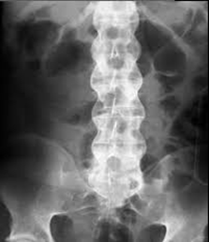

Slide 10
Management
• NSAID
• physical therapy
• For severe and/or persistent peripheral joint involvement, both SSZ and MTX
• In patients who fail to respond adequately or who cannot tolerate NSAIDs, progression
to biologic therapy with either TNF-α, or IL-17A inhibitors.
• Anti-TNFα therapy is effective for both the axial and peripheral lesions
• Local glucocorticoid injections can be useful for persistent plantar fasciitis, other
enthesopathies and peripheral arthritis.
• Oral glucocorticoids may be required for acute uveitis, but do not help spinal disease.

Slide 11
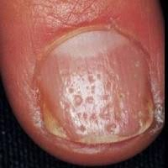
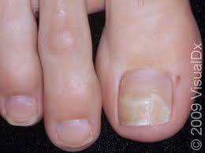
2- Psoriatic arthritis
• Associated with skin psoriasis and nail lesions
1. (90% has nail pitting)
2. (onycholysis)
• Asymmetric and patchy involvement.
• Psoriatic differ in its effect
small joint of the hand (DIJ)
• DIJ: found in:
1. osteoarthritis
2. psoriatic arthritis
Note :Psoriasis and psoriatic arthritis maybe ocure to gother

Slide 13
Investigations
The diagnosis is made on clinical grounds.
Autoantibodies are usually negative, though low-dose RF, ACPA
and ANA can be detected, and acute phase reactants, such as ESR
and CRP, are raised in only a proportion of patients with active disease.
X-rays may be normal or show juxta-articular osteoproliferation
or erosive change with joint space narrowing.

Slide 14
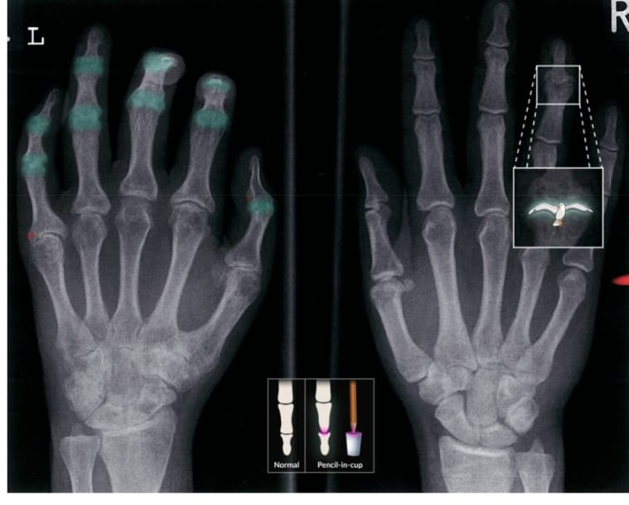
X-ray hands (PA view)
Asymmetric advanced arthritis involves the left hand, with ankylosis of several proximal and
distal interphalangeal (PIP and DIP) joints (examples indicated by green overlay) along with
multiple flexion deformities. Marginal erosions are present at the bases of the small finger
proximal phalanx and thumb distal phalanx (red overlay). Central subchondral erosions and
proliferative changes with a gull-wing deformity are seen at the right ring finger DIP joint.
Also shown is an illustration of a pencil-in-cup deformity (not present here), which can occur
in psoriatic arthritis and several other inflammatory arthritides.
Advanced degenerative changes additionally involve multiple left carpal and metacarpal
joints.

Slide 15
Management
• Weight loss may play a therapeutic role to limit clinical impact.
• Therapy with NSAIDs and analgesics may be sufficient to manage symptoms in mild disease.
• Intra-articular glucocorticoid injections can control isolated synovitis or enthesitis.
• Splints and prolonged rest should be avoided because of the tendency to fibrous
and bony ankylosis.
• Therapy with cDMARDs should be considered for polyenthesitis or synovitis unresponsive
to conservative treatment.
• MTX is the drug of choice and is also effective for skin disease.

Slide 16
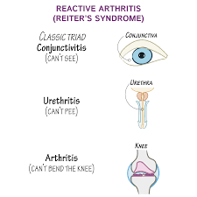
3- Reactive arthritis
Associated with infections by Shigella,
Campylobacter, E coli, Salmonella,
Chlamydia, Yersinia enteric or
urogenital infections
• Arthritis is preceded by an infectious process that is remote from the site of arthritis
(1 to 4 weeks prior)
• Usually after GI or urogenital infections
• Before called (Reiter syndrome)
Classic triad:
1) Conjunctivitis (anterior uveitis)
2) Urethritis (cervicitis, prostatitis)
3) Arthritis (asymmetric)

Slide 17
• The diagnosis is usually made clinically,
• ESR and CRP are raised.
• High vaginal swabs may reveal Chlamydia on culture.
• For post-Salmonella arthritis, stool cultures are usually negative by the time the arthritis
presents, but serology may help conform previous dysentery.
• RF, ACPA and ANA are negative

Slide 18
Management
• Acute Reactive arthritis should be treated with rest, NSAIDs and analgesics.
• Intraarticular or systemic glucocorticoids may be required in patients with Severe
monarticular synovitis or polyarticular disease
• There is no convincing evidence for the use of antibiotics unless
a triggering infection is identified.
• If chlamydial urethritis is diagnosed, it should be treated empirically with a short course
of doxycycline or a single dose of azithromycin.
• Treatment with DMARDs (usually SSZ or MTX) should be considered for patients with
persistent marked symptoms, recurrent arthritis or severe keratoderma blennorrhagica.
• Anterior uveitis is a medical emergency requiring topical, subconjunctival or systemic
glucocorticoids.

Slide 19
4- Enteropathic-arthropathy
A seronegative spondyloarthropathy that develops in association with inflammatory bowel disease
Typically affects joints of the lower extremities but can also involve the spine (e.g., sacroiliitis, spondylitis, inflammation of peripheral joints
• Crohn disease and ulcerative colitis (IBD) are often associated with spondylarthritis.
Symptoms
• fever
• weight loss
• mild lymphadenopathy may occur during
• fatigue
• low-grade joint pains can be constant and not particularly associated with
active inflammatory disease.

