Slide 1
Immunoheamatology
Dr.Eman Albataineh,
Associate Prof. Immunology
College of Medicine, JUST university
Immunology,

Slide 3
Introduction
The term immunohematology refers to the serologic, genetic, biochemical, and molecular study of antigens associated with membrane structures on the blood cells, as well as the immunologic properties and reactions of blood components and constituents.

Slide 4
Chromosome | Epitope or carrier, notes | System symbol | Blood groupingSystem
9 | Carbohydrate (N-Acetylgalactosamine, galactose). A, B and H antigens | ABO | ABO
4 | Main antigens M, N, S, s. | MNS | MNS
1 | Protein. C, c, D, E, e antigens (there is no "d" antigen; lowercase "d" indicates the absence of D | RH | Rh
7 | Glycoprotein. K₁ can cause hemolytic disease of the newborn (anti-Kell), which can be severe. | KEL | Kell
6 | Polysaccharide | Li | LI
1 | Protein (chemokine receptor). Main antigens Fyª and Fy^{b}. Individuals lacking Duffy antigens altogether are immune to malaria caused by Plasmodium vivax and Plasmodium knowlesi. | FY | Duffy

Slide 5
Introduction
Transfusion medicine is a multidisciplinary specialty encompassing all aspects of:
blood donation.
blood component preparation.
blood cell serology.
blood transfusion therapy.

Slide 6
Introduction
Operationally, transfusion medicine is divided between blood centers and transfusion services.

Slide 7
Introduction
Blood centers recruit and collect blood from donors and manufacture and distribute blood components.
Transfusion services perform pretransfusion compatibility testing (blood grouping and cross match), select and issue blood components for patients, and provide medical support for blood transfusion.

Slide 8
pretransfusion compatibility testing
Evaluation of the donor includes
Testing of the donor unit for infectious diseases
ABO/Rh typing and antibody screen
Evaluation of the recipient includes
ABO/ Rh typing
Antibody screen. Perform antibody identification if antibody screen is positive to determine the identity of the antibody,
Crossmatch Tests the compatibility of the recipient’s serum with RBCs from potential donor unit

Slide 9
Blood bank
Units of WB and packed RBC are both kept refrigerated at 33.8 to 42.8 °F (1.0 to 6.0 °C), with maximum permitted storage periods of 35 and 42 days respectively.
When keeping blood tube in standing position,a layer between the red cells and the plasma is formed and referred to as the buffy coat and is sometimes removed to make platelets and WBC for transfusion.
Platelets have a shelf life of 5 to 7 days. Platelets are stored at room temperature (72 °F or 22 °C) and must be rocked/agitated

Slide 10
If the plasma is frozen promptly and is intended for transfusion, it is typically labeled as fresh frozen plasma. If it is intended to be made into other products, it is typically labeled as recovered plasma or plasma for fractionation.

Slide 11
The ABO antigens (Lewis antigens) are carbohydrates linked to cell surface proteins and lipids that are synthesized by polymorphic glycosyltransferase enzymes
Most individuals possess a fucosyltransferase that adds a fucose moiety to a nonterminal sugar residue of the core glycan, and the resulted fucosylated glycan is called the H antigen (O antigen).
A single gene on chromosome 9 encodes a glycosyltransferase enzyme that may further modify the H antigen.
There are three allelic variants of this
O allele gene product is devoid of enzymatic activity and cannot attach terminal sugars to the H antigen and express
only the H antigen
The A allele– encoded enzyme transfers a terminal N-acetylgalactosamine moiety onto the H antigen.
B allele gene product transfers a terminal galactose moiety.

Slide 13
Mutations in the gene encoding the fucosyltransferase that produces the H antigen are rare; people who are homozygous for such a mutation are said to have the Bombay blood group
And cannot produce H, A, or B antigens. and cannot receive type O, A, B, or AB blood.

Slide 14
Rh antigens are non-glycosylated, hydrophobic cell surface proteins found in red blood cell membranes. 15% of the population has a deletion or other alteration of the RhD allele.

Slide 15
Rh System
Rh Antigens and Encoding Genes
Subsequently it was confirmed that the RH locus is on chromosome 1 and comprises two highly homologous, very closely linked genes, RHD and RHCE.
The main antigens are D, C, E, c and e, which are encoded by two adjacent gene loci, the RHD gene which encodes the RhD protein with the D antigen and the RHCE gene which encodes the RhCE protein with the C, E, c and e antigens. There is no d antigen.
The RHCE gene has four main alleles; CE, Ce, ce and cE.
This concept of D and CcEe genes linked closely and transmitted together is consistent with the Fisher nomenclature.
Examples on antigens in RH+ and -
D− C+ E+ c− e+ (RhD−)
D+ C+ E− c− e+ (RhD+)

Slide 16
The Rh blood group system consists of 49 defined blood group antigens,
Rh(D) status of an individual is normally described with a positive or negative suffix after the ABO type (e.g., someone who is A Positive has the A antigen and the Rh(D) antigen, whereas someone who is A Negative lacks the Rh(D) antigen). The terms Rh factor, Rh positive, and Rh negative refer to the Rh(D) antigen only.

Slide 17
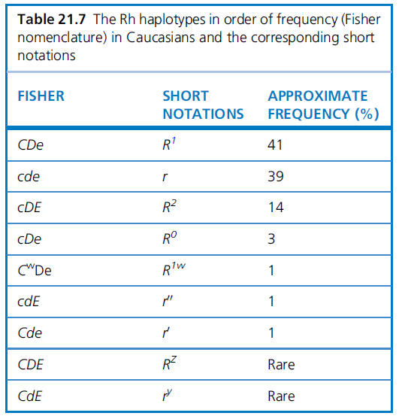

Slide 18
Rh System
Antibodies
antibodies directed against all Rh antigens, except d, have been described: anti-D, anti-C, anti-c, anti-E and anti-e.
Rh antigens are restricted to red cells and Rh antibodies result from previous alloimmunization by previous pregnancy or transfusion.
Immune Rh antibodies are predominantly IgG (IgG1 and/or IgG3).

Slide 19
Rh System
Antibodies
Anti-D is clinically the most important antibody. Some times antibodies to Rh(c)
it may cause hemolytic transfusion reactions and was a common cause of fetal death resulting from hemolytic disease of the newborn before the introduction of anti-D prophylaxis.

Slide 20
hemolytic disease of the newborn
When the condition is caused by the Rh D antigen-antibody incompatibility, it is called Rh D Hemolytic disease of the newborn
The major clinical significance of anti-Rh antibodies is related to hemolytic reactions associated with pregnancy that are similar to transfusion reactions. Rh-negative mothers carrying an Rh-positive fetus can be sensitized by fetal red blood cells that enter the maternal circulation, usually during childbirth. IgG antibodies are generated in Rh-negative mothers. Subsequent pregnancies in which the fetus is Rh positive are at risk because the maternal anti-Rh D IgG antibodies can cross the placenta and mediate the destruction of the fetal red blood cells. This causes anemia, dyspnea, jaundice and erythroblastosis fetalis

