Slide 1
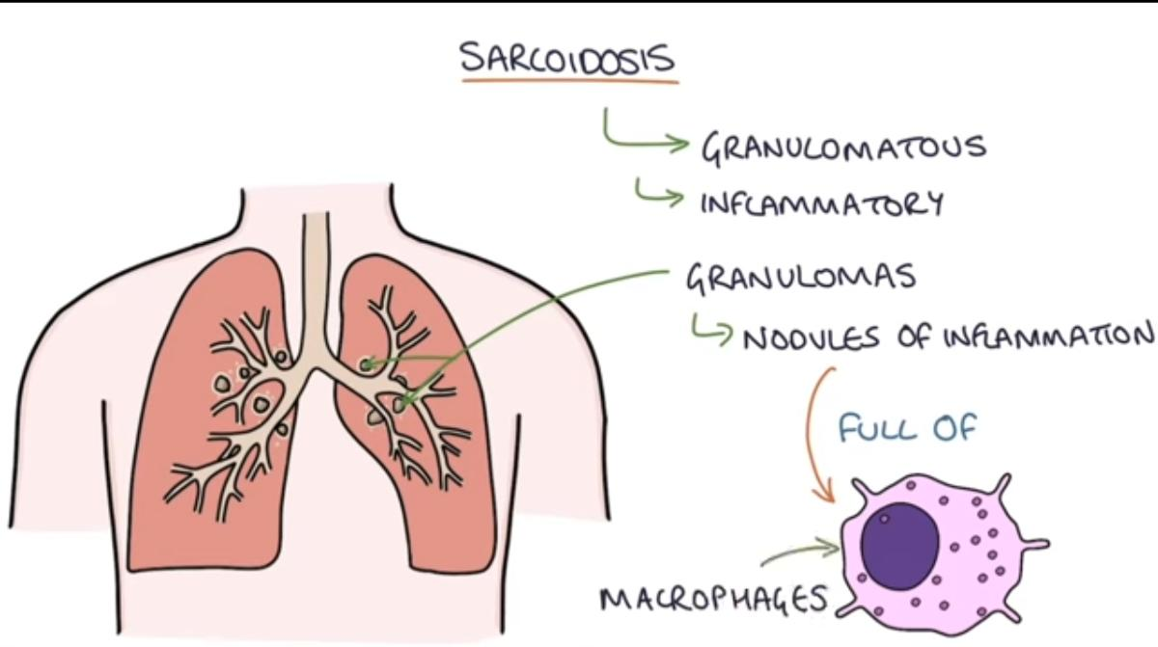
Sarcoidosis
•Sondus walled Almalahmeh
•Musheer Ali Aldrweesh
•Sarah Yahya Alqudah

Slide 2
Granulomatous diseases
Sarcoidosis
Is a multisystem disease of unknown etiology characterized by noncaseating granulomatous inflammation in many tissues and organs
It is classified as either acute or chronic
-Lungs are almost always involved . Most affected organ
- immune-mediated
- Restrictive lung disease (problem in getting the air in)

Slide 3
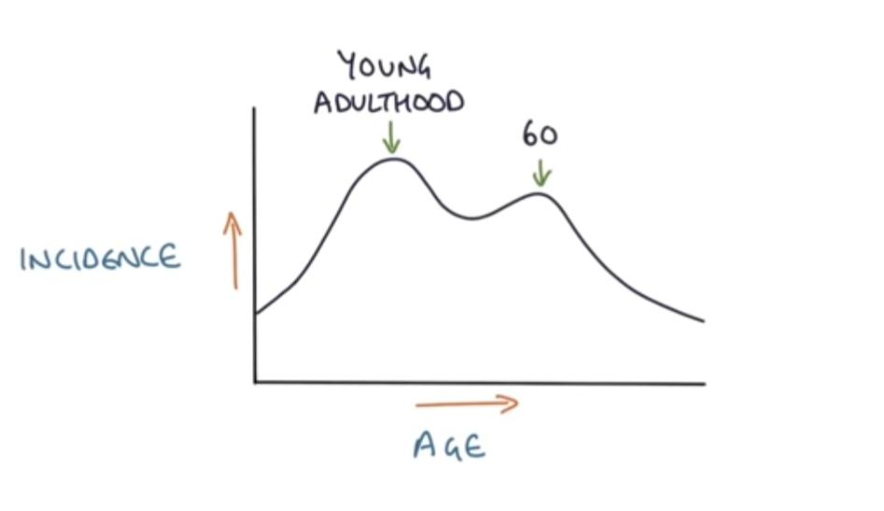
Epidemiology
occurs most often in African American population esp. Women .
Peak incidence : 25–35 years old with a second peak for females 50–65 years old
Females > males (2:1)
But it could Occurs throughout the world
Affecting both genders and all races and age groups .
A higher prevalence among nonsmokers , an association that is virtually unique to sarcoidosis among pulmonary diseases .

Slide 4
Etiology and pathogenesis
Unknown etiology
Several lines of evidence suggest that it is a disease of disordered immune regulation in genetically predisposed individuals exposed to certain environmental agents .
Several immunologic abnormalities in sarcoidosis suggest the development of cell-mediated response to an unidentified antigen .
The process is driven by CD4+ helper Tcells that stimulated by unknown antigen
After lung transplantation , sarcoidosis recurs in the new lung in at least one-third of pt
Several putative “ antigens “ have been proposed as the inciting agent for sarcoidosis ( viruses , mycobacteria , borreia , pollen )
Possible etiology:
•Genetic
•Environmental Beryllium and it’s salt
•Infection; mycobacteria

Slide 5
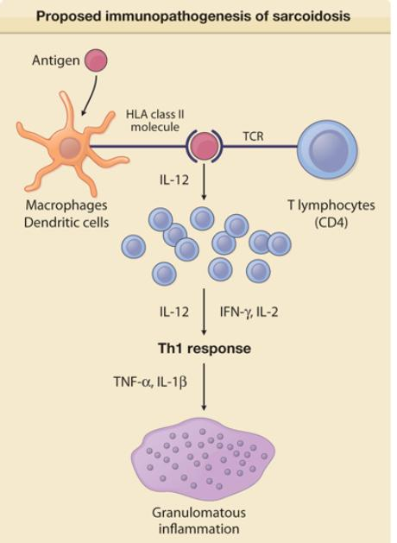
Antigen-presenting cells
present antigens to CD4+ Th cells
and secrete IL-12 → stimulation of Th
-cell
differentiation into Th 1 cells
Th₁ cells activate macrophages by secreting IFN-γ → cytokine release
from macrophages (e.g., TNF) →
formation
of epithelioid macrophages and giant cells
HLA II gene polymorphism (HLA-DRB1 with environmental factors are thought to have a role

Slide 6
Morphology
The cardinal histopathologic feature of sarcoidosis , irrespective of the organ involved , is the nonnecrotizing epitheloid granuloma .
This is a discrete , compact collection of epithelioid cells rimmed by an outer zone rich in CD4+ T cells . Intermixed multinucleated giant cells formed by fusion of macrophages .
Early on , a thin layer of laminated fibroblasts is found peripheral to the granuloma ; over time , these proliferate and lay down collagen that replaces the entire granuloma with hyalinized scar .
Schaumann bodies laminated concretions composed of calcium and protein .
Asteroid bodies stellate inclusions within giant cells .
Rarely foci of central necrosis may be present in sarcoid granulomas , especially in the nodular form .
*Epithelioid cells produce angiotensin-converting enzyme (ACE) and release cytokines, which
recruit more immune cells.
The histologic diagnosis is one of exclusion .

Slide 7
Asteroid

Slide 8
remember
Non-caseating granulomas are different from the “caseating”(e.g. TB) by the absences of necrotic tissue in the center
The center is formed by large multinucleated cell /giant cell (fused macrophages) and epithelioid cells. Inclusion “ asteroid bodies” and schaumann bodies are seen within.
And it’s surrounded by fibroblast, mast cells, monocytes and lymphocytes (the outer layer )

Slide 9
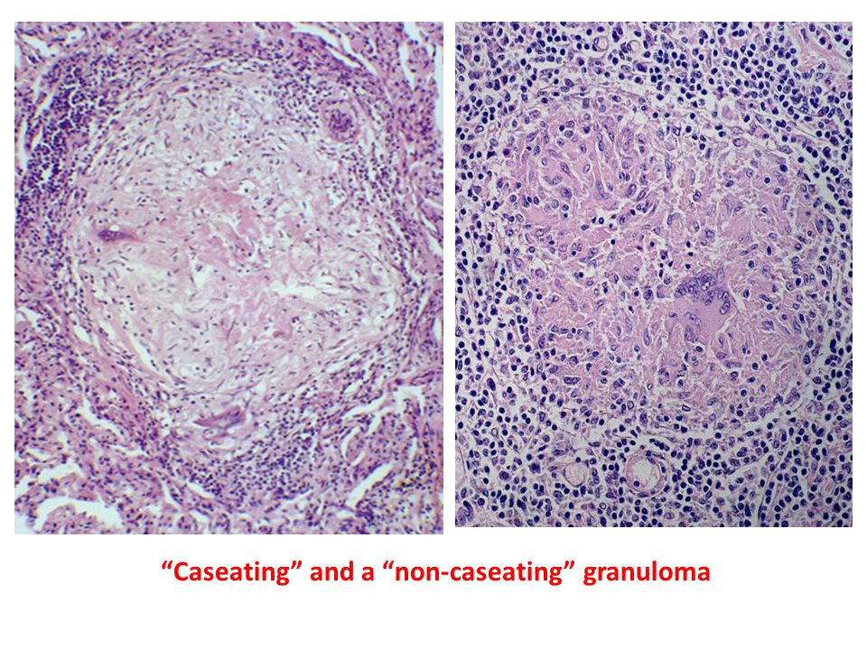

Slide 10
Clinical features
Mainly asymptomatic discovered on routine chest film as bilateral adenopathy .or as an incidental finding at autopsy .
In about two-thirds of symptomatic cases , there is gradual appearance of respiratory symptoms ( shortness of breath , dry cough , or vague substernal discomfort ) , or constitutional signs and symptoms ( fever , fatigue , weight loss , anorexia , night sweats ).
A definitive diagnostic test for sarcoidosis does not exist .
60 %to 70% of affected individuals recover with minimal or no residual manifestation.
20% develop permanent lung dysfunction or visual impairment.
10% to 15% progressive pulmonary fibrosis pulmonary fibrosis and cor pulmonale .

Slide 12
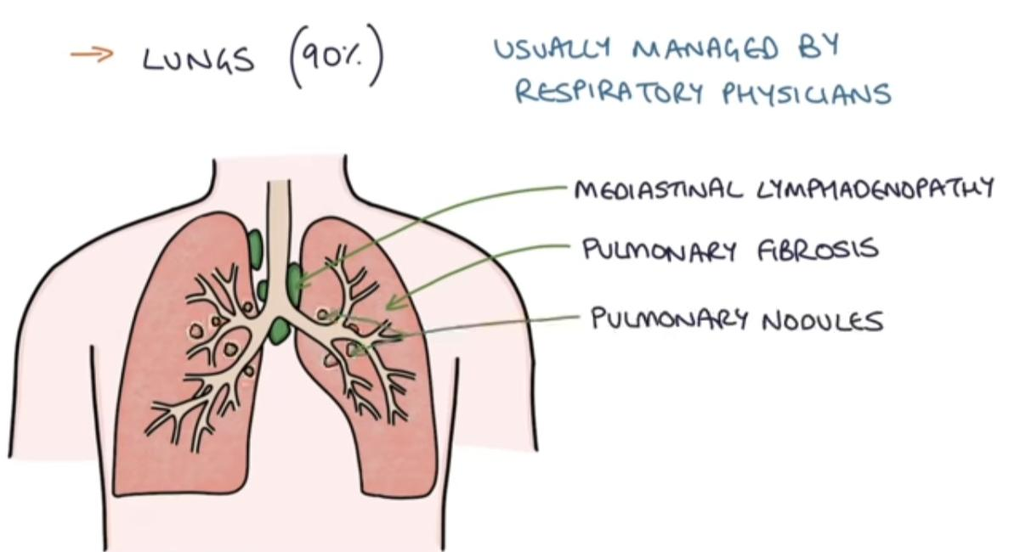
The lung
90% of pts .
The granulomas involve interstitium rather than air space with tendency to localized in the connective tissue around bronchioles and pulmonary venules and in pleura “ lymphangitic distribution “ .
The bronchoalveolar lavage fluid contains abundant CD4+ T cells .
In 5% to 15% of pts , the granulomas are replaced by diffuse interstitial fibrosis , resulting in honey comb lung .
Intrathoracic hilar and paratracheal lymph nodes are enlarged in 75% to 90% of pts , while one-third present with peripheral lymphadenopathy .
The nodes are characteristically painless and have a firm , rubbery texture .notmatted .

Slide 13
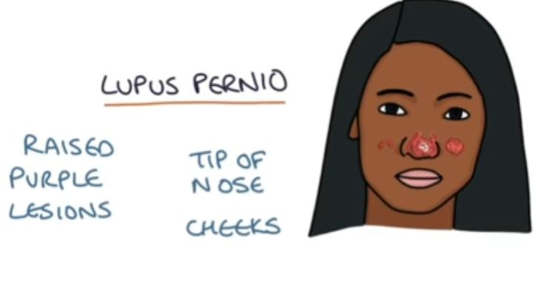
Skin lesion
25% of pts .
Erythema nodosum , the hallmark of acute onset , consists of raised , red , tender nodules on the anterior aspect of the lege . Granulomas are uncommon .
Discrete painless subcutaneous nodule with abundant noncaseating granulomas .

Slide 14
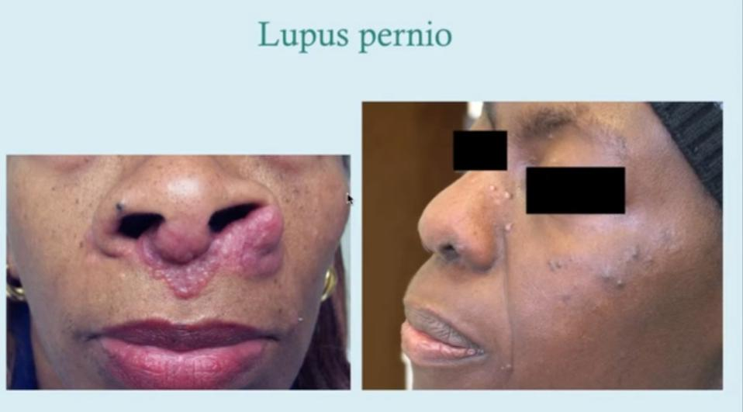
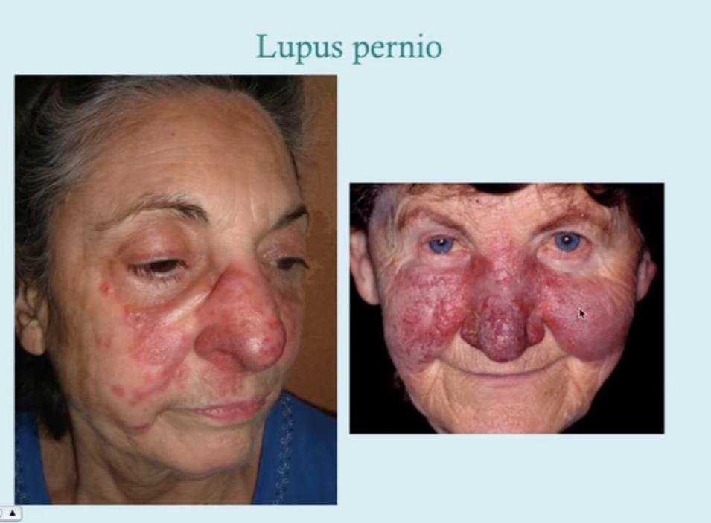

Slide 15
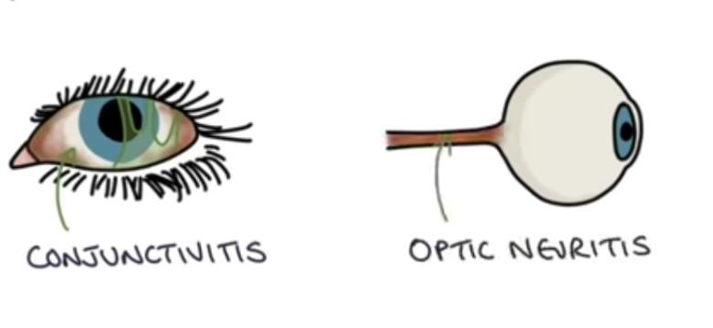
. Eyes (25% of cases)
Anterior uveitis (75%)
Posterior uveitis (25%)
Conjunctivitis
Corneal opacities , glaucoma and total loss of vision .
The posterior uveal tract is affected with resultant choroiditis , retinitis and optic nerve involvement.
These ocular lesions are frequently accompanied by inflammation in the lacrimal glands , with suppression of lacrimation sicca syndrome .
Nervous system (5%)
Cranial nerve VII involvement (Bell palsy)

Slide 16
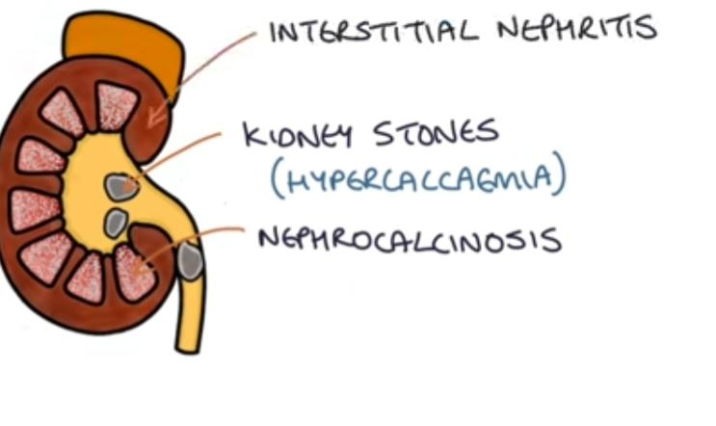
Parotid gland
unilateral or bilateral partitis with painful enlargement of it .
In less than 10% of pts .
Combined uveoparotid involvement Mikulicz syndrome .
The spleen may appear unaffected grossly , but three-fourth of cases , it contains granulomas .10% it becomes clinically enlarged .
The liver granulomas in the portal triads one-third of pts demonstrate hepatomegaly abnormal liver function .
Hypercalcemia ,hypercalciuria caused by increased calcium absorption secondary to production of active vitamin D by the macrophages that form the granulomas .

Slide 17
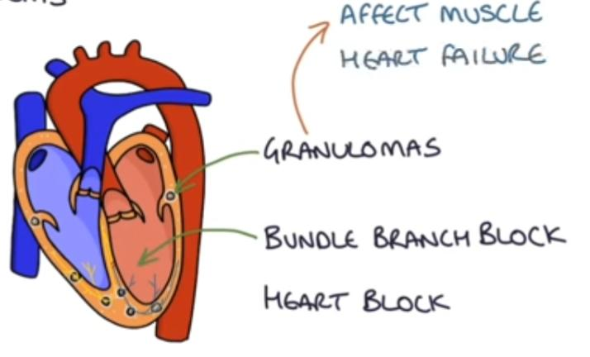
Heart (5% of cases)
Arrhythmias
Conduction disturbances, such as heart block Sudden death
Musculoskeletal Arthralgias/arthritis bone lesion

Slide 19
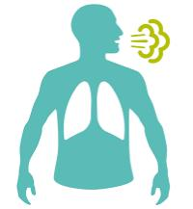
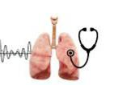
Clinical findings

Slide 20
Diagnosis

Slide 21
Stages of sarcoidosis on CXR
Stages of sarcoidosis on CXR
Chronic sarcoidosis | Chest x-ray findings
Stage 0 | Normal findings
Stage I | Bilateral hilar lymphadenopathy (reversible)*
Stage II | Bilateral reticular or ground-glass opacities with hilar lymphadenopathy ; disseminated, reticulonodular infiltrates
Stage III | Bilateral reticular or ground-glass opacities without hilar lymphadenopathy
Stage IV | Lung fibrosis (Irreversible reduction in lung function)
* In most cases, the disease resolves spontaneously at this stage.

Slide 24
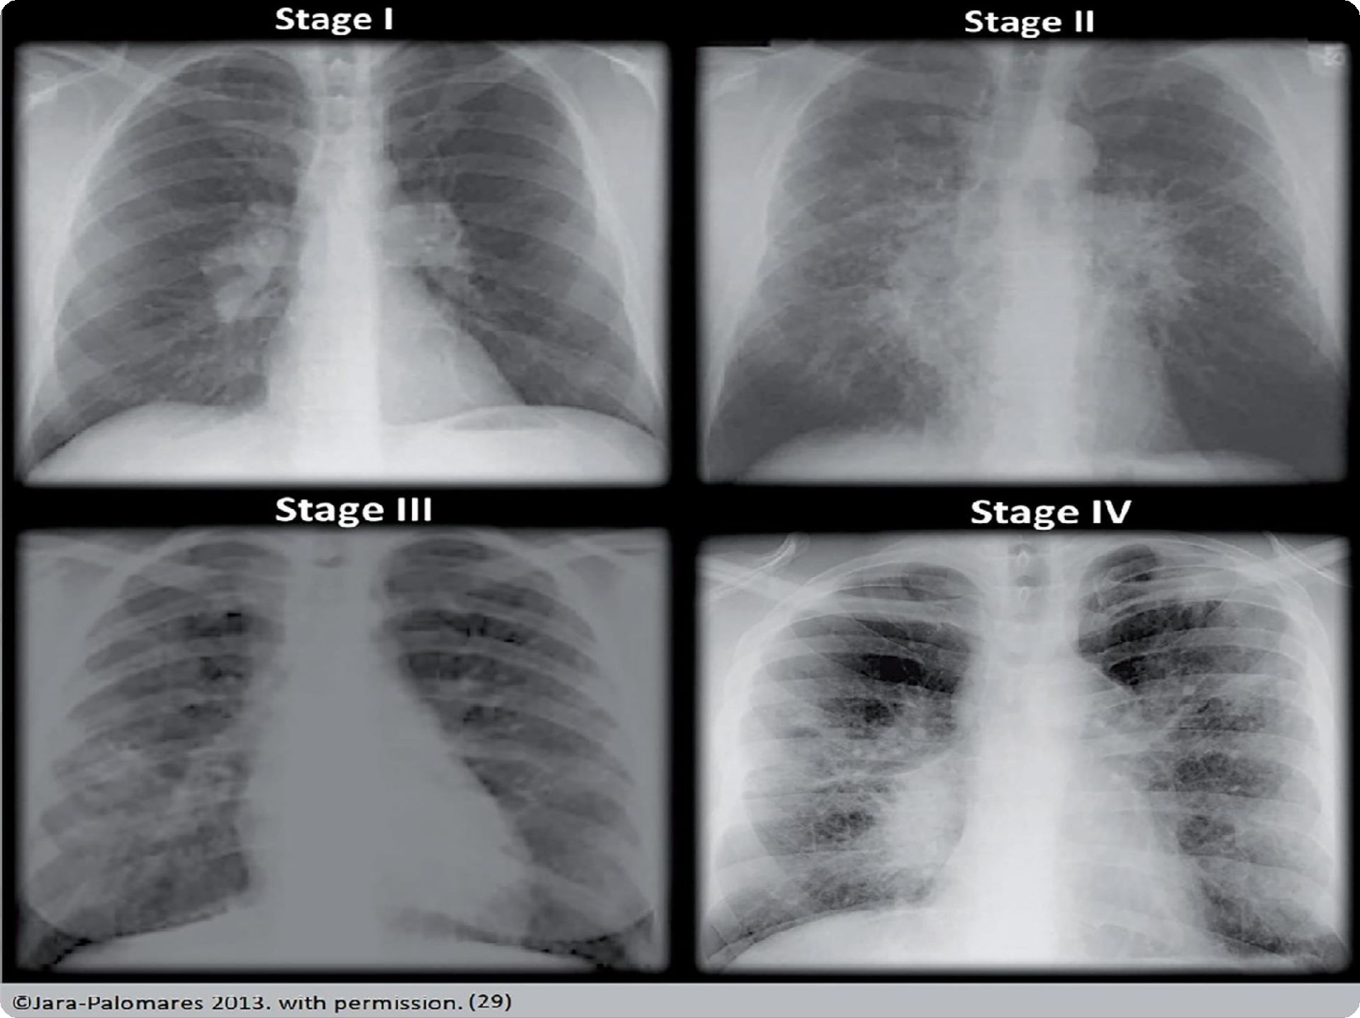

Slide 25
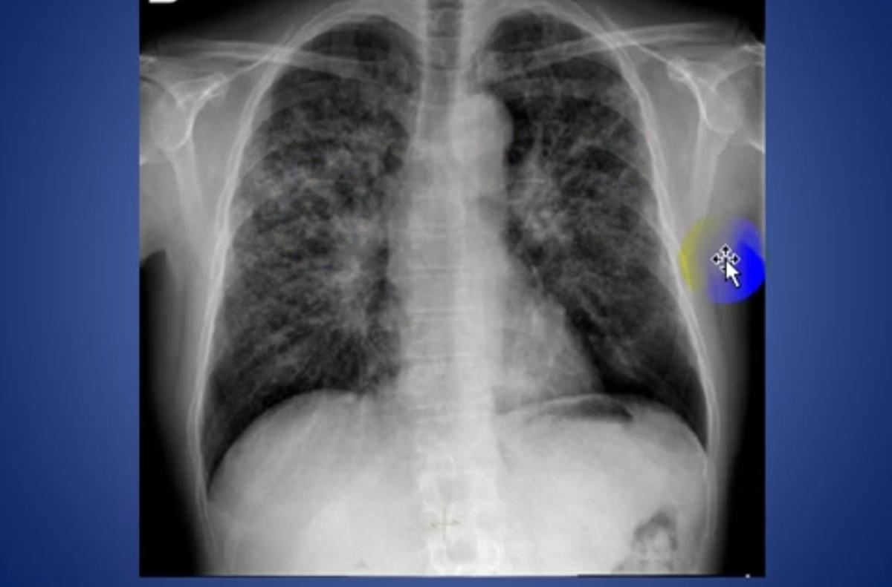
Question?
Stage 2

Slide 29
Treatment
Patient with BHL alone don’t need treatment as most recover spontaneously in 2 years … acute sarcoidosis : (bed rest , NSAIDs) for symptomatic relief
•Systemic corticosteroids are the treatment of choice.
The indications for corticosteroids treatment are (unclear) . However ; patient with this indication should start a steroid therapy for 6 months at least
(Parenchymal lung disease , Uveitis , Hypercalcaemia , Neurological or cardiac involvement )
•In sever illness (Methotrexate or other immunosuppressive agents) can be used in patients with progressive disease refractory to corticosteroids.
•Anti-TNFa therapy my be tried in lung transplantation

