Slide 1
UROGENITAL SYSTEM
THE BONY PELVIS & PELVIC DIAPHRAGM
Dr. Aiman Qais Afar
Surgical Anatomist
College of Medicine / University of Mutah

Slide 2
Pelvic bones
Hip Bone
In children, each hip bone consists of the ilium, which lies superiorly; the ischium, which lies posteriorly and inferiorly; and the pubis, which lies anteriorly and inferiorly .
The three separate bones are joined by cartilage at the acetabulum.
At puberty, these three bones fuse together to form one large, irregular bone.

Slide 3
Pelvic bones
Hip Bone
On the outer surface of the hip bone is a deep depression, the acetabulum, which articulates with the hemispherical head of the femur
Behind the acetabulum is a large notch, the greater sciatic notch, which is separated from the lesser sciatic notch by the spine of the ischium.
The sciatic notches are converted into the greater and lesser sciatic foramina by the presence of the sacrotuberous and sacrospinous ligaments

Slide 4
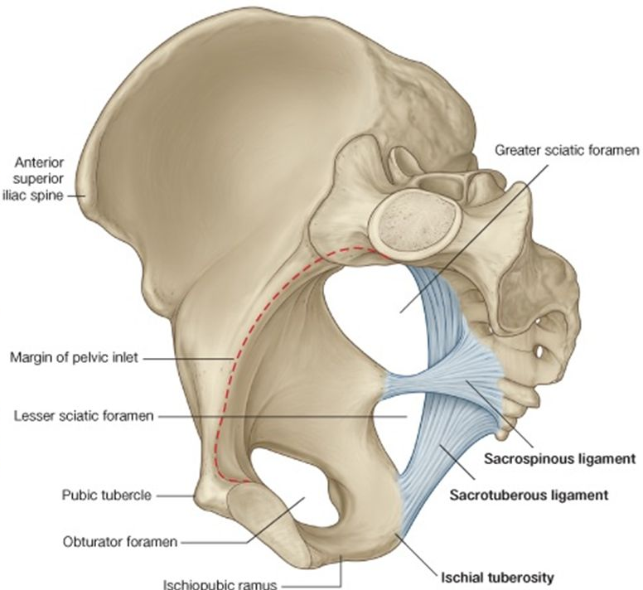
Hip Bone
The ilium possesses the iliac crest which runs between the anterior and posterior superior iliac spines. Below these spines are the corresponding anterior and posterior inferior iliac spines. The ilium has a large auricular surface for articulation with the sacrum. The iliopectineal line runs downward and forward around the inner surface of the ilium and serves to divide the false from the true pelvis.

Slide 5
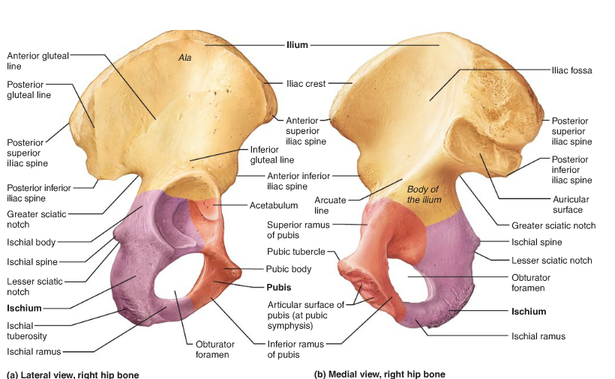
Hip Bone
The ischium is the inferior and posterior part of the hip bone and possesses an ischial spine and an ischial tuberosity
The pubis has a body and superior and inferior pubic rami.
The body of the pubis bears the pubic crest and the pubic tubercle and articulates with the pubic bone of the opposite side at the symphysis pubis .
There is a large opening, the obturator foramen, which is bounded by the parts of the ischium and pubis is filled in by the obturator membrane

Slide 6
Sacrum
Consists of five rudimentary vertebrae fused together.
The upper border or base of the bone articulates with the fifth lumbar vertebra.
The narrow inferior border articulates with the coccyx.
Laterally, the sacrum articulates with the two iliac bones to form the sacroiliac joints .
The sacral promontory which is an important obstetric landmark used when measuring the size of the pelvis.

Slide 7
Pelvic bones
Sacrum
The vertebral foramina together form the sacral canal.
Which contains the anterior and posterior roots of the lumbar, sacral, and coccygeal spinal nerves; the filum terminale; and fibrofatty material.
It also contains the lower part of the subarachnoid space down as far as the lower border of the second sacral vertebra

Slide 8
Sacrum
The anterior and posterior surfaces of the sacrum possess on each side four foramina for the passage of the anterior and posterior rami of the upper four sacral nerves
The sacrum is usually wider in proportion to its length in the female than in the male

Slide 9
Coccyx
Pelvic bones
عجب الذنب
The coccyx consists of four vertebrae fused together to form a small triangular bone, which articulates at its base with the lower end of the sacrum
The coccygeal vertebrae consist of bodies only, but the first vertebra possesses a rudimentary transverse process and cornua.
"كل ابن آدم يأكله التراب إلا عجب الذنب, منه خلق وفيه يركب“
صدق رسول الله

Slide 10
The Pelvis
The main function is to transmit the weight of the body from the vertebral column to the femurs. In addition, it contains, supports, and protects the pelvic viscera and provides attachment for trunk and lower limb muscles.
The bony pelvis is composed of four bones: the two hip bones, which form the lateral and anterior walls, and the sacrum and the coccyx, which are part of the vertebral column and form the back wall

Slide 11
The Pelvis
The two hip bones articulate with each other anteriorly at the symphysis pubis and posteriorly with the sacrum at the sacroiliac joints
The front of the symphysis pubis and the anterior superior iliac spines should lie in the same vertical plane. This means that the pelvic surface of the symphysis pubis faces upward and backward and the anterior surface of the sacrum is directed forward and downward.

Slide 12
The Pelvis
The pelvis is divided into two parts by the pelvic brim, which is formed by the sacral promontory behind, the iliopectineal lines laterally, and the symphysis pubis anteriorly.
Above the brim is the false pelvis, which forms part of the abdominal cavity.
Below the brim is the true pelvis

Slide 13
The Pelvis
False Pelvis
It is bounded behind by the lumbar vertebrae, laterally by the iliac fossae and the iliacus muscles, and in front by the lower part of the anterior abdominal wall. It considered as part of the abdominal cavity.

Slide 14
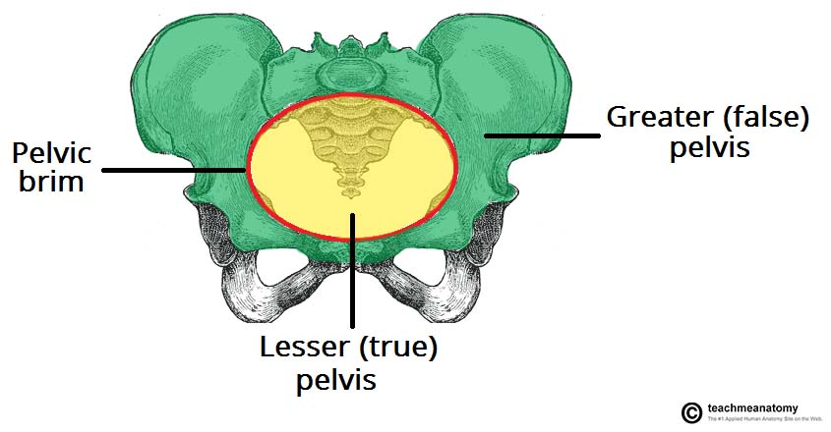
The Pelvis
True Pelvis
The true pelvis has an inlet, an outlet, and a cavity.
The pelvic inlet, or pelvic brim , is bounded posteriorly by the sacral promontory, laterally by the iliopectineal lines, and anteriorly by the symphysis pubis
The pelvic cavity lies between the inlet and the outlet.
It is a short, curved canal, with a shallow anterior wall and a much deeper posterior wall.

Slide 15
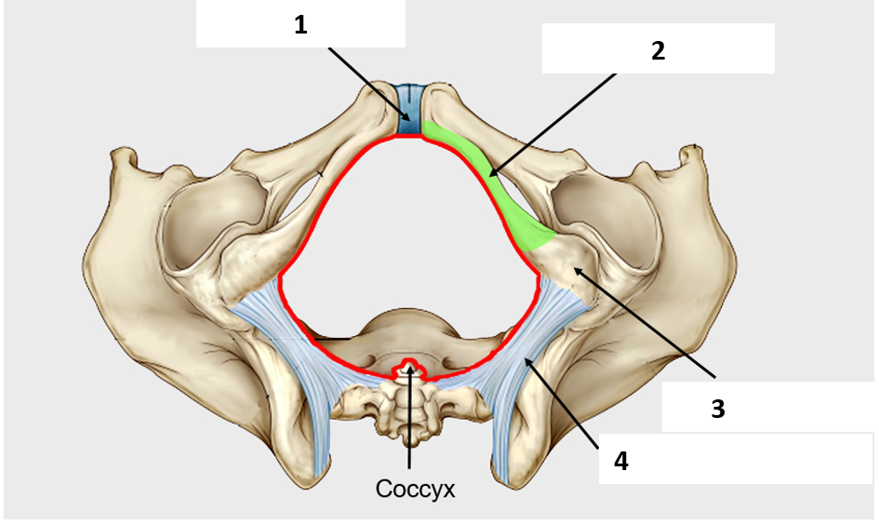
The Pelvis
The pelvic outlet is bounded posteriorly by the coccyx, laterally by the ischial tuberosities, and anteriorly by the pubic arch ...
The pelvic outlet has three wide notches.
The pubic arch is Anteriorly, between the ischiopubic rami, and laterally are the sciatic notches.
The sciatic notches are divided by the sacrotuberous and sacrospinous ligaments into the greater and lesser sciatic foramina

Slide 16
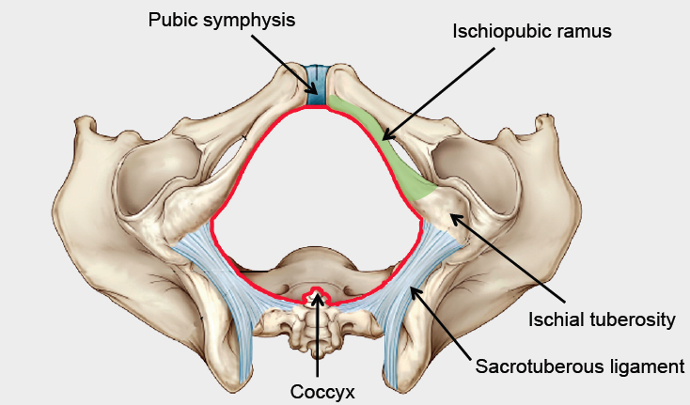
The Pelvis
From an obstetric standpoint, because the sacrotuberous ligaments are strong and relatively inflexible, they should be considered to form part of the perimeter of the pelvic outlet.
Thus, the outlet is diamond shaped, with the ischiopubic rami and the symphysis pubis forming the boundaries in front and the sacrotuberous ligaments and the coccyx forming the boundaries behind

Slide 17
Pelvic Muscles
Piriformis Muscle
Arises from the front of the lateral mass of the sacrum and leaves the pelvis to enter the gluteal region by passing laterally through the greater sciatic foramen . It is inserted into the upper border of the greater trochanter of the femur
Action: It is a lateral rotator of the femur at the hip joint.
Nerve supply: It receives branches from the sacral plexus.

Slide 18
Pelvic Muscles
Obturator Internus Muscle
Arises from the pelvic surface of the obturator membrane and the adjoining part of the hip bone . The muscle fibers converge to a tendon, which leaves the pelvis through the lesser sciatic foramen and is inserted into the greater trochanter of the femur.
Action: It laterally rotates the femur at the hip joint.
Nerve supply: The nerve to the obturator internus, a branch from the sacral plexus

Slide 19
Pelvic Muscles
Coccygeus Muscle
This small triangular muscle arises from the spine of the ischium and is inserted into the lower end of the sacrum and into the coccyx .
Action: The two muscles assist the levatores ani in supporting the pelvic viscera.
Nerve supply: A branch of the fourth and fifth sacral nerves

Slide 20
Pelvic Muscles
Levator Ani Muscle
Is a wide thin sheet that has a linear origin from the back of the body of the pubis, a tendinous arch formed by a thickening of the fascia covering the obturator internus, and the spine of the ischium . From this extensive origin, groups of fibers sweep downward and medially to their insertion , as follows:

Slide 21
Pelvic Muscles
Anterior fibers: The levator prostatae or sphincter vaginae form a sling around the prostate or vagina and are inserted into a mass of fibrous tissue, called the perineal body, in front of the anal canal.
The levator prostatae support the prostate and stabilize the perineal body
The sphincter vaginae constrict the vagina and stabilize the perineal body

Slide 22
Pelvic Muscles
Intermediate fibers: The puborectalis forms a sling around the junction of the rectum and anal canal.
The pubococcygeus passes posteriorly to be inserted into a small fibrous mass, called the anococcygeal body, between the tip of the coccyx and the anal canal
Posterior fibers: The iliococcygeus is inserted into the anococcygeal body and the coccyx.

Slide 23
Pelvic Muscles
Action: The levatores ani muscles of the two sides form an efficient muscular sling that supports and maintains the pelvic viscera in position. They resist the rise in intrapelvic pressure during the straining and expulsive efforts of the abdominal muscles (as occurs in coughing). They also have an important sphincter action on the anorectal junction, and in the female they serve also as a sphincter of the vagina.
Nerve supply: The perineal branch of the fourth sacral nerve and from the perineal branch of the pudendal nerve

Slide 24
Structure of the Pelvic Walls
The pelvis has anterior, posterior, and lateral walls and an inferior wall or floor.
Anterior Pelvic Wall
The anterior pelvic wall is the shallowest wall and is formed by the bodies of the pubic bones, the pubic rami, and the symphysis pubis

Slide 25
Structure of the Pelvic Walls
Posterior Pelvic Wall
The posterior pelvic wall is extensive and is formed by the sacrum and coccyx and by the piriformis muscles and their covering of parietal pelvic fascia

Slide 26
Structure of the Pelvic Walls
The lateral pelvic wall is formed by part of the hip bone below the pelvic inlet, the obturator membrane, the sacrotuberous and sacrospinous ligaments, and the obturator internus muscle and its covering fascia

Slide 27
Lateral Pelvic Wall
Obturator Membrane
is a fibrous sheet that almost completely closes the obturator foramen, leaving a small gap, the obturator canal, for the passage of the obturator nerve and vessels as they leave the pelvis to enter the thigh .
Sacrotuberous Ligament
is strong and extends from the lateral part of the sacrum and coccyx and the posterior inferior iliac spine to the ischial tuberosity .

Slide 28
Lateral Pelvic Wall
Sacrospinous Ligament
is strong and triangle shaped.
It is attached by its base to the lateral part of the sacrum and coccyx and by its apex to the spine of the ischium
The sacrotuberous and sacrospinous ligaments prevent the lower end of the sacrum and the coccyx from being rotated upward at the sacroiliac joint by the weight of the body

Slide 29
Inferior Pelvic Wall, or Pelvic Floor
The floor of the pelvis supports the pelvic viscera and is formed by the pelvic diaphragm
The pelvic diaphragm is formed by the important levatores ani muscles and the small coccygeus muscles and their covering fasciae
It is incomplete anteriorly to allow passage of the urethra in males and the urethra and the vagina in females

Slide 30
Sacroiliac Joints
strong synovial joints.
formed between the auricular surfaces of the sacrum and the iliac bones.
The sacrum carries the weight of the trunk.
The strong posterior and interosseous sacroiliac ligaments suspend the sacrum between the two iliac bones.
The anterior sacroiliac ligament is thin and lies in front of the joint.

Slide 31
Movements
A small but limited amount of movement is possible at these joints. In older people, the synovial cavity disappears and the joint becomes fibrosed. Their primary function is to transmit the weight of the body from the vertebral column to the bony pelvis.
Nerve Supply
The nerve supply is from branches of the sacral spinal nerves.

Slide 32
Symphysis Pubis
The articular surfaces are covered by a layer of hyaline cartilage and are connected together by a fibrocartilaginous disc. The joint is surrounded by ligaments that extend from one pubic bone to the other.
Movements
Almost no movement is possible at this joint.

Slide 33
Sacrococcygeal Joint
is a cartilaginous joint between the bodies of the last sacral vertebra and the first coccygeal vertebra.
The cornua of the sacrum and coccyx are joined by ligaments.
Movements
Extensive flexion and extension are possible at this joint

Slide 34
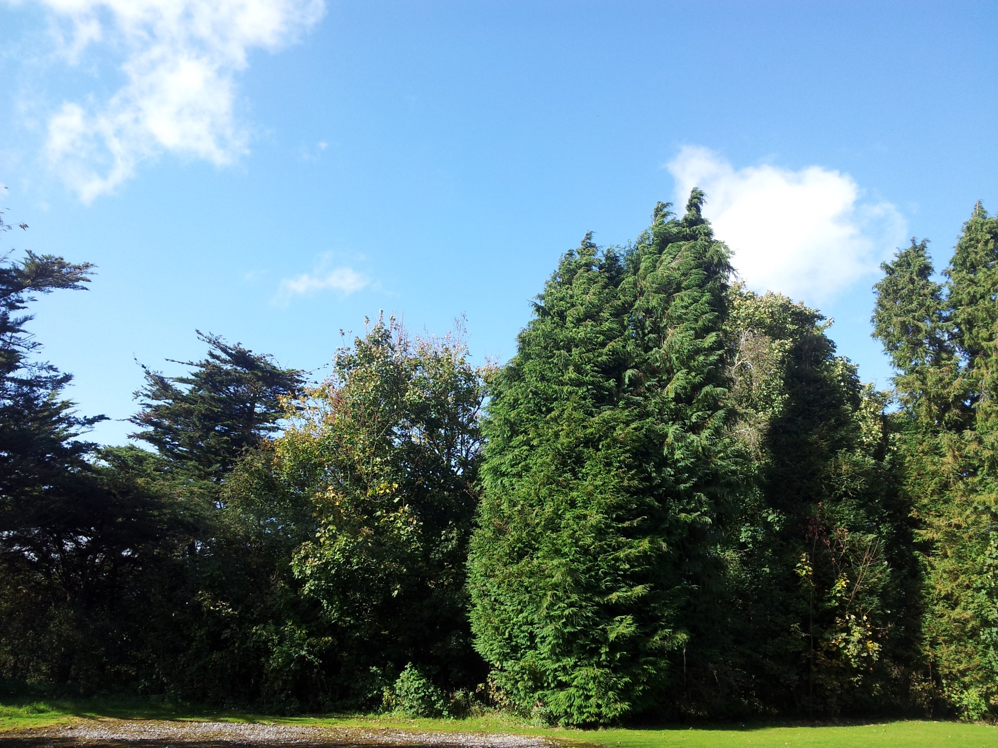
Dr. Aiman Al-Maathidy
Sunday 8 April 2022

