Slide 1
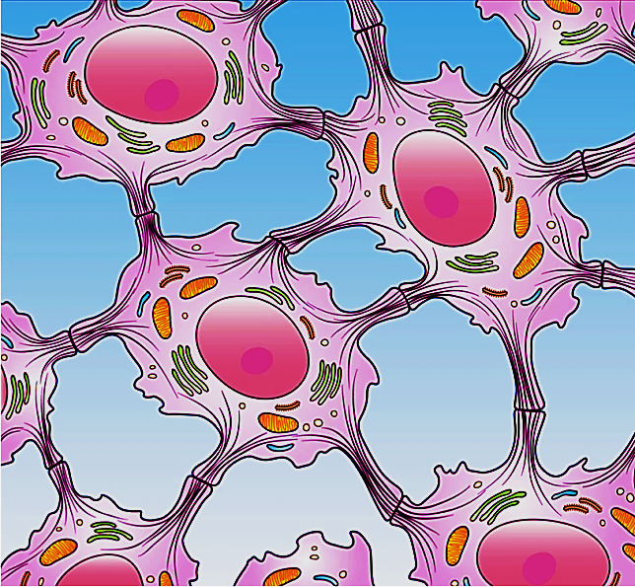
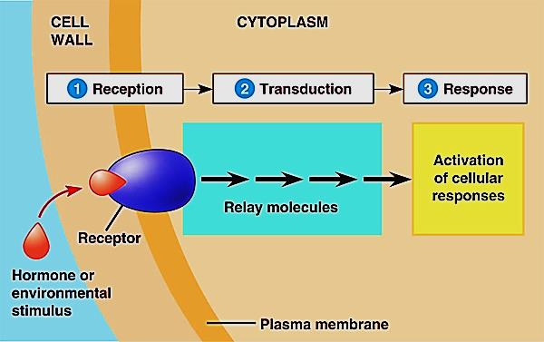
Cell Junctions & Cell Communication

Slide 2
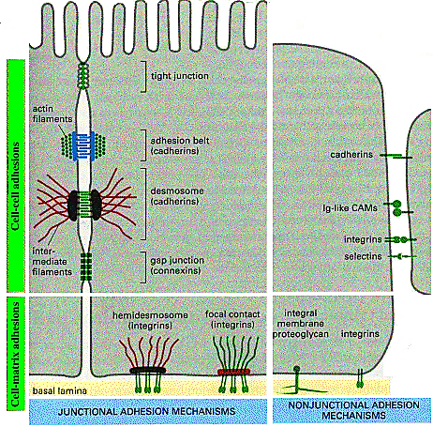
Cell Junctions
Definition & classification:
Cell junction is the connection between adjacent cells or between the cell and extracellular matrix
1- cell- cell adhesion
2- cell- matrix adhesion

Slide 3
Cell membrane proteins
They are of two types either peripheral or integral
Peripheral: are temporary attached to the cell membrane. Found on the outside & inside surfaces of the cell membrane. Can be dissociate from membrane following treatment with salty solutions
Integral : are permanently attached to the membrane. They are of two types :
Transmembrane proteins that span across the cell membrane
Monotopic : proteins attached to only one side of the membrane and do not span the whole way across.

Slide 4
Types of cell membrane proteins

Slide 5
Function of integral membrane proteins
Junctions – Serve to connect and join the cells together
Enzymes – Fixing to membranes to perform a localized metabolic pathways
Transport – Responsible for facilitated diffusion and active transport
Recognition – May function as markers for cellular identification
Anchorage – Attachment points for cytoskeleton and extracellular matrix
Transduction – Function as receptors for peptide hormones

Slide 6
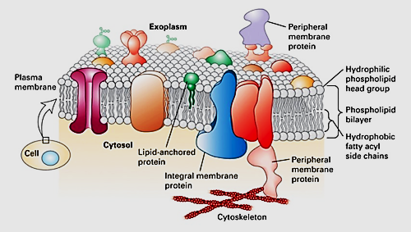
Function of cell membrane integral proteins

Slide 7
Function of cell- cell junctions (adhesions)
Communication between adjacent cells.
Support & reduce stress placed upon cells.
Cell adhesion (junction) is due to the action of :
1- Cell Adhesion Molecules (CAMs)
2- Intercellular junctions
(Adhesions)

Slide 8
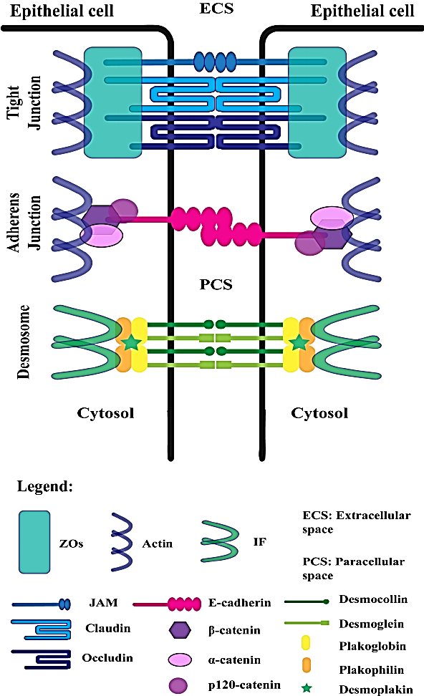
Cell adhesion molecules (CAMs)
A group of cell proteins located on the cell surface & involved in binding of the cell with other cells or with the extracellular matrix in a process called
cell adhesion)
Cell-cell junctions (Adhesions)
Represent the mechanism behind how cells interact with each other, this is achieved by molecules (CAMs) present at the surface of both cells. Cell junctions is crucial for multicellular structural maintenance

Slide 9
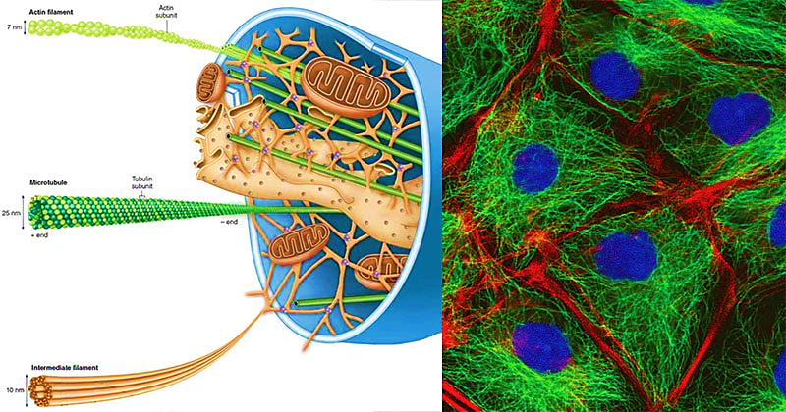
Inside the cell there are 3 types of cytoskeletons : actin filament , intermediate filament &
Microtubules
Theses cytoskeleton is responsible for contraction, motility , movement of organelles,
organization of the cytoplasm & polarity of the cell

Slide 10
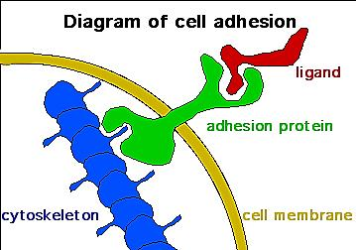
Cell Adhesion Molecules (CAMs)
Proteins located on the cell surface
(typically trans-membrane proteins)
They help in attaching cells e each
other & e their EC matrix
also Play a role in immunity & cancer
composed of 3 domains:
Intracellular domain that interacts with the cytoskeleton
Transmembrane domain : span across the membrane
Extracellular domain that interacts either with other
CAMs of the same kind (homophilic binding) or e different
CAMs or the extracellular matrix (heterophilic binding).

Slide 11
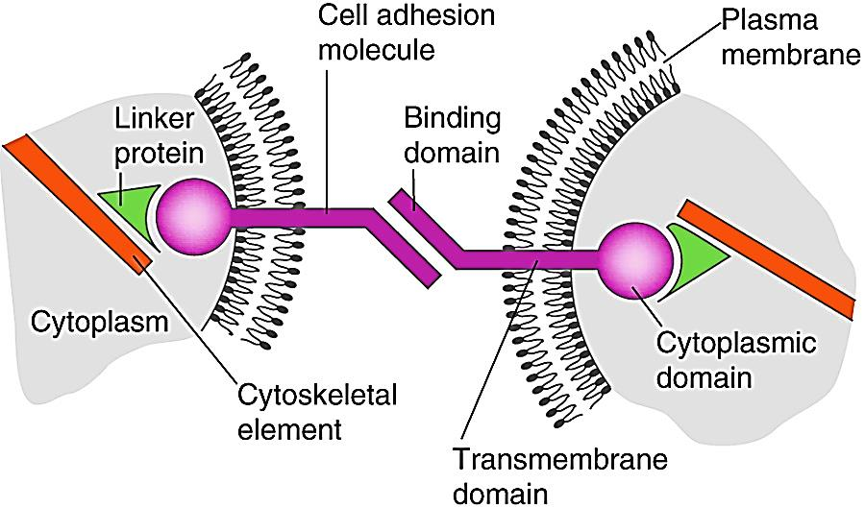
CAMs express 3 major domains:
The extracellular domain: allows one CAM to bind with another CAM on an adjacent cell.
The transmembrane domain: links the CAM to the plasma membrane through hydrophobic forces.
The cytoplasmic domain: is directly connected to the cytoskeleton by linker proteins.

Slide 12
CAMs can be divided into 4 major protein families:
selectins
Immunoglobulin superfamily
Integrins
cadherin

Slide 13
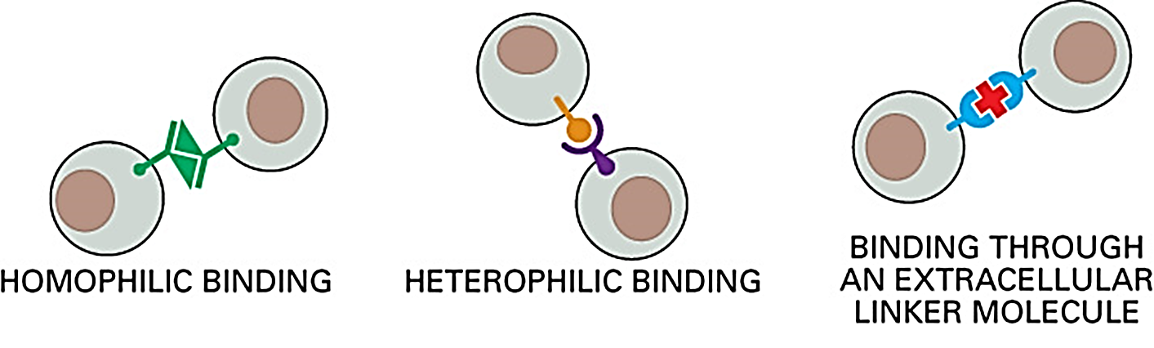
Interactions between CAMs can be mediated by :
CAM on one cell type binds to a different type of CAM on a second cell
Selectins – mucins
The linker molecule in most cases is Laminin, a family of large cross shaped molecules with multiple receptor domains.
Binding of CAM on one cell to the same CAM on a second cell
Cadherin - cadherin
CAM binds to EC matrix is also a heterophilic binding

Slide 14
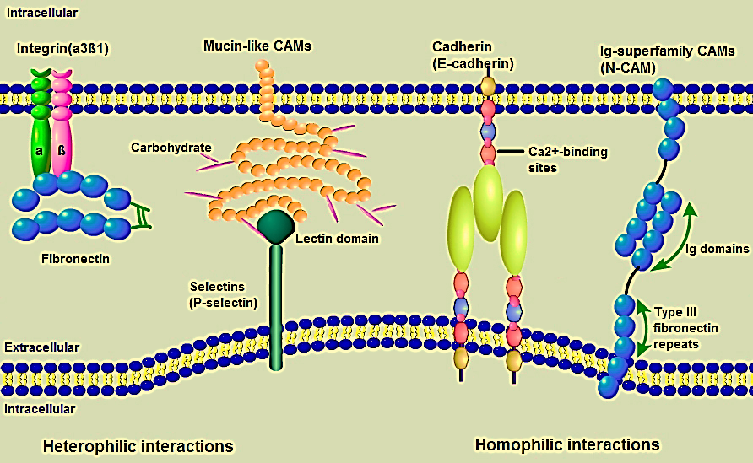
CAMs Families: Integrins typically binds to the extracellular matrix,
while selectins, cadherins , and IgSF members are associated
with cell- cell adhesion

Slide 15
Epithelial Cells are polar in nature because :
Epithelial Cells rest on basal lamina & have apical & lateral borders
Adjacent cells attach with CAMs & intercellular junctions
CAMs Protect & hold the tissues together

Slide 16
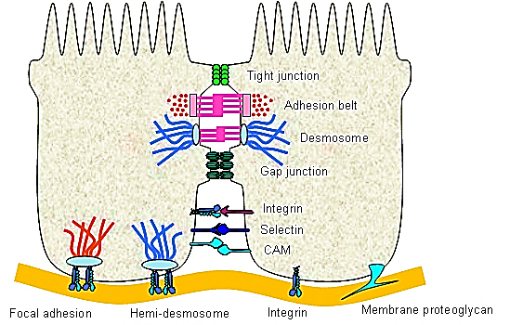
A. Cell- Cell junctions
Cell junctions consist of multi-protein complexes
They are particularly plentiful in epithelial tissue
Types of cell junctions :
1- Occluding/Tight junctions: Seal cells
Together like a sheet to prevent flow of
molecules even water or ions between cells
2- Anchoring junctions: attach cells & their
cytoskeleton to other cells or to ECM
provide mechanical support
3- Gap junctions: allow exchange of chemical / electrical information between adjacent cells

Slide 17
Types of cell junctions in multicellular organism
1- Adherens junction, 2- Desmosome,
3- Hemidesmosome
Tight junctions (zonula occludens)
Gap junctions
Synapse

Slide 18
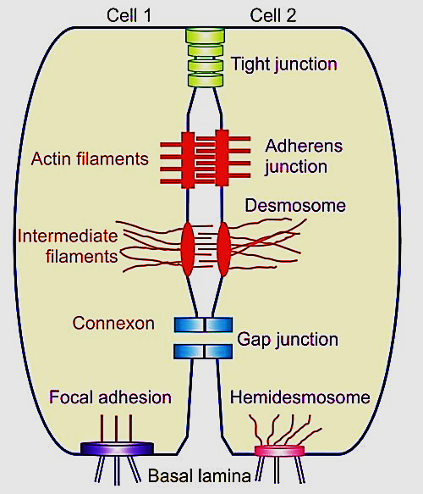
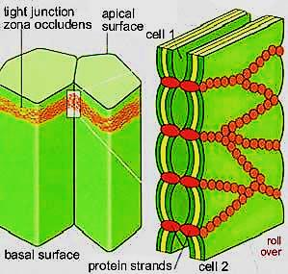
1- Occluding junctions
Also called tight Junctions / zonula occludens
Seal adjacent epithelial cells & is
the most apical type of junctions
Belt-like structure encircle each cell
completely just below the free surface
Water & ion molecules cant pass through that
junction (passaging either through active transport or facilitated diffusion
The membranes of adjacent cells fuse at the tight junction completely forming impermeable barrier
Proteins forming this junction are occludins and claudins & members of IG superfamily

Slide 19
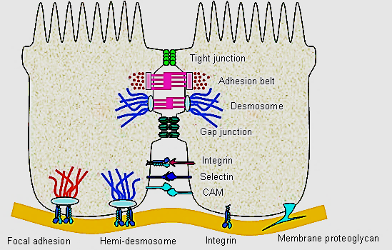

Slide 20
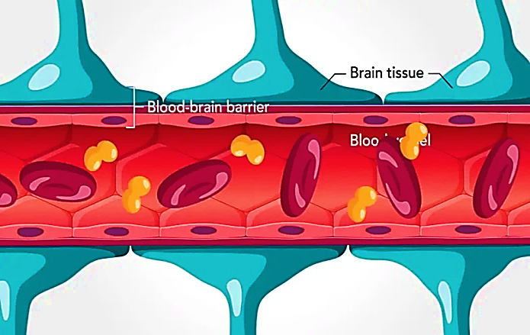
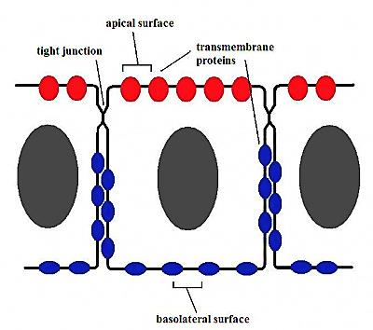
Functions of Tight Junction
Protection: Seals cells thus it creates barriers to prevent leaks
Blood-brain barrier &
other barriers in the body
Maintain cell polarity: prevent
membrane proteins of apical surface
from being moved to basolateral surface
to maintain cell receptors & function
Ensure unidirectional transport, the apical set of transport proteins
must not be allowed to migrate to the basolateral surface & vice
versa

Slide 21
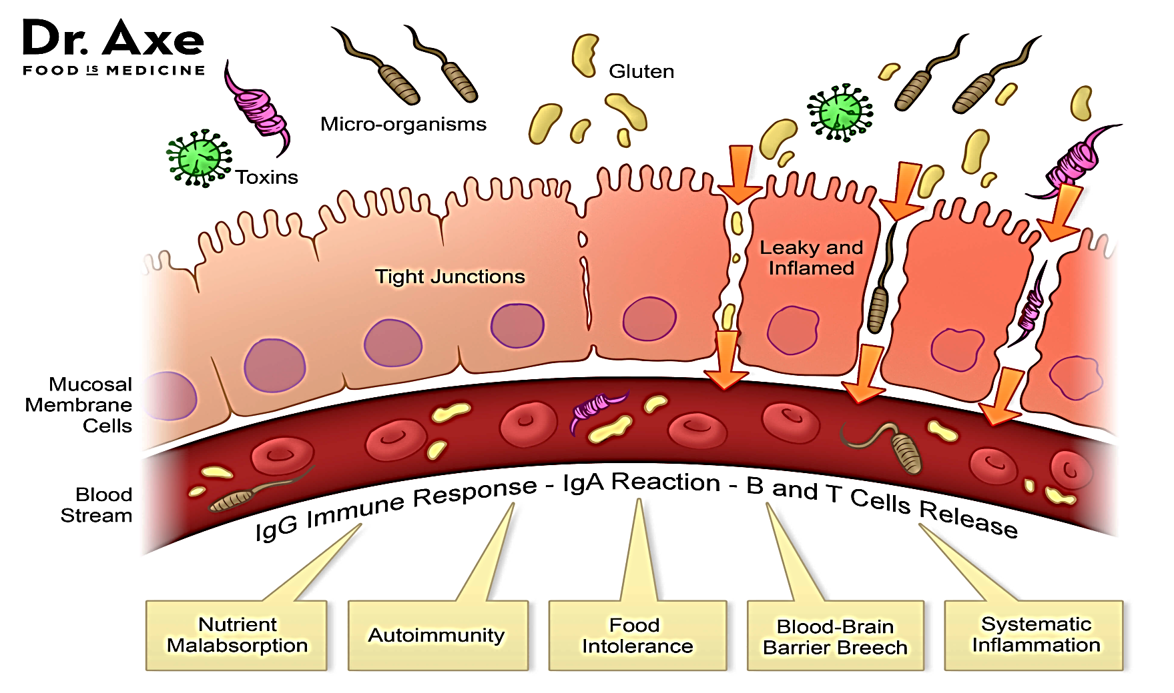
Leaky gut syndrome : is a disease happen when tight junctions between intestinal epithelial cells (intestinal barrier) become defective → abnormal increases in the intestinal permeability → leaking of a undigested food particles, toxins & microbes from the lumen into the bloodstream → digestive disorders and various inflammatory and immune diseases

Slide 22
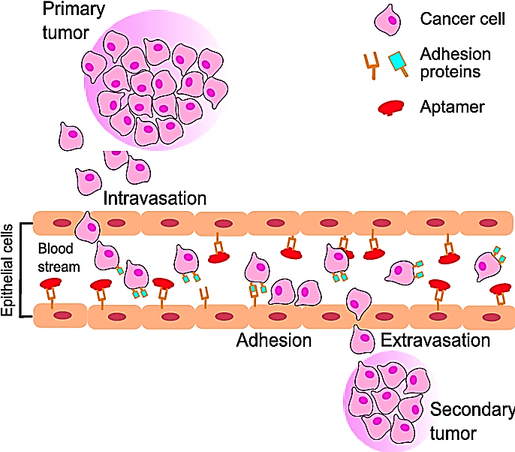
Most cancers originate from epithelial cells.
Down regulation of Tight junctions adhesion proteins lead to tumor dissociation and subsequent metastasis.
Researchers observed low expression of TJ among highly metastatic cancer cells

Slide 23
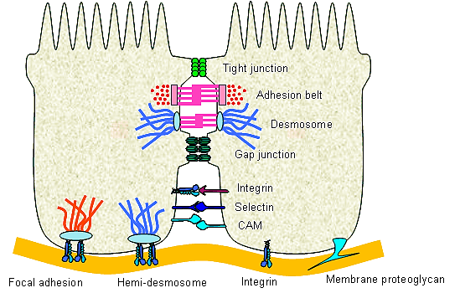
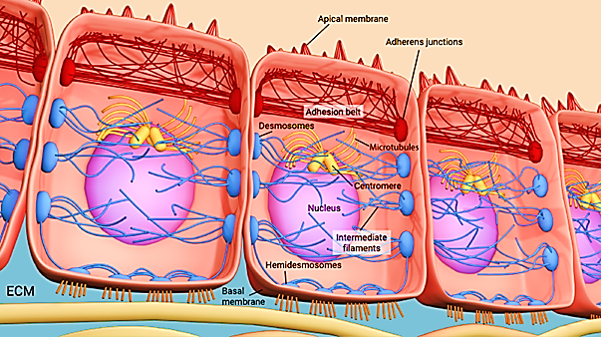
2- Anchoring junctions
Cell – cell: Adherens junction
Desmosome
Cell – matrix: Hemi-desmosome

Slide 24
2- A- Adherens junction/Zonula adherens
Integral membrane proteins, connect the cell cytoskeleton to another cell
Encircle the cell, just below ZO, but don’t seal
Found in tissues subject to Stretch to resist separation during contraction (bladder, uterus, skin).
The opposing plasma membranes has a narrow space in-between
The cytoplasmic surfaces of adjacent cell membranes at the junction have electron dense plaques (glycoprotein)

Slide 25
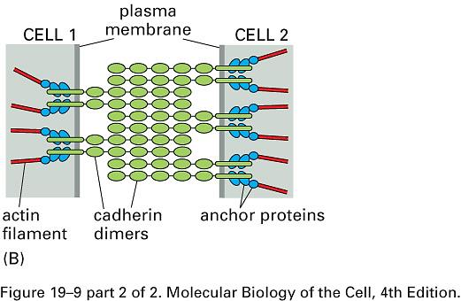
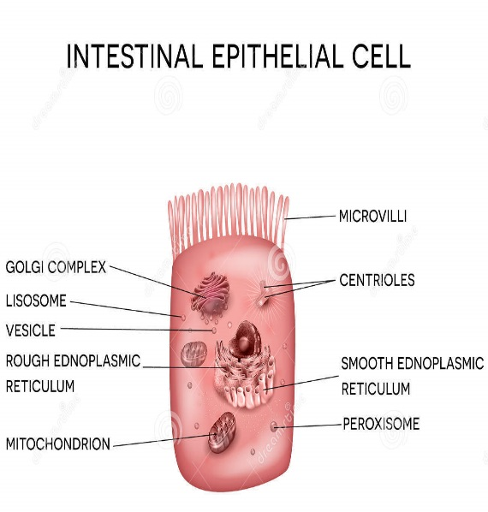
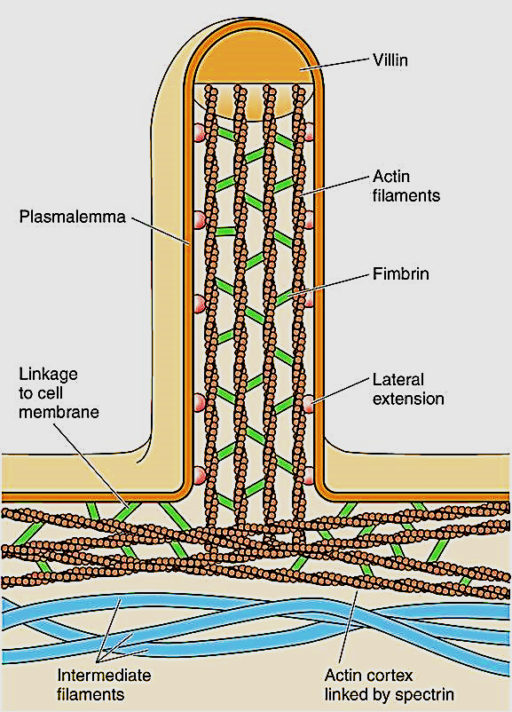
Proteins forming the Junction are Cadherins, Catenin
The plaques(catenin) provide attachment for transmembrane protein (cadherins) and for the fine cytoskeleton filaments (actin filaments). This junction makes the Terminal Web at the apical part of epithelial cells having microvilli

Slide 26
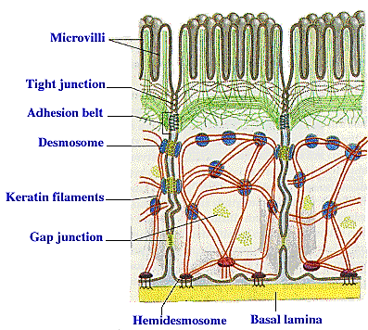
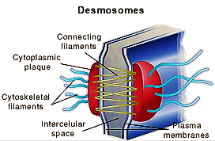
2- B- Desmosomes/Macula adherens
Scattered disc- shaped structures, do not form belt (spot- like) randomly arranged on lateral sides of cells
Disc plaque at the surface of one cell
connects with an identical one at
the surface of the adjacent cell
Proteins forming the junction of the desmosome are desmoplakin (plaque) & desmoglein( transmembrane proteins, members of the cadherin family)

Slide 27
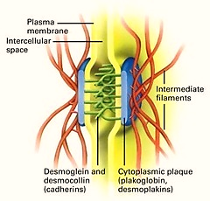
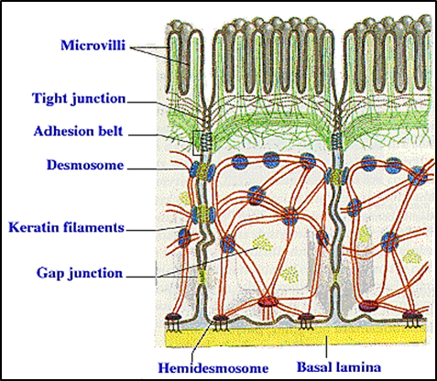
Within the cell, the plaque of the desmosome provide insertion to intermediate cytoskeleton filaments (keratin)
Found in tissues of constant state of stretching and stress e.g. skin, intestine, between cardiac muscles

Slide 28
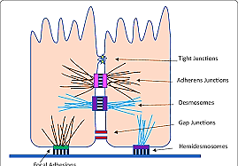
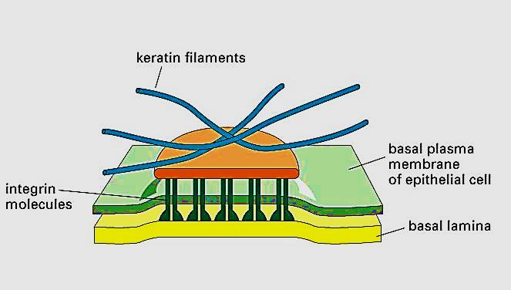
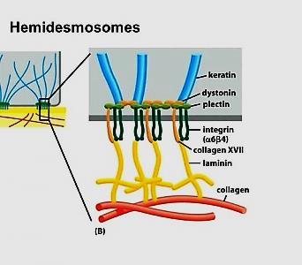
2- Hemidesmosomes
Half desmosome (cell – basal lamina /ECM)
At the base of epithelial cells
Bind epithelial cells to basal lamina
The transmembrane protein is integrins protein
Plaques provide attachment for keratin filaments
integrin molecules connect to laminin of basal lamina in turn connect e collagen in ECM → cell-matrix adhesion

Slide 29
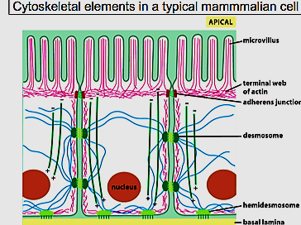
Function of anchoring junctions
Stabilize cells against mechanical stress
Mechanically attach cells & their cytoskeleton to their neighbor cells or to the extra cellular matrix

Slide 30
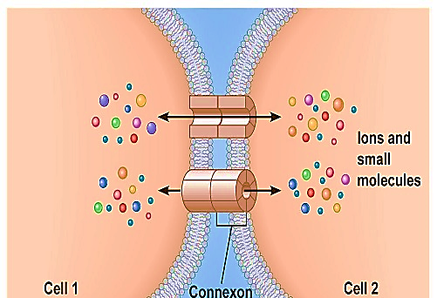
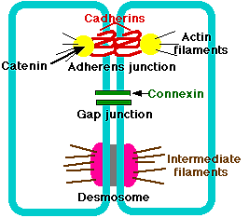
3- Gap junction (GJ)
Transmembrane proteins form intercellular
channels that allow direct transfer of ions, small
molecules, electric impulses between cytoplasm of
adjacent cells
This type of junction makes the cells
chemically or electrically coupled
This type of junction is important in heart
muscle cells. It provides low resistance
ions pathways through GJ allowing the cell
to contract

Slide 31
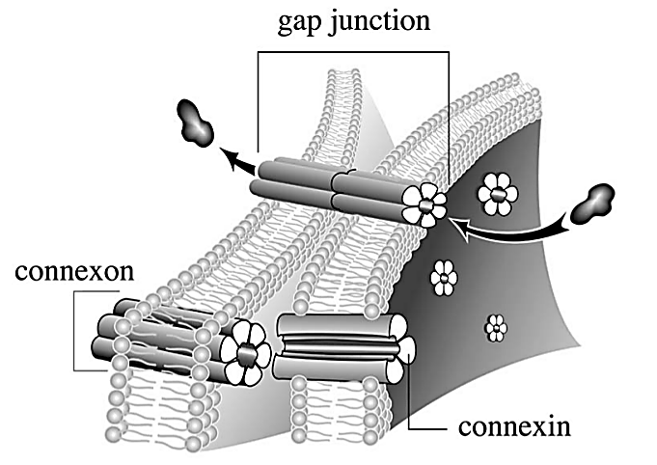

Slide 32
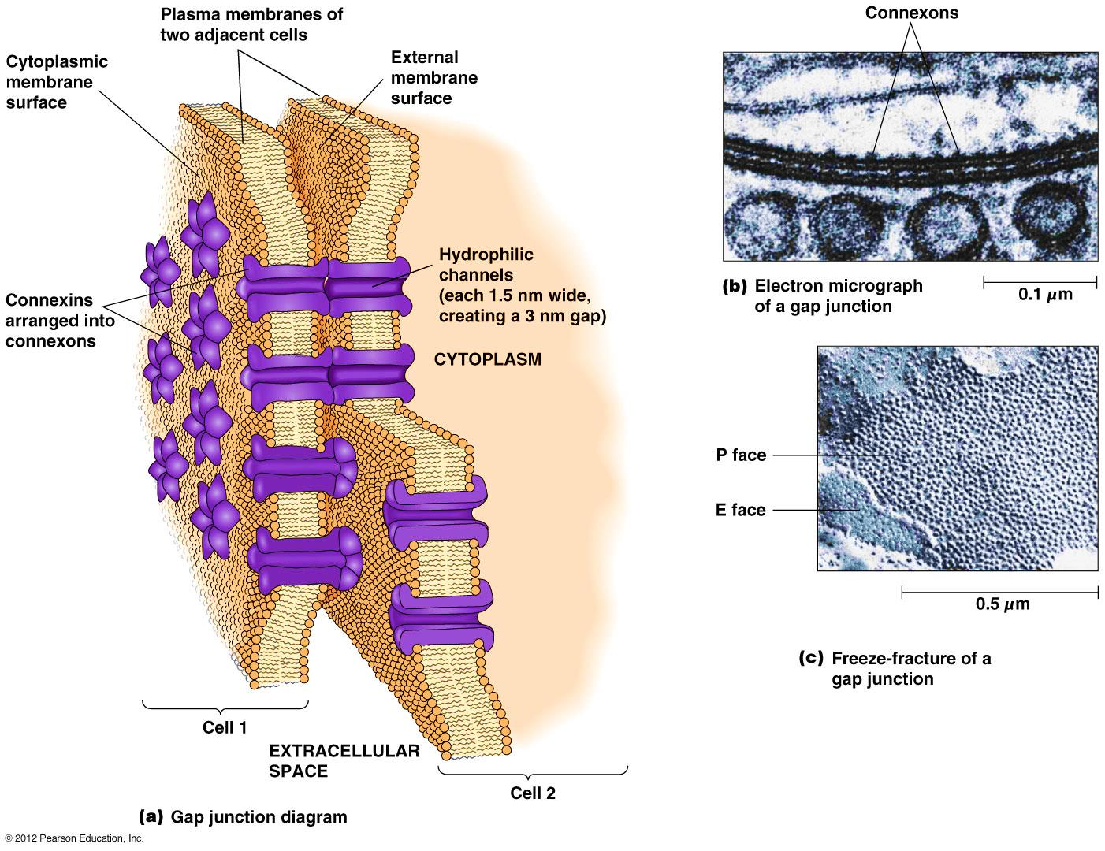
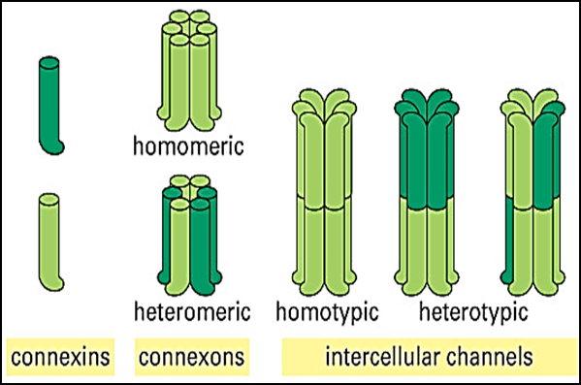
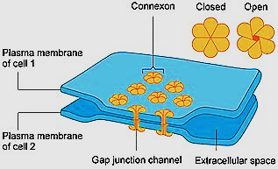
* The protein subunit forming the
junction is called Connexin
* Each channel called Connexon
is formed by 6 Connexins subunits
which span the lipid bilayer of the
cell membrane (hydrophobic)
* The connexons tubes of 2 cells
join together to make a GJ
* GJ tend to close by high
concentration of Ca⁺ ions or low pH.
The closing of the GJ serves to
seal normal cells from traumatized or dying neighbors

Slide 33
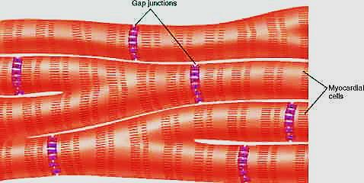
Electrical & Chemical synapses
Synapse is a type of GJ where information is transmitted between adjacent cells. There are 2 types:
Electrical synapse
is a GJ which has channel proteins connecting the adjacent cells. The signal in electric synapse can travel faster . Found between: cardiac muscles (intercalated discs) , and in synapses between neurons involved in reflexes in nervous system
*Intercalated discs: contain both GJs
(to allow flow of ions from one cell to
another → spread of actional potential)
& Desmosomes(to hold cells together)
Cardiac muscles

Slide 34
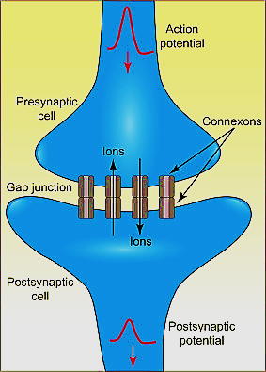
Electric synapse

Slide 35
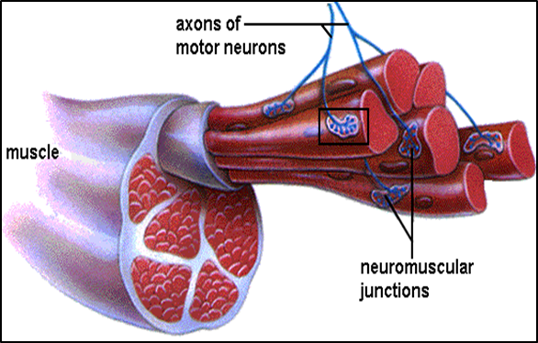
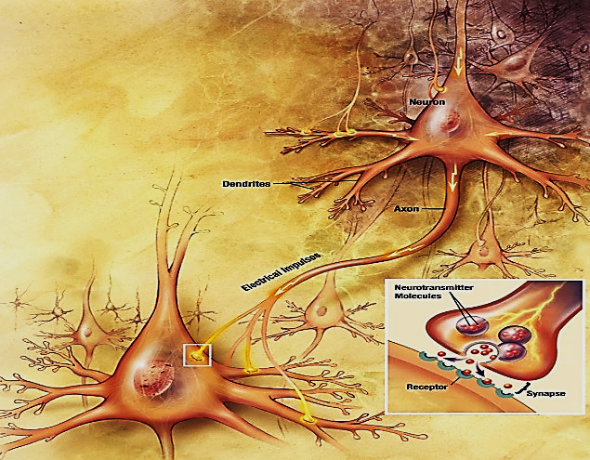
4- B- chemical synapse (Signal relaying junction)
Junction between a nerve fiber and a muscle fiber (motor end plate) or between two neurons
The neuron transmitting the signal is called presynaptic neuron. Synaptic vesicles containing neurotransmitters are found in the presynaptic neurons
These neurotransmitters will be released into the synaptic cleft (space between pre & postsynaptic membranes). Neurotransmitter will bind to protein receptors on the postsynaptic membrane

Slide 36
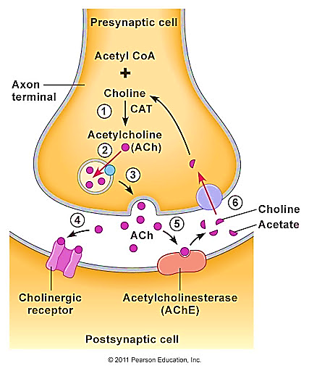
Chemical synapse

Slide 37
Gap junctions also found between many cells e.g. osteocytes, astrocytes, endocrine cells , smooth muscles
Cancer cells don’t have gap junctions so that they fail to transfer their mitotic activity to each other which may explain their uncontrolled growth
Changes in the number and distribution of gap junctions has been reported in many cardiac diseases e.g. arrhythmias

Slide 38
Thank you

