Slide 1
وسهلا
أهلا
الأستاذ الدكتور/ يوسف حسين
أستاذ التشريح وعلم الأجنة
كلية الطب – جامعة مؤتة - الأردن
كلية الطب – جامعة الزقازيق- مصر
دكتوراة من جامعة كولونيا المانيا
د. يوسف حسين (استاذ التشريح)

Slide 2
Blood supply
of the brain

Slide 3
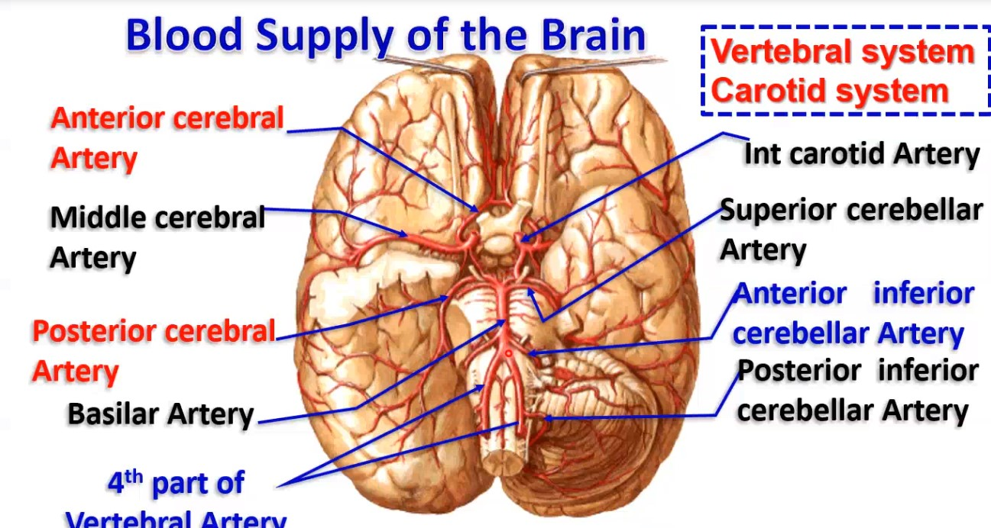
4th part of vertebral artery

Slide 4
Anterior cerebral
artery

Slide 5
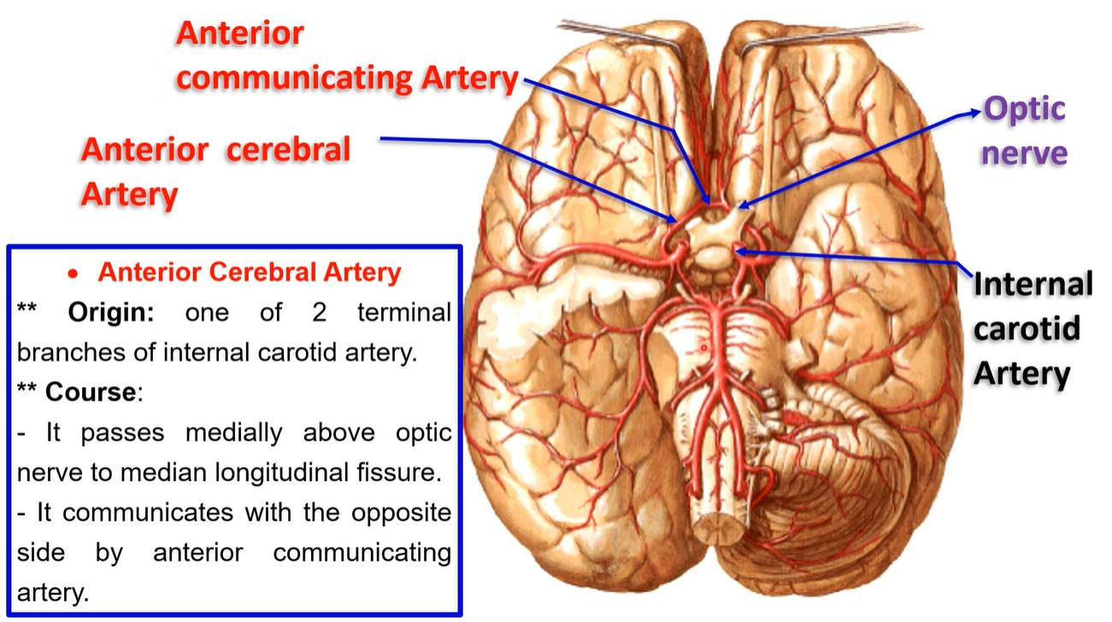
• Anterior Cerebral Artery
**Origin: one of 2 terminal branches of internal carotid artery.
** Course:
It passes medially above optic nerve to median longitudinal fissure.
It communicates with the opposite side by anterior communicating artery.

Slide 6
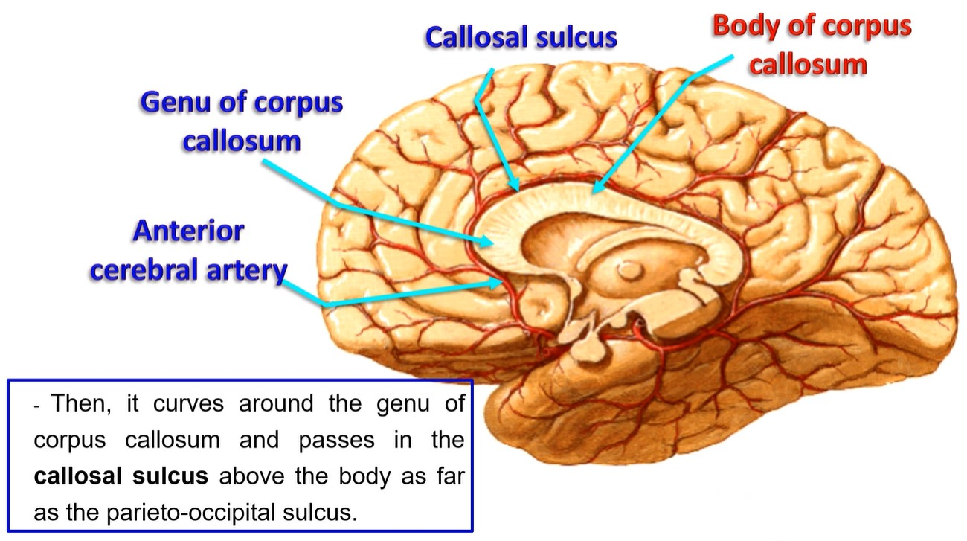
- Then, it curves around the genu of corpus callosum & passes in the callosal sulcus above the body as far as the parieto-occipital sulcus.

Slide 7
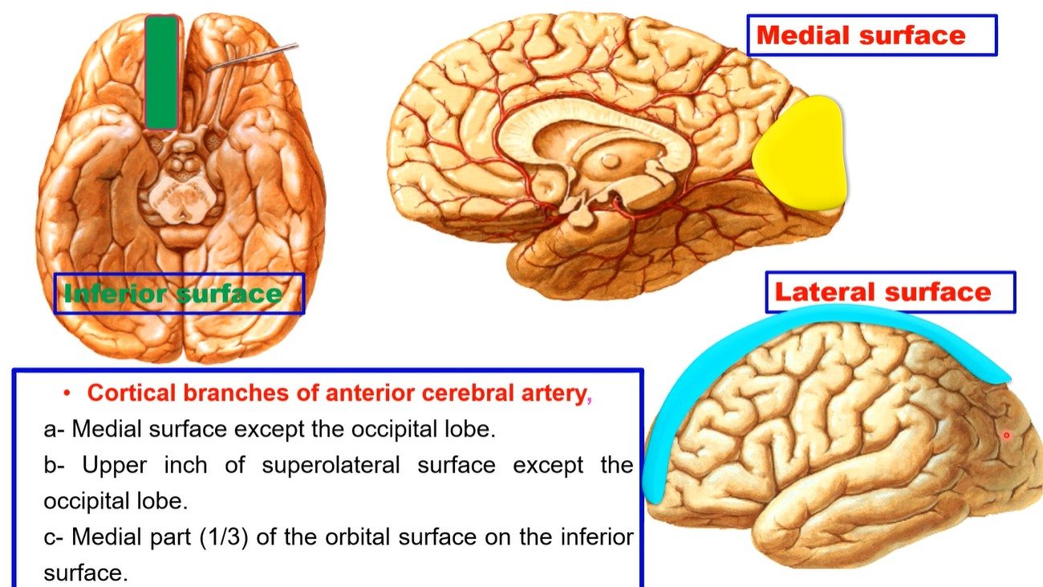
Cortical branches of anterior cerebral artery,
a- Medial surface except the occipital lobe.
b- Upper inch of superolateral surface except the occipital lobe.
c- Medial part (1/3) of the orbital surface on the inferior surface.

Slide 8
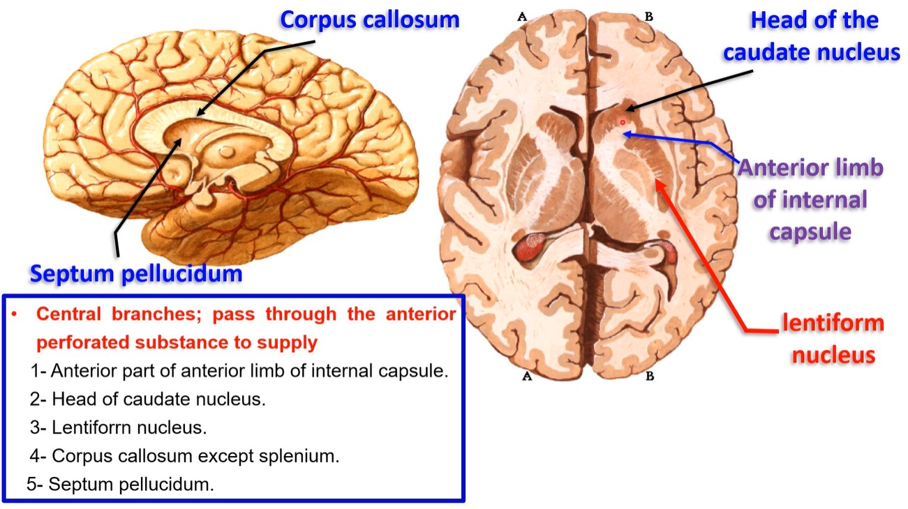
- Central branches; pass through the anterior perforated substance to supply
1- Anterior part of anterior limb of internal capsule.
2- Head of caudate nucleus.
3- Lentiform nucleus.
4- Corpus callosum except splenium.
5- Septum pellucidum.

Slide 9
Middle cerebral
artery

Slide 11
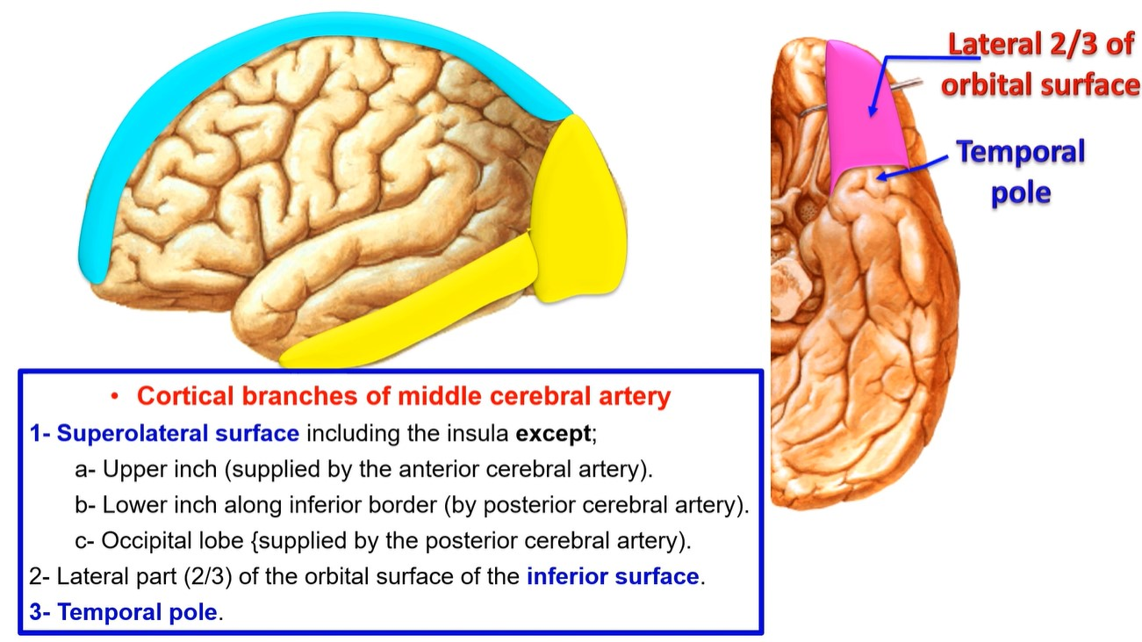

Slide 13
Posterior cerebral
artery

Slide 14
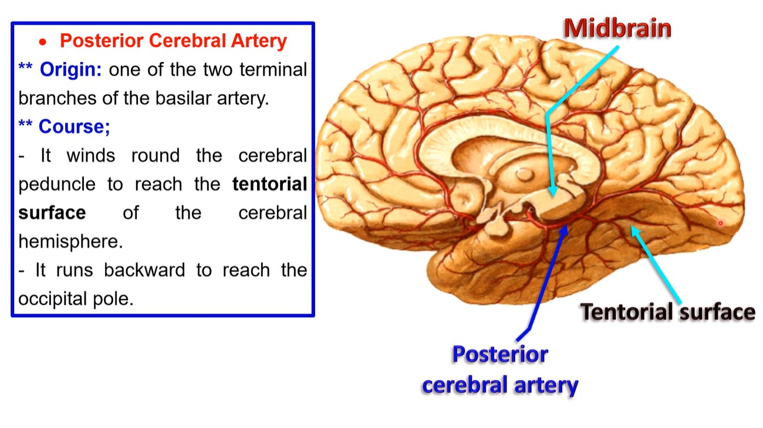
Cerebral peduncle of Midbrain
• Posterior Cerebral Artery
**Origin: one of the two terminal branches of the basilar artery.
** Course; It winds round the cerebral peduncle to reach the tentorial surface of the cerebral hemisphere.
-It runs backward to reach the occipital pole.

Slide 15
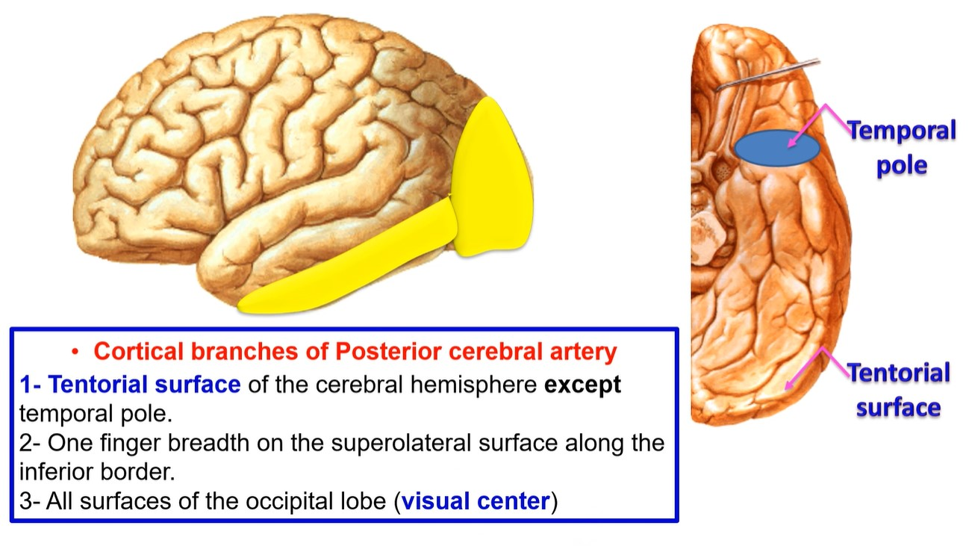
Cortical branches of Posterior cerebral artery
1- Tentorial surface of the cerebral hemisphere except temporal pole.
2- One finger breadth on the superolateral surface along the inferior border.
3- All surfaces of the occipital lobe (visual center)

Slide 16
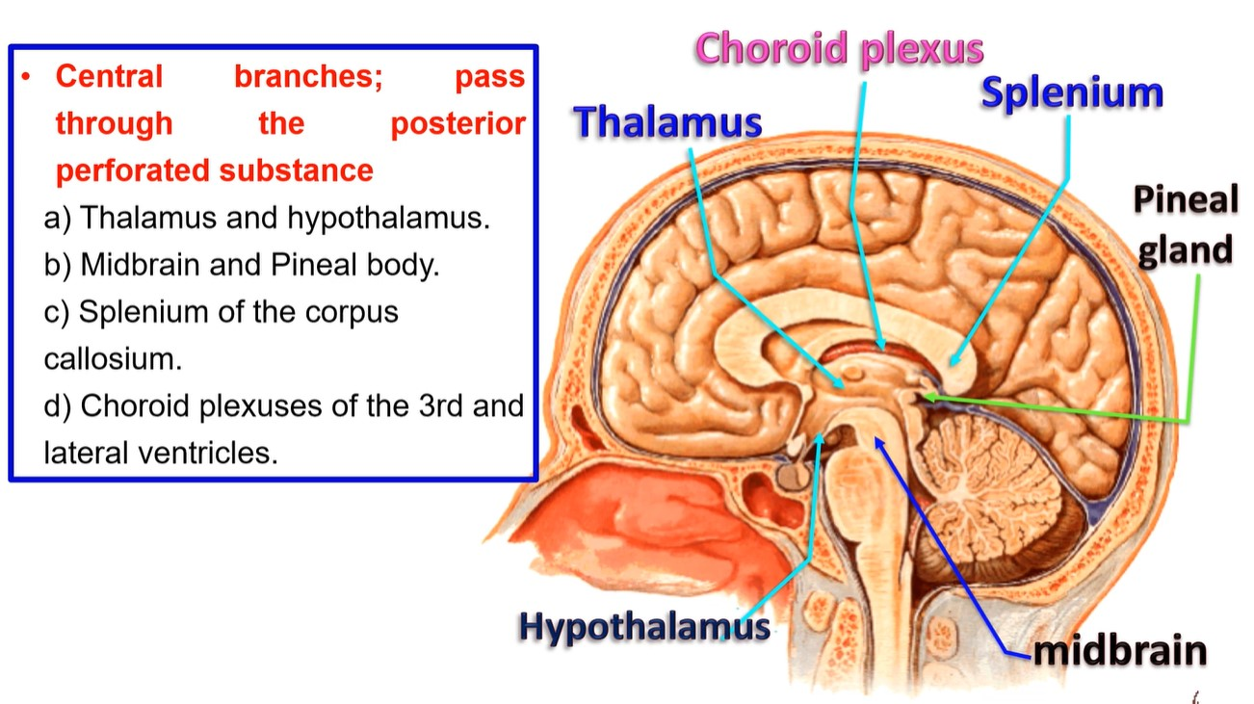
• Central branches; pass through posterior the perforated substance
a) Thalamus and hypothalamus.
b) Midbrain and Pineal body.
c) Splenium of the corpus callosium.
d) Choroid plexuses of the 3rd and lateral ventricles.

Slide 17
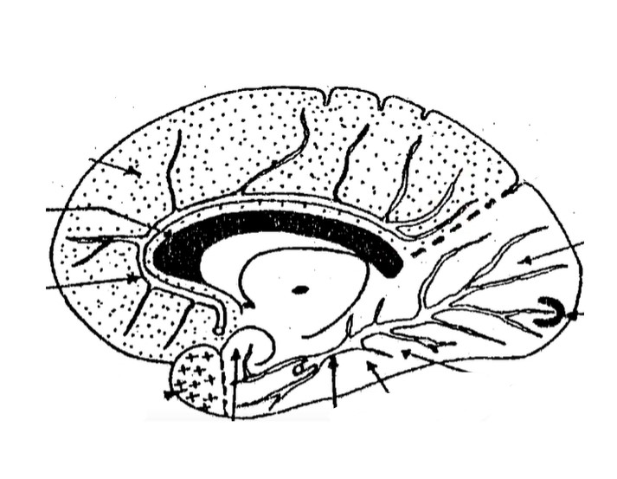
Area supplied by ACA
Corpus callosum
Occipital area
Visual area
Anterior cerebral artery
Tentorial surface by PCA
Temporal pole by MCA
Posterior cerebral artery
Uncus
Medial surface of right cerebral hemisphere

Slide 18
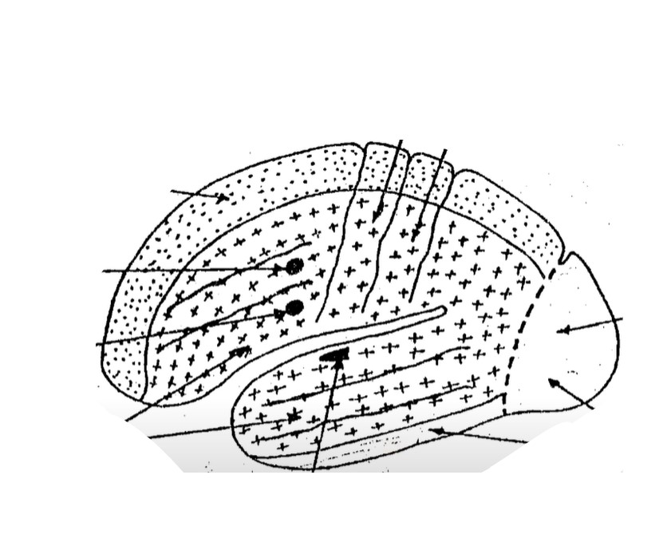
Motor area
Sensory area
Area supplied by ACA
Occipital lobe by PCA
Writing center
Motor speech
Area supplied by PCA
Area supplied by MCA
Auditory area
Suprolateral surface of left cerebral hemisphere

Slide 19
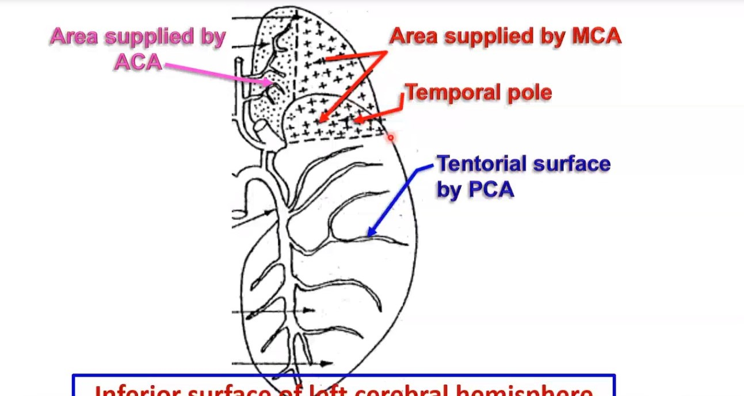
Inferior surface of left cerebral hemisphere

Slide 20
Interpeduncular
fossa

Slide 21
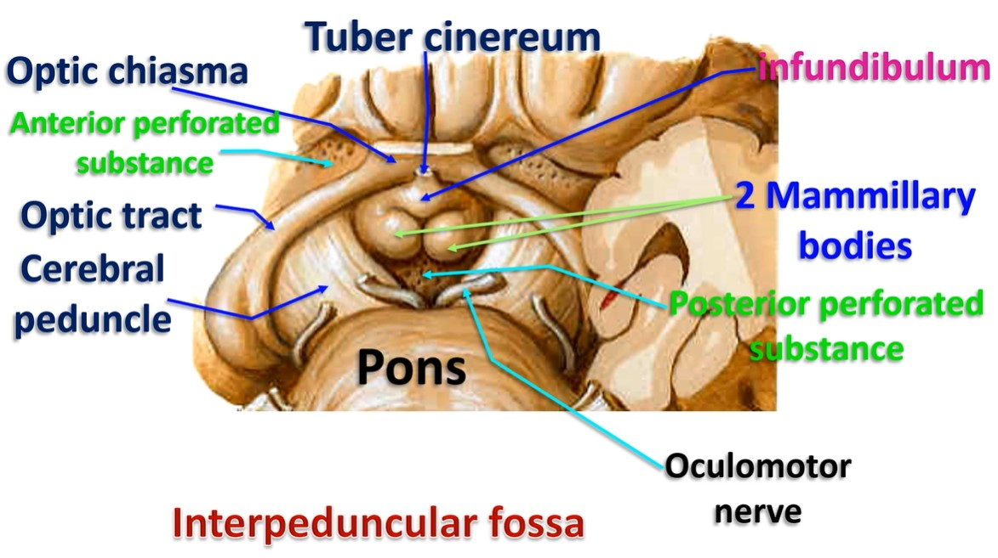

Slide 22
Interpeduncular Fossa
* Shape and site; this is a diamond shaped depression at the base of the brain between the two cerebral peduncles.
* Boundaries:
1- Anteriorly, Optic chiasma. 2- Posteriorly, Upper border of the pons.
3- Anterolaterally, Optic tracts. 4- Posterolaterally, Cerebral peduncles.
Contents:
1-Tuber cinereum 2- Infundibulum.
3- 2 Mammillary bodies. 4- Posterior perforated substances
5- The oculomotor (3rd) nerve exits through the medial sides of the cerebral peduncles.
6- Interpeduncular cistern contains: C.S.F & Arteries of the circle of Willis.
Anterior perforating substance : area in front of optic tract, it is pierced by branches of anterior choroidal artery from ICA, anterior & middle cerebral arteries to internal capsule & basal nuclei.
Posterior perforating substance is area in the interpeduncular fossa, it is pierced by branches of posterior cerebral artery to the thalamus.

Slide 23
Circle of willis

Slide 24
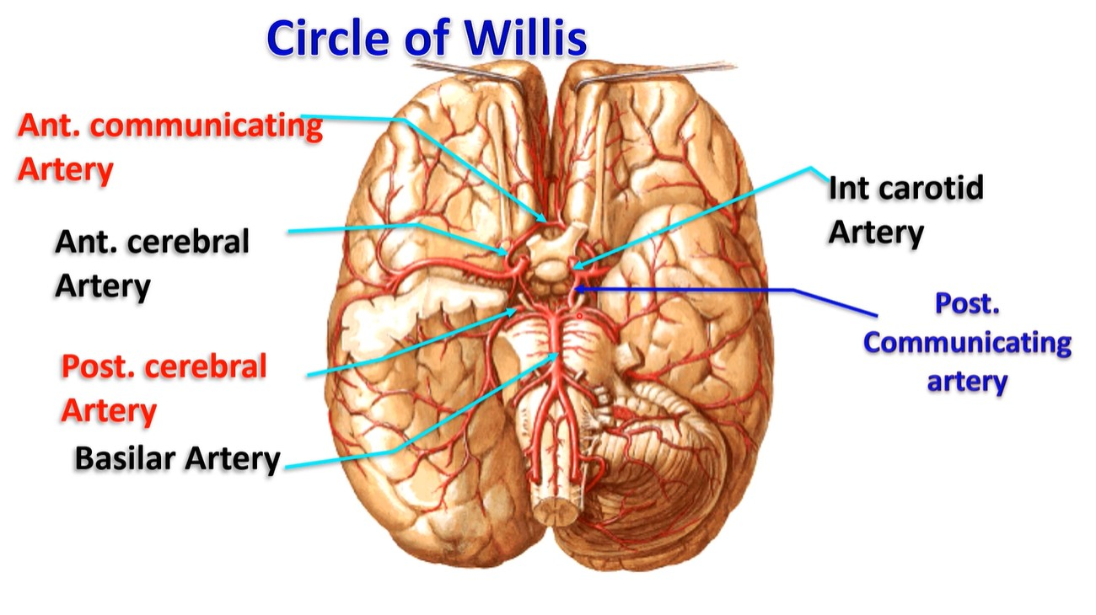

Slide 25
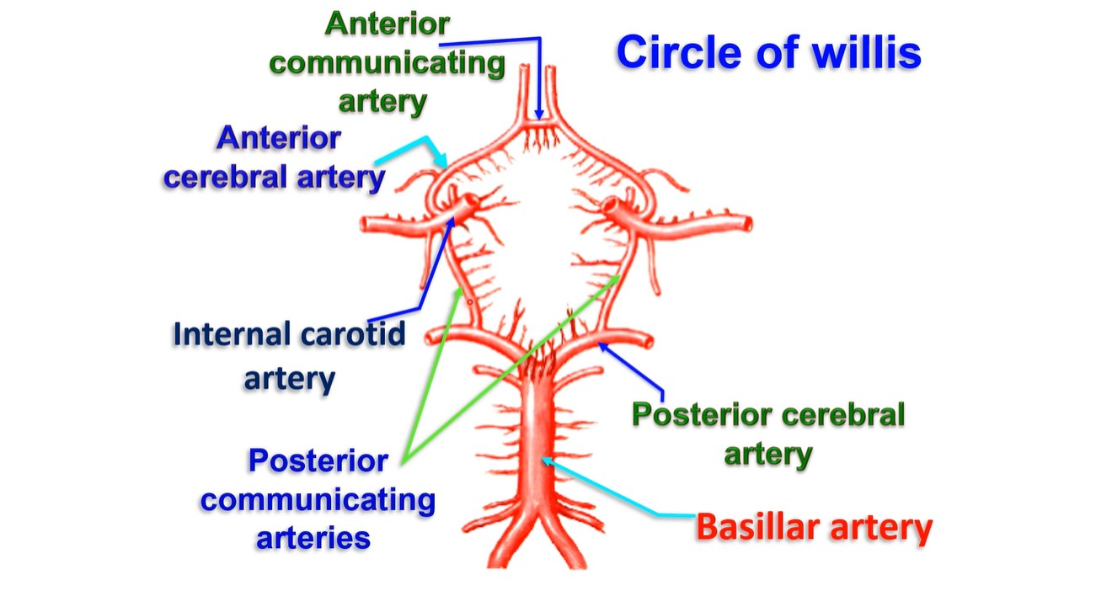

Slide 26
• Circle of Willis
• Site; it is situated in interpeduncular fossa at the base of the brain.
• Formation; anastomosis between carotid systems and vertebral system.
- The arteries sharing in the circle are;
1- Two internal carotid arteries.
2- Two anterior cerebral arteries from internal carotid artery.
3- One anterior communicating artery; between 2 anterior cerebral arteries.
4- Two posterior cerebral arteries terminal branches of basilar artery.
5- Two Posterior communicating arteries from internal carotid artery to the posterior cerebral artery of the same side.

Slide 27
Thank you
Questions
I/Azzam - 2004

