Slide 1
Excitation –contraction coupling.
Prof. Sherif W. Mansour
Physiology dpt., Mutah School of medicine
2021-2022

Slide 2
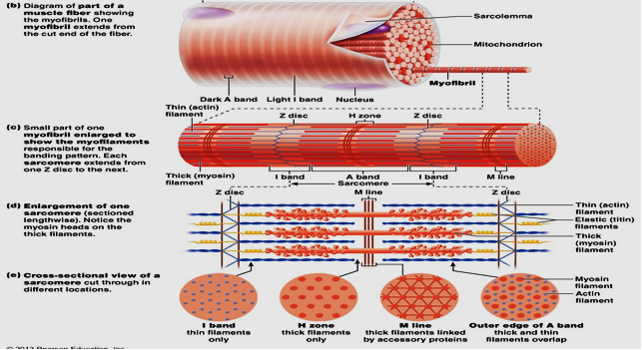

Slide 3
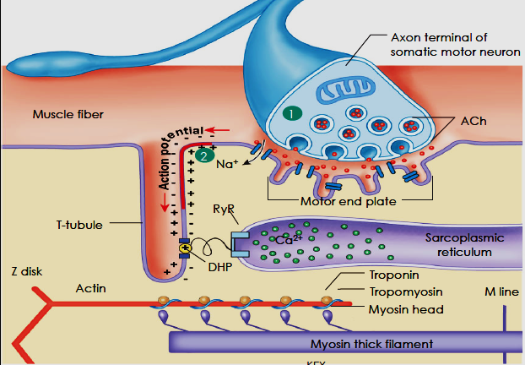
Muscle proteins
[A] Contractile proteins:
1- Myosin: -Myosin is complex protein with M.W. 480,000.
-Composed of 6 polypeptide chains (2 heavy chains and 4 light chains).
-The 2 heavy chains wrap spirally around each other as double helix forming long tail (light meromyosin) and arm (heavy meromyosin) while the terminal part combine with the 4 light chains forming 2 globular heads ,one head contains actin-binding sites and the other contain sites of ATP hydrolysis.
-Cross bridges arise from the head with arm of 2 flexible points called hinges (one between arm and tail and the other between the arm and heads) to bind to the actin.
2- Actin: - It is small globular protein with M.W. 42,000.
- The globules attached to each other to form filamentous structure arranged in two chains as long double helix.

Slide 4
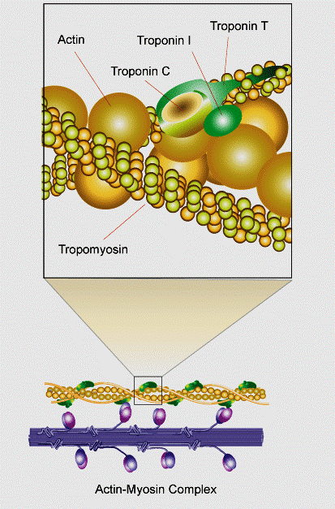
[B] Regulatory protein:
1- Tropomyosin:
-It is long filament of two polypeptide chains twisting on each other and located between the 2 chains of actin covering its active sites which combine to myosin and keeps the actin structure.
2- Troponin:
-Small globules located at intervals along tropomyosin.
-Of 3 subunits with MW 18,000-25,000.
1-Troponin T: binds troponin to tropomyosin.
2-Troponin I: inhibit binding of actin & myosin.
3-Troponin C: bind Ca+2 ions  contraction.

Slide 5
Thank You

