Slide 1
NS-II Lab Tetanus Botulism Rabies
Mathhar Ahmad Abu Morad MD
Mutah university
Faculty of Medicine

Slide 2
Diagnosis of Tetanus
Introduction
The usual route of infection is a soil-contaminated wound
Rarely done to diagnose tetanus
The laboratory diagnosis of tetanus involves the
Isolation and identification of C. tetani
Detection of toxigenicity in the isolate by mouse toxicity testing (The definitive test for the laboratory diagnosis of tetanus).

Slide 3
Diagnosis of Tetanus
Isolation and identification of C. tetani
Suitable specimens
Wound swabs in Stuart’s transport medium are the usual clinical specimens submitted for the laboratory diagnosis of tetanus.
Surgical specimens also suitable when collected
2. Test details - Culture of C. tetani
After incubation under anaerobic conditions at 35⁰C for 24 h, C. tetani produces a thin transparent film of swarming growth on the agar surface. Blood in blood agar plates is haemolysed. The thin film of growth may be difficult to detect.
In Gram-stained smears of cultures at 24 h, the vegetative cells stain as gram-positive rods but sporing rods showing the typical round, terminal, distending spores (i.e. ‘drumstick’ spores)

Slide 4
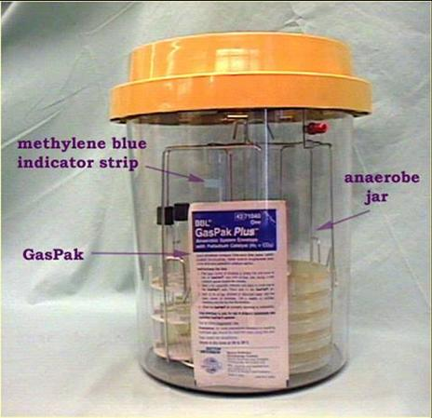
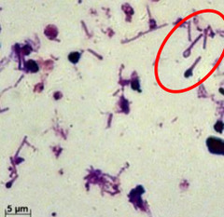
Diagnosis of Tetanus
Gram stain pattern of C. tetanus
Anaerobic jar

Slide 5
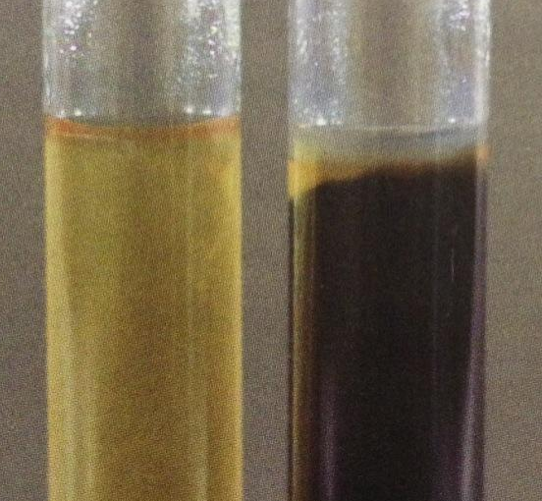
Diagnosis of Tetanus
3. Biochemically
C.tetani is an asaccharolytic.
H2S and DNAse positive
Nitrate reduction, aesculin and starch hydrolysis and lipase negative.
Notes:
Gas liquid chromatographic analysis of metabolic products shows a predominance of acetic and butyric acids with a minor amount of propionic acid.

Slide 6
Diagnosis of Tetanus
Mouse testing for tetanus toxin (tetanospasmin)
Suitable specimens
Cultures of C. tetani in Cooked Meat Medium (CMM) broth. The supernatant broth culture is filtered through a filter of 0.45 µm and small volumes of the filtrate are injected into mice.
Results
Typical paralysis or death of the mice with prevention of these effects by the prior administration of tetanus antitoxin constitutes a positive test for tetanus toxin

Slide 7
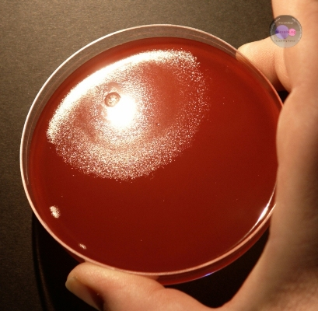
Diagnosis of Tetanus
Culture of C. tetani produces
a thin transparent film of
swarming growth on the
agar surface.

Slide 8
Diagnosis of Botulism
To make a diagnosis, your doctor will ask questions and examine you to find out the cause of your symptoms.
However, these clues are usually not enough to diagnose you because some diseases have symptoms similar to those of botulism, such as Guillain-Barré syndrome, stroke, myasthenia gravis.
Your doctor may perform special tests to make a diagnosis. Some of these tests are:
Brain scan
Spinal fluid examination
Nerve and muscle function tests (nerve conduction study [NCS] and electromyography [EMG])
Test for myasthenia gravis
If these tests don’t determine what is making you sick, your doctor may order laboratory tests to look for the toxin and the bacteria that cause botulism.
Start empirical therapy

Slide 9
Diagnosis of Botulism
Botulism is confirmed in the laboratory by identifying botulinum neurotoxin in the serum, feces, vomitus, or gastric contents of patients, and/or in remnants of a food they consumed .
Methods of idntifications:
Lab test
Mouse toxicity
Immunological methods.

Slide 10
Diagnosis of Botulism
Lab test
Toxin and viable bacteria may be identified in serum, stool, vomitus, gastric aspirate, and suspected foods.
C botulinum may be grown on selective media from samples of stool or foods.
The specimens for toxin analysis should be refrigerated, but culture samples of C botulinum should not be refrigerated.
Blood agar and egg yolk agar (EYA) are used for culturing samples.
Subterminal spore

Slide 11
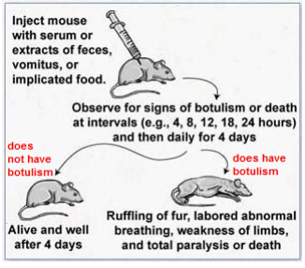
Diagnosis of Botulism
Mouse toxicity
Notes:
A small amount (0.4 ml) of patient serum or extract from the patient's feces, vomitus, or implicated food is inJected into the abdominal cavity of the mouse. 2) The mouse is then observed at intervals for signs suggestive of botulism and death. If the serum or extract contains botulinum toxin, the mouse will die or develop signs of botulism beginning with ruffling of the fur, followed by labored abdominal breathing, weakness of the limbs, and total paralysis. Death is caused by respiratory failure.

Slide 12
Diagnosis of Botulism
Immunological methods.
Compared with the mouse test, the immunoassays are technically simple and fast to perform and interpret.
Radioimmunoassay
Gel diffusion assay
Passive hemagglutination assay
Enzyme-linked immunosorbent assay (ELISA)

Slide 13
Laboratory Diagnosis of Rabies
In man:
Specimens: Saliva, CSF, Urine
the direct fluorescent antibody (DFA) from saliva, cornea smears and skin biopsy of neck or face
Isolation by inoculating saliva in mice.
Detection of antibodies by serology.
RNA detection by RT- PCR in blood
In Animals:
Cytology of brain tissue for Negri inclusion bodies in nerve cells.
Immunofluorescence to detect rabies antigens in the brain, Isolation by inoculating mice.
Electron microscopy to detect the bullet-shaped virus.

