Slide 1
Renal Pathology Glomerular diseases L2
Sura Al Rawabdeh MD
May 11 2022

Slide 2
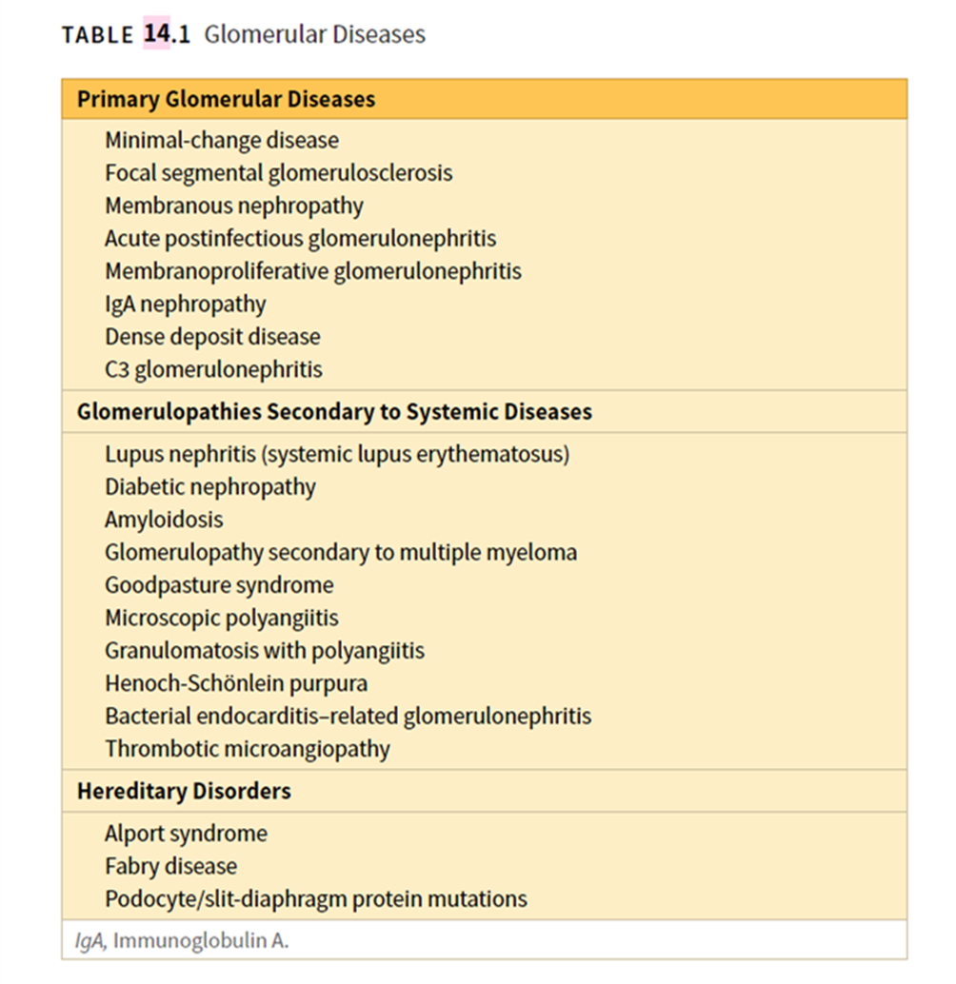

Slide 5
Membranous GN
Characterized by uniform thickening of the capillary wall due to diffuse deposition of electron dense deposits on epithelial aspect of GBM.
It usually presents in adults between the ages of 30 and 60 years and follows an indolent and slowly progressive course
Adults 30%, children 5%.
85% Idiopathic, 15% Secondary.

Slide 6
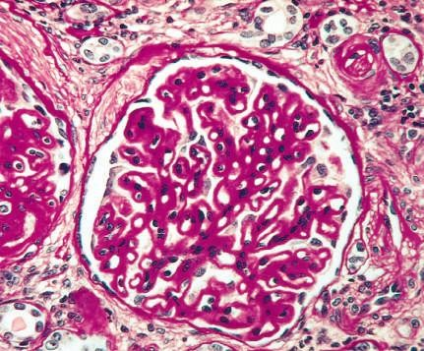
Membranous GN
The main histologic feature is diffuse thickening of the capillary wall (GBM glomerular basement PAS stain

Slide 7
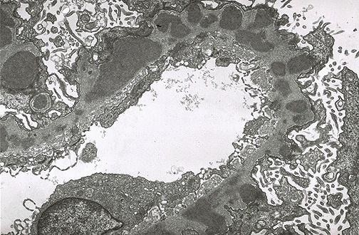
Membranous GN
EM reveals that thickening is caused by subepithelial deposits, which nestle against the GBM & are separated from each other by
small, spike-like protrusions of GBM matrix that form in reaction to the deposits (spike & dome pattern)

Slide 8
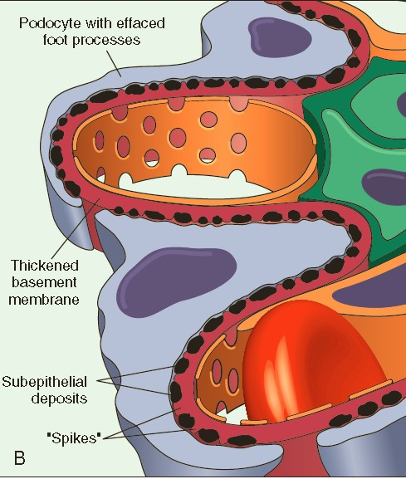
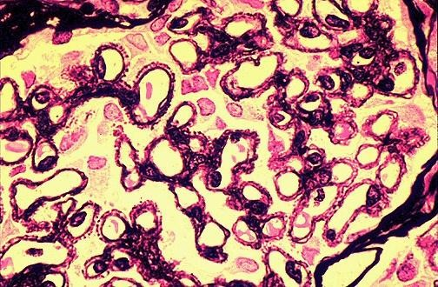
Membranous GN

Slide 9
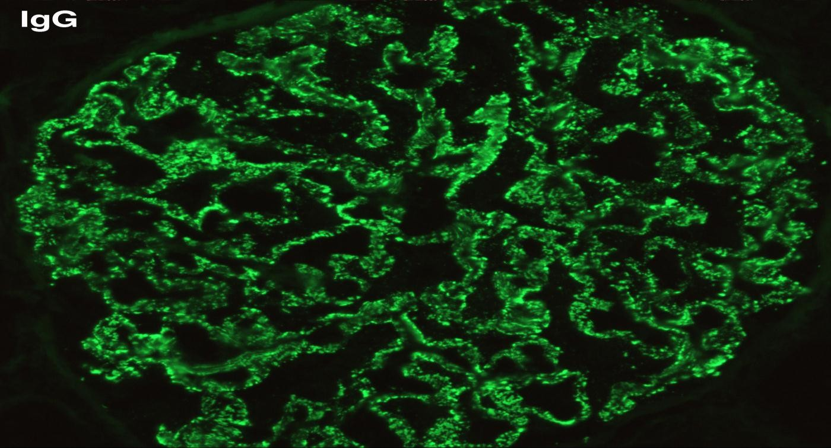
Membranous GN
IF microscopy demonstrates that the granular deposits contain both immunoglobulins & complement

Slide 10
Membranous GN
Sudden onset full-blown nephrotic syndrome
In contrast to MCD, the proteinuria is nonselective
Usually fails to respond to corticosteroid therapy
Secondary causes should always be ruled out
Variable prognosis:
Proteinuria persists in > 60% of patients
~ 40% progress to renal failure over 2 to 20 years.
10-30% benign course → partial or complete remission of proteinuria.

Slide 11
Membranous GN ( cont )
LM
EM
THICK CAPILLARY WALL, NO PROLIFERATION.
“SPIKES “ by SILVER stain
EM
DIFFUSE SUB EPITHELIAL DEPOSITS
IF
GRANULAR IgG &C3
Clinical
Nephrotic syndrome
proteinuria non-selective
Prognosis
Prognosis: 33% spontaneously remit, 33% stable with proteinuria, 33% progress to end- stage renal disease

Slide 12
Nephritic Syndrome
Acute, rapidly progressive, or chronic
Manifestations
Hematuria
Variable proteinuria
Impaired renal function(increase in blood urea & serum creatinine)
Hypertension
Edema

Slide 13
Nephritic Syndrome
caused by inflammatory lesions of glomeruli
The lesions have in common proliferation of the cells within the glomeruli + an infiltrate of leukocytes.
Injury the capillary walls → permitting blood to pass into the urine → lead to a reduction in the GFR.
Reduced GFR →oliguria, fluid retention, and azotemia
Hypertension is caused by both the fluid retention and augmented renin release from the ischemic kidneys
may be primary glomerular diseases, such as postinfectious glomerulonephritis (GN) and various forms of crescentic GN, or secondary to systemic disorders such as systemic lupus erythematosus.

Slide 14
Acute Diffuse Proliferative GN
Post infectious GN:
strep., pneumococc., staph., measels, mumps, Hep. B&C

Slide 15
POSTSTREPTOCOCCAL GN
Acute nephritic syndrome presents 1 - 4weeks after a strep infection of throat or skin.
Group A ,B -hemolytic
Light microscopy
Diffuse proliferation , leukocytic infiltration
EM
subepithelial humps
IF
granular IgG & C3 in GBM & Mesangium

Slide 16
Poststrep GN ( cont )
Pathogenesis
Nephritogenic strains >90%
ASO titer increase
Immune complex disease/ circulating or implanted Ag or both.
Decrease in serum complement.
Implicated Ags streptococcal exotoxin B (Spe B) and streptococcal glyceraldehyde-3-phosphate dehydrogenase (GAPDH) affinity for glomerular proteins and plasmin

Slide 17
Poststrep GN ( cont )
Clinical picture
fairly common , usually children (6 - 10 years
Urine---- red cell casts ; proteinuria mild
Prognosis
children >95% recovery ,1% RPGN ,2% CRF
Adults 15-50% develop ESRD

Slide 18
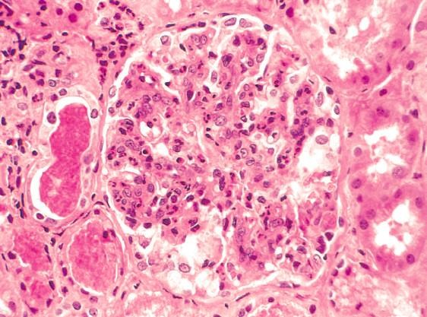
Post infectious GN LM morphology
Most characteristic change → increased cellularity of all glomeruli (nearly all glomeruli) → caused by
(1) proliferation & swelling of endothelial & mesangial cells
(2)by infiltrating neutrophils & monocytes.

Slide 19
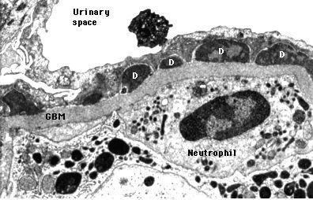
Post infectious GN EM morphology
EM: shows deposited immune complexes as subepithelial “humps” (on the epithelial side of GBM)
IF: scattered granular deposits of IgG & complement within the capillary walls

Slide 20
Post infectious GN
Most commonly present as acute nephritic syndrome
Fever, nausea, gross hematuria, & mild proteinuria.
Serum complement levels are low during the active phase of the disease.
Serum anti–streptolysin O antibody titers are elevated in poststreptococcal cases.
Recovery occurs in most children with poststreptococcal disease

Slide 21
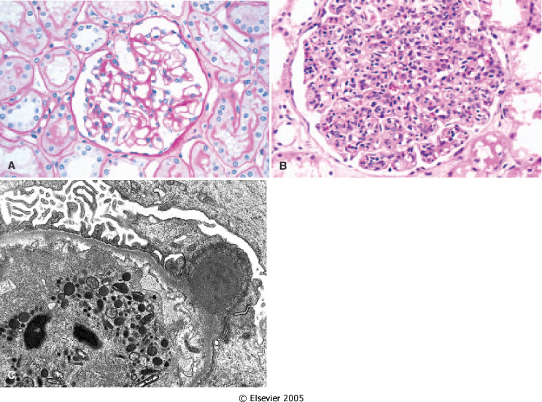
Acute proliferative GN
Normal

Slide 22
IgA Nephropathy (IgA-N)
GN characterized by the presence of prominent IgA deposits in the mesangial regions.
Commonest type of GN
Children & young adults
Usually 1 to 2 days after URTI
Microscopic or gross hematuria
LM ----- normal / mesangioprolif / focal or diffuse prolif.
EM ---- electron dense deposits in the mesangium
IF ---- diffuse , usually global mesangial IgA in all cases .

Slide 23
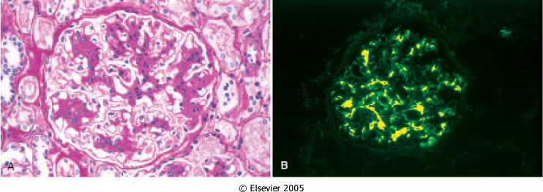
IgA Nephropathy

Slide 24
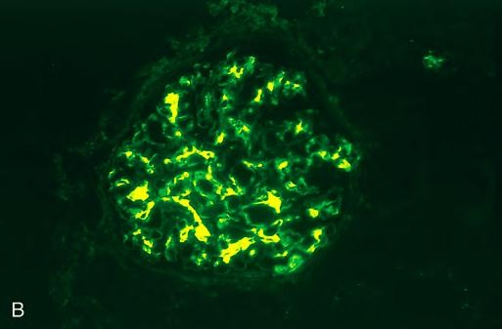
IgA Nephropathy
Different LM findings but whatever the histologic lesions, the pathognomonic feature by IF is the deposition of IgA and C3, in the mesangial region. (diagnostic)

Slide 25
Pathogenesis of IgA-N
Activation of alternative pathway of complement
Genetic or acquired abnormality leading to increase IgA synthesis by mucosal surfaces after antigenic stimulation → Circulating IgA aggregates or complexes entrapped in mesangium and activate alternative pathway.
Increased frequency in individuals with celiac disease in liver disease (secondary IgA nephropathy).

Slide 26
IgA - Nephropathy
Prognosis
initial benign course but slowly progressive
20 - 50% progress to CRF in 20 years
Bad prognostic features
old age
heavy proteinuria
Hypertension
sclerosis
20 - 60% recur in transplants.

Slide 27
Membranoproliferative (mesangiocapillary) GN
Characterized histologically by alterations in the basement membrane, proliferation of glomerular cells and leukocyte infiltration.
Children and young adults
nephrotic syndrome, nephritic syndrome, proteinuria, hematuria or nephrotic/nephritic.
Secondary
chronic immune complex disorder (SLE, HCV, HIV)
malignant conditions (CLL, lymphoma, melanoma)
MPGN type I and dense deposit disease (formerly MPGN type II).

Slide 28
MPGN
Dense Deposits disease
Type I
The antigens Mostly are proteins derived from infectious agents e.g., hepatitis C & B viruses;
“planted” antigens: after first binding to or becoming trapped within glomerular structures.
Contained in preformed immune complexes deposited from the circulation.
Complement dysregulation
Autoantibody against C3 convertase (called C3 nephritic factor)
Ab stabilizes the enzyme
→ uncontrolled cleavage of C3 & activation of the alternative complement pathway

Slide 29
MPGN
Light microscopy:
enlarged glomeruli, proliferation + infiltration of inflammatory cells, lobular accentuation, thickening of capillary walls ”reduplication” of glom capillary “tram-tracking”, crescents may be seen.
tubulointerstitial changes & vascular changes of HT.
EM type I
subendothelial deposits, circumferential mesangial interposition, increase in mesangial cells & matrix.
IF type I
C3 ,C1q,C4 in granular pattern in mesangial area.

Slide 30
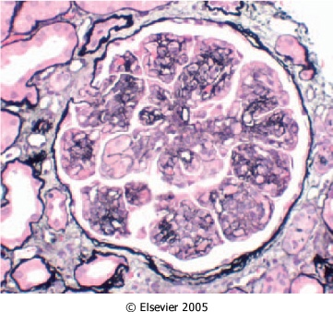
MPGN

Slide 31
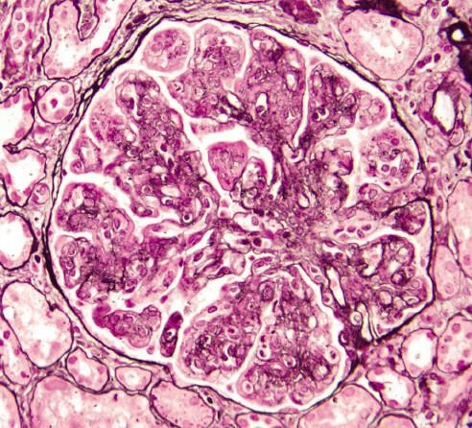
MPGN
Glomeruli are large, have an accentuated lobular appearance; proliferation of mesangial & endothelial cells as well as infiltrating leukocytes

Slide 32
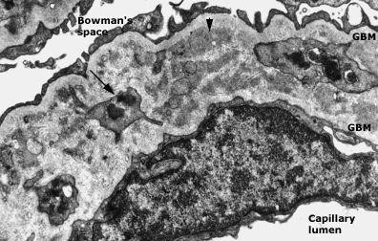
MPGN EM
Marked thickening of the glomerular capillary wall by immune deposits (short arrow) & by interposition of mesangial cell processes (long arrow).

Slide 34
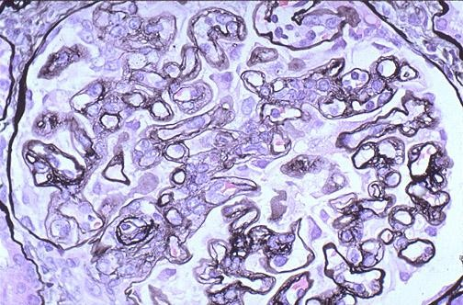
MPGN LM morphology
The GBM is thickened, and the glomerular capillary wall often shows a double contour, or “tram track,” appearance, especially evident with use of silver

Slide 35
Dense Deposit Disease (DDD)
Pathogenesis of Dense deposits disease (previously Type II MPGN):
Patients have abnormality that lead to activation of alternative pathway of complement. They have persistent low C3 , normal C1 & C4.
>70% have C3 nephritic factor (C3NeF), an auto Ab that stabilizes C3 convertase leading to persistence of C3 degradation & hypocomplementemia.
Mutation of factor H, or autoantibodies to factor H.

Slide 36
Dense Deposit Disease (DDD)
Dense deposits disease (previously Type II MPGN)
LM
similar to type I: The glomeruli are hypercellular, the capillary walls show duplicated basement membranes, and the mesangial matrix is increased
EM
lamina densa transformation into an irregular , ribbon - like ,extremely electron dense structure.(Dense Deposit Disease ) DDD.
IF
granular mesangial & short or discontinuous linear capillary loop deposits of C3. No early complement components or Igs.

Slide 37
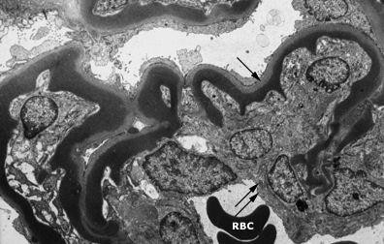
MPGN II/ DDD
There are dense homogeneous deposits within the basement membrane. Ribbon-like appearance of subendothelial & intramembranous material

Slide 38
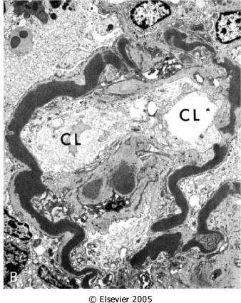
Dense Deposit Disease (DDD)

Slide 39
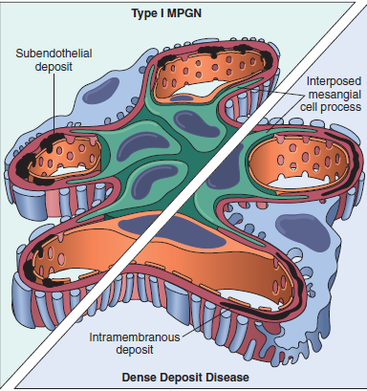
In type I: Subendothelial deposits. In dense deposit disease: Intramembranous dense deposits. In both types: Mesangial interposition gives appearance of split basement membranes viewed by light microscopy.
Schematic representation of patterns in two types of MPGN.

Slide 42
MPGN clinical manifestations
MPGN type I is more common than DDD.
Clinical course:
The principal mode of presentation (50% of cases) is the nephrotic syndrome, may begin as acute nephritis or mild proteinuria.
Prognosis:
Generally poor.
40% progress to end-stage renal failure, 30% had variable degrees of renal insufficiency, and the remaining 30% had persistent nephrotic syndrome without renal failure.
Dense-deposit disease has a worse prognosis, and it tends to recur in renal transplant recipients

Slide 43
Hereditary Nephritis
A group of heterogeneous hereditary - familial renal diseases associated with glomerular lesions.
Alport syndrome
Nephritis + nerve deafness + eye disorders.
Males > females
X-linked, AR or AD
LM - Normal glomeruli early in the disease, secondary sclerosis later, Foam cells in the interstitium.

Slide 44
Hered. Nephritis (cont.)
EM ----GBM shows irregular thickening, lamination, splitting (“basketweave” appearance)
Defective GBM synthesis, mutation in encoding for alpha-5 chain of collagen type IV.
Gross hematuria-- mostly males 5 - 20 yrs
CRF in 20 yrs

Slide 45
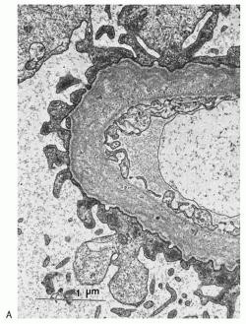
Alport syndrome
Early: GBM is thin & attenuated Later: develops irregular foci of thickening, splitting and lamination, yielding a “basket-weave” appearance.

Slide 46
RAPIDLY PROGRESSIVE GLOMERULONEPHRITIS (RPGN)
Clinically - rapid and progressive loss of renal function with severe oliguria and (if not treated) death from renal failure within weeks or months.
Histologically- presence of crescents in most glomeruli.
RPGN is not a single disease it is a syndrome which could be caused by a number of diseases both primary of kidney and systemic diseases.

Slide 47
CLASSIFCATION AND PATHOGENESIS OF( RPGN) ACCORDING TO IMMUNOFLUORESCENCE FINDING
1- Anti-GBM antibody–mediated crescentic GN: Linear pattern for IgG & C3 (12%)
Anti glomerular basement membrane disease
anti bodies to G.B.M , could cross react with pulmonary alveolar B.M to produce the clinical syndrome of lung hemorrhage and renal failure (Good Pasture`s syndrome).
2-Immune complex–mediated crescentic GN: Granular pattern for IgG & C3 (44%)
Immune complex disease
post infect., SLE, IgAnN, HSP
idiopathic

Slide 48
RPGN (cont)
3- Pauci-immune type crescentic GN: Immunofl. Negative (44%)
most have ANCA in serum ( ANCA Associated RPGN)
some associated with systemic vasculitis
the rest no association (idiopathic).

Slide 49
MORPHOLOGY OF RPGN
RPGN (cont)
Light microscopy ( CRESCENTIC GN )
> 50 - 75% of glomeruli contain crescents obliterating Bowman capsule and compressing the underlying glomeruli which could show normal, or focal proliferative changes.
EM
rupture of GBM only or with electron dense deposits
IF
linear, granular or none.

Slide 50
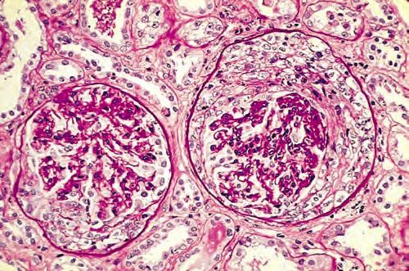
MORPHOLOGY OF RPGN LM
Collapsed glomerular tufts and crescent-shaped mass of proliferating parietal
epithelial cells & leukocytes
internal to Bowman capsule

Slide 51
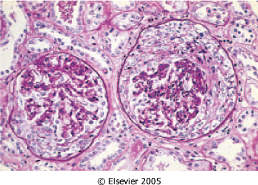
Cresentric GN

Slide 52
Prognosis of ( RPGN)
Prognosis depends roughly on the fraction of the involved glomeruli.
Milder forms may subside but renal involvement is usually progressive leading to oliguria.
Therapy
Plasmapheresis (Immune complex–mediated crescentic GN usually doesn’t respond)
steroids
cytotoxic drugs
Some patients requires long term dialysis, and renal transplant.

Slide 53
The end
Good luck

