Slide 1
Done by Ahmad Aldabbas
Supervised by Dr. Mahmoud Abu Znaid

Slide 2
•Secondary hypertension is hypertension due to an identifiable underlying cause.
•Secondary hypertension represents 5% of all HTN cases )
•Renal artery stenosis is the most common cause.

Slide 3
•The following groups should be screened for secondary hypertension:
-Those who become hypertensive at age <25 or >55
-Those with essential (primary) hypertension who remain hypertensive despite increasing doses and numbers of antihypertensive medications
-Those with a key features in their history, physical examination or investigations

Slide 4
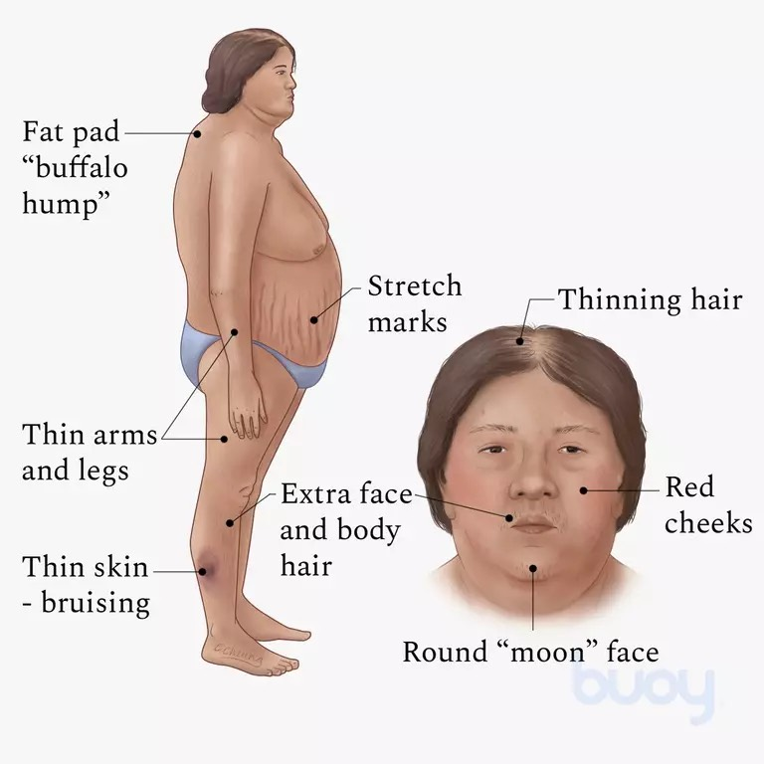
•With secondary hypertension, the presentation depends on the cause :
-Renovascular disease causes an abdominal bruit
-Chronic kidney disease shows edema
-Cushing disease causes weight gain, moon-like face, striae and ecchymosis
-Primary hyperaldosteronism causes muscular weakness and polyuria & polydipsia from hypokalemia
-Pheochromocytoma (very rare) causes episodic hypertension associated with headache, palpitations and sweating

Slide 5
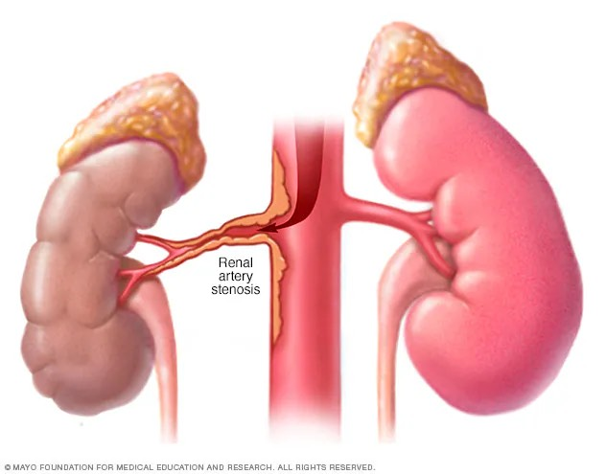
Causes of Secondary HTN:
1)Renal artery stenosis:
The most common cause of 2ry HTN
It is caused by atherosclerotic disease (inflammatory disease, lipid accumulation within the artery wall) in elderly persons and fibromuscular dysplasia (non inflammatory disease, abnormal growth within the artery wall) in young women.
The key feature is an upper abdominal bruit radiating laterally (in 50-70% of patients).

Slide 6
•Fibromuscular Dysplasia (FMD) :
-Most commonly affects women at age 15-50
-It is a non-inflammatory and non-atherosclerotic condition caused by abnormal cell development in the arterial wall that can lead to vessel stenosis, aneurysm or dissection.
-FMD can involve any artery but most commonly involves the renal, carotid and vertebral arteries.
-Recurrent headache caused by carotid artery stenosis or aneurysm is the most common presenting symptom.
•Hypertension results from renal artery stenosis (RAS) leading to secondary hyperaldosteronism.
•The best initial screening test is the renal artery duplex U/S. Although magnetic resonance angiography (MRA) and CT angiography (CTA) are also used to detect stenosis.

Slide 7
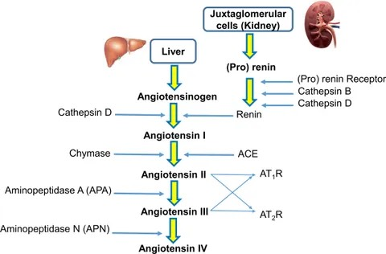
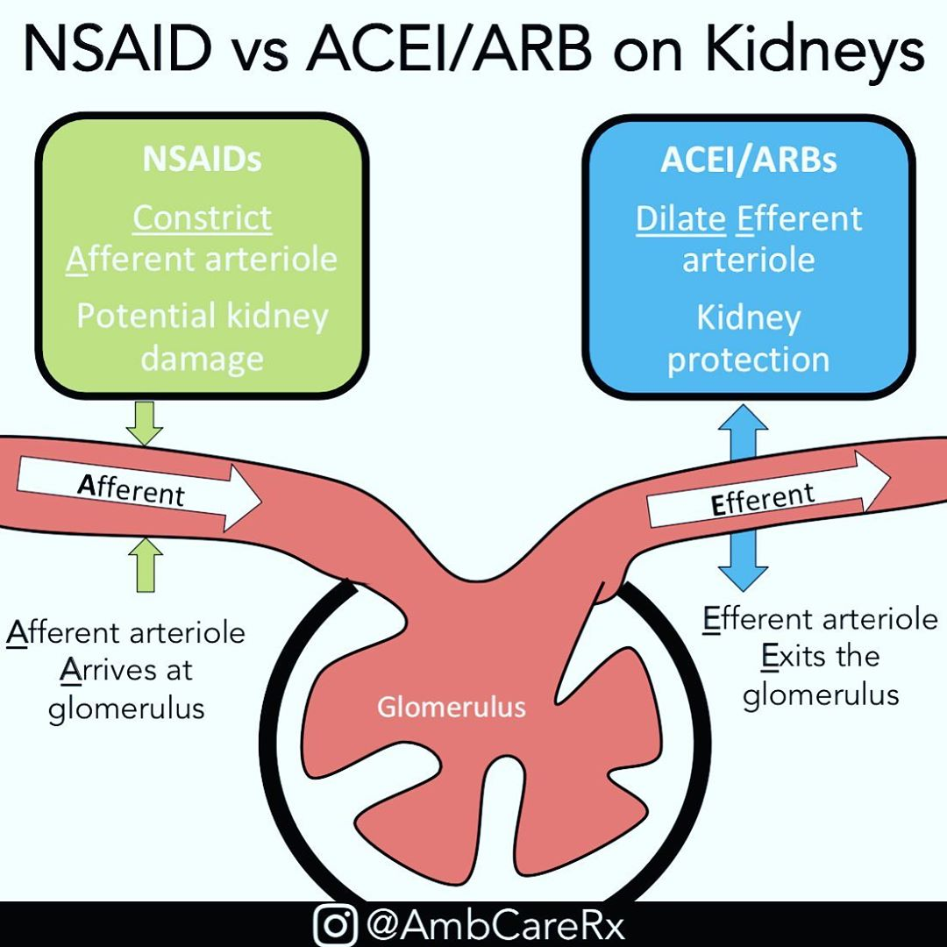
•Management :
- Angiotensin-converting enzyme (ACE) inhibitors (reduces angiotensin II levels) or angiotensin II receptor blockers (ARBs) (dilating the glomerular efferent arterioles and decreasing blood volume by loss of salt) are indicated for initial therapy in patients with hypertension and renal artery stenosis.
-Renal artery stenting or surgical revascularization is reserved for patients with resistant hypertension or recurrent sudden pulmonary edema and/or refractory heart failure due to severe hypertension.

Slide 8
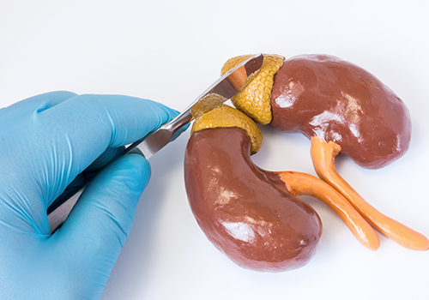
2)Primary Hyperaldosteronism :
Causes :
In the case of primary hyperaldosteronism, there is high blood pressure in association with a low potassium level. The low potassium level is either found on routine lab testing or because of symptoms of muscular weakness or diabetes insipidus from the hypokalemia.
•High BP + hypokalemia = hyperaldosteronism
-Adrenal adenomas (70% of cases) (Sometimes called "Conn’s syndrome").
-Idiopathic bilateral adrenal hyperplasia (25% of cases).
-Adrenal carcinoma (Rare cause).

Slide 9
The ratio of plasma aldosterone concentration to plasma renin activity is the preferred initial screening test for primary hyperaldosteronism
(PAC:PRA) Such that the ratio is usually > 20:1(< 10:1 in normal individual)
To confirm hyperaldosteronism, NaCl challenge test is required. This can be via normal saline, NaCl tabs, or fludrocortisone. After giving NaCl, plasma aldosterone concentration should be suppressed as in a normal individual. If PAC is still elevated, this confirms the diagnosis.
CT scan of the adrenals should only be done after biochemical testing confirms:
o Low potassium.
o Low plasma renin level.
o Aldosterone-to-renin ratio > 20:1 and aldosterone > 15 = hyperaldosteronism.
o High aldosterone despite a high-salt diet.
Screening and Diagnosis :

Slide 10
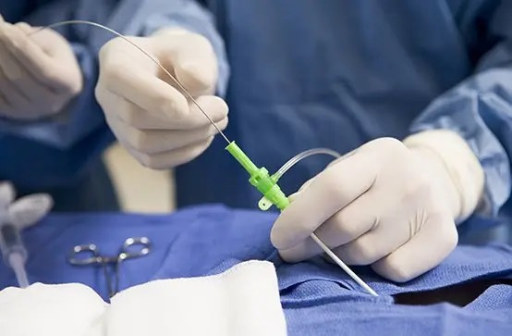
Adrenal venous sampling
is the most sensitive test for differentiating adrenal adenoma and bilateral adrenal hyperplasia in patients without discrete unilateral adrenal mass on imaging.
•It involves an interventional radiolosist using contrast dye to map the veins of your adrenal gland, then taking a sample of your blood from both your left and right adrenal veins. Then, they compare the blood samples to see if excess aldosterone is coming from the right, left or both adrenal glands

Slide 11
Treatment :
Surgery is preferred for unilateral adrenal adenoma.
(Unilateral adrenal adenomas are surgically removed with excellent results, whereas patients with bilateral adrenal hyperplasia are managed with diuretics alone because bilateral adrenalectomy resolves the HTN in only 33% of these patients)
•Medical therapy is recommended for patients with bilateral adrenal hyperplasia or with unilateral adrenal adenoma who refuse surgery or are poor surgical candidates.
- Bilateral hyperplasia is treated with eplerenone or spironolactone

Slide 12
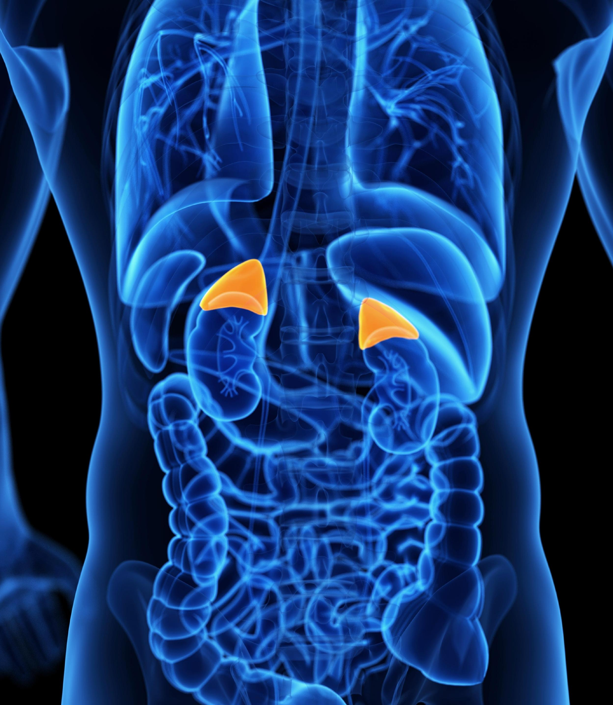
3)Pheochromocytoma :
Rare tumor of the adrenal medulla that produce catecholamines (dopamine, norepinephrine and epinephrine) that act on adrenergic receptors in CVS causing increased HR, increased cardiac output and vasoconstriction leading to HTN
Hypertension will be episodic in nature.
The attack has a sudden onset, lasting from a few minutes to several hours or longer.
Headache, sweating, palpitations and tremor
Rule of 10’s:
10% of cases are malignant.
10% of cases are bilateral.
10% of cases are multiple
10% of cases are extra adrenal.
10% of cases are occurs in children

Slide 13
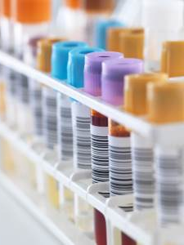
•Diagnostic Tests:
Plasma metanephrines (metabolites of epinephrine) level test (best initial test)
Urine screen : for the presence of metanephrines and vanillylmandelic acid (end-stage metabolite of catecholamines)
Urine epinephrine and norepinephrine levels
CT and MRI (done after biochemical testing)
MIBG scan ( meta-iodo-benzyl-guanidine) : is a nuclear scan test that uses injected radioactive material (radioisotope) and a special scanner to locate or confirm the presence of pheochromocytoma and neuroblastoma. An alternative name is adrenal medullary imaging.

Slide 14
Treatment:
Alpha-adrenergic blockers (phenoxybenzamine) , is required to control BP and prevent a hypertensive crisis, since high circulating catecholamine levels stimulate alpha receptors on blood vessels and cause vasoconstriction.
Beta blockers (propranolol) , used to decrease tachycardia
Surgical tumor resection (laparoscopic adrenalectomy can be preformed)
Beta-blockers should never be used before alpha-blocker in patients with pheochromocytoma or paraganglioma because this can result in unopposed alpha-adrenergic stimulation, which can cause severe vasoconstriction and hypertensive crisis

Slide 15
4)Cushing disease :
It is most often due to ACTH secreting pituitary adenoma leading to excess secretion of cortisol from the adrenal glands
Clinical features :
Hypertension ,truncal obesity , buffalo hump, menstrual abnormalities, striae and impaired healing, etc.
•Diagnostic Tests:
1. Two of three following tests need to be positive in order to give the diagnosis :
A. 1 mg overnight dexamethasone suppression test. 1 mg of dexamethasone at night should normally suppress the morning cortisol level. If this suppression occurs (serum cortisol <5) , cushing can be exclude.
B. 24-hour urinary free cortisol level . Value greater than four times of normal are rare except in cushing syndrome. Urine-free cortisol is more accurate and is the gold standard for confirming or excluding of Cushing syndrome.

Slide 16
C. Midnight salivary cortisol:
In normal patients, cortisol is at its lowest at midnight. In Cushing patients, cortisol is abnormally elevated at midnight.
2. Establish the Cause of Hypercortisolism:
A. ACTH testing is the best initial test to determine the cause (source) or location of hypercortisolism :
ACTH level low: This means the origin is in the adrenal gland ( tumor/ hyperplasia) (Scan the gland with a CT or MRI and remove the adenoma that you find) or exogenous (by drug history).
ACTH level high: This means the origin is either in the pituitary gland (pituitary adenoma) or from ectopic production of ACTH such as lung cancer. How to determine which one? (Go to B)

Slide 17
High-dose dexamethasone suppression test :
If high-dose dexamethasone suppresses the ACTH (>50%), so the origin is the pituitary. Scan the pituitary.
If high-dose dexamethasone does not suppress the ACTH, the origin is an ectopic production of ACTH.
•Treatment:
Pituitary cause; transsphenoidal ablation of pituitary adenoma
Adrenal adenoma or carcinoma; adrenalectomy
Exogenous (stop drug intake)
Ketoconazol (inhibits the synthesis of cortisol)

Slide 18
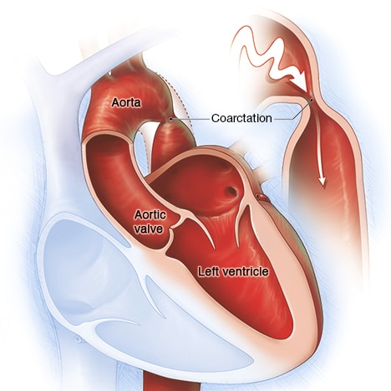
5)Coarctation of the aorta:
Hypertension in upper extremities greater than lower extremities
Low perfusion to kidneys activate RAAS system which lead to more elevation in BP

Slide 19
OCPs
Pregnancy and HTN
Recommended antihypertensives during pregnancy include beta blockers (especially labetalol) and methyldopa. Hydralazine and calcium channel blockers are acceptable alternate therapies. Angiotensin-converting enzyme inhibitors and angiotensin receptor blockers are contraindicated in pregnancy.
▪ Women who developed hypertension during a previous pregnancy or have a family history of hypertension are more likely to develop hypertension from OCP use.
The mechanism is unclear but possibly due to an estrogen-mediated increase in hepatic angiotensinogen synthesis or other effects on the renin-angiotensin-aldosterone system.
▪ Discontinuing OCPs can reduce the blood pressure over 2-12 month period and can often correct the problem.

Slide 20
Thank You

