Slide 1
MEASURES OF
DISEASE FREQUENCY
Part 2
15 th Nov. 2021
Prof DR. Waqar Al – Kubaisy

Slide 2
morbidity
Incidence
Prevalence
Attack Rate
Prevalence
Prevalence
is the № of All cases of disease,, or condition, present at a particular time , in relation to the size of population from which it is drown.
Prevalence means ALL. (Old+ New)
Prevalence
quantifies the proportion of individuals in a population who have the disease at a specific time
Prevalence: in the number of cases of a disease present in a defined population at a given point of time
*Proportion of a population already affected by a particular disease at a particular time

Slide 3
example,
visual examination survey conducted in Al Karak among
individuals , 52 - 85 years of age, during 2017
310 of the 2477 persons examined had cataracts at the time of the survey. ???????
The prevalence of cataract in that age group was
310 / 2477 X100 ,=12.5% prevalence of cataract among population aging 52 - 85 years in Al Karak during 2017
P = № of existing cases of a disease X 100
total population at risk at a given point in time

Slide 4
Prevalence is controlled by two elements
No. of individuals who have been diseased in the past
the length or duration of the illness.
Duration and
Incidence
Prevalence will vary in direct relation
duration of the illness
Prevalence
incidence
Prevalence

Slide 5
Relationship Between Incidence and Prevalence
Recovery
Incidence
Death
Prevalence
Pot
Incidence is all new cases of the disease.
They enter the prevalence pot.
If no cases leave the prevalence pot, it continues to Fill, adding to the number of cases unless
some cases either recover or die reducing the prevalence.

Slide 6
Relationship Between Incidence and Prevalence
Prevalence = I * D
Recovery
Death
Incidence
Prevalence
Pot
I = incidence
D = duration
Duration and
Incidence
Prevalence will vary in direct relation

Slide 7
Factors influencing prevalence rate
Increased by:
longer duration of disease
prolongation of life without cure
Increase in the incidence of the disease
Immigration of cases
out migration of healthy people
improved diagnosisBetter reporting
Better reporting
Decreased by:
short duration of disease
high case-fatality rate from disease
decrease in incidence
in-migration of healthy people
Emigration of cases
improved cure rate
Immunization prevents new cases
Prolongation of non diseased & healthy population
Prevalence
Prevalence

Slide 8
Types of Prevalence
Period Prevalence
Point Prevalence
A study done on 1000 school children at Al Karak during 2018 found 20 with TB. By follow up of school children during 2019 the number of students with TB was 28
prevalence 20 2018
prevalence 28 2019
Period prevalence:
Number of cases that occur during a specified period of time
2018 –2019

Slide 9
Period Prevalence
includes the total individuals who had have the dis. of concern at any time during the specific time period 2018-2019. S0
Period .P
started at a point of time and stop at a point of time
included all persons with the dis.
2018
2019.
that have carried over from the previous time period or
have become ill at the end of the time period
New cases (incidence) occurring within the time period
recurrences during a succeeding time period

Slide 10
Point Prevalence
is the No. of cases of individuals with a disease, condition, or
illness at a single specific point in time
The No. of existing cases at point in time.
P = № of existing cases of a disease X 100
total population at risk at a given point in time
Point .P
measure the presence of the disease or condition on a single short – time point

Slide 11
Example
visual examination survey conducted among individuals 52 - 85 years of age in Al-Karak during 2017. 310 of the 2477 persons examined had cataracts at the time of the survey.
The prevalence of cataract in that age group was
310 / 2477 X100 ,=12.5%
prevalence of cataract among population aging 52 - 85 years in Al Karak during 2017
Point prevalence:
Number of cases present at a specified moment of time
2017

Slide 12
Period Prevalence =
№. of existing cases of a disease within time period X1000 Average study population within time period
Point Prevalence =
№. of existing cases of the disease at a point in time X1000
Total study population at a point in time
Factors affecting the prevalence and incident rate:
In and out migration of susceptible or of the resistant (immune)
Changes in the environmental quality (air and water sanitation)
Changes in the social customs (tobacco smoke) and travel abroad.
Changes in the reporting system.
Changes in the preventing program (immunization)

Slide 13
Mortality rates
Analogous to incidence but refers to the process of dying rather than the process of becoming ill.
Crude death rate: =
№ of deaths in certain population in a year & locality
№ of population in the same year and locality
The crude death rate is
calculated for the total population irrespective of age, sex, or any other characteristics of importance in determining death
If the population is growing or shrinking, use the population size at the midpoint of the time interval as an estimate of the average population at risk.
E.g. death rate for 1993, use population of July 1st 1993 for the denominator.

Slide 14
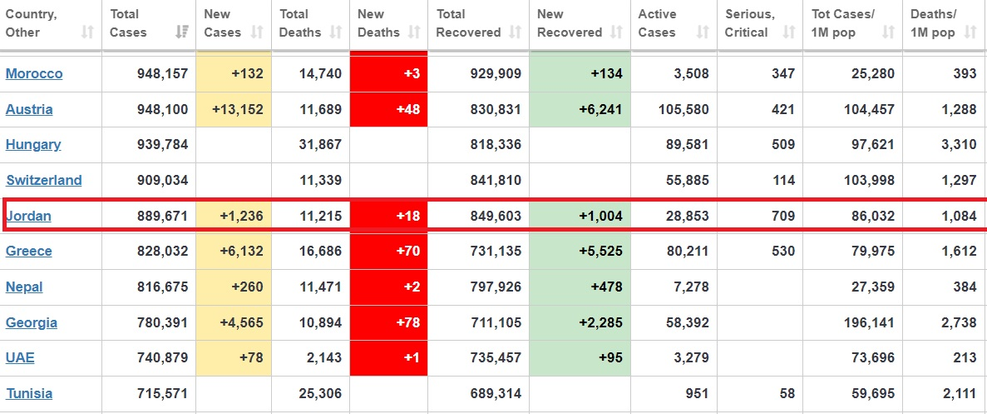
13th Nov 2021

Slide 15
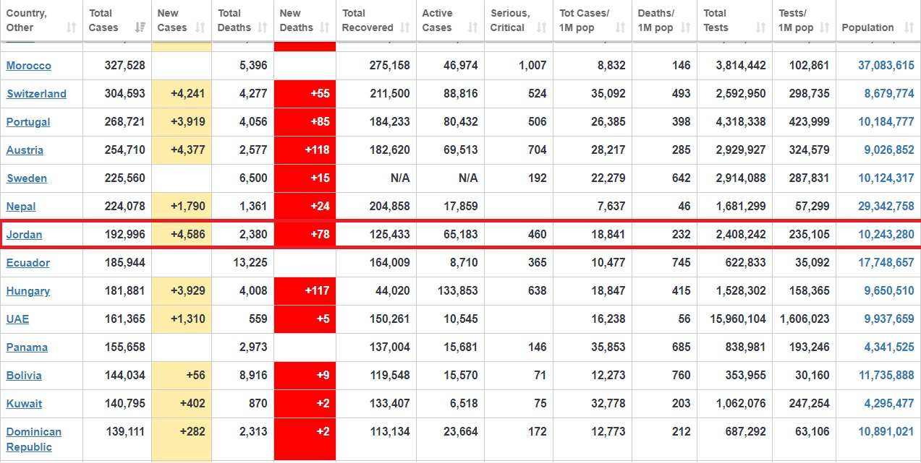

Slide 16
Age and sex specific death rate:
A. Age Specific Death Rate:
No. of persons dying in a certain age and a certain year and areaX1000
Total № of the same age group in the same year and same area
Example of age specific mortality rates::
Infant mortality rate=
Total № of deaths aged from zero to lessthan one year during a year and a given locality X1000
Total № of live births in the same Year and locality
Sex Specific Death Rate:
№ of deaths in a certain sex during a year in a certain localityX1000
Total № of the same sex during the same year and locality

Slide 17
Cause Specific Mortality Rate=
Total № of deaths due to a certain cause during a year & a given locality X 100
Estimated midyear population during the same year and locality
4. Case Fatality Rate=
Total №. of deaths from certain disease in specific time & place X1000
Total № of those having the same disease in the same time &place
Proportionate Mortality Rates=
Total № of deaths due to a certain cause during a year in given localityX1000
Total № of deaths from all causes during the same year and locality

Slide 18
Uses of Morbidity and Mortality Rates
Case fatality rate is used for measuring the pathogenesis and virulence of agent of the disease.
Secondary attack rate is used to measure the ease of communicability of communicable diseases.
Morbidity and mortality rates can be used to allow comparison of disease frequencies and deaths in different population and all over years

Slide 19
Uses of Morbidity and Mortality Rates
Comparison of two rates result in a ratio (relative risk or risk ratio) e.g.:
If the incidence rate of diarrheal disease among bottle fed (a)is 20 % while among breast fed (b)is 2 %,
then the relative risk or risk ratio = 20/2= 10, i. e. the bottle fed children have a 10 times greater risk of developing diarrheal disease than the breast fed.
interpretation
Relative risk = incidence a / incidence b
If both are equal then it is 1 (no risk)
If a > b then it is more than one, it is risky
If a < b then it is less than one, protective

Slide 21
Uses of Morbidity and Mortality Rates
5. Difference between two incidence rates is called
attributable risk=
Incidence of disease rate among exposed- incidence of disease rate among non-exposed X100
Incidence of disease rate among exposed
In the previous example: Attributable risk = 20-2 X100
20
= 90%child/year (risk diarrhea attributing to bottle feeding).
interpretation
Attributable risk = incidence a - incidence b
incidence a
If both are equal then it is 0 (no risk)
If a > b then it is more than zero, it is risky
If a < b then it is less than zero, protective

Slide 22
example
In 1976 a study done in the U SA, the incidence rate of stroke was measured in a population of women who were 30–55 years of age and free from coronary heart disease, stroke and cancer. A total of 274 stroke cases were identified in eight years of follow-up .
Never smoked : 70 cases among 395 594
Ex-smoker : 65 cases among 232 712
Smoker: 139 cases among 280 141
Calculate
-Incidence for each group
-Relative for smoking
-attributable risk for smoking (ignore ex-smoker

Slide 23
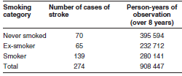
In a study in the USA, the incidence rate of stroke was measured in a population of women who were 30–55 years of age and free from coronary heart disease, stroke and cancer in 1976. A total of 274 stroke cases were identified in eight years of follow-up .
Never smoked : 70 cases among 395 594
Ex-smoker : 65 cases among 232 712
Smoker: 139 cases among 280 141
Calculate
-Incidence for each group
-Relative for smoking
-attributable risk for smoking (ignore ex-smoker

Slide 24
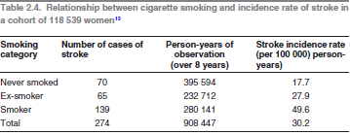
Relative risk = 49.6/ 17.7 = 2.80
Attributable risk= 49.6- 17.7 X100= 46.31 %
49.6

Slide 25
Attributable risk can be useful as a measure of the public health
impact of a particular exposure
Risk difference (attributable risk)
the risk difference tells you the amount of disease that potentially could be prevented if the risk factor could be eliminated
Attributable risk can be useful as a measure of the public health impact of a particular exposure
Population Attributable Risk (PARs)
PAR tells us about the amount of extra disease occurring in the exposed group because of exposure.
How much of disease in the whole community can be attributed to the exposure
I_{T} is the rate in the population
I₀ is the rate in the unexposed group

Slide 26
Population Attributable Risk
PAR estimate the excess rate of disease in the total study population of exposed and non-exposed individuals that is attributable to the exposure.
PAR, helps determine which exposures have the most relevance to the health of a community
PAR = IT–IO
I_{T} is the rate in the population
I₀ is the rate in the unexposed group

Slide 27
Population AR Versus AR
AR tell us how much disease in exposed group can be attributed to exposure
PAR: how much disease in the whole population can be attributed to exposure
The population attributable-risk percent (PAR%)
PAR% expresses the proportion of disease in the study population that is attributable to the exposure and thus could be eliminated (removed) if the exposure were eliminated

Slide 28
To summarize,
Both relative risk and attributable risk are valuable tools for determining the
contribution of risk factors to an adverse outcome.
Relative risk (RR)
is a measure of the strength of the association or causal link between a
risk factor and an outcome.
Attributable risk (AR)
helps measure the excess risk associated with the risk factor.
Population attributable risk (PAR)
gives the added risk in relation to the total population.
Population attributable risk percent (PAR%),
gives the percent of cases in the total population that can be attributed
to the risk factor.
The PAR% is an especially useful, and underutilized tool in program planning.
It can be used to predict the impact of public health interventions on
adverse outcomes, since it considers both the excess risk associated
with the exposure and the proportion of the population that is exposed.

Slide 29
THANK YOU ALL
GOOD LUCK

Slide 30
example
The following table shows the data concerning a NCD among adults during a year in a certain community. Calculate the prevalence and incidence rates, If male sex was the risk factor what is the relative and attributable risks for this factor.
Total population | Old case | New case
6213 | 12 | 4 | females
5365 | 24 | 9 | males
11578 | 36 | 13 | Both sexes
Incidence among males
Incidence among females
Total incidence
Relative risk
Attributable risk
Prevalence among males
Prevalence among females
Total prevalence
(for prevalence old + new case)

Slide 31
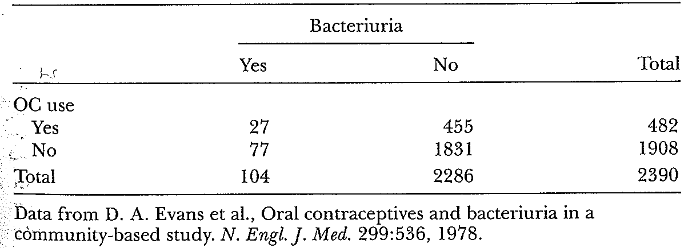
Example
Data from a cohort study of oral contraceptive (OC) use and bacteriuria among women aged 16-49 years
The population attributable risk of bacteriuria associated with OC use can therefore be calculated as:
PAR=I_{T} - I₀= 104/2390 - 77/1908 == 316/10⁵/year
Thus, if OC use were stopped, the-excess annual incidence rate of bacteriuria that could be eliminated among women in this study is 316 per 100,000. 0.04351 0.04035
Notes:
bacteriuria is the presence of bacteria in urine
31

