Slide 1
History Taking
Dr Maha Alsadik

Slide 2
General Approach
Introduce yourself.
Note – never forget patient names
Create patient appropriately in a friendly relaxed way.
respect patient privacy.
Try to see things from patient point of view. Understand patient mental status, anxiety, irritation or depression.
Listening
Questioning: simple/clear/avoid medical terms , leading, , direct questions .

Slide 3
Personal history
name,
Sex
age,
address,
occupation,
marital status.

Slide 4
Name: To be familial with the patient & DOTs.
Sex:
Diseases common in males ( COPD,bronchogenic CA, occupational lung diseases)
Diseases common in females (Bronchial adenoma, SLE, sarcoidosis)
3. Age:
Infancy and childhood ( Congenital bronchiectasis,cystic fibrosis,FB aspiration,bronchial asthma,1ry TB)
Adolescence and adults (Bronchial asthma,post-primary TB)
Middle age (COPD,CAP,post-primary TB,collagen vascular)
Elderly (bronchogenic CA,IPF)

Slide 5
4-Residence: -Industrial area (occupational lung diseases) -Endemic areas of certain diseases: ◊ El Korein → Filariasis ◊ Belbas → Hydatid cyst -Travelling abroad: ◊western countries → AIDS,fungal infection ◊Iraq → Hydatid,leishmania ◊India → Filaria,TB - For DOT program for TB treatment. 5- Marital state: -For infertility → TB,Kartagnar syndrome,cystic fibrosis

Slide 6
Patient complaints
In patient OWN words
NO Guiding Questions
Arranged Chronologically

Slide 7
History of presenting symptoms
Specific respiratory symptoms
• Breathlessness • Wheeze • Cough • Sputum/haemoptysis • Chest pain • Fever/rigors/night sweats • Weight loss • Sleepiness
Past medical history
• Respiratory disease
• Other illness/hospital encounters
Drug and allergy history
• Drugs causing or relieving respiratory symptoms
• Allergies to pollens/pets/dust; anaphylaxis
Social and family history
• Family history of respiratory disease
• Home circumstances/effect of and on disease
• Smoking
• Occupational history
Systematic review
• Systemic diseases involving the lung
• Risk factors for lung disease

Slide 8
Present Illness COMMON SYMPTOMS OF PULMONARY DISORDERS
Primary symptoms:
– dyspnea
– cough
– chest pain
– sputum production
– hemoptysis
– wheezing
Secondary symptoms:
– hoarseness or voice change
- Dysphagia (difficult swallowing)
-syncope/dizziness/ fainting
– ankle swelling (peripheral edema)
– fever, chills, night sweats
– long bone, joint, muscle pain
-Respiratory failure

Slide 9
COUGH
It is an explosive expiratory manoeuvre which can performed volantarily or involantarily,,,,to remove foreign objects and abnormal excessive secretions. Most common pulmonary symptom
Stimulation of cough receptors:
Inflammatory
Mechanical
Chemical
Thermal
Phases of cough mechanism:
Inspiratory.
compression
Expiratory.

Slide 10
Cough reflex -Cough is a reflex that occurs when afferent nerve receptors are stimulated by inhaled, aspirated, or endogenous substances. -The cough receptors lie in: (Ear,nose,pharynx, larynx, the trachea,bronchi,parenchyma,pleura). Cough receptors also are present in extrapulmonary structures, including the esophagus, diaphragm, and stomach. - Afferent nerve fibers vagus pass to a central cough receptor in the medulla, triggering a forced expiratory maneuver against a closed glottis, followed by glottal opening and high-velocity expiration via Efferents (recurrent laryngeal, phrenic and spinal nerves)

Slide 11
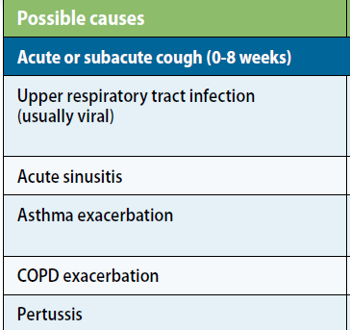
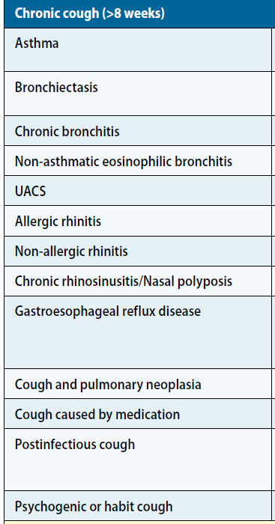
Types & duration:
acute: severe with a short course (< 3 weeks)
chronic: usually > 8 weeks

Slide 12
COUGH
Effective:
strong enough to clear the airway
Noneffective or inadequate: too weak to mobilize secretions
Dry:
viral,inhalation of irritants,cardiac
Dry progressed to productive:
Pneumonia, BA,PE
productive: suppurative syndrome,TB

Slide 13
Postural related
Supine: LVF,Suppuratives,mediastinal tumors post nasal drip,GERD

Slide 14
Chch:
1-Whooping cough (violent fits of cough then insp.stridor due to lary.spasm)
2-Bovine cough (vocal cord paralysis)non explosive cough
3-Brassy cough(Tracheal compression)dry metalic with stridor
4-Hawking cough:loud harsh cough for clearing throat in smokers,post nasal drip
5-Barking cough:dry ,barking as in croup

Slide 15
Timing, and setting may provide clues to cause of cough:
Early morning……chronic bronchitis
Nocturnal ….. Post-nasal discharge, Bronchial asthma, PND,GERD
In the evening …… Exposure to irritants during the work day
Post-prandial ….GERD
Disappear during sleep ….Psychogenic

Slide 16
COUGH
Complications (Hx & Exam):
fatigue
torn chest muscles
rib fractures(tussic fracture)
disruption of surgical wounds
pneumothorax or pneumomediastinum
syncope
dysrhythmia
esophageal rupture
urinary incontinence
Transmitted infections
Rupture aneurysm

Slide 17
Expectoration
Sputum is abnormal secretion produced in or expelled from the
Broncho-pulmonary system.
It is NOT saliva…NOT nasopharyngeal in origin

Slide 18
SPUTUM PRODUCTION
Tracheobronchial tree secretes ~ 100 ml of mucus daily
Usually swallowed unnoticed
May need to collect and inspect mucus over 24 hours for accurate analysis

Slide 19
SPUTUM DESCRIPTION:
onset ,course ,duration
Color, consistency, quantity, time of day
produced, odor, and presence of blood or other distinguishing matter,relation to posture.
Character of sputum may be indicative of a particular disorder.

Slide 20
Types of sputum
Type | Appearance | cause
Serous | Clear, watery Frothy, pink | Acute pulmonary oedema Alveolar cell cancer
Mucus | Clear, grey White, viscid | Chronic bronchitis/COPD Bronchial asthma
Purulent | Yellow Green | Acute bronchopulmonary infection, Asthma (eosinophils) Suppurative lung
Rusty | Rusty red | Pneumococcal pneumonia

Slide 21
Bronchorrhea:
• expectoration of more than 100cc/24hours watery fluid due to chronic bronchitis,bronchial asthma, alveolar cell carcinoma.
Red-current jelly sputum:
• Klebseilla pneumonia
* bronchial carcinoma
Watery ,salty fluid ….ruptured hydatid cyst
Melanoptysis (black):
• coal miners.
-Milky sputum → Candidiasis,chylothorax with fistula
-Lithoptysis → calcified LN eroding the airway,FB
-Anchovy-sauce → hepatopulmonary amebiasis

Slide 22
-Odor … fetid in Anaerobic infections due to release of indole and skatol metabolites from tryptophan metabolism -Relation to posture -Amount- duration curve,for D.D. of: 1-Acute,chronic lung abscess 2-bronchiectasis,infected cystic lung 3-Empyema with bronchopleural fistula

Slide 23
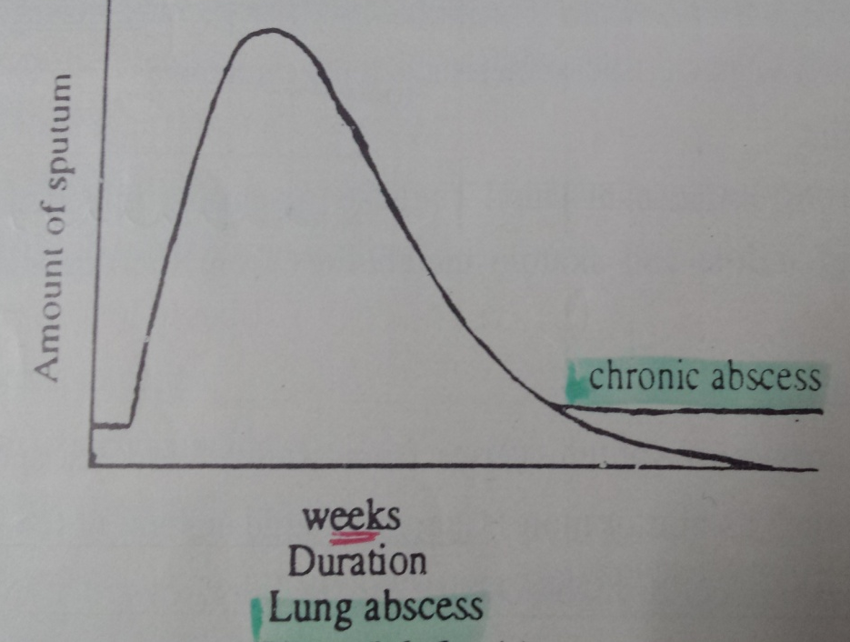
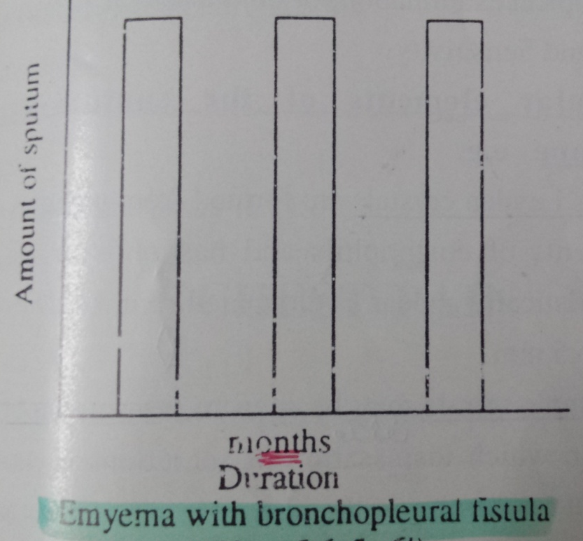

Slide 24
HEMOPTYSIS
Expectoration of sputum containing blood, varying in severity from slight streaking to frank bleeding.
It is an alarming symptom that may herald serious disease or massive hemorrhage.

Slide 25
Hemoptysis has to be differentiated from:
1- Epistaxis.
2- Spurious or false hemoptysis:its origin from above vocal cord 3- Hematemesis (Vomited blood).
Hemoptysis | Hematemesis
-Red, frothy, fresh bl. - Alkaline pH. - Resp. symptoms. - Bl. Streaked sputum | Dark & may contain food particles - Acidic pH. - GIT upset (dyspepsia). - Tarry stool.

Slide 26
HEMOPTYSIS causes
Pulmonary
Airways diseases
bronchitis
bronchiectasis
cystic fibrosis
Neoplasms
bronchogenic carcinoma
bronchial carcinoid
Inflammatory disorders
tuberculosis
pneumonia
lung abscess
aspergilloma
Pulmonary vascular diseases
pulmonary thromboembolism
pulmonary vasculitis
arteriovenous malformations
Cardiovascular
Mitral stenosis
Congestive heart failure
Miscellaneous
Use of anticoagulants or fibrinolytics

Slide 27
I) Evaluation of the patient: A) Assessment of severity of hemoptysis: - Mild → occasionally blood-streaked sputum. - Moderate → persistent blood-streaked. - Massive → coughing up 150 cc or more at once. → 400 cc or more within 3 hours. → 600 cc or more within 24 hours N.B.: Massive hemoptysis can be recognized by: 1) Physical exam. → hypotension – tachycardia – tachypnea. 2) Rate of hemorrhage → collection of blood in sputum cups. 3) Chest X-ray → diffuse opacity → large amount. 4) Arterial blood gas analysis → hypoxemia in massive one. 5) Hemoglobin level → for blood transfusion.

Slide 28
II) Treatment: Aim: (1) Patent airways. (2) Adequate gas exchange. (3) Hemodynamically stable patient.

Slide 29
DYSPNEA(difficult breathing)
Definitions :
Shortness of breath
“Difficult, labored, uncomfortable breathing”,
“awareness of breathing”,
“ inability to get enough air or experiencing air hunger”,
Suffocation

Slide 30
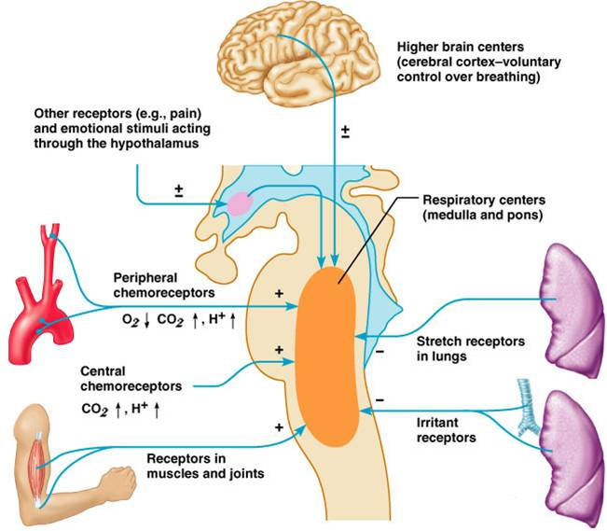
MECHANISMS OF DYSPNEA

Slide 31
Common Causes
Physiological
obesity , pregnancy,exercise,high altitude
Psychological
e.g. anxiety and stress
Pulmonary
e.g. Asthma, bronchitis, emphysema, pulmonary fibrosis, pulmonary hypertension and pleurisy.
Cardiac
e.g. heart failure, cardiomyopathy and pericarditis
Others
e.g. acute kidney failure,anemia,fever,hypothyroidism

Slide 32
Comment on dyspnea:
Onset,course,duration
Timing
Postural dyspnea
Grading,severity
Associated Preciptating,relieving factors

Slide 33
Mode of onset and course: 1- Sudden onset → pulmonary embolism, pneumothorax. 2- Acute → inhalation of fumes. 3- Subacute → (progressive over weeks) → pleural effusion. 4- Chronic (progressive over months or years) → COPD, IPF and Primary pulmonary hypertension. 5- Paroxysmal (intermittent) → in asthma.

Slide 34
Timing
Paroxysmal dyspnea during night:
Start ,after 2 hrs,early morning, at down time
Seasonal dyspnea

Slide 35
Postural Dyspnea
Orthopnea is the sensation of breathlessness in the recumbent position, relieved immediately by sitting or standing.
Paroxysmal nocturnal dyspnea (PND) is a sensation of shortness of breath that awakens the patient, often after 1 or 2 hours of sleep, and is usually relieved in the upright position for 5-15 minutes.( Patients with PND are functionally classified into NYHA class III)
Trepopnea is dyspnea that occurs in one lateral decubitus position as opposed to the other .
Platypnea refers to breathlessness that occurs in the upright positionand is relieved with recumbency, was originally described in: chronic obstructive pulmonary disease , Bilateral basal A-V malformations
Prayer’s position

Slide 36
The modified Medical Research Council (mMRC) scale The modified Medical Research Council (mMRC) scale is the most commonly used validated scale to assess dyspnea in daily living in chronic respiratory diseases
Grade | Description of Breathlessness
Grade 0 | I only get breathless with strenuous exercise
Grade 1 | I get short of breath when hurrying on level ground or walking up a slight hill
Grade 2 | On level ground, I walk slower than people of the same age because of breathlessness, or I have to stop for breath when walking at my own pace on the level
Grade 3 | I stop for breath after walking about 100 yards or after a few minutes on level ground
Grade 4 | I am too breathless to leave the house or I am breathless when dressing

Slide 37
CHEST PAIN
Questions to ask:
Onset,course,duration
Site,radiation
Character
What increases or decrease??
Severity

Slide 38
CHEST PAIN
Pulmonary causes:
– usually involves chest wall or parietal pleura
– lung parynchema has no pain receptors but pulmonary diseases may involve pleura
Pleuritic pain:
– most common symptom of pleurisy
– sharp, abrupt,stitching or stabing
– increases with inspiration and cough
-localized or refered.

Slide 39
Anginal pain
Squeezing ,
retrosternal,
radiates toward axilla and inner aspect of lt arm+others
>ex.,stress,meals cold
<rest nitroglycerin
D.D:abdominal ,muscular pain

Slide 40
NOISY BREATHING AND VOICE CHANGES
TERMS USED TO DESCRIBE NOISY
BREATHING:
Wheezing.
Stridor.
Snoring.
Hoarsenes of voice.

Slide 41
Chest Wheezes
Continous musical sound produced by narrowing of the airways:
– spasm, edema ,plugging
– pressure from surrounding masses,LN
Comment:onset course duration,timing,ass.sympyoms

Slide 42
WHEEZING
Normally results from bronchospasm or excess mucus or fluid.
Common in asthma but
“NOT ALL WHEEZING IS ASTHMA”
May occur in CHF - “cardiac wheezing”.
Localized in Br. carcinoma

Slide 43
D.D
Stridor:continous harsh sound caused by partial closure of upper airway mainly during inspiration as in croup

Slide 44
Past History
Previous:
Illnesses (pulm diseases may recur: TB, malignancies).
Operations.
Trauma to Chest/lungs.
Loss of consciousness,Epilepsy,coma
Current & past medications
Allergies.

Slide 45
Family History
TB,
Bronchial asthma
Emphysema
Heredofamilial bronchiactasis
Smoking

Slide 46
Social history & Smoking
Passive smoking increases the risk of respiratory infection and burning biomass fuels in confined spaces increases the risk of bronchitis and COPD.
Domestic pets, especially cats and rodents, may be the cause of suboptimal asthma control.
A pet bird, feather duvet or an infestation of mould may cause hypersensitivity pneumonitis or suboptimal asthma control.

Slide 47
Tobacco : - What? (cigarettes, goza) and how much?. - Use 'pack years' to estimate the risk of tobacco-related health problems . Calculating pack years of cig. smoking = (No of cig/day*No of years)/20 Mild smoker……………….up to 19 Moderate smoker………20-49 Heavy smoker………..≥ 50

