Slide 2
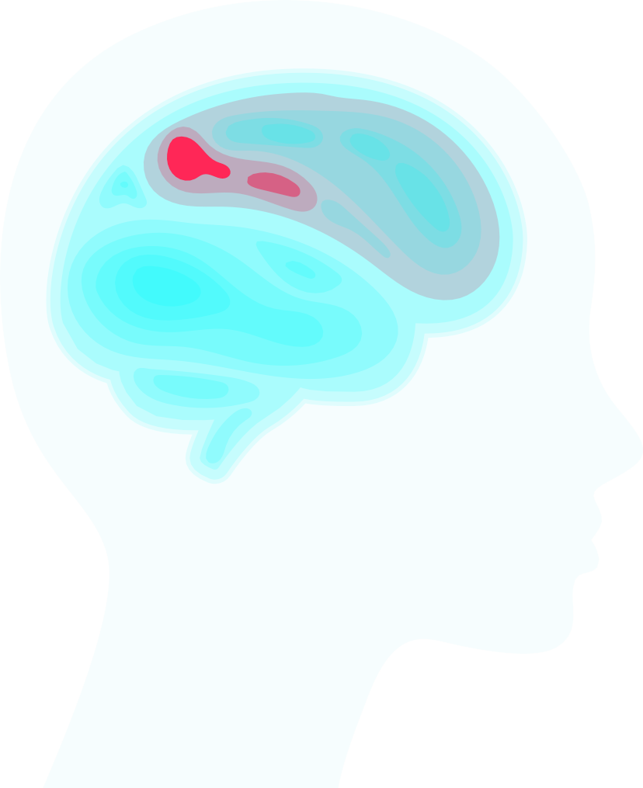
APPROACH TO UNCONSCIOUS
PATIENT
Rama Yasen
Maha Jamaliah

Slide 3
Table of contents
Definition
Taking History
2
Examination of an
unconscious patient
Types
6
Treatment
Causes

Slide 4
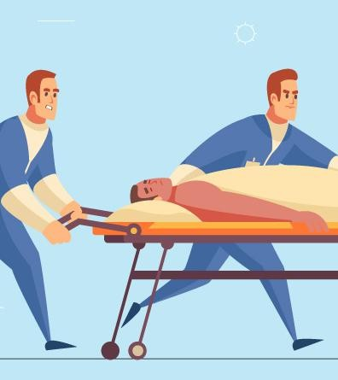
Introduction

Slide 5
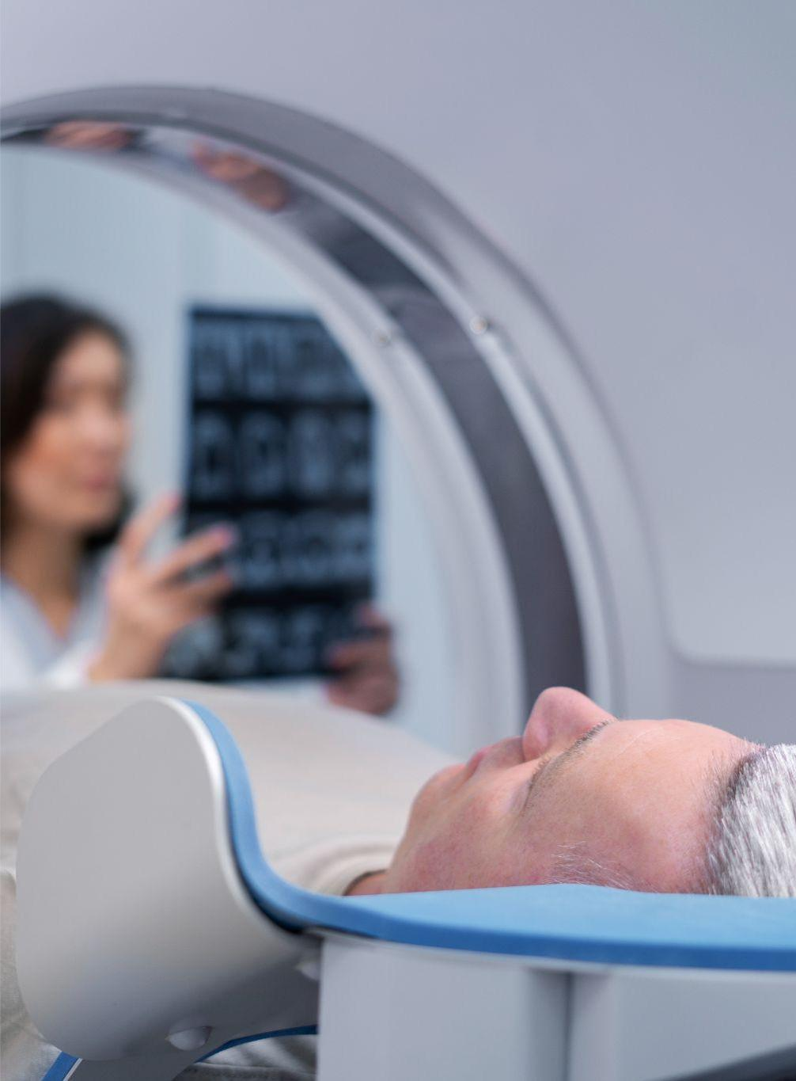
1
What is the Definition?
In medical terms, an “unconscious patient” a patient who’s in a state of altered consciousness and lacks awareness, and the ability to voluntarily interact with their environment.

Slide 6
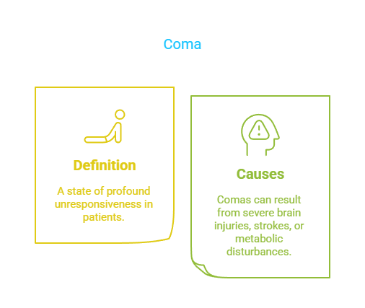
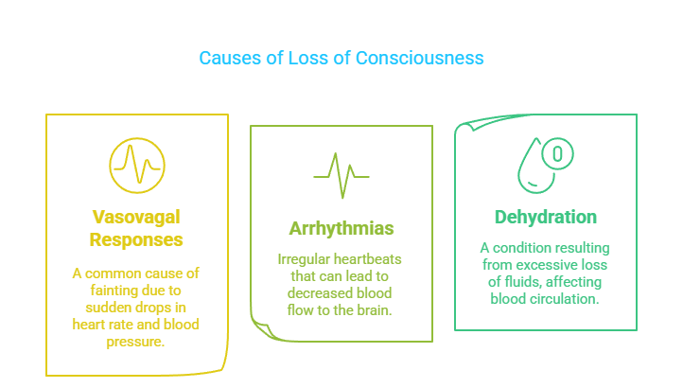
Types
2
1. Coma : A state of profound unconsciousness where the patient cannot be awakened and does not respond to stimuli.
Comas can result from severe brain injuries, strokes or metabolic problem.
2. Syncope : A temporary loss of consciousness due to a decrease in blood flow to the brain, often resulting from vasovagal responses, arrhythmias, or Dehydration.

Slide 7
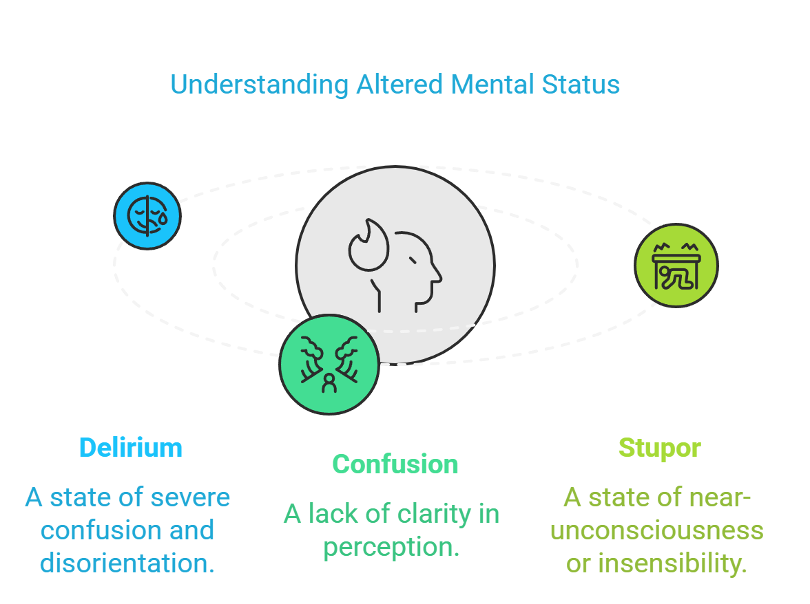
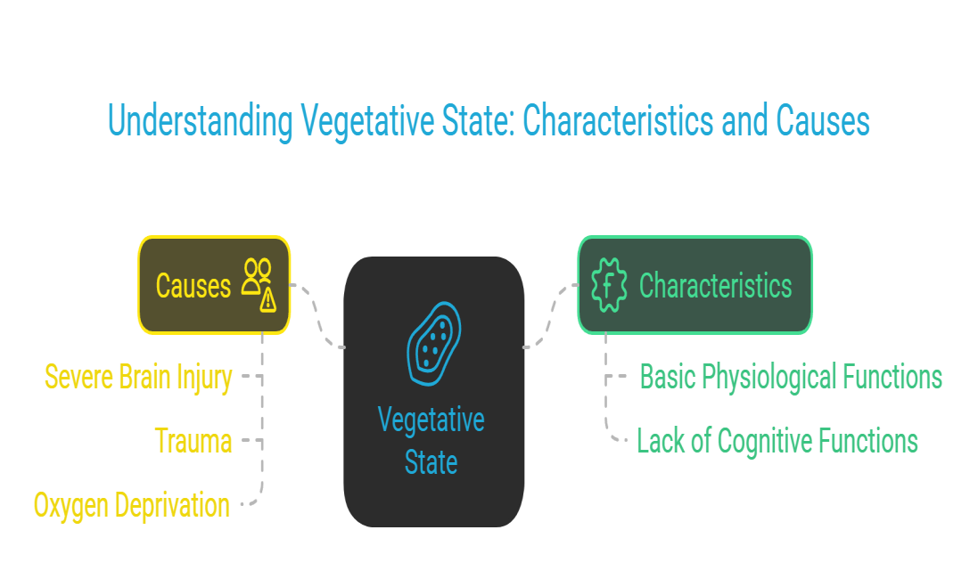
4. Vegetative State : A state in which the patient has lost cognitive functions but maintains basic physiological functions like breathing and heart rate.
3. Altered Mental Status : This is a term used to describe a range of consciousness levels between full alertness and unconsciousness.
It includes conditions like: delirium, confusion, or stupor, where individuals may not be fully aware of their surroundings.
This can occur after severe brain injury

Slide 8
Causes
3
Toxicological Causes
Alcohol intoxication
Drug overdose
Carbon monoxide
poisoning
3. Metabolic Causes
Hypoglycemia
Electrolyte imbalances (e.g., hyponatremia)
Hepatic encephalopathy (liver failure)
Uremic encephalopathy (kidney failure)
1. Trauma
Head injuries or severe physical injuries can lead to unconsciousness.
4. Neurological Causes
Stroke (ischemic or hemorrhagic)
Seizures
Brain tumors
Infections (meningitis,
encephalitis)
5. Cardiovascular Causes 6. Respiratory Causes
Cardiac arrest
Severe arrhythmias
Hypotension
Shock (septic, hypovolemic,
cardiogenic)
Hypoxia
Respiratory failure
choking

Slide 9
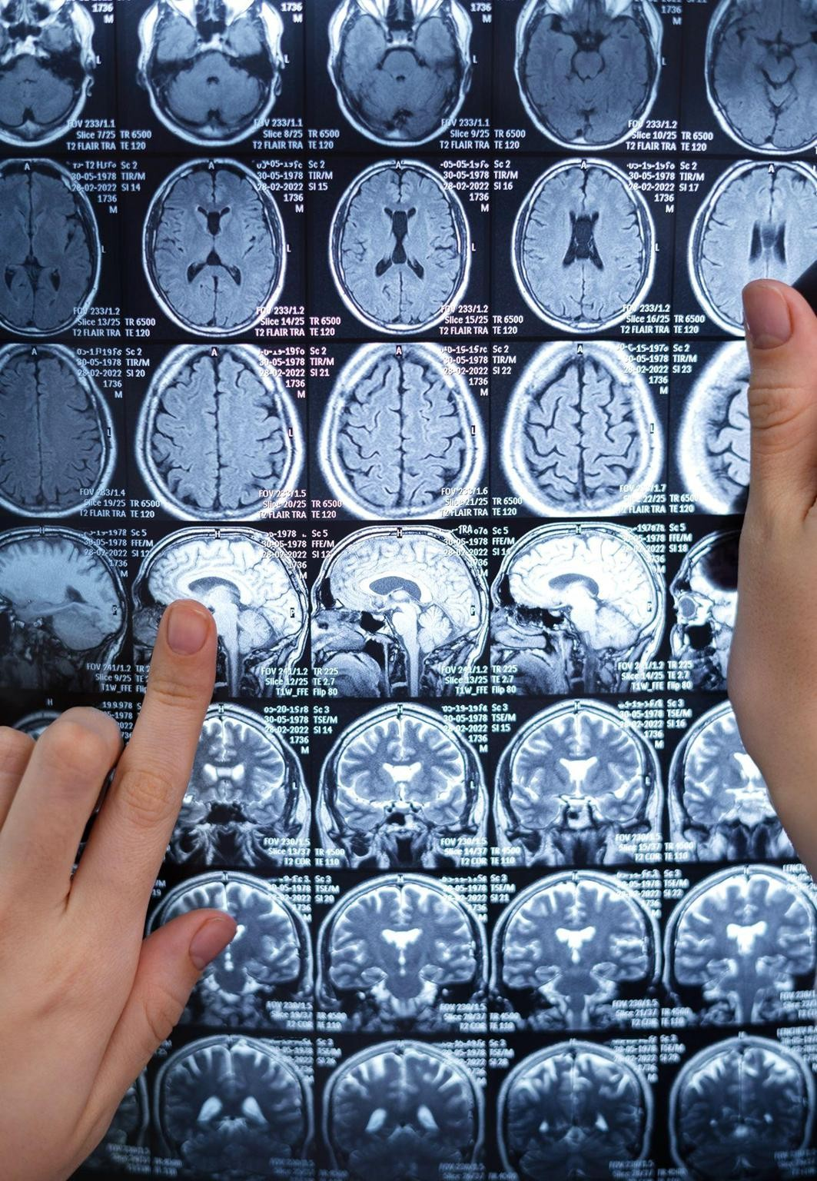
It's important to note that the underlying cause of unconsciousness varies widely and may require different approaches to evaluation and management. Medical evaluation is important when dealing with loss of consciousness to determine the cause and provide appropriate treatment.

Slide 10
4
Taking History

Slide 11
Accurate history-taking, even when the patient is unconscious, is critical for determining the cause and guiding further investigation and management.
2) Circumstances of the Event
Time of Onset: When was the patient last seen conscious? How long has the patient been unconscious?
Sudden or Gradual Onset.
Sudden onset may suggest (trauma, stroke, arrhythmia, or seizure).
Gradual onset may point to metabolic causes (e.g., hypoglycemia, intoxication)
Trauma: Was there any head injury? Look for external signs of injury or witness accounts of falls, accidents, or blows to the head
Poisoning or Overdose: Is there evidence of drug or alcohol use? Were there medications
or substances nearby (e.g., empty pill bottles, syringes)?

Slide 12
3) Preceding Symptoms
Witness Accounts: Did the patient experience any warning signs such as chest pain, shortness of breath, headache, confusion, or visual disturbances?
Seizure Activity: Any jerking movements, tongue biting, or incontinence that could indicate a
seizure?
Prodromal Symptoms of Syncope: Did the patient report dizziness, lightheadedness, or nausea before collapsing? Was there pallor or sweating before the event, which might indicate vasovagal
syncope?
4) Medical History
Previous Episodes: Does the patient have a history of similar episodes? Recurrent fainting, seizures, or comas?
Chronic Medical Conditions:
Diabetes (risk of hypoglycemia or diabetic ketoacidosis ) Hypertension (risk of stroke)
Epilepsy (risk of seizure-induced unconsciousness) Coronary artery disease (risk of myocardial infarction or arrhythmia) Chronic liver or kidney disease (risk of metabolic encephalopathy)

Slide 13
5) Medications ( Drug History )
Current Medications: Are there any medications known to cause sedation , hypotension,
or altered mental status
Common culprits include:-
Sedatives (benzodiazepines)
Opiates
Antihypertensive
Insulin or oral hypoglycemic agents.
Alcohol or Recreational Drugs: Ask about recent alcohol consumption or drug use (including opioids, stimulants, or hallucinogens), as these are common causes of altered
consciousness.
Toxic Exposures: Was the patient exposed to carbon monoxide, other gases, or toxins
6) Family History
Cardiac History: A family history of sudden cardiac death, arrhythmias, or heart disease.
Seizures or Neurologic Conditions: A family history of epilepsy or other neurological disorders.
Metabolic Disorders: Family history of diabetes

Slide 14
Examination of an unconscious patient
5
The goal is to quickly identify life-threatening causes, stabilize the patient, and begin appropriate management.
This is typically done using a structured approach known as ABCDE and involves further
investigations to diagnose the underlying cause.
Stabilization: vital signs, including heart rate, blood pressure, respiratory rate, temperature and oxygen saturation
Initial Approach: ABCDE Assessment:
Airway:
Look for signs of airway compromise: angioedema, cyanosis, see-saw breathing, use of accessory muscles
Listen for abnormal airway noises: stridor, snoring, gurgling
Open the mouth and inspect: look for anything obstructing the airway, such as secretions or
a foreign object

Slide 15
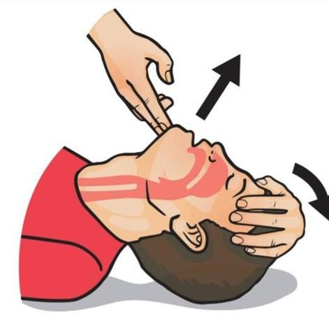
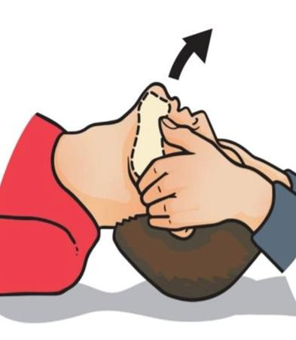
You can perform basic airway maneuvers
Head-tilt chin-lift maneuver
Jaw thrust
. 1. Place one hand on the patient’s forehead and the
If the patient is suspected of having suffered significant trauma with potential spinal
other under the chin
2. Tilt the forehead back whilst lifting the chin forwards involvement, perform a jaw-thrust rather than
to extend the neck
ahead-tilt chin-lift maneuver:
Identify the angle of the mandible
Place two fingers under the angle of the mandible (on both sides) and anchor your thumbs on the patient’s cheeks
Lift the mandible forwards
C. 3. Inspect the airway for obvious obstruction. If an
obstruction is visible within the airway, use a finger sweep or suction to try and remove it .
. 4. Be careful not to push it further into the airways .

Slide 16
2) Breathing:
Assess for adequate breathing by looking for chest rise, listening for breath sounds, and feeling for airflow.
Count the respiratory rate, and assess the oxygen saturation using pulse oximetry.
Look for signs of respiratory distress: cyanosis, labored breathing, or use of accessory
muscles.
Initiate oxygen therapy if saturation is low or there are signs of respiratory compromise.
3) Circulation:
Check pulse (carotid or femoral), heart rate, and blood pressure
Assess skin color, temperature, and capillary refill (normal refill < 2 seconds).
Look for signs of shock: hypotension, tachycardia, cold and clammy skin, or altered peripheral pulses.
Insert IV access and start fluid resuscitation if necessary (e.g., in cases of hypotension or shock).

Slide 17
4) Disability:
Assess the patient's level of consciousness :
Alert: the patient is fully alert
Confusion: the patient has new onset confusion or worse confusion than
usual
Verbal: the patient makes some kind of response when you talk to them (e.g. words, grunt)
Pain: the patient responds to a painful stimulus (e.g. supraorbital
pressure)
Unresponsive: the patient does not show evidence of any eye, voice or motor responses to pain
If a more detailed assessment of the patient's level of consciousness is
required, use the Glasgow Coma Scale (GCS).

Slide 18
5) Exposure:
Investigation
Laboratory tests | CBC, electrolytes, Calcium ‹BUN, creatinine, glucose plasma osmolarity, arterial blood gas
Toxicology screen | of blood and urine
Imaging studies | CT or MRI of the brain
Electrocardiogram (ECG) | to assess cardiac function.
LP (lumbar puncture ) | if meningitis or subarachnoid hemorrhage is suspected.
Expose the patient to assess for signs of trauma, rashes, needle marks, or
signs of poisoning.
Look for injuries, burns, or bleeding that might be contributing to
unconsciousness.
Maintain body temperature and
prevent hypothermia by covering the patient after

Slide 19
6
Treatment
1.Assess (ABC) :
Airway, breathing and circulation Intubation: if GCS ≤ 8
2. IV fluid: to support the circulation and if there is evidence of hypovolemia or shock

Slide 20
3. Administer medications to treat specific underlying cause that include
medications | underlying cause | medications | underlying cause | medications | underlying cause
Anti-seizure | seizure | Antidote | to treat drug overdose or remove toxins | Thrombolytics | acute ischemic stroke
Stabilize the cervical spine | trauma | IV naloxone | opioid overdose | Cefotaxime 2g bd | septic
Glucose | 200ml 10% glucose iv state of hypoglycemia | IV flumazenil | benzodiazepines toxicity | Artemisinin and quinine | malaria
IV thiamine | Wernicke’s encephalopathy | Epinephrine | anaphylaxis | IV acyclovir | encephalitis

