Slide 1
Leukemia 1
Dr. Omar Hamdan
Gastrointestinal and liver pathologist Mutah University School of Medicine-Pathology Department Undergraduate Lectures 2023

Slide 2
Definition
It is a group of malignant disorders, affecting the blood and blood forming tissue of the bone marrow, lymph system and spleen.
The word leukemia comes from the greek leukos which means "white" and aima which means "blood".
The stem cells are committed to produce specific types of blood cells. Lymphoid stem cells produce either T or B lymphocytes.
Myeloid stem cells differentiate into three broad cell types: RBCS, WBCS, and platelets.

Slide 3
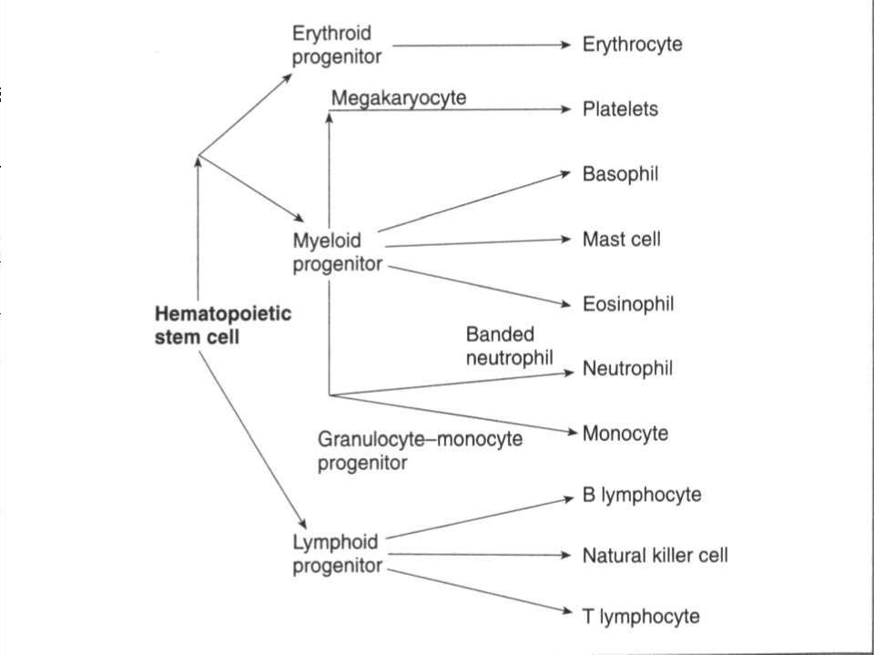

Slide 4
Function of bone marrow
The bone marrow is found inside bones. The marrow in the large bones of adults produces blood cells. Approximately 4% of our total body weight consists of bone marrow.
There are two types of bone marrow:
Red marrow, made up mainly of myeloid tissue.
Yellow marrow, made up mostly of fat cells.

Slide 5
Function of bone marrow
Red marrow can be found in the flat bones, such as the skull, vertebrae, shoulder blades, hip bone and ribs. Red marrow can also be found at the ends of long bones, such as the Humerus and femur.
White blood cells (lymphocytes), red blood cells and platelets are produced in the red marrow.
Yellow marrow can be found inside the middle section of long bones.

Slide 6
Function of bone marrow
WBCS, which help to body fight infection.
RBCs, which carry oxygen to all parts of the body.
Platelets, which help in blood clot.
If a person loses a lot of blood, the body can convert yellow marrow to red marrow in order to raise blood cell production.

Slide 7
Risk factors
Combination of predisposing factors including genetic and environmental influences:
1. Chronic exposure to chemical such as benzene
2. Radiation exposure.
3. Cytotoxic therapy of breast, lung and testicular cancer.
4. Congenital anomaly
5. The presence of primary immunodeficiency and infection with the human T –cell leukemia virus type-1

Slide 8
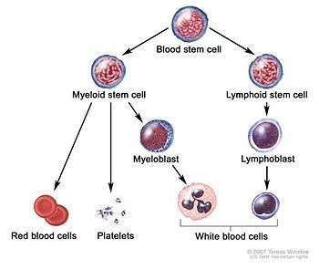
PATHOPHYSIOLOGY

Slide 9
Pathophysiology
The lack of control causes normal bone marrow to be replaced by immature and undifferentiated leukocytes or blast cells .
Abnormal immature leukocytes then circulates in the blood and infiltrate the blood forming organs (liver, spleen, lymph nodes) and other sites throughout the body.

Slide 10
Different types of leukemia
It may be acute or chronic.
Acute leukemia gets worse very fast and may make feel sick right away.
Chronic leukemia gets worse slowly and may not cause symptoms for years.
Lymphocytic and myelogenous leukemia are also subdivided into the type of affected blood cell.
If the cancerous transformation occurs in the type of marrow that makes lymphocytes, the disease is called lymphocytic leukemia.
If the cancerous change occurs in the type of marrow cells that produce red blood cells, other types of white cells, and platelets, the disease is called myelogenous leukemia

Slide 12
FRENCH -AMERICAN- BRITISH (FAB) CLASSIFICATION LEUKEMIA

Slide 13
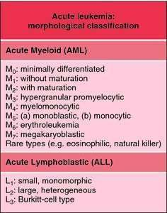

Slide 14
INCIDENCE
In adults, chronic lymphocytic leukemia (CLL) and acute myelogenous leukemia (AML) are the most common leukemia.
In children, the most common leukemia is acute lymphoblastic leukemia (ALL).
Childhood leukemias also include acute myelogenous leukemia (AML) and other myeloid leukemias, such as chronic myelogenous leukemia (CML) and juvenile myelomonocytic leukemia (JMML).

Slide 15
Relate to problems caused by bone marrow failure:
Overcrowding by abnormal cells, inadequate production of normal marrow elements, anemia, thrombocytopenia, ↓ number and function of WBCs.
Relate to problems caused by leukemic cells infiltrate patient’s organs:
Splenomegaly, hepatomegaly, lymphadenopathy, bone pain, meningeal irritation and oral lesions (chloromas)

Slide 16
Classification of leukemia
Acute lymphatic leukemia (ALL)
ALL is the most common childhood malignancy accounting for one-fourth of all childhood cancers and three-fourths of all newly diagnosed patients with acute leukemia. There is a peak in the incidence of childhood ALL, between the ages of 2 and 5 yrs. Boys have higher rates than girls, especially in adolescents with T cell ALL.

Slide 17
Classification of leukemia
Acute lymphatic leukemia (ALL) Pathophysiology :
It arising from a single lymphoid stem cell, with impaired maturation and accumulation of the malignant cells in the bone marrow.

Slide 18
The etiology of ALL
unknown in a majority of cases.
several genetic syndromes associated with an increased risk of leukemia.
10-20 fold increased risk of leukemia (ALL and AML) in children with down syndrome.
Other genetic syndromes associated with leukemia include bloom syndrome, fanconi anemia, neurofibromatosis, klinefelter syndrome, immunodeficiency and ataxia-telangiectasia.
Exposure to ionizing radiation, certain pesticides and parental smoking are associated with a higher incidence of ALL.

Slide 19
Acute lymphatic leukaemia
Signs and symptoms
Anemia, bleeding, lymphadenopathy, infection
Clinical manifestation | Clinical manifestation
Fever Pallor Bleeding Anorexia Fatigue | Weakness Bone, joint and abdominal pain

Slide 20
ALL CLINICAL PRESENTATION
Generalized lymphadenopathy
Infection of respiratory tract
Anemia and bleeding
Weight loss
Mouth sore
The duration of symptoms in a child with ALL may vary from days to weeks and in some cases few months. The clinical features of ALL are attributed to bone marrow infiltration with leukemic cells (bone marrow failure) and extramedullary involvement.

Slide 21
ALL CLINICAL PRESENTATION
Few patients (2-5%) show central nervous system involvement at diagnosis; most are asymptomatic but some have features of raised intracranial pressure.
The diagnosis of CNS leukemia is made on examination of the cerebrospinal fluid.
Overt testicular leukemia may be seen in about 1 % of cases. It presents with firm, painless, unilateral or bilateral swelling of the testes; the diagnosis is confirmed by testicular biopsy.
Other rare sites of extramedullary involvement include heart, lungs, kidneys, ovaries, skin, eye or the gastrointestinal tract.

Slide 22
L1 morphology: Lymphoblasts, are the most common subtype of childhood ALL (80-85%), have scant cytoplasm and inconspicuous nucleoli; these are associated with a better prognosis.
Patients in the L2 category: accounting for 15% cases, show large, pleomorphic blasts with abundant cytoplasm and prominent nucleoli.
Only 1-2% patients with ALL show L3 morphology: in which cells are large, have deep cytoplasmic basophilia and prominent vacuolation; these cells show surface imrnunoglobulin and should be treated as burkitt lymphoma.

Slide 23
Immunophenotype classification describes ALL as either B cell derived or T cell derived.
Progenitor B cell Derived ALL constitutes 80-85% ALL, 15% are derived from T Cells.

Slide 24
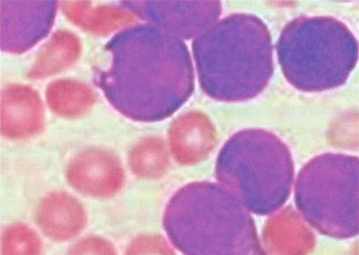
Bone marrow from a child with acute lymphoblastic leukemia shows reduced marrow elements and replacement by lymphoblasts. Neoplastic lymphoblasts are slightly larger than lymphocytes and have scant, faintly basophilic cytoplasm and round or convoluted nuclei with inconspicuous nucleoli and fine chromatin, often in a smudged appearance

Slide 25
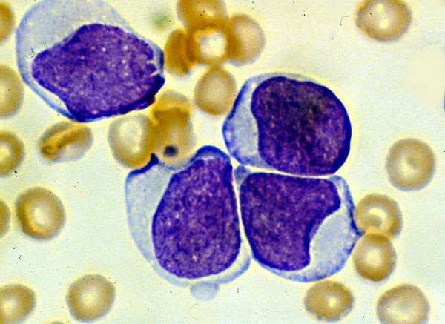
ALL Histology

Slide 26
Specific chromosomal translocations in ALL, including t(8;14, associated with burkitt leukemia) in B cell ALL, t(4;11) in infant leukemia and t(9;22) translocation, that forms the Philadelphia chromosome, are associated with a poor prognosis.

Slide 27
prognostic factors
The 2 most important prognostic factors are age at diagnosis and the initial leukocyte count.
Children less than 1-yr-old have an unsatisfactory prognosis; infant leukemia is often associated with t(4;11) translocation and high leukocyte counts. Children between the ages of 1 and 9 yrs do well. The presence of leukocyte count more than 50,000/mm3 at diagnosis is associated with a bad prognosis.
The presence of T cell leukemia is not a poor prognostic factor unless associated with other risk factors, including high leukocyte count, mediastinal mass or disease affecting the central nervous system at diagnosis.

Slide 28
Diagnosis and Differential Diagnosis
Clinical presentation and peripheral blood counts and morphology are indicative of the diagnosis of ALL.
Children may present with pancytopenia or hyperleukocytosis.
The diagnosis is confirmed by peripheral smear examination, bone marrow aspirate and biopsy. It is important to do both an aspirate as well as biopsy at time of initial diagnosis. Very rarely leukemic cells may be seen only in the biopsy specimen and not in the aspirate. Higher white blood cell counts are more common with T cell ALL.

Slide 29
Diagnosis and Differential Diagnosis
Bone marrow showing >25% lymphoblasts is diagnostic for ALL.
The clinical profile of acute lymphoblastic leukemia may mimic many other clinical conditions like infectious mononucleosis, acute infectious lymphocytosis, idiopathic thrombocytopenic purpura, aplastic anemia and viral infections like cytomegalovirus that result in leukemoid reactions and pancytopenia. Idiopathic thrombocytopenic purpura (ITP) is the most common cause of acute onset of petechiae and purpura in children. Children with ITP have no evidence of anemia and have normal total and differential leukocyte count. Bone marrow smear reveals normal hematopoiesis and normal or increased number of megakaryocytes. ALL must be differentiated from a plastic anemia, which may present with pancytopenia.

Slide 30
Diagnosis and Differential Diagnosis
ALL should be distinguished from other malignancies (neuroblastoma, Non-hodgkin lymphoma, rhabdomyosarcoma, Ewing sarcoma and retinoblastoma) that present with bone marrow involvement.
Morphologic, cytochemical, immunophenotypic and cytogenetic characteristics of the malignant cells should be done. Occasionally, patient with ALL may present with hypereosinophilia or as an emergency with very high white cell count (hyperleukocytosis, TLC > 1,00,000/mm3), life-threatening infections, hemorrhage, organ dysfunction secondary to leukostasis or signs and symptoms of superior vena cava or superior mediastinal syndrome.

Slide 31
Management
The management of acute leukemia needs the combined effort of a number of health professionals. Improvement in survival from ALL with modern therapy is one of the greatest successes in the field of pediatric oncology.
Improvement in supportive care and use of combination chemotherapy has led to a survival more than 80% overall and greater than 95% in children with low risk all. Treatment is determined by the risk of relapse in each patient.

Slide 32
The treatment on ALL is divided into 4 stages:
(I) Induction therapy (to attain remission)
(II) CNS prophylaxis or CNS preventive therapy
(III) Intensification (consolidation)
(IV) Maintenance therapy (continuation).
The average duration of treatment in ALL ranges between 2 and 2.5 yrs; there is no advantage of treatment exceeding 3 yrs.

Slide 33
Induction Therapy
The goal of this phase is to eradicate leukemia from the bone marrow such that at end of this phase there are <5% leukemic blasts in the bone marrow by morphology. Patients who achieve rapid early remission (<5% blasts in bone marrow) by day 7 or 14 of induction have a better prognosis than slow responders.
The drug regimen combining vincristine and prednisone induces remission in 80-95% patients with ALL. Since the remission rate and duration are improved by the addition Of a third and fourth drug (l-asparaginase and/ or anthracycline),
Current induction regimens include vincristine, prednisone, l-asparaginase and an anthracycline, with remission achieved in 95-98% of cases. The induction therapy lasts for 4-6 weeks.

Slide 34
CNS Preventive Therapy
Most children with leukemia have subclinical CNS involvement at the time of diagnosis and this acts as a sanctuary site where leukemic cells are protected from systemic chemotherapy because of the blood brain barrier. The early institution of CNS prophylaxis is essential to eradicate leukemic cells which have passed the blood brain barrier.
CNS prophylaxis has enabled increased survival rates in leukemia. Most children in the past received a combination of intrathecal methotrexate and cranial irradiation. However, there is considerable concern regarding long term neurotoxicity and risk of development of brain tumors following this therapy. In order to achieve effective CNS prophylaxis while minimizing neurotoxicity, experts now recommend a lower dose of cranial irradiation with intrathecal methotrexate.

Slide 35
Intensification (Consolidation) Therapy
This is a period of intensified treatment administered shortly after remission induction with administration of new chemotherapeutic agents to tackle the problem of drug resistance. There is clear evidence that intensification has improved the long term survival in patients with ALL, especially those with high-risk disease. Commonly used agents for intensification therapy include high dose methotrexate, l-asparaginase, cytarabine and cyclophosphamide.

Slide 36
It has been estimated that approximately two to three logs of leukemic blasts are killed during the induction therapy.
Additional therapy is therefore necessary to prevent a relapse. Once remission is achieved, maintenance therapy is continued for an additional 2-2.5 yr. Without such therapy, patients of ALL relapse within the next 2-4 months.
A number of drug combination and schedules are used. The main agents used include 6- Mercaptopurine daily and methotrexate once a week given orally, with or without pulses of vincristine and prednisone or other cytostatic drugs.

Slide 37
Infant ALL
Outcome of ALL remains poor in this group of patients even with very intense therapy including stem cell transplant.
Only 30-40% of children with MLL t(4;11) gene rearrangement are cured. Role of transplantation remains controversial.
Therapy usually includes high dose Cytarabine and methotrexate in addition to standard ALL therapy.

Slide 38
Supportive Care
Because of the complications encountered with treatment and the need for aggressive supportive care like blood component therapy, detection and management of infections, nutritional and metabolic needs and psychosocial support, these children should be treated at centers with appropriate facilities.
These children should be given cotrimoxazole as prophylaxis against pneumocystis jiroveci pneumonia.
They should be vaccinated against hepatitis B infection and screened for HIV infection.
Oral hygiene should be taken care of.

Slide 39
Prognosis
Hypodiploidy, philadelphia chromosome positivity, T cell ALL, MLL rearrangement, age <1 yr and > 10 yr, leukocyte count >50,000 / cu mm and presence of CNS disease are poor prognostic features.
More that 80% of children with ALL are long term survivors in the developed countries. However, survival remains poor in the developing nations, chiefly due to infection related mortality.

Slide 40
Down Syndrome and Acute Leukemia
Children with trisomy 21 have a 15-20 fold higher risk of acute leukemia as compared to general population .

