Slide 1
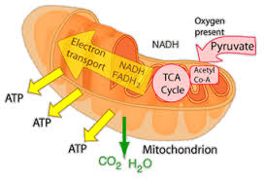
Citric Acid Cycle
Dr. Nesrin Mwafi
Biochemistry & Molecular Biology Department
Faculty of Medicine, Mutah University

Slide 2
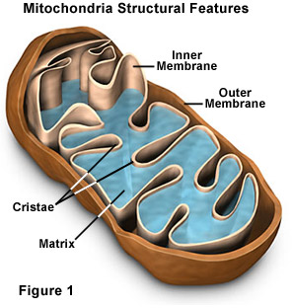
Citric Acid Cycle
Citric acid, Tricarboxylic acid cycle (TCA) or Krebs cycle is a central pathway used by all aerobic organisms to generate energy through the oxidation of acetate (in the form of acetyl CoA) into CO₂ and ATP. Also it releases the energy-rich molecules: NADH and FADH2
It occurs in mitochondrial matrix except reaction 6 in which succinate dehydrogenase enzyme is found in inner mitochondrial membrane (it is the only transmembrane protein in Krebs cycle)

Slide 3
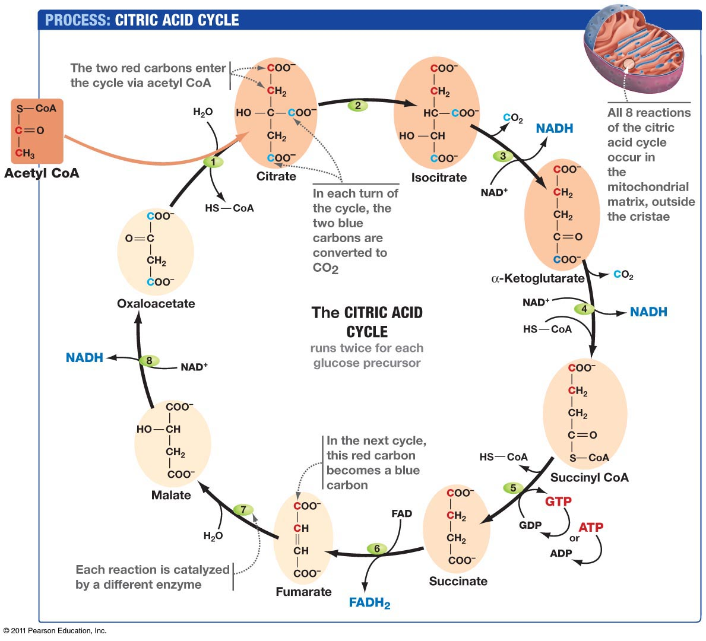
Citric Acid Cycle
aconitase
Isocitrate
dehydrogenase
citrate synthase
α-ketoglutarate
dehydrogenase
complex
malate
dehydrogenase
fumarase
Succinyl CoA
synthase
succinate
dehydrogenase

Slide 4
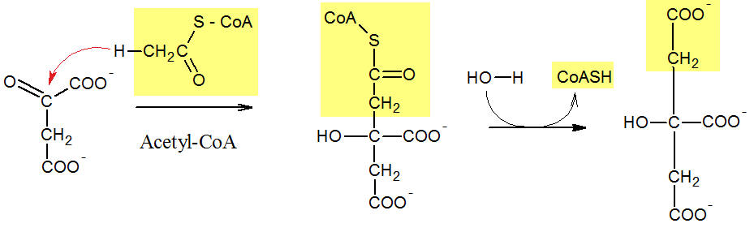
Citric Acid Cycle
Krebs cycle is a series of 8 reactions run twice / glucose molecule:
Step 1: The irreversible condensation of acetyl CoA (2C) and oxaloacetate (4C) via citrate synthase to form citrate (6C)
Oxaloacetate
Citrate

Slide 5
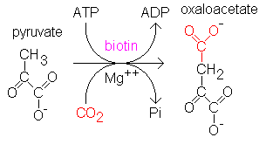
Citric Acid Cycle
Oxaloacetate is already found in matrix. It can be produced in several ways in nature. For example, it is generated from an ATP-dependent carboxylation of pyruvate catalyzed by pyruvate carboxylase. This reaction occurs in the matrix
Step 2: Aconitase enzyme catalyzes the reversible isomerization of citrate to isocitrate (isomers differ in the position of OH group from C3 to C2)
Pyruvate
carboxylase

Slide 6
Citric Acid Cycle
This isomerization reaction is pre-required step to prepare substrates for decarboxylation reaction
It involves successive dehydration and hydration
reactions
3
3
2
2

Slide 7
Citric Acid Cycle
Step 3: Isocitrate dehydrogenase catalyzes the first oxidative decarboxylation of isocitrate (6C) to α-ketoglutarate (5C) resulting in the release of first CO₂ and the formation of first NADH molecule
It involves successive oxidation and decarboxylation reactions

Slide 8
Citric Acid Cycle
Step 4: α-ketoglutarate dehydrogenase complex catalyzes the oxidative decarboxylation of α-ketoglutarate (5C) to succinyl CoA (4C) releasing the second CO₂ and producing the second NADH molecule

Slide 9
Citric Acid Cycle
Step 5: Succinyl CoA synthetase generates the first ATP (e.g. brain & heart tissues) or GTP (e.g. liver tissues). The thioester bond of succinyl-CoA is energy-rich and can drive the phosphorylation of ADP or GDP

Slide 10
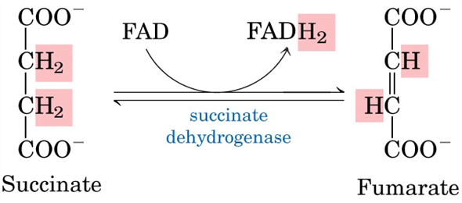
Citric Acid Cycle
Step 6: Succinate dehydrogenase catalyzes the oxidation of succinate to fumarate and consequently, the reduction of prosthetic group FAD into FADH₂

Slide 11
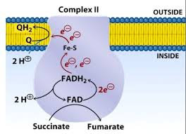
Citric Acid Cycle
Succinate dehydrogenase is the only enzyme found in the inner membrane of mitochondria
FAD is more powerful oxidizing agent than NAD⁺
It is stereoselective enzyme and only the trans isomer “fumarate” is formed but not the cis isomer “maleate”
H
H
H
H
( )

Slide 12
Citric Acid Cycle
Step 7: Fumarate is converted to L-malate in a hydration reaction catalyzed by fumarase (reversible reaction)
Fumarase is a stereospecific enzyme

Slide 13
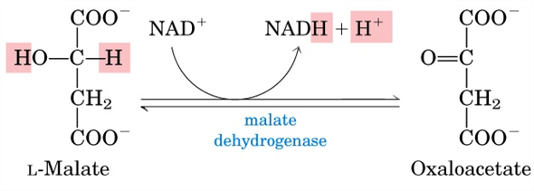
Citric Acid Cycle
Step 8: L-malate is oxidized to regenerate oxaloacetate via malate dehydrogenase enzyme thus generating the third NADH (reversible)
At the end of krebs cycle, the products of oxidation of one glucose via glycolysis and TCA are:
4 ATP + 6 CO₂ + 10 NADH + 2 FADH2

Slide 14
ATP Yield per one Glucose
Stage | ATP produced by substrate-level phosphorylation
Glycolysis | 2 ATP
Acetyl CoA production | none
Krebs Cycle | 2 ATP
Total/glucose 4 ATP molecules
Stage | Electron-carrier molecule | Total H⁺ pumped | ATP synthase 4H⁺ 1 ATP
Glycolysis | 2 NADH | 12-20 | 3-5 ATP
Acetyl CoA production | 2 NADH | 20 | 5 ATP
Krebs Cycle | 6 NADH 2 FADH₂ | 60 12 | 15 ATP 3 ATP
Total/glucose 26-28 ATP produced by oxidative phosphorylation

Slide 15
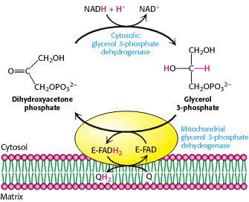
Cytosolic NADH Shuttling
The electrons carried by cytosolic NADH (i.e. NADH generated by glycolysis) will be shuttled to the matrix by one of two mechanisms:
DHAP/G3P shuttle: it is active in brain and skeletal muscle. This pathway delivers the 2e from cytosolic NADH to mitochondrial FAD

Slide 16
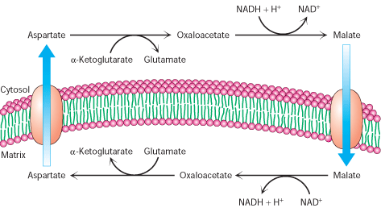
NADH Shuttling
Aspartate/malate shuttle: it is active in liver and heart. This pathway delivers the 2e from cytosolic NADH to mitochondrial NAD⁺ (found in the matrix)

Slide 17
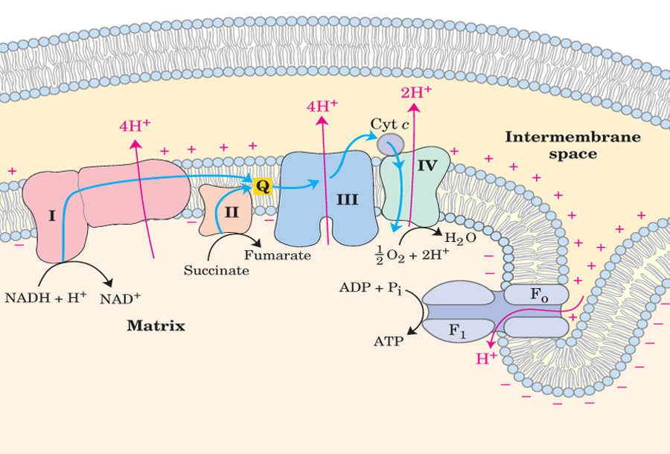
Oxidative Phosphorylation
FADH₂
TCA is considered as a part of aerobic metabolism although it does not use O₂ in any of its reaction ??

Slide 18
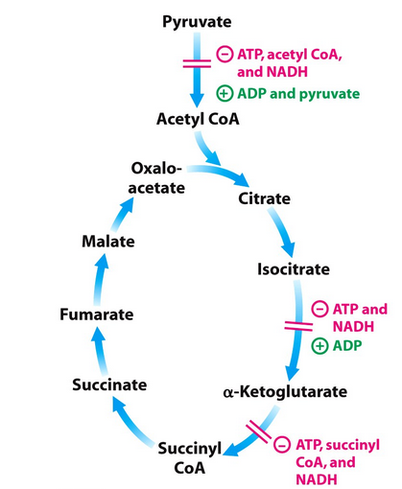
TCA Cycle Regulation
Reactions 3 and 4 are key sites for allosteric regulation:
Isocitrate dehydrogenase is activated by ADP and directly inhibited by NADH and ATP
α-ketoglutarate dehydrogenase activity is inhibited by NADH, ATP and succinyl-CoA

Slide 19
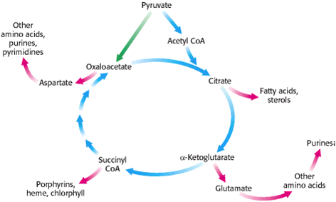
Biosynthetic Role of TCA Intermediates
In addition to its role in catabolism and energy generation, TCA intermediates have anabolic role in biosynthesis of other molecules:
2
2
3
3
2
2
1
1

Slide 20
Biosynthetic Role of TCA Intermediates
Succinyl CoA is used in synthesis of heme and other porphyrins
Oxaloacetate and α-ketoglutarate are converted by transamination to the corresponding amino acids aspartate and glutamate, respectively
Citrate in some tissues is transported to cytosol where it is converted back to acetyl CoA for fatty acids biosynthesis

Slide 21
Anaplerotic Pathway
Anaplerotic pathways (from Greek word meaning filling up) are the processes that replenish TCA intermediates so that the flow of carbon out of the cycle is balanced by these reactions
Reactions that replenish oxaloacetate:
Pyruvate carboxylase (PC) catalyzes the irreversible ATP-dependent carboxylation of pyruvate to generate oxaloacetate (occurs in the matrix)

Slide 22
Anaplerotic Pathway
Transamination replenish TCA intermediates:
Transamination are reversible reaction in which an
amino acid loses an amino group thereby converted
itself to a keto acid
For example glutamate and aspartate undergo transamination to generate the TCA intermediates α-ketoglutarate and oxaloacetate, respectively

