Slide 1
Alveolar ventilation
Dr. Arwa rawashdeh

Slide 2
Continued mechanics of breathing Forced inspiration
In forced inspiration ; sternocloidmastoid connects to the sternum, the anterior middle and posterior scalenes lateral side of the neck and they also connected to the rib , for the well developed the pectoralis minor they connect to the third fourth and fifth rib.
Increase the thoracic cavity even more than the quiet inspiratory muscles Intrapleural pressure is -7mmHg, intrapulmonary pressure is -2mmHg
F= p1-p2/R more air would flow in as the difference increases between the atmospheric pressure and the intrapulmonary pressure

Slide 3
Quit expiration
During quit expiration no muscles are involved is a passive process
Depends upon the elasticity of the lung ; assume the smallest size as possible
E= ∆ pressure/ ∆ volume
During expiration we want the volume to decrease so the elasticity would increase
Stretch receptors inside the lung and bronchi is going to inhibited the ventral respiratory group nucleus inside the medulla and relax the quite inspiration . The diaphragm would goes up and decrease the volume of thoracic cavity and increase the pressure according to
boyels law P 1\V
The intrapleural pressure is going back from -6 to -4mmHg and the lung is trying to recoil thus it pulling the visceral parietal from the parietal but because they are sticky to each other the visceral would pull the parietal and increase the pressure the intrapulmonary pressure is going to increase +1mmHg above the atmospheric thus the air would flow out until equilibrate with atmospheric pressure

Slide 4
Forced expiration
Forced expiration needs muscles; abdominal wall muscles like external oblique and internal oblique, transverse abdominis and to the little degree rectus abdominis, when these muscle are contracting they increase the intraabdominal pressure and pushing against the relaxed diaphragm thus decreasing the thoracic cavity
Intrapleural pressure would be more positive about -3mmHg and the intrapulmonary pressure +2mmHg thus more air would flow out until equalize with atmospheric pressure

Slide 5
Respiratory mechanics
Ventilation
External respiration alveolar ventilation and blood gas exchange between alveoli and blood
Transport
Internal respiration blood gas exchange between blood and the cells
Cellular respiration in mitochondria

Slide 6
Alveolar ventilation
We are going to talk briefly on gas partial pressure to understand the dynamic of how oxygen and carbon dioxide into and out of blood stream
Clinically they are very important because you have to notice the term used when interpreting blood gas exchange

Slide 7
Mole fraction
Barometric or atmospheric pressure is a random thermal motion of all molecules
Nitrogen 76%
Oxygen 20%
Water vapour 3%
Carbon dioxide 0.04%
Fraction
The fraction of the gas is the total gas percentage to the total gas mixture

Slide 8
Partial pressure
barometric pressure is 760mmHg the total pressure P total based on Daltons law
PN + PO2+ PH20+ PCO2
if you add up all pressures you come up approximately with 760mmHg

Slide 9
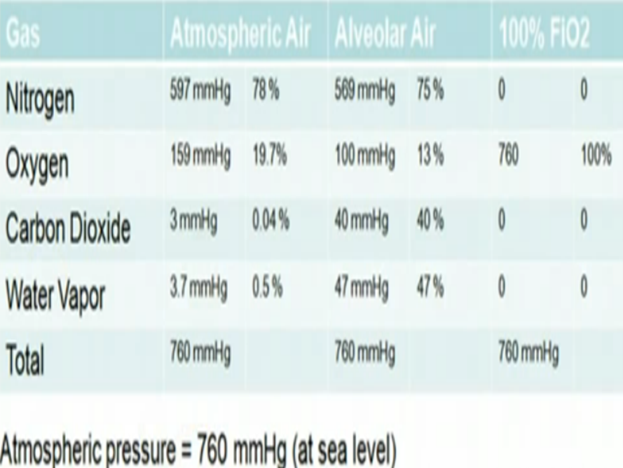
Implication of Daltons law
When we breath in the gases get mixed with our alveoli because it is a large space where gases diffusing in and out of our blood and gases coming through our airway are getting mixed so the partial pressure and fraction within our alveoli look a little bit different
Oxygen dissolving in our blood stream the PO2 is lower about 100-106mmHg
CO2 is diffusing out of our blood stream into the alveoli so it is quit higher
If we increase the fraction of oxygen that we breath in then theoretically we are going to inhale 100% of oxygen and the patrial pressure is going to be 760mmHg

Slide 10
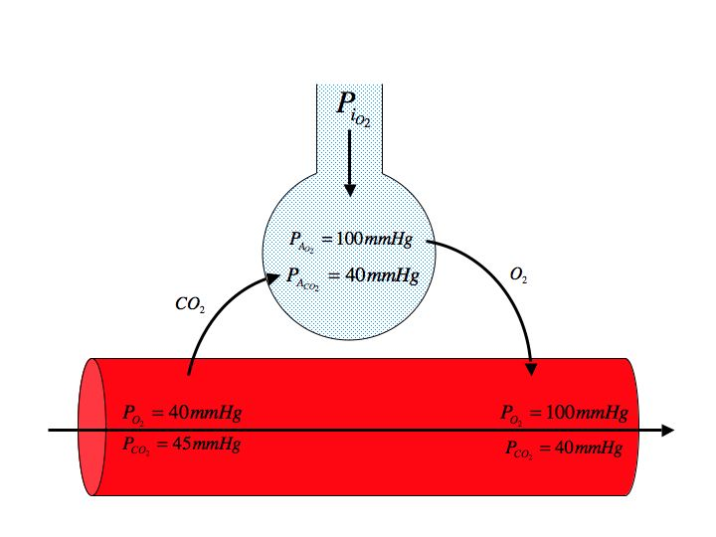
106mmHg of oxygen and 40mmHg to 50mmHg of CO2 inside the alveoli
In order for the gas to go through the blood gas barrier the gas particles need to dissolve first and then they need to diffuse to bloodstream
CO2 is 20 times soluble than the oxygen it diffuses much quicker
So the concentration of CO2 dropped down to 35-45mmHg and this is the normal value of Arterial Blood Gas ABG
O2 is going to drop down from 80-100mmHg and again this the ABG value of oxygen
This is clinically really relevant if you have a person with hypoventilation and say the patient is going to breath 4 times a minute , the CO2 is going to climb much bigger and it going to take a while for oxygen to drop. So for hypoventilation tends to cause hypercapnia first

Slide 11
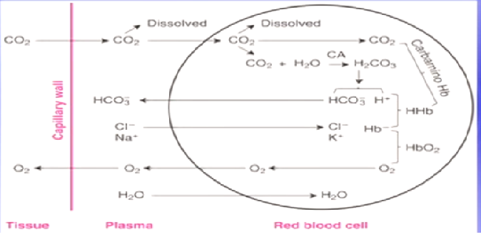
O2
After diffusing into the capillaries is taken by hemoglobin and instantly it decreasing the partial pressure of oxygen and this make more room of oxygen and this allow to carry many times more oxygen than it would be otherwise
1.5% of oxygen is dissolved
98% of oxygen is carried by hemoglobin
CO2
7% because more readily dissolved
23% carboxyhemoglobin
70% H2CO3

