Slide 1
3- Pulmonary Circulation. By Dr. Sherif W. Mansour Prof. of Physiology , Mutah school of Medicine . 2023/2024

Slide 3
The pulmonary circulation
The pulmonary circulation is that part of circulation which lies between the right ventricle and left atrium.
•The pulmonary circulation is characterized by:
1)The wall of right ventricle and pulmonary vessels are 30% of left ventricle and aortic thickness.
2)The volume of the blood in pulmonary vessels is about one liter of which about 100 ml in capillaries.
3)The pulmonary vascular system is distensible low pressure system in which the pulmonary artery pressure = 24/10 mmHg (average 15 mmHg) and the left atrium pressure = 5 mmHg, so the driving force for blood return = 15-5 = 10 mmHg (in systemic circulation = 100-0= 100 mmHg).
4)The mean velocity of the blood in the pulmonary artery = 0.4 m/sec. and the blood travel across pulmonary capillary in 0.75 sec. during rest and 0.3 sec. during exercise.
5)The pulmonary capillaries are large, with many anastomosis and exposed to –ve intrathoracic pressure.

Slide 4
6)The lungs are the only organs which receives 101% of cardiac output (all C.O.P of Rt. vent + 1% of COP of left ventricle to the bronchial arteries).
7)The pulmonary artery carries non-oxygenated blood & the pulmonary veins carry oxygenated blood.
8)The pulmonary odema is rare and very serious conditions, if occur acutely it leads to death within one hour from sever hypoxia and heart failure.
9)Safety factors against pulmonary odema are:
a) Low pulmonary capillary pressure (10 mmHg) while the osmotic (oncotic) pressure of plasma proteins = 25 mmHg, so alveoli are always dry.
b) Surfactant decreases surface tension, which attract fluid towards alveoli.
c) The rich lymphatic circulation carries any fluid remains out the capillaries.

Slide 5
* Factors controlling pulmonary blood flow:
1) Nervous control:• Sympathetic stimulation via alpha adrenoceptors → VC of pulmonary bl. vs → decrease bl. flow by 30%.
•Parasympathetic stimulation via muscurinic receptors → VD of pulmonary bl. vs →increase bl. flow.
2) Oxygen & Co₂:
- ↓O₂ & ↑ Co­₂ levels as in obstruction of bronchi → vasoconstriction of the pulmonary vessels in this area of hypoxia to shift blood to well ventilated area (this occur in localized hypoxia).
- But in generalized hypoxia (↓O₂ inspired) → generalized VC of pulm. vessels →↑ pulmonary pressure → opening of closed capillaries →↑ surface area for gas exchange →↑O₂ supply & Co₂ loss.
3) Chemical regulation:
a- Pulmonary arterioles are constricted by: catecholamines, angiotensin-II, thromboxane-A₂ prostaglandin-F_{2α} , dopamine, phenylephrine.
b- Pulmonary arterioles are dilated by: acetylcholine, histamine, bradykinin, prostaglandin I₂, Ca⁺⁺ channels blocker,↑O₂ and endothelium derived substance as nitric oxide.

Slide 6
4) Physical regulation:
a) Effect of gravity:
• In recumbent position: 400 ml of bl. is shifted to pulmonary circulation.
• In standing up: This blood shifted to lower limb and the basal parts of the lung has more blood than the apical parts.
b) Effect of cardiac output:
- ↓ COP as in haemorrhage → ↓ pulm. circulation and also pulm. vasoconstriction occur.
- ↑ COP →↑ pulm. flow with more opening of capillaries.
c) Effect of Respiratory movement:
-Inspiration →↑ negativity of intrapleural pressure →↑ venous return →↑ pulm. bl. flow but the pulmonary pressure decreases due to passive widening of pulmonary vs. under the negative intrathoracic pressure - Expiration → the reverse effects.
- Forced expiration against closed glottis (valsalva’ maneuver) → +ve IPP → compression of pulm. vessels → ↓ flow but lead to increase in the pulm. pressure.

Slide 7
Functions of the pulmonary circulation:
1- Gas exchange 2- Defensive function 3- Blood reservoir
4- Metabolic function 5- Removal of thrombi (filtering).
Physiologic shunts:
It was observed that:
- O₂ tension in alveoli & pulm. veins = 100 mmHg
- O₂ tension in arterial bl. = 95 mmHg
This is because some venous blood (2%) passes directly to the arterial blood without oxygenation in the alveoli :
1- Venous blood from some parts of lung parenchyma are drained directly into the pulmonary veins.
2- Some coronary venous blood drained directly into the left heart.

Slide 8
N.B.: Regional pulmonary blood flow: (Gravity effect)
• In upright position the pulmonary blood flow at base of the lung = 5 times as at lung apex and the pulmonary pressure in base is higher than at apex by 23 mmHg.
• The pulmonary blood flow depends on either the pressure inside the capillaries and outside the capillaries (alveolar pr.). So, the lung can be classified into 3 zones according to blood flow in relation to cardiac cycle:
Zone I: No blood flow at all (alveolar pressure > capillary pressure)
Zone II: Blood flow occurs only during systolic pressure but the diastolic pressure is less than alveolar pr.
Zone III: continuous blood flow as the blood pressure is always above alveolar pressure in both systole & diastol.

Slide 9
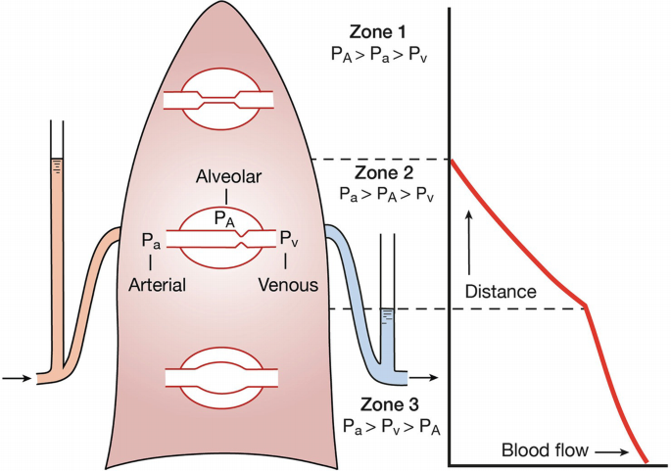
1
5

Slide 10
-In normal healthy lung during standing, there are zone II (Apex) and zone III (at base) and during recumbent position all lung are of zone III.
So, in cases of hypertension with more blood flow to the lung during lying down lead to severe dyspnea.
-Zone I presents abnormally if the person breaths air under positive pressure in which intra-alveolar pressure reaches 10 mmHg also occur in hypovolemic shock.
-During muscular exercise the pulmonary blood flow increases in all parts of the lung via opening of new capillaries especially the apex which was already closed capillaries during rest.

Slide 11
Thank You

