Slide 1
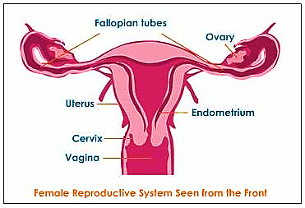
The Female genital system Professor Dr. Hala El-mazar

Slide 2
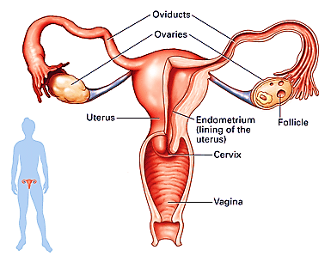
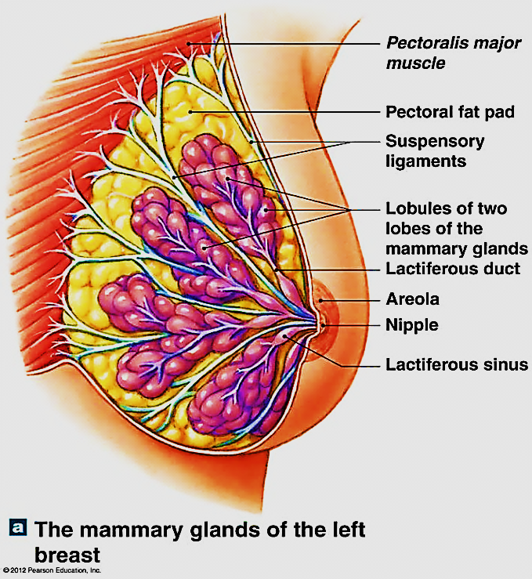
The female genital system composed of:
2 ovaries
2 Oviducts (fallopian tubes)
Uterus
Vagina
External genitalia
2 mammary glands

Slide 3
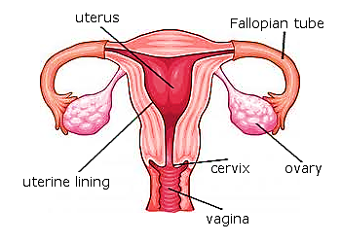
Function of the female genital system:
1- Produce Female hormones: ovaries→ secrete estrogen &
progesterone (endocrine function)
2- Produce female gametes : ovaries → [ova: oocytes]
(exocrine function)
3- Support & protect developing
Embryo in the uterus

Slide 4
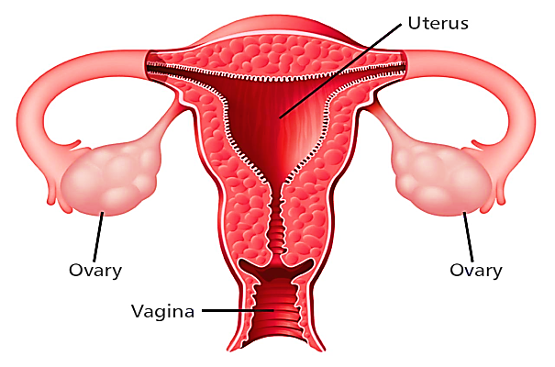
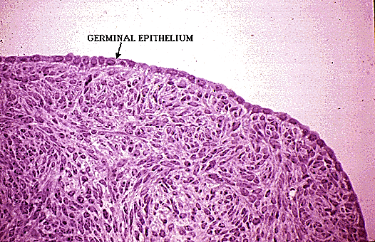
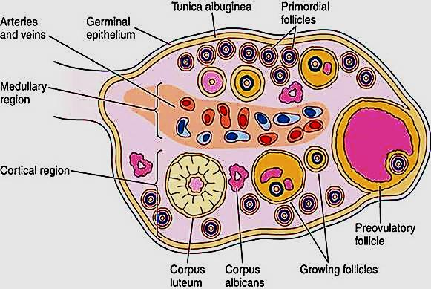
The ovary
Ovoid organ located in the pelvic cavity
Its outer surface is covered by a layer of simple cuboidal epithelium called germinal epithelium
The epithelium rests
directly on CT capsule of
the ovary: tunica albuginea

Slide 5
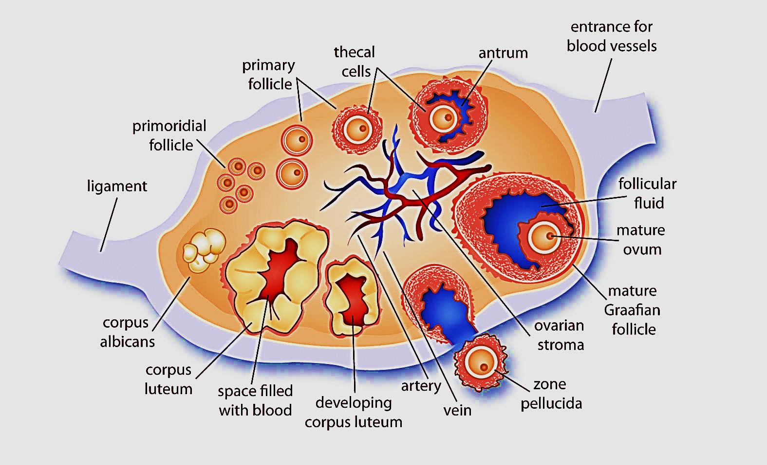
The ovary
Is formed : cortex & medulla
The cortex : contains ovarian
follicles at various stages of
development,
separated by CT contains
spindle - shape stromal cells
The medulla: highly vascular
CT, lymphatic's , nerves

Slide 6
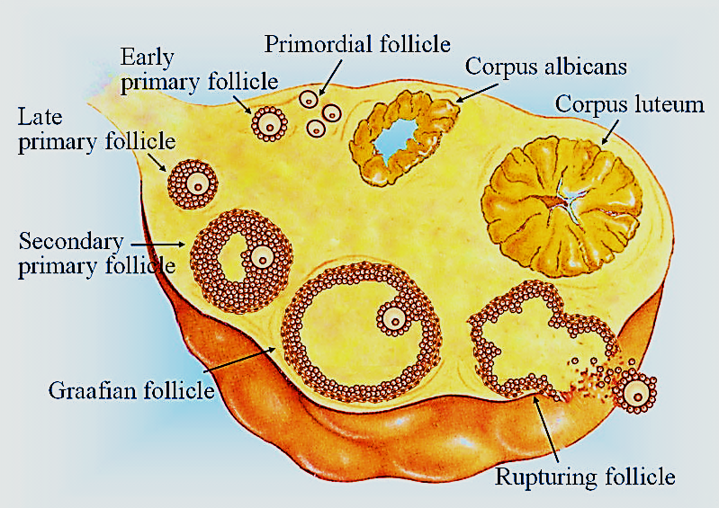
Ovarian follicles
Found mainly in the ovarian cortex
Their proliferation occurs at puberty & under the effect of FSH
Primitive germ cells called oogonia
surrounded e single layer of
follicular cells
At puberty the ovaries contain
about 400,000 follicles. However
Only about 450 are liberated
the rest become atretic

Slide 7
Types of ovarian follicles
1-Primordial follicles
2- Primary follicles:
(uni or multi-laminar)
3- Secondary follicles: antral
4- Mature Graafian follicles
5- Atretic follicles

Slide 8
A- Oogenesis
Is the process of formation of female gamete, occurs
before birth
1- Proliferation:
During fetal development (1st trimester), oogonia in the fetal ovary divide by mitosis to give rise to a large # of oogonia ( 7 millions/ 2 ovaries)
2- Growth: ( 2nd trimester)
mitotic division stops producing any more oogonia
The oogonia will enter the prophase of 1st meiotic division & stop → then called 1ry oocytes
Primary oocytes will remain in arrested development in prophase of meiosis 1 until puberty

Slide 9
By the beginning of 3rd trimester, most oogonia have completed their change into 1ry oocytes which become surrounded with follicular cells
(Ovarian follicle : oocyte surrounded by one or more
layer of epithelial cells )
B- Folliculogenesis (At puberty)
Each month, FSH cause several follicles to mature.
Throughout folliculogenesis from 1ry follicle→ mature follicle, oocyte is arrested in the prophase of 1st meiotic division
The primary oocytes resume meiosis I, just before ovulation. 1ry oocyte are diploid (2n)

Slide 10
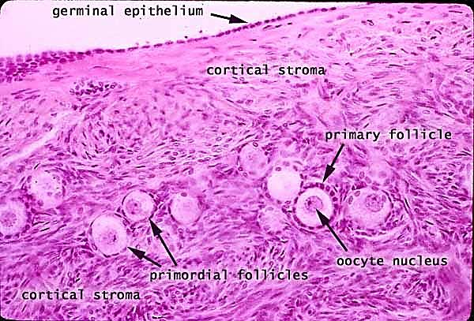
primordial follicles
Present in groups in peripheral cortex
Formed during fetal life
Each consists of 1ry oocyte enveloped
by single layer of flat follicular cells
Oocyte (1ry oocyte):
Spherical in shape
nucleus large contains (diploid #)
e prominent nucleolus.
Organelles tend to gather close to
nucleus
oocyte
Follicular cells

Slide 11
Facts about the growth of the ovarian follicles :
With the release of FSH at puberty small group of primordial follicles each month begins a process of follicular growth
This involves growth of oocyte, proliferation & changes in follicular cells, proliferation & differentiation of stromal fibroblasts around each follicle
it not true that the entire process of maturation occurs within a single menstrual cycle. Once a primordial follicle is recruited for development almost a year is required before ovulation can occur

Slide 12
Primary follicle
The oocyte grows reaching a maximum diameter of about 120 µm
Its nucleus enlarges &its
mitochondria & rER ↑
Oocyte (1ry oocyte)
arrested in prophase of 1st meiotic division
The 1ry follicle are of 2 types uni- laminar & multi – laminar
Uni-laminar, single layer of cuboidal cells, develops from primordial follicle
Multi- laminar develops from uni –laminar, by proliferation of follicular cells

Slide 13
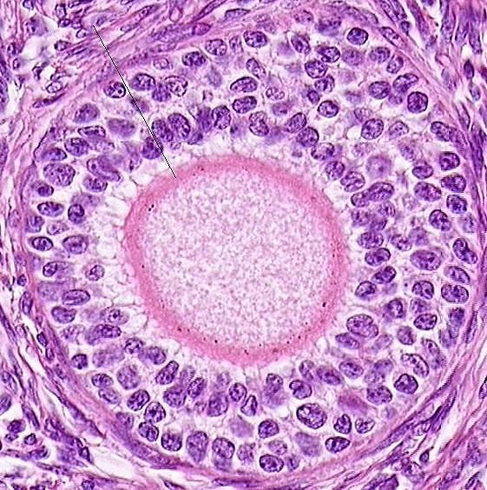
1ry follicle growth is FSH – Independent, local factors like epidermal growth factor stimulate its development
The follicular cells are now called granulosa cells.
Thick homogenous acidophilic layer, called zona pellucida formed between oocyte & the granulosa cells.
Ovarian stromal cells arrange in
concentric layers forming
theca folliculi
Zona pellucida
Theca folliculi

Slide 14
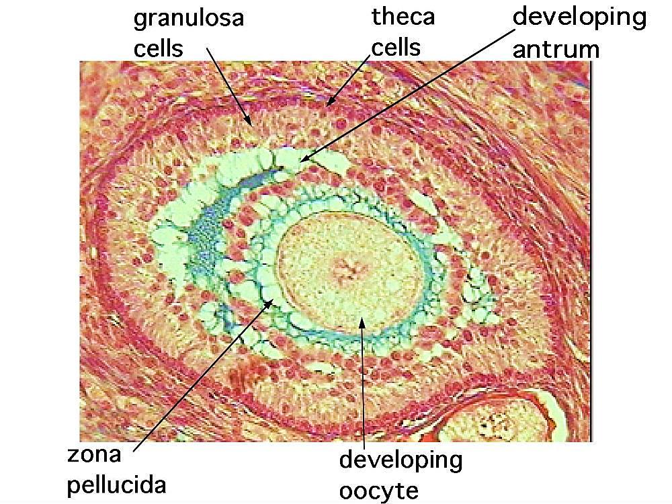
Secondary (antral) follicles
Granulosa cells start to secret fluid which begins to accumulate in spaces between the cells (FSH- dependant)
These fluid spaces fuse together to form a large cavity called the antrum
The oocyte (1ry) enlarges &
will be pushed to one side
Theca folliculi will differentiate
into:
Theca interna ( inner layer)
Theca externa (outer layer)
fluid

Slide 15
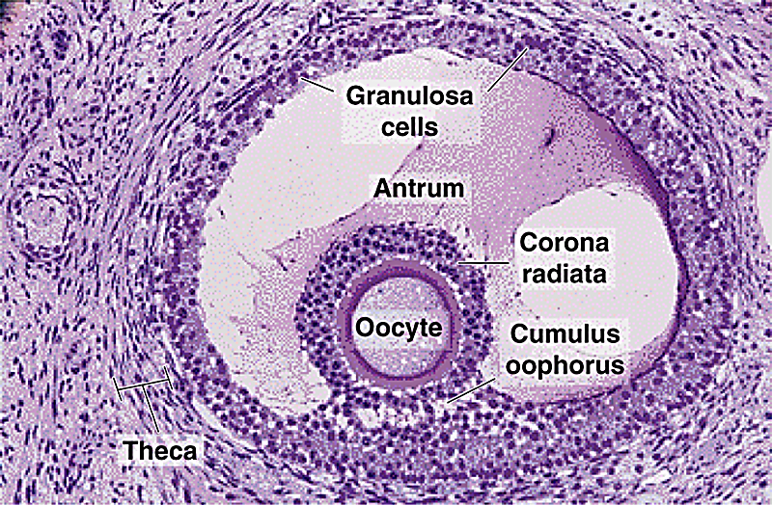
Graafine (Mature) follicles:
The largest , bulges from the ovarian surface & consists of:
1- Oocyte:
it changes to 2ry oocyte with haploid # of chromosomes
just before ovulation
2- Zona pellucida:
A glycoprotein layer surrounds
the oocyte
3- Corona radiata:
layer of granulosa cells
surrounds the oocyte

Slide 16
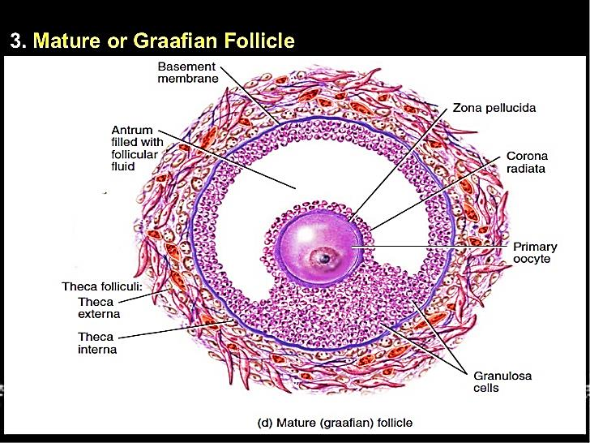
4- Cumulus oophorus:
A group of granulosa cells suspend the corona radiata + oocyte in follicular fluid
5- the granulosa cells inning the
cavity called membrana granulosa
6- Theca interna:
Large polyhedral cells, secrete estrogen
& androgen (steroid secreting cells)
7- Theca externa:
fibroblast- like layer.
Have no secretory function
There is no clear boundary between the 2 theca layers or the surrounding stroma
4
fluid
6
7

Slide 17
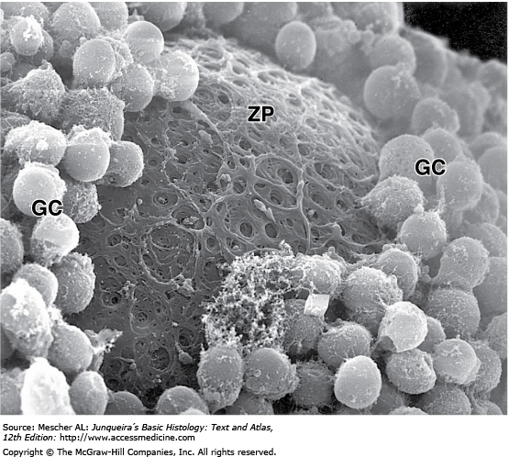
corona radiata cells penetrate the zona pellucida & make contact with microvilli of membrane of oocytes via gap junctions to provide oocyte with nourishment

Slide 18
Mature Graafian Follicle secretes inhibin hormone that shuts off FSH release
Oocyte completes meiosis 1 just before ovulation
2^{ry} oocyte: is the stage at which ovulation occurs
After ovulation , 2ry oocyte enter 2nd meiotic division
( which will be completed only after fertilization)
Polar bodies: When the cell divides, all the cytoplasm and organelles stay with one of the new cells, the other cell is just DNA, and is called a polar body and is discarded

Slide 19
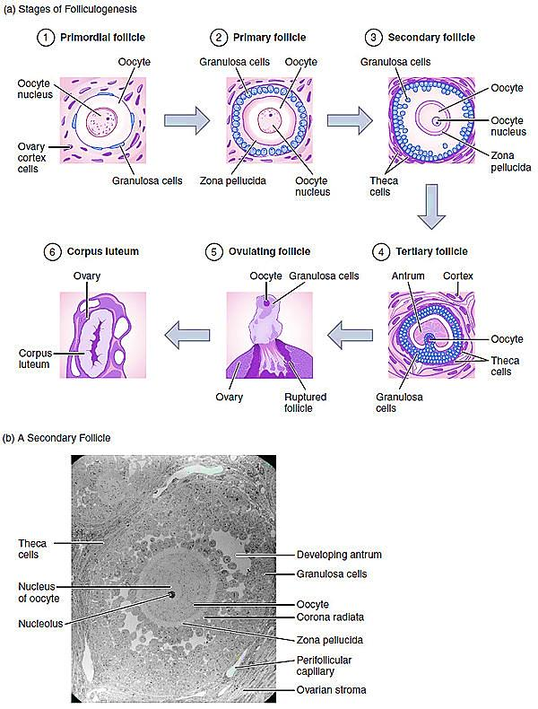

Slide 20
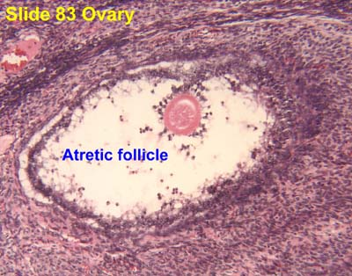
Atretic follicles
Every month about 20 1ry follicles
are activated, only one reach maturation
& the rest become degenerate (atresia)
Atresia occurs at any stage of follicular growth
Characterized by death of oocyte & degeneration of surrounding cells. Macrophages invade the follicle to phagocytose it
When large follicles ( 2ry & 3ry) degenerate→ collagen scar in the ovary while the small one resorb completely

Slide 21
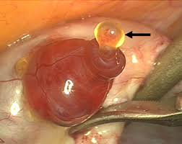
Fate of mature (Graafian) follicles
(ovulation)
High estrogen levels → + ant. pituitary → secretes a surge of LH
LH is the stimulus for ovulation
(mid of menstrual cycle 14/28)
The pressure of the liquor folliculi→ causes a bulge in the follicle wall called stigma → which then rupture → liberation of oocyte in the peritoneal cavity
The liberated oocyte is surrounded by zona pellucida, corona radiata & some cumulus oophorus cells

Slide 22
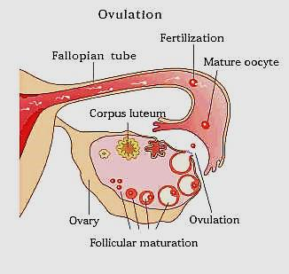
The oocyte is then picked up by fallopian tube
The oocyte remain viable for
24 hours after that it degenerates
The follicular fluid + some blood
from the vascular theca expelled
into the peritoneal cavity
The remaining granulosa + theca interna cells
→ corpus luteum

Slide 23
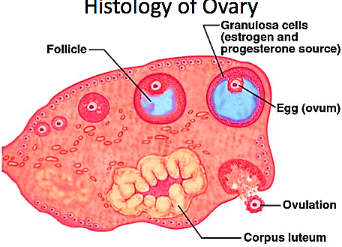
The corpus luteum
Temporary endocrine gland
present in the ovarian cortex
after rupture of the mature
Graafian follicle
The CL produces ↑levels of
progesterone & moderate
levels of estrogen
Formation & structure of CL:
After ovulation & under the effect of LH,
the granulosa & theca interna cells from the corpus luteum

Slide 24
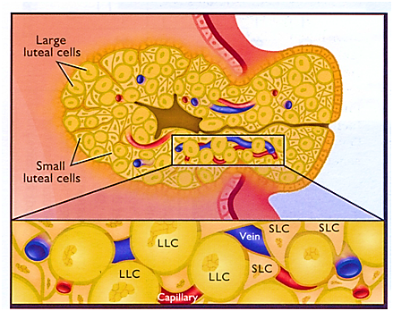
The granulosa cells ↑ in size, & becomes more vascularized → granulosa-lutein cells
These cells will secrete
progesterone hormone (↑SER)
The theca interna cells are
smaller in size & deeply stained→ theca lutein cells
These cells will secret estrogen hormone (↑SER)

Slide 25
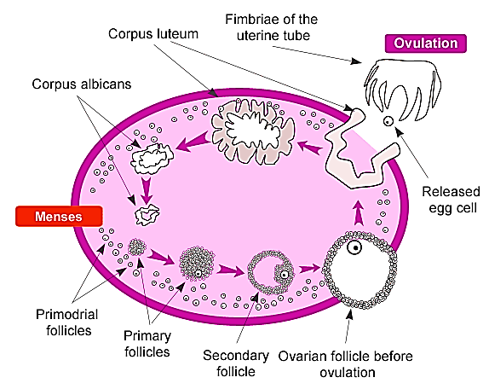
Fate of corpus luteum
Depends on the possibility of pregnancy
High levels of LH stimulate the corpus luteum to secrete progesterone for 10 -12 days
In the absence of pregnancy →
corpus luteum undergo apoptosis
→ progesterone levels ↓
→ leads to menstruation,
& CL then called corpus albicans

Slide 26
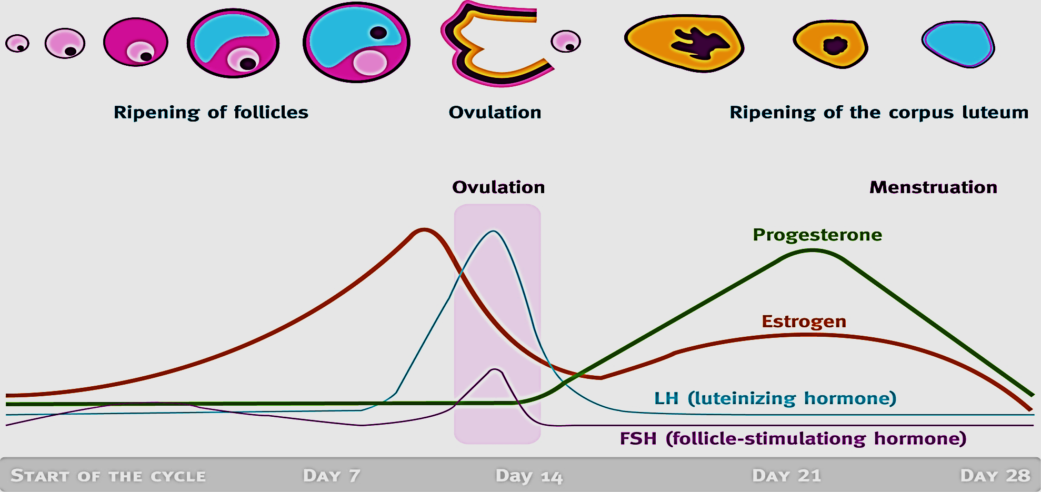
When the corpus luteum degenerates → ↓ estrogen & progesterone in blood → ↑ FSH secretion
This stimulate the growth of another group of follicles & beginning of another cycle

Slide 27
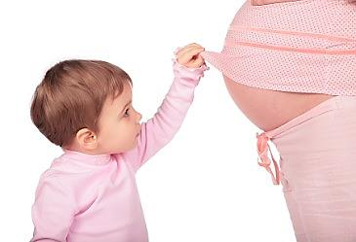
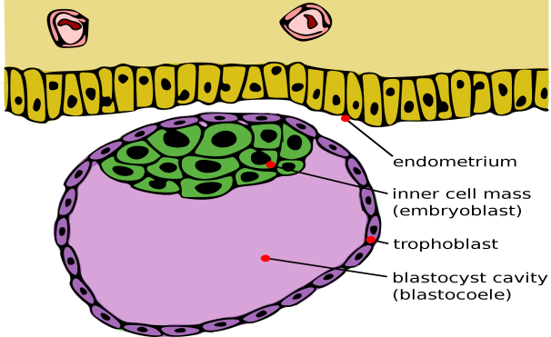
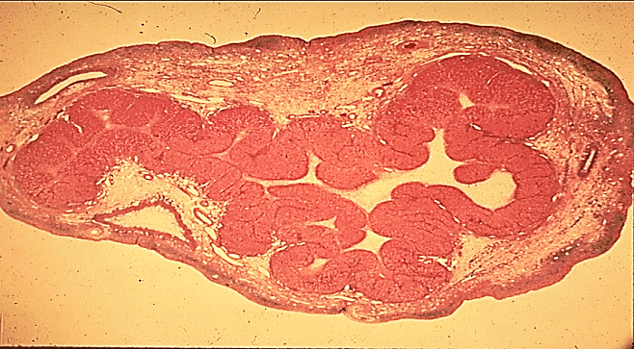
Corpus luteum of pregnancy
If pregnancy occurs→ the trophoblast cells of the implanted embryo→ produce human chorionic gonadotropin (HCG, similar in action to LH) → maintain corpus luteum & promotes its growth
CL will secrete progesterone &
estrogen to maintain the uterine
mucosa until the placenta become
fully functioning.
This called corpus luteum of pregnancy & lasts for about 8 weeks gestation → degenerate→ corpus albicans

Slide 28
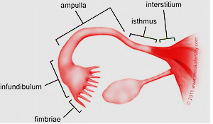
Fallopian tubes (oviducts)
muscular tubes, receive the ovulated oocyte and provide a site for fertilization
Composed of:
1- Interstitium which open into the uterus
2- Isthmus: narrow short segment
3- Ampulla expand segment where fertilization occur
4- infundibulum contains fingerlike projections called fimbriae

Slide 29
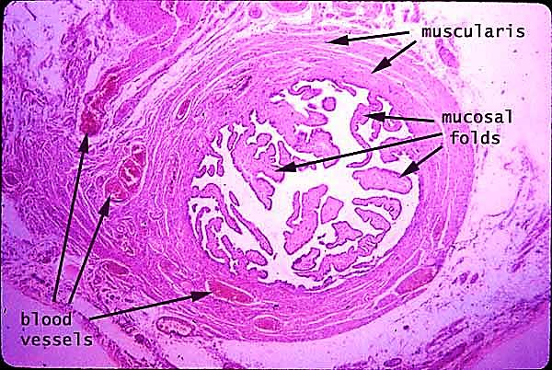
The wall of the oviduct is formed of 3 layers
1- mucosa:
Highly folded
Simple columnar consists of :
ciliated & secretory (Peg cells)
Peg cells :Its secretion is rich in nutrient
& cytokines that lubricate the tube
aid in capacitation of spermatozoa
2- musculosa :
IC & OL layers
Their peristalsis play major role in pushing the ovum
3- Serosa:

Slide 30
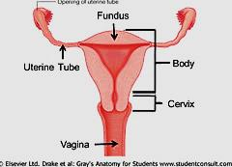
The uterus
Pear shaped organ
Fundus: dome shaped region
Body: Major portion of the uterus
Cervix: cylindrical part extends from the internal os & ends at external os
I O
E O

Slide 31
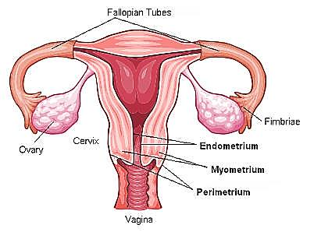
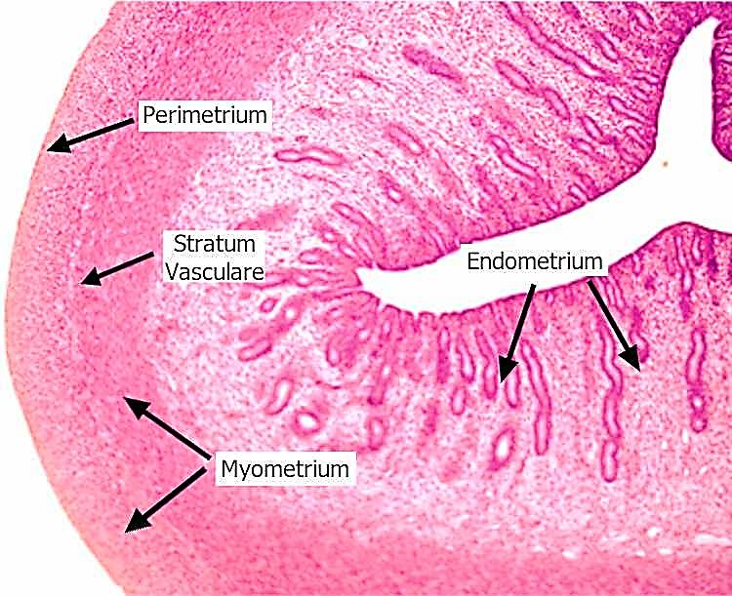
The uterine wall consists of 3 layers:
Endometrium
Myometrium
Perimetrium
Endometrium (mucosa)
Lined e simple columnar epithelium partially ciliated & contain simple tubular glands
(endometrial glands)

Slide 32
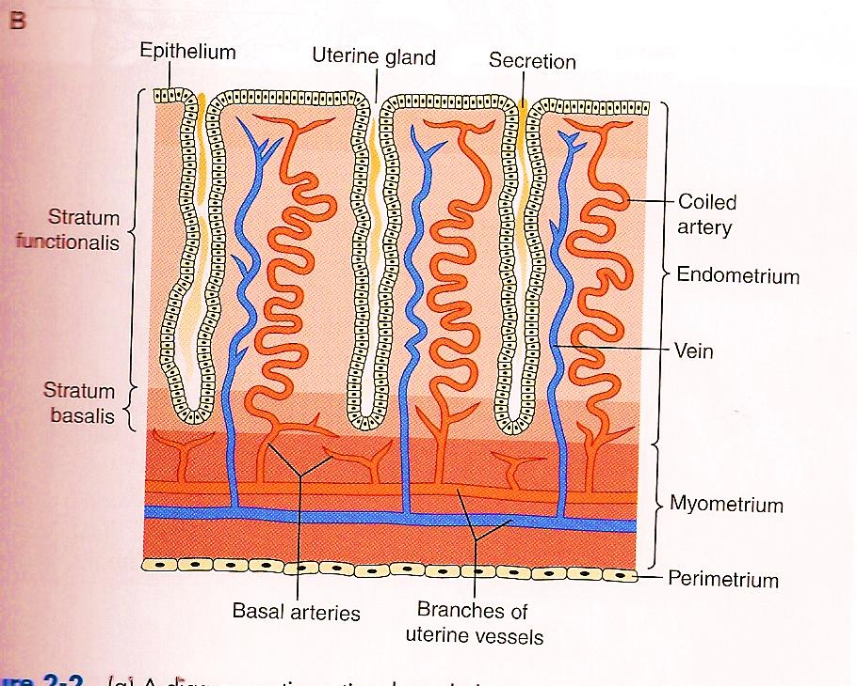
Endometrium composed of 2 layers:
Functional layer superficial layer (spiral /coiled arteries) undergoes cyclic changes during menstruation (i.e. proliferative & secretory uterine phases)
Basal layer: deeper & adjacent to myometrium. It remains mostly unchanged during menstruation & consider as the reserve part (straight arteries)
Functional layer
Basal layer

Slide 33
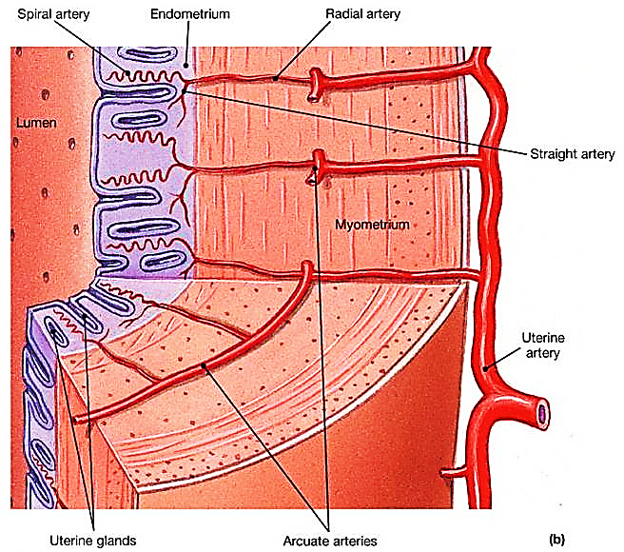
Myometrium:
Is the thickest layer, Composed 3 layers of smooth muscles:
Inner & outer longitudinal
Middle circular, thick, richly vascularized
Uterine muscles during pregnancy undergs hyperplasia & hypertrophy
Perimetrium: CT &
peritoneal mesothelium

Slide 34
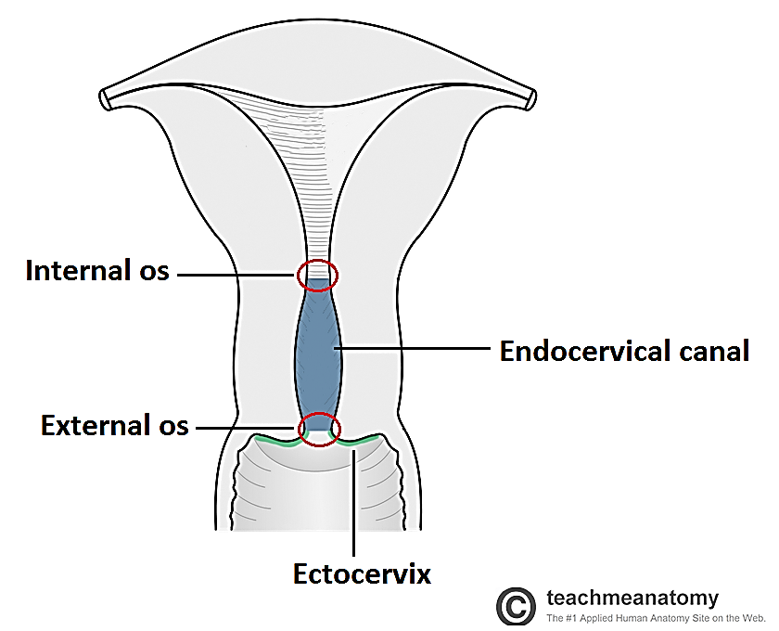
Cervix of uterus
Is the lower cylindrical part of
the uterus (endocervix)
Its mucosa lined with simple columnar
mucus secreting epithelium & contain
branched cervical glands
external os: junction between cervix & vagina, lined e stratified squamous epithelium

Slide 35
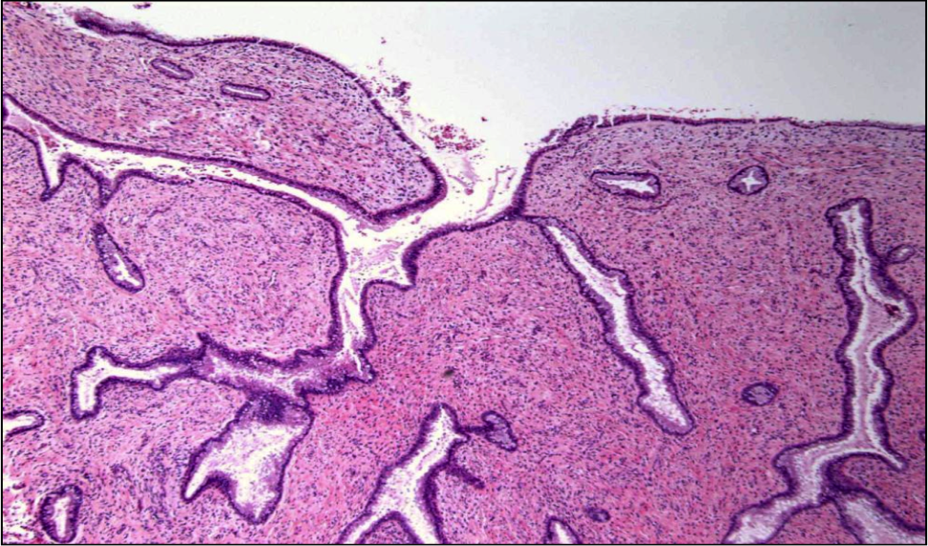
Cervical glands
1- Branched mucus glands
2- Not significantly affected by
Menstruation
3- cervical secretions are watery
at time of ovulation to allow the passage of sperms to uterus
4- Proliferate during pregnancy& secrete viscid mucus to prevent passage of microorganisms
5- Cervical dilatation(ripening) before labor is due to intense
collagenolysis, which promote its softening & normal labor

Slide 36
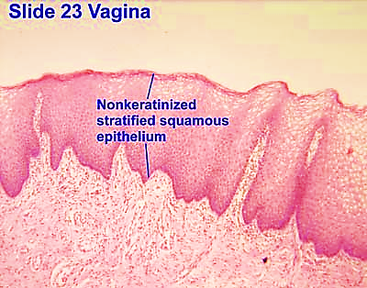
The vagina
It is a fibro-muscular canal
Wall consists of 3 layers: Mucosa, musculosa,
adventitia
Epithelium : stratified squamous epith.
The epith synthesize & accumulate ↑ glycogen
(estrogen effect)
Normal bacteria in vaginal lumen
→ glycogen → lactic acid
→ acidic pH of vagina
(protective barrier)

Slide 37
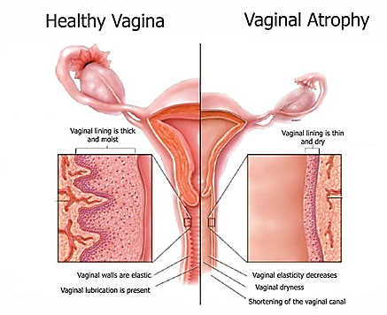
Musculosa : formed of IC & OL smooth ms. fibers
Adventitia: dense CT rich in elastic fibers
The elasticity of the vagina is
due to large number
of elastic fibers
in mucosa & adventitia
The mucus in vagina comes from cervical glands . The vagina contains No glands

Slide 38
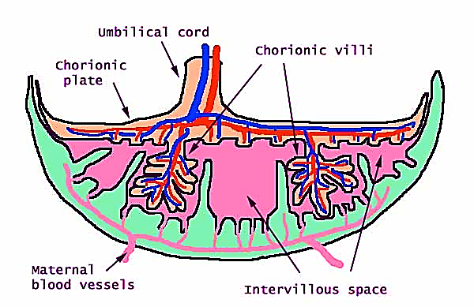
The placenta
Is disc shaped endocrine organ, forms during implantation
It consists of 2 parts: maternal & fetal
Function :
Is the site of exchange between the mother & fetus
Nutrition & respiration
Removal of waste
Secretion of hormones

Slide 39
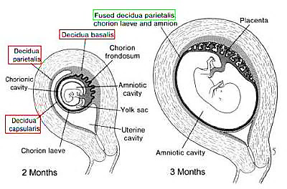
A- maternal part (decidua basalis):
The decidua (endometrium) is divided into:
Decidua basalis: between embryo
& myometrium (most imp)
Decidua capsularis: between
embryo & lumen of uterus
Decidua parietalis : endometrium
lining the rest of uterine cavity

Slide 40
B- fetal part( chorionic villi):
Finger- like projections from the outer wall of blastocyst (Trophoblast) allow the embryo to invade the uterine wall
By day 9 after fertilization the embryo is completely embedded in the endometrium
The villi branch & embed in the decidua basalis
The villi are separated by inter-villous spaces which contain maternal blood

Slide 41
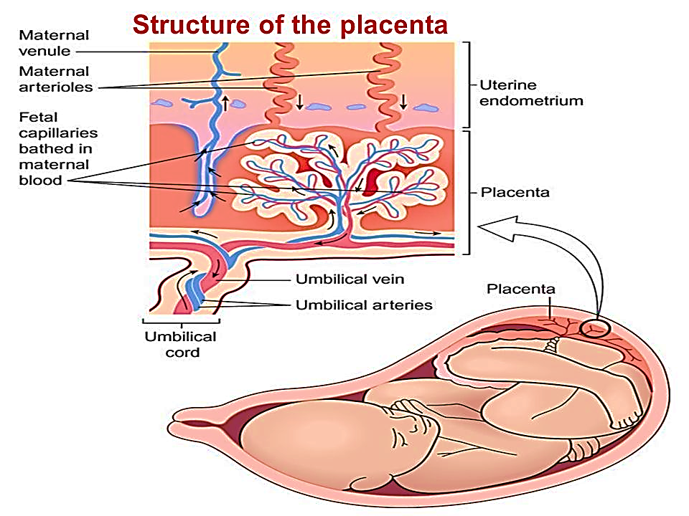
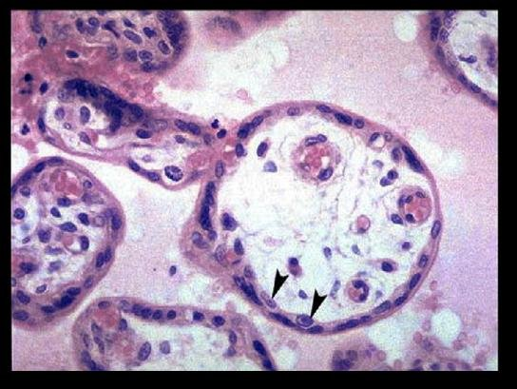
Each chorionic villus consists of:
1- Central core: contain fetal BV
2- Trophoblast: epithelial
Covering formed of 2 layers:
cytotrophoblast: inner layer
(Arrow heads)
Syncytiotrophoblast: outer layer
Fetal capillaries
Extra embryonic mesenchyme

Slide 42
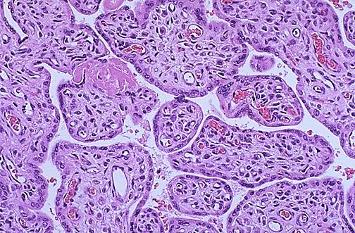
The placental barrier:
Barrier that separate blood in the fetal circulation from blood in maternal circulation
Is composed of:
Endothelium of fetal capillaries
Basal lamina of fetal capillary endothelium
Basal lamina of cytotrophoblast
Cells of Cytotrophoblast
Cells of Syncytiotrophoblast
Fetal capillary

Slide 43
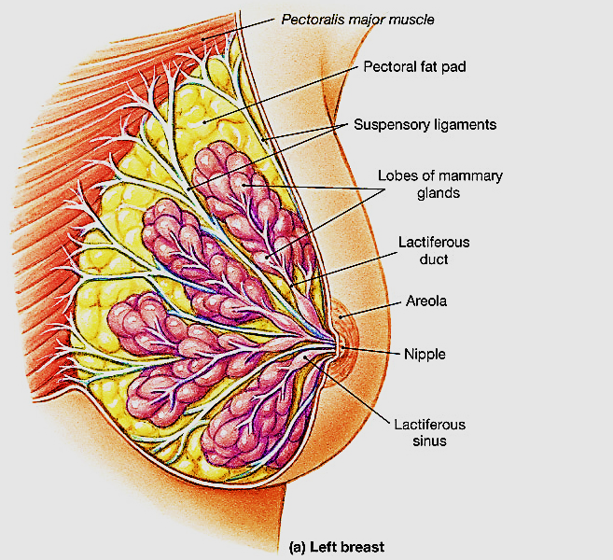
The mammary gland
An exocrine, compound tubulo-alveolar gland
Each mammary gland consists of 15- 25 lobes separated by CT rich in fat cells
Each lobe has a main lactiferous duct that open separately into nipple
breast structure differs to whether
Resting ( non-pregnant)
Lactating

Slide 44
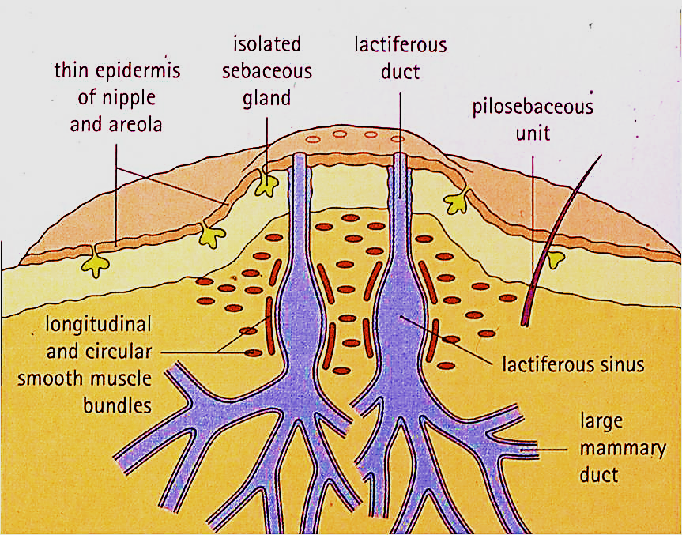
Lactiferous ducts

Slide 45
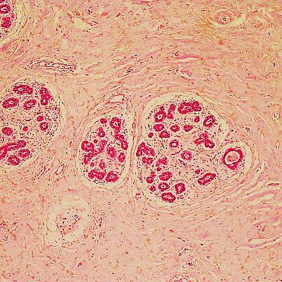
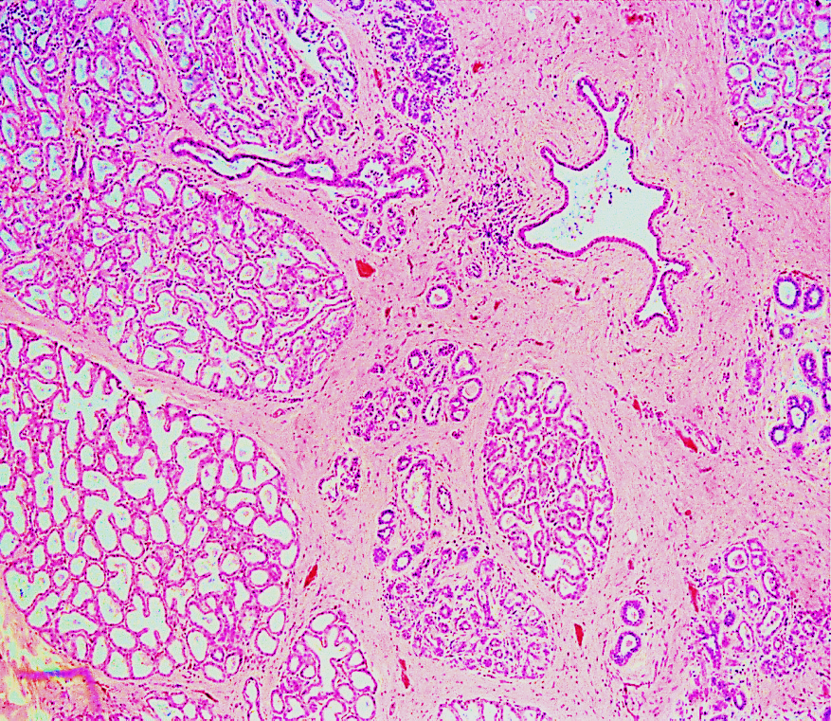
A- resting state:
Each lobe consists of several
branching ducts, embedded
In abundant, thick loose CT
No secretory units
B- lactating state:
Stimulated by several hormones
Lobules contain ducts & secretory
acini separated by thin CT septa
The acini lined by simple columnar
cells surrounded by myoepithelia
cells

Slide 46
Thank you

