Slide 1
THE LARGE INTESTINE
Dr. Aiman Qais Afar
Surgical Anatomist
College of Medicine / University of Mutah
2022-2023

Slide 2
Large Intestine
The large intestine extends from the ileum to the anus. It is divided into the cecum, appendix, ascending colon, transverse colon, descending colon, and sigmoid colon.
The primary function of the large intestine is the absorption of water and electrolytes and the storage of undigested material until it can be expelled from the body as feces

Slide 3
Large Intestine
Cecum
Is that part of the large intestine that lies below the level of the junction of the ileum with the large intestine It is a blind-ended pouch that is situated in the right iliac fossa. It is about 2.5 in. (6 – 7.5 cm) long and is completely covered with peritoneum
It possesses a considerable amount of mobility, although it does not have a mesentery
Attached to its posteromedial surface is the appendix

Slide 4
Cecum
The terminal part of the ileum enters the large intestine at the junction of the cecum with the ascending colon.
The opening is provided with two folds, or lips, which form the so-called ileocecal valve .
The appendix communicates with the cavity of the cecum through an opening located below and behind the ileocecal opening

Slide 5
Cecum
Relations
Anteriorly: Coils of small intestine, sometimes part of the greater omentum, and the anterior abdominal wall in the right iliac region
Posteriorly: The psoas and the iliacus muscles, the femoral nerve, and the lateral cutaneous nerve of the thigh.
The appendix is commonly found behind the cecum.
Medially: The appendix arises from the cecum on its medial side

Slide 6
Cecum
Blood Supply
Arteries
Anterior and posterior cecal arteries form the ileocolic artery, a branch of the superior mesenteric artery
Veins
The veins correspond to the arteries and drain into the superior mesenteric vein

Slide 7
Cecum
Lymph Drainage
The lymph vessels pass through several mesenteric nodes and finally reach the superior mesenteric nodes
Nerve Supply
Branches from the sympathetic and parasympathetic (vagus) nerves form the superior mesenteric plexus

Slide 8
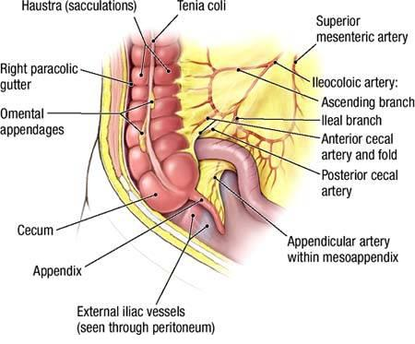
Appendix
Is a narrow, muscular tube containing a large amount of lymphoid tissue.
It varies in length from (6 to 9 cm)
The base is attached to the posteromedial surface of the cecum about 1 in. (2.5 cm) below the ileocecal junction.
The remainder of the appendix is free.

Slide 9
Appendix
It has a complete peritoneal covering, which is attached to the mesentery of the small intestine by a short mesentery of its own, the mesoappendix.
The mesoappendix contains the appendicular vessels and nerves

Slide 10
Appendix
The appendix lies in the right iliac fossa, and in relation to the anterior abdominal wall its base is situated one third of the way up the line joining the right anterior superior iliac spine to the umbilicus (McBurney's point).
Inside the abdomen, the base of the appendix is easily found by identifying the teniae coli of the cecum and tracing them to the base of the appendix, where they converge to form a continuous longitudinal muscle coat.

Slide 11
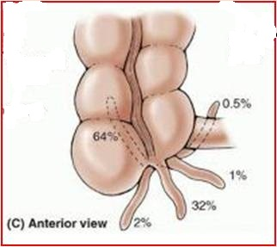
Appendix
Common Positions of the Tip of the Appendix
The tip of the appendix is subject to a considerable range of movement and may be found in the following positions:
(A) hanging down into the pelvis against the right pelvic wall,
(B) coiled up behind the cecum,
(C) projecting upward along the lateral side of the cecum, and
(D) in front of or behind the terminal part of the ileum.
The first and second positions are the most common sites

Slide 12
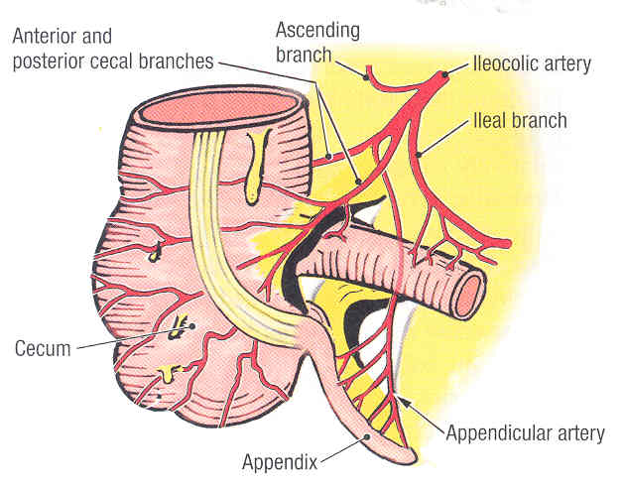
Appendix
Arteries
The appendicular artery is a branch of the posterior cecal artery
Veins
The appendicular vein drains into the posterior cecal vein
Lymph Drainage
The lymph vessels drain into one or two nodes lying in the mesoappendix and then eventually into the superior mesenteric nodes

Slide 13
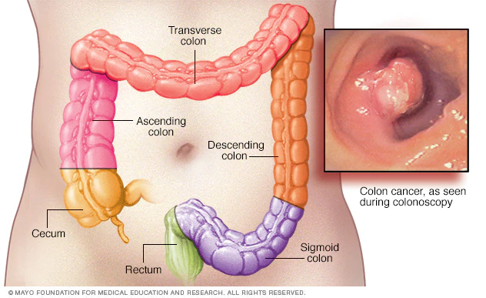
Ascending Colon
Is about 5 in. (13 cm) long and lies in the right lower quadrant
It extends upward from the cecum to the inferior surface of the right lobe of the liver, where it turns to the left, forming the right colic flexure, and becomes continuous with the transverse colon.
The peritoneum covers the front and the sides of the ascending colon, binding it to the posterior abdominal wall.

Slide 14
Ascending Colon
Relations
Anteriorly: Coils of small intestine, the greater omentum, and the anterior abdominal wall
Posteriorly: The iliacus, the iliac crest, the quadratus lumborum, the origin of the transversus abdominis muscle, and the lower pole of the right kidney. The iliohypogastric and the ilioinguinal nerves cross behind it

Slide 15
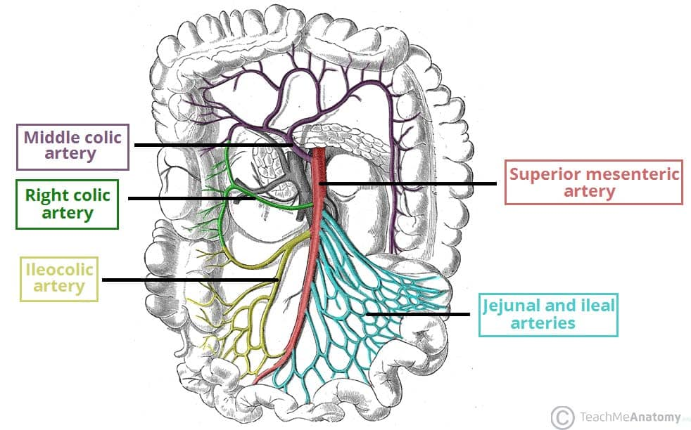
Ascending Colon
Arteries
The ileocolic and right colic branches of the superior mesenteric artery supply this area.
Veins
The veins correspond to the arteries and drain into the superior mesenteric vein.
Lymph Drainage
The lymph vessels drain into lymph nodes lying along the course of the colic blood vessels and ultimately reach the superior mesenteric nodes

Slide 16
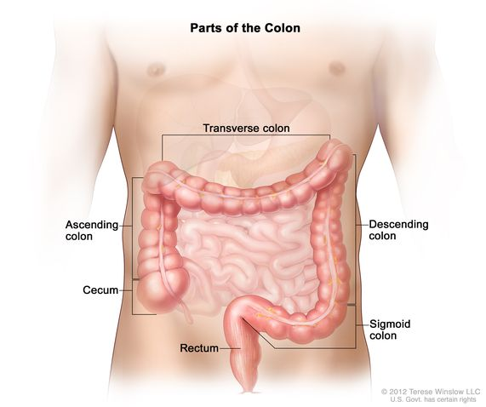
Transverse Colon
The transverse colon is about (38 to 50 cm) long and extends across the abdomen, occupying the umbilical region.
It begins at the right colic flexure below the right lobe of the liver and hangs downward, suspended by the transverse mesocolon from the pancreas . It then ascends to the left colic flexure below the spleen.
The left colic flexure is higher than the right colic flexure and is suspended from the diaphragm by the phrenicocolic ligament

Slide 17
Transverse Colon
The transverse mesocolon, or mesentery of the transverse colon, suspends the transverse colon from the anterior border of the pancreas
The mesentery is attached to the superior border of the transverse colon, and the posterior layers of the greater omentum are attached to the inferior border
Because of the length of the transverse mesocolon, the position of the transverse colon is extremely variable and may sometimes reach down as far as the pelvis

Slide 18
Transverse Colon
Relations
Anteriorly: The greater omentum and the anterior abdominal wall (umbilical and hypogastric regions)
Posteriorly: The second part of the duodenum, the head of the pancreas, and the coils of the jejunum and ileum

Slide 19
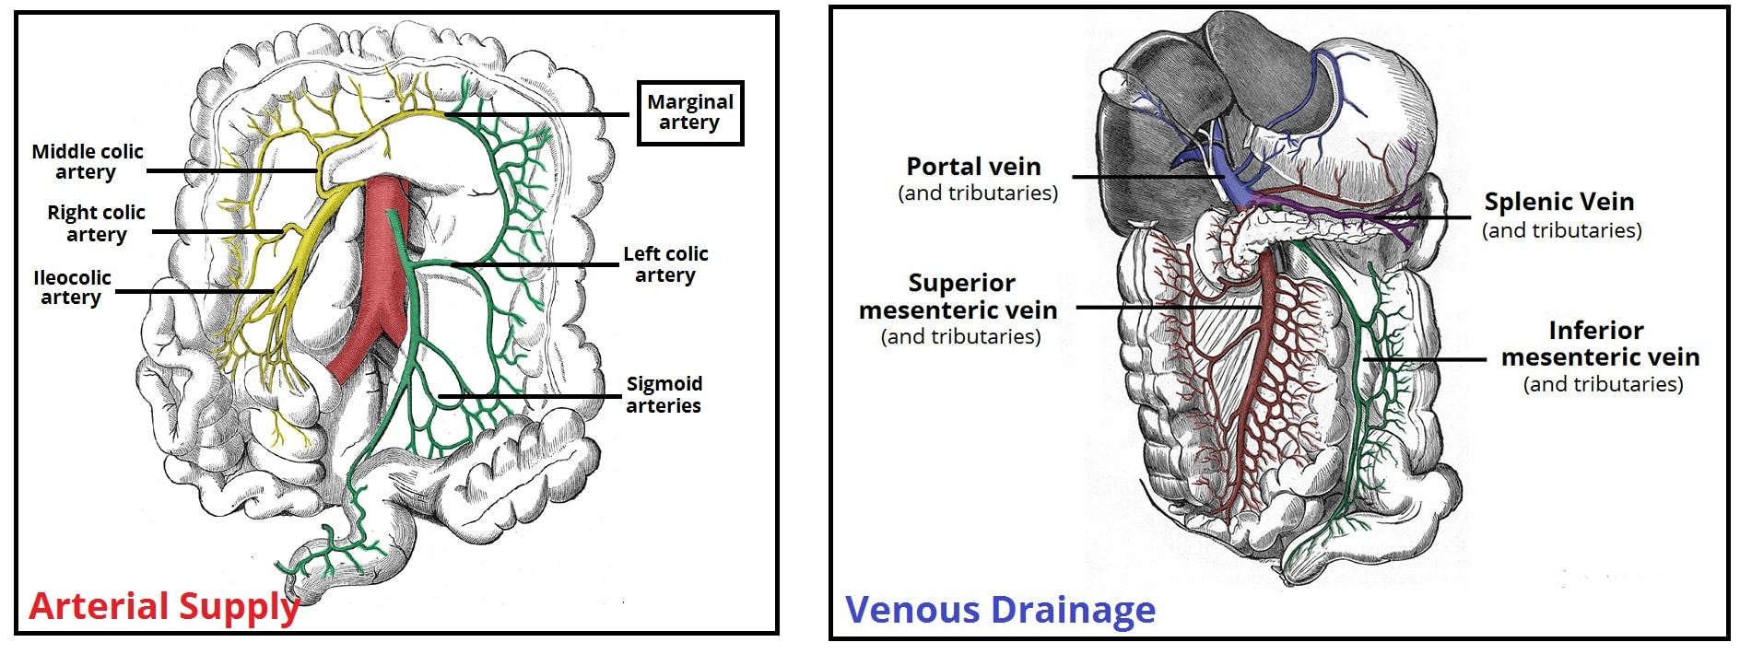
Transverse Colon
Arteries
The proximal two thirds are supplied by the middle colic artery, a branch of the superior mesenteric artery . The distal third is supplied by the left colic artery, a branch of the inferior mesenteric artery Veins
The veins correspond to the arteries and drain into the superior and inferior mesenteric veins.

Slide 20
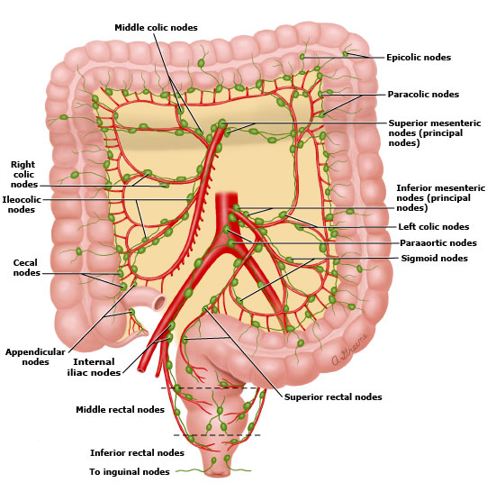
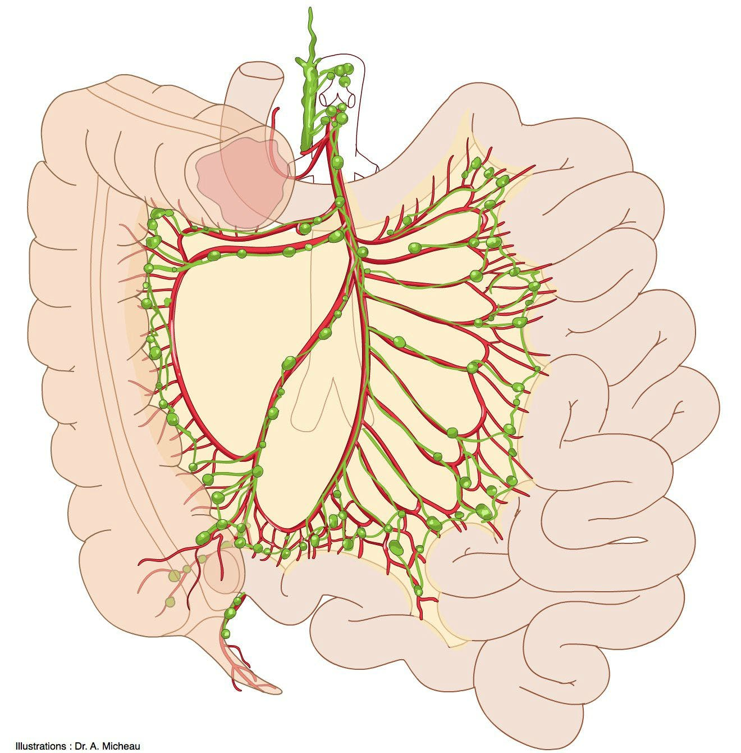
Transverse Colon
Lymph Drainage
The proximal two thirds drain into the colic nodes and then into the superior mesenteric nodes; the distal third drains into the colic nodes and then into the inferior mesenteric nodes.

Slide 21
Descending Colon
The descending colon is about 10 in. (25 cm) long and lies in the left upper and lower quadrants
It extends downward from the left colic flexure, to the pelvic brim, where it becomes continuous with the sigmoid colon
The peritoneum covers the front and the sides and binds it to the posterior abdominal wall

Slide 22
Descending Colon
Relations:
Anteriorly: Coils of small intestine, the greater omentum, and the anterior abdominal wall
Posteriorly: The lateral border of the left kidney, the origin of the transversus abdominis muscle, the quadratus lumborum, the iliac crest, the iliacus, and the left psoas. The iliohypogastric and the ilioinguinal nerves, the lateral cutaneous nerve of the thigh, and the femoral nerve also lie posteriorly.

Slide 23
Descending Colon
Blood Supply
Arteries
The left colic and the sigmoid branches of the inferior mesenteric artery supply this area.
Veins
The veins correspond to the arteries and drain into the inferior mesenteric vein

Slide 24
Descending Colon
Lymph Drainage
Lymph drains into the colic lymph nodes and the inferior mesenteric nodes around the origin of the inferior mesenteric artery.

Slide 25
Examination of large intestine
The interior of the colon can be observed and photographed in a procedure called colonoscopy or coloscopy, using a long, flexible fiberoptic endoscope (colonoscope) inserted into the colon through the anus and rectum. Small instruments can be passed through the colonoscope and used to facilitate minor operative procedures, such as biopsies or removal of polyps.

Slide 26
Sigmoid Colon
The sigmoid colon, is 10 to 15 in. (25 to 38 cm) characterized by its S-shaped loop of variable length, links the descending colon and the rectum.
The sigmoid colon extends from the iliac fossa to the third sacral (S3) vertebra, where it joins the rectum.
The termination of the teniae coli, approximately 15 cm from the anus, indicates the rectosigmoid junction

Slide 27
Sigmoid Colon
Relations
Anteriorly: In the male, the urinary bladder; in the female, the posterior surface of the uterus and the upper part of the vagina
Posteriorly: The rectum and the sacrum.
The sigmoid colon is also related to the lower coils of the terminal part of the ileum

Slide 28
Sigmoid Colon
The sigmoid colon usually has a long mesentery—the sigmoid mesocolon and therefore has considerable freedom of movement, especially its middle part.
The root of the sigmoid mesocolon has an inverted V-shaped attachment

Slide 29
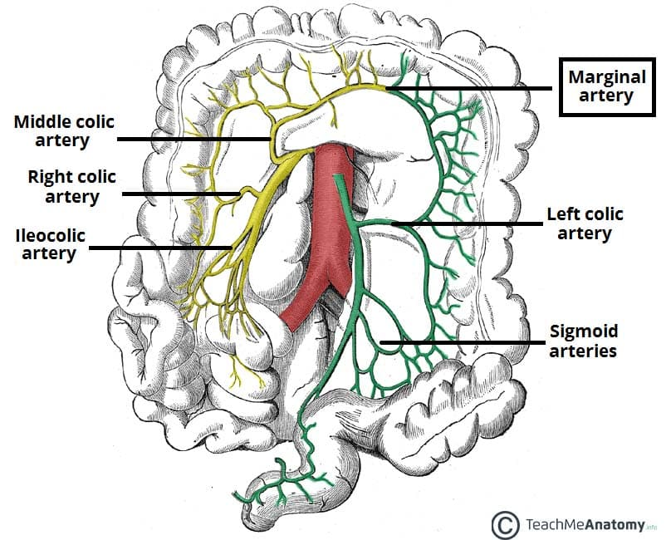
Sigmoid Colon
Blood Supply
Arteries
Sigmoid branches of the inferior mesenteric artery.
Veins
The veins drain into the inferior mesenteric vein, which joins the portal venous system.

Slide 30
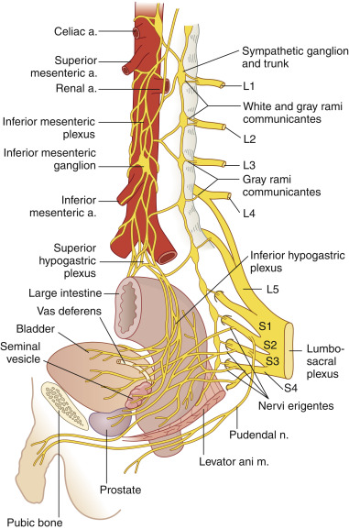
Sigmoid Colon
Lymph Drainage
The lymph drains into nodes along the course of the sigmoid arteries; from these nodes, the lymph travels to the inferior mesenteric nodes
Nerve Supply
The sympathetic and parasympathetic nerves from the inferior hypogastric plexuses

Slide 31
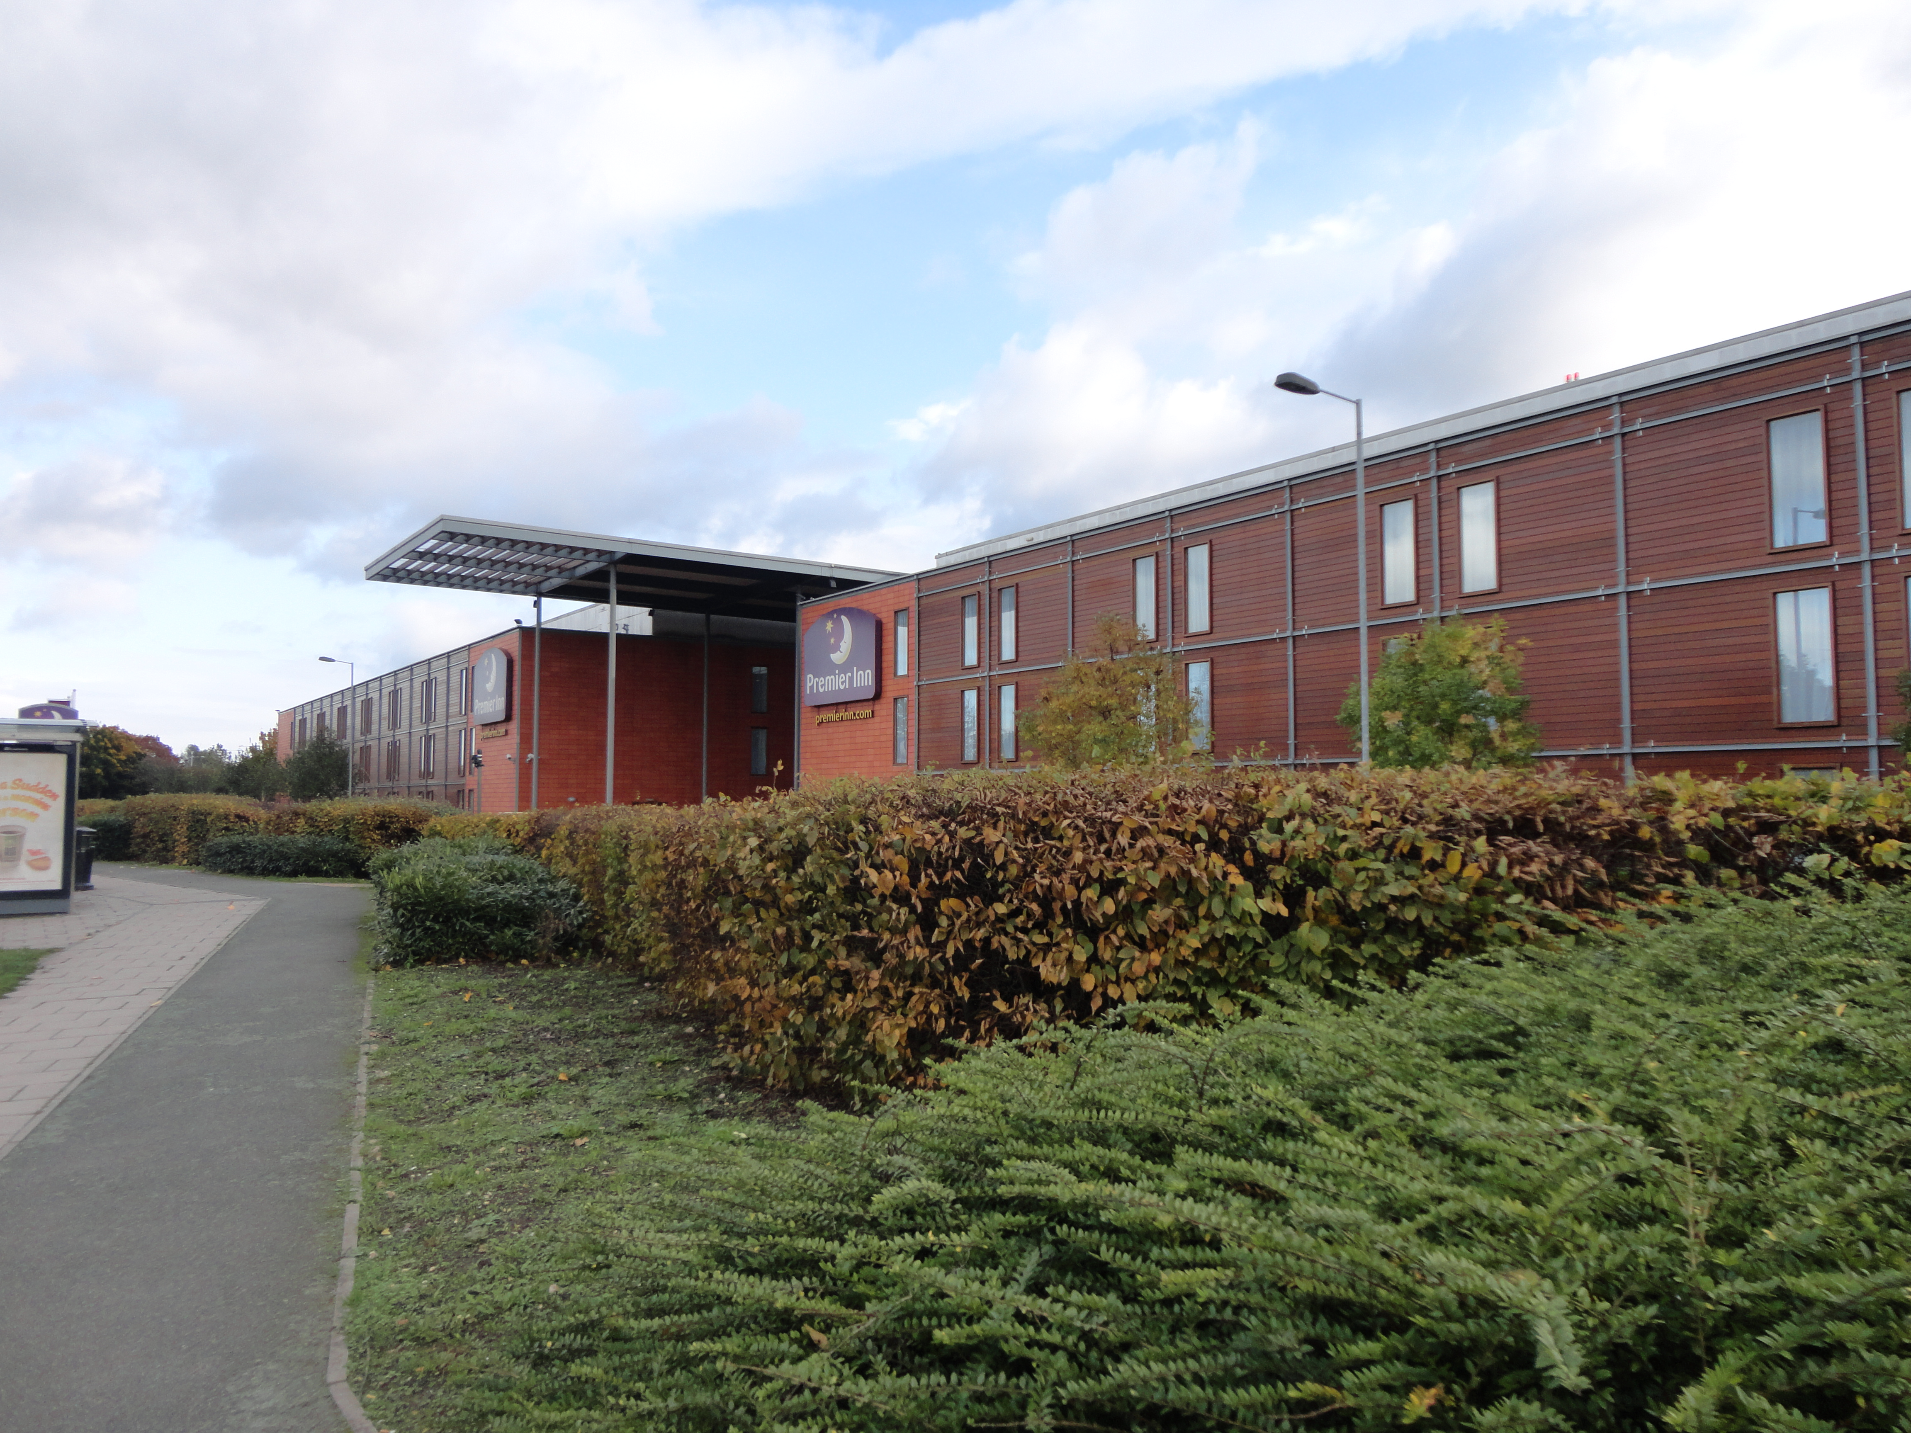
Dr Aiman Q. AL Maathidy
Surgical Anatomist
Sunday 9 April 2023

