Slide 1
Electrical burn
Raheeq dumour

Slide 2
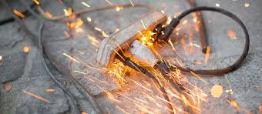
Electrical burn :
Is a burn that results from electricity passing through the body causing rapid injury.

Slide 3
Electrical burns differ from thermal or chemical burns in that they cause much more subdermal damage
Electrical burn sometimes cause mild skin damage but there can still be sever internal organ and tissue damage
The spectrum of electrical injury is broad, ranging from minimal injury to severe multiorgan involvement to death

Slide 4
Electrical injuries relatively uncommon.
Electrical injuries in adults are most commonly occupational
in children household electrical injuries are most common.
Males are more commonly injured via electricity than females
The hands are the most common source point, followed by the head, Feet are usually the ground point.

Slide 5
characteristics
Electricity is generated by the flow of electrons across a potential gradient from high to low concentration through a conductive material.
As the body comes into contact with an electrical source, it becomes part of the electrical current.
Electrical severity is defined by:
Current
Voltage
Resistance
Frequency and contact time
Pathway of current

Slide 6
current: Its intensity that corresponds to the electric charge carried by the electrons crossing a section of circuit during a second. It is measured in amperes.
Voltage: that corresponds to the circulation of the electric field along an electrical circuit a measure of the difference in electrical potential between two points measured in volts
Resistance : is the tendency of a material to resist the flow of electric current , temperature , and other physical properties .
Generally, the pathway of the current will follow the course of the least resistant tissues: firstly nerves,blood vessels, and muscle, then skin, tendon, fat, and bone

Slide 7
Human tissues differ in their resistance to electrical energy , The skin offers varying resistance levels, depending on its condition: dry skin offers the most resistance, but as skin absorbs more energy, its resistance breaks down. Wet or lacerated skin offers much less resistance to electricity
Nerve tissue typically has the least resistance to electrical energy, and may be damaged even when current is of low voltage and no cutaneous or musculoskeletal manifestations are present.
Blood and vascular tissue have low resistance to current, and muscle and viscera have slightly higher resistance.
Bone and fat have the highest resistance to current. The consequence of higher resistance is that more energy is lost to higher-resistance tissue in the form of heat, causing coagulation necrosis and burns both in the high resistance tissues and in surrounding tissues.
This poses a challenge for the emergency clinician, as the extent of surface burns may not reveal the extent of burns to visceral and deep muscular tissues

Slide 8
electrical burns has an entry point and an exit point, which will make it possible to imagine the path of the current and thus evaluate the severity of the damage and lesions.
at entry point The skin is the first organ affected, and then the current follows through variable and unpredictable paths depending on the degree of resistance encountered.
At the exit point it will go out of the body through the skin at a zone in contact with the ground or another external element.
The point of entry tends to be depressed and leathery whereas the exit wound is typically more extensive and explosive
It is hard to accurately diagnose an electrical burn because only the entry and exit wounds are visible and the internal damage is not

Slide 9
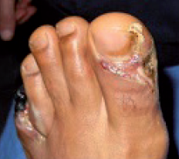
At the entry point is a marble colored or whitish area , charred, insensitive and does not bleed when scarification is done
At the exit point, there is a small area of white and gray necrosis but wider than the entry point
Entry point
Exit point

Slide 10
Classifications
Classifications of electrical injuries generally focus on
the power source (lightning or electrical)
voltage (high or low voltage)
type of current (alternating AC or direct DC).
High-voltage DC contact tends to cause a single muscle spasm, often throwing the victim from the source
AC exposure to the same voltage tends to be three times more dangerous than DC cause continuous muscle contraction or tetany can occur to the muscle fibers causing more contact time since the patient can’t let go of electrical source

Slide 11
Electrical burns can be classified into:
depolarization lesion.
Low-voltage burn.
High voltage burn.
Heat induced
flame burn.
Arc burn.
Flash burn.
Oral burn .

Slide 12
Depolarization lesions:
they are due to the direct action of the current on the human cell whatever its type. It can induce a direct lesion of the nervous, cardiac, or muscular cells, which can cause cardio-respiratory arrest. In this case, we speak of an electrocution accident. The depolarization effect is a function of the current intensity.

Slide 13
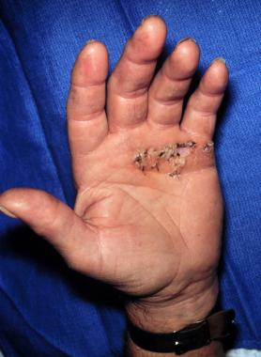
Low-voltage burn
A burn produced by contact with a power source of 500 volts or less .
The current at this voltage is not enough to cause tissue damage along its path except at the contact site.
This type of burn may be mild, superficial, or severe depending on the contact time.

Slide 14
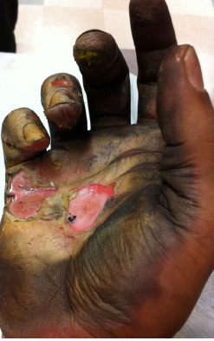
High voltage burn.
This burn is very severe as the victim makes direct contact with the high voltage supply and the damage runs its course throughout the body.
The resistance of dry skin is significantly reduced when current voltage exceeds 500 V.
Exterior injuries are misleading as most of the damage occurs underneath the skin.
In this case, subdermal tissues are severely damage.

Slide 15
Low-Voltage Shock Effects (< 500 Volts) | High-Voltage Shock Effects (500+ Volts)
Superficial burns | Deep and occult burns
No late arrhythmia Case reports of | late arrhythmia
Usually alternating current | Either alternating current or direct current
Rhabdomyolysis uncommon | Rhabdomyolysis common
Secondary trauma less common | Secondary trauma from falls and tetanic muscle contractions
Contact is prolonged (unable to let go) | Contact can be brief (thrown from voltage source)
Cardiac arrest from ventricular fibrillation | Cardiac arrest from ventricular fibrillation; direct damage to myocardium, causing asystole; and coronary artery thrombosis

Slide 16
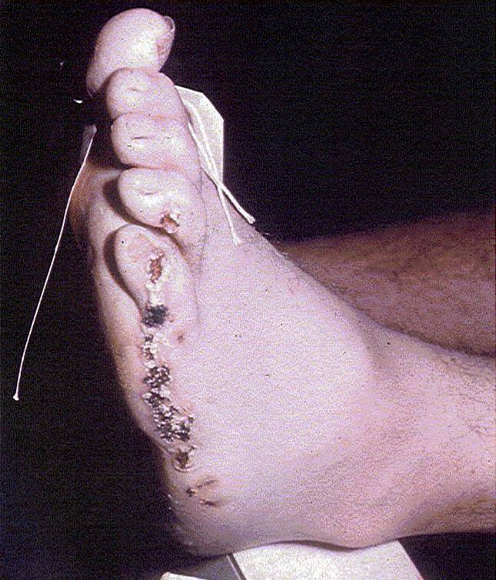
Arc burn.
This type of burn occurs when electrical energy passes from a high-resistance area to a low-resistance area.
it is a rare phenomenon but which must not be neglected. in some cases when the voltage is very high, there can be an attack without direct contact with the current. The electric jump distance is 2–3 m per 10,000 V. This high voltage generated remotely can cause real skin and muscle damage.

Slide 17
Flash burn.
Flash burns are caused by electrical arcs that pass over the skin.
The intense heat and light of an arc flash can cause severe burns.
Although the burns on the skin are largely superficial and cover a large area, tissues beneath the skin are generally undamaged and unaffected.
these are thermal burns that can be observed during an electric shock accident and are secondary to the spark that can occur during contact with the electricity

Slide 18
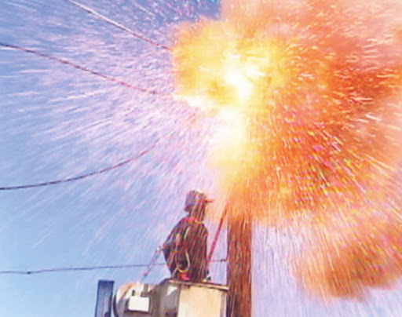

Slide 19
Heat induced lesions:
produced by the passage of the current according to the resistance of the tissues.
the higher the tissue resistance is, the more heat will be emitted and the more serious the lesions will be.
So fluid environments, nerves, blood, and vessels are low resistance tissues that emit little heat during the passage of electric current and lesions will be minimal.
However, the skin (mainly the stratum corneum) and the bone tissues are of high resistance and emit a lot of heat, which will cause lesions in the tissue cells in addition to a devastating action on the surrounding tissues like the muscles

Slide 20
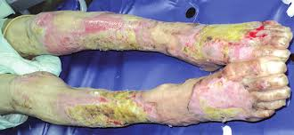
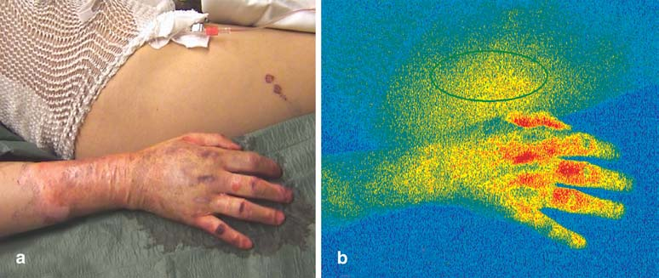
Flame burn.
Electrical burns of this type are caused by contact to things that were set in flame as a result to electrical fires such as clothing.

Slide 21
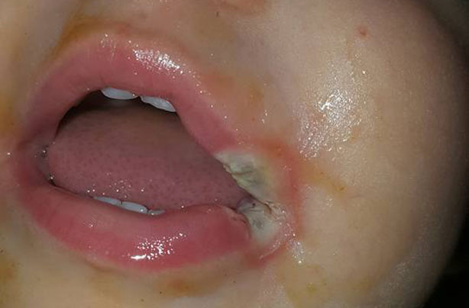
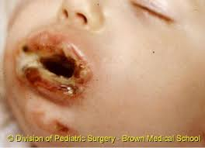
Oral burns
This is caused by biting or sucking on electrical cords, and it most commonly happens to children. Electric current typically passes from one side of the child's mouth to the other, possibly causing deformity.

Slide 22
Mangment of electrical burns
Rawan zedaneen

Slide 23
Patients with electrical injury should be initially evaluated as both trauma and cardiac patients
Tetanic contractions induced in the muscle prevent the victim to free himself/ herself from the source. Strong contractions of flexor muscle group in upper limb tend to maintain the contact and it may cause muscle injury, joint dislocations and fractures .
It is important to consider that the outward appearance of an electrical burn does not accurately predict the true extent of the injury, as internal tissues or organs may be much more severely burned than the skin . As a result, electrical burns are difficult to accurately diagnose, and many people underestimate the severity of their burn.
Thermal injuries may also be present due to ignition of the clothing after electric contact.

Slide 24
Pre hospital management
Look first. Do not touch. The person may still be in contact with the electrical source. Touching the person may allow the current to pass through the rescuer.
Turn off the source of electricity if possible. If this is not possible, move the source away from the injured person using a non-conducting object made of cardboard, plastic or wood
Check for signs of circulation breathing, coughing or movement. If absent, begin cardiopulmonary resuscitation (CPR) immediately.
Prevent shock. Lay the person down with the head slightly lower than the trunk and the legs elevated.
Cover the affected areas. If the person is breathing, cover any burned areas with a sterile gauze bandage, if available, or a clean cloth. Do not use a blanket or towel. Loose fibers can stick to the burns.

Slide 25
Examination for associated injuries (head/chest/abdomen/limb injuries
In general, trauma takes priority over burns, so patients with evidence of significant trauma should be transported to a trauma center as traumatic injuries are more common in this group
To prevent further thermal damage, remove smoldering clothes, etc.
Apply a bandage. Cover any burned areas with a sterile gauze bandage, if available, or a clean cloth. Don't use a blanket or towel, because loose fibers can stick to the burns.

Slide 26
Emergency department management of electrical burns

Slide 27
Emergency department management
Stop the burning process: Use water for smouldering clothes, chemicals, hot tar, etc.
Check airway: If deep facial burns are present and/or there is a history of smoke exposure with obtundation or stridor or other symptoms of impaired airway – INTUBATE
Initiate high flow oxygen therapy if history of smoke exposure is present, to treat carbon monoxide toxicity.
Check for other Injuries especially to chest (rib fractures, pneumothorax, etc.) due to other trauma suffered in the accident.
Assess hemodynamic stability and perfusion by looking for evidence of impending burn shock.

Slide 28
6. Start I / V infusion if burn size is greater than 15% of total body surface (or if there are other injuries) infuse lactated Ringers An estimate of fluid requirement is:
15-25% BSA = 500 ml per hour
b. 25-50% BSA = 750 ml per hour
c. > 50% BSA = 1 Liter per hour
7. Assess depth and size of burn while keeping the patient warm (remove wet clothes). Cover patient with clean and dry dressing to conserve heat.
8. High tension (> 1000 Volts) injury—Look for cardiac abnormalities, entrance and exit sites and other injuries.

Slide 29
9. Remove any constricting objects (Rings, Bangles, etc)
10. Evaluate the following
A.Neurologic status at scene
All patients should be assessed for responsiveness with the Glasgow coma scale; they may be confused because of hypoxia or hypovolaemia.
So , Cervical spine immobilization with or without spinal immobilization is needed based on the mechanism of injury/neurologic examination
b. Smoke exposure and airway status
c. Hemodynamic stability
d. Approximate size, depth and areas involved in burn
e. evaluate for hidden injuries.

Slide 30
Low voltage injuries <240 volts: Asymptomatic patients with a normal ECG on arrival and no abnormal clinical findings on examination can be discharged No other investigations needed Not even cardiac monitoring
Red flags in the history and exam for more serious injury
chest pain, palpations loss of consciousness, altered mental status, confusion, weakness dyspnea, abdominal pain, weakness, burn with subcutaneous damage , vascular compromise, or abnormal results on ECG
Further investigations : Urinary and serum myoglobin CK Lipase, Coag studies Imaging Admit these patients

Slide 31
Admit all high voltage (>600 volts) injuries
These patients will likely need transfer to a burns centre
Cutaneous injuries: Basic burns treatment Tetanus Prophylaxis
Injuries to extremities:* Close monitoring for signs of compartment syndrome *Elevation of limb and splinting *Fracture and dislocation reduction
Myoglobinuria high risk for renal failure *Treat with aggressive fluid resuscitation until urine is clear and any acidosis is corrected
Lightning strikes: anyone who is struck by lightning who does not suffer immediate cardiac or respiratory arrest will survive
Multiple delayed injuries: Neurological demyelination, cataracts – need careful follow up after discharge

Slide 32
hospitalization
Typically, an electrical burn patient has a lower affected body surface area than other burn patients, yet complication risks are much higher due to internal injury.
Often, the damaged internal tissue demands hospitalization. If not treated, this damaged tissue can cause complications (such as gaseous gangrene from dead tissue or loss of blood flow to limbs) and the damaged body parts may need to be amputated , limb amputation rates for victims who experience direct electrical contact can be as high as 75%.
Repeated removal of the damaged tissue and extensive rehabilitation are common
Burn treatment for severe wounds may require skin grafting, debridement, excision of dead tissue, and repair of damaged organs

Slide 33
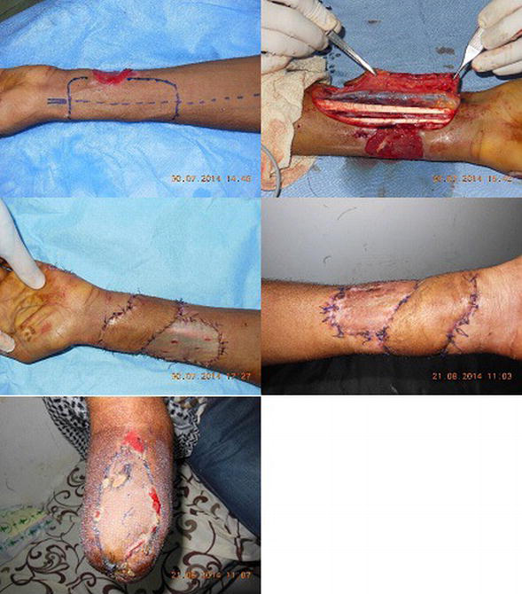

Slide 34
Complications
infection (which can progress to sepsis)
compartment syndrome
rhabdomyolysis (due to extensive muscle damage from internal burns).
Lung Injury
•Impairment of the brain centers stimulation of breathing and severe central nervous system damage
• Decreased muscle activity in the chest wall caused by a chest burn or muscle damage

Slide 35
Cardiac complications
One can have an arrhythmia, possibly even a fatal arrhythmia, at the time of the injury.
Anyone who experiences an arrhythmia or any chest pain or other typical cardiac-related symptoms is also at risk of arrhythmia in the 24 to 48 hours following the injury.
Thus these patients should be kept on a cardiac monitor at all times.
Any high voltage injury should have continuous cardiac monitoring for a minimum of 8 hours

Slide 36
Outcome and Prognosis
The location and extent of injury, the development of complications, and the functional result determine outcome and prognosis.
Recent advances in ICU care, resuscitation, nutritional support, and surgical techniques, along with new skin substitutes, have significantly improved outcomes.
Since most electrical injuries are preventable, prevention, education, and adherence to safety measures both at home and at work constitute the most important aspect of management

Slide 37
Low-voltage
If no significant burns are present and if consciousness returns before arriving to or in the ED, full recovery is expected.
Rare persistent arrhythmias have been reported.
Persistence of unconsciousness carries a worse prognosis, and full recovery is not expected after 24 hours of unconsciousness.
With proper treatment, the disfigurement of low-voltage mouth injuries can be minimized.
Scarring is almost always present.

Slide 38
High-voltage
Survival with massive burns is now the rule rather than the exception.
However, rates of amputation and significant morbidity from traumatic injuries and burns remain high.

