Slide 1
Collagen fiber
Collagen fiber H&E
EM of Collagen fiber

Slide 2
Elastic CT (H&E)

Slide 3
Elastic CT VVG

Slide 4
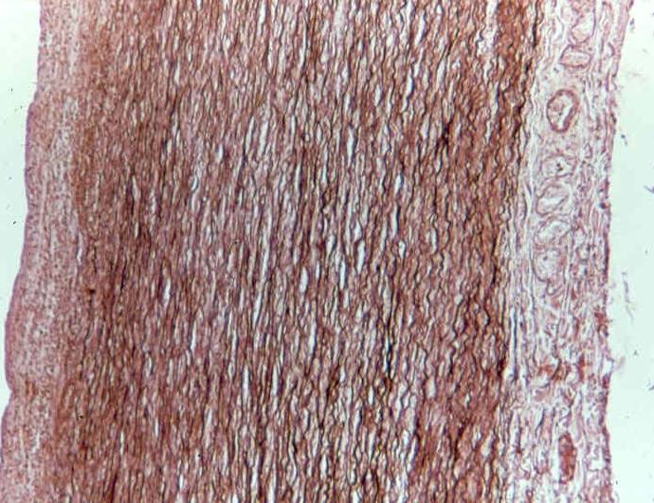
Elastic C.T. (orcein stain )

Slide 5
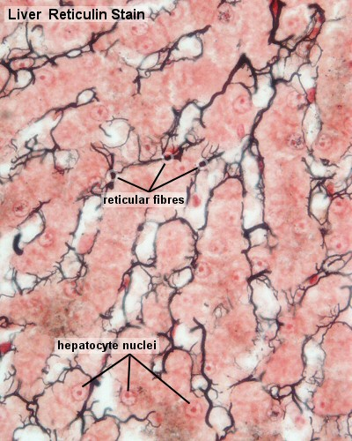
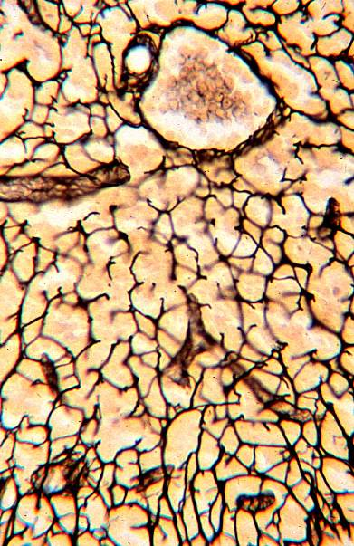
Reticular CT

Slide 6
Fibroblast & Fibrocyte
Smaller cells
with darker
nuclei
Larger cells
with paler
nuclei

Slide 7
EM: Fibroblast& Fibrocyte

Slide 8
Unilocular Adipose Tissue

Slide 9
Fat cell (osmic acid)

Slide 10
Fat cell (Sudan III)

Slide 11
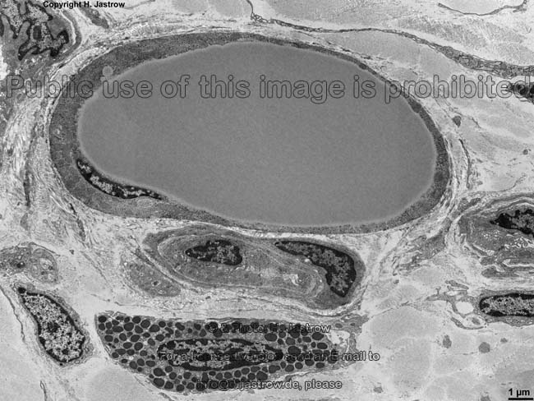
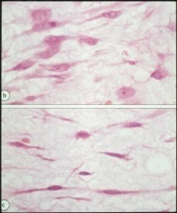
EM: Fat cell

Slide 12
Multilocular Adipose Tissue (H&E stain)

Slide 13
AdiposeTissue (multilocular & unilocular) H&E stain

Slide 14
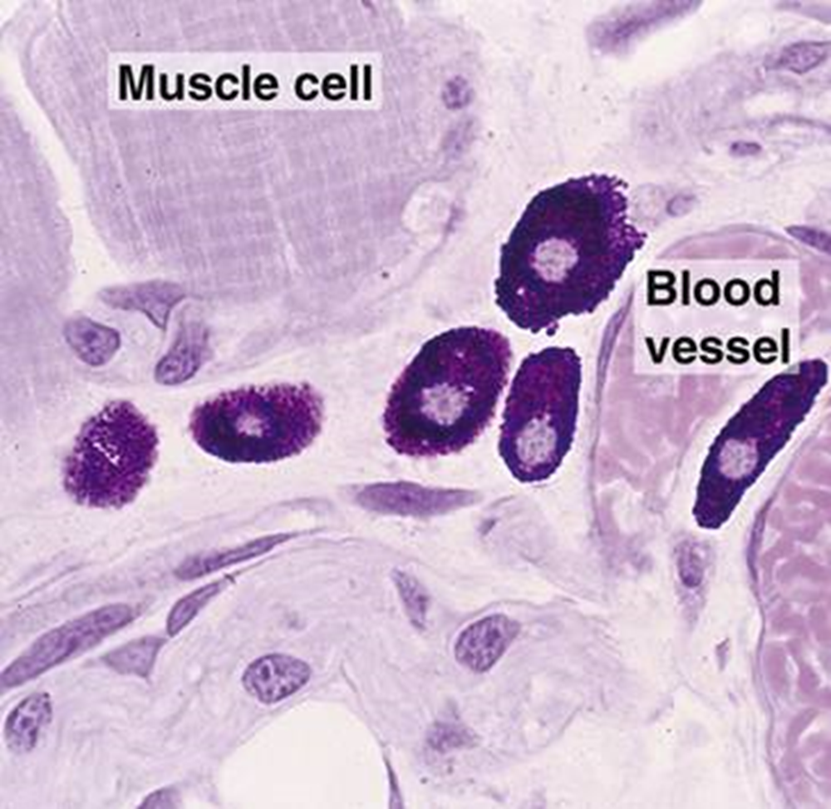
Mast Cell (H&E)

Slide 15
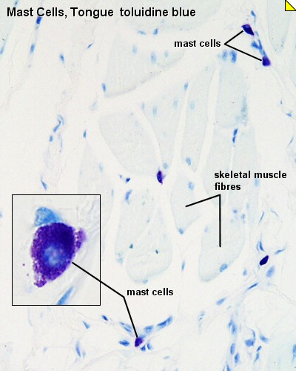
Mast Cells (Touldine Blue)

Slide 16
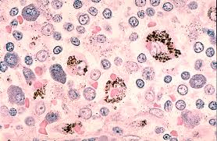
LM: Macrophage

Slide 17
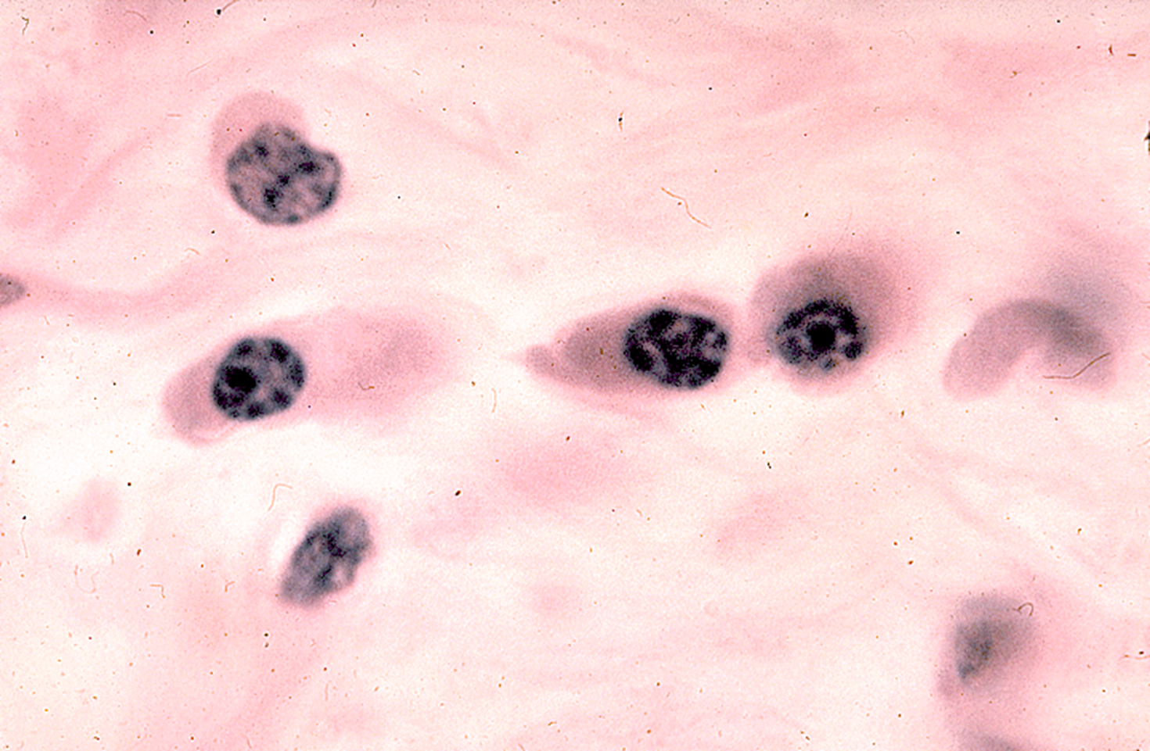
LM: Plasma Cells

Slide 18
EM: Plasma Cells

Slide 19
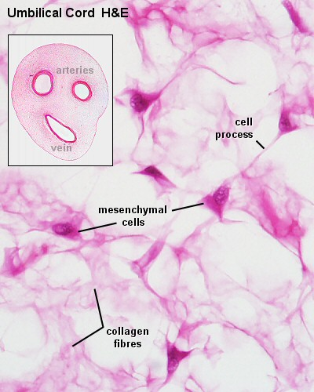
Mucoid CT
Sites:
Umbilical cord (Wharton's jelly).
Pulp of growing teeth.
Vitreous humor of the eye.
Structure:
Jelly like matrix rich in mucin.
Young fibroblasts, (UMCs).

Slide 20
Mucoid C.T. Umblical cord

Slide 21
Loose Areolar CT

Slide 22
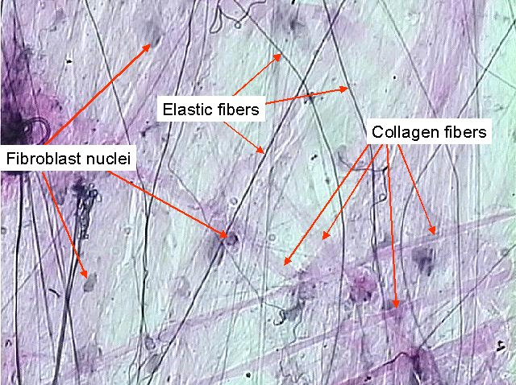
Loose Areolar CT

Slide 23
Loose Areolar CT

Slide 24
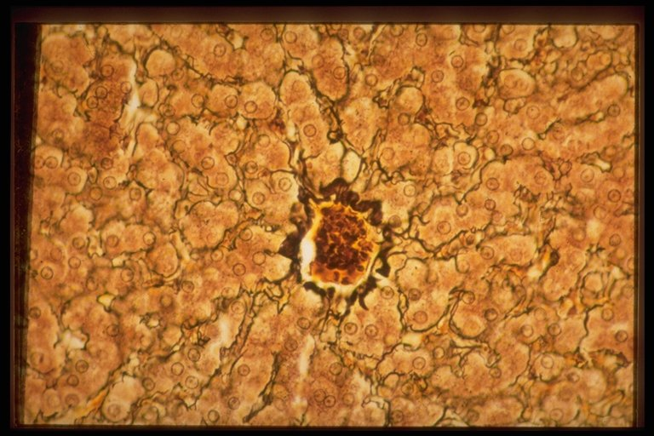
Reticular CT
Sites: liver ,Lymph node , Bone marrow
Structure: Formed mainly of reticular fibers & modified fibroblasts = reticular cells0.
Stain : silver stain
Function = Support

Slide 25
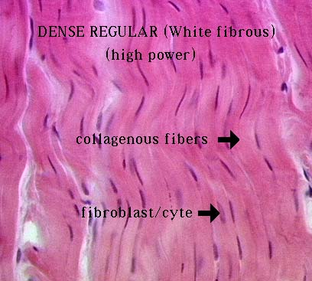
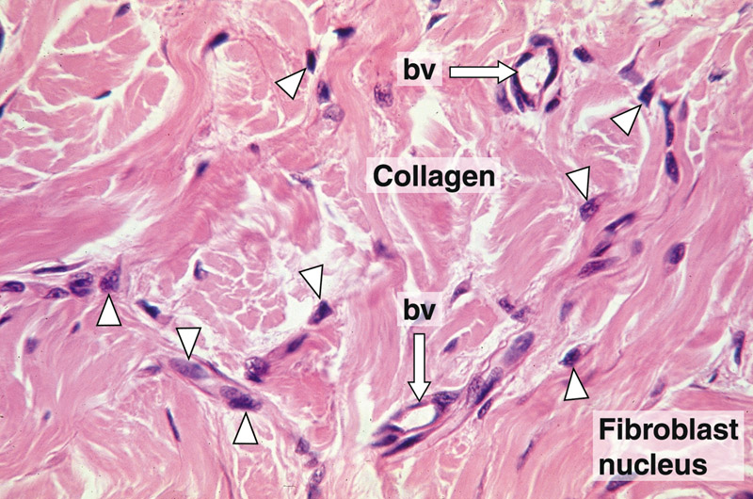
1-Regular : tendons , ligaments & cornea (substantia propria).
2-Irregular : dermis of skin , capsules of organs ,periostium & perichondrium.

Slide 26
White Fibrous CT(in tendon)

Slide 27
Elastic CT (H&E)

Slide 28
Elastic CT VVG

Slide 29
Elastic C.T. (orcein stain )

