Slide 1
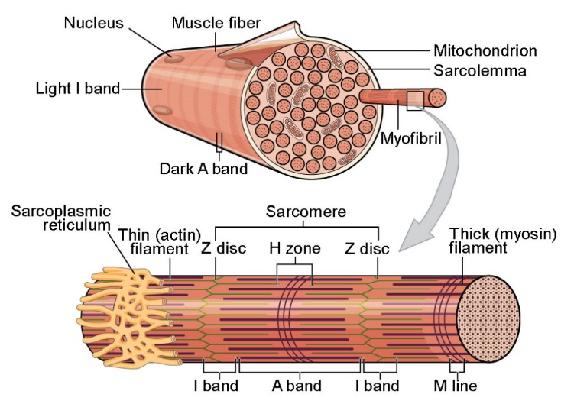
Neuromuscular junction
Prof. Sherif W. Mansour
Physiology dpt., Mutah School of medicine
2021-2022

Slide 2
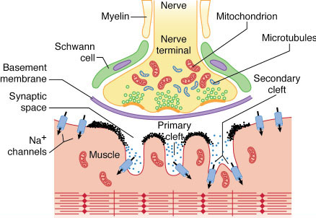
Neuromuscular junction
The area of contact between a nerve fibre and muscle fibre is called neuromuscular junction or Motor end plate (MEP).
The motor end plate

Slide 3
Structure of the motor end plate:
1-The motor nerve loses it myelin sheath and branches into many sole foots(to increase the surface area) which contain large number of mitochondria, acetylcholine vesicles and dense bars. These foots are covered by neurolemma which continue with the sarcolemma of muscle fibres.
2-Synaptic cleft is a distance (200-300 A°) between end of nerve (sole foot) and muscle fibre in which Ach is released from the nerve to stimulate the muscle and contain cholinesterase enzyme which hydrolyze Ach.
3-The muscle fibre membrane has invagination called synaptic gutter and subneural clefts to increase surface area of Ach effect.

Slide 4
Neuromuscular innervation
The motor unit: consisted of one anterior horn cell + its axon + muscle fibres supplied by this axon (one nerve fibre /3-300 muscle fibres).
- The motor pool: consisted of all AHCs + nerve + skeletal muscle supplied by it.
N.B.: The motor unit only obeys all or none law.
Miniature end-plate potential:
Spontaneous rupture of some Ach vesicles → sub-threshold depolarization in MEP without action potential in the muscle fibre.

Slide 5
Neuromuscular transmission (The end plate potential):
-Stimulation of the nerve causes Ca⁺² influx into nerve terminals → Ach vesicles binds to the dense bars in axon terminals and the viscosity of the intracellular fluid decreases→ fusion of Ach vesicles to the pre-synaptic membrane → rupture of Ach vesicles and release of Ach by exocytosis.
-Ach passes into the synaptic cleft.
-Ach combines with specific receptors in the muscle membrane this increases Na⁺ permeability via Na⁺ gates cause partial depolarization of MEP when reaches the firing level an action potential is produced.
-The EPP spread along the muscle fibre in both direction. Then repolarization occurs by ↑K⁺ permeability & Na⁺-K⁺ pump.
-Then Ach is rapidly hydrolyzed by cholinesterase in the cleft to prevent re-excitation of the muscle.

Slide 6
Properties of neuromuscular transmission:
1- The impulse passes from the nerve to the muscle (uni-direction).
2- Synaptic delay: is the time needed for the release of Ach and its effect on the muscle (0.5 msec).
3-Fatigue: may occur due to repeated stimulation → exhaustion of Ach.
4- The 10 folds safty factor: as the number of Ach molecules is 10 times more than the number of Ach receptors.
5- Drugs affect the N-M transmission:
a- Stimulators:
- Ach-like drugs (carbachol).
- Anticholinesterase drugs (prostigmine)
b- Blockers(muscle relaxing):
- Curare: by competitive inhibition.
- Succinylcholine: by persistent depolarization.
6-Effect of ions: - ↑ Ca⁺⁺ →↑ release of Ach →↑ transmission.
- ↑ Mg⁺⁺→ ↓ release of Ach →↓ transmission.

Slide 7
Myasthenia gravis
- It is a hereditary disease which affects females more than males.
- It is characterized by marked weakness and easy fatigability of muscles (if affect respiratory ms → death).
- Causes: 1- presence of curare – like substance in the blood.
2- decrease Ach synthesis, release from MEP.
3- decrease Ach receptors.
4- ↑ activity of cholinesterase enzyme.
5- Autoimmune disease (presence of antibody against Ach-activated ion channels)
Treatment:
- Rest.
- Anti-cholinesterase drugs e.g prostigmine.
- If associated with thymus enlargement, surgical removal of thymus gland is required (if the cause is autoimmune).
- Cortisone may be used.
N.B. other types of myasthenia as secondary myasthenia to bronchogenic carcinoma and neonatal type in some babies but for short time (2-6 weeks).
Myopathies:
- It is a progressive degeneration of the muscle due to endocrinal, metabolic or toxic causes.

Slide 8
Thank You

