Slide 1
Pancreatic diseases
Presesnted by Dr .Mohammad Nofal

Slide 2
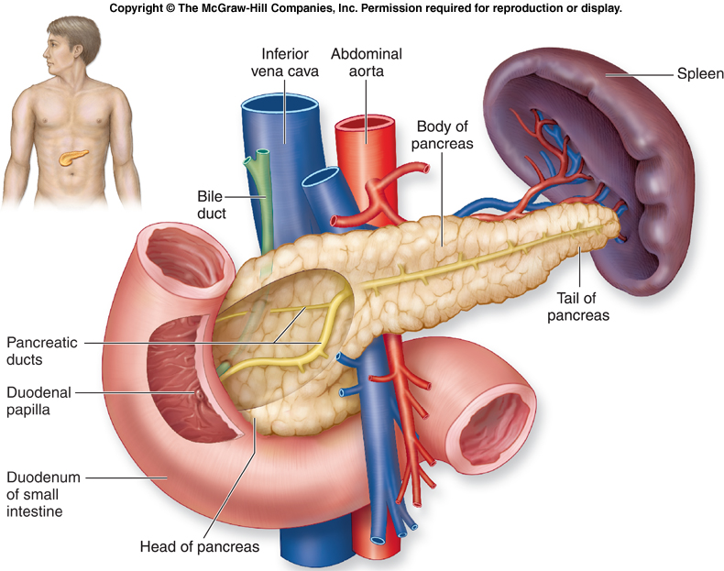
Anatomy
Retroperitoneal Organ
Weighs 75 To 100 G
15 To 20 Cm Long
Head
Neck
Body
Tail

Slide 3
What is Pancreatitis?
Inflammation or infection of the pancreas
Normally digestive enzymes secreted by the pancreas are not active until they reach the SI.
When the pancreas is inflamed, the enzymes attack and .damages the tissue that produce them
2 types: 1. Acute Pancreatitis 2. Chronic Pancreatitis

Slide 4
Acute Pancreatitis

Slide 5
Definition and Incidence
Inflammatory disease with little or no fibrosis.
Initiated by several factors:
90% of acute pancreatitis is secondary to acute cholelithiasis or ETOH abuse
Develop additional complications
300,000 cases occur in the united states each year leading to over 3000 deaths.

Slide 6
Etiology: (GET SMASHED)
G: Gallstone
E: Ethanol
T: Trauma
S: Steroid
M: Mump
A :Autoimmune
S: Scorpion bits
H: Hyperlipidemia
E: ERCP
D: Drugs

Slide 7
Clinical Presentation
Abdominal pain
Epigastric
Radiates to the back
Worse in supine position
Nausea and vomiting
Garding
Tachycardia, Tachypnea, Hypotension, Hyperthermia
Elevated Hematocrit & Pre renal azotemia
Cullen's sign
Grey Turner's sign

Slide 8
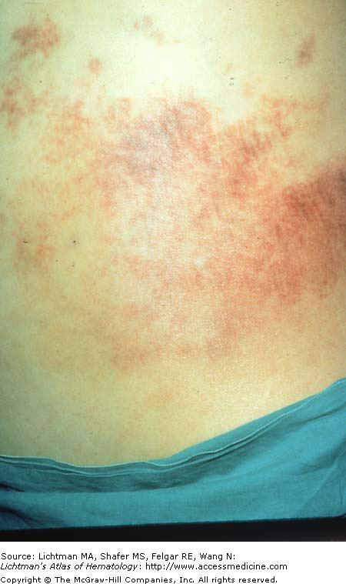
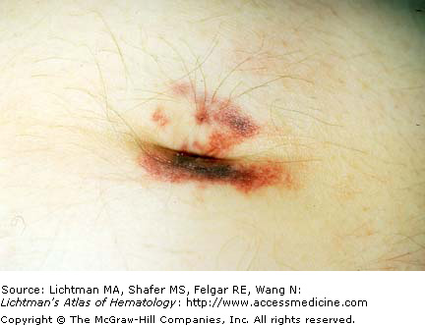
Grey Turner sign
Cullen’s sign

Slide 9
Diagnosis: Biochemical
serum amylase
Nonspecific
Returns to normal in 3-5 days
Normal amylase does not exclude pancreatitis
Level of elevation does not predict disease severity
Urinary amylase
P-amylase
Serum Lipase
CBC
Increased Hb
Thrombocytosis
Leukocytosis
Liver Function Test
Serum Bilirubin elevated
Alkaline Phosphatase elevated
Aspartate Aminotransferase elevated

Slide 10
Assessment of Severity
Criteria
1.ranson
2.APACHE-2
Biochemical Markers
Computed Tomography Scan
Notes:
. Several recent research studies have suggested additional markers that may have prognostic value, including acute phase proteins such as C-reactive protein (CRP), alpha₂-macroglobulin, polymorphonuclear neutrophil–elastase, alpha1-antitrypsin, and phospholipase A2.

Slide 11
Ranson Criteria Criteria for acute gallstone pancreatitis
Admission
Age > 55
WBC > 16
Glucose > 200
LDH > 350
AST > 250
During first 48 hours
Hematocrit drop > 10
Pao2 less than 60mm Hg
Serum calcium < 8
Base deficit > 4
Increase in BUN > 5
Fluid sequestration > 6l

Slide 12
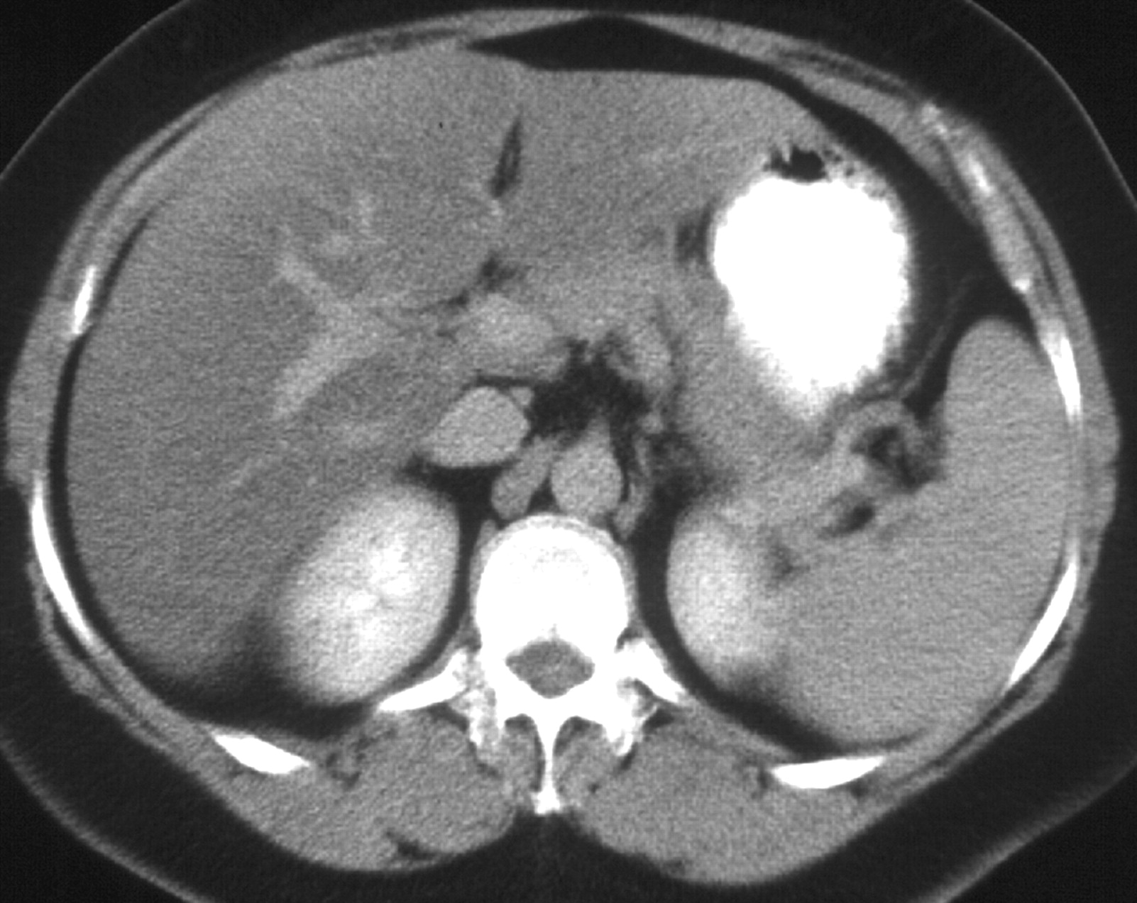
CT scans of normal kidneys and pancreas
Stomach
Liver
Pancreas
V
A
L Kidney
R Kidney
Spleen

Slide 13
Pancreatic Necrosis

Slide 14
Treatmaent of Mild Pancreatitis
Pancreatic rest
Supportive care
fluid resuscitation – watch BP and urine output
Pain Control
NG tubes and H₂ blockers or PPIs are usually not helpful
Refeeding (usually 3 to 7 days) If:
Bowel Sounds Present
Patient Is Hungry
Nearly Pain-free (Off IV Narcotics)
Amylase & Lipase Not Very Useful

Slide 15
Treatment of Severe Pancreatitis
Pancreatic Rest & Supportive Care
Fluid Resuscitation – may require 5-10 liters/day
Careful Pulmonary & Renal Monitoring – ICU
Maintain Hematocrit Of 26-30%
Pain Control – PCA pump
Correct Electrolyte Derangements (K⁺, Ca⁺⁺, Mg⁺⁺)
Contrasted CT scan at 48-72 hours
Prophylactic antibiotics if present
Nutritional support
May be NPO for weeks
TPN

Slide 16
Complications
Local
Phlegmon, Abscess, Pseudocyst, Ascites
Involvement of adjacent organs, with hemorrhage, thrombosis, bowel infarction, obstructive jaundice, fistula formation, or mechanical obstruction
Systemic
A. Pulmonary: pleural effusions, atelectasis, hypoxemia, ARDS.
B. Cardiovascular: myocardial depression, hemorrhage, hypovolemia.
C.Metabolic:Hypocalcemia,hyperglycemia,Hyperlipidemia,coagulopathy
D. GI Hemorrhage
E. Renal
F. Hematologic
G. CNS
H. Fat necrosis

Slide 17
Management

Slide 18
Chronic Pancreatitis

Slide 19
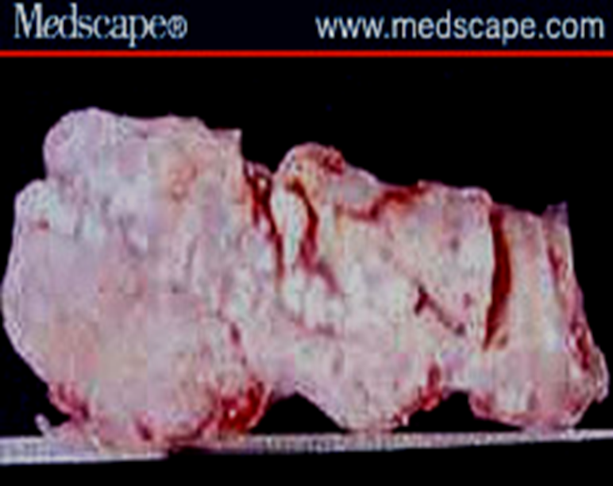
Definition and Prevalence
Defined as chronic inflammatory condition that causes irreversible damage to pancreatic structure and function.
Incurable
5 To 27 Persons Per 100,000

Slide 20
Etiology
Alcohol, 70%
Idiopathic (including tropical), 20%
Other, 10%
Hereditary
Hyperparathyroidism
Hypertriglyceridemia
Autoimmune pancreatitis
Obstruction
Trauma
Pancreas divisum

Slide 21
Classification:
1. calcific pancreatitis
2. obstruction pancreatitis
3. inflammatory pancreatitis
4. auto immune pancreatitis
5. asymptomic fibrosis
6. tropical pancreatitis
7. hereditary pancreatitis
8. idiopathic pancreatitis

Slide 22
Signs and Symptoms
Steady And Boring Pain
Not Colicky
Nausea Or Vomiting
Anorexia Is The Most Common
Malabsorption And Weight Loss
Diabetes

Slide 23
Laboratory Studies
Tests for Chronic Pancreatitis
I. Measurement of pancreatic products in blood
A. Enzymes
B. Pancreatic polypeptide
II. Measurement of pancreatic exocrine secretion
A. Direct measurements
1. Enzymes
2. Bicarbonate
B. Indirect measurement
1. Bentiromide test
2. Schilling test
3. Fecal fat, chymotrypsin, or elastase concentration
4. [¹⁴C]-olein absorption
III. Imaging techniques
A. Plain film radiography of abdomen
B. Ultrasonography
C. Computed tomography
D. Endoscopic retrograde cholangiopancreatography
E. Magnetic resonance cholangiopancreatography
F. Endoscopic ultrasonography

Slide 24
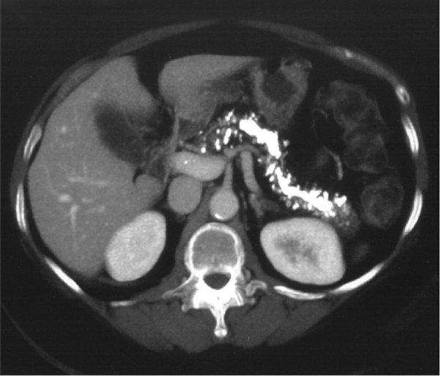
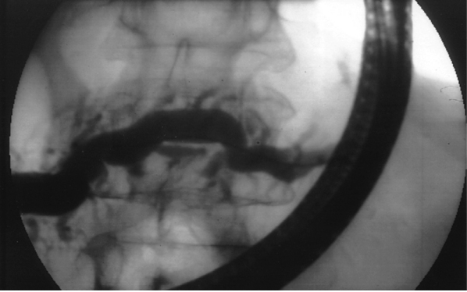
Pancreatic calcifications. CT scan showing multiple, calcified, intraductal stones in a patient with hereditary chronic pancreatitis
Endoscopic retrograde cholangiopancreatography in chronic pancreatitis. The pancreatic duct and its side branches are irregularly dilated

Slide 25
CT features
The cardinal CT features of CP are pancreatic atrophy, calcifications, and main pancreatic duct dilation .

Slide 26
Treatment
Analgesia
Enzyme Therapy
Antisecretory Therapy
Neurolytic Therapy
Endoscopic Management
Surgical Therapy

Slide 27
Complications
Pseudocyst
Pancreatic Ascites
Pancreatic-Enteric Fistula
Head-of-Pancreas Mass
Splenic and Portal Vein Thrombosis

Slide 28
Management

Slide 29
Annular Pancreas
When the ventral pancreatic anlage fails to migrate correctly to make contact with the dorsal anlage, the result may be a ring of pancreatic tissue encircling the duodenum.
Such an annular pancreas may cause intestinal obstruction in the neonate or the adult.
Symptoms of postprandial fullness, epigastric pain, nausea, and vomiting may be present for years before the diagnosis is entertained.

Slide 30
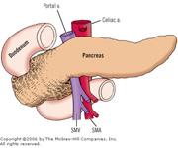

Slide 31
The radiographic findings are symmetric dilation of the proximal duodenum with bulging of the recesses on either side of the annular band, effacement but not destruction of the duodenal mucosa, accentuation of the findings in the right anterior oblique position, and lack of change on repeated examinations.
The differential diagnosis should include duodenal webs, tumors of the pancreas or duodenum, postbulbar peptic ulcer, regional enteritis, and adhesions.
Patients with annular pancreas have an increased incidence of pancreatitis and peptic ulcer.

Slide 32
Pancreas divisum
Occurs when the embryologic ventral and dorsal pancreatic anlagen fail to fuse, so that pancreatic drainage is accomplished mainly through the accessory papilla.
Is the most common congenital anatomic variant of the human pancreas.
Does not predispose to the development of pancreatitis in the great majority of patients .
However, the combination of pancreas divisum and a small accessory orifice could result in dorsal duct obstruction.

Slide 33
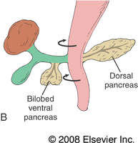

Slide 34
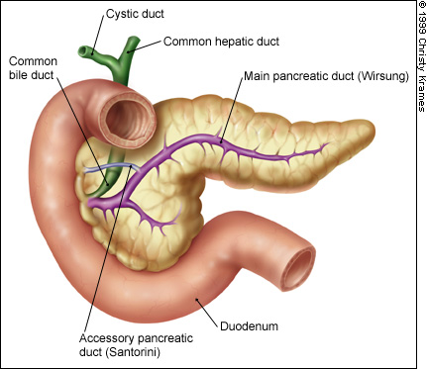

Slide 35
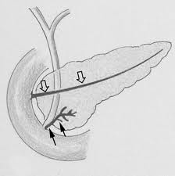

Slide 36
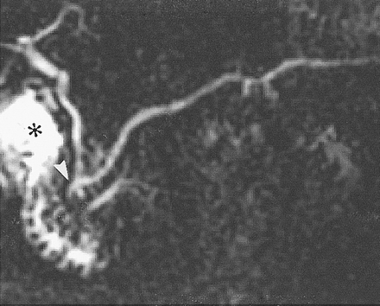
MRCP of pancreas divisum

Slide 37
TUMOURS OF THE PANCREAS
The tumours of the pancreas can be -
A. Non-Endocrine neoplasms
B. Endocrine neoplasms

Slide 38
Malignant non-endocrine neoplasms.
exocrine
The most common are:-
Ductal adenocarcinoma
Cystadenocarcinoma
NOTE: Periampullary carcinoma is term used for juxta-pancreatic carcinomas.
They are three forms:-
 Carcinoma of the ampulla
 Carcinoma of the lower CBD
 Duodenal carcinoma

Slide 39
ENDOCRINE NEOPLASMS:
These are less common than non-endocrine tumours and generally benign and sometimes multiple. They includes:
■ Insulinoma
■ Glucogonomas
■ Others:
- Gastrinomas
- Somatostatatinomas
- Vipomas (Vasoactive Intestinal Polypeptide)
common

Slide 40
EVALUATION OF PANCREATIC NEOPLASMS:
■ History
■ Clinical Examination
■ Investigations
The specific investigations:-
 Ultrasound Scan  Histology & cytology
 CT Scan  Angiography
 MR Imaging  Laparoscopy
 ERCP

Slide 41
NON-ENDOCRINE NEOPLASMS: (ADENO- CARCINOMA OF PANCREAS)
■ Ductal adeno carcinoma (arising in the exocrine part of pancreas) account for 90% of pancreatic tumour 2/3rd located in the head of pancreas.
Cystadenocarcinoma and endocrine tumour account for most of the remains of malignancy.

Slide 42
■ The exact causative factors responsible are unknown. The peak incidence in the 6th and 7th decade and more in men than women
The predisposing factors are:
 Diet (high protein & high fat)
 Smoking
 Exposure to industrial carcinogens

Slide 43
■ Spread of pancreatic tumours:
A. Local Invasion
B. Lymphatic
C. Blood
D. Via peritoneal & omental causing ascites

Slide 44
CLINICAL FEATURES:
■ The diagnosis of pancreatic cancer varies from the simple and clinically obvious to the most difficult and almost impossible the initial symptoms and signs depend on the site and extent of the pancreatic cancer.

Slide 45
■ Modes of presentation:
 Weight loss
 Pain
 Jaundice
 Steatorrhoea
 Diabetes Mellitus
 Acute Pancreatitis
 Malignant Ascites
 Gastric Outlet Obstruction

Slide 46
■ Approach to Investigations:
(Selective Investigations)
 Ultrasound Scan
 C.T. Scan
 MR Imaging Scan
 ERCP
 Histology & Cytology
 Angiography (Coeliac, Superior - Mesenteric)
 Laparoscopy

Slide 47
DELAY IN DIAGNOSIS:
■ Over 90% of patient with pancreatic cancer present in the late stage of their disease. At time no chance of cure.
■ The factors responsible for late diagnosis
A. Tumour is asymptomatic in the early stage.
B. Patient delay.
C. Physician delay.
D. The patient may not have ready and easy access to competent diagnostic center .

Slide 48
MANAGEMENT OF PANCREATIC CANCER:
A. Surgical Treatment
B. Non Surgical Treatment

Slide 49
SURGICAL TREATMENT:
■ Pancreatic Cancer is essentially incurable since metastasis occurs at such early stage. Any treatment must be regarded as palliative.

Slide 50
■ Surgical Options:
 For curative surgical treatment of cancer in the head of pancreas the optims are available:
A. Whipple operation (Pancreatico- duodenectomy)
B. Pylorus Preserving Pancreaticoduodenectomy
C. Total Pancreatectomy

Slide 51
 Palliative Surgical Treatment
(Surgical Bypass)
 For tail of the pancreas
(Distal pancreatectomy)
 Body of the pancreas
(Distal + removal of the body of the pancreas)

Slide 52
■ Pre-operative preparation of the patient for major surgery:
1. All jaundiced patients must be kept in good state of nutrition and hydration.
2. Blood clotting deficiencies must be corrected.
3. Cardio pulmonary functioning carefully assessed.
4. Drainage procedure consider in certain cases.

Slide 53
NON-SURGICAL TREATMENT:
The following options available:
(Pallative procedure for non operable cases)
 Percutaneous coeliac ganglion blockade.
(For pain)
 Stent to compress bile duct.
.
 Combination of chemotherapy and radiotherapy may become alterative in
the future.
h

Slide 54
FUNCTIONING ENDOCRINE TUMOURS OF THE PANCREAS:
These are much less common than adeno carcinoma.
The beta cell tumours secrete (Insulin) and called INSULINOMAS.
Another functioning tumour secrete(Gastrin) called GASTRINOMA which come from the islets which cannot be classified into either alpha or be (non-beta).

Slide 55
■ Other tumours are:
a. Vipoma (Werner-Morrison syndrome, Pancreatic cholera)
b. Somastatinoma
c. Glucagonoma
d. HP (Human Pancreatic Polypeptide tumours)
■ Slow growing and therefore carry much better prognosis.

Slide 56
INSULINOMA:
■ The commonest islet cell tumour and arise from the beta cell and situated anywhere on the surface or within the substance of the pancreas.
■ Most tumours are benign adenomas but 15% are low grade carcinomas and secrete (insulin).

Slide 57
CLINICAL FEATURES:
Whipple described a triad of features which typify the (insulinomas):
1. Fasting produces fainting.
2. During these “attacks” there is hypoglycaemia.
3. The attacks may be relieved by ingestion of glucose.

Slide 58
INVESTIGATIONS:
1. Measurement of blood sugar in an attack. Overnight fasting serum glucose and 2. insulin level (before & after overnight). Insulin level are estimated by radio-immunoassay.
3.Pre-operative localization of the tumour very important identification at operation can be difficult.
[Combination CT Scan and selective angiography]

Slide 59
TREATMENT:
1.If the tumour localized surgical resection is the TR of choice also this apply to metastases.
2.If the tumours not localized during surgery (Intra operative USS can be done to localize the tumour) than resected.
3.Sub total distal resection for multiple tumours is appropriate.

Slide 60
4.With negative exploration it is appropriate to perform pancreatectomy distal to the superior mesenteric vessels.
5.The Hypoglycemic attacks may be relieved by diazoxide or streptazotocin.

Slide 61
GASTRINOMA: (Zollinger-Ellison Syndrome)
The tumour arising from the islets cell of langhans in the pancreas and in the duodenal wall.
The majority (60%) of these tumours are malignant. They may be associated with (MEN 1)which are Parathyroid Hyperplasia, and Pituitary Adenoma. Gastrinoma give rise to ZE Syndrome which consist of triad (hypersecretion of gastric acid, severe peptic ulceration and the presence of non-beta cell tumour of the pancreas or duodenum).

Slide 62
CLINICAL FEATURES:
■ The disease present as peptic ulcer disease in over 90%.They have typical pain more severe and less response to medical treatment.
■ Co-existing diarrhoea.
■ All complications of peptic ulcer disease are present in (ZE-Syndrome) as acute haemorrhage, perforation and recurrent ulceration.

Slide 63
THE DIAGNOSIS OF ZE-SYNDROME:
Severe peptic ulcer disease doesn’t respond to treatment.
Multiple peptic ulcers or ulcers in unusual locations such as the distal duodenum or jejunum.
Peptic ulcer disease associated with diarrhoea.

Slide 64
Recurrent peptic ulcer disease following in acid reducing operation (surgery).
 Peptic ulcer is associated with MEN- 1 Syndrome.
 Marked elevation of serum gastrin.

Slide 65
TREATMENT:
Medical therapy for control of the acid hypersecretion in patient with ZE-Syndrome Omprazole considered the antisecretory drug of choice for all gastrinoma patients.

Slide 66
■ Surgical Treatment:
Tumour excision.
Total gastrectomy.
Patient with metastases should have medical therapy if fail total gastrectomy.
Gastrinoma patient with MEN 1 Syndrome and documented hyperparathyroidism should have parathyroid surgery performed prior to removal of gastrinoma.

Slide 67
Thank You

