Slide 1
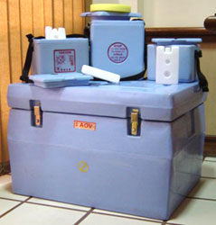
The Vaccine Cold Chain
Maintaining Cool Links

Slide 2
Cold chain system
Immunization program are widely recognized as one of the most effective types of health interventions.
However, for many countries, the delivery of safe injection practices and quality vaccines is a significant challenge.
The cold chain system, when implemented properly, can help overcome this challenge.

Slide 3
Cold chain system
The cold chain system can enhance the on-going :
of an immunization program.
Quality, Safety, and Efficacy

Slide 4
The cold chain system
Vaccines are sensitive biological substances that, with time, lose their potency, especially when exposed to heat, sunlight or fluorescent light and, in some cases, when cold.
Once potency has been lost, it can’t be restored.
To provide protection against disease, vaccines need to be distributed, stored and administered at recommended temperatures

Slide 5
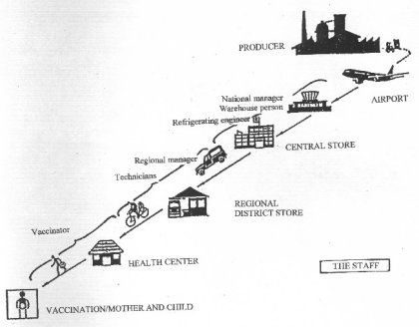
The cold chain system
The cold chain system is means of delivering effective vaccinations in children.
The common elements of all cold chain systems are a series of storage and transport links through a network of :
fridges,
freezers and
cold boxes
that keep vaccines at a safe temperature throughout their journey.

Slide 6
Typical cold chain system
As shown in the diagram, a typical cold chain system begins when vaccine is manufactured and ends with the child being immunized.

Slide 7
Storage conditions for vaccines and diluents
All vaccines are sensitive to heat; however, some are more sensitive than others.
WHO, EPI recommends the safe temperature range
+2º C to +8º C,
for storing most EPI vaccines.
OPV is the most heat-sensitive vaccine and must be kept between -15º C and -25º C.

Slide 8
Storage conditions for vaccines and diluents
The WHO no longer recommends that freeze-dried vaccines such as BCG, measles and Yellow fever be kept frozen at -20º C.
Storing them at this temperature is not harmful to the vaccines but takes up unnecessary deep-freeze storage space.
Instead, they should be stored between +2º C to +8º C.
All freeze-dried vaccines become more heat-sensitive after they have been reconstituted

Slide 9
Storage conditions for vaccines and diluents
BCG, measles, MR, MMR and rubella vaccines are not only sensitive to heat but also to light.
Normally, these vaccines are supplied in dark brown glass vials to protect them against light damage.
Nevertheless, they should always be covered and protected from strong light.
Hepatitis B, Hib (liquid), DTP, DT, Td and TT vaccines are sensitive to both heat and freezing (i.e., below 0º C), and should be protected accordingly

Slide 10
Storage conditions for vaccines and diluents
Freeze-dried vaccines and their diluents should always be distributed together.
Each type of freeze-dried vaccine requires a specific diluent.
A diluent made by one manufacturer should not be reconstituted with a vaccine produced by another manufacturer.
Reconstituted vaccines do not contain preservatives and thus become an ideal environment for growing dangerous organisms.
Reconstituted vials should therefore be used in one immunization session, or within 6 hours of reconstitution

Slide 11
Cold Chain Equipment
All cold chain equipment has to comply with a set of performance
standards defined by the WHO EPI program and
United Nations Children’s Fund (UNICEF), or national policy.
The recommended
equipment typically used
for vaccine storage are :
cold rooms,
refrigerators and
freezers.
For transporting vaccines
equipment such as
cold boxes,
vaccine carriers and
international containers
are commonly used.

Slide 12
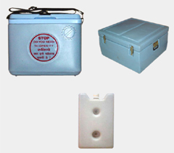
Cold chain equipment “for transporting vaccine”
Vaccine carrier
Cold box
Ice bags

Slide 13
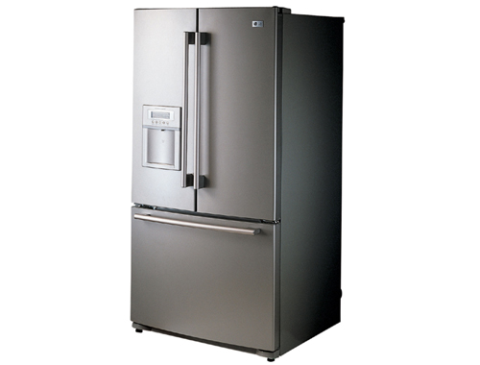
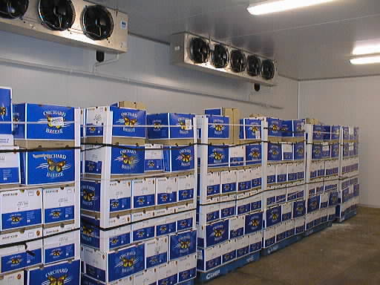
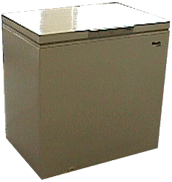
Cold chain equipment “For vaccine storage”
refrigerators
Freezer
Cold room

Slide 14
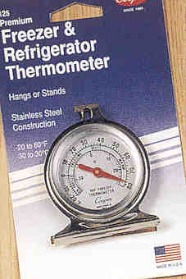
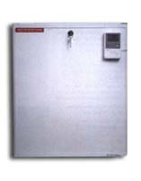
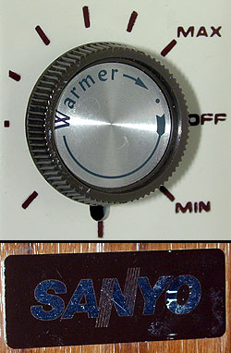
Controlling and monitoring temperatures
There are different types of monitoring devices for measuring, controlling and recording storage temperature of vaccines.
Refrigerators, freezers and cold boxes normally have thermometers that measure the internal temperature.
Most refrigerators and freezers are fitted with an adjustable thermostat to control and correct storage temperature.

Slide 15
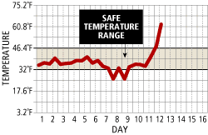
Controlling and monitoring temperatures
A designated person in charge of cold chain equipment should read and record storage temperature on a record sheet at least twice daily or according to policy

Slide 16
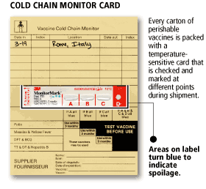
Controlling and monitoring temperatures
A Cold Chain Monitor card (CCM) approved by the WHO is always packaged with each consignment of vaccine supplied by UNICEF.
All CCMs have temperature-sensitive indicators that monitor heat exposure throughout the entire journey of vaccine, from manufacturer to health facility.
This indicator changes irreversibly from white to blue if exposed to temperatures higher than +10 and +34°C to monitor conditions in transit and in storage.

Slide 17
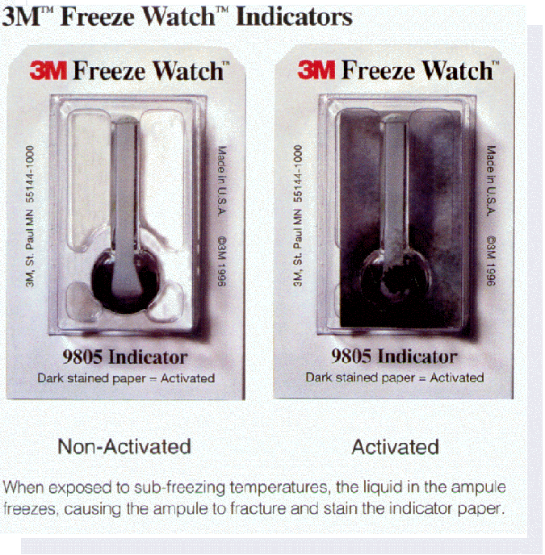
Controlling and monitoring temperatures
FreezeWatch indicators are CCMs used to monitor storage conditions of cold-sensitive vaccines.
Stop! Watches comprise of CCM and FreezeWatch devices to monitor high and low storage temperatures in a refrigerator.

Slide 18
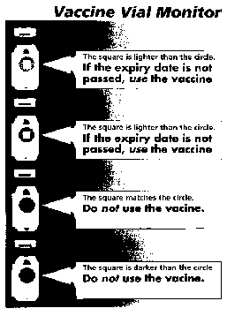
Controlling and monitoring temperatures
A Vaccine Vial Monitor (VVM) is a label
on a vaccine vial that is marked by a circle with a small square inside.
A heat-sensitive material on the label registers cumulative heat exposure of each individual vaccine vial over time.
When the inner square matches or is darker than the outer circle, it indicates that the vaccine has lost its potency and must be discarded.
VVMs are NOT substitutes for expiry dates.
Vaccines must never be used after their expiry dates.
VVM

Slide 19
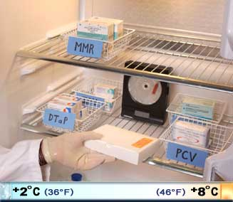
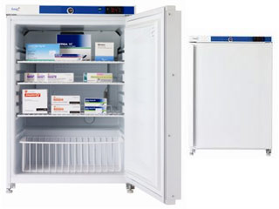
Keeping vaccines in the domestic refrigerator at health center
1. The refrigerator must be placed in the coolest place away from direct sunlight with adequate air circulation around it (12 – 15 inches away from the wall)
2. It must be kept locked and opened only when necessary
3. It must be defrosted regularly
4. Its temperature must be recorded twice daily
5. Both monitor and thermometer are placed in the refrigerator, while temperature chart is stuck on the outer-surface of the refrigerator door

Slide 20
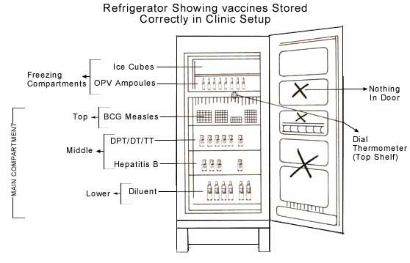
Arrangement of vaccines in the refrigerator
MMR

Slide 21
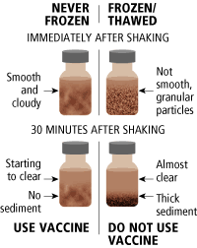
Shake test
DPT, DT, dT, TT
These vaccines are damaged
by freezing
Shake test should be performed on a sample of vaccine vial in question and on the sample of the same batch/manufacture which is known to have been frozen.
The two vials should be shaken vigorously for few minutes, and observed for the rate of sedimentation

