Slide 1
Conus medullaris syndrome
VS.
Cauda equina syndrome
!
are medical emergencies that have the potential to cause permanent neurological damage
DONE By :
Eslam wasfi Al-tarawneh

Slide 2
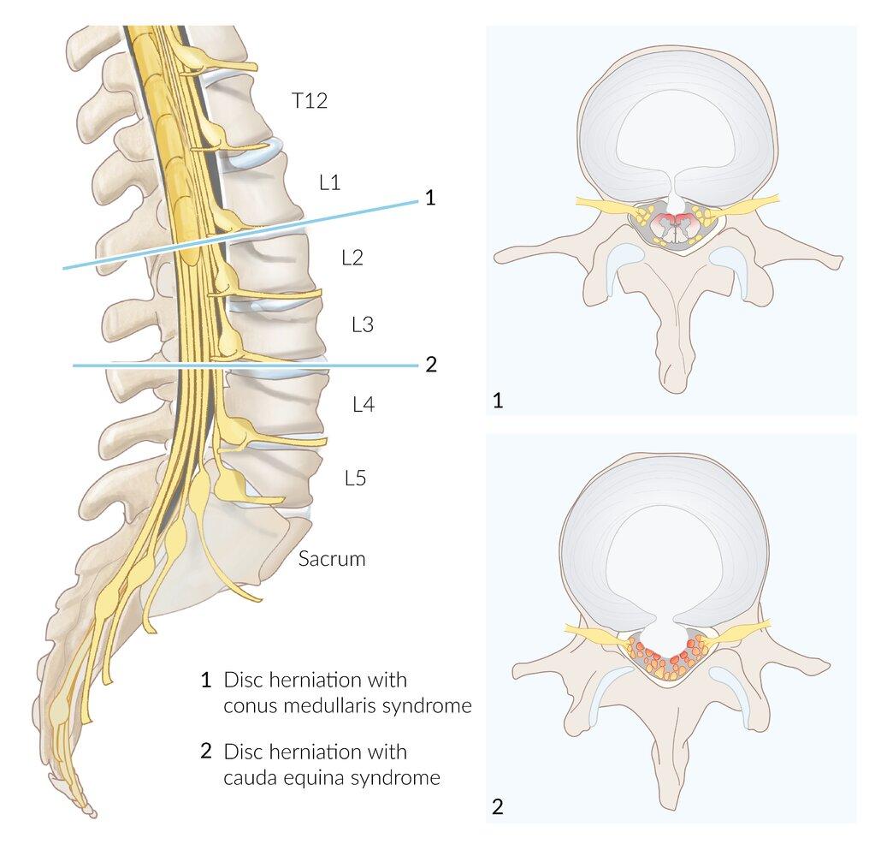
Notes:
Conus medullaris and cauda equina syndromes
1 (conus medullaris syndrome): disk herniation at L1-L2 with pressure on the conus medullaris
2 (cauda equina syndrome): disk herniation at L3-L4 with pressure on the cauda equina
While disk herniation has been used to illustrate the process here, any pathology that compresses the conus medullaris or cauda equina can result in these syndromes.

Slide 3
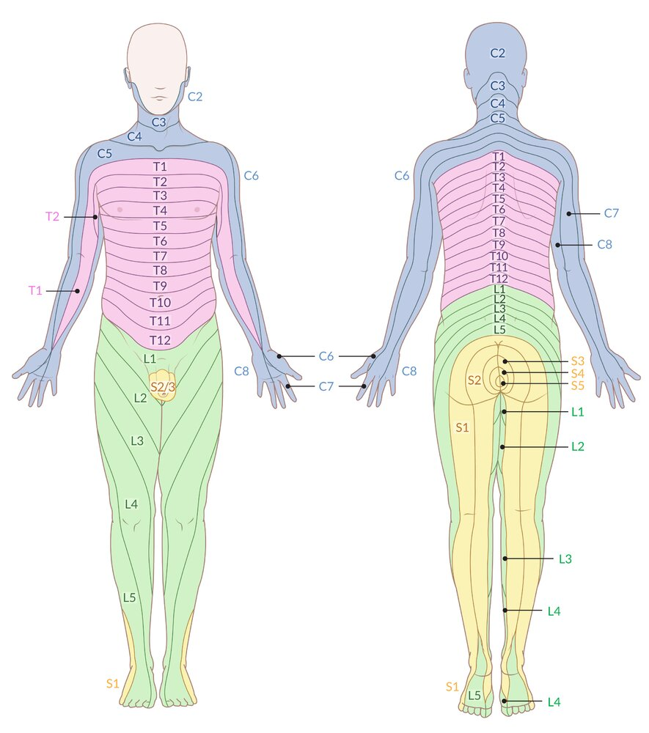
Dermatome map

Slide 4
Cauda equina syndrome
The clinical condition arising from dysfunction of multiple lumbar and sacral nerve roots within the lumbar spinal canal. Usually due to compression of the cauda equina (the bundle of nerve roots below the conus medullaris arising from the lumbar enlargement and conus).
Possible findings in CES:
1. sphincter disturbance:
a) urinary retention: the most consistent finding. Sensitivity ≈ 90% (at some point in time during
course).25,26 To evaluate acutely: have patient empty bladder and check post-void residual (by
catheterization or with bladder ultrasound). In a patient without retention, only 1 in 1000
will have a CES. Cystometrogram (when done) shows a hypotonic bladder with decreased
sensation and increased capacity
b) urinary and/or fecal incontinence some patients with urinary retention will present with
overflow incontinence
c) anal sphincter tone: diminished in 60–80%

Slide 5
2. “saddle anesthesia”: the most common sensory deficit. Distribution: region of the anus, lower
genitals, perineum, over the buttocks, posterior-superior thighs. Sensitivity ≈ 75%. Once total perineal anesthesia develops, patients tend to have permanent bladder paralysis
3. significant motor weakness: usually involves more than a single nerve root (if untreated, may progress to paraplegia)
4. low back pain and/or sciatica (sciatica is usually bilateral, but may be unilateral or entirely absent; prognosis may be worse when absent or bilateral
5. bilateral absence of Achilles reflex has been noted
6. sexual dysfunction (usually not detected until a later time)

Slide 6
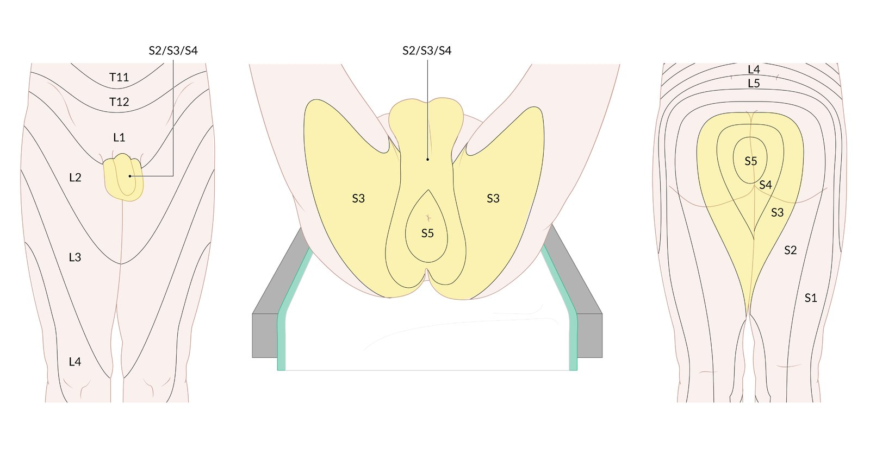

Slide 7
Etiologies
◘compression of cauda equina
a) massive herniated lumbar disc:
b) tumor
● from compression: e.g. with metastatic disease to the spine with epidural extension
● intravascular lymphomatosis (B-cell lymphoma)
c) free fat graft following discectomy
d) trauma: fracture fragments compressing cauda equina
e) spinal epidural hematoma

Slide 8
infection
a) compression: typically from spinal epidural abscess complicating discitis or vertebral osteomyelitis
b) a significant number of cases of CES from infection may be due to vascular compromise resulting from local septic thrombophlebitis. This may carry a worse prognosis as surgical decompression cannot correct this mechanism

Slide 9
3. neuropathy:
a) ischemic
b) Inflammatory
4. ankylosing spondylitis: etiology is often obscure

Slide 10
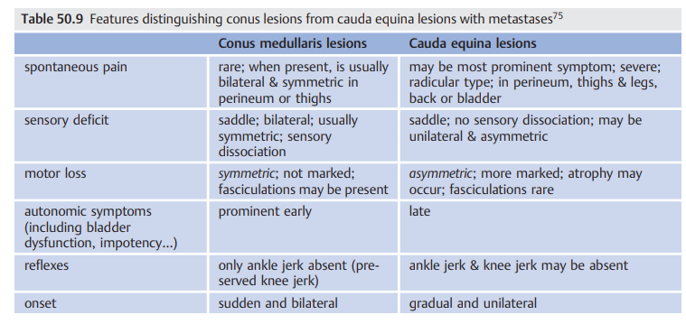

Slide 11
CASE
A 75-year-old man comes to the physician because of a 2-week history of sharp, stabbing pain in the lower back that radiates to the back of his left leg. He also has had a loss of sensitivity around his buttocks and inner thighs as well as increased trouble urinating the last week. Two years ago, he was diagnosed with prostate cancer and was treated with radiation therapy. Neurologic examination shows reduced strength and reflexes in the left lower extremity; the right side is normal. The resting anal sphincter tone is normal but the squeeze tone is reduced. What is the most likely diagnosis?

Slide 12
CASE
A 75-year-old man comes to the physician because of a 2-week history of sharp, stabbing pain in the lower back that radiates to the back of his left leg. He also has had a loss of sensitivity around his buttocks and inner thighs as well as increased trouble urinating the last week. Two years ago, he was diagnosed with prostate cancer and was treated with radiation therapy. Neurologic examination shows reduced strength and reflexes in the left lower extremity; the right side is normal. The resting anal sphincter tone is normal but the squeeze tone is reduced. Which of the following is the most likely diagnosis?

Slide 13
Thank you！

