Slide 1
Musculo-skeletal System INJURY An Overview Of The Global Burden Of Injury
Introduction:
Injuries have traditionally been regarded as random, unavoidable “accidents”.
Today both unintentional and intentional injuries are viewed as largely preventable events.
Acceptance of injuries as a preventable public health problem over the past decade has lead to the development of preventative strategies and, consequently, a decrease in the human death toll due to injuries

Slide 2
Injuries, unintentional or intentional, constitute a major public health problem, killing more than 5 million people worldwide each year and causing many more cases of disability.
People from all economic groups suffer fatal injuries, but death rates due to injury tend to be higher in those in the lower income groups.
The poor are also less likely to make a full recovery following an injury.

Slide 3
Definition
An injury is defined as "a bodily lesion at the organic level, resulting from acute exposure to energy (mechanical, thermal, electrical, chemical or radiant) in amounts that exceed the threshold of physiological tolerance.
In some cases (e.g. drowning, strangulation, freezing), the injury results from an insufficiency of a vital element”.

Slide 4
Magnitude Of The Problem Of Injuries:
While mortality is an important indicator of the magnitude of a health problem, it is important to realize that for each injury death, there are several thousand injury survivors who are left with permanent disabling sequelae.
These non-fatal outcomes must also be measured in order to describe accurately the burden of disease due to injury.
The indicator used to quantify the loss of healthy life due to disease is the disability-adjusted life year or DALY, a measure that accounts not only for the years of life lost from premature death but also for the years of life lived with disability.

Slide 5
Causes Of Injuries:
Abnormal energy transfer:
Mechanical energy (moving objects)
Thermal
Electric
Chemical
Radiation
All injuries can be characterized from the perspective of an abnormal transfer of energy.
For example, the catastrophic injuries arising from the transfer of energy between the victim and a stationary object (the ground) or a moving object-mobile (another vehicle), which lead to trauma and possibly death.

Slide 6
Energy Forces And Injuries:
If the energy transfer is localized in one area, the likely outcome may be a penetrating injury. If the energy transfer is dispersed over a broad area, The result will often be a non-penetrating injury (blunt).
In situations involving thermal energy transfer, the result will be a burn. And so on, depending upon the mode of energy involved.
So injuries may be:
Blunt (compression)
Penetrating
Others:
Deceleration / Acceleration
Shear (shave or cut off)
Blast (explosion)
Thermal / Chemical

Slide 7
Injuries Are Not Accidents:
Accidents: an unexpected occurrence happening by chance…. Implies a random and uncontrollable event.
Injuries: a definable correctable event with specific risks for occurrence….implies something amenable to intervention.
Nearly all injuries are not the result of random events.
There are distinct patterns and circumstances that characterize their occurrence.
Injuries most often occur to certain risk groups and are fairly predictable (whether it be to certain persons, at certain times, or in common locations)

Slide 8
Example: road traffic injuries.
Driving under influence of alcohol
Speeding
Under-utilization of seat belts and child restraints
Poor road design and roadway environment
Unsafe vehicle design
Under-implementation of road safety standards

Slide 9
Types Of Injuries:
There are several different types of injuries, though, which may occur from abnormal energy transfer.
The two main injury categories:
Unintentional injuries: Are subdivided into:
Road traffic injuries, poisoning, falls, fires, drowning
“Other unintentional injuries”:
Exposure to animate and inanimate mechanical forces (including firearms)
Exposure to electric current, radiation and extreme ambient temperature and pressure, and to forces of nature; and contact with heat and hot substances, and venomous plants and animals.

Slide 10
Intentional injuries: are subdivided into:
Self-inflicted injuries (i.e. suicide),
Interpersonal violence (e.g. homicide)
War-related injuries
“Other intentional injuries”. includes injuries due to legal intervention.

Slide 11
Injuries Of The Musculo-skeletal System:
Injuries occur in particular if the energy transfer (mechanical workload) is higher than the load-bearing capacity of the components of the musculo-skeletal system.
Injuries of muscles and tendons (e.g. strains, ruptures), ligaments (e.g. strains and ruptures) and bones (fractures, unnoticed micro-fractures and degenerative changes) are typical consequences.
In addition irritation of the insertion points of the muscles and tendons and of tendon sheaths as well as functional restrictions and degeneration of bones and cartilage (e.g. menisci, vertebrae, inter-vertebral discs and articulations) may occur.

Slide 12
Two Fundamental Types Of Musclu-skeletal Injuries:
Acute and painful injury: Caused by strong and short-term energy transfer leading to sudden failure in structure and function e.g.:
Tearing of a muscle due to a heavy lift.
Fracture of a bone due to a fall.
Blocking of a vertebral joint due to vigorous movement.
Chronic and persistent: results from a permanent overload or energy transfer leading to continuously increasing pain and dysfunction (e.g. wear and tear of ligaments, tendinitis, muscle spasm and hardening

Slide 13
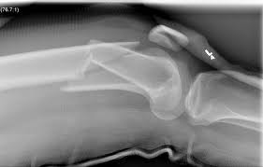
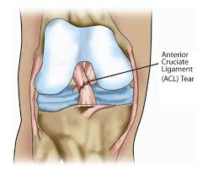
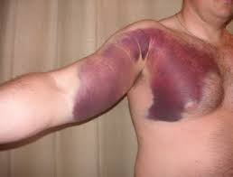
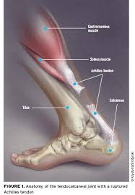
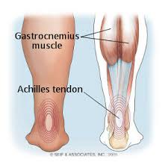

Slide 14
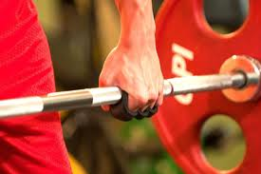
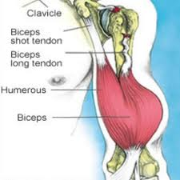
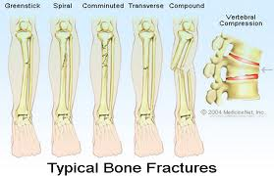
BICEPS BRACHII ORIGIN Long head: supraglenoid tubercle of scapula. Short head: coracoid process of scapula with coracobrachialis
INSERTION posterior border of bicipital tuberosity of radius (over bursa) and bicipital aponeurosis to deep fascia and subcutaneous ulna
ACTION Supinates forearm, flexes elbow, weakly flexes shoulder
NERVE Musculocutaneous nerve (C5, 6) (from lateral cord)

Slide 15
One disability-adjusted life year (DALY) is defined as one lost year of healthy life, either due to premature death or disability.
Although DALYs include premature death, injury and physical disability, they do not, for example, account for:
Mental health consequences of violence and war
Conditions such as sexually transmitted diseases resulting from rape
The effects of infectious diseases and malnutrition following war.

Slide 16
Global injury related mortality
An estimated 5 million people worldwide died from injuries in 2000 — a mortality rate of 83.7 per 100 000 population.
Injuries accounted for 9% of the world's deaths in 2000 and 12% of the world’s burden of disease.
What is the global burden of injuries?
Injuries are recognized as a major concern in public health worldwide. Results of the Global Burden of Disease (GBD) study showed that globally in 2019, 8% of all deaths were due to injury
The burden of disease related to injuries, particularly road traffic injuries, interpersonal violence, war and self-inflicted injuries is expected to rise dramatically by the year 2020.
Road traffic injuries are the leading cause of injury-related deaths worldwide

Slide 17
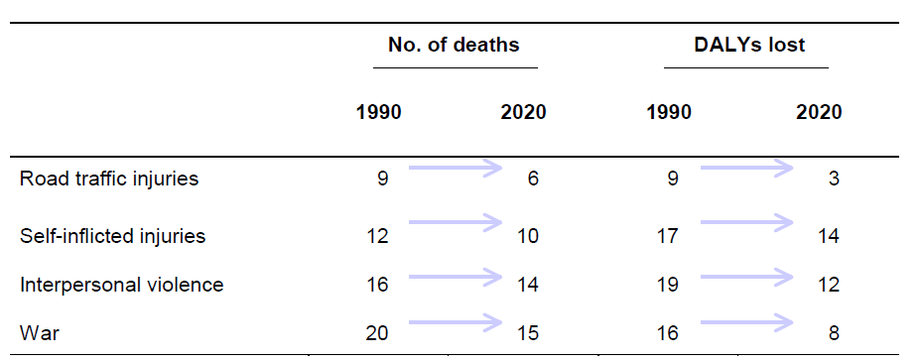
World rankings of injury-related mortality and burden of disease (DALYs lost), 1990 and 2020
The table shows that if current trends continue, road traffic and intentional injuries (i.e. self-inflicted injuries, interpersonal violence and war-related injuries) will rank among the 15 leading causes of death and burden of disease.

Slide 18
Injuries Mortality By Region:
More than 90% of the world's deaths from injuries occur in low- and middle-income countries.
The low- and middle-income countries of Europe have the highest injury mortality rates.
The South-East Asia and Western Pacific Regions account for the highest number of injury deaths worldwide.
Injuries Mortality By Sex And Age Group
Globally, injury mortality among men is twice that among women. In some regions, however, mortality rates for suicide and burns in females are as high or even higher than in males.
Males in Africa and Europe have the highest injury-related mortality rates.

Slide 19
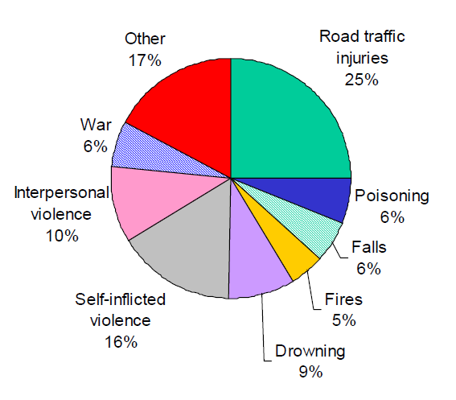
Young people between the ages of 15 and 44 years account for almost 50% of the world’s injury-related mortality.
Mortality from road traffic injuries and interpersonal violence in males is almost 3 times higher than that in females.
Children under 5 years of age account for approximately 25% of drowning deaths and a little over 15% of fire-related deaths worldwide.
Distribution of global injury mortality by cause, 2000
One quarter of all injury deaths are due to road traffic injuries; suicides and interpersonal violence combined account for another quarter of the global total

Slide 20
Magnitude Of Injury Mortality In Jordan:
Accidents and injuries emerge as an increasingly significant problem. According to the Jordan Traffic Institute, there were 62115 road accidents in 2003 causing 832 deaths and 18368 injuries.
According to the same source, road traffic accidents have been increasing over years and leading to more human and economic losses.
Occupational accidents amounted to 15619 causing an estimate of 97522 work day’s lost.

Slide 21
Prevention of injuries
To date, injury prevention has tended to be an issue only in wealthier countries.
The highest rates of death and permanent disability due to injury are, however, currently found in the poorer nations; It is these countries therefore that have the most urgent need for prevention strategies that are appropriate, cost-efficient and effective. In this context, “appropriate” means taking into account:
The complexities of the problem
The availability of resources and, furthermore,
What strategies have been shown to work elsewhere.

Slide 22
To develop effective prevention strategies, most countries need better information.
In particular, countries need to know about the numbers and types of injuries that occur and about the circumstances in which those injuries occur.
Such information will indicate how serious the injury problem is, and where prevention measures are most urgently needed

Slide 23
Injury Control:
The primary focus of injury control is to:
Identify energy forces which cause injury,
Define mechanisms of human exposure,
Identify precisely where interventions can interrupt the causal pathway.
Unlike many chronic diseases, the agent and time of injury onset is almost always known and can be measured, the mechanism of energy transfer from reservoir to host can be described.
With several exceptions, injuries usually occur immediately after exposure and rarely have the long incubation or latent periods of many infectious and chronic conditions

Slide 24
Primary Prevention
which occurs during the pre-event phase, prevents the injury event by eliminating the mechanisms of energy transfer or exposure: examples:
Traffic safety laws
Vehicle modifications which prevent automobile crashes,
fences around swimming pools which prevent submersion,
Trigger locks on guns,
Safety caps on poisonous substances

Slide 25
Secondary Prevention
which occurs during the injury phase, its goal is to eliminate or reduce injury severity once an energy transfer has occurred. Examples:
Motorcycle helmets,
seatbelts,
life vests,
Bullet proof vests
While measures on the secondary level do not prevent the event which causes injury, they do reduce the energy absorbed by the host.
It is important to note that some of the most effective secondary prevention strategies do not eliminate all injuries.
For example, the motorcycle helmet is very effective in reducing head trauma in motorcycle crashes, but is not effective in preventing trauma to other body regions

Slide 26
Tertiary Prevention:
Which occurs in the post injury phase, aims to reduce the consequences of the injury once an injury-producing energy transfer has occurred.
Examples:
Emergency and trauma care, as well as rehabilitation efforts.
Some of the most important advances in injury control have been improvements in the early response and treatment of serious injury.

Slide 27
Specific Injury-prevention Strategies
can be divided into two very broad groups based on need for host actions.
Passive intervention requires no input or action by the host and is usually accomplished by modifying the agent, vehicle, vector, or environment. Modifications in car design to improve brakes and increase the energy absorbed by vehicle components are two examples.
Active intervention requires that the host take some type of action for the intervention to work. Seatbelts and helmets are examples of active intervention
Intervention strategies to be effective, they should incorporate both active and passive ones.
Passive intervention strategies are usually considered more effective, especially when compared with active interventions which require frequent or time-consuming action.
Air bags, for example, require no driver action, whereas seatbelts can only be effective when fastened by the occupant. However, the most effective crash protection occurs when both are available.

Slide 28
The Haddon Matrix, a model of the agent–host relationship in injury causation, was the foundation for the study of motor vehicle crashes and countermeasures for highway safety, and continues to be an applicable theoretical framework for injury prevention. The Haddon Matrix divides the timing of the injury event into three phases, these phases correspond to the three levels of prevention defined by public health:
Pre-event,
Event,
Post event.
Each of these phases is influenced
by three factors:
The human (host),
Vehicles or vectors,
The environment, which can be
separated into physical and social,
with economic and cultural aspects.

Slide 29
These different 3 phases and 3 factors can be used to create a 3 by 3 matrix.
In developing a program of injury control measures for a particular injury problem, we can go systematically through each cell of the matrix and think up all possible countermeasures applicable to that cell.
The usefulness of the matrix is as a tool for generating ideas, at this stage every possible strategy should be documented and nothing held back because of political or financial considerations.
Factors Phases | Human | Vehicle & Equipment | Environment
Pre-event | 1 | 2 | 3
event | 4 | 5 | 6
Post-event | 7 | 8 | 9

Slide 30
Phase | Human | Vehicles/Equipment | Environment
Pre Crash (Crash Prevention) | Information Attitude Impairment Police Enforcement | Roadworthiness Lighting Braking Handling Speed Management | Road Design and Road Layout Speed Limits Pedestrian facilities
Crash (Injury Prevention during the crash) | Use of Restraints Impairment | Occupant Restraints Other Safety Devices Crash Protective Design | Crash-protective Roadside objects
Post Crash | First-aid skills Access to Medics | Ease of Access Fire Risk | Rescue Facilities Congestion

