Slide 1
Child’s Healthcare
Dr. Israa Al-Rawashdeh MD, MPH ,PhD
Faculty of Medicine
Mutah University
2019

Slide 2
Definitions:
A child is a person 18 years or younger unless national law defines a person to be an adult at an earlier age.
An infant is a child younger than one year of age
An adolescent is a person aged 10 to 18 years inclusive.

Slide 3
Why focus on child’s health?
One of the most vulnerable segments of the population.
A child is dependant on adults for their optimal development and survival.
Critical years of life: biologic immaturity (immunity)—increased risk of infectious diseases and rapid growth and development (e.g. brain).
Majority of child deaths are preventable or/and treatable.
Childhood illness contribute substantially to the global burden of disease.
A good measure of societal progress

Slide 4
Scope of the Problem
An estimated 6.2 million children and young adolescents under age 15 died, mostly from preventable causes (2018).
the highest risk of death is during the neonatal period (the first 28 days of life).
1 in 26 children died before reaching age five in 2018, compared to 1 in 11 in 1990.
UN report.

Slide 5
Child Mortality indicators
Under-five mortality rate U5MR - Probability of dying between birth and exactly five years of age expressed per 1,000 live births.
Infant mortality rate IMR - Probability of dying between birth and exactly one year of age expressed per 1,000 live births
Neonatal mortality rate NMR: Probability of dying during the first 28 days of life, expressed per 1,000 live births.

Slide 6
Causes of death
Differ by age group
Common problems that occur beyond the neonatal period tend to be more easily addressed by public health strategies while neonatal problems may require more clinical based interventions.
Most interventions aimed at decreasing neonatal mortality are linked to prenatal and maternal care interventions.

Slide 7
There is an inequitable distribution of child deaths; 99% of childhood deaths occur in Low and Middle Income Countries
93% of all childhood deaths occur in Asia (42%) and Africa (51%).
The under‐5 mortality rate in Sub‐Saharan Africa is >10 fold that of the rate in industrialized countries.

Slide 8
In general,
Leading causes of death in children under-5 years are:
preterm birth complications,
pneumonia,
Intrapartum related events ( birth asphyxia),
congenital anomalies,
diarrhoea
Neonatal sepsis and malaria.
*Injuries play a more prominent role in the deaths of older children.
(WHO, 2018)

Slide 9
Factors that Affect the Health of Children
Poverty
Poor and inadequate nutrition
Inequality/Relative Poverty
Lack of access to care and Inadequate health services (PHC)
Lack of maternal education
Conflict/War/Disaster
Lack of safe and adequate water supply and Poor sanitation
High fertility rate
Poor maternal health services

Slide 10
Morbidity
Common diseases with low fatality but cause significant disability.
Not evident if we only consider U5MR, IMR,NMR!
Examples:
- Vit. A deficiency: leading cause of preventable blindness worldwide.
Iodine deficiency: preventable cause of developmental delay.
Iron deficiency: affects >50% of children—anemia, decreased performance at school
Helminthic infections: anemia, poor growth, decreased learning.

Slide 11
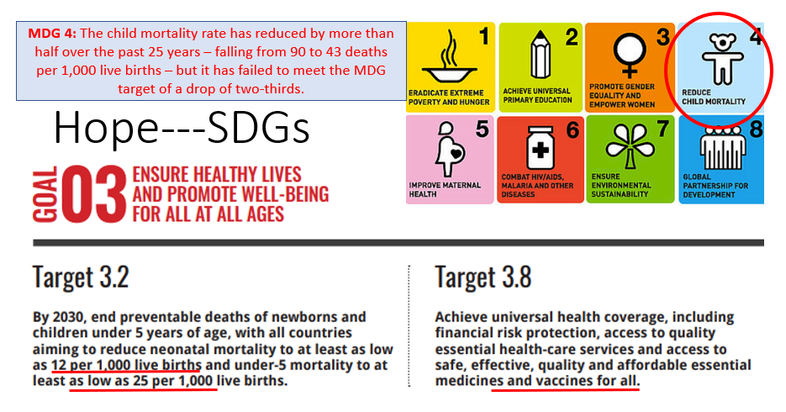

Slide 12
Health Services
The main functions can be summarized as follows:
A. Preventive and promotive care.
B. Care in illness
C. Monitoring of growth and development

Slide 13
A. Preventive and promotive care.
It includes:
Immunization
Health check up
Health education
Nutritional education

Slide 14
Immunization
Seven, easily, preventable diseases are responsible for most childhood morbidity and mortality.
These are TB, diphtheria, pertussis, neonatal tetanus, poliomyelitis, measles and viral hepatitis B.
Children can be protected by a fairly cheap and simple program on immunization before they are one year old.

Slide 15
Health check up
A newborn has to be examined at least twice; once within the first 24 hours after birth and just before discharge.
Monthly health check-ups should be done during infancy as well as in all visits to the clinic including routine immunization sessions.
The health check- up can be very helpful in identifying at risk children, who can be followed more closely by appropriate screening or diagnostic tests and / or paid home visits if needed.

Slide 16
At risk children include:
Birth weight < 2500 grams.
Twins.
Birth order > 5th
Artificial feeding.
Weight below 60% of the expected weight for age.
Failure to gain weight for three successive months.
Children having protein energy malnutrition (PEM).
Children having diarrhea or ARI.

Slide 17
Newborn Screening Program in Jordan
The purpose is to screen for congenital and heritable disorders.
Identification is a multi-step process:
(1) Blood specimens from infants are analyzed by the laboratory
(2) If a result is abnormal, laboratory staff notifies case management / Clinic
(3) The clinic provides follow-up to assist linking families with appropriate providers to confirm the test results.

Slide 18
The National Newborn Screening Project covers nearly 29 conditions. These include twenty inborn errors of metabolism, three hemoglobinopathies (including Sickle Cell disease), two endocrine disorders (HT), one hearing loss disease and three other metabolic disorders.
These disorders may cause severe mental retardation, illness, or death if not treated in the early stages. If treated, infants may live relatively normal resulting in savings in medical costs over time.

Slide 19
Health education
Child rearing: cleaning, bathing, as well as the importance of exposure to the ultraviolet rays of the sun.
Immunization: benefits, timing and possible side effects.
Family planning: it is indirectly related to child’s health

Slide 20
Nutritional education
(Breast-feeding)
Breast milk is the perfect food for babies and the best protection against life-threatening illness.
Breast-feeding binds mother and child, costless and naturally encourages birth spacing. Also, could prevent deaths of at least one million children a year
Yet breast feeding practice is not uniformly common in many developing countries for several reasons:
o Hospitals and maternity clinics promote bottle-feeding, because of the aggressive marketing by infant formula manufacturers, who provide free or low-cost supplies.
o Other practices, such as separating babies from mothers at birth, which inhibit breast feeding.

Slide 21
Initiation and Maintenance of Breast feeding
The decision of breast- feeding should be made during antenatal period by the help of the obstetrician and pediatrician.
Breast Feeding Guidelines:
1. Begin breast feeding as soon as possible, preferably within the first half-hour after delivery.
2. Breast feeding should be on demand, whenever the infant is hungry, both day and night.
3. Exclusive breast feeding through the first 6 months of life.

Slide 22
Breast Feeding Guidelines:
4. Appropriate complementary semi-solid food should be started after 6 months of age, but the breast milk should be offered first.
5. Breast-feeding should be continued throughout the second year of life.
6. Position the infant so that its mouth covers both the nipple and areola, and latches on properly.
7. Avoid the use of bottles or pacifiers.
8. The mother’s food and fluids should meet her needs during lactation.

Slide 23
Supplementary foods
Babies can grow on breast milk alone for the first 6 months of life.
After that age, breast milk alone may not be enough; other foods need to be added with continuation of breast feeding for as long as possible, preferably 24 months.
Gradual foods introduction other than breast milk “weaning” is recommended.
In most communities, supplementary feeding starts by semisolid prepared from (the local staple food)

Slide 24
The weaning period poses two risks:
o Malnutrition: it is a common problem during the weaning period as the weaning foods are usually watery, less nutritive and less energy supplying than breast milk.
o Contamination: the risk of contamination of the weaning food is high, so diarrhea is common during this period. With diarrhea parents usually starve the infant, which aggravates malnutrition.

Slide 25
-To avoid such hazards; the UNICEF developed the following guidelines' for safe supplementary feeding.
1. It should be started at the age of 6 months. By that age, the iron stores in the liver are depleted so the infant needs a diet rich in iron.
2. Abrupt weaning should be avoided.
3.The nutritional value of the traditional weaning foods should be improved.
4. All foods offered to the infant should be freshly prepared.
Breast- feeding should be continued until the end of the second year of life, together with supplements, as breast milk may be the only available clean source of animal protein.

Slide 26
Continued guidelines for safe supplementary feeding:
Cleanliness & hygiene should be ensured during food preparation
Only one new food is introduced at a time.
Small quantities of the new food is introduced first and gradually increased. Foods are introduced by plate and spoon, which should be colored and attractive. Infant starvation during diarrhea should be avoided.
With the beginning of weaning, the chances of another pregnancy are greatly increased, so an action for child spacing should be motivated.

Slide 27
FYI
The brain develops more rapidly when the child first enters school than at any other age!
False
The brain develops most rapidly before birth and in the first two years of life. The efforts to help the child learn at this age will benefit the child for their whole life.

