Slide 1
vacuum-assisted vaginal delivery vacuum extraction (VE)
(Ventouse)
Done by : QUTAIBA HABAHBEH.
Supervised by: Dr. ALAA OWAIS .
Notes:
Its traction of fetal head by created Negative pressure through a cup applied to the head

Slide 2
Definition :
Traction of fetal head by CREATING Negative pressure through a SUCTION cup ( RIGID OR SOFT ) applied to the head .

Slide 3
Overview :
used in the second stage of labour if it has not progressed adequately.
cannot be used when the baby is in the breech PRESENTATION or for premature births.
Its generally safe, but it can occasionally have negative effects on the mother or the child.
Notes:
Preterm fetal head and scalp are more prone to injury from the suction cup

Slide 4
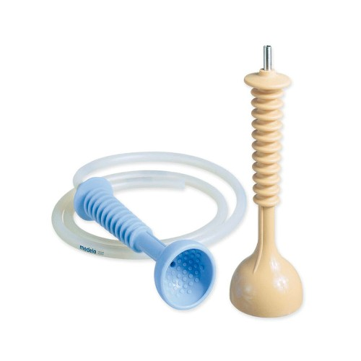
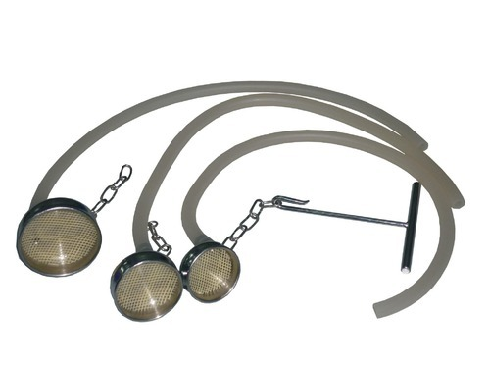
Rigid VS. Soft cups
Soft Cups (polyethylene or silastic ) : are associated with less scalp injuries and appropriate for occipitoanterior position .
Rigid cups (Metal or Plastic ) are more suitable for occipitoposterior , transverse , and difficult occipitoanterior position where the infant is larger.
There is higher rate of failure with soft cups .
Notes:
Cups diameter average 40-60 mm
Shapes : mushroom , bell

Slide 5
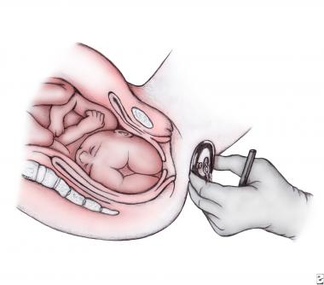
Vacuum Extraction Technique
The doctor holds the vacuum cup in front of the perineum in the same angle and position expected once the extractor has correctly been applied to the fetal head.
Notes:
Befor these
1- explain to mother why its important to use the vacuum and tell them about the swelling of fetal scalp that may appear worring
2- set the mother in lithotomy position
3- insure woman bladder is empty
4-palpat the mother abdomen to insure that the head is engaged
5-check the vacuum deviice that working befor start

Slide 6
Insertion: the labia are gently spread, and the device is slipped into the vagina and then positioned against the fetal head.
Correct application : the vector of traction is directed through the cranial FLEXION point.
Flexion of fetal head must be maintained to provide the smallest diameter to the maternal pelvis by the correct application .
(the FLEXION POINT is a point over the sagittal suture of the fetal skull, located approximately 6 cm posterior to the center of the anterior fontanel or 3 cm anterior to the posterior fontanel. )

Slide 7
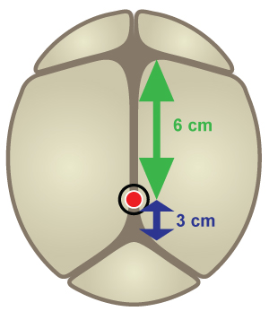
Ant Fontanelle
6 cm
Pivot Point
3 cm
Post Fontanelle

Slide 8
Correct application

Slide 9
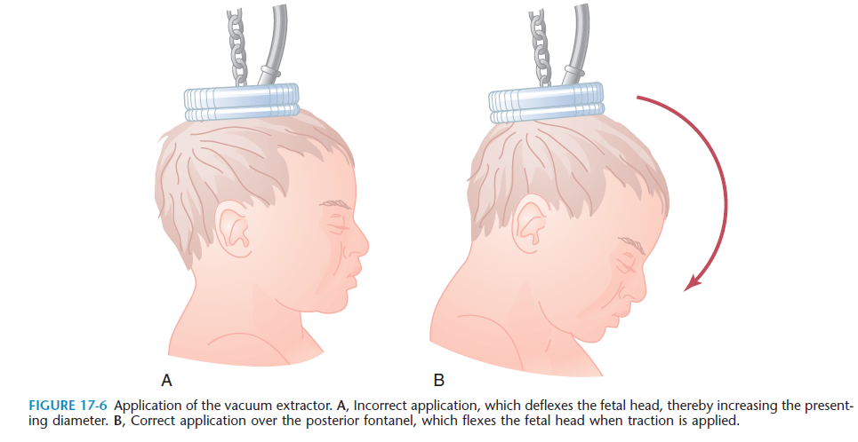

Slide 10
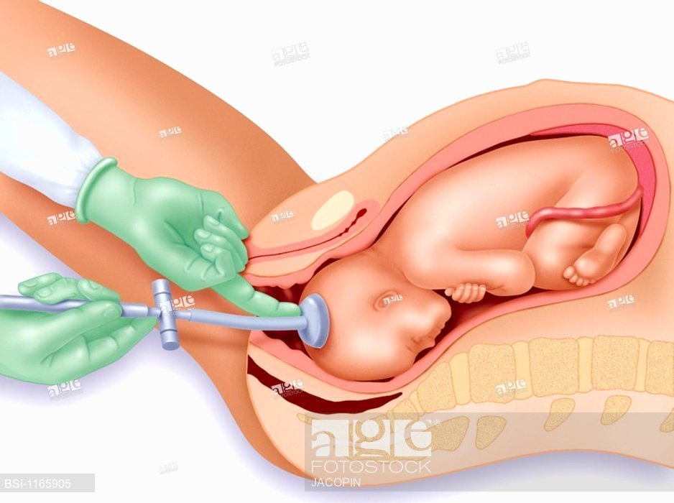
360° check should be performed to ensure that the pelvic tissue of the mother ( cervix or vagina) or umbilical cord . is not trapped in the vacuum cup

Slide 11
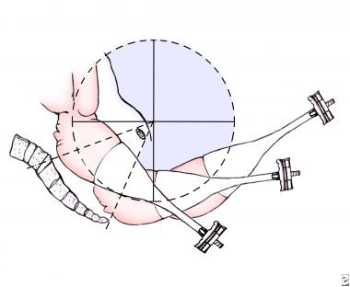
Traction :
Once the doctor has verified cup placement, full vacuum is applied (450-600 mm Hg) with onset of contraction and the traction pulls along the axis of the pelvis , handle perpendicular to the cup , paralleling the uterine contractions with the aid of maternal pushing effort .
Notes:
With onset of contraction , vacuum pressure is raised rapidly to -450 to -600 mm hg ( never exceed ) . Then , apply traction in time of mother’s contractions , with each successive contraction draw the head gently toward the perineum
It takes less than 15 min

Slide 12
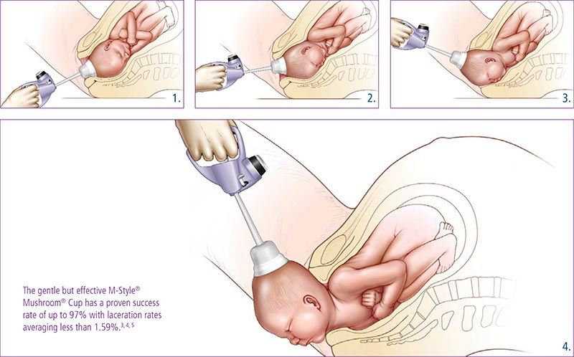

Slide 13
Applying rotational force to rotate the head of the fetus is contraindicated because it can lead to detachment of the cup, cephalohematoma of the fetus, and scalp laceration .
“ Pop-off “
>>Detachment of the suction cup from the fetal head during traction
IF two “pop-offs” occur , the procedure should be discontinued in favor of CS .
Maximum time from application to delivery should ideally be less than 15-20 minutes .
Notes:
An episiotomy is not recommended as a routine measure during a VE operation unless the soft tissue impedes the descent of the presenting part. Episiotomy has been shown to increase the incidence of third and fourth degree lacerations.

Slide 14
Birth Injuries
fetal death or severe fetal injury from vacuum extraction (VE) is low, ranging from 0.1-3 cases per 1,000 extraction procedures.
The most common injuries are to the fetal scalp.

Slide 15
Injuries :
Cephalo-hematomas : collection of blood between fetal scalp and skull
Caput succedaneum
Subgaleal hemorrhages : bleeding in the potential space between the skull periosteum and the scalp galea aponeurosis .
Intracranial hemorrhage , Scalp Lacerations
radiographic or ultrasonic studies of the CNS performed on newborns who were delivered by instrumental assistance ,help to discover injuries more frequently than clinical examination .
Notes:
Also include : intracranial hemorrhage, subgaleal hematomas, scalp lacerations (if torsion is excessive), hyperbilirubinemia, and retinal hemorrhage.

Slide 16
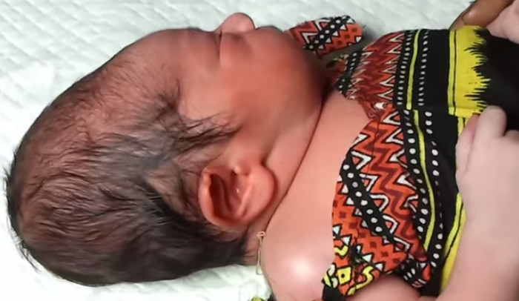
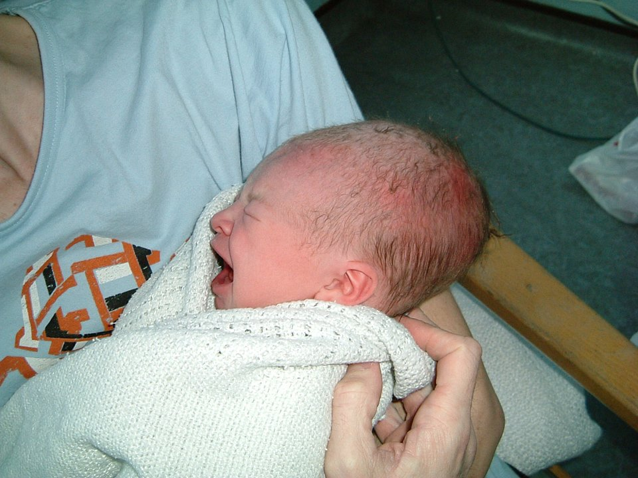
Caput succedaneum
A swelling at the top of the head after a ventouse delivery , in most cases nothing but oedema of the scalp skin and shortly disappear.

Slide 17
Maternal injury
Vacuum extraction has a low rate of maternal injury in comparison with forceps operations or cesarean delivery
such as urinary incontinence, fecal incontinence, pelvic organ prolapse, and occasionally fistula formation.

Slide 18
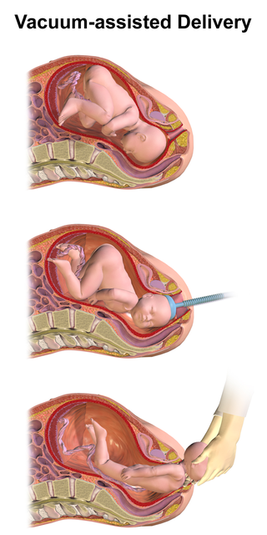
Advantages of VE :
1- less training
2- no risk of excessive traction
3-less injury to mother
Disadvantages :
1-cannot used for ➔ preterm , face or breech presentation
2-need more complex equipments
3-more trauma for baby

