Slide 1
Viral and Bacterial Meningitis
Amin Aqel,
Professor of Medical Microbiology
CNS, 3ed year students
Faculty of Medicine, Mutah University

Slide 2
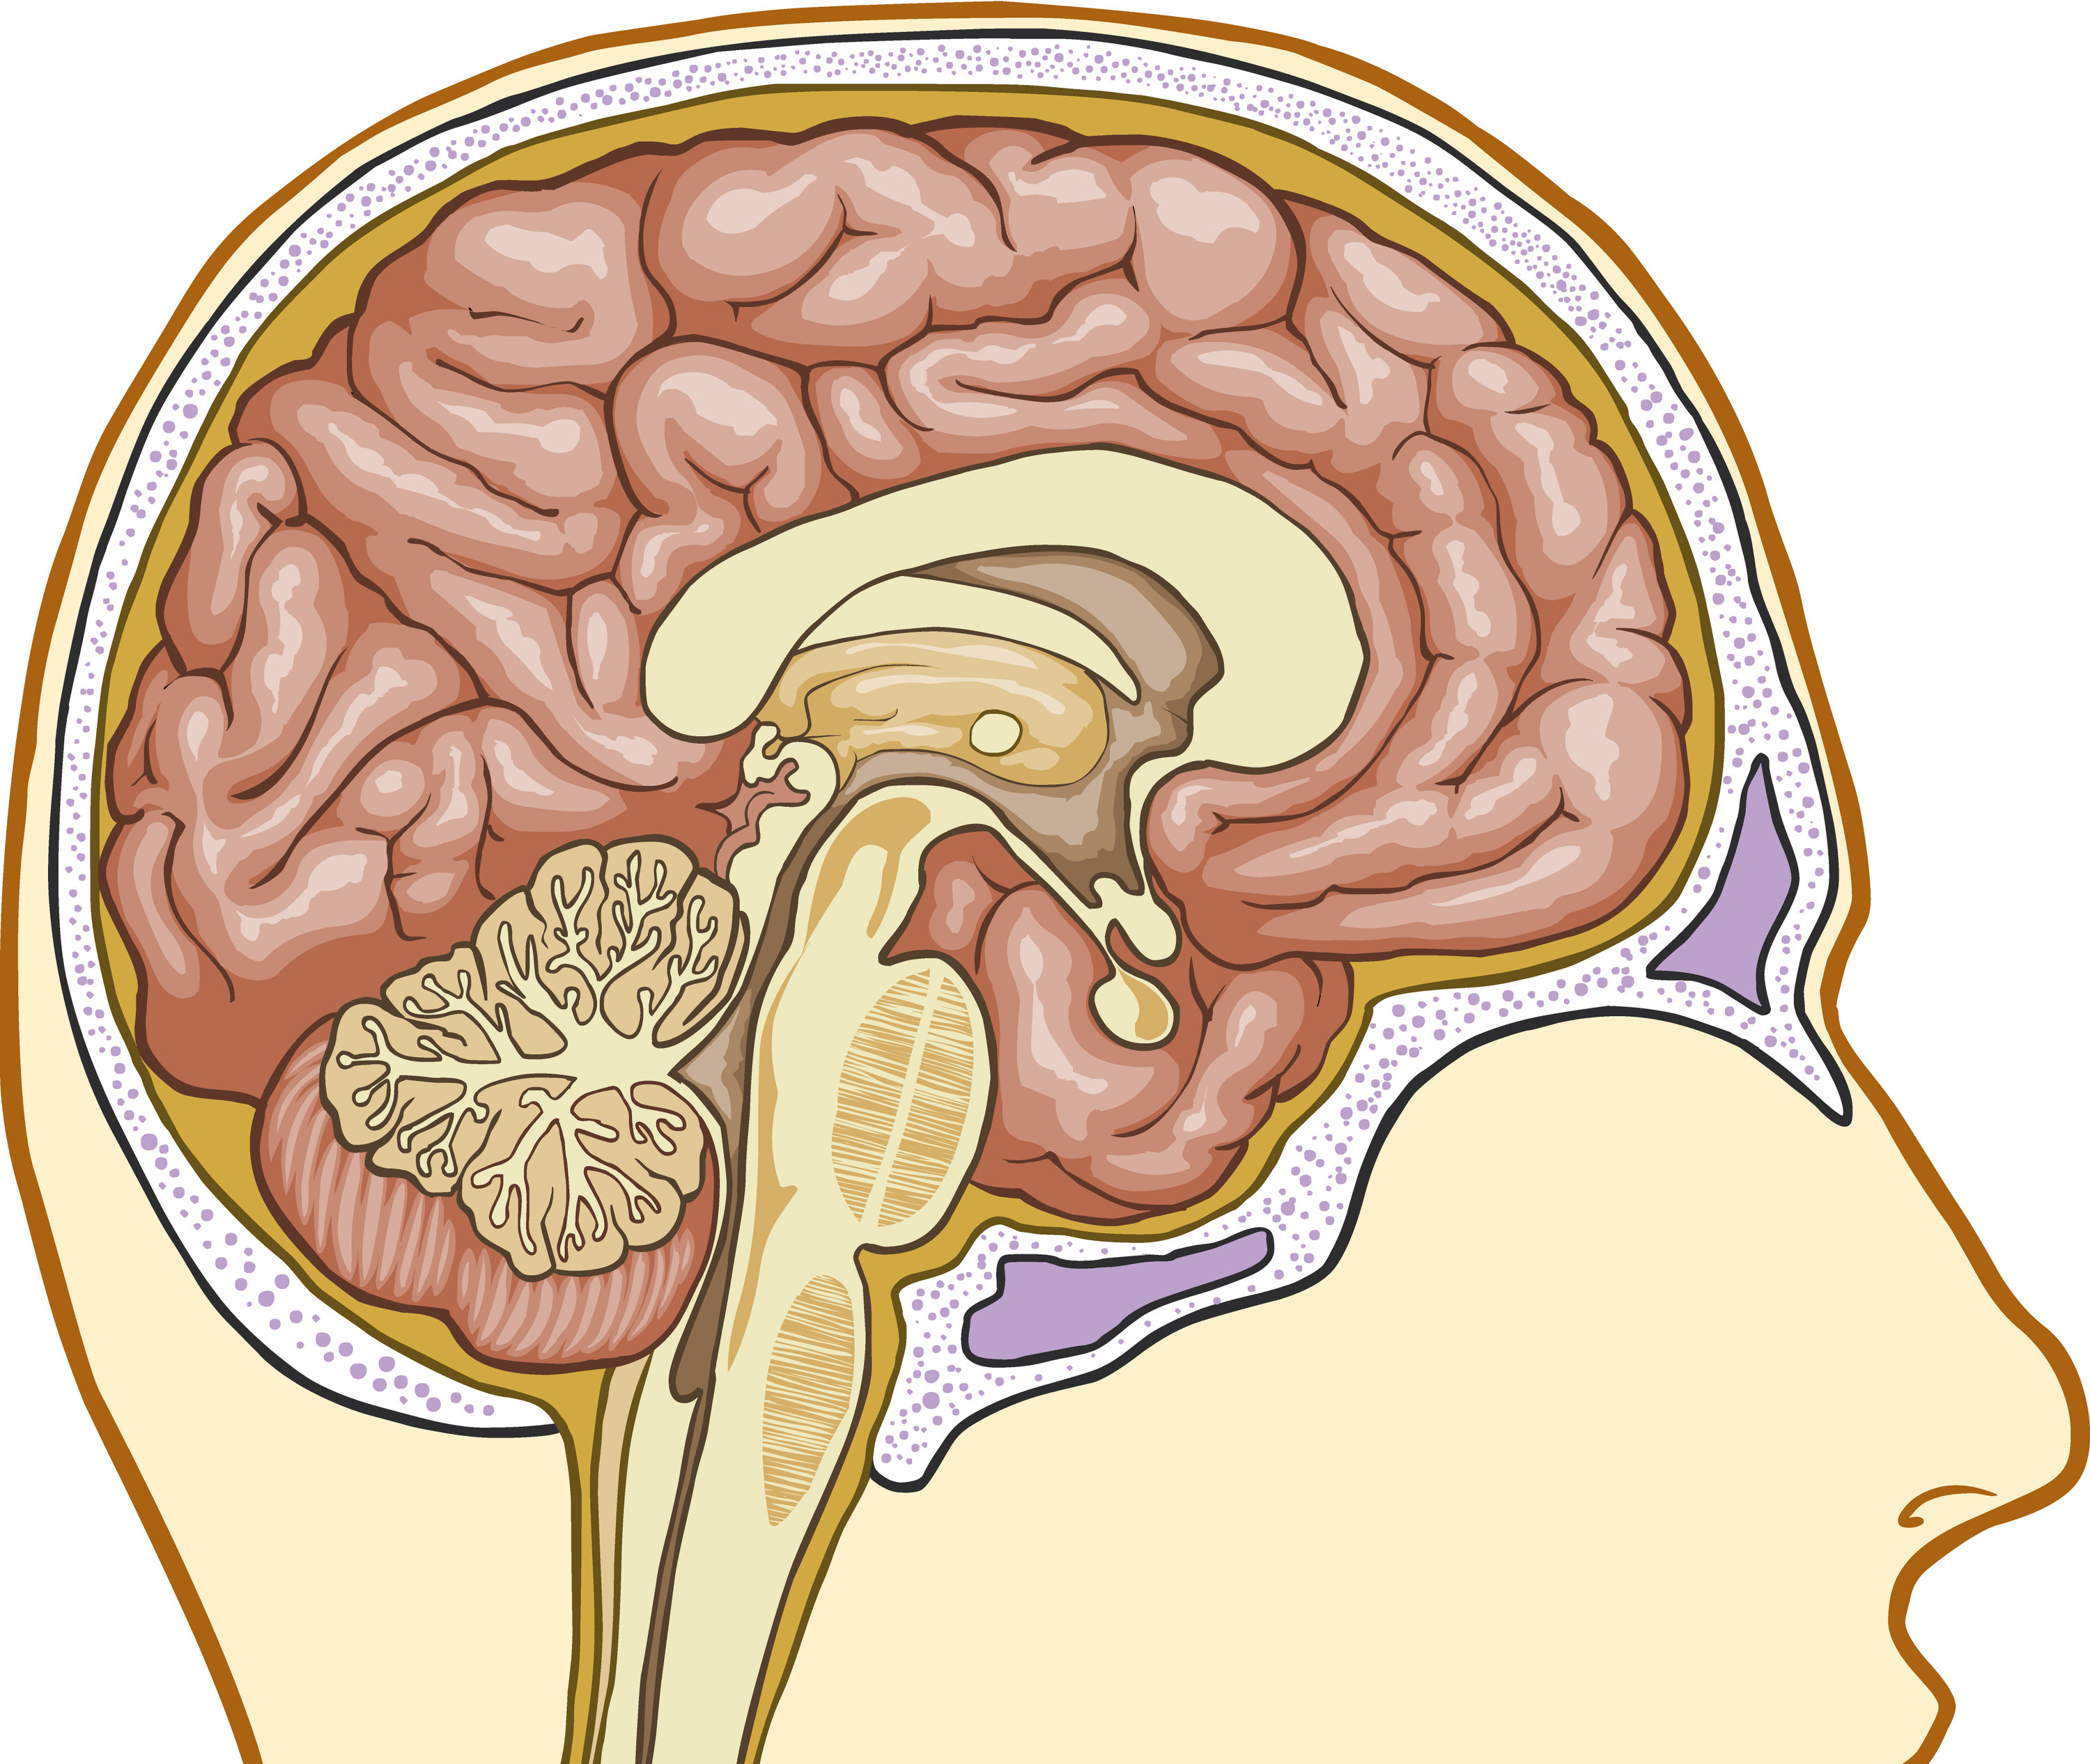
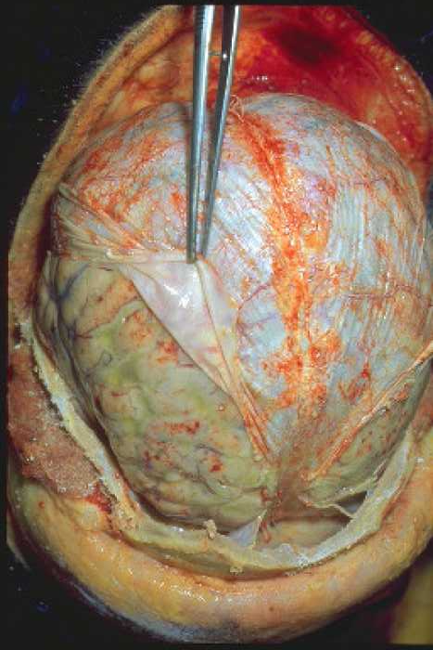
What is meningitis?
Meningitis is an infection
which causes inflammation
of the membranes covering
the brain and part of spinal
cord.
Skull
Meninges
Brain
Top of the spinal cord
What is septicaemia?
Some bacteria that cause meningitis can also cause septicaemia (blood poisoning). Septicaemia is a cause of sepsis - a life-threatening condition that arises when the body’s response to an infection injures its own tissues and organs.

Slide 3
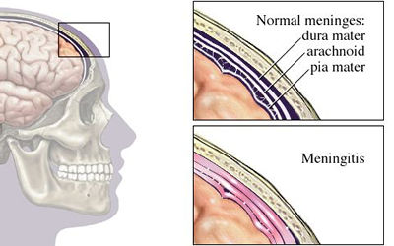
Meningitis……
- Non-bacterial meningitis is often referred to as ‘aseptic meningitis’ – eg. viral meningitis
- Bacterial meningitis may be referred to as ‘purulent meningitis’.
Common causes and risks
The most common causes of meningitis are viral infections that usually resolve without treatment.
Bacterial infections of the meninges are extremely serious illnesses, and may result in death or brain damage even if treated.

Slide 4
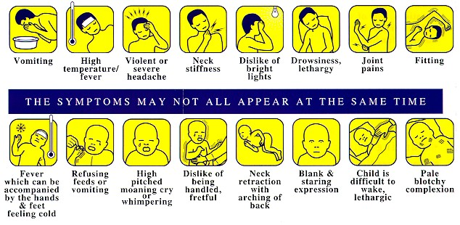
Symptoms of meningitis….
Adults and children
Babies
Neonates and the elderly often present atypically .

Slide 5
What causes meningitis?
Meningitis is most commonly caused by bacteria or viruses
Bacterial
Viral
Meningococcal (most common cause)
Pneumococcal
TB
Group B streptococcal
E. coli
Hib
Enteroviruses
Herpes Simplex
Mumps (now rare)

Slide 6
Definitions
Doctors call meningitis caused by the bacteria Neisseria meningitidis meningococcal meningitis
TB meningitis Tuberculous meningitis is caused by Mycobacterium tuberculosis.
S. agalactiae, or group B streptococcus or GBS causes pneumonia and meningitis in newborns and the elderly
Pneumococcal meningitis is caused by Streptococcus pneumoniae bacteria (also called pneumococcus, or S. pneumoniae).
Hib meningitis Haemophilus influenzae type b (Hib) is a bacterium that infects the lining of the brain, causing meningitis.

Slide 7
Viral and bacterial meningitis
Viral meningitis
Bacterial meningitis
Rarely life-threatening
Life-threatening
Rapid admission to hospital, treated with antibiotics
Pain relief, fluids and rest
Not considered to be contagious
Can be contagious and may require public health action
After-effects include deafness, acquired brain injury and limb loss (septicaemia)
After-effects include headaches, tiredness and memory loss

Slide 8
Meningococcal disease
A term used to describe two major illnesses – meningitis and septicaemia (blood poisoning) caused by meningococcal bacteria
Meningococcal disease is the most common cause of bacterial meningitis in the UK
There are five main groups of meningococcal bacteria that commonly cause disease - MenA, MenB, MenC, MenW, MenY

Slide 9
Recognising the signs and symptoms
Meningitis and septicaemia often happen together. Be aware of all the signs and symptoms
Symptoms can appear in any order. Some may not appear at all
Someone with meningitis or septicaemia can get a lot worse very quickly. Keep checking them

Slide 10
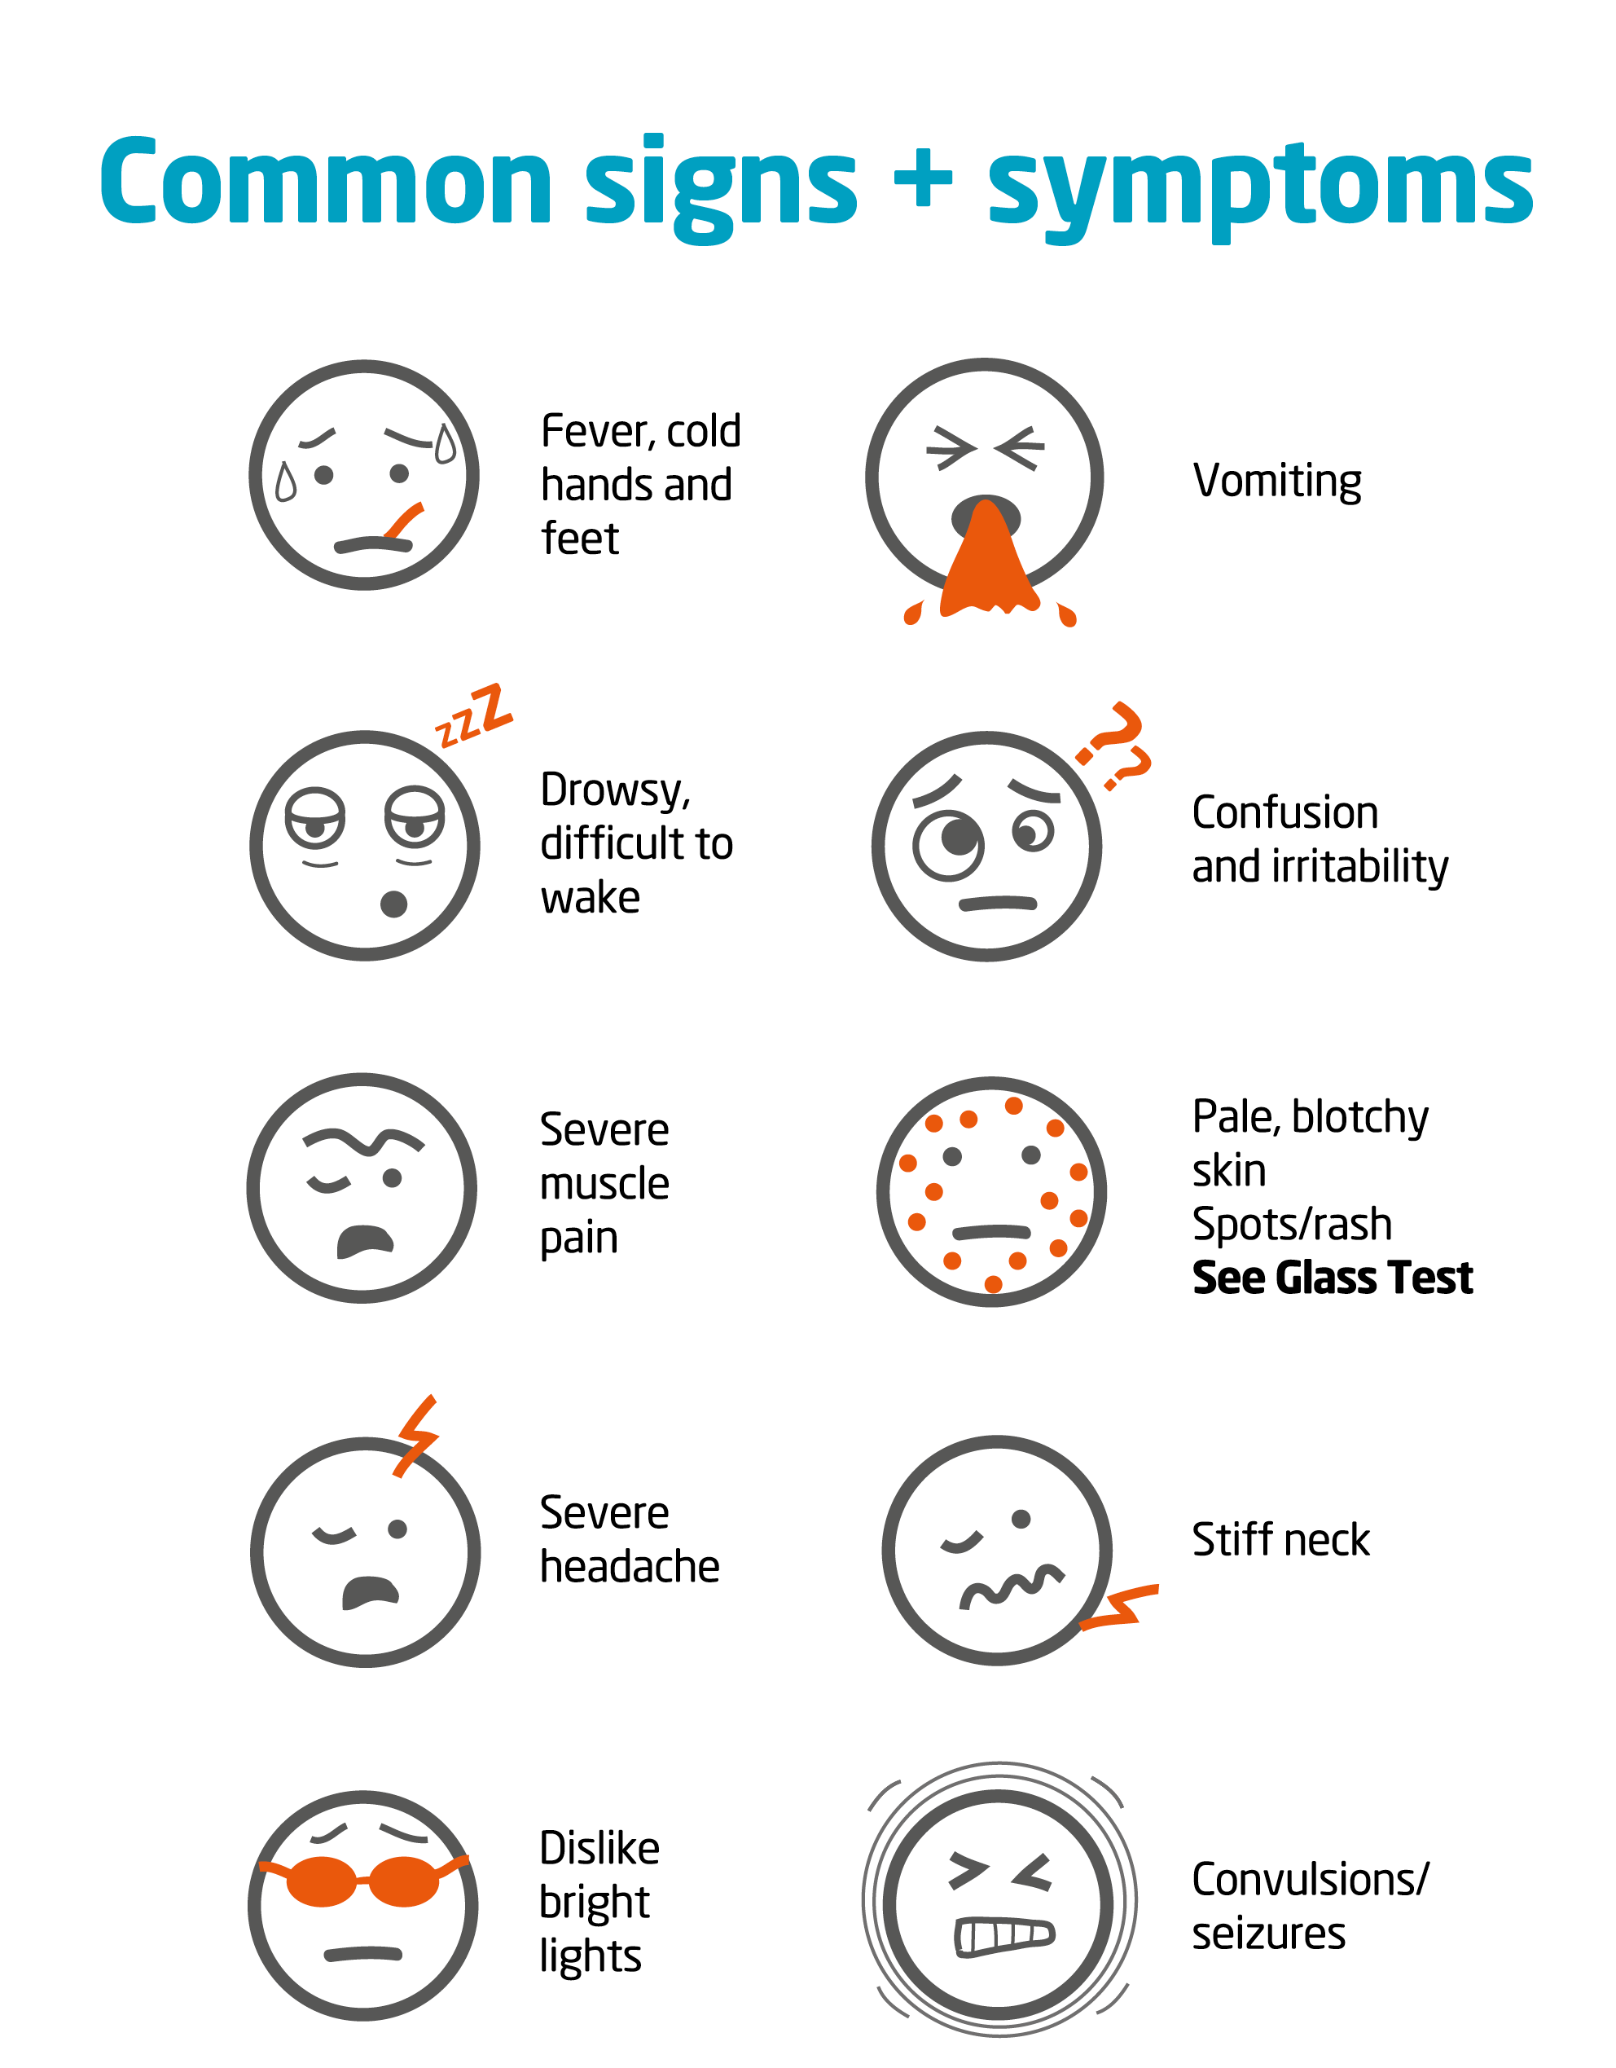
Be aware
Early symptoms can include: fever, headache, vomiting, diarrhoea, muscle pain, stomach cramps and fever with cold hands and feet
If someone is ill and getting worse, get medical help immediately

Slide 11
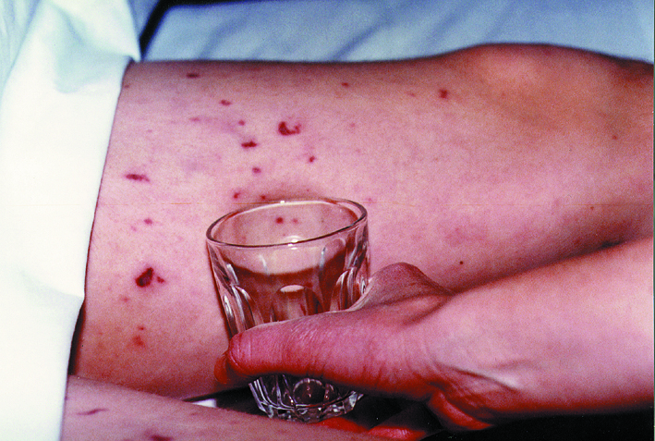
Septicaemia and the ‘glass test’
People with septicaemia may develop a rash of tiny red ‘pin pricks’ which can develop into purple bruising
This rash does not fade under pressure; do the ‘glass test’
Fever with spots/rash that do not fade under pressure is a medical emergency
Do not wait for a rash. If someone is ill and getting worse, get medical help immediately
On dark skin the spots/rash can be more difficult to see. Do not wait for the rash. Be aware of all the signs and symptoms

Slide 12
How can meningitis be prevented?
Vaccines are the only way to prevent meningitis
BUT vaccines are not available to prevent all types of meningitis
Know the signs and symptoms to look out for, and the action to take

Slide 13
The impact of meningitis and septicaemia
Following bacterial meningitis 10% will die
It's estimated up to one person in every two or three who survives bacterial meningitis is left with one or more permanent problems
After-effects are more common following bacterial meningitis or septicaemia

Slide 14
After-effects following meningitis and septicaemia
Physical
Neurological and Emotional
Hearing loss
Sight problems
Speech problems
Limb loss, weakness or paralysis
Skin scarring/damage
Organ damage
Epilepsy
Learning and behavioural problems
Headaches
Memory and concentration issues
Emotional difficulties
Meningitis can devastate lives within hours and its impact can last a lifetime

Slide 15
Viral (aseptic) Meningitis
Definition: A syndrome characterized by acute onset of meningeal symptoms, fever, and cerebrospinal fluid pleocytosis, with bacteriologically sterile cultures.
Laboratory criteria for diagnosis:
No evidence of bacterial or fungal meningitis
Case classification
Confirmed: a clinically compatible illness diagnosed by a physician as aseptic meningitis, with no laboratory evidence of bacterial or fungal meningitis
Comment
Aseptic meningitis is a syndrome of multiple etiologies, but most cases are caused by a viral agent.

Slide 16
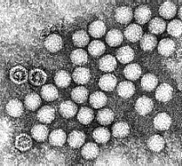
Viral Meningitis
Etiological Agents:
Enteroviruses (Coxsackie's A,B and echovirus): most common.
Adenovirus
Measles virus
Herpes Simplex Virus
Varicella
Arbovirus
Modes of transmission:
Primarily person to person and arthropod vectors for Arboviruses
Incubation Period:
Variable. For enteroviruses 3-6 days, for arboviruses 2-15 days
Treatment: No specific treatment available or symptomatic.
Most patients recover completely on their own.

Slide 17
Transmission
Fecal – oral route: poor hygiene, dirty diapers(especially in day-care settings)
Ingestion via contaminated food and water
Contact with infected hands
Inhalation of infectious aerosols

Slide 18
Viral Meningitis
90% caused by enteroviruses
Coxsackie virus (A and B groups)
Echo virus
Other viruses
HSV2 (HSV1 causes encephalitis)
HIV
Lymphocytic choriomeningitis virus
Mumps
Varicella Zoster

Slide 19
Viral Meningitis
Cannot distinguish initially from bacterial meningitis
May be preceded by a few weeks by viral gastroenteritis
Almost never involves brain in (enteroviruses) (meningoencephalitis)
Patient never obtunded, no History of seizure
Disease is self-limited, resolves after 7 to 10 days without treatment
No serious sequelae

Slide 20
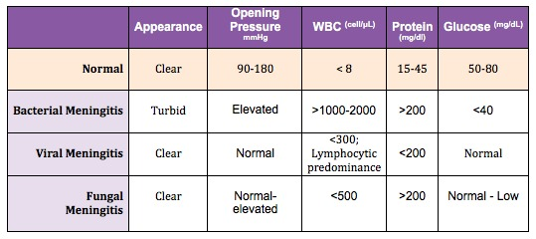
CSF

Slide 21
Laboratory Diagnosis
Virus Isolation
Mainstay of diagnosis of enterovirus infection
Coxsackie B and Echoviruses can be readily grown in cell culture from throat swabs, faeces, and rectal swabs. They can also be isolated from the CSF
Coxsackie A viruses cannot be easily isolated in cell culture. They can be isolated readily in suckling mice but this is not offered by most diagnostic laboratories because of practical considerations. Molecular techniques may provide a better alternative.
Serology
Neutralization tests or EIAs are used but are very cumbersome and thus not offered by most diagnostic laboratories
Molecular
PCR

Slide 22
Approach
Treat like bacterial meningitis until the 72 hrs culture comes back negative
But
HSV meningitis:
Behavioral and personality changes
Ct scan Temporal lobe
Aciclovir iv

Slide 23
Viral meningitis - Treatment
Supportive
No antibiotics
Analgesia
Fever control
Often feel better after LP
No isolation - Standard precautions
Notes:
Not clear why sometimes feel better after diagnostic LP

Slide 24
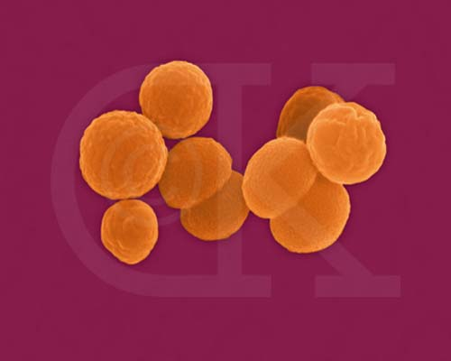
Viral meningitis - Outcomes
Adverse outcomes rare
Infants <1 year have higher incidence of speech & language delay
Neurological complications are rare
Encephalitis may develop, though this is rare. (HSV1, Measles, Flaviviruses)

Slide 25
MENINGITIS CAN AFFECT ANYONE
It can strike quickly and kill within hours

Slide 26
Referencing, Some of the above slides reference

