Slide 1
Pediatric Radiology
Dr. ESSMAT AL-OMARI
Consultant Radiologist
Mu’tah university
Note : in pediatric cxr it is mostly AP and not PA

Slide 2
Pneumonia
Is an inflammation of the lung caused by bacteria, viruses or chemical irritants.
Viral pneumonia is more common in children.
Bronchopneumonia: usually refers to a bilateral multifocal areas of consolidation.
What is a pneumatocele ?
Is a thin walled cavity that may be seen as a complication of pneumonia (staphylococcal pneumonia), usually resolve without sequelae

Slide 3
Pneumonia /2
Can pneumonia cause abdominal pain ?
Yes, occasionally in children a pneumonia that is adjacent to the diaphragm can cause abdominal pain.
The lung bases should be carefully examined on abdominal radiographs obtained for abdominal pain.
Note: abdominal x-ray in children must include the lower lobes and the diaphragm because some of the abdominal pain cases may be caused by lower lobe pathology and diaphragm irritation causing abd. Pain.

Slide 4
Area of consolidation (opacity) in the right upper zone involving the right middle lobe (obliteration of the right heart border) with air bronchogram
Note: Consolidation in the upper anterior sihllioate the ascending aorta.
On upper posterior sihllioate descending aorta.
In middle lobe sihllioate the heart borders.
In lower lobe sihllioate the diaphragm

Slide 5
Right upper lobe collapse : showing opacity in the right upper lobe , horizontal fissure displacement toward the collapse. No air bronchogram

Slide 6
Area of consolidation in the right middle zone with obliteration of the right heart border indicating the involvement of the middle lobe .
The transverse fissure is pushed down.
Consolidation in the middle lobe, the transverse fissure is pushed down. Since the consolidation is above the oblique fissure and below the horizontal it is in the middle lobe (maybe)??

Slide 7
Transient tachypnea of the newborn (TTN)
TTN is a cause of respiratory distress in the newborn that occurs in full-term infants within 6 hours of birth and resolve by 3 days.
The etiology is due to retained fetal fluid in the lungs (Wet lung).
On chest film:
There is increased vascular and interstitial marking.
The lungs are usually mildly hyperinflated .

Slide 9
Hyaline membrane disease
Usually affects premature infants , and is the most common cause of respiratory distress in the premature infant due to deficiency of pulmonary surfactant preventing alveolar distention .(airways are normal)
chest x-ray shows :
The lung have a fine granular appearance (ground glass), with air bronchogram.
The volume of the lungs are reduced .(small lung)
Poorly aerated lung (appears white)
Ground glass appearance due collapse the wall of the alveoli near each other and poorly aerated lung with air bronchgram.

Slide 10
fine granular (ground glass) appearance of the lungs , Small Poorly aerated lungs , air bronchogram , the heart and diaphragm borders are not clear, this is the typical appearance of hyaline membrane disease.
Notice the endotracheal tube , normally it should be placed in a way that it is at least 4-5 cm above the carina because with any movement it can descend into one main bronchus causing the other lung to collapse

Slide 11
Meconium Aspiration
Is a cause of respiratory distress that occurs secondary to intrauterine aspiration of meconium.
The lungs appear relatively hyperinflated with heterogeneous bilateral pulmonary infiltrate.
Which newborns develop meconium aspiration ?
Infants who have prolonged or stressful deliveries.

Slide 13
Congenital diaphragmatic hernia
Is the result of a congenital defect or hole in the diaphragm, allowing bowels to herniate into the thoracic cavity, occurring before birth.
Herniation may occur at two sites:
Bochdaleck hernia: is the most common and usually occur at the left side of the diaphragm posteriorly.(posterior mediastinum)
Morgagni`s hernia: occur on the right side anteriorly.
A chest film shows either air filled spaces or the typical appearance of multiple bowel loops in the thorax.

Slide 14
Dx. For air filled spaces in the chest are C. diaphragmatic hernia and congenital cystic adenomatoid malformation, differentiate between them by barium (no bowel herniation into the thorax
Multiple Air filled spaces in the chest in the left hemi thorax with shifting of the heart to the R.side caused by the bowel that pushed the heart .
barium shows herniated bowel loops into the thorax confirming congenital diaphragmatic hernia mostly bochdaleck hernia (left side)

Slide 15
Cystic adenomatoid malformation
Is a congenital lung mass of adenomatoid proliferation.
The lesions communicates with the bronchial tree at birth and fill with air early in life.
The lesions can be cystic, solid or mixed, but the majority are cystic.
CCAM should be differentiated from congenital diaphragmatic hernia. by barium or omnipaque)

Slide 16
After barium, bowel loops (all GIT)are in the normal site, so no herniation, it is CCAM
Air filled space in the left hemithorax and soft tissue masses push the heart to the R.side. No gas continued with the bowel suggesting CCAM , but in congenital hernia there are also air filled space, to dd we need barium study.

Slide 17
….(CCAM)….
CT, shows a cystic mass wih adhesions, the heart is pushed to the opposite side.
the the cyst contain fluid and it is not enhanced after iv contrast injection
CXR shows water density (opacity like the heart), the heart is pushed to the left, CCAM in the right side .

Slide 18
The normal Thymus
The thymus is located in the anterior superior mediastinum. Its size and shape is variable.
What is sail sign ?
The sail sign refers to the appearance of the prominent thymus in an infant, which have triangular extension out laterally that looks like a sail.

Slide 19
Superior medistinal mass looks like triangular laterally well-defined with smooth contour (sail sign), it is normal thymus gland in infant.
In infants the normal mediastinum is wider than adullt because the thymus is larger, and the x-ray is taken in the supine position.

Slide 20
Pyloric stenosis
Is thickening (hypertrophy) of the pyloric muscle in infancy.
usually present between 3 to 6 weeks after birth, and creates progressive gastric outlet obstruction .
Ultrasound is the imaging study of choice:
The pyloric channel length more than 16 mm
Single wall thickness of pylorus more than 4mm
Pyloric diameter more than 12 mm

Slide 21
Pyloric stenosis / 2
The barium study reveal :
The stomach is distended with delayed gastric emptying .
The pyloric canal is elongated and narrowed.
(String Sign)

Slide 22
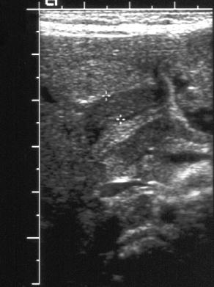
Pyloric stenosis:
Thickening of the wall of the pylorus . Muscle hypertrophy
stomach
-Single wall thickness (red)
-Pyloric canal-lumen- (yellow)
-pyloric diameter (green)

Slide 23
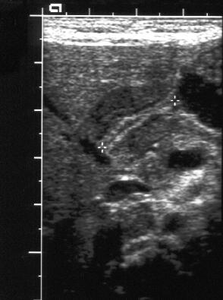

Slide 24
Pyloric stenosis :US cross-section shows widening of the pyloric diameter (yellow)
Lumen (white).

Slide 25
Pyloric stenosis:
Distended stomach (red) with narrow elongated
Pyloric canal (yellow)
Partial obstruction with delayed gastric emptying(delayed entry of barium)

Slide 26
Pyloric stenosis:
Distended stomach (red) with elongated narrow pyloric canal –more severe and narrower than the previous one- giving the appearance of string-sign (yellow)
String sign indicate severe pyloric stenosis (very narrow pyloric canal)

Slide 27
Pyloric stenosis:
Very severe pyloric stenosis (almost causing complete gastric outlet obstruction), the pyloric canal is very narrow (no or little amount of barium passed through it) the stomach is very distended , this severe stenosis resulted in what is called the “peak sign” (black arrow).
In this pt. it is expected to be associated with projectile vomiting because no food is leaving the stomach.
In dueodenal atresia the barium never gets in.

Slide 28
What is Malrotation ?
Malrotation is abnormal rotation and fixation of the bowel.
In malrotation the duodenal- jejunal junction lies in the midline or in the right upper quadrant.(normally at the left , marked by ligament of teres)
The caecum lies in the midline or upper abdomen.

Slide 29
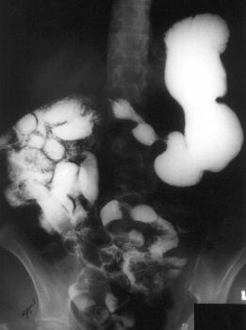
D-J junction on the right side. And the whole duedenum and jejunum lies in the right side (normally part of duedenum and all the jejunum lies on the left)
malrotation
stomach

Slide 30
Intussusception
Is invagination of bowel segment into another adjacent segment , producing bowel obstruction.
The commonest ileocolic type (the ileum invaginates into the colon )
The plain film may indicate small bowel obstruction and the intussusception mass may be visible .(leading point)
Barium enema is necessary for a definite diagnosis.(and Tx)

Slide 31
Sonographic appearances of an Intussusception
The intussusception mass is almost always visible on ultrasound.
The transverse scan shows the Donut sign (or Target sign), which consist of an echogenic center surrounded by a hypoechoic periphery.
The longitudinal scan reveal the called pseudo-kidney sign.
Echogenic center representing mucosa , submucosa , wall

Slide 32
How is an intussusception treated ?
By barium enema which is diagnostic and therapeutic .
Hydrostatic reductions are attempted using diluted barium.
Reflux of contrast into multiple loops of small bowel indicate successful reduction.
Rule of three for reduction of intussception:
3 attempts, 3min, 3 feet
If reduction failed, surgery is indicated.

Slide 33
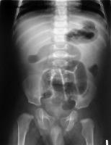
Dilated bowel loop in the center of the abdomen (small bowel), little or no gas in the large intestine , sign of intestinal obstruction.

Slide 34
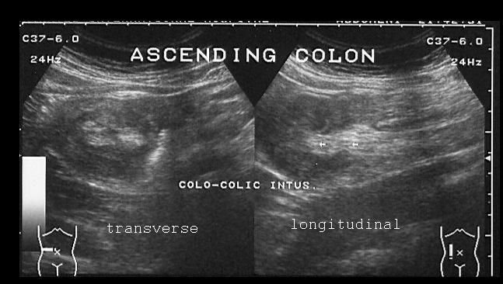
Intussusception : cross-section US shows target sign ,
Longitudinal : psuedokidney sign with multiple layers due to invagination ,the echogenic center resemble the medulla of the kidney , and the hypoechoic periphery is similar to the cortex.

Slide 35
Intussusception: longitudinal section shows sausage like appearance and multiple layers

Slide 36
Intussusception: cross-secion (target sign) or donut sign

Slide 37
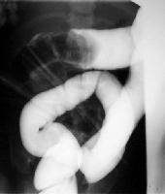
Barium enema shows Coiled- spring sign ( intucessuption in the transverse colon) appears as a large filling defect.

Slide 38
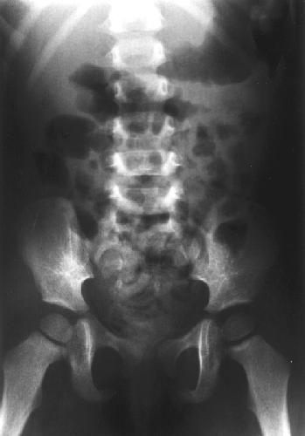
Dilated bowel loops , area of gas and soft tissue mass (red) crescent in shape
This represents the intussussception mass considered as a “leading point”.

Slide 39
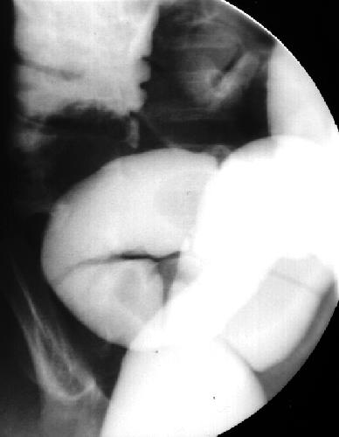
Successful reduction: the intussusscepting segment returned to its normal position.

Slide 40
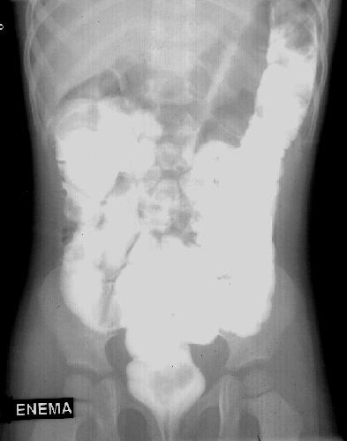
After Successful reduction the barium contrast should reach the loops of the small intestine.

Slide 41
Hirschsprung’s disease (Aganglionic megacolon)
Is caused when certain nerve cells (parasympathetic ganglion cells) are absent in the wall of a portion of the colon.
The aganglionic segment fails to relax (non-distensible), and fecal propulsion is interrupted, leading to a functional obstruction.
Hirschsprung’s disease most commonly involves the rectosigmoid colon (70- 80% of cases), and rarely (less than 10%) the entire colon may be involved.

Slide 43
Vesico-ureteric reflux
The normal vesico- ureteric junction does not allow backward flow of urine from the bladder into the ureter.
With reflux, the junction is incompetent and urine flows retrogradely up into the ureters, especially during micturition.
Most of the grade 1 and 2 refluxes tend to resolve spontaneously during childhood.

Slide 44
Bladder
Feeding tube
lateral
bilateral VU reflux more visible on oblique view during micturition

Slide 45
V-U reflux on both side, on right grade 1 on left grade 4 or 5
Unilateral VU reflux (before micturition)
The bladder wall is irregular with diverticulae(yellow)
Bilateral VU more severe on the left (the mild VU reflux on the right discoversd only during micturition)

Slide 46
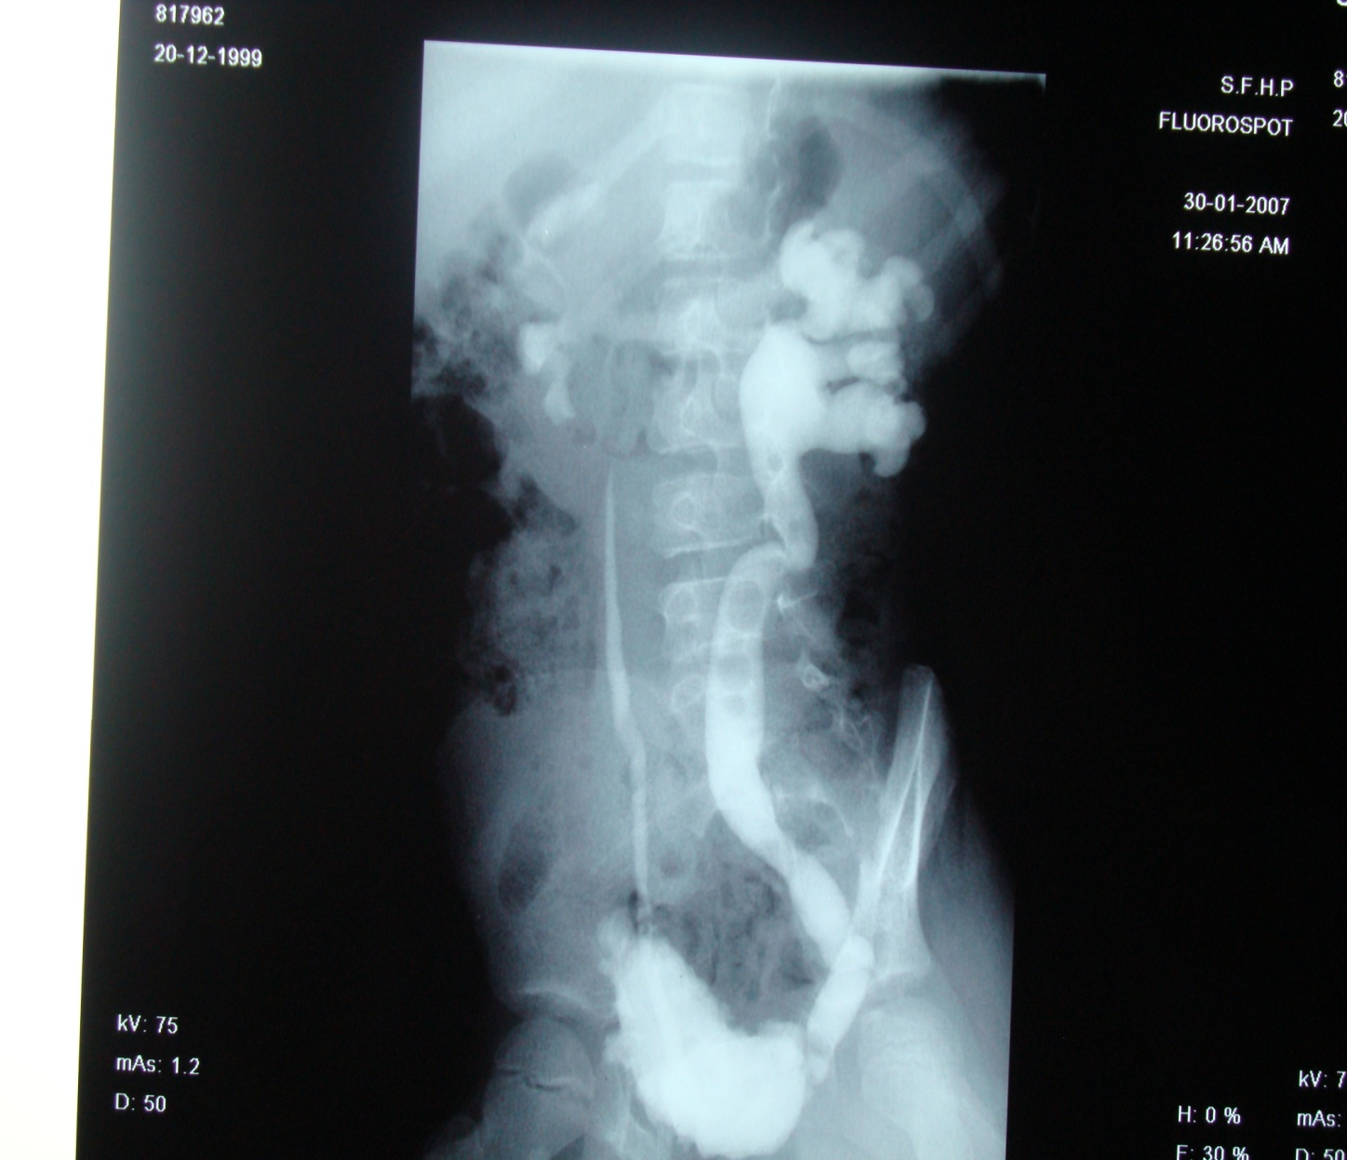
Lateral cystogram of the same pt. reveals Neurogenic bladder, abnormal in shape elongated irregular outline with multiple diverticulie, (pine tree appearance)
With grade 5 V-U reflux on left side (severe hydronephrosis) and grade 2 on rightside. Notice the dilated renal pelvis , calyces.

Slide 47
Posterior urethral valve
In the posterior urethra (at the level of the verumentanum) several folds, arise and pass caudally to encircle a portion of the membranous urethra.
The posterior urethra proximal to the valve become markedly dilated.
During insertion of the catheter for injection of the contrast the valve will not be seen and the contrast will pass to the bladder, then we ask the patient to void and the the appearance of posterior Urethral valve well appear.

Slide 48
Oblique position, voiding cystogram shows Dilatation of the posterior urethra proximal to the posterior urethral valve

Slide 49
Dilatation of the posterior urethra proximal to the posterior urethral valve normal penile urethra but not good voiding , the bladder is irregular with multiple diverticuli due to obstruction.

Slide 50
Rickets
Is a disease caused by deficiency of vitamin D leading to bony deformities and hypocalcemia.
Deficiency of vitamin D may be nutritionaly, due to malabsorption, chronic renal disease or prolonged anticonvulsant therapy.

Slide 51
Rickets / 2
Radiological features:
Splaying (widening) of the distal end of the metaphyses with cupping of the bony margins.
Periosteal reactions
Bowing انحناء of bones
Enlargement or widening of the anterior ends of the ribs (rachitic rosary).

Slide 52
Rickets : decrease bone density , widening metaphysis (red), cupping of bony margin (yellow), periosteal reaction (blue), bowing of bone more obvious on the left hand, involving radius and ulnar bones

Slide 53
Rickets: widening of the anterior end of the ribs (rachitis rosary)

Slide 54
Congenital dislocation of the hips (CDH) Developmental dysplasia of the hips (DDH)
CDH is thought to have genetic and developmental etiologies.
CDH is more common in female, and sometimes is bilateral.
Radiological investigation.
1- Ultrasound : is more useful in the first three months of life, as the epiphysis of the femoral head is not ossified yet.

Slide 55
CDH / 2
2- Plain pelvic film:
Lateral and superior dislocation of the proximal femur relative to the acetabula.
Delay in ossification of the capital femoral epiphysis.
Shallow acetabulum (vertically oriented).
Shinton line is not semi lunar in CDH.
Perkins line away from the shaft of the femur

Slide 56
CDH : the left acetabula is shallow (vert. oriented)-red-, delayed ossification of the left epiphysis which is smaller than the normal right one (yellow), upward and lateral displacement of the femur (blue), shinton and perkins lines do not apply on the left side.

Slide 57
CDH : the left acetabula is shallow (vert. oriented)-red-, delayed ossification of the left epiphysis which is smaller than the normal right one (yellow), upward and lateral displacement of the femur (blue), shinton and perkins lines do not apply on the left side.

Slide 58
CDH on the left (normal right) : shallow acetabulum , notice in the right the epiphysis is small (normal) while in the left it has not been formed yet (absent) , upward and lateral displacement of the femur , abnormal shinton and perkins lines on the left ,

Slide 59
Bilateral CDH more severe on the right

Slide 60
Neglected bilateral CDH in 2 y old pt. : the femurs are completely dislocated from the acetabulm (red) and fixed to the ischial bone (yellow).all the features of CDH are applied.

Slide 61
Thank You

