Slide 1
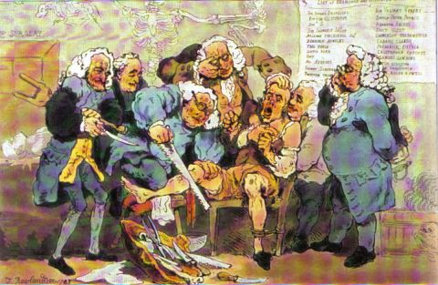
Inhalation Anesthetics
Dr. ashraf aldmour
(Anesthesia, icu) specialist

Slide 2
Definition of general anesthesia
General anesthesia ; is altered physiological state characterized by reversible loss of consciousness , analgesia of the entire body , amnesia , and some degree of muscle relaxation .

Slide 3
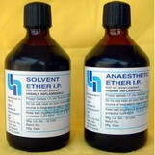
Diethyl Ether
1st inhaled anesthetic
No longer used as an anesthetic agent
Others anesthetic agent like chloroform
later , another agents like cyclopropane ethylene .
The main problem of these agents : toxicity and flammability .

Slide 4
Pharmacokinetics & Pharmacodynamics
Pharmacokinetics : (how a body affects a drug ) the relationship between a drug’s dose, tissue concentration , and elapsed time
Pharmacodynamics : ( how a drug affects a body) the study of drug action including toxic responses .

Slide 5
Factors affecting inspiratory concentration (Fi)
The fresh gas flow rate
The volume of the breathing system
Any absorption by the machine or breathing circuit

Slide 6
Factors affecting alveolar concentration (fA)
UPTAKE :
solubility in the blood
Alveolar blood flow ( CO )
The difference in partial pressure between alveolar gas and venous blood .
CONCENTRATION
VENTILATION

Slide 7
FACTORS AFFECTING ARTERIAL CONCENTAION (Fa )
Ventilation /perfusion mismatch

Slide 8
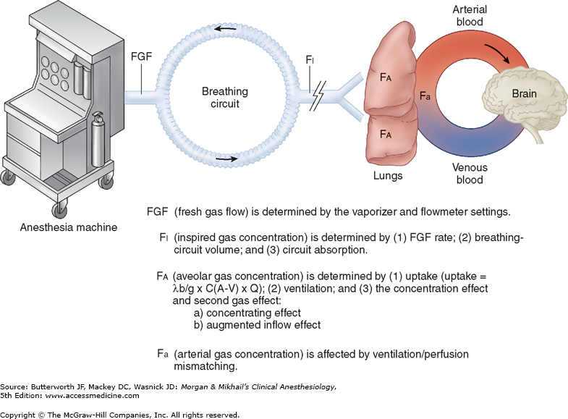

Slide 9
Theories of anesthetics action
The reticular activating system
The cerebral cortex
The cuneate nucleus
The olfactory cortex
The hippocampus

Slide 10
How to determine the potency of the anesthtetic agent
Mac ????
Blood solubility ???
Meyer- overton role ???

Slide 11
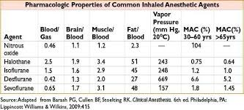
MINIMUM ALVEOLAR CONCENTRATION

Slide 12
FACTORS AFFECTING MAC
Tempreture
Age
Alcohol
Anemia
PaO2< 40
PaCO2> 95
Blood pressure
Electrolytes ( hypercalcemia , hyponatremia )
Pregnancy
Iv anesthetic agents
Amphetamine
Cocaine ??
Ephidrine

Slide 13
Blood:Gas Partition Coefficient
The measure of the solubility of an inhalation anesthetic in blood as compared to alveolar gas (air)
Indication of the speed of induction and recovery for an inhalation anesthetic agent
Low blood:gas partition coefficient
Agent is more soluble in alveolar gas than in blood at equilibrium
Agent is less soluble in blood
Faster expected induction and recovery

Slide 14
Halogenated Organic Compounds
Isoflurane and sevoflurane are the most commonly used agents in this class
Others include Desflurane, Halothane, Methoxyflurane, and Enflurane, but these are not commonly used
Liquid at room temperature
Stored in a vaporizer on an anesthetic machine
Vaporized in oxygen that flows through the vaporizer

Slide 15
Uptake and Distribution of Halogenated Organic Compounds
Liquid anesthetic is vaporized and mixed with oxygen
Mixture is delivered to the patient via a mask or endotracheal tube (ET tube)
Mixture travels to lungs (alveoli) and diffuses into the bloodstream
Diffusion rate is dependent on concentration gradient (alveoli/capillary) and lipid solubility of the anesthetic gas
Concentration gradient is greatest during initial induction

Slide 16
Elimination of Halogenated Organic Compounds
Reducing amount of anesthetic administered reduces amount in the alveoli
Anesthetic will move from the brain into the blood and then into the alveoli where it is finally breathed out
Patient wakes up

Slide 17
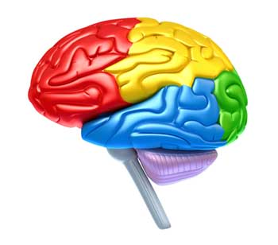
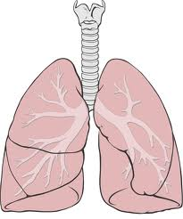
Inhalant Anesthetics
EFFECTS:
ADVERSE EFFECTS:
EFFECTS:
ADVERSE EFFECTS:
EFFECTS:
ADVERSE EFFECTS:

Slide 18
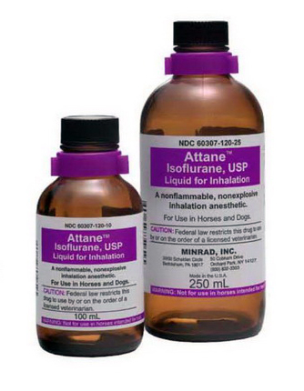
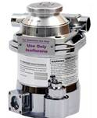
Isoflurane
Most commonly used inhalant agent in North America
Approved for use in dogs and horses; commonly used in other species

Slide 19
Isoflurane
Properties
Low blood:gas partition coefficient: rapid induction and recovery
Not Good for induction with mask or chamber
MAC = 1.2 : helps determine initial vaporizer setting

Slide 20
Effects and Adverse Effects
Maintains cardiac output, heart rate, and rhythm
Fewest adverse cardiovascular effects
Depresses the respiratory system
Maintains cerebral blood flow
Almost completely eliminated through the lungs- 0.2% metabolized by the liver
Induces adequate to good muscle relaxation
Provides little or no analgesia after anesthesia
Difficult to mask patient
Can produce carbon monoxide when exposed to a desiccated carbon dioxide absorbent

Slide 21
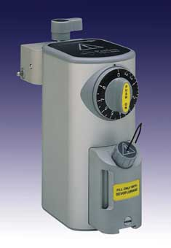
Sevoflurane
Low Blood:gas partition coefficient = rapid induction and recovery
Good for induction with a mask or chamber
High controllability of depth of anesthesia
MAC = 2.0
Cost about 10x more than Isoflurane
Easier to mask a patient, more pleasant
smelling

Slide 22
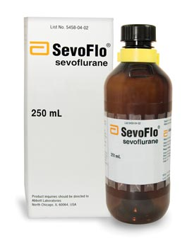
Effects and Adverse Effects of Sevoflurane
Minimal cardiovascular depression
Depresses respiratory system
Eliminated by the lungs, minimal hepatic metabolism- 2-5%
Maintains cerebral blood flow
Induces adequate muscle relaxation
Some paddling and excitement during recovery
No post-op analgesia
Can react with potassium hydroxide (KOH)
or sodium hydroxide (NaOH) in desiccated
CO2 absorbent to produce a chemical
(Compound A) that causes renal damage

Slide 23
Desflurane
Closely related to isoflurane
Expensive
Lowest blood:gas partition coefficient: very rapid induction and recovery
Used with a special heated electronic precision vaporizer
MAC = 6.0
Least potent inhalant agent
Eliminated by the lungs- 0.02% metabolized in liver

Slide 24
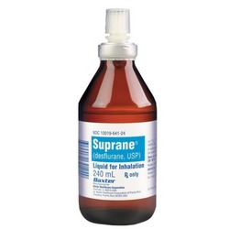
Effects and Adverse Effects of Desflurane
Strong vapors cause coughing and holding the breath= difficult to mask
Other effects are similar to isoflurane
Transient increase in heart rate and blood pressure (humans)
Produces carbon monoxide with spent soda lyme

Slide 25
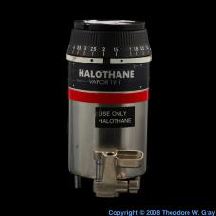
Other Halogenated Inhalation Agents
Halothane (Fluothane)
Not available anymore
replaced by isoflurane and sevoflurane
B:G -2.54
20-46% metabolized in the liver
MAC- 0.75
Sensitizes heart to catecholamine and induces arrhythmias
Cardiac, respiratory depression
Increased cerebral blood flow

Slide 26
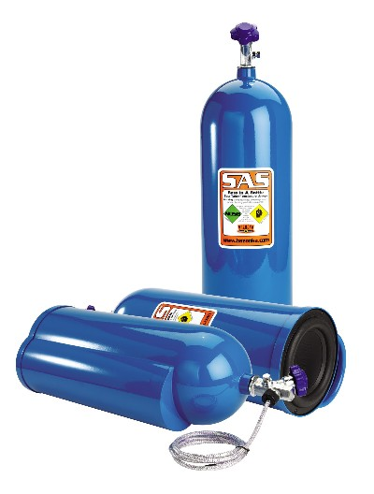
Nitrous Oxide
Nitrous oxide
Used primarily in human medicine; some veterinary use
A gas at room temperature; no vaporizer is required
Mixed with oxygen at 40-67%, then delivered to patient
Reduces MAC 20-30%
Used with Halothane and Methoxyflurane
to reduce the adverse effects of these gases

