Slide 1
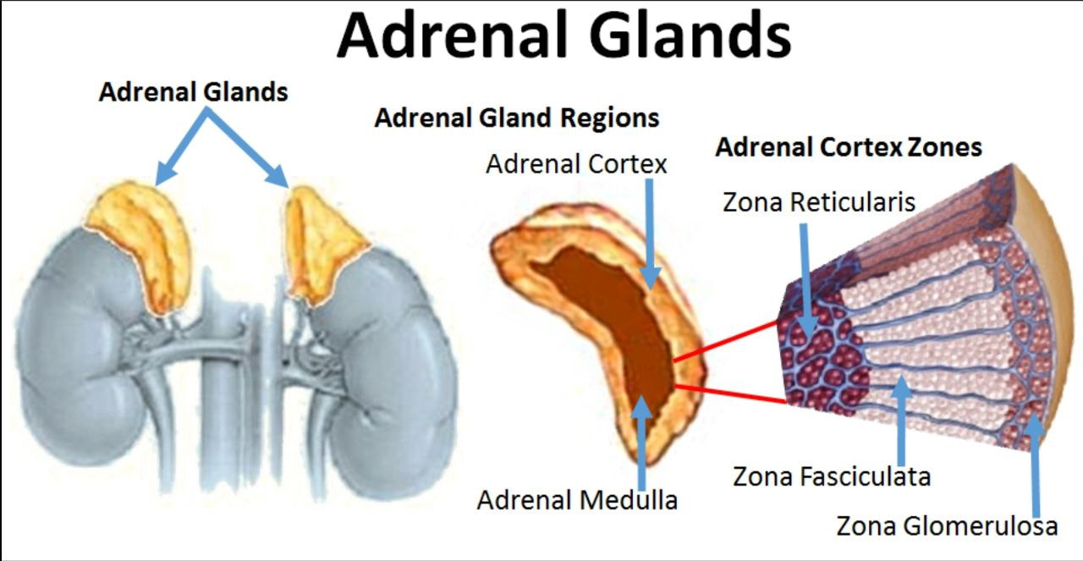
Adrenal Insufficiency
dr.Ahmad Khalil altarawneh

Slide 2
Table of contents
01
04
02
05
03
06
Introduction
Clinical assessment
Pathophysiology
Investigation
Causes
Management
07
Adrenal crisis

Slide 3
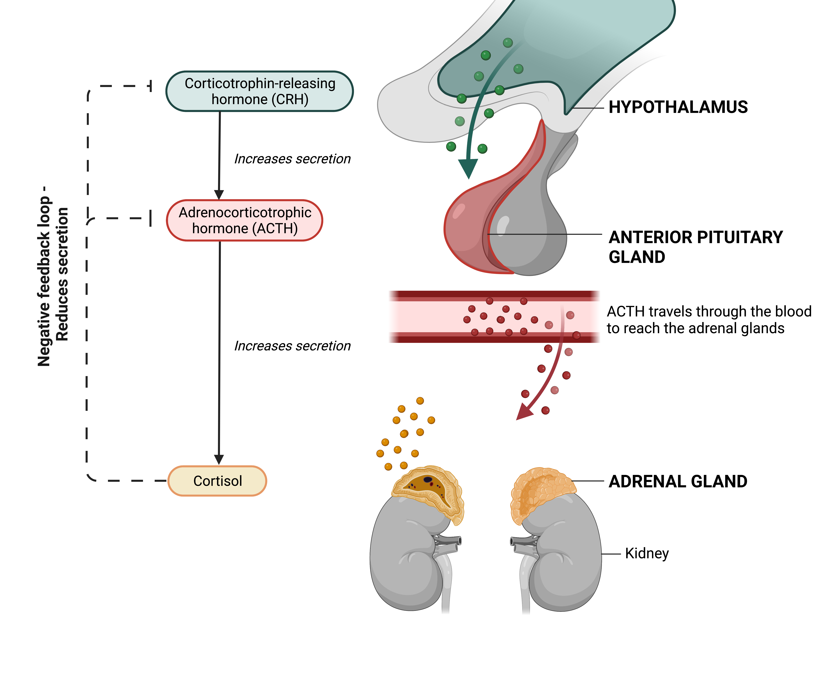

Slide 4
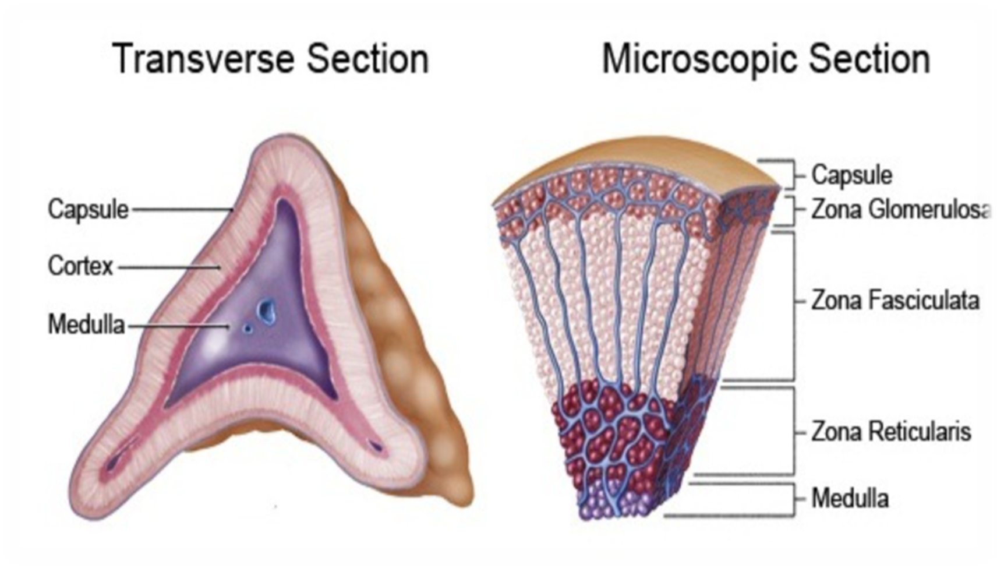
ZONA GLUMERULOSA
ZONA FASICULATA
ZONA RETICULARIS
MINERALOCORTICOID
CORTISOL
ANDROGEN

Slide 5
Pathophysiology
Corticotrophin- releasing hormone (CRH) is secreted in the hypothalamus in response to circadian rhythm, stress and other stimuli.
CRH travels down the portal system to stimulate adrenocorticotrophin (ACTH) release from the anterior pituitary.
ACTH is derived from the prohormone pro-opiomelanocortin (POMC), which undergoes processing within the pituitary to produce ACTH and a number of peptides like MSH and others. Circulating ACTH stimulates cortisol production in the adrenal.
The secreted cortisol (or any other synthetic corticosteroid administered to the patient) causes negative feedback on the hypothalamus and pituitary to inhibit further CRH/ACTH release.

Slide 6
Unlike cortisol, mineralocorticoids and sex steroids do not cause negative feedback on the CRH/ACTH axis.
Mineralocorticoid secretion is mainly controlled by the renin– angiotensin system
Androgens produced by the adrenals makes the majority of androgens in female but are negligible in males (produced mainly in the testicles)
Following adrenalectomy or other adrenal damage (e.g. Addison’s disease), cortisol secretion is absent or reduced; ACTH levels will therefore rise

Slide 7
Introduction
Adrenal insufficiency is defined by the inability of the adrenal cortex to produce sufficient amounts of glucocorticoids and/or mineralocorticoids.
Adrenal insufficiency may be caused by disease of the adrenal glands (primary) or
Disorders of the pituitary gland (secondary).
Primary disease (eg. Addison disease) results in loss of cortisol, aldosterone, and adrenal androgens; while secondary insufficiency causes only cortisol and adrenal androgen deficiencies (aldosterone synthesis is not acth-dependent ➔ it’s controlled by the RAS system).

Slide 8
Causes
➢ Primary hypoadrenalism
In primary adrenal insufficiency there is destruction of the entire adrenal cortex.
→ Glucocorticoid, mineralocorticoid and sex steroid production are therefore all reduced.
→ This differs from hypothalamic–pituitary disease, in which mineralocorticoid secretion remains largely intact, being predominantly stimulated by angiotensin 2.
Cause:
1. Autoimmune (addison’s disease) >> most common causes of primary adrenal insufficiency in developed countries .
Which might be isolated or part of APS
- Autoimmune polyendocrine syndrome type I
(Addison's disease, chronic mucocutaneous candidiasis, hypoparathyroidism, dental enamel hypoplasia)
- Autoimmune polyendocrine syndrome type II (schmidt's syndrome) :
Addison's disease + primary hypothyroidism, or insulin-dependent diabetes.

Slide 9
2. Infections (tuberculosis, fungal infections, CMV, HIV)
3. Metastatic tumor
4. Infiltrations (amyloid, hemochromatosis)
5. Intra-adrenal hemorrhage (waterhouse-friderichsen syndrome) after meningococcal septicemia
6. Congenital adrenal hypolasia
7. Bilateral adrenalectomy

Slide 10
Secondary hypoadrenalism
1. Exogenous glucocorticoid therapy >> most common cause of secondary adrenal insufficiency .
Look for patients who recently discontinued glucocorticoid
Therapy or did not increase their glucocorticoid dose in times of stress.
2. Hypopituitarism
3. Pituitary apoplexy
4. Granulomatous disease (tuberculosis, sarcoid, eosinophilic granuloma)
5. Secondary tumor deposits (breast, bronchus)
6. Postpartum pituitary infarction (sheehan's syndrome)
7. Pituitary irradiation (effect usually delayed for several years)
8. Isolated ACTH deficiency
9. Idiopathic

Slide 11
❖ Clinical features
The sign and symptoms of AI are rather nonspecific such as :
O weakness, fatigue
O musculoskeletal pain
O weight loss, depression, and anxiety.
O abdominal pain, nausea , vomiting
As a result, the diagnosis is frequently delayed, resulting in a clinical presentation with an acute life-threatening adrenal crisis .
Or sign and symptoms related to hormonal changes .....

Slide 12
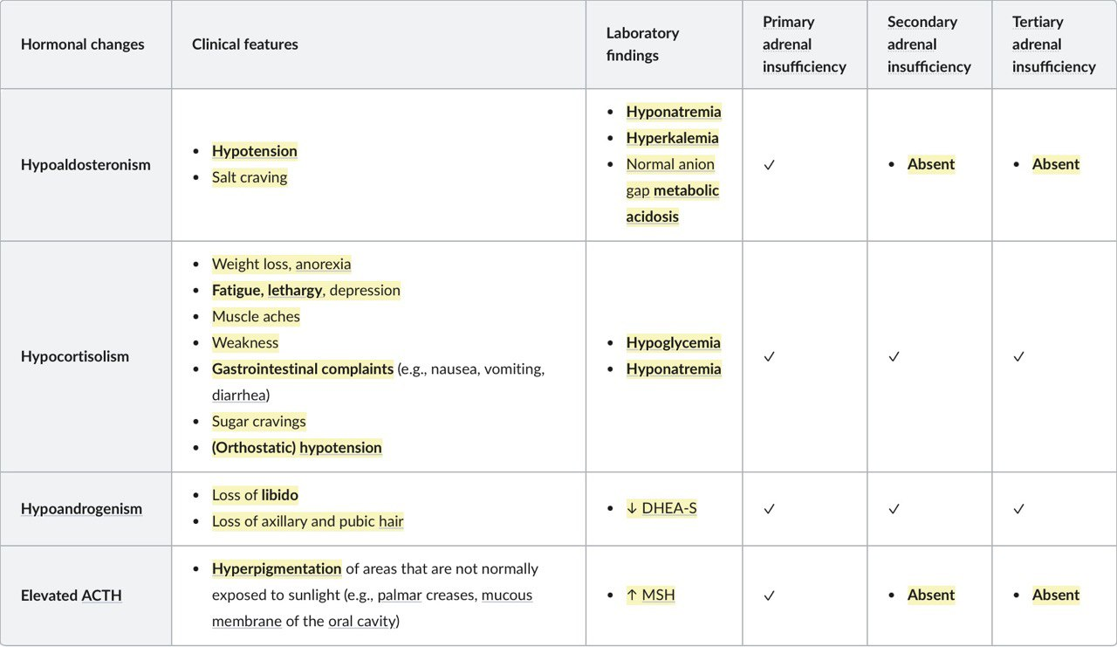

Slide 13
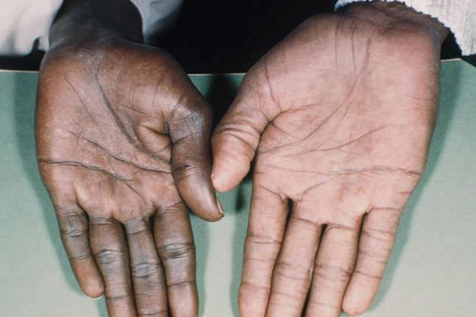
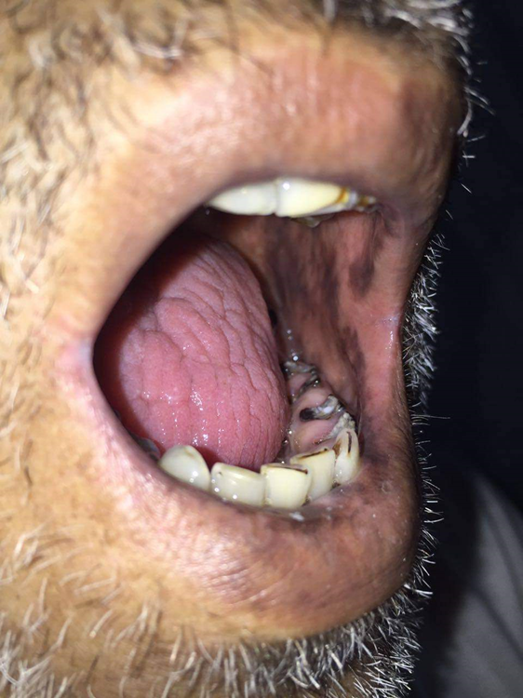

Slide 14
Approach of adrenal insuff. patients
Acute adrenal insufficiency: In acute adrenal crisis, where treatment should not be delayed in order to do the tests, a blood sample for a random plasma cortisol level should be drawn prior to starting hydrocortisone replacement.
Chronic adrenal insufficiency: Use stepwise endocrine testing in all patients.
Morning cortisol
Morning ACTH
ACTH stimulation test
Notes:
Primary adrenal insufficiency: Screen for hypoaldosteronism and hypoandrogenism.
Secondary and tertiary adrenal insufficiency: Differentiating between the two is often not required, as it does not influence management.
All patients: Investigate for an underlying cause.

Slide 15
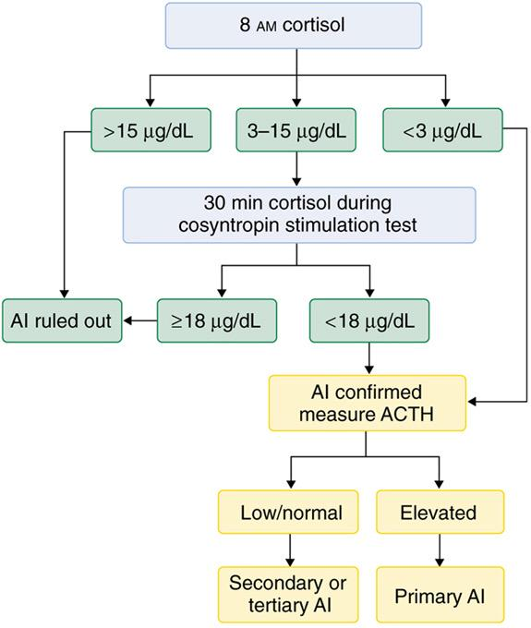
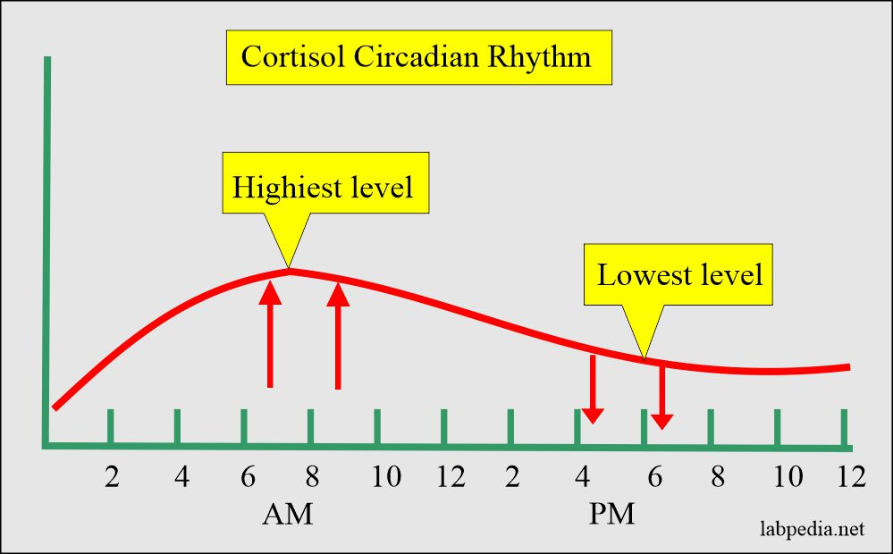

Slide 16
Endocrine studies
Endocrine testing is typically performed sequentially
Morning cortisol level: initial test
Levels ≥ 18 mcg/dL have a high negative predictive value for ruling out adrenal insufficiency.
Levels < 3 mcg/dL strongly suggest hypocortisolism.
Morning ACTH level: obtain if morning cortisol is low
Primary adrenal insufficiency: elevated ACTH levels
Secondary/tertiary adrenal insufficiency: ACTH levels low to normal
ACTH and cortisol secretion is subject to diurnal variation, which is why a morning sample is desirable.
Exogenous glucocorticoids (via any route) can suppress ACTH secretion through negative feedback.

Slide 17
Standard-dose ACTH stimulation test (cosyntropin test): gold standard to confirm the diagnosis of primary adrenal insufficiency
Method
Administration of exogenous ACTH to stimulate cortisol secretion
Measurement of cortisol levels before and 30 and/or 60 minutes after injection
Interpretation
In primary adrenal insufficiency: peak cortisol level < 18–20 μg/dL
In secondary/tertiary adrenal insufficiency: usually a rise in cortisol > 18–20 μg/dL
Screening for hypoaldosteronism and hypoandrogenism
Hypoaldosteronism
↑ Plasma renin activity (PRA) or ↑ plasma renin concentration (PRC)
normal or ↓ serum aldosterone
Hypoandrogenism
↓ DHEA-S

Slide 18
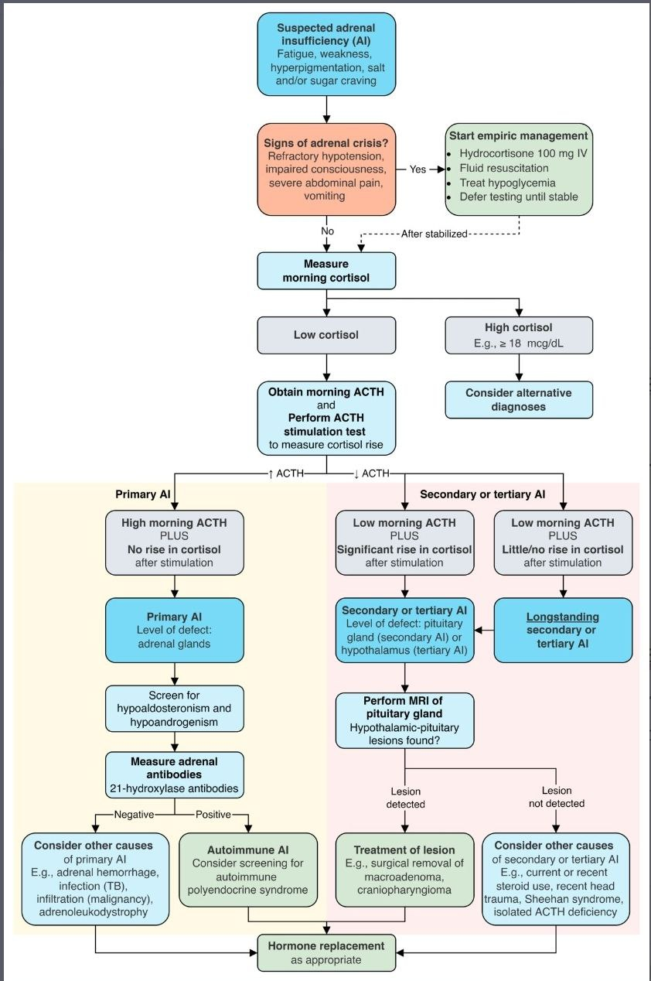

Slide 19
Other investigations
CBC: eosinophilia, lymphocytosis
Kidney function &electrolytes: hypoglycemia, hyponatremia and hyperkalemia. High creatinine and urea (prerenal).
Thyroid function abnormalities
4. Imaging:
If morning ACTH is elevated (>20pg/ml) → Primary hypoadrenalism → Adrenal CT
If morning ACTH is suppressed or normal → Secondary hypoadrenalism →Do Pituitary MRI
CXR :screen for TB as a cause if sus .
Other tests : Autoantibody testing - Thyroid autoantibodies, specifically antithyroglobulin (anti-Tg) and antimicrosomal or antithyroid peroxidase (anti-TPO) antibodies, and/or adrenal autoantibodies may be present 21 hydroxylase antibodies
Notes:
For confirmation, corticotropin stimulation test should be performed in most cases unless basal results are absolutely unequivocal

Slide 20
Treatment :
Primary adrenal insufficiency: replacement for hypocortisolism, hypoaldosteronism, and hypoandrogenism.
Glucocorticoids
Agent: Hydrocortisone
S.E: hypercortisolism (Cushing dx)
Mineralocorticoids
Agent: fludrocortisone (a synthetic mineralocorticoid with mostly mineralocorticoid and limited glucocorticoid effects)
S.E are analogous to glucocorticoids (e.g., hyperpigmentation).
Additional side effects include: Worsening of preexisting heart failure or cardiac dx if present.
Edema
Androgens
Consider treatment in female patients with low libido, depressive symptoms, and low energy levels.
Agent: DHEA

Slide 21
Secondary/tertiary adrenal insufficiency: replacement for hypocortisolism and hypoandrogenism
Glucocorticoids
Androgens (as needed)
Prevention of adrenal crisis: “Stress-dose steroids”
Steroid doses should be increased to prevent adrenal crisis in at-risk patients, e.g., in acute illness, surgery, or trauma.
Inpatient steroid doses are adjusted according to the level of stress.
If the dose of glucocorticoids is not increased during periods of stress, the patient may develop an adrenal crisis!

Slide 22
Adrenal crisis

Slide 23
Acute primary (Adrenal crisis)
Precipitating factors for adrenal crisis :
Stress in patients with underlying adrenal insufficiency :
Gastrointestinal illness (most common)
Other infections
Perioperative period
Physical stress or pain
Psychological stress
Sudden discontinuation of glucocorticoids after prolonged glucocorticoid therapy
Bilateral adrenal hemorrhage or infarction (e.g., Waterhouse-Friderichsen syndrome)
Pituitary apoplexy

Slide 24
Signs and symptoms of crisis:
Similar symptoms and signs of adrenal insufficiency but are more severe, including :
1. Severe hypotension,shock (<90/50)
2. Fever & decreased level of consciousness.
3. Hyperkalemia & hyponatremia & metabolic acidosis
Vomiting, diarrhea
Severe abdominal pain
Consider adrenal crisis in patients with severe hypotension refractory to fluid resuscitation and/or vasopressors.
Adrenal crisis can be life-threatening, so treatment with high doses of hydrocortisone should be started immediately, without waiting for diagnostic confirmation of hypocortisolism!

Slide 25
In patients in acute adrenal crisis, intravenous (IV) access should be established urgently, and an infusion of isotonic sodium chloride solution should be begun to restore volume deficit and correct hypotension.
Some patients may require glucose supplementation.
no mineralocorticoid replacement is necessary. The mineralocorticoid activity of hydrocortisone in this dosage is sufficient.

Slide 26
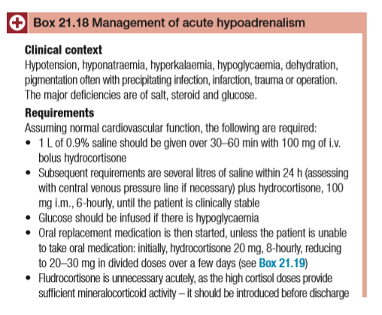

Slide 27
Long term replacement therapy
1. Glucocorticoid Replacement
• Hydrocortisone 10 mg on awakening and 5 to 10 mg in early afternoon.
• Monitor clinical symptoms and morning plasma ACTH.
2. Mineralocorticoid Replacement
• Fludrocortisone 0.1 (0.05 to 0.2) mg orally.
• Liberal salt intake.
• Monitor lying and standing blood pressure and pulse, edema, serum potassium, and plasma renin activity.

Slide 28
Patient advice
All patients requiring replacement steroids should:
1. Know how to increase steroid replacement by doubling the dose for intercurrent illness
2. Carry a ‘steroid card’
3. Wear a MedicAlert bracelet (or similar), which gives details of their condition so that emergency replacement therapy can be given if found unconscious
4. Keep an ampoule of hydrocortisone at home in case oral therapy is impossible, for administration by self, family, ambulance or doctor.

