Slide 1
Hydrocephalus
Done by :
Abdelrahman Nour
Moneeb abu-ruqayah

Slide 2
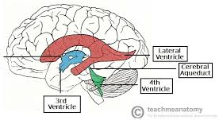
Abdelrahman Nour
The brain ventricles are four cavities located within the brain that contain cerebral spinal fluid (CSF).
two lateral ventricles , the third ventricle and the fourth ventricle
It protects the brain by allowing it to “float” in a fluid bath and provides a shock absorber against head trauma. The CSF itself also helps to provide nutrients to the brain and to keep the brain in chemical balance.
CSF
The normal volume of CSF is 140 ml.
CSF is produced by the choroid plexus in the lateral ventricles at a rate of 0.4 ml per minute (or about 500 ml in 24 hours).

Slide 4
NORMAL CSF CIRCULATION

Slide 5
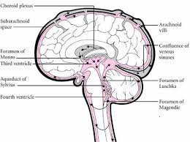
CSF circulation
The CSF flows from the lateral ventricles through the foramen of Monro into the 3rd ventricle, via the aqueduct of Sylvius into the 4th ventricle and then through the foramina of Magendie and Luschka into the subarachnoid space and basal cisterns.
The CSF circulates throughout the spinal subarachnoid space and the basal cisterns up through the tentorial hiatus. It flows over the cerebral hemispheres and is largely absorbed by the arachnoid villi of the dural sinuses.

Slide 7
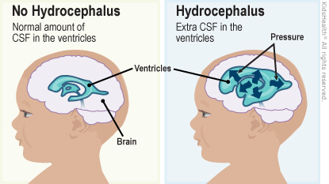
Hydrocephalus is an abnormal enlargement of the ventricles due to an excessive accumulation of CSF resulting from a disturbance of its flow, absorption or, uncommonly, secretion.

Slide 8
Classification of hydrocephalus
Obstructive hydrocephalus—when there is an obstruction to the flow of CSF through the ventricular system.
Communicating hydrocephalus—when there is no obstruction to the flow of CSF within the ventricular system but the hydrocephalus is due either to obstruction to CSF flow outside the ventricular system or to failure of absorption of CSF by the arachnoid villi.

Slide 9
Causes of hydrocephalus
1 Obstructive hydrocephalus:
(a) lateral ventricle obstruction by tumours.
(b) 3rd ventricular obstruction, due to colloid cyst of the 3rd ventricle or glioma of the 3rd ventricle.
(c) occlusion of the aqueduct of Sylvius (either primary stenosis or secondary to a tumour).
(d) 4th ventricular obstruction due to posterior fossa tumour.
Notes:
Glioma is a type of tumor that occurs in the brain and spinal cord ,, begin in the gluey supportive cells (glial cells)

Slide 10
2 Communicating hydrocephalus:
(a) obstruction to flow of CSF through the basal cisterns.
(b) failure of absorption of CSF through the arachnoid granulations over the cerebral hemispheres.
The most common causes of communicating hydrocephalus are infection (especially bacterial and tuberculous) and subarachnoid haemorrhage (either spontaneous, traumatic or postoperative).

Slide 11
The most common congenital cause is stenosis of the aqueduct of Sylvius. This is a major cause of hydrocephalus in children with spina bifida and myelomeningocele .
The acquired forms of hydrocephalus occur most frequently after intracranial bleeding, in meningitis and because of tumours.

Slide 12
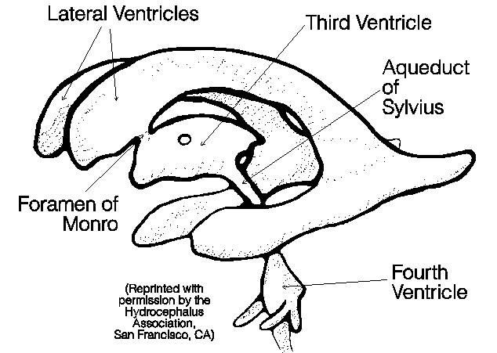
Aqueductal stenosis
The normal aqueduct measures about 1 mm in diameter, and is about 11 mm in length.

Slide 13
Aquductal stenosis
Is the most common cause of congenital hydrocephalus (43%).
Aqueduct develops about the 6th week of gestation .
M:F = 2:1 .
Other congenital anomalies (16%): thumb deformities.
Prognosis: 11-30% mortality .

Slide 14
Etiology of Aquductal stenosis
Intrinsic Pathology of the Aqueduct
Gliosis of the Aqueduct: Usually of infectious origin showing a marked gliofibrillary response. The lumen is clear of ependyma. ( proliferation +
Stenosis of the Aqueduct: Narrowed aqueduct without evidence of gliosis. This may have hereditary basis.
Forking of the Aqueduct: Typically, there are two channels seen in midsagittal plane unable to handle CSF volume. Most often seen with spina bifida.
Septum or Membrane Formation: A thin membrane of neuroglia may occlude the aqueduct. There may be a primary developmental defect or it may follow granular ependymitis from intrauterine infections. This is the rarest of the types of narrowing.
Notes:
The ependyma is the thin neuroepithelial lining of the ventricular system of the brain and the central canal of the spinal cord

Slide 15
Etiology of Aquductal stenosis
Extrinsic Pathology of the Aqueduct:
Infectious: Abscesses.
Neoplastic: Pineal tumors, brainstem gliomas, medulloblastoma, ependymoma.
Vascular: AVM, aneurysm.
Developmental: Arachnoid cysts.
Notes:
AVM
Arteriovenous Malformations

Slide 16
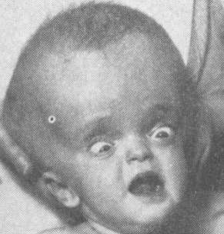
Clinical features of aqueductal stenosis
Obstructive hydrocephalus: presents with macrocephaly and/or intracranial hypertension.
Parinaud's syndrome: Inability to elevate eyes.
Collier's sign: Retraction of the eyelids.
Notes:
Parinaud 5sosn in pineal tumor

Slide 17
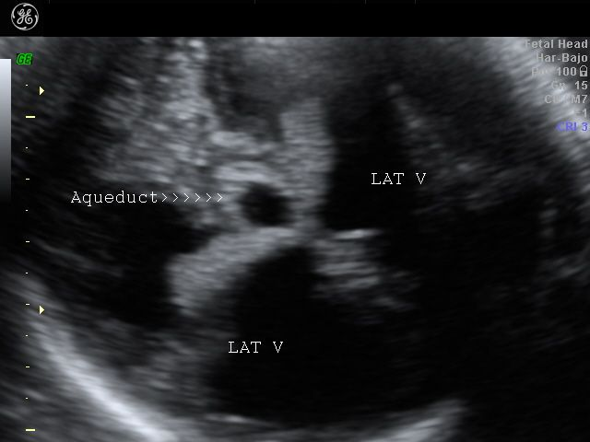
Imaging of aqueductal stenosis
Ultrasonography can detect aqueductal stenosis in utero.

Slide 18
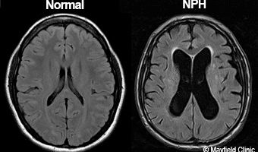
Imaging of aqueductal stenosis
CT and MRI. MRI is essential if third ventriculostomy is to be considered.

Slide 19
Treatment of aqueductal stenosis
Remove underlying cause of obstruction if possible.
Third ventriculostomy as initial treatment of choice.
VP shunt if technical reasons do not allow third ventriculostomy or if the child fails after ventriculostomy.
Aqueductal stent can be placed if technically feasible. Usually rarely done due to risk of upper brain stem injury.

Slide 20
Presenting features Hydrocephalus in infants
failure to thrive.
• increased skull circumference (compared with normal growth curves).
• tense anterior fontanelle.
• ‘cracked pot’ sound on skull percussion. ( hyper-resonance)
• transillumination of cranial cavity with strong light.
• severe, impaired conscious level and Vomiting .
• ‘setting sun’ appearance due to lid retraction and impaired upward gaze from 3rd ventricular pressure on the midbrain tectum.
• thin scalp with dilated veins.
Notes:
Crack pot إناء متصدع

Slide 21
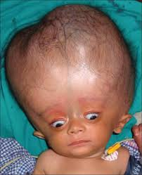

Slide 22
Presenting features Hydrocephalus in Adult
acute onset and deterioration
or
• gradual onset and slowly progressive deterioration.

Slide 23
Acute-onset adult hydrocephalus
This type of presentation occurs particularly in patients with tumours causing obstructive hydrocephalus, although it may occur with any of the causes of hydrocephalus and an acute rapid neurological deterioration may occur in patients who have had long-standing chronic hydrocephalus.
The major presenting features are due to the signs and symptoms of raised intracranial pressure :
headache
vomiting
papilledema
deterioration of consciousness .
Upgaze will often be impaired due to pressure of the dilated 3rd ventricle on the superior colliculus of the tectum.
Notes:
Papilledema : the optic nerve at the back of the eye becomes swollen

Slide 24
Gradual onset adult hydrocephalus
this type of onset occurs less frequently than the previous type. The symptoms of raised intracranial pressure are only very gradually progressive and late diagnosis is common.
Early features in the adolescent involve deteriorating school performance as a result of headaches, failing mental function, memory loss and behavioural disturbances.
Endocrine abnormalities such as infantilism and precocious puberty can occur in association with chronic hydrocephalus in older children and adolescents due to disturbance of the hypothalamus and possible compression of the pituitary gland.
If the condition is unrecognized progressive visual failure will occur, secondary to papilloedema and optic atrophy. acute decompensation may occur and the patient may suddenly develop a rapid deterioration of conscious state.

Slide 25
Radiological investigation
The most important investigation is either a CT scan or MRI of the brain which will show which ventricles are dilated.
If the lateral ventricles and 3rd ventricle are all very dilated, and the 4th ventricle is small, it is likely that the obstruction is at the level of the aqueduct of Sylvius.
In a communicating hydrocephalus all the ventricles are dilated.

Slide 26
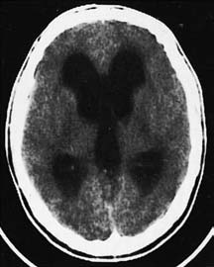
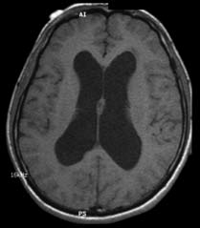
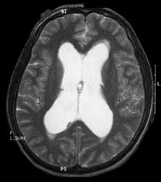
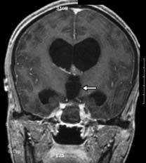
CT
MRI

Slide 27
Ultrasonography Ultrasonography through the open anterior fontanelle is useful in assessing ventricular size in infants and may obviate the need for repeated CT scans.
Records of the head circumference and its comparison with body weight and length centile charts are an integral part of postnatal follow-up of any child, and post op .

Slide 29
Treatment
Moneeb abu-ruqayah

Slide 30
Treatment
Management of hydrocephalus will depend on the underlying cause.
Options include :
1- removing a causative mass lesion.
2- ventricular shunting.
3- third ventriculostomy.

Slide 31
Removing a causative mass lesion
In some circumstances it may be appropriate to treat the hydrocephalus by tumour removal and decompression of the CSF pathways, perhaps with the insertion of an external ventricular drain (EVD) to cover the early postoperative period.

Slide 32
Ventriculoperitoneal shunt
involves the insertion of a catheter into the lateral ventricle. The catheter is then connected to a shunt valve under the scalp and ﬁnally to a distal catheter, which is tunneled subcutaneously down to the abdomen and inserted into the peritoneal cavity.
If the CSF pressure exceeds the shunt valve pressure, then CSF will ﬂow out of the distal catheter and be absorbed by the peritoneal lining.

Slide 34
Ventriculoperitoneal shunt

Slide 35
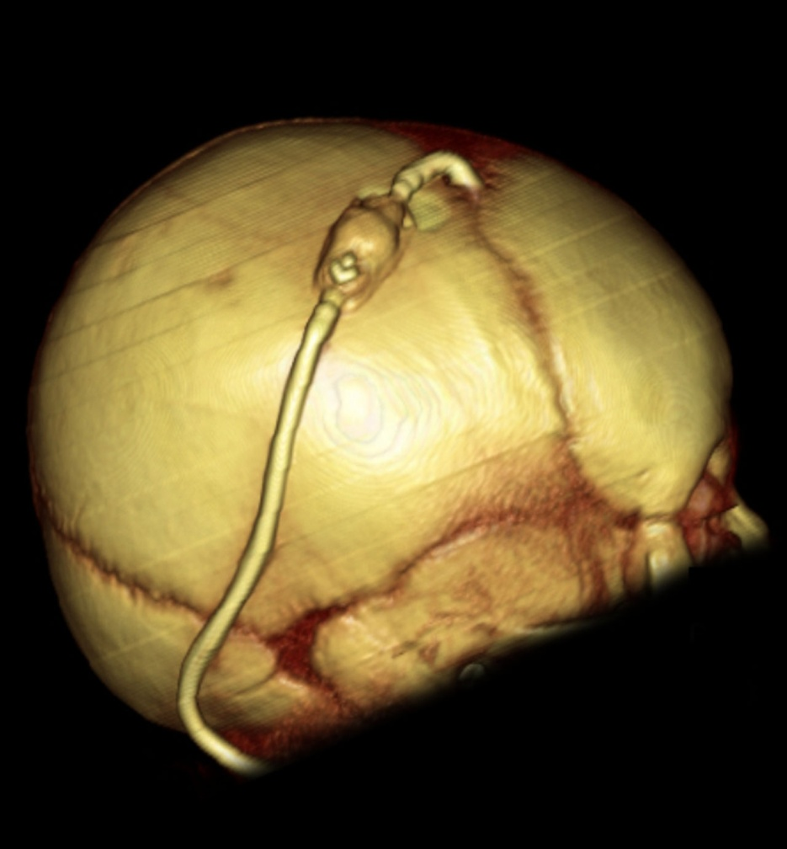
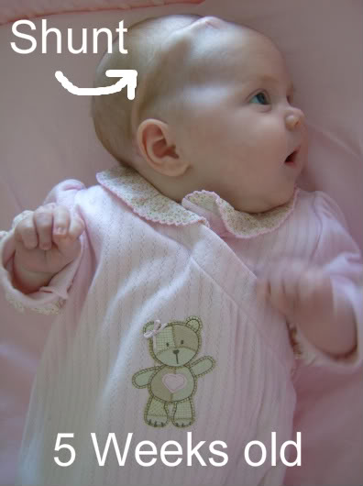
Ventriculoperitoneal shunt

Slide 36
Other options for distal catheter placement include:
1) (ventriculo-atrial shunt): from the right atrium via the deep facial and jugular vein , it’s necessary when there has been marked intraperitoneal sepsis or multiple abdominal operations .
2) (lumboperitoneal shunts) : The lumboperitoneal shunt involves drainage of the CSF from the lumbar theca rather than the ventricle. (pseudotumor cerebri)

Slide 37
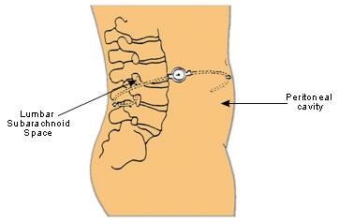
LP SHUNT

Slide 38
Complications of shunt
1) infection :
Shunt infection affects between 1% and 7% of shunt insertions and is usually caused by skin commensals, such as Staphylococcus epidermidis. Neonates are susceptible to Escherichia coli and haemolytic streptococcal infections.
Most infections become apparent clinically by 6 weeks and over 90% are apparent within 6 months.
Risk factors for infection include :
very young children.
open myelomeningocele.
longer operative time .
excessive staff movement into and out of theatre.

Slide 39
Complications of shunt
Treatment is by :
removal of the shunt, external CSF drainage and treatment of infection prior to re-insertion of the shunt at a different site.
The introduction of antibiotic-impregnated catheters has resulted in a reduction in shunt infection rates.

Slide 40
Complications of shunt
2) shunt blockage :
Shunt blockage may affect the ventricular catheter, shunt ,valve or distal catheter.
More than one-half of cases of shunt blockage are subsequently shown to be infected.
Causes of blockage :
choroid plexus adhesion, blood, cellular debris or misplacement of the distal catheter in the pre-peritoneal space.

Slide 41
Complications of shunt
3) intracranial hemorrhage :
Shunt systems may over drain leading to subdural haemorrhage .
Other complications are common to intracranial surgery and include seizures (5%), CSF leak, stroke and (< 1%) intracerebral haemorrhage.

Slide 42
External drains
External drains can be placed within the ventricle (EVD) or the lumbar thecal sac (lumbar drain).
These are useful for temporary CSF drainage and can be used to administer intrathecal antibiotics to treat CSF infection., take sample and decrease ICP

Slide 43
Notes:
Indications
Indications for an EVD or ICP monitor can include hydrocephalus, haemorrhage, tumour, meningitis or traumatic brain injury.
Contraindications
An EVD / ICP monitor is contraindicated in the following circumstances:
The patient is receiving anticoagulation therapy or who is known to have coagulation problems
The patient has a scalp infection
The patient has a brain abscess

Slide 44
Endoscopic third ventriculostomy
involves the insertion of a neuroendoscope into the frontal horn of the lateral ventricle and then into the third ventricle through the foramen of Munro. A stoma can be created in the ﬂoor of the third ventricle in between the mamillary bodies and infundibular (pituitary) recess.
CSF can then communicate freely between the ventricular system and interpeduncular subarachnoid space.
The technique is particularly useful when there is obstruction of the CSF pathways below the third ventricle such as with aqueduct stenosis or posterior fossa mass lesions.

Slide 45
It has an advantage over shunting in that no tubing is left in the patient and therefore infection rates are lower.
ETVs may block off, however, with about one-half of these patients ending up with a shunt. Rare, but serious, complications include basilar artery rupture or memory impairment from injury to the fornix.
The procedure is less useful for communicating types of hydrocephalus or in infants of less than 6 months of age, but has a success rate of over 70% for accepted indications.
Notes:
Colloid cyst opstruct the monro

Slide 46
Normal-pressure hydrocephalus
Normal-pressure hydrocephalus was first discussed by describing a group of patients with triad of symptoms; dementia, ataxia and incontinence, where the radiological studies showed hydrocephalus but the lumbar CSF pressure was normal.

Slide 47
Etiology
in a large percentage the communicating hydrocephalus may have resulted from obliteration of the subarachnoid pathways in the basal cisterns following an episode of meningitis or subarachnoid haemorrhage, from either rupture of an aneurysm, arteriovenous malformation or following trauma.
Although lumbar puncture pressure is within the normal range, continuous monitoring of the intracranial pressure in these patients will frequently reveal abnormal wave formation, especially at night.

Slide 48
Investigation
The CT scan or MRI will show dilated ventricles without significant cortical atrophy. The difficulty arises that normal-pressure hydrocephalus may occur in patients with a scan appearance of cortical atrophy, but in these patients the degree of ventricular dilation should be more than would be expected just to compensate for the degree of atrophic change.
Other investigations, including isotope cisternography, neuropsychological assessment and CSF infusion studies, have been used but they have a high failure rate in predicting which patients will benefit from a CSF shunt.

Slide 49
Treatment
The following criteria can be used to assess the patients with the greatest chance of improvement following a shunt:
• Aclinical presentation of the classic triad, particularly if the features of gait disturbance predominate.
• The CT scan or MRI showing marked hydrocephalus with minimal cortical atrophy.
• Aclearly defined cause for the hydrocephalus, such as a past episode of subarachnoid haemorrhage, trauma or meningitis.
• Abnormal pressure waves on continuous intracranial pressure monitoring.
Naturally, a patient who has all these positive criteria deserves a shunt and should make a good recovery following the operation.

Slide 50
Hydrocephalus ex-vacuo
occurs when there is damage to the brain caused by stroke or injury, and there may be an actual shrinkage of brain substance. Although there is more CSF than usual, the CSF pressure itself is normal
Notes:
known as compensatory enlargement of the CSF spaces

Slide 51
External hydrocephalus
A condition that occurs in infancy and early Childhood.
characterised by: enlargement of the subarachnoid space,typically in the frontal areas and interhemispheric fissure with raised intracranial pressure without significantly enlarged ventricles.
It is attributed to an absorption deficiency and typically resolves within a year.

Slide 52
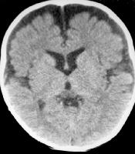
Benign External Hydrocephalus

