Slide 1
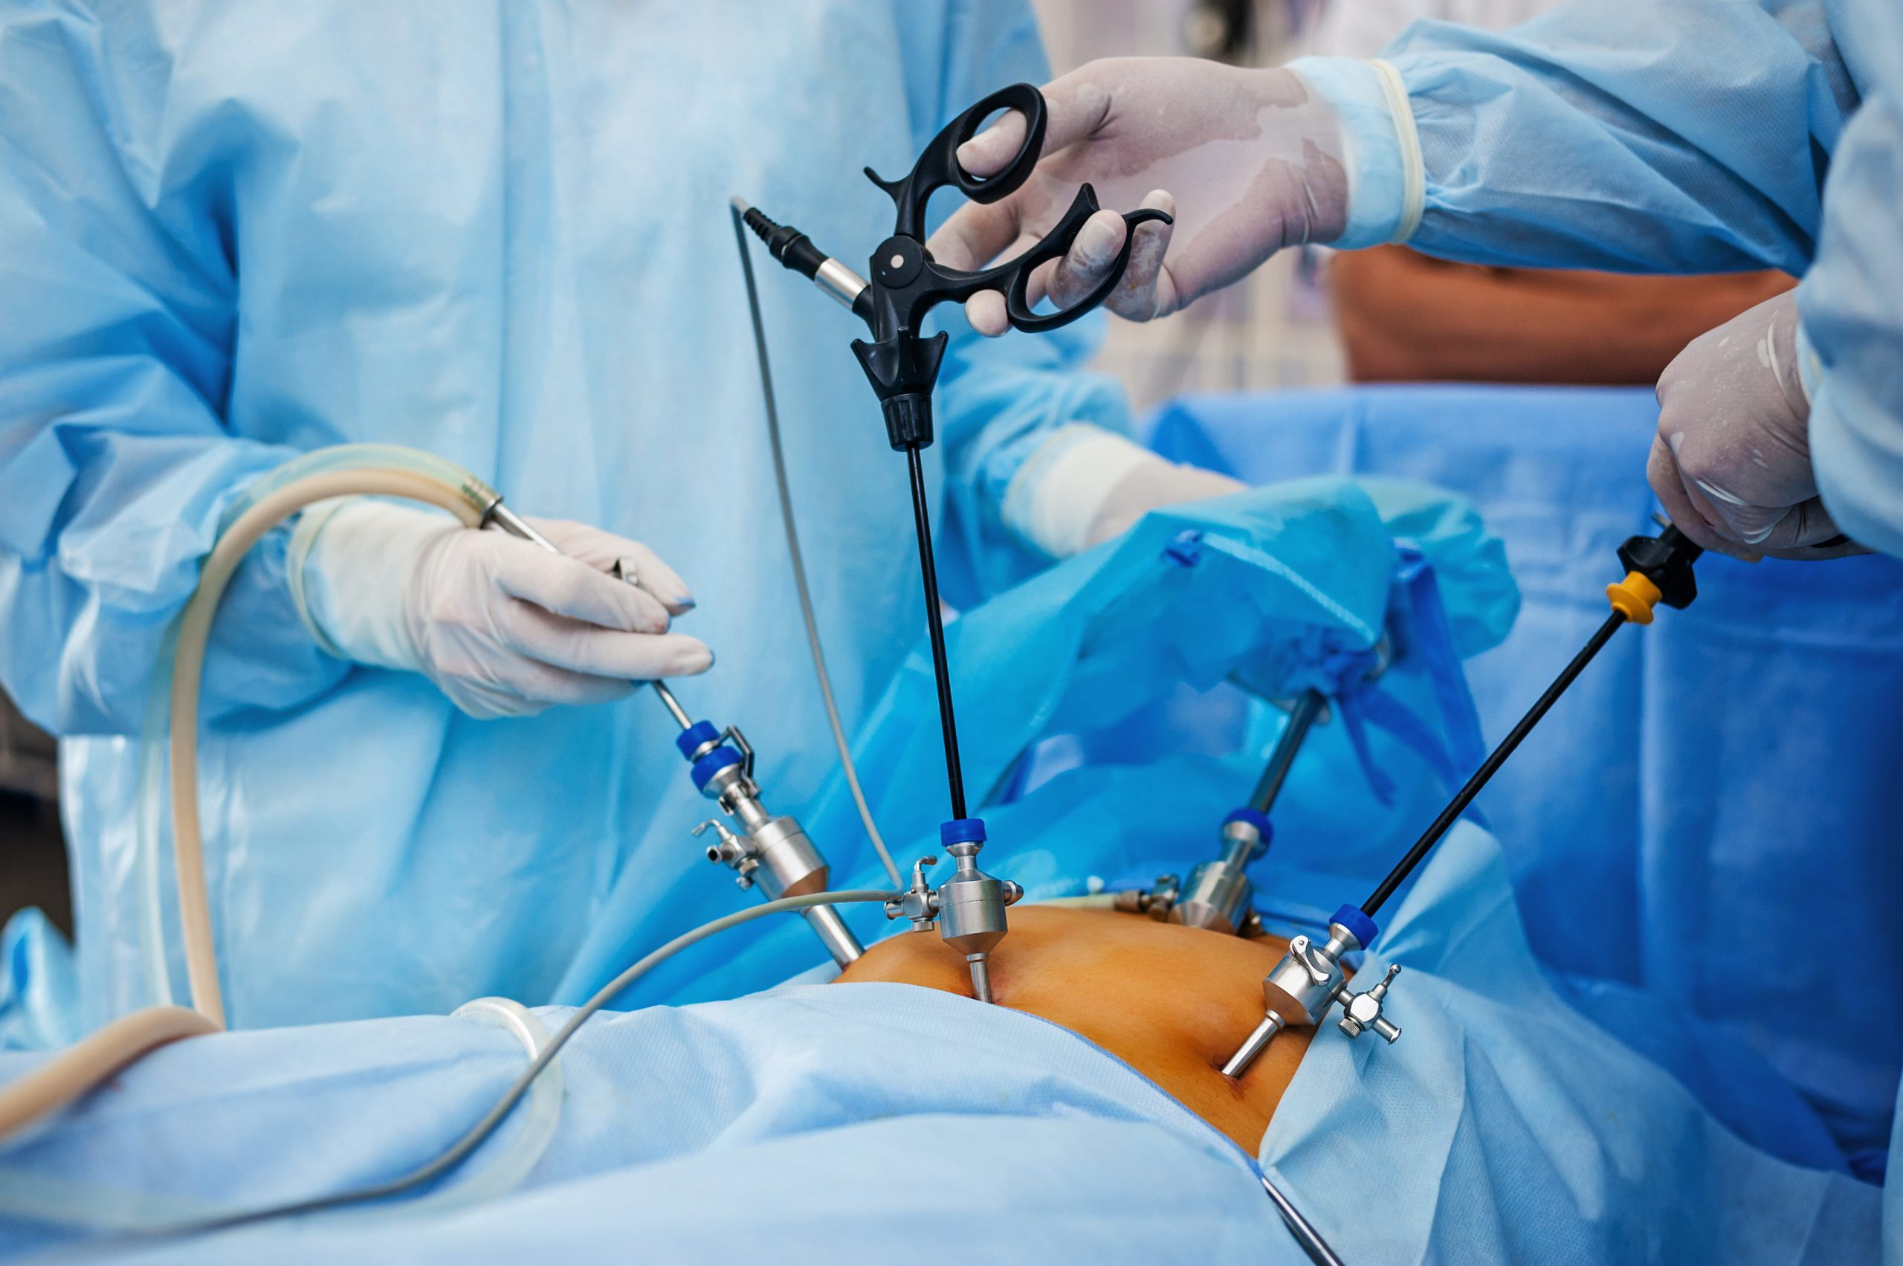
Principles of Laparoscopic Surgery
Presented by:
Mustafa Ayman
Noor Adel
Tamer Jaafreh
Abdallah Abu-Adas

Slide 2
Definition
Laparoscopic surgery is a product of modern technology and surgical innovation that aims to accomplish surgical therapeutic goals with minimal somatic and psychological trauma.
Also known as minimal invasive surgery (MIS).

Slide 3
History
1901 | Kelling | 1st laparoscopic examination of abdominal cavity in rays called it “Calioscopy”
1911 | Jacobeus | 1st human laparoscopy
1938 | Veress | Spring loaded obturator needle for pneumoperitoneum
1966 | Hopkins | ***Developed Road Lens Optical system
1960-70 | Semm | Developed automatic insufflator & instuments. 1st lap appendisectomy. Father of modern laparoscopic surgery
1987 | Phillip Mouret | 1st L.C.

Slide 4
Core Principle of MIS (I-VITROS)
I -insufflate/create space
V-visualize-( anatomical landmark, tissue , surgical environment)
I -identify-(specific structures for surgery)
T-triangulate(surgical tools to optimize efficiency, ergonomics, minimize crowding/clashing)
R -retract (manipulate and access the correct tissue plane)
O -operate (incise, suture, anastomose)
S -seal/Hemostasis

Slide 5
MIS Categories
-Laparoscopy
-Thoracoscopy
-Endoluminal endoscopy-urology, git, respiratory and vascular systems
-Perivisceral endoscopy- mediastinoscopy, retroperitoneoscopy
-Arthroscopy and intra-articular joint surgery
-combined -Diagnostic/Therapeutic

Slide 6
Equipment and Instrumentation
-optics
-abdominal access instruments
-laparoscopic instruments

Slide 7
Laparoscopy A rigid endoscope (laparoscope) is introduced through a port into the peritoneal cavity. This is insufflated with carbon dioxide to produce a pneumoperitoneum.
Further ports are inserted to enable instrument access and their use for dissection.

Slide 8
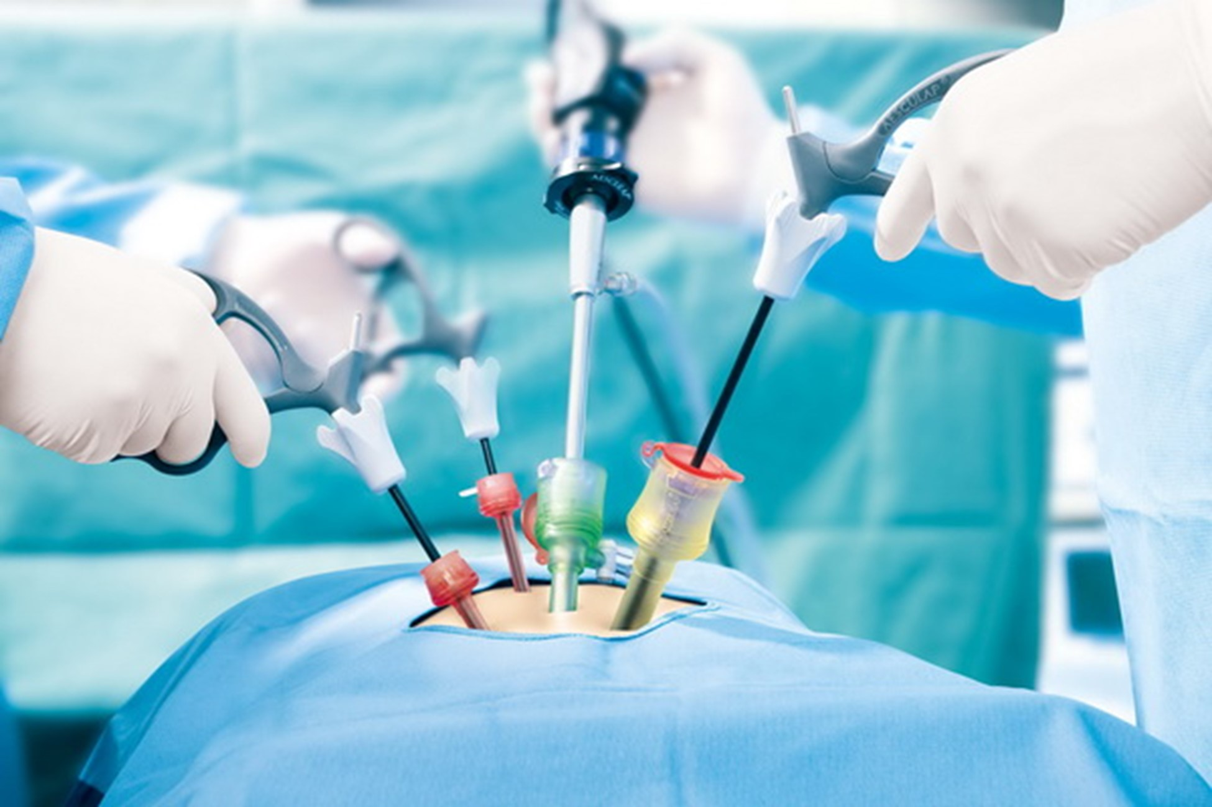

Slide 10
Advantages of Minimal Invasive Surgery
● Decrease in wound size
● Reduction in wound infection, dehiscence, bleeding, herniation and nerve
entrapment
● Decrease in wound pain
● Improved mobility
● Decreased wound trauma
● Decreased heat loss
● Improved visualization

Slide 11
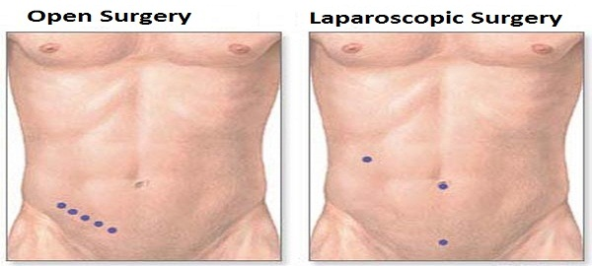

Slide 12
Limitations of Laparoscopic Surgery
● Reliance on remote vision and operating
● Loss of tactile feedback
● Dependence on hand–eye coordination
● Difficulty with haemostasis
● Reliance on new techniques
● Extraction of large specimen

Slide 13
Pre-OP Evaluation
Preparation of the patient Although the patient may be in hospital for a shorter period, careful preoperative management is essential to minimize morbidity.
● Overall fitness: cardiac arrhythmia, emphysema, medications, allergies.
● Previous surgery: scars, adhesions.
● Body habitus: obesity, skeletal deformity.
● Normal coagulation
● Thromboprophylaxis.
● Informed consent.

Slide 14
History
Patients must be fit for general anesthesia and open operation if necessary.
Potential coagulation disorders (e.g. associated with cirrhosis) are particularly dangerous in laparoscopic surgery. adhesions, previous abdominal operations or peritonitis should be documented.

Slide 15
Examination
• Routine preoperative physical examination is required as for any major operation.
• in general, laparoscopic/thoracoscopic surgery allows quicker recovery, it may involve longer operating time
• Severe chronic obstructive airways disease and ischaemic heart disease contraindicated in laparoscopic approach.
• jaundice, abdominal scars, palpable masses ,tenderness or obesity .

Slide 16
General Intraoperative Principles
• Creating a pneumoperitoneum
• Preoperative problems:
-Previous abdominal surgery
-Obesity
• Operative problems:
-Intraoperative perforation of a viscus
-Bleeding

Slide 17
Creating a Pneumoperitoneum
• There are two methods for creation of a pneumoperitoneum:
1. Closed method
2. open method
• The closed method:
- involves blind puncture using a Verres needle.
- this method is fast and relatively safe.
- there is a small but significant potential for intestinal or vascular injury on introduction of the needle or first trocar.

Slide 18
•Open method (Hasson approach):
avoids the morbidity related to a blind puncture.
Definite and small risk of bowel injury
Useful in patients with abdominal surgery or underlying adhesions
- To achieve this, a 1 cm vertical or transverse incision is made at the level of the umbilicus.

Slide 19
Procedure
-Abdomen is insuffled with 5 to 6 litre of CO₂ to:-
create working space.
allow lens to focus on target tissue.
- Instrument is inserted through an incision in abdominal wall through an air tight trocar.
- This port have gasket that seal around the instrument maintaining the positive pressure and working space.
- Surgeons rely on texture and compressibility to evaluate tissue character and pathology.

Slide 20
Insufflators
-Automatic.
-Pressure regulated high flow.
-Monitor intrabdominal pressure which is usually set at 12-15 mmHg.
-Alarm sound or pressure release valves when pressure limit is exceeded.
-Flow rate of 8-10 Its/min.

Slide 21
Physiological Changes
Are due to pneumoperitoneum
Pneumoperitoneum
-Required to create working space
-Gases used:
-Air
-O2
-CO2
-N2O
-He, Ne, Ar (newer)

Slide 22
CO2
Advantages:
-Does not support combustion or explosion
-Rapidly absorbed
-Rapidly soluble (lower chance of gas embolism)
Disadvantages:
-Not readily available
-Hypercarbia
-Causes peritoneal discomfort when used with LA

Slide 23
N2O
Advantages:
-Readily available
-Better analgesia
-Physiologically inert
-Hypercarbia is not a problem
-Non explosive
-Decreased intraop entitled CO2 & minute ventilation required to maintain homeostasis
Disadvantages:
-Supports combustion
-Absorbed slower than CO2

Slide 24
Complications
-Insertion related
-Major vascular injury (0.25%)
-GI injury (0.14%)
-Bladder injury
-CO2 embolism
-Abdominal wall hemorrhage

Slide 25
Post Insertional Complications
-GI perforations (acute or delayed)
-Laceration & bleeding from solid organs
-Abdominal wall hernia

Slide 26
Contraindication
Absolute:
-Uncorrectable coagulopathy
-Frozen abdomen
-Intestinal obstruction with massive abdominal distension
-Hemorrhagic shock
-Severe cardiac dysfunction (class IV)
-Concomitant disease requiring laparotomy

Slide 27
Relative:
-Inability to tolerate GA
-Abdominal sepsis/peritonitis
-Multiple previous abdominal operations
-severe COPD
-Pregnancy
-Diaphragmatic hernia
-Morbid obesity

Slide 28
Postoperative Care
The postoperative care of patients after laparoscopic surgery is
generally straightforward, with a low incidence of pain or other
problems.
The most common routine postoperative symptoms are upper
abdominal pain, nausea and pain around the shoulders.
If the patient develops a fever or tachycardia, or complains of severe
pain at the operation site we know that something is wrong and
close observation is necessary.

Slide 29
routine investigation should include a full blood count, C reactive protein
(CRP) measurement, liver function tests, an amylase test and, probably, an ultrasound scan of the upper abdomen to detect fluid collections.
If bile duct leakage is suspected, endoscopic retrograde
cholangiopancreatography (ERCP) may be needed.
If in doubt, relaparoscopy or laparotomy should be performed earlier rather than later because Death following technical errors in laparoscopic
cholecystectomy has often been associated with a long delay in deciding to re-explore the abdomen.
In the absence of problems, patients should be fit for discharge within 24
hours.

Slide 30
Most Common Postoperative Symptoms
1-Nausea
• 50% of cases
• Maneged with antiemetics
• Controlled within 12-24 h
• Avoid opiate analgesics
2- Shoulder tip pain
• Referred from diaphragm, worst 24 hours after operation.
• Settles within 2–3 days and is relieved by simple analgesics,
such as paracetamol.

Slide 31
3- abdominal pain
• port site pain and is worse if there is haematoma formation.
• Increasing pain after 2–3 days suspect infection
Herniation through port site may produce localized pain.
• If increasing pain , tachycardia and or pyrexia review the
case and relaparoscopy should be considered.

Slide 32
Oral fluids
- Started 4–6 hours after the end of the operation except in
colectomy or small bowel resection .
Oral feeding
- a light meal can be taken 4–6 hours after the operation. Some
patients remain slightly nauseated at this stage, but almost all
eat a normal breakfast on the morning after the operation.

Slide 33
Urinary Catheter and Drains
-Foleys if applied remove after procedure.
- Drain applied to assess :
1- Postoperative blood loss
2- Nature of intraperitoneal fluid
3- Postoperative monitoring needs
-Drain if placed to peritoneal fluid→ remove within 1 hour after operation.
If placed for hepatic bleeding or bile leakage→ remove when drain has achieved its function (after 12-24 hours)
- If continued blood loss from drain→ re-explore the abdomen

Slide 34
Discharge from Hospital
-Patient discharge is based on clinical indicators and their fitness for
recuperating in a non-hospital environment.
-One of the advantages for the application of minimally invasive surgery is an earlier recovery and therefore discharge from hospital.
-For the common laparoscopic procedure of cholecystectomy, most surgeons discharge a laparoscopic cholecystectomy patients on the day of surgery, but some are kept in overnight and discharged the following morning.
-Patients should not be discharged until they are seen to be comfortable, have passed urine and are eating and drinking satisfactorily. They should be told that if they develop abdominal pain or other severe symptoms they should return to the hospital or to their general practitioner.

Slide 35
Mobility and Convalescence
-Patients can get out of bed to go to the toilet as soon as they have recovered from the anesthetic.
-patients can cough actively and clear bronchial secretions, and this helps to diminish the incidence of chest infections.
-Many patients are able to walk out of hospital on the evening of their operation and almost all are fully mobile by the following morning. Thereafter, the postoperative recovery is variable.
-The average return to work is about 10 days.

Slide 36
FURTHER DEVELOPMENTS THAT HAVE MADE MINIMALLY INVASIVE SURGERY EVEN LESS INVASIVE
1) Single incision laparoscopic Surgery
2) Natural orifice translumenal endoscopic surgery (NOTES)

Slide 37
THANK YOU

