Slide 1
Cerebrovascular diseases
Dr.Bushra Al-Tarawneh, MD

Slide 2
Cerebrovascular diseases denote brain disorders caused by pathologic processes involving the blood vessels.
The three main pathogenic mechanisms are:
1. Thrombotic occlusion of vessels
2. Embolic occlusion of vessels
3. Vascular rupture.
Thrombosis and embolism cause ischemic injury or infarction of specific regions of the brain, depending on the vessel involved.
Hemorrhage accompanies rupture of vessels, leading to direct tissue damage as well as secondary ischemic injury

Slide 3
Clinically
1. Stroke :
- Is the clinical designation applied to:
a. Abrupt onset of focal or global neurological
Symptoms.
b. caused by ischemia or hemorrhage.
c. The symptoms must continue for more than 24 hours.
d. There should be permanent damage to the brain.

Slide 4
2. Transient ischemic attack(TIA):
a. The neurologic symptoms resolve within 24 hours
b. No irreversible tissue damage
c. The cause is small emboli from the carotids or
vertebrobasilar circulation that resolve before
causing irreversible injury

Slide 5
i. Ischemia
Ischemia can result from:
a. A reduction in the perfusion pressure such as in hypotension.
b. Large vessel obstruction.
When blood flow to a portion of the brain is
reduced, the survival of the tissue at risk depends on:
a. The presence of collateral circulation.
b. The duration of ischemia.
c. Magnitude and rapidity of
the reduction of the blood flow.
i. The precise anatomic site
ii. Size of the lesion
iii. consequently the clinical deficit

Slide 6
From the standpoint of the pathophysiology and pathologic anatomy, cerebrovascular diseases are divided into two main processes:
A. Hypoxia, ischemia and infarction
i. Hypoxia
ii. Ischemia can result from:
a. A reduction in the perfusion pressure such as in hypotension
b. Large vessel obstruction
B. Hemorrhage

Slide 7
When blood flow to a portion of the brain is reduced, the survival of the tissue at risk
depends on :
a. The presence of collateral circulation.
b. The duration of ischemia.
c. Magnitude and rapidity of the reduction of
the blood flow.
These factors determine :
i. The precise anatomic site
ii. Size of the lesion
iii. And consequently the clinical deficit

Slide 8
Ischemia can be
I. Global cerebral ischemia.
II. Focal cerebral ischemia.
Global cerebral ischemia :- Called diffuse ischemic/hypoxic
Encephalopathy and occurs when there is generalized reduction
in the cerebral perfusion.
A. Mild global ischemia:
- The patient may have only a transient post-ischemic confusion
- Followed by complete recovery
No irreversible tissue damage
B. Severe global ischemia
- Widespread neuronal death occurs irrespective of the regional vulnerabilitya.
- Clinical outcomes
i. Patients who survive this injury remains in persistent vegetative state ( awake but not aware)

Slide 9
Neurons are the most sensitive cells to transient
mild global ischemia
Followed by oligodendrocytes and astrocytes
The most sensitive neurons to transient global
ischemia are;
i. The pyramidal cells of the hippocampus
(especially) CA1 neurons.
ii. Cerebellar purkinji cells.
iii. Pyramidal neurons in the cerebral cortex
produces a pattern called pseudolaminar
Necrosis.

Slide 10
Hippocampus

Slide 11
Death of purkinjii cells

Slide 12
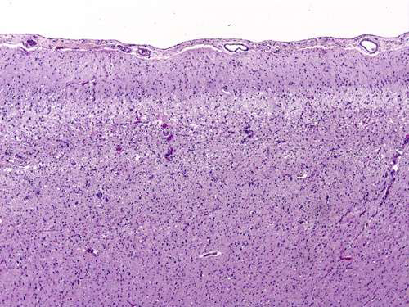
Pseudolaminar necrosis necrosis of pyramidal cells

Slide 13
ii. Brain death
- Other patients meet the clinical criteria for
"brain death," including:
1. Evidence of diffuse cortical injury.
(isoelectric, or "flat," electroencephalogram
2. And brain stem damage, including absent
reflexes and respiratory drive.

Slide 14
Border zone ("watershed") infarcts
- Are wedge-shaped areas of infarction that occur
in those regions of the brain and spinal cord that
lie at the most distal fields of arterial perfusion.
- Border zone infarcts are usually seen after
hypotensive episodes

Slide 15
In the cerebral hemispheres
1. Double watershed area
- Is the border zone between the anterior and
the middle cerebral artery distributions is at
greatest risk(double watershed area).
- Damage to this region produces a band of
necrosis over the cerebral convexity a few
centimeters lateral to the inter-hemispheric
fissure.

Slide 16
2. Triple watershed area
- Is the border zone between anterior,
middle and posterior cerebral arteries
and located posteriorly in the parietal
lobe.

Slide 17
The major sources of collateral flow are
1. Circle of Willis
2. Partial and inconstant reinforcement is
available over the surface of the brain for the distal branches of the anterior, middle and posterior cerebra arteries through corticoleptomeningeal anastomosis.
3. In contrast, there is little if any collateral flow for
thalamus, basal ganglia, and deep white matter
which are supplied by deep penetrating vesseles

Slide 18
Occlusive vascular disease of severity
sufficient to lead to cerebral infarction may be
due to
1. Embolization from a distal source
2. Insitu throbmosis
3. Vasculitis

Slide 19
Embolism
- Sources of emboli:
a. Cardiac mural thrombi are a frequent source
b. Thromboemboli also arise in arteries, most
often from atheromatous plaques within the
carotid arteries.
c. Fat emboli
d. Bone marrow emboli

Slide 20
-The territory of distribution of the middle cerebral artery-the direct extension of the internal carotid artery-is most frequently affected by embolic Infarction.
- Widespread hemorrhagic lesions involving the white matter are characteristic of embolization of bone marrow after trauma

Slide 21
2. In situ thrombosis;
- Are most commonly associated with
atherosclerosis and plaque rupture.
- The most common sites of primary thrombosis are:
a. The carotid bifurcation
b. The origin of the middle cerebral artery
c. And at either end of the basilar artery

Slide 22
3. Inflammatory processes that involve blood vessels
a. Infectious vasculitis is common in the setting of immunosuppression and in opportunistic infection such as aspergillosis and CMV encephalitis.
b. Primary angiitis of the CNS:
- Is an inflammatory disorder that involves multiple small to medium-sized parenchymal and subarachnoid vessels.
- Characterized by chronic inflammation, multinucleated giant cells and destruction of the vessel wall.
c. Granulomas if present it called granulomatous angiitis of the central nervous system.
- Affected individuals may present with diffuse encephalopathy or multifocal clinical picture often with cognitive dysfunction.
- Patients improve with steroids or immunosuppressive therapy

Slide 23
Primary angiitis of CNS

Slide 24
INFARCTIONS
Infarcts can be divided into two broad groups hemorrhagic and non-hemorrhagic based on their macroscopic and corresponding radiologic appearance

Slide 25
Morphology
- The macroscopic appearance changes in time.
1. During the first 6 hours of iirreversible injury.
2. By 48 hours:
- The tissue becomes pale, soft, and swollen, and
the corticomedullary junction becomes indistinct.
3. From 2 to 10 days:
- The brain becomes gelatinous and friable, with
distinct boundary between normal and abnormal
Tissue.
4. From 10 days to 3 weeks:
- The tissue liquefies, leaving a fluid-filled cavity

Slide 26
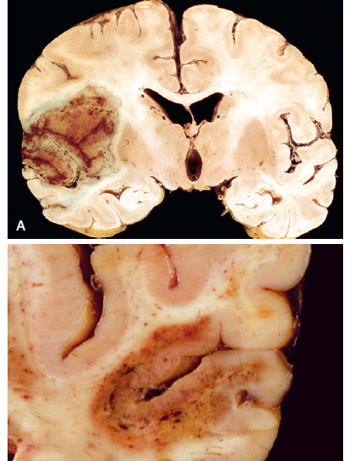
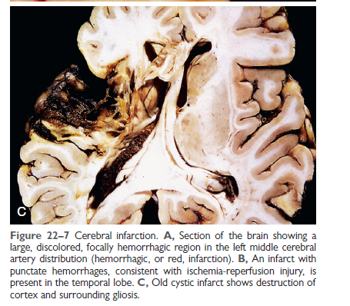

Slide 27
Microscopically,
1. After the first 12 hours:
a. Red neurons and both cytotoxic and vasogenic
edema predominate.
b. Disintegration and myelinated fibers.
2-Up to 48 hours, there is some neutrophilic emigration.
3. 2-3 weeks
a. Mononuclear phagocytic cells predominate and
macrophages containing myelin breakdown products or blood may persist in the lesion for months to years.
b. Gemistocytic gliosis followed by fibrillary astrocytosis after several months.

Slide 28
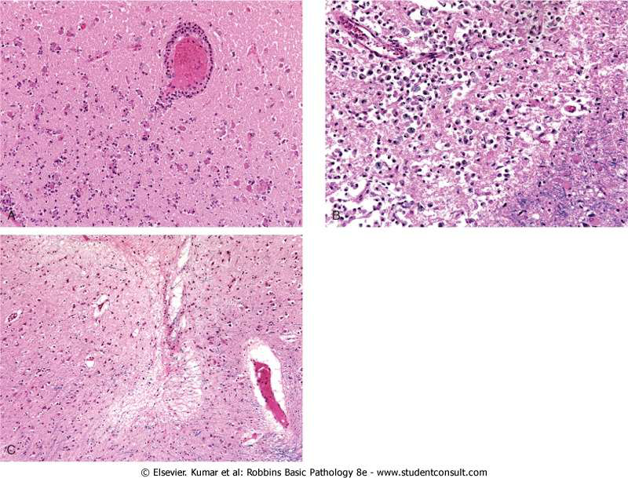
Cerebral infarction

Slide 29
Hypertensive cerebrovascular diseases

Slide 30
Hypertensive cerebrovascular diseases
Effect of hypertension on the brain include:
1. Lacunar infarcts
2. Slit hemorrhages
3. Hypertensive encephalopathy
4. Massive hypertensive intraparenchymal
hemorrhage

Slide 31
1. Lacunes or lacunar infarcts :
Mechanism
- Hypertension causes arteriolosclerosis of the
deep penetrating arteries and arterioles that
supply the basal ganglia, hemispheric white
matter and brain stem.
This arteriolosclerosis sclerosis leads to occlusion of these vessels.
- The result is development of lake-like spaces
defined as less than 15 mm wide. Occur mainly in :
i. Lenticular nucleus.
ii. Thalamus
iii. Internal capsule
iv. Caudate nucleus
v. Pons
- In descending order of frequency

Slide 32
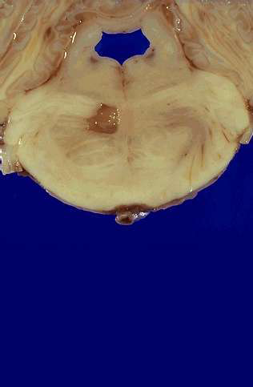
Lacunar infarct in the Pons

Slide 33
2. Slit hemorrhages;
- Hypertension can lead to rupture of the small caliber blood vessels and lead to development of small hemorrhages.
- With time these hemorrhages resorb leaving behind a slit-like spaces called slit hemorrhages.
Microscopically characterized by:
i. Focal tissue destruction
ii. Pigment-laden macrophages
iii. Gliosis

Slide 34
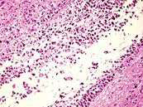
Microscopically characterized by
i. Focal tissue destruction
ii. Pigment-laden macrophages
iii. Gliosis

Slide 35
3. Hypertensive encephalopathy
Is a clinicopathologic syndrome arising in the setting of malignant hypertension.
- Most often is associated with sudden sustained rises in diastolic blood pressure to greater than 130 mm Hg and characterized:
a. By increased intracranial pressure due to
loss of autoregulation and forcefull overdistention of blood vessels, leading to fluid extravasation (hydrostatic edema).
B.Global cerebral dysfunction, manifesting as
headaches, confusion, vomiting, convulsions, and sometimes coma.
- Rapid therapeutic intervention to reduce the intracranial pressure is essential, because this syndrome does not remit spontaneously.

Slide 36
MICROSCOPICAL AND MACROSCOPICAL FEATURES
- Postmorteum examination shows edematous
brain with or without trantentorial or tonsillar
Herniations.
- Microscopic examination shows
Fibrinoid necrosis and thrombosis of arterioles
and capillaries ASSCOITAED with microinfarcts and microhemorrhages

Slide 37
C. Intracranial Hemorrhage
May occur at any site within the CNS either
1. Intraparenchymal hemorrhage Causes
a. Hypertension
b. Amyloid angiopathy
2. Subarachnoid hemorrhages:
- Are most commonly seen with aneurysms but occur also with other vascular malformations.
3. Hemorrhages associated with the dura (in either subdural or epidural spaces) usually due to trauma.

Slide 38
1. Intraparenchymal hemorrhages:
Rupture of a small intraparenchymal vessel can lead to intraparenchymal hemorrhage and this condition is called hemorrhagic stroke
Spontaneous non traumatic brain hemorrhage
occur most commonly in the middle to late
adult life and the peak incidence is at about 60 years.

Slide 39
- Is divided into
i. Ganglionic hemorrhages
- Occur in the basal ganglia and thalamus
- Mainly caused by hypertension
ii. Lobar hemorrhages
- In the cerebral hemispheres
- Main cause by cerebral amyloid angiopathy

Slide 40
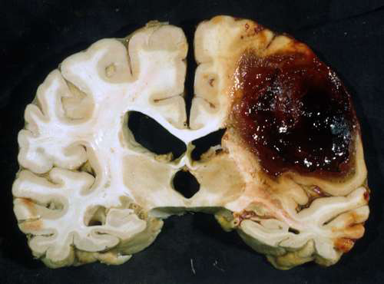
Lobar intraparenchymal hemorrhages

Slide 41
- Other causes of intraparenchymal hemorrhages
i. Systemic coagulation disorder
ii. Neoplasms
a. Primary brain tumors mainly glioblastoma and
oligodendroglioma
b. Metastatic tumors to brain mainly melanoma
and renal cell carcinomaiv.
iii. Vascular malformations

Slide 42
- Sites
i. Putamen in 50-60% of the case
ii. Thalamus
iii. Pons
iv. cerebellum

Slide 43
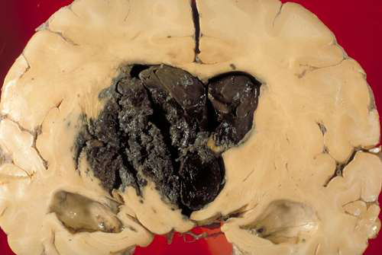
Basal ganglia hemorrhage

Slide 44
Mechanisms
of massive hemorrhage in Hypertension:
1. Hyaline arteriolar sclerosis
- Affects the deep penetrating arteries and
arterioles that supply the basal ganglia and the
brain stem
- Affected arteriolar walls are weakened and are
more vulnerable to rupture.

Slide 45
Cerebral Amyloid Angiopathy (CAA) :
- Is the risk factor most commonly associated with lobar hemorrhages.
- In CAA, amyloidogenic peptides usally the same ones in Alzheimer diseases ((Aβ amyloid) are deposited in the walls of medium-small caliber menigeal and cortical vessel.
- This deposition can weaken the vessel wall
and lead to hemorrhage
Morphology
- The underlying vascular abnormality in CAA is
typically restricted to the leptomeningeal and
cerebral cortical arteioles and capillaries

Slide 46
Subarachnoid Hemorrhage
Causes:
A. Saccular (berry) aneurysm rupture
- Is the most frequent cause of clinically significant
subarachnoid hemorrhage
B. Vascular malformation
C. Trauma
D. Rupture of intraparenchymal hemorrhages into
the ventricles

Slide 47
1. Berry (saccular ) aneurysms
- Rupture of berry aneurysms is the most
frequent cause of clinically significant subarachnoid hemorrhage
- Saccular aneurysm is the most common type
of intracranial aneurysms
- Other types of aneurysms include:
1. Atherosclerotic aneurysm , mostly of the
basilar artery
2. Mycotic aneurysms
3. Traumatic aneurysms
4. Dissecting aneurysms

Slide 48
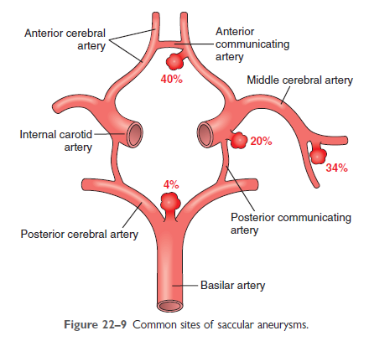

Slide 49
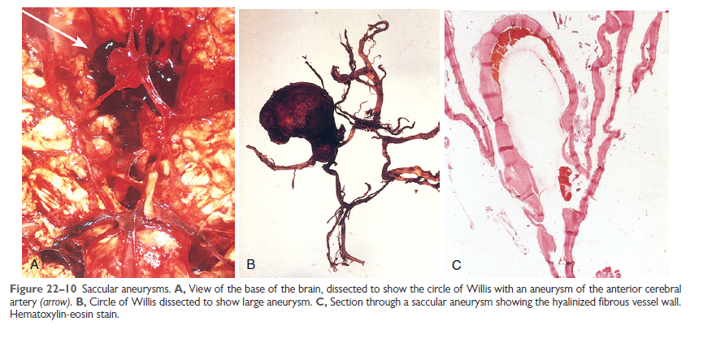

Slide 50
Note: Mycotic, traumatic and dissecting
aneurysms
1. Arise in the anterior circulation
2. Cause infarction rather than hemorrhage

